Slide 1
Week 1 Progress Report
Lab Setup, Linux and Networking Foundations
Preethi R | Intern ID: 008
National Forensic Sciences University (NFSU) | DG Interns Hub | October 2026

Slide 2
What I Did This Week
1. Built a safe home lab
2. Practised Linux
VirtualBox with Kali, Ubuntu, Windows 10/11, Metasploitable and Wazuh VMs.
Users, groups, shared folder, permissions, find, grep, ps, ss and cron.
3. Learned networking
4. Security basics and wargames
IP, MAC, DNS, DHCP, ports, OSI and TCP/IP, and checked VM connectivity with ping.
CIA triad, SOC vs VAPT roles, legal basics, 7 TryHackMe rooms and Bandit levels 0 to 10.
DG Interns Hub | Week 1 | Preethi R
2

Slide 3
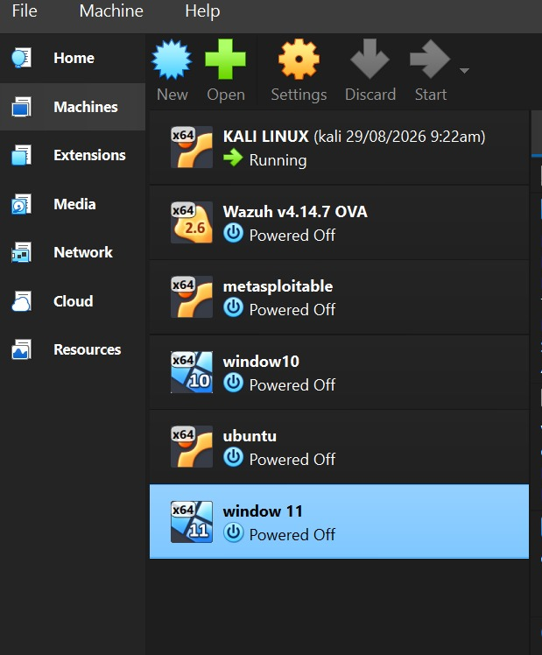
Home Lab: Virtual Machines
Virtual Machine | Purpose
Kali Linux (running) | Attacker / testing workstation
Ubuntu | Linux practice and admin server
Windows 10 and 11 | Windows evaluation targets
Metasploitable | Intentionally vulnerable target
Wazuh v4.14.7 OVA | Security monitoring (SIEM)
Safety rule: vulnerable VMs like Metasploitable stay on Host-only or NAT Network, never Bridged.
VirtualBox VM list
DG Interns Hub | Week 1 | Preethi R
3

Slide 4
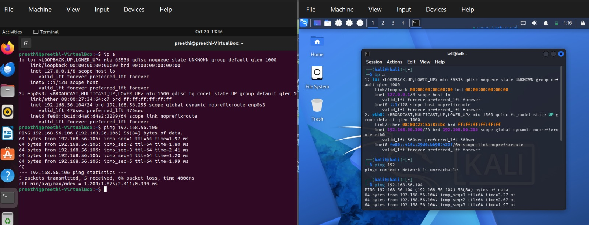
Network Map and Connectivity Tests
Ubuntu (left) and Kali (right): ip a and successful ping both ways
Ubuntu: 192.168.56.104 | Kali: 192.168.56.106 (Host-only network)
Ubuntu to Kali: 5 sent, 5 received, 0% packet loss. Kali to Ubuntu: replies received with no loss.
DG Interns Hub | Week 1 | Preethi R
4

Slide 5
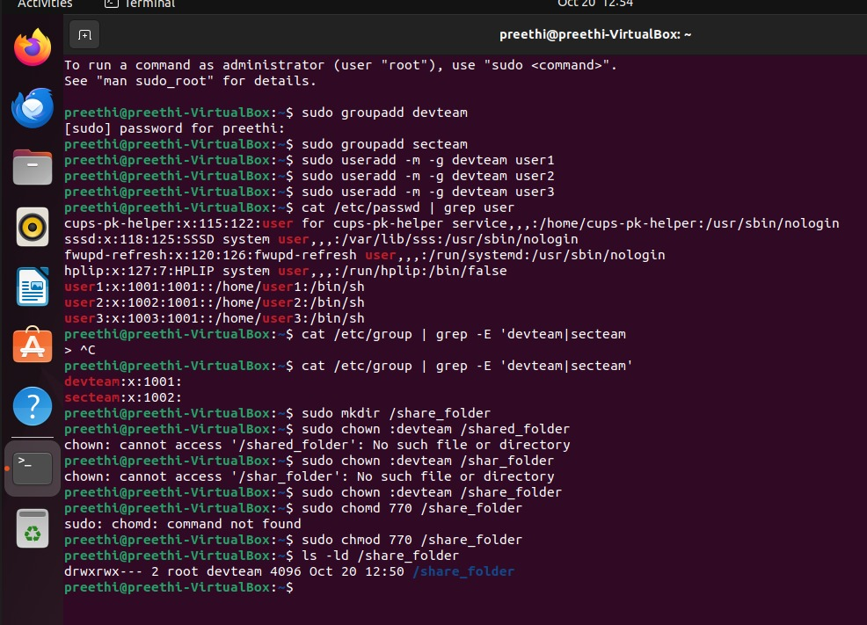
Linux Practice: Users, Groups and Shared Folder
Task | Command used
Create 2 groups | sudo groupadd devteam / secteam
Create 3 users | sudo useradd -m -g devteam user1 (user2, user3)
Verify | cat /etc/passwd | grep user
Create folder | sudo mkdir /share_folder
Set group owner | sudo chown :devteam /share_folder
Set permissions | sudo chmod 770 /share_folder
Terminal: users, groups, folder, permissions
Result: drwxrwx--- root devteam. Owner and devteam have full access, others have none.
DG Interns Hub | Week 1 | Preethi R
5

Slide 6
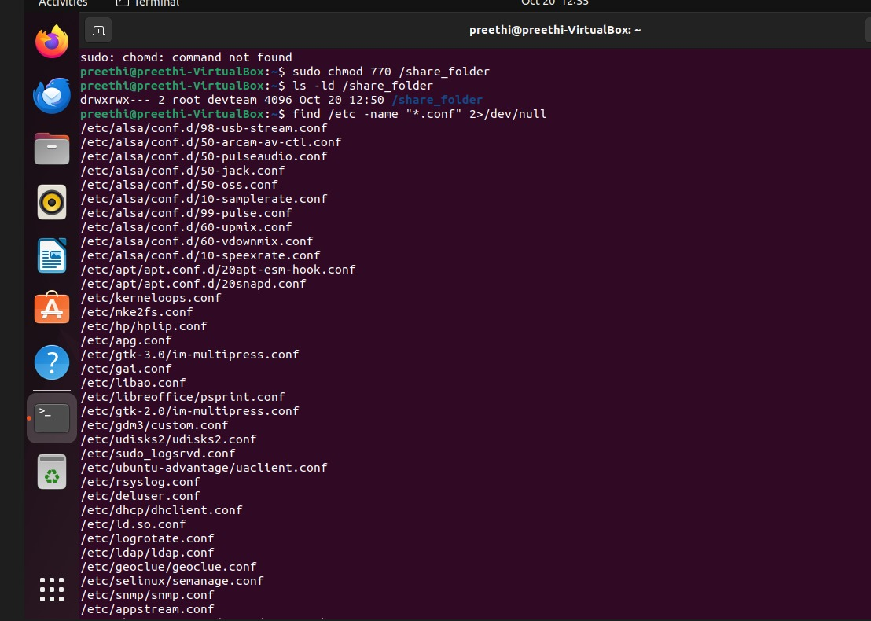
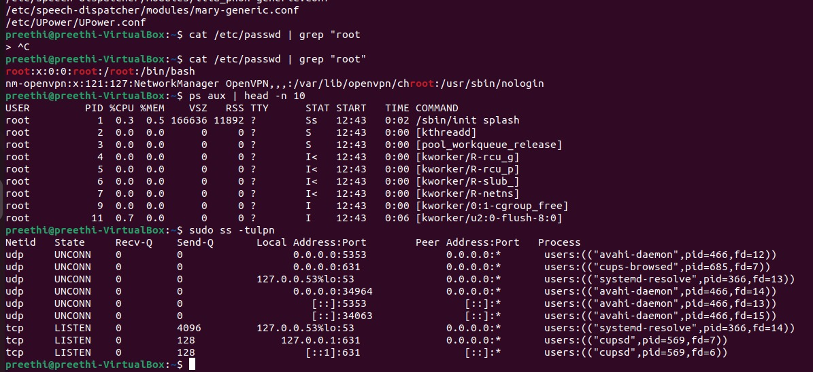
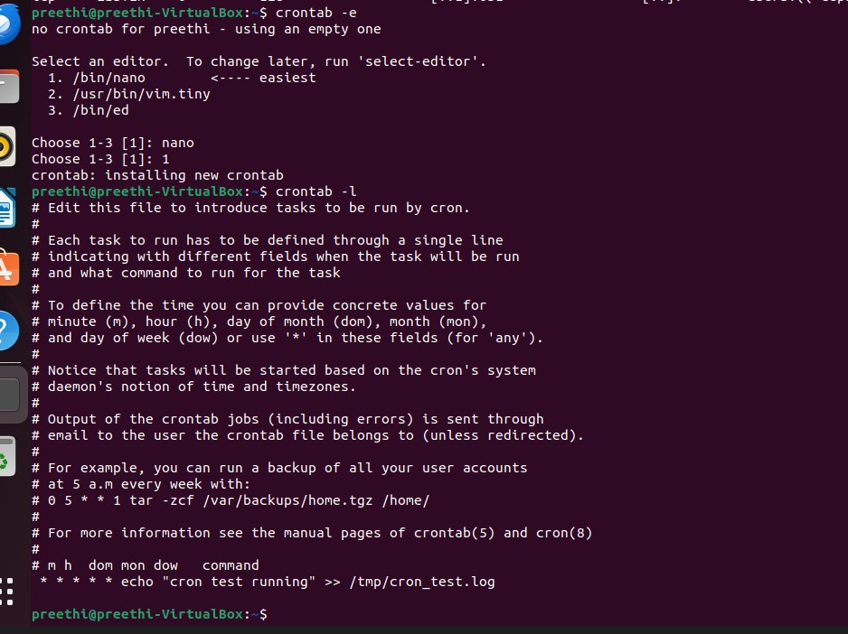
Searching, Monitoring and Scheduling
ps aux and ss -tulpn
find /etc -name "*.conf"
crontab -e and crontab -l
find and grep search files and filter output.
ps aux shows processes. ss -tulpn shows listening ports: DNS (53), CUPS (631), Avahi (5353).
Cron job runs every minute: echo "cron test running" >> /tmp/cron_test.log
DG Interns Hub | Week 1 | Preethi R
6

Slide 7
TryHackMe: 7 Rooms Completed (1 of 2)
1. Search Skills
2. Learning Cyber Security
How to search smartly: use search operators, judge whether a source is trustworthy, and find official documentation fast.
An introduction to offensive security (how attackers think) and defensive security (how defenders detect and respond).
3. Linux Fundamentals Part 1
4. What is Networking
Basic terminal use: ls, cd, cat, pwd, find, grep, echo, touch and mkdir, plus how the Linux file system is organised.
How devices connect to each other and to the internet, and what IP addresses, MAC addresses and ping are used for.
DG Interns Hub | Week 1 | Preethi R
7

Slide 8
TryHackMe: 7 Rooms Completed (2 of 2)
5. Introductory Networking
6. Networking Concepts
7. Pyramid of Pain
The OSI and TCP/IP models, how data is packed in layers, and simple tools such as ping and traceroute.
How devices find and talk to each other, including ARP, ICMP and DHCP.
Six types of indicators: hash values, IP addresses, domain names, artifacts, tools and TTPs. The higher the level, the harder it is for attackers to change.
What I gained from these rooms
A clear base in Linux commands and networking, the habit of using trusted sources, and the blue-team idea of detecting attackers by their behaviour, not only by simple indicators.
DG Interns Hub | Week 1 | Preethi R
8

Slide 9
OverTheWire Bandit: How the Game Works
Bandit is a free wargame for beginners. It is played in the terminal over SSH, so no account is needed.
Server: bandit.labs.overthewire.org, port 2220. Level 0 login: user bandit0 with password bandit0.
Each level hides a password. That password is the login for the next user (bandit1, bandit2, and so on).
I played from the Kali VM terminal and wrote one writeup per level.
Rule followed: passwords are never published in my writeups.
My routine for every level
1. Read the level goal on the website.
2. Log in with the current password.
3. Pick the right command and run it.
4. Copy the new password safely.
5. Exit and log in to the next level.
6. Write the writeup without the password.
DG Interns Hub | Week 1 | Preethi R
9

Slide 10
Bandit Level 0 → 1
Goal: Connect to the server over SSH on port 2220 and read the readme file.
Paste your screenshot here
ssh login, ls -la and cat readme
(hide the password)
ssh bandit0@bandit.labs.overthewire.org -p 2220
ls -la
cat readme
Connected on custom port 2220 and accepted the host key.
Logged in with the default password for Level 0.
Listed files with ls -la, then read readme with cat.
Saved the Level 1 password privately (not published).
DG Interns Hub | Week 1 | Preethi R
10

Slide 11
Bandit Level 1 → 2
Goal: Read the password from a file named "-".
Paste your screenshot here
cat ./- output
(hide the password)
ssh bandit1@bandit.labs.overthewire.org -p 2220
cat ./-
Logged in with the Level 1 password.
A plain cat - fails because "-" means standard input or an option.
Used the explicit path cat ./- to read the file.
DG Interns Hub | Week 1 | Preethi R
11

Slide 12
Bandit Level 2 → 3
Goal: Read the password from a file named "spaces in this filename".
Paste your screenshot here
ls and cat with quotes
(hide the password)
ssh bandit2@bandit.labs.overthewire.org -p 2220
cat "spaces in this filename"
Spaces separate arguments unless the name is quoted or escaped.
Quoted the full name (or escaped each space with a backslash).
Read the file and saved the Level 3 password privately.
DG Interns Hub | Week 1 | Preethi R
12

Slide 13
Bandit Level 3 → 4
Goal: Find the password in a hidden file inside the inhere directory.
Paste your screenshot here
ls vs ls -la and cat .hidden
(hide the password)
ssh bandit3@bandit.labs.overthewire.org -p 2220
cd inhere
ls -la
cat .hidden
Moved into inhere with cd.
Plain ls showed nothing, because hidden files start with a dot.
ls -la revealed the file .hidden.
Read it with cat .hidden.
DG Interns Hub | Week 1 | Preethi R
13

Slide 14
Bandit Level 4 → 5
Goal: Find the only human-readable file among several data files.
Paste your screenshot here
file ./* output and cat
(hide the password)
ssh bandit4@bandit.labs.overthewire.org -p 2220
cd inhere
file ./*
cat ./-file07
Found files -file00 to -file09 in inhere.
Ran file ./* to check the type of every file at once.
Only -file07 was ASCII text, the others were data.
Read it with cat ./-file07.
DG Interns Hub | Week 1 | Preethi R
14

Slide 15
Bandit Level 5 → 6
Goal: Find a file that is readable, 1033 bytes and not executable.
Paste your screenshot here
find command and cat output
(hide the password)
ssh bandit5@bandit.labs.overthewire.org -p 2220
find inhere -type f -size 1033c ! -executable
cat inhere/maybehere07/.file2
-type f: regular files only.
-size 1033c: exactly 1033 bytes.
! -executable: skip executable files.
One match: inhere/maybehere07/.file2. Read it with cat.
DG Interns Hub | Week 1 | Preethi R
15

Slide 16
Bandit Level 6 → 7
Goal: Find a file owned by user bandit7, group bandit6, 33 bytes in size, anywhere on the system.
Paste your screenshot here
find / command and cat output
(hide the password)
ssh bandit6@bandit.labs.overthewire.org -p 2220
find / -user bandit7 -group bandit6 -size 33c 2>/dev/null
cat /var/lib/dpkg/info/bandit7.password
Searched the whole system starting from /.
2>/dev/null hides "Permission denied" errors.
Found /var/lib/dpkg/info/bandit7.password and read it with cat.
DG Interns Hub | Week 1 | Preethi R
16

Slide 17
Bandit Level 7 → 8
Goal: Find the password next to the word "millionth" in data.txt.
Paste your screenshot here
grep millionth output
(hide the password)
ssh bandit7@bandit.labs.overthewire.org -p 2220
grep "millionth" data.txt
data.txt holds thousands of lines.
grep searched it for the keyword "millionth".
The matching line showed the next password.
DG Interns Hub | Week 1 | Preethi R
17

Slide 18
Bandit Level 8 → 9
Goal: Find the only line in data.txt that appears exactly once.
Paste your screenshot here
sort | uniq -u output
(hide the password)
ssh bandit8@bandit.labs.overthewire.org -p 2220
sort data.txt | uniq -u
uniq only compares neighbouring lines, so the data must be sorted first.
sort groups the same lines together.
uniq -u prints only the lines that do not repeat.
DG Interns Hub | Week 1 | Preethi R
18

Slide 19
Bandit Level 9 → 10
Goal: Find the password in a binary file. It is a readable string after several "=" characters.
Paste your screenshot here
strings | grep output
(hide the password)
ssh bandit9@bandit.labs.overthewire.org -p 2220
strings data.txt | grep "="
data.txt is mostly unreadable binary data.
strings prints only the human-readable text.
grep "=" keeps the lines with equals signs, which shows the password line.
DG Interns Hub | Week 1 | Preethi R
19

Slide 20
Bandit Takeaways
Connected securely over SSH on a custom port (2220).
Moved through directories and handled hidden and special file names.
Filtered files by size, owner, group and type with find.
Searched and processed text with grep, sort, uniq and strings.
Used 2>/dev/null to keep the output clean while searching.
All passwords are redacted, as the rules require.
DG Interns Hub | Week 1 | Preethi R
20

Slide 21
Core Concepts: CIA Triad and Security Roles
CIA part | Meaning | Real-world example
Confidentiality | Only allowed people see data | Login with OTP / MFA
Integrity | Data is not changed secretly | SHA-256 hash to check a file
Availability | Systems work when needed | Backup servers
Role | Goal | Team
SOC Analyst | Watch alerts and logs, detect attacks | Blue
VAPT / Pen Tester | Find weaknesses by safe attacking | Red
Incident Responder | Contain, investigate and recover | Blue
DG Interns Hub | Week 1 | Preethi R
21

Slide 22
Risk, VM Networking and Ethics
Threat, vulnerability, risk, exploit
VM network modes
Threat: who or what can cause harm. Vulnerability: a weakness. Risk: the chance and impact of harm. Exploit: the method that uses the weakness.
NAT: internet access. NAT Network: VMs talk to each other. Host-only: private lab. Bridged: on the real LAN, never for vulnerable labs.
Legal and ethical basics
Always get written authorization, stay inside the agreed scope, and follow the Rules of Engagement. In India, the Information Technology Act, 2000 covers unauthorized access and other cyber crimes.
DG Interns Hub | Week 1 | Preethi R
22

Slide 23
Week 1 Conclusion
Lab built and tested: all VMs can reach each other with ping.
Linux skills practised: users, groups, permissions, searching, process and port checks, and cron.
Completed 7 TryHackMe rooms and OverTheWire Bandit levels 0 to 10.
Notes, writeups, findings, cheat sheet, PDF report and README are ready for submission.
Thank you

