Slide 1

THESIS DEFENCE· MSc in Data Analytics
Student academic performance prediction with feature importance and visual analytics
Comparison of machine learning models | Feature Importance Analysis| Dashboard Analytics
Student Name: Preethi Janakiraman
Student ID: 20082379
Lecturer Name: Dr. Anesu Nyabadza
Submission Date: 25th August 2026

Slide 2
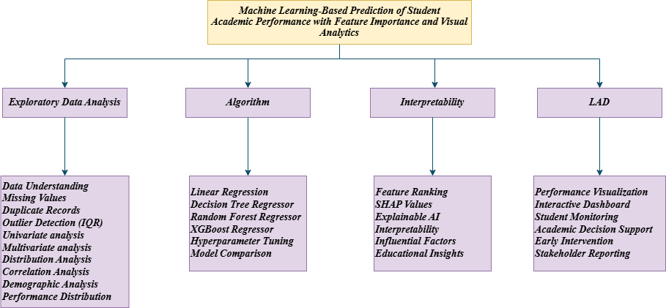
BACKGROUND
Literature Review
The reviewed research articles are structured as a relevance tree with 4 categories.
PROBLEM STATEMENT
Machine learning models are capable of predicting student performance, but focused on increased prediction accuracy.
The models used as black -box systems rather than interpretability.
The existing models perform predictions where target data leakage can affect prediction.
Results are shown as numerical metrics but lack visual analytics.
Relevance tree of literature review
THE GAP THIS STUDY FILLS
Most prior work optimises for accuracy alone, rarely checks for target leakage, and reports results as raw metrics rather than visual, educator-facing insight. This study combines all three: a leakage-aware pipeline, SHAP explainability, and an interactive dashboard.
4

Slide 3
FOUNDATIONS
Research Questions & Objectives
AIM
RESEARCH QUESTIONS
This study builds a
prediction pipeline — combining regression models, SHAP interpretability, and an interactive dashboard to improve interpretability and help educators identify at-risk students early.
Which machine learning model provides the best predictive accuracy? How can interpretability be incorporated with ML models to identify the factors most influencing student performance?
How does visual analytical dashboards enable educators improve the understanding of prediction?
OBJECTIVES
Exploratory data analysis
Leakage-aware regression pipeline
Predict students' Global Score
Feature importance analysis
Evaluate model performance
Interactive dashboard
5

Slide 4
DATA
Dataset Overview
Mendeley Data Repository — sourced from Colombia's ICFES education evaluations
12,411
44
2
1
Student records
Variables
Assessment stages
Target: Global Score
Two-stage academic assessment
SABER 11 · High School Exam
SABER PRO · Professional Exam
Mathematics · Critical Reading · Citizen Competencies · Biology · English
Quantitative Reasoning · Critical Reading · Citizen Competencies · English · Written Communication · Formulation of Engineering Projects → Global Score (G_SC)
6

Slide 5
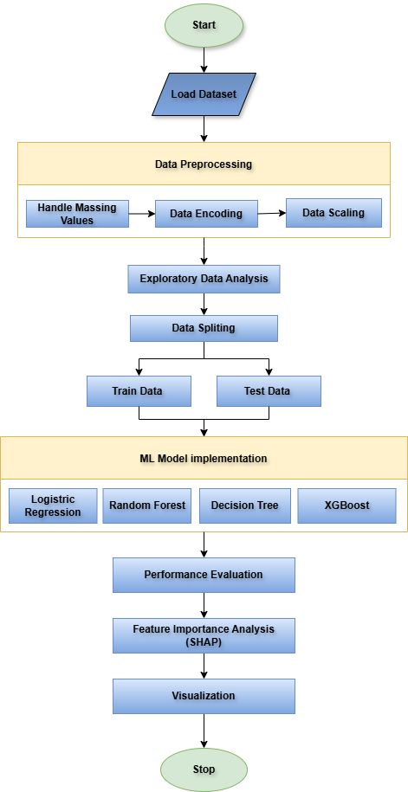
APPROACH
Research Methodology
1
Data collection & cleaning
2
Exploratory data analysis
3
Feature engineering
4
Leakage check & removal
5
Model training (4 algorithms)
6
Evaluation & SHAP explainability
7
Interactive dashboard
7
Research methodology pipeline

Slide 6
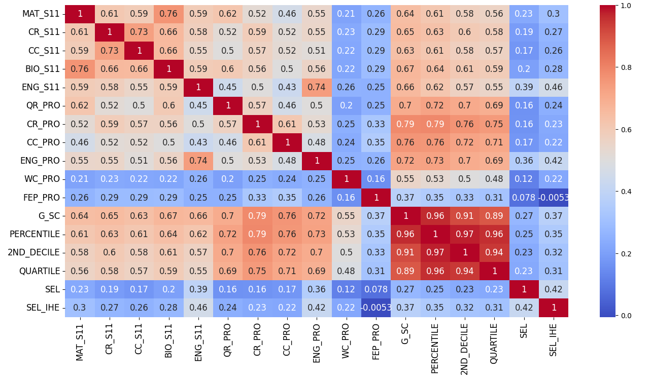
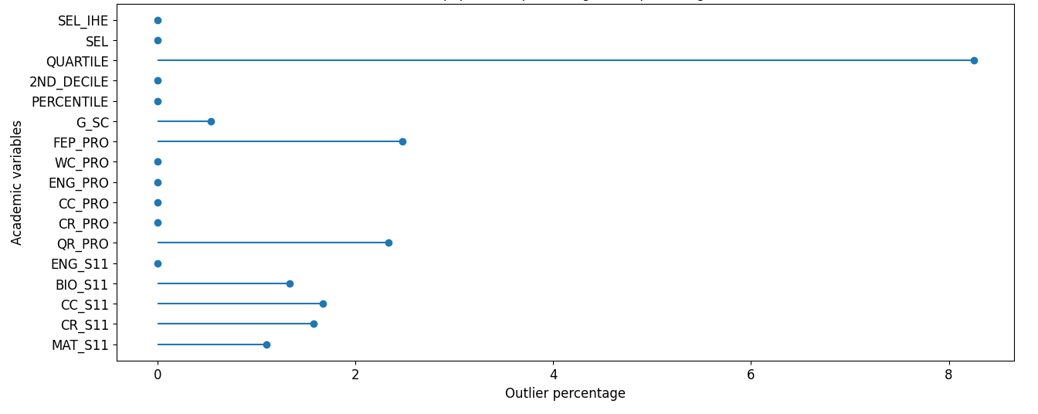
EXPLORATORY DATA ANALYSIS
Correlation & Outlier Detection
(a) Correlation matrix of numerical variables
(b) Outlier percentage by IQR method
8

Slide 7
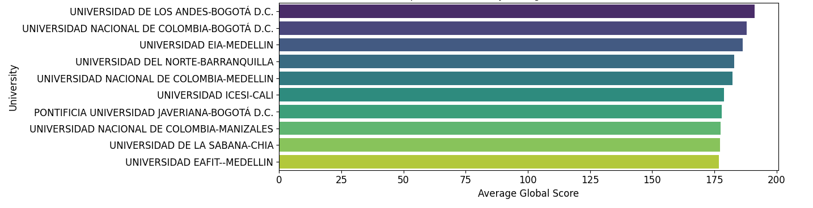
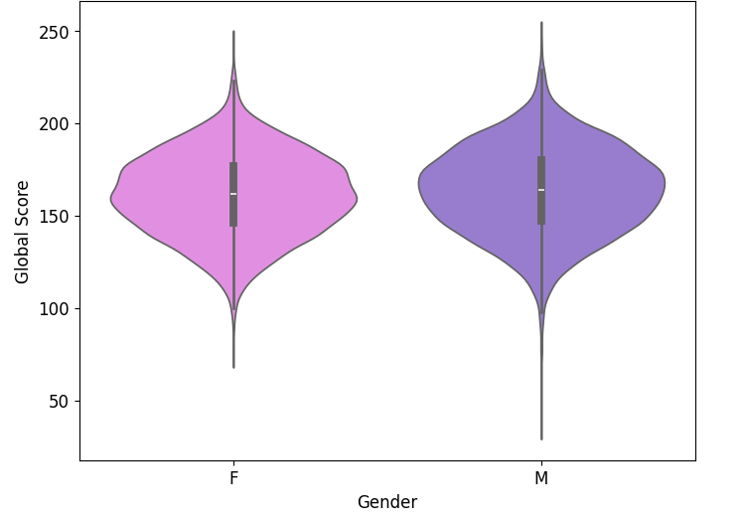
EXPLORATORY DATA ANALYSIS
Demographic & Institutional Patterns
(a) Distribution of global score by gender
(b) Top 10 universities with average global score
9

Slide 8
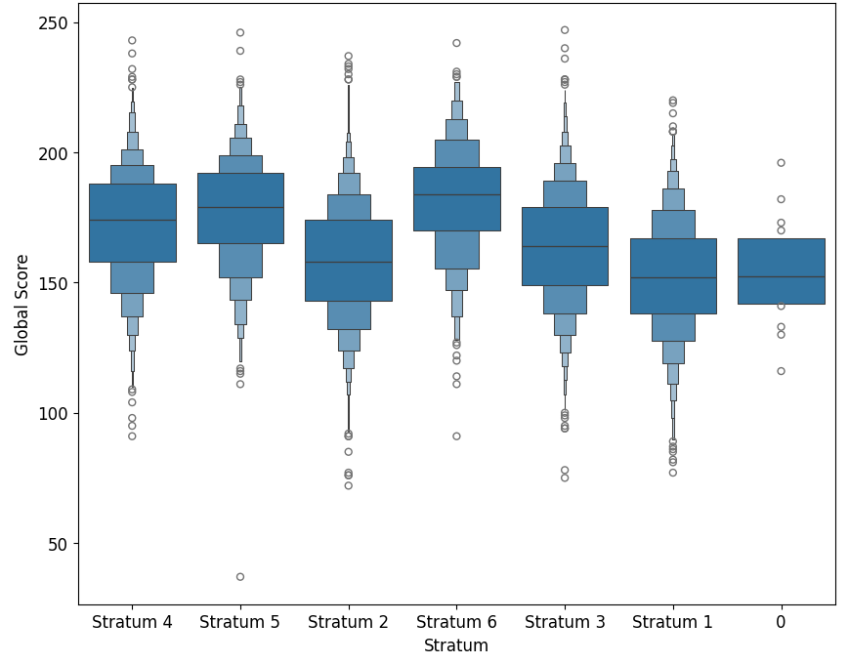
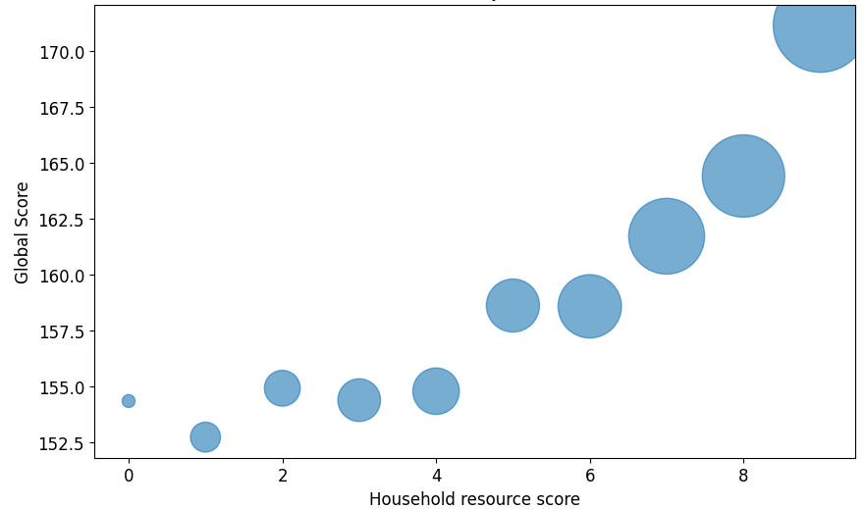
EXPLORATORY DATA ANALYSIS
Distribution of academic performance by Stratum and resources
(a) Distribution of academic performance by Stratum
(b) Global score distribution by household resources
10

Slide 9
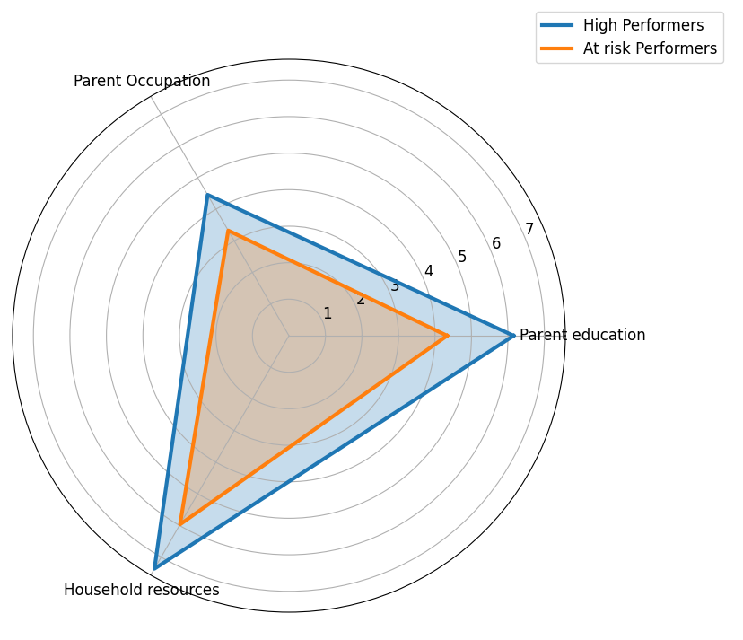
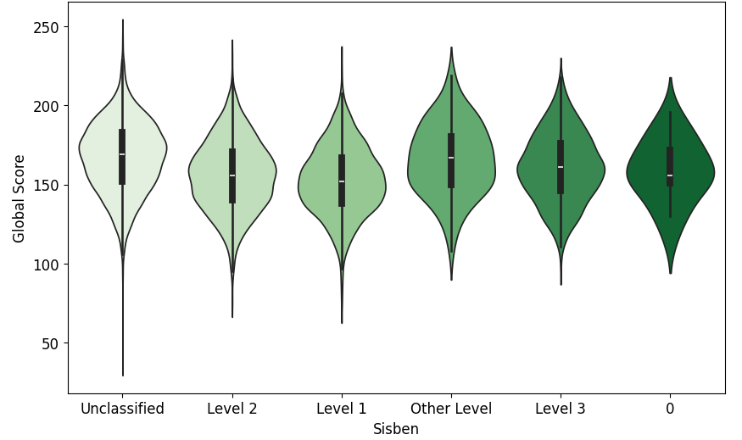
EXPLORATORY DATA ANALYSIS
Socioeconomic Influence on Performance
(a) Socioeconomic impact on academic result
(b) Distribution of academic performance among SISBEN levels.
10

Slide 10
RESULTS
COMPARISON OF MODEL PERFORMANCE
Train-test split = 80:20
random state = 42
Model | MAE (Train) | MAE (Test) | RMSE (Train) | RMSE (Test) | R² (Train) | R² (Test) | R² Gap
Linear Regression | 10.98 | 10.94 | 14.27 | 14.31 | 0.62 | 0.61 | 0.01
XGBoost | 10.72 | 10.90 | 13.95 | 14.31 | 0.64 | 0.61 | 0.03
Decision Tree | 10.87 | 11.12 | 14.19 | 14.56 | 0.62 | 0.59 | 0.03
Random Forest | 10.57 | 10.93 | 13.80 | 14.36 | 0.65 | 0.61 | 0.04
Linear Regression generalised best — R² gap of just 0.01 between train and test.
XGBoost was the closest competitor (test R² = 0.61, test MAE = 10.90), fitting the training data more tightly but generalizing almost as well.
Complex models did not yield significant performance and is against the assumption of complex model outperforms linear baseline model.
12

Slide 11
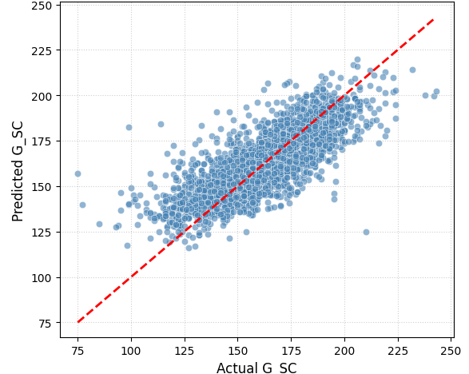
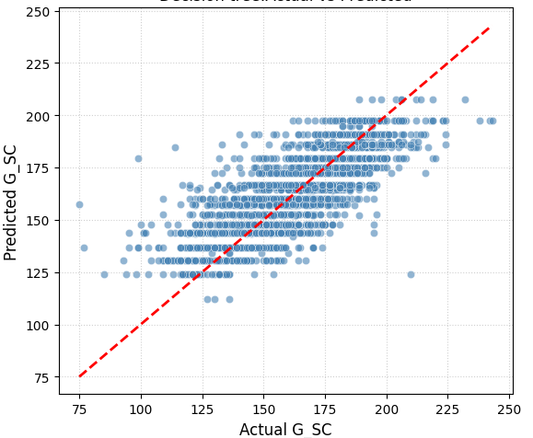
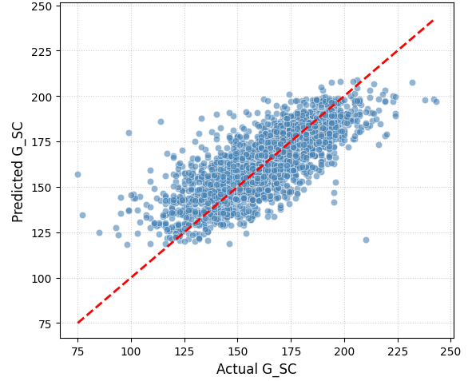
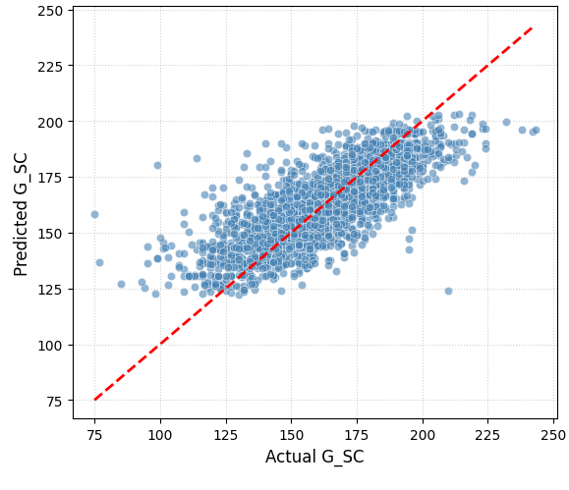
RESULTS
Model Performance: Actual vs. Predicted
Linear Regression — best fit (R² = 0.61)
Decision Tree
Random Forest
XGBoost — Test MAE = 10.90
R² across all four models ranged 0.59–0.61 — moderate but consistent fit. Linear Regression edged out XGBoost, suggesting the engineered features (S11_AVG, parental & resource indices) already capture most of the relationship linearly.
11

Slide 12
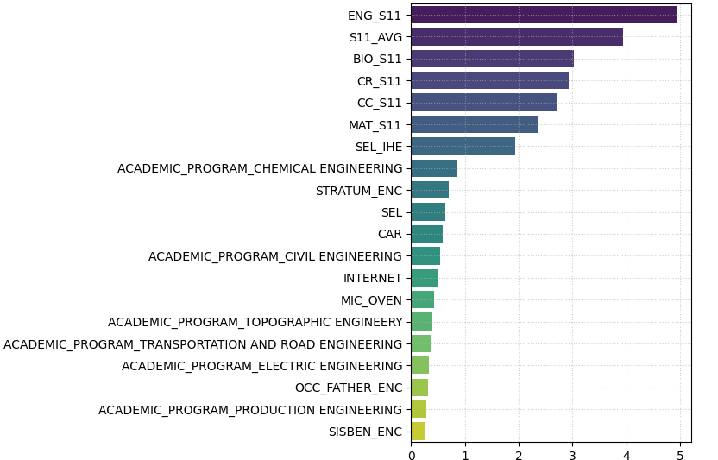
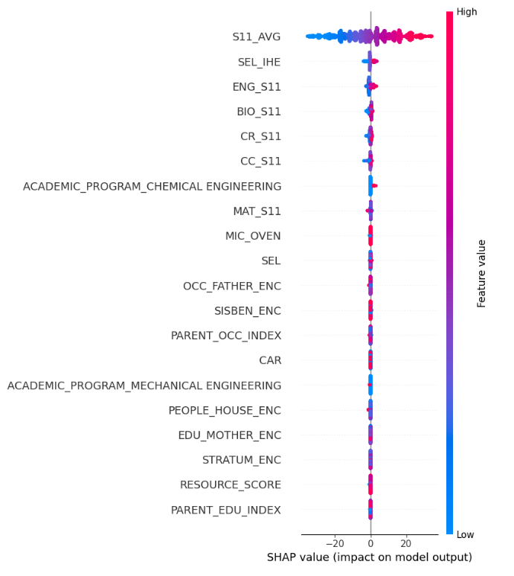
EXPLAINABILITY
Feature Importance & SHAP Analysis - XGBoost
(a) Feature importance ranking
(b) SHAP summary plot
13

Slide 13
DISCUSSION
Key takeaways
01
Previous academic performance dominates
02
Simplicity held its own
S11_AVG and its subject scores are, by a wide margin, the strongest predictor of the Global Score across both feature importance and SHAP.
Linear Regression matched or beat ensemble methods — model complexity wasn't a substitute for well-engineered features.
03
Socioeconomic context matters, moderately
04
Association, not causation
Parental education, revenue, and resources showed a consistent but secondary association with outcomes.
SHAP explains what the model relies on — not what would causally change a student's score if altered.
14

Slide 14
REFLECTION
Limitations
Single-country, single-cohort dataset — findings may not generalise beyond Colombian engineering students
Cross-sectional data only — can't capture how a student's trajectory changes over time
!
!
Moderate R² (0.59–0.61) — ~40% of variance remains unexplained by available features
Single train–test split, manual hyperparameters — no k-fold CV or systematic tuning
!
!
Dashboard usability untested with real educators
SHAP shows association, not proven causal effect
!
!
15

Slide 15
LOOKING AHEAD
Future Work
Add behavioural & engagement data (attendance, LMS activity)
k-fold cross-validation and systematic hyperparameter tuning
→
→
External validation on other institutions, countries, cohorts
Fairness auditing across gender, stratum & revenue subgroups
→
→
Causal inference methods (matching, instrumental variables)
Dashboard usability testing with real educators
→
→
16

Slide 16
CONCLUSION
Accurate, interpretable, and actionable
Leakage-aware regression pipeline compared four models honestly — no inflated accuracy
SHAP and feature importance agree prior academic achievement is the dominant driver
A 3-page interactive dashboard turns model output into insight educators can use
17

Slide 17
CLOSING THE LOOP
Were the Research Questions Answered?
✓
RQ1 — Can interpretability be incorporated with ML models to identify the factors most influencing student performance, and which model predicts best?
Yes. SHAP and feature importance independently agree that prior academic achievement (S11_AVG) dominates. Linear Regression gave the best, most stable fit (R² = 0.61, R² gap = 0.01), with XGBoost close behind.
✓
RQ2 — How do visual analytics dashboards help educators improve their understanding of predictions?
Yes. The 3-page interactive dashboard (Student Landscape, Academic Journey, ML Prediction & Explainability) translates model output and SHAP explanations into a form educators can read without interpreting raw coefficients.
Both questions are answered with evidence — with the caveat that SHAP shows association, not proven causation.
18

Slide 18
Thank You
Questions & Discussion
Preethi Janakiraman · MSc Data Analytics · Dublin Business School

