Slide 1
Indexing

Slide 2
Introduction
An index in SQL Server is a data structure associated with a table or view that speeds up the retrieval of rows from the table based on the values in one or more columns.
It works like the index of a book, allowing the database system to quickly locate data within tables.
By creating indexes on columns frequently used in queries, we can significantly enhance query performance.

Slide 3
Hard disk -> RAM -> Cache -> Register
Reading or updating operations will bring data from hard disk to RAM segment by segment
Once the data is in RAM, it is analyzed by CPU and rows are selected / rejected to prepare result
Index Table will be created
By default the primary key will be the index to create the table
We can also create an index table based on particular column as per requirement

Slide 4
Pro’s of Indexing:
Improved query performance: Indexing allows the database engine to quickly locate and retrieve data based on the indexed columns, resulting in faster query execution times.
Faster data retrieval: Indexes facilitate rapid data retrieval, especially for SELECT statements, by reducing the number of rows that need to be scanned.
Efficient sorting and ordering: Indexes enable efficient sorting and ordering of query results, making it easier to retrieve data in sorted order without the need for additional sorting operations.

Slide 5
Cons of Indexing:
Increased storage overhead: Indexes consume additional storage space, as they store redundant copies of indexed columns, leading to increased storage requirements for the database.
Slower data modification: Indexes can slow down data modification operations, such as INSERT, UPDATE, and DELETE statements, as the database engine needs to update the indexes along with the underlying data.
Overhead during index maintenance: Indexes require regular maintenance, such as index rebuilding and reorganization, which can impose additional overhead on database maintenance tasks and system resources.

Slide 6
Guidelines
Index table should not be created while creating the table
Analyze the traffic on Database and take relevant actions to create index

Slide 7
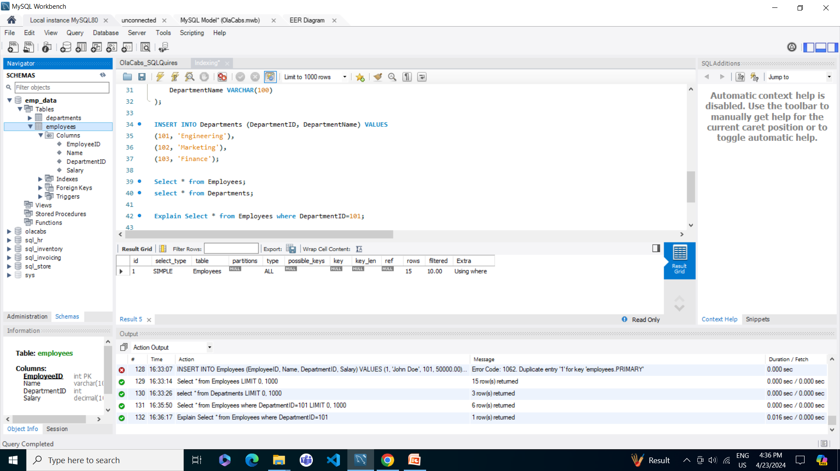
Example:

Slide 8
