Slide 1
Vehicle-to-Vehicle Communication using Visible Light
- Preethika M

Slide 2
Abstract
Demonstrates Vehicle-to-Vehicle (V2V) communication using Visible Light Communication (VLC).
LED used as transmitter and Photodiode as receiver.
Arduino microcontroller processes sensor data and transmits via optical signals.
Provides secure, interference-free, and low-cost alternative to RF-based systems.

Slide 3
Problem Statement & Need
Current V2V systems rely on RF (Wi-Fi, DSRC) → prone to congestion,
interference, hacking.
Growing traffic → need for reliable, fast, and safe data sharing between
vehicles.
VLC offers high bandwidth, security, and no RF interference.

Slide 4
Objectives
Implement data transmission between two vehicles using visible light.
Encode vehicle motion (velocity/acceleration) into LED pulses.
Decode at receiver side using photodiode + Arduino.
Demonstrate feasibility of VLC in transportation safety.

Slide 5
Literature Survey
Existing V2V (RF-based):
DSRC, Wi-Fi, Bluetooth, 5G → provide wireless links.
Disadvantages:
Congestion in crowded areas.
Security risks (hacking/jamming).
Limited bandwidth in RF spectrum.

Slide 6
Proposed System
Use Visible Light as medium.
Arduino + Accelerometer to sense vehicle motion.
LED (Tx) transmits encoded pulses.
Photodiode (Rx) detects and decodes pulses.
More secure (line-of-sight), higher bandwidth, no EM interference.

Slide 7
System Overview
Input: Vehicle acceleration (MPU6050).
Processing: Arduino calculates velocity.
Transmission: LED encodes velocity → light pulses.
Reception: Photodiode receives pulses → Arduino decodes.
Output: Vehicle 2 displays velocity info → collision avoidance.

Slide 8
Key Components Integrated
Arduino Uno
MPU6050 Accelerometer
LED (Transmitter)
Photodiode BPW34 (Receiver)
Resistors, breadboard, jumper wires

Slide 9
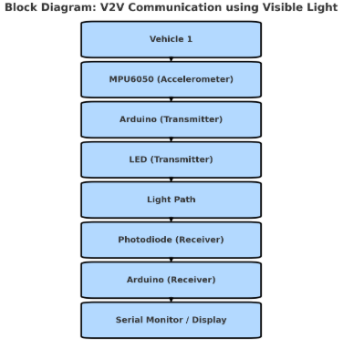
Block Diagram

Slide 10
Hardware & Software
Hardware:
Arduino UNO
MPU6050
LED
Photodiode
Resistors
Wires
Software:
Arduino IDE

Slide 11
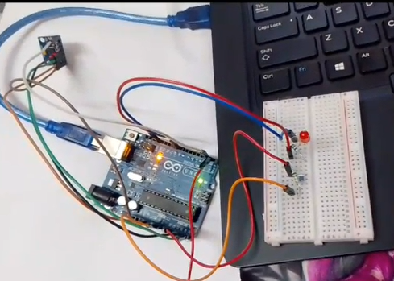
Hardware Setup
Vehicle 1: Arduino + MPU6050 + LED (Tx)
Vehicle 2: Arduino + Photodiode (Rx)
LED → Photodiode line-of-sight
Serial Monitor for velocity output

Slide 12
Working Principle
Acceleration measured by MPU6050 → Arduino calculates velocity.
Velocity encoded into LED blinks (PWM).
Photodiode detects pulses → converts to electrical signals.
Receiver Arduino decodes → displays velocity data.

Slide 13
Code Snippet
Transmitter (Arduino):
int ledPin = 9;
void loop() {
int velocity = 60; // Example
int freq = map(velocity, 0, 200, 1000, 100);
digitalWrite(ledPin, HIGH);
delayMicroseconds(freq);
digitalWrite(ledPin, LOW);
delayMicroseconds(freq);
}
Receiver (Arduino):
int sensorValue = analogRead(A0);
if(sensorValue > 100)
Serial.println("Light pulse detected → Vehicle moving");
else
Serial.println("No pulse → Vehicle stopped");

Slide 14
Outputs
Transmitter:
LED blinking with velocity info.
Receiver:
Serial monitor shows →
"Vehicle moving" when pulses detected.
"Vehicle stopped" when no pulses.

Slide 15
Applications
Vehicle collision avoidance.
Intelligent traffic management.
Platooning (convoy of vehicles).
Secure vehicle data exchange (speed, braking info).

Slide 16
Future Enhancements
Use high-power LEDs for longer range.
Advanced modulation schemes (OOK, PWM, OFDM).
Integration with real cars.
Combine VLC with 5G for hybrid V2V systems.

Slide 17
Conclusion
VLC provides secure, interference-free, and high-speed communication.
Demonstrated working V2V prototype using Arduino, LED, and
photodiode.
Strong potential for future intelligent transportation systems.

