Slide 1
AI-Driven Phishing Email Detection
Using Natural Language Processing (NLP)
Presented by: Preethika Enrollment Number: 937271 Department of Information Science and Engineering NMAM Institute of Technology (NMAMIT), Nitte

Slide 2
Introduction & Problem Statement
Introduction
Problem Statement
Email is a widely used communication channel, increasingly targeted by phishing attacks aiming to steal sensitive information.
Traditional rule-based filters and blacklists struggle against constantly evolving phishing techniques.
This project uses NLP and Machine Learning to automatically classify emails as Safe or Phishing.
Rule-based and blacklist approaches are ineffective against sophisticated, constantly changing phishing attacks.
An intelligent system is required to analyze email content and accurately classify phishing vs. legitimate emails.
Objective
Build an AI-driven system that preprocesses email text, extracts TF-IDF features, trains multiple ML models, and provides real-time phishing prediction through a Gradio interface.
AI-Driven Phishing Email Detection Using NLP
2

Slide 3
Methodology
Dataset Collection
Data Preprocessing
Lowercase Conversion • HTML Tag Removal • URL Removal • Punctuation Removal • Stopword Removal
TF-IDF Feature Extraction
Train-Test Split (80:20)
Machine Learning Models
Logistic Regression • Naïve Bayes • Random Forest • MLP Neural Network
Performance Evaluation
Gradio Prediction Module
AI-Driven Phishing Email Detection Using NLP
3

Slide 4
Algorithms Used
Logistic Regression
Naïve Bayes
A supervised learning algorithm for binary classification; simple, efficient, and effective for text classification problems.
A probabilistic classifier based on Bayes' theorem, known for fast training and prediction speed.
Random Forest
MLP Neural Network
An ensemble algorithm combining multiple decision trees; robust against overfitting on complex datasets.
A feed-forward neural network that learns complex relationships from TF-IDF features; achieved the best performance.
Algorithm | Type | Purpose
Logistic Regression | Supervised – Linear | Binary classification of email messages
Naïve Bayes | Supervised – Probabilistic | Fast text classification using Bayes' theorem
Random Forest | Supervised – Ensemble | Robust classification using multiple decision trees
MLP Neural Network | Supervised – Neural Network | Learns complex patterns; best-performing model
AI-Driven Phishing Email Detection Using NLP
4

Slide 5
Results & Performance Comparison
Confusion Matrix — MLP Neural Network
 | Pred: Legitimate | Pred: Phishing
Actual: Legitimate | 2179 | 86
Actual: Phishing | 53 | 1409
Classification Metrics (Weighted Average)
Model | Accuracy | Precision | Recall | F1-score
Logistic Regression | 0.9600 | 0.96 | 0.96 | 0.96
Naïve Bayes | 0.9488 | 0.95 | 0.95 | 0.95
Random Forest | 0.9573 | 0.96 | 0.96 | 0.96
MLP Neural Network | 0.9627 | 0.96 | 0.96 | 0.96
Best-Performing Model
MLP Neural Network
Highest classification accuracy: 96.27%
AI-Driven Phishing Email Detection Using NLP
5

Slide 6
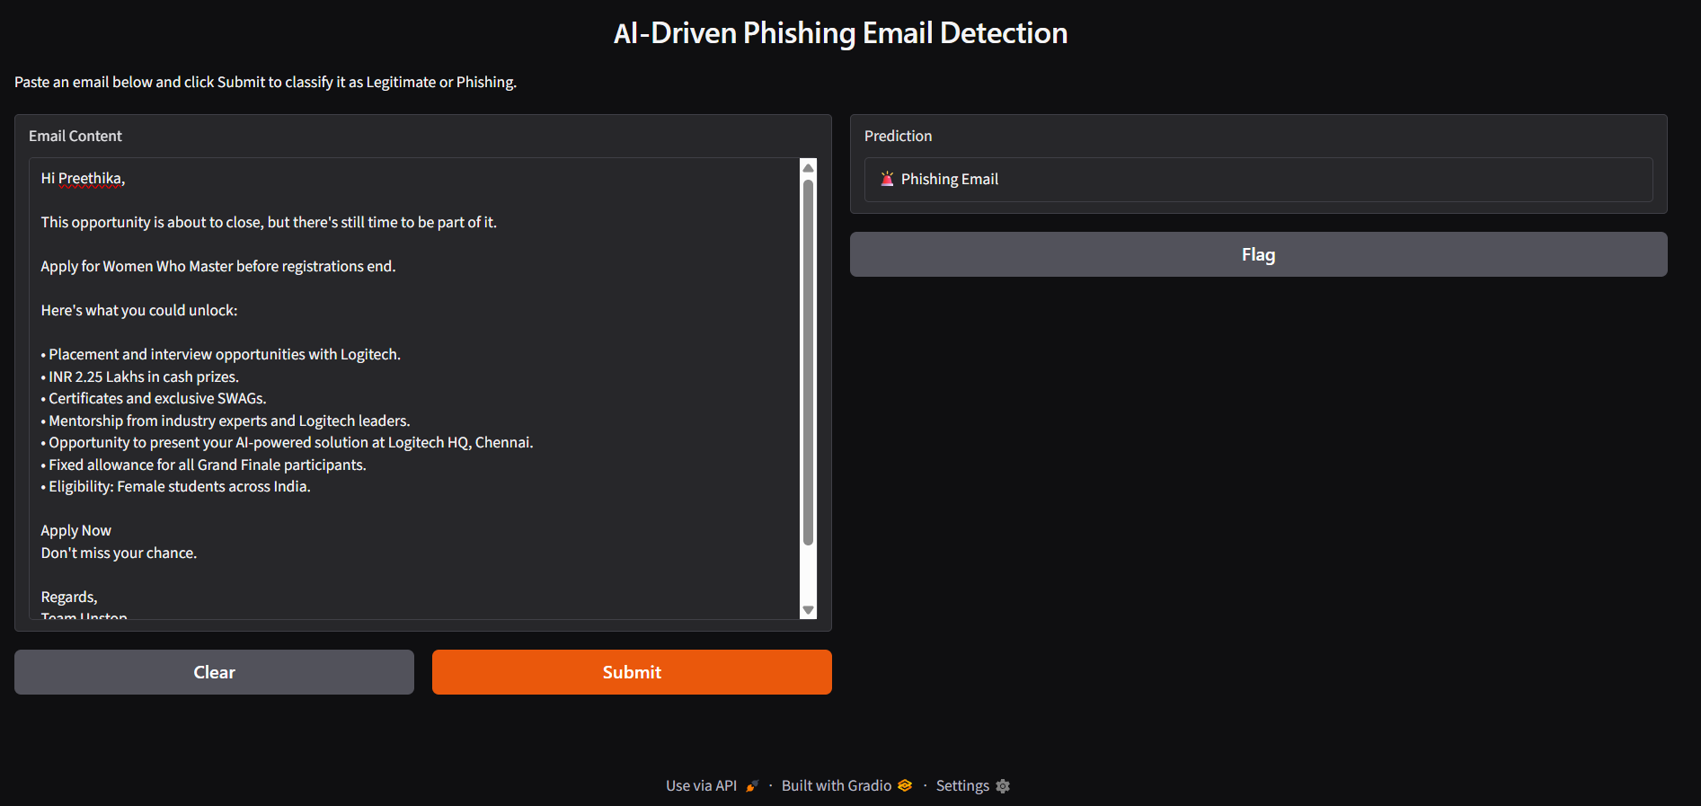
Demo — Gradio Prediction Module
Input Email
Preprocessing
Prediction
Output
Live email text is cleaned using the same preprocessing pipeline as training, converted to TF-IDF features, and classified by the trained MLP model in real time.
Gradio interface classifying a submitted email as a Phishing Email in real time.
AI-Driven Phishing Email Detection Using NLP
6

Slide 7
Conclusion & Future Scope
Project Summary
Future Scope
This project presented an AI-driven phishing email detection system using Natural Language Processing and Machine Learning. Email text was preprocessed and transformed into TF-IDF features, then used to train four supervised models: Logistic Regression, Naïve Bayes, Random Forest, and MLP Neural Network. A Gradio-based interface was developed to classify email messages as Safe or Phishing in real time.
Apply advanced deep learning models such as LSTM, GRU, and BERT for improved phishing detection.
Extend the system to support multilingual phishing email detection.
Integrate the model with email services or browser extensions for real-time protection.
Continuously retrain the model using newly collected phishing emails to improve accuracy.
Deploy the model as a cloud-based web application for wider accessibility.
Key Achievements
MLP Neural Network achieved the highest classification accuracy of 96.27%.
Four ML models were trained, evaluated, and compared using accuracy, precision, recall, F1-score, and confusion matrix.
A Gradio-based interface was built for real-time email classification.
AI-Driven Phishing Email Detection Using NLP
7

