Slide 1
GOOGLE App store DATA ANALYSIS link for google colab (click_here)

Slide 2
Introduction
The Google Play Store is a widely recognized online marketplace for Android applications, offering a vast range of apps for users to download and install on their devices. With millions of apps available, the Google Play Store provides users with a diverse selection of categories, including games, productivity tools, social media platforms, and more . Users can explore and discover new apps through various features and recommendations provided by the Google Play Store, enhancing their mobile experience.

Slide 3
Overview
Analyzing the Google Play Store is crucial for understanding the dynamics of the Android app market. It provides valuable insights into app categories, user preferences, and emerging trends. By studying user ratings and reviews, developers can improve their apps based on user feedback. Analyzing download statistics helps identify popular apps and potential market gaps. Overall, Google app store analysis enables data-driven decision-making and optimization strategies for developers and marketers in the competitive app ecosystem.

Slide 4
Categories of apps:
There are various categories in apps . They are:
ART_AND_DESIGN | EVENTS | LIBRARIES_AND_DEMO | SOCIAL | TOOLS
AUTO_AND_VEHICES | FINANCE | LIFESTYLE | SHOPPING | PERSONALIZATION
BEAUTY BOOKS_AND_REFERENCE BUSINESS | FOOD_AND_DRINK HEALTH_AND_FITNESSESS HOUSE_AND_HOME | GAME FAMILY MEDICAL | PHOTOGRAPHY SPORTS TRAVEL_AND_LOCAL | PRODUCTIVITY PARENTING WEATHER

Slide 5
Interesting facts
Some interesting facts about Google app store :
Highest reviewed apps are of the category communication ,social, game ,photography ,video players .
Highest Installations apps are same as the highest reviewed apps.
Teens are more active rather than any age group.

Slide 6
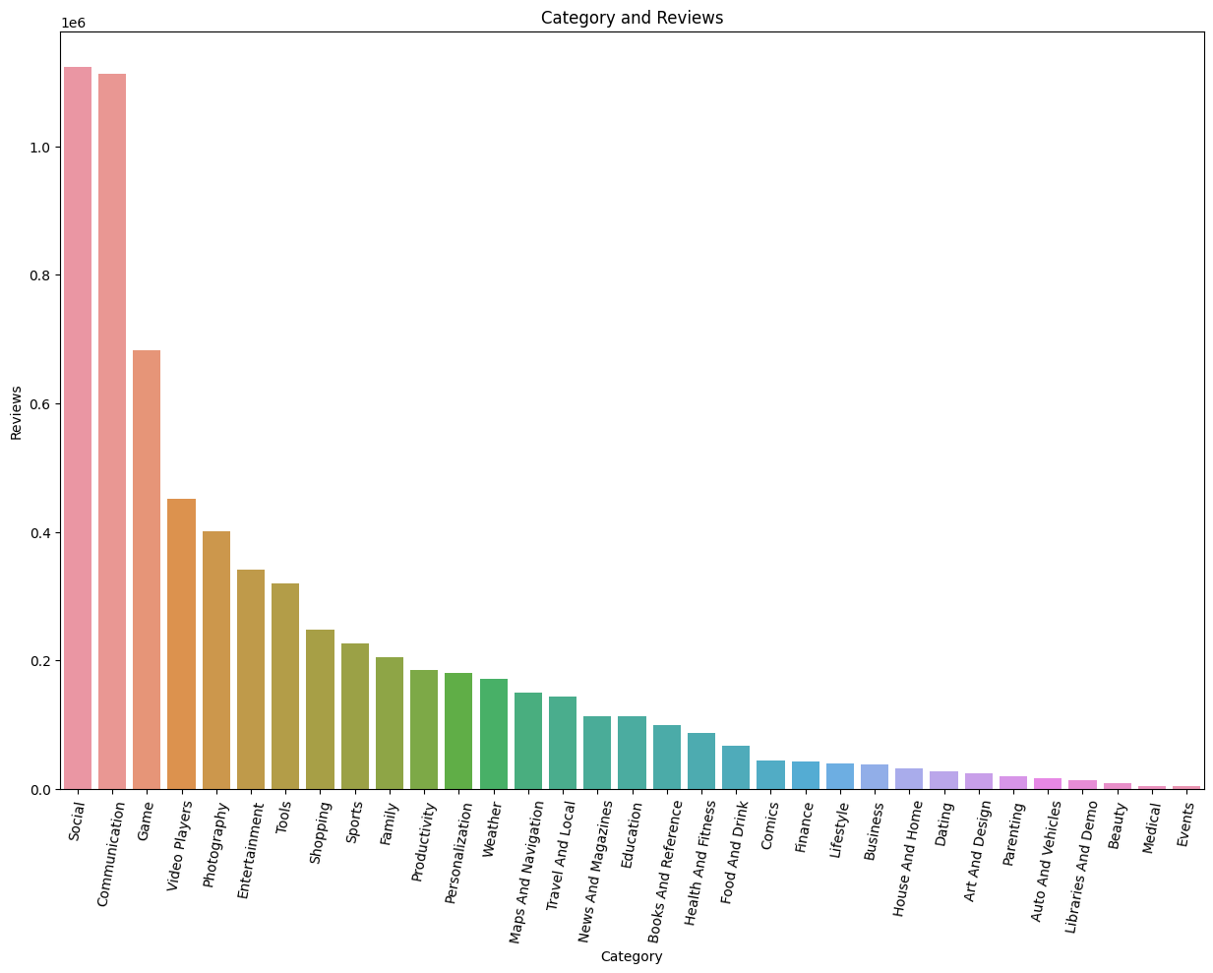
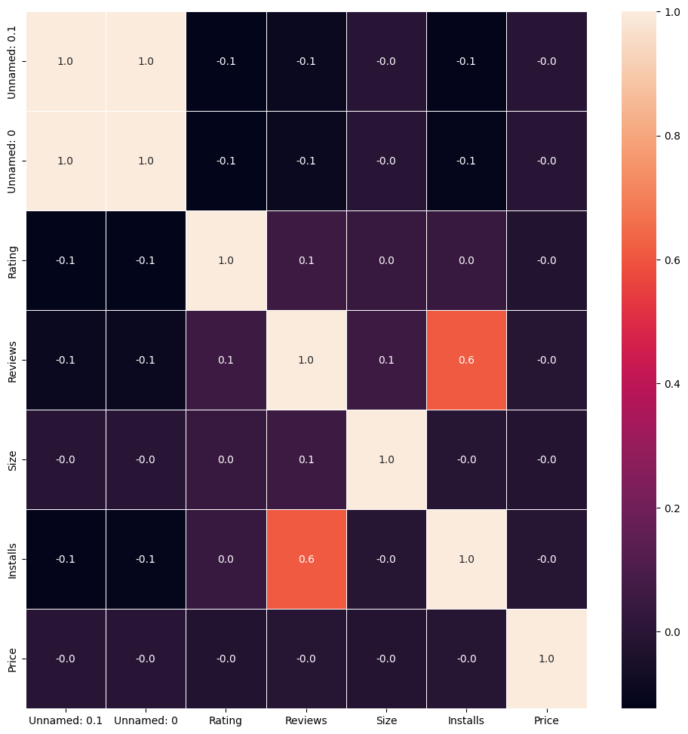
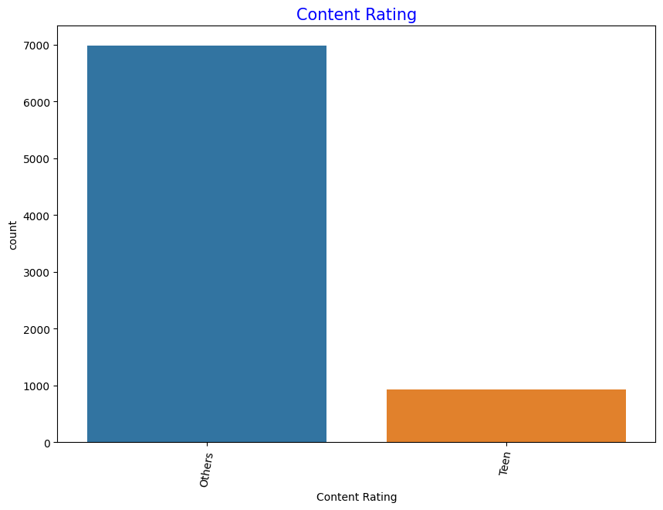
My Design
These are the few graphs which are analysed from given data:

Slide 7
Swiggy - Bangalore Outlet Analysis link for tableau (click here)

Slide 8
About
Swiggy was founded by Nandan
Reddy,Sriharsha Majety and Rahul
Jamini in 2014.
Swiggy started it’s journey in
Bangalore with 6 delivery
executives and 25 restaurants.
It is totally a service based
company.

Slide 9
Overview
By analyzing Swiggy data we can
know that in which location many
restaurants are situated,average
cost of a dish,rating of dish.

Slide 10
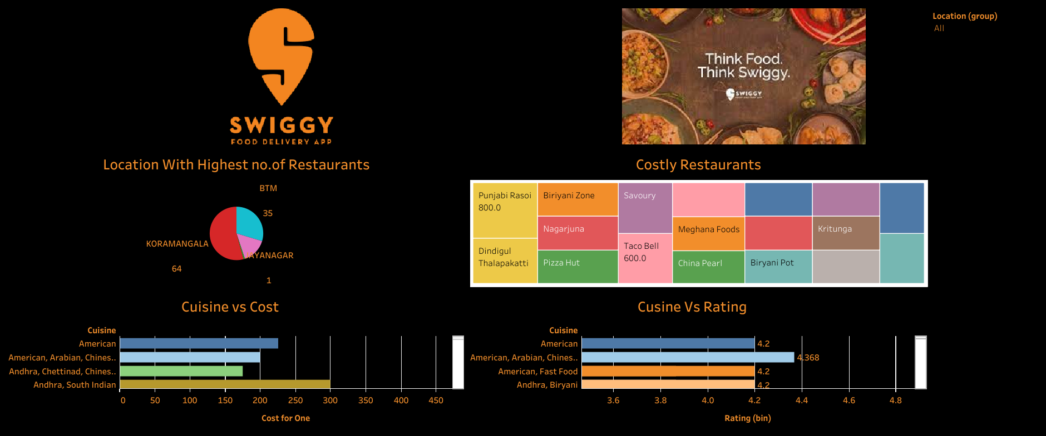
DASHBOARD

Slide 11
THANK YOU
- A SMALL ANALYSIS FROM PREETHI KOTARU

