Slide 1
EMPLOYEE Data Analysis using Excel
STUDENT NAME: K.PREETHI
REGISTER NO: 312214906
DEPARTMENT: B.COM COMPUTER APPLICATION
COLLEGE: ANNAI VEILANKANNI’S COLLEGE FOR WOMEN

Slide 2
PROJECT TITLE
Employee Performance Analysis using Excel

Slide 3


AGENDA
Problem Statement
Project Overview
End Users
Our Solution and Proposition
Dataset Description
Modelling Approach
Results and Discussion
Conclusion
3/21/2024 Annual Review

Slide 4

PROBLEM STATEMENT Employee performance growth is an good performer to increase a salaries,promotion and appreciation. A lower performer employee we will motivate in better manar and affective manar.

Slide 5

PROJECT OVERVIEW
Set goals: Establish performance goals for your employee.
Create a spreedsheet: Create a spreedsheet to track employee performance.
Enter data: Enter employee names,jobroles,and review dates at the top of the spreedsheet.the add the evalution .whichshould be customized for your business and role.
Use formulas and charts: Use formulas and charts to calculate average scores,identify top performer,and hightlightsarea for improvements
Provide feedback: Provide feedback to employee.
Monitor prograss: Monitorthe prograss of your employee.

Slide 6

WHO ARE THE END USERS? •Manager ● Employee ● Employer ● Organization ● IT sectors ● Industries

Slide 7

OUR SOLUTION AND ITS VALUE PROPOSITION Conditional formatting missing. Filter removed. Formula performance. Pivot table. Graph data visualisation.

Slide 8
DATA DESCRIPTION •Employee ID •Name • Gender • Department • salary • Start date • FTE • Employee TYPE •Work location

Slide 9

the "WOW" IN OUR SOLUTION 1.Interactive dashboard for realtime data exploration 2.regression analysis for identifying factors impacting performance 3.text analysis for feedback and survey analysis. 4.efficient workforce planning. 5.targeted retention strategies. 6.succession planning identifying future leader.
3/21/2024 Annual Review
9

Slide 10
MODELLING
Data collection:
1.Google
2.Idunet dashboard
DATA CLEANING:
1.Missing values to identify
2.Missing values to filterout
SUMMARY:
Pivot chart,visualization;
Open the excel sheet in employee data analysis and click the insert option. the right side will show a pivot table and click the table and select the new worksheet and they are showing a left side table what values you wants to select and the values are showing and create a pie chart.
10

Slide 11
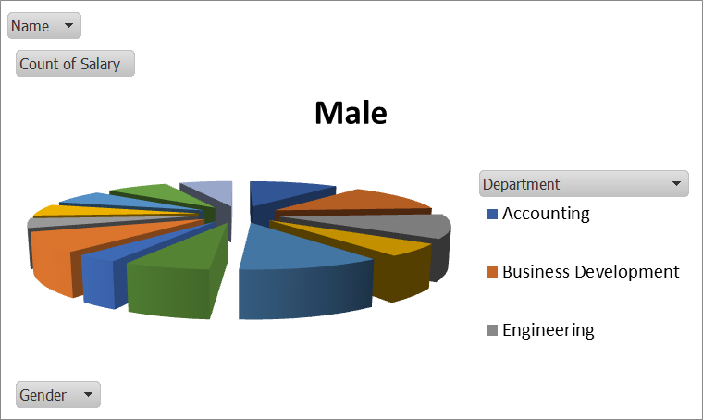
RESULT
11
Notes:
RESULT

Slide 12
M,
CONCLUSION
Our employee data analysis using excel has provided valuable insights into[company name] workforce dynamics the analysis revealed trends, patterns,and correlations that inform strategic decision
1.Summarizes key finding
2.Provides actionable recommendations
3.Highlights excel tools used
4.Acknowleadges limitations
5.Outlines future directions
6.Expand analysis to include predictive modelling

