Slide 1

Git log Summary
Enterprise Code Review
March 13 2020

Slide 2
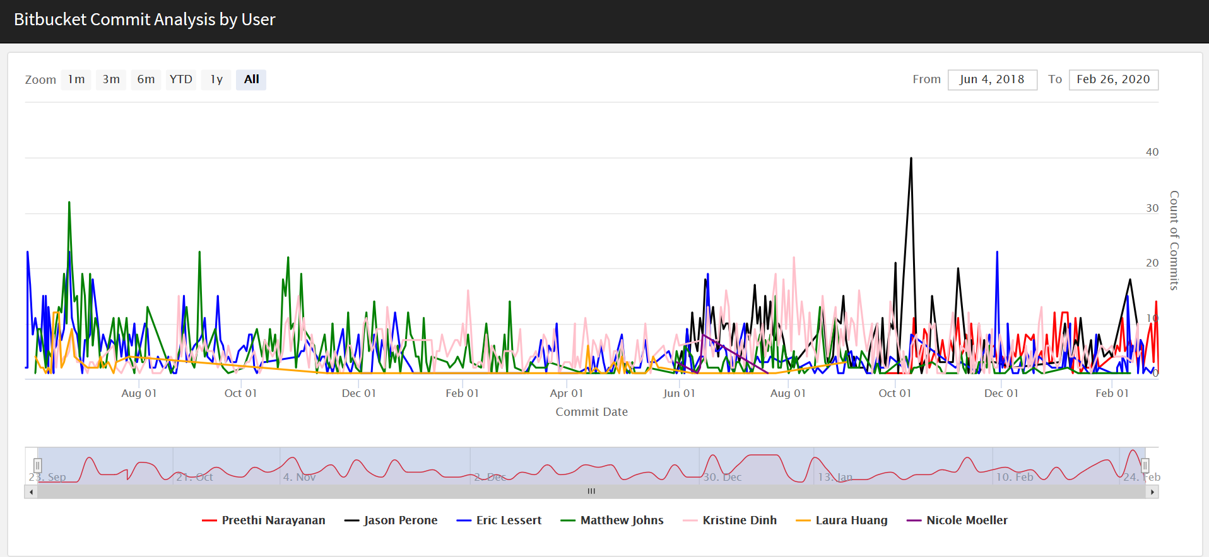
Visual of commits made by our team

Slide 3
Motivation
Software is invisible until complete
Bring visibility in intermediate steps of work
One way is to look at the commits made on a particular day
Shows the volume of work produced

Slide 4
Sections of Code
1. Loading Libraries
2. Function Definition to get git log
3. Loop that operates all repos in the directory on the defined function
4. Data cleanup to add repo and change date to a format easier to plot
5. Plot Required fields from the data

Slide 5
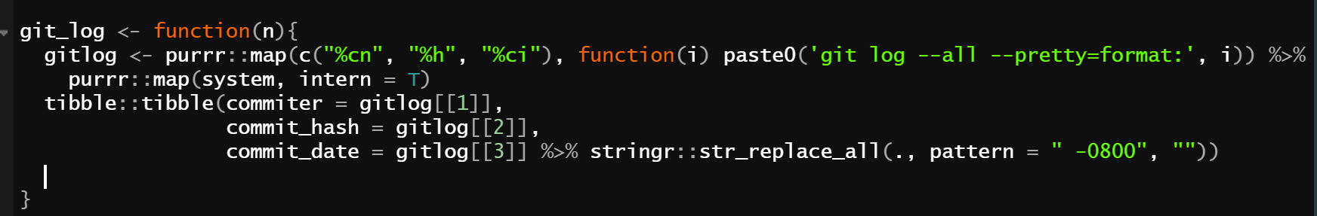
Function definition to get git log
System command used to get git log in R
Pretty format to get commit information in a neat format
Using tibble to get commiter, commit_date, commit_hash by indexing the system output
Get git log in cmd by navigating to where the repo is stored locally

Slide 6

Any questions?

