Slide 1
CampusPulse 2026
BIG DATA & CLOUD COMPUTING · ACADEMIC YEAR 2025–2026
IMPLEMENTED SERVERLESS FLOW
Amazon API Gateway
REST endpoints
Cloud-Based Smart Campus Operations Platform
AWS Lambda
Joswikkha Dilli Babu
Preethi Krishnamoorthi
Anbuselvan Ponnusamy
Python backend
Amazon DynamoDB
CampusPulseEvents
with IAM · CloudWatch · SAM / CloudFormation
Amazon Web Services · Europe (Paris) eu-west-3 · 10 October 2026
Notes:
[Time: 0:30]
SAY: Good morning everyone. We are Joswikkha, Preethi and Anbuselvan, and this is CampusPulse 2026, our project for Big Data and Cloud Computing. It is a small cloud-based prototype that shows how a smart campus could monitor its operations using AWS serverless services in the Paris region.
KEY TECHNICAL POINT: Implemented chain: API Gateway, one Lambda function (Python), DynamoDB. IAM, CloudWatch and SAM/CloudFormation support it. Region eu-west-3.
TRANSITION: Let me start with the problem this prototype tries to address.

Slide 2




Problem and motivation
Campus events
Occupancy
Energy use
Operational alerts
Classes, requests and activities generate a constant stream of events.
Knowing how busy rooms and buildings are supports planning.
Energy readings show where resources are being consumed.
Abnormal readings need to be spotted quickly.
The need: one cloud view of events, readings and alerts. CampusPulse is a prototype that addresses this need; these are not measured real-world findings.
Notes:
[Time: 0:40]
SAY: A campus produces constant signals: events, how many people are in rooms, energy use, and things that go wrong. If these live in separate places, it is hard to see what is happening. CampusPulse tries to bring them into one cloud view. To be clear, this slide describes the need; these are not measured findings from a real campus.
KEY TECHNICAL POINT: Four themes: campus events, occupancy, energy readings, operational alerts. All data in the project is simulated.
TRANSITION: So what did we set out to build?

Slide 3





Project objectives and solution
Receive
Simulated campus events arrive through the REST API
OBJECTIVE
Demonstrate how AWS serverless services combine into a small, scalable campus monitoring solution.
Process
Lambda (Python) handles the application logic
Store
Event records persist in DynamoDB
Calculate
Operational statistics via /stats
Prototype scope
Simulated data
REST API
Serverless
Detect
Abnormal readings surfaced via /alerts
Notes:
[Time: 0:40]
SAY: Our objective was to show that AWS serverless services can be combined into a small, scalable monitoring solution. The prototype receives simulated events, processes the readings, stores the records, calculates statistics, and flags abnormal readings, all through a REST API.
KEY TECHNICAL POINT: Five capabilities: receive, process, store, calculate, detect. Exposed via REST endpoints; no servers to manage.
TRANSITION: Here is the architecture that makes this work.

Slide 4
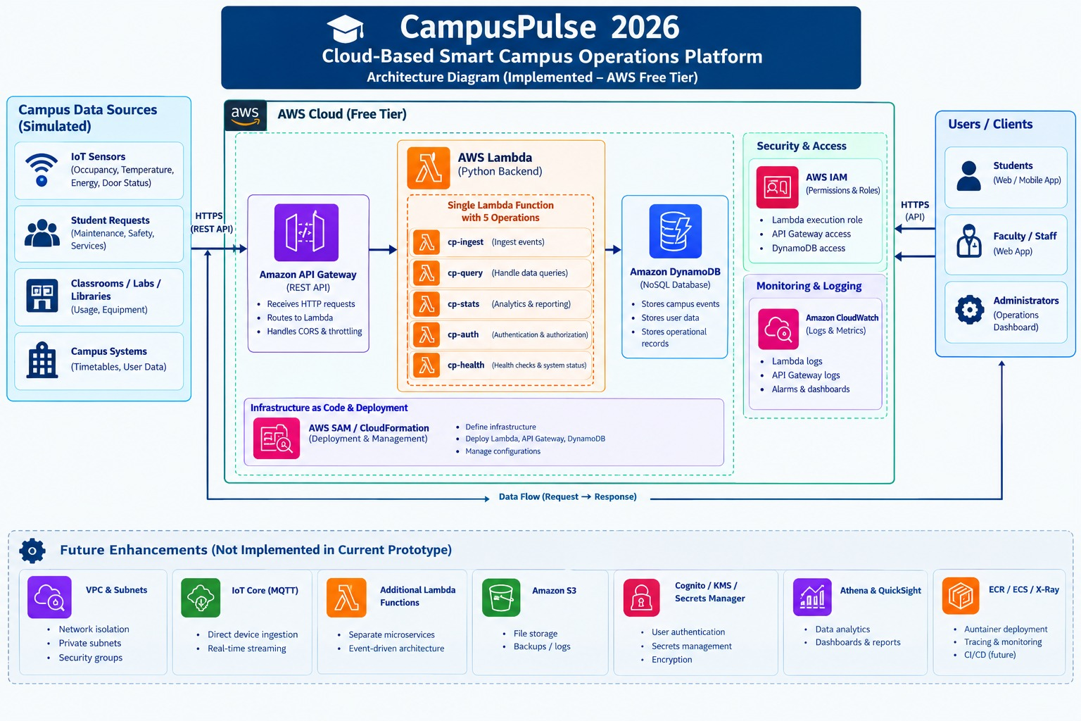
AWS architecture
REQUEST PATH
Amazon API Gateway
Receives REST calls
1
AWS Lambda
CampusPulseFunction: one function, five logical operations
2
Amazon DynamoDB
Table CampusPulseEvents
3
Supporting: IAM (permissions, Lambda execution role) · CloudWatch (logs, monitoring) · SAM / CloudFormation (deployment)
Implemented
Future (not deployed)
Orange band at the bottom of the diagram = future enhancements only.
Notes:
[Time: 1:00]
SAY: This is our real architecture diagram. A request enters through Amazon API Gateway, which routes it to AWS Lambda. Lambda runs our Python code and reads or writes the CampusPulseEvents table in DynamoDB. IAM controls permissions, including the Lambda execution role, and CloudWatch collects the Lambda logs. We deploy it with SAM and CloudFormation. One important point: there is one deployed Lambda function, CampusPulseFunction, with several logical operations, not five separate functions. The orange section at the bottom of the diagram shows future enhancements. Those are not deployed.
KEY TECHNICAL POINT: API Gateway -> Lambda -> DynamoDB. IAM = security; CloudWatch = monitoring; SAM/CloudFormation = infrastructure definition and deployment. The diagram also shows conceptual clients and some monitoring items; only what is listed on this slide is claimed as implemented.
TRANSITION: Now let us look at the technology stack and how data moves through it.

Slide 5



Technology stack and data flow
Python event generator
Amazon API Gateway
AWS Lambda
Amazon DynamoDB
Simulates campus events and posts them to the API
Exposes REST endpoints and routes each request
CampusPulseFunction: Python logic, five logical operations
Table CampusPulseEvents stores event records
SUPPORTING SERVICES
AWS IAM
Amazon CloudWatch
AWS SAM / CloudFormation
Permissions, including the Lambda execution role
Lambda execution logs and monitoring
Infrastructure definition and deployment
Notes:
[Time: 0:45]
SAY: Data starts with our Python event generator, which simulates campus events and sends them to the API. API Gateway receives and routes each request. Lambda applies the application logic. DynamoDB stores the event records. Underneath, IAM, CloudWatch and SAM support security, monitoring and deployment.
KEY TECHNICAL POINT: Flow: generator -> API Gateway -> Lambda -> DynamoDB. DynamoDB table name: CampusPulseEvents.
TRANSITION: Next, the API itself and what happens to one event.

Slide 6
API functionality and implementation
Endpoint | Purpose
/health | Checks application health
/login | Authenticates users (role-based login)
/events | Handles campus event records
/stats | Returns operational statistics
/alerts | Retrieves alert information
LIFE OF A SIMULATED EVENT
1
Python generator sends a simulated event to the API
2
API Gateway receives and routes the request
3
Lambda validates and processes the event
4
DynamoDB stores the record in CampusPulseEvents
One deployed Lambda function (CampusPulseFunction) handles all five operations. They are logical operations, not five separate functions.
5
/stats and /alerts compute results from stored data
Notes:
[Time: 0:50]
SAY: The API has five operations. Health checks the service. Login authenticates users with our role-based mechanism. Events handles event records. Stats returns operational statistics. Alerts retrieves alert information. Follow one simulated event: the generator sends it, API Gateway routes it, Lambda validates and processes it, DynamoDB stores it, and then stats and alerts read from the stored data.
KEY TECHNICAL POINT: All five operations are handled by the single CampusPulseFunction.
TRANSITION: Let me show what we verified.

Slide 7

Testing and results
VERIFIED /stats RESULT (after login)
6/6
Metric | Value
Total events | 5
Latest occupancy | 180 people
Energy readings count | 1
Sum of energy values | 18.5 kWh
Alert count | 3
Unit tests passed
SAM build and template validation succeeded
CloudWatch logs inspected
Note: occupancy 180 is the aggregated latest occupancy across rooms, not necessarily one room.
Notes:
[Time: 0:50]
SAY: Our automated test suite passed 6 unit tests. The SAM build and template validation succeeded, and we inspected the CloudWatch logs. On the deployed system, health worked, and after logging in, the stats endpoint returned 5 total events, 180 people as the latest occupancy, 1 energy reading with a sum of 18.5 kilowatt-hours, and 3 alerts. The 180 is the aggregated latest occupancy across rooms, not one room. We have not measured performance or scale, and we do not claim any.
KEY TECHNICAL POINT: Verified results only. Counts are charted together; occupancy (people) and energy (kWh) stay in the table because their units differ.
TRANSITION: Now I will show it running live.

Slide 8
Live demo
1
2
3
4
5
/health
/login
/events
/stats
/alerts
Check the service is up
Authenticate with a role
Send a simulated event
Read operational statistics
Retrieve alert information
Show: Healthy response
Show: Login succeeds (token stays hidden)
Show: Event is recorded
Show: Totals reflect stored events
Show: Alert list returned
Safety: credentials and tokens stay off-screen. Backup: CloudWatch logs and slide 7 results. ~3 minutes
Notes:
[Time: 3:00]
SAY: Now the live demo, about three minutes. First, health check to confirm the service is up. Second, log in; I will keep credentials off screen. Third, send a simulated event. Fourth, call stats to see the totals. Fifth, call alerts. If anything fails, I will switch to the CloudWatch logs and the verified results on slide 7.
KEY TECHNICAL POINT: Because the demo may add an event, live numbers can differ from the verified baseline of 5 events. Say this out loud if it happens.
TRANSITION: After the demo, I will go back to the slides: challenges and security.

Slide 9




Challenges, lessons learned and security
CHALLENGES AND LESSONS
Implemented
Proposed (not deployed)
Serverless integration
Connecting API Gateway to Lambda
IAM execution role for Lambda
Role-based login
CloudWatch logs
Infrastructure defined with SAM
Amazon Cognito for identity
VPC and private subnets
Managed secrets handling
Backup and DR improvements
API validation
Checking input before processing
DynamoDB persistence
Storing and reading back events
IAM permissions
Getting the execution role right
Logs and debugging
CloudWatch to trace errors
Notes:
[Time: 0:45]
SAY: The main challenges were connecting API Gateway to Lambda, validating API input, making sure events persist in DynamoDB, and getting IAM permissions right. CloudWatch logs were our main debugging tool. On security, what exists today is the IAM execution role, role-based login, and logging. Cognito, a VPC and better secrets handling are proposed improvements, not deployed.
KEY TECHNICAL POINT: Keep implemented vs proposed clearly separated.
TRANSITION: To finish, here is the summary and what comes next.

Slide 10
Conclusion and future enhancements
Built and validated
Future Enhancements (not deployed)
Serverless prototype on AWS: API Gateway, Lambda, DynamoDB
Supported by IAM, CloudWatch, SAM / CloudFormation
6 unit tests passed; SAM build and validation succeeded
Deployed API tested: /health and /stats verified
Amazon VPC and private subnets
Amazon Cognito
Dashboard on S3 and CloudFront
IoT Core / MQTT ingestion
Additional Lambda functions
Backup and disaster recovery
Thank you. Questions?
Athena and QuickSight analytics
ECR / ECS container deployment
Notes:
[Time: 0:45]
SAY: To conclude: we built and deployed a serverless prototype on AWS with API Gateway, Lambda and DynamoDB, supported by IAM, CloudWatch and SAM. We validated it with 6 passing unit tests and a working deployment. The future enhancements on the right are proposals only: VPC, Cognito, a hosted dashboard, IoT Core ingestion, more Lambda functions, disaster recovery, Athena and QuickSight, and containers. Thank you. We are happy to take questions.
KEY TECHNICAL POINT: Checklist below.
TRANSITION: Questions.
Live-demo checklist (no credentials in notes):
[ ] AWS region eu-west-3 confirmed; API base URL ready (not shown on slides)
[ ] Credentials loaded locally and hidden from screen share
[ ] /health tested once just before presenting
[ ] Python event generator ready with one event to send
[ ] Terminal font enlarged; commands pre-typed or in history
[ ] CloudWatch log group open in a tab as backup
[ ] Screenshot of /stats results ready as backup
[ ] Remember: sending an event changes the stats from the verified baseline

