Slide 1
Digital Portfolio
STUDENT NAME: A.Preethi
REGISTER NO AND NMID: 30924ucs028
DEPARTMENT: Computer Science
COLLEGE: Jawaharlal Nehru College for Women , Annamalai University

Slide 2
PROJECT TITLE CODE AND CREATIVITY : MY PORTFOLIO

Slide 3


AGENDA
Problem Statement
Project Overview
End Users
Tools and Technologies
Portfolio design and Layout
Features and Functionality
Results and Screenshots
Conclusion
Github Link
3/21/2024 Annual Review

Slide 4

PROBLEM STATEMENT
In today’s competitive environment, students and job seekers often struggle to effectively showcase their skills, projects, and achievements in a way that is accessible to recruiters and collaborators. Traditional resumes and CVs provide only limited insight into a candidate’s abilities and do not offer an interactive experience.
The lack of a personalized, digital portfolio makes it difficult for individuals to:
1. Highlight their technical skills and practical work.
2. Provide recruiters with an easy way to explore their projects and achievements.
3. Establish an online presence that reflects professionalism and credibility.
To address this problem, I developed a Portfolio Website using HTML, CSS, and JavaScript, where all my academic experiences, skills, and projects are showcased in one accessible platform.

Slide 5

PROJECT OVERVIEW
The Portfolio Website is a personal web-based platform developed as part of the Naanmudhalvan Project. It is designed to showcase my skills, academic achievements, and projects in an organized and visually appealing way. The portfolio highlights my journey as a student, my technical expertise in HTML, CSS, and JavaScript, and my ability to create responsive and user-friendly interfaces.
The website contains key sections such as About Me, Skills, Projects, and Contact Information, ensuring that visitors such as recruiters, peers, and collaborators can easily understand my background and connect with me. The inclusion of a hosted profile image, clean navigation, and responsive layout ensures that the site works seamlessly across devices.
This project serves both as a demonstration of my web development skills and as a personal branding tool that helps me present myself professionally in academic and career opportunities.

Slide 6

WHO ARE THE END USERS?
1. Students – Can take inspiration for building their own portfolio and showcasing academic work.
2. Recruiters/Companies – Can view my skills, projects, and contact details at a glance.
3. Collaborators – Developers, designers, or peers who may want to connect for team projects.

Slide 7

TOOLS AND TECHNIQUES
Frontend : HTML5, CSS3, basic JavaScript.
Styling : TailwindCSS (for responsive design & modern layout).
Hosting : Can be deployed using GitHub Pages / Netlify.
Editor : Visual Studio Code (VS Code).

Slide 8
POTFOLIO DESIGN AND LAYOUT
Header Section : My name (A. Preethi) + navigation menu (About, Skills, Projects, Contact).
Hero Section : A short introduction about myself with a profile picture.
About Me : A paragraph about my journey in the Naanmudhalvan Project and career goals.
Skills Section : A list of my technical and soft skills (HTML, CSS, JS, teamwork, problem-solving).
Projects Section : At least one sample project (Portfolio Website).
Contact Section : Email (preethitherebel@gmail.com) .
Footer : "Naanmudhalvan Project Portfolio" branding.
8

Slide 9
POTFOLIO DESIGN AND LAYOUT
My project uses a single-page, multi-section portfolio design built with a modern, minimalist layout.
CORE DESIGN & LAYOUT ELEMENTS
Overall Structure:
I've used a classic single-page architecture where users scroll down to navigate through different sections (Hero, About, Skills, Projects, Contact). This is facilitated by a sticky navigation bar that stays at the top of the screen for easy access.
Layout Technique:
The layout is fully responsive, built using the Tailwind CSS framework. Key layout features include:
Centered Content: Most sections use container mx-auto to center the content horizontally, ensuring it looks good on all screen sizes
Grid System: I use Tailwind's grid (grid grid-cols-1) and flexbox (flex justify-between) utilities to structure your components, like the navigation bar and project cards
Visual Style (Aesthetics):
Color Scheme: The design employs a multi-colored pastel theme, where each section has a distinct background color (e.g., bg-pink-100, bg-blue-100, bg-green-100).
Typography: I've implemented a multi-font design, assigning different typefaces to specific sections (Inter for the body, Playfair Display for About, Roboto for Skills, Montserrat for Contact) to create varied visual tones.
Component Style: The design relies on card-based components with soft shadows (shadow-lg), rounded corners (rounded-xl), and clear padding for a clean, organized look. A unique custom element is the double-underline effect on headings, which adds a decorative and personalized touch
9

Slide 10
FEATURES AND FUNCTIONALITY
Responsive Design – Works on mobile and desktop screens.
Simple & Clean UI – Easy navigation with minimal distractions.
Profile Image Integration – Image hosted online (postimg link) displayed in the hero section.
Card-Based Project Display – Projects shown in a clean layout with descriptions.
Direct Contact Info – Recruiters/visitors can connect via Gmail .

Slide 11
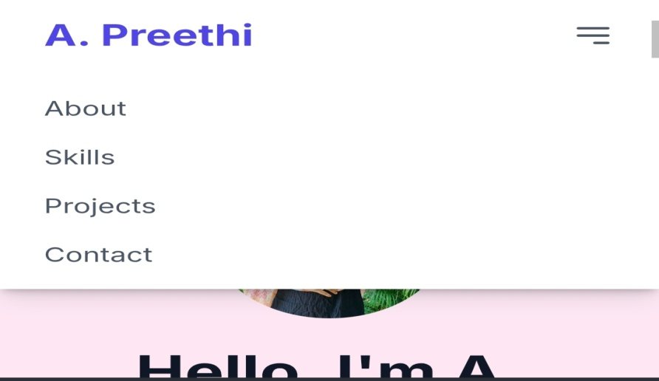
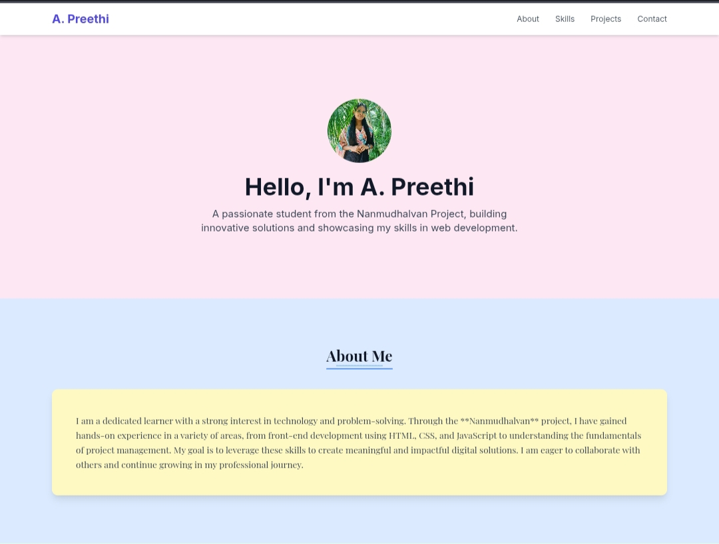
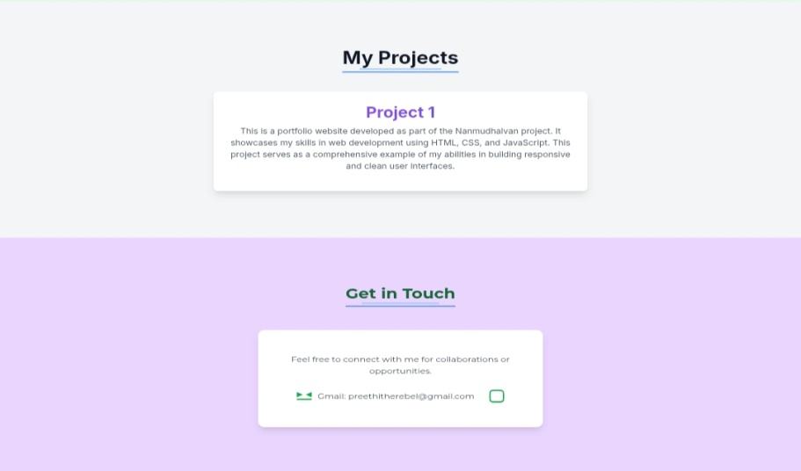

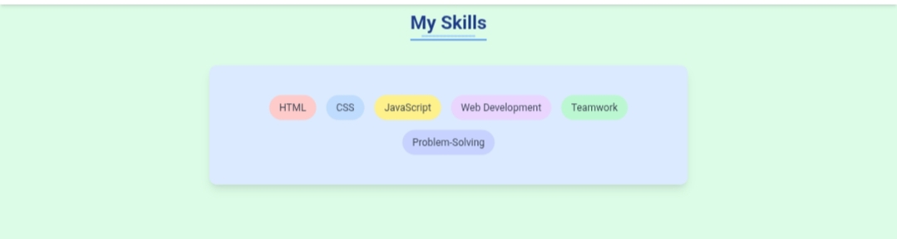
RESULTS AND SCREENSHOTS
3/21/2024 Annual Review
11

Slide 12
CONCLUSION
This project has given me the opportunity to apply my theoretical knowledge in a practical way, and it stands as a step forward in my journey of becoming a professional software developer.
12

Slide 13
GITHUB LINK :
13

