Slide 1

Indoor navigation app

Slide 2
Problem statement:
Create an app that would show a navigation path inside a building by taking into account rooms, corridors and floors in the real world on your mobile device screen

Slide 3
Proposed solution:
→We intend to develop an augmented reality application which will show the directions to the destination in the user’s camera.
→The precise location of user’s indoors are determined using the streaming data fed by the user’s camera and directions are augmented with an arrow.
→The application is developed in Unity using Google ARCore, Vuforia, Blender.

Slide 4
Features:
→The user opens the app and is asked to scan the visual marker at his present location, then a list of destinations based on his present location are displayed.
→ Once the destination is chosen, route is loaded and animated directions are shown along the user’s path to reach the destination

Slide 5
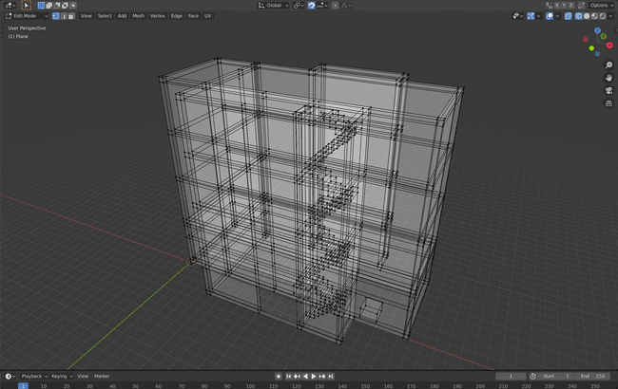
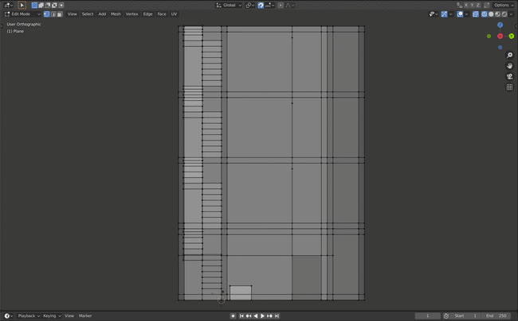
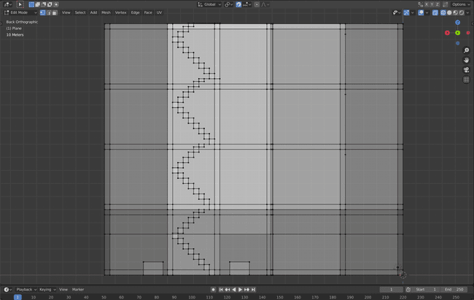
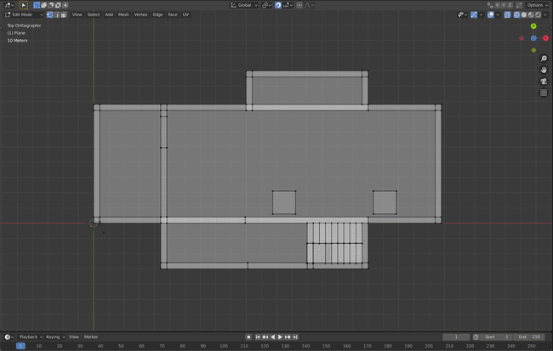

Slide 6
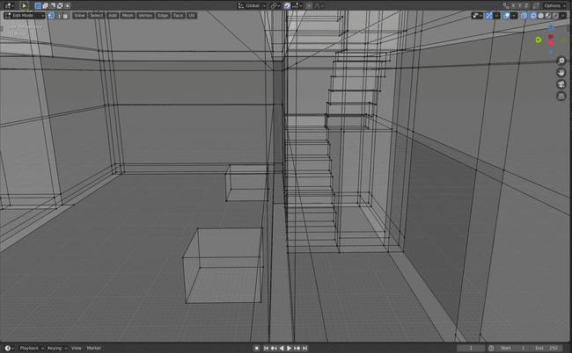
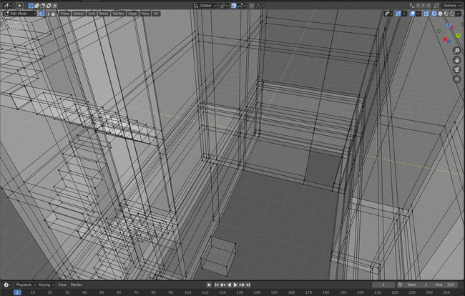
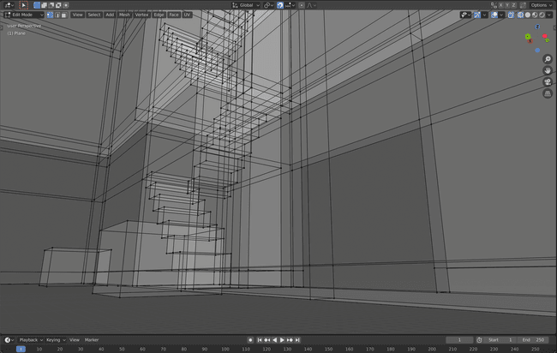

Slide 7
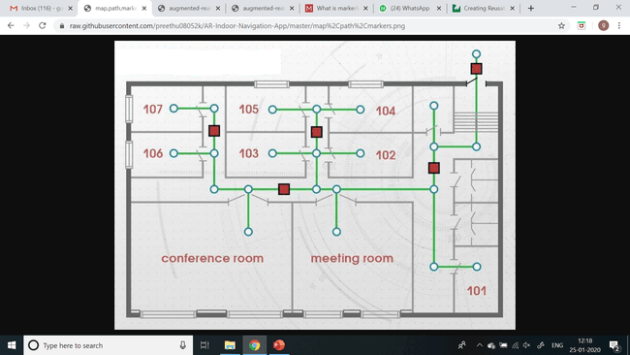

Slide 8
