Slide 1

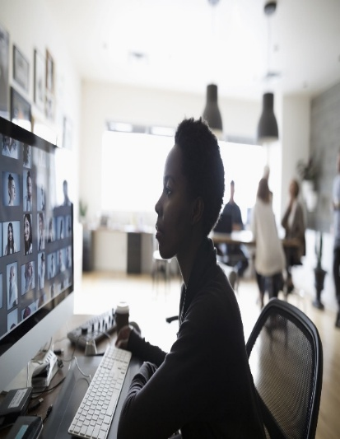
DIGITAL PORTFOLIO
STUDENT :PREETHA . S
REGISTER NO :36324u18048
DEPARTMENT :Bsc (Computer science)
COLLEGE :Sree Abiraami arts and science college foe women
UNVERSITY :Thiruvalluvar university
EMAIL NO : preethasampath063@gmail.com

Slide 2

PROJECT TITLE

Slide 3
AGENDA
PROBLEM STATEMENT
PROJECT OVERVEIW
END AND USERS
FEATURES AND FUNCTIONALITY
TOOLS AND TECHNOLOGIES
PORTFOLIO DESIGN AND LAYOUT
RESULTS AND SCREENSHORT
GITHUB AND PORTFOLIO LINKS
CONCLUSION

Slide 4


PROBLEM STATEMENT
In today’s digital age, students and professionals need an efficient and organized way to showcase their skills ,achievements , and work . Taditional paper-based portfolios are limited in accessibility , lack interactivity, and are hard to update . There is a need for a digital portfolio that allows users to easily present their academic and professional accomplishments , project, certifications, and experiences in an accessible , customizable , and visually appealing online format

Slide 5
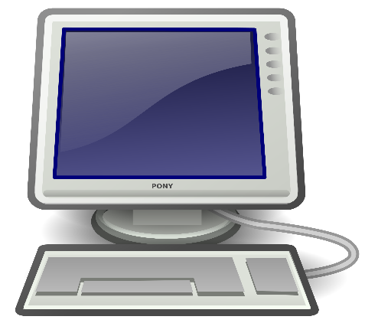

PROJECT OVERVIEW
The portfolio will include sections like personal information , resume, project , certificate , skills ,and contact details. This platform will be user-friendly ,customizable , and easily shareable via a web link. It helps individuals build a strong personal brand and improves their chances in academic admissions , job recruitment ,or freelance opportunities by providing a professional and organized presentation of their work.

Slide 6

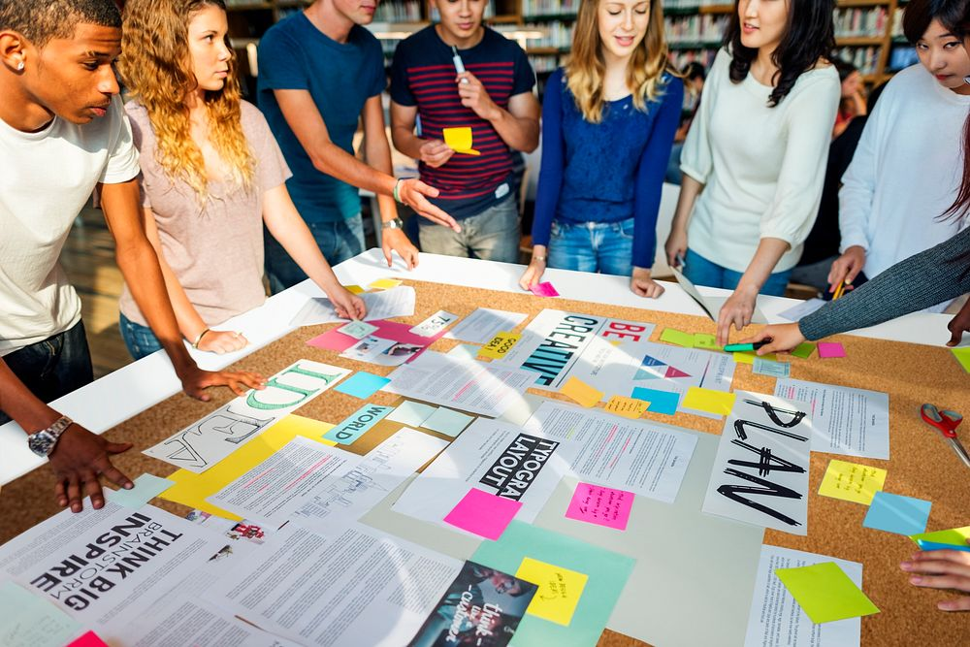
WHO ARE THE END USERS ?
1.Students-To showcase academic achievements ,project , and skills for Internships.
2.Job seekers-To present resumes , experiences, and certifications to
Potential employers.
3.Educators-To review student progress and provide feedback.
4.Employers-To evaluate candidates through their portfolio links.
5.Freelancers-To display portfolio of completed work for attracting
Clients.

Slide 7


FEATURES AND FUNCTIONALITY
“Homepage” - Introducation with name ,profile , picture , and a brief bio.
“Embedded Media” – videos , presentations ,or audio clips embedded directly.
“Downloadable Content” – PDFs, project files, or resources available for download.
“Skills Display – Visual respresentation of technical and soft skill.
“Contact form”- Allwos users to reach out via email or message.
“Social Media Links”-Quick access to Linkedin , GitHub link.

Slide 8

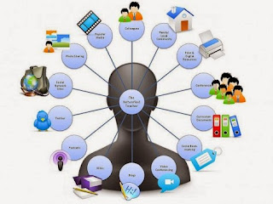
TOOLS AND TECHNIQUES
*Coding Languages :HTML ,CSS , Javascript .
* Version Control : Git and GitHub for managing project versions and updates.
*Mention code editor (vs code) or CODEPEN and hosting platform (GitHub pages).

Slide 9
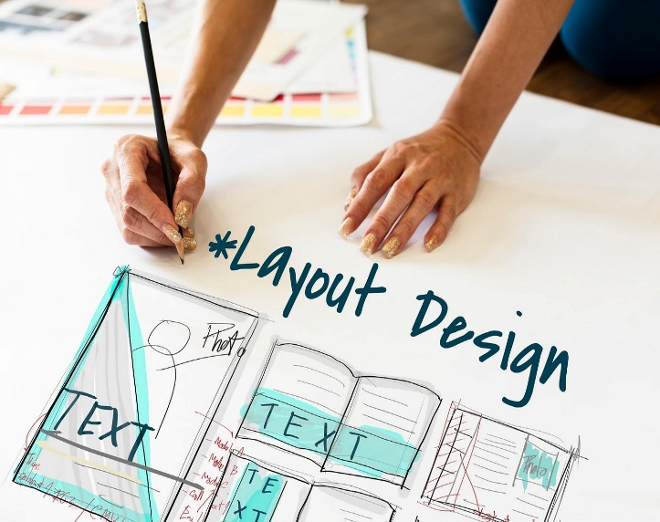
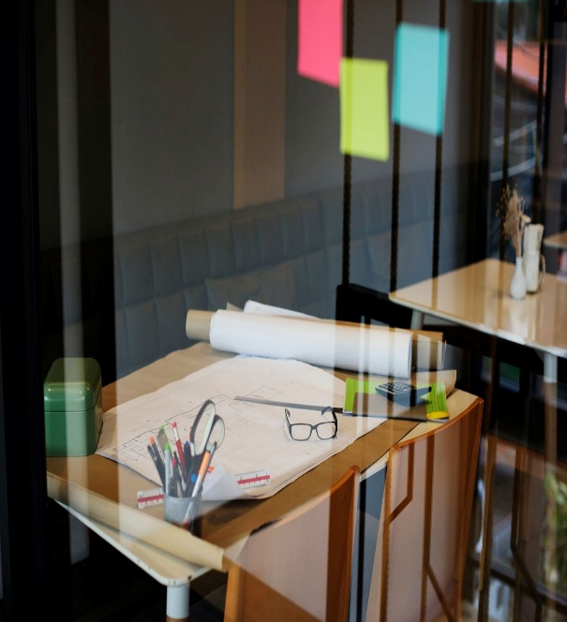
POTFOLIO DESIGN AND LAYOUT
* HOME :* Engaging introduction with a professional photo and a brief tagline.
* ABOUT ME:*short bio detailing background , interests , and career goals.
* CERTIFICATES:*Display of earned certifications with visuals or downloadable links.
* CONFERENCE:*Details of conferences attended or presented at.
SKILLS:*visual skill bars or icons for technical and soft skills.
LAYOUT :
Clean grid-based format
Mobile-responsive design for accessibility on all
Devices.
9

Slide 10
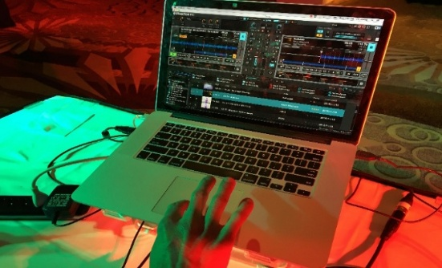
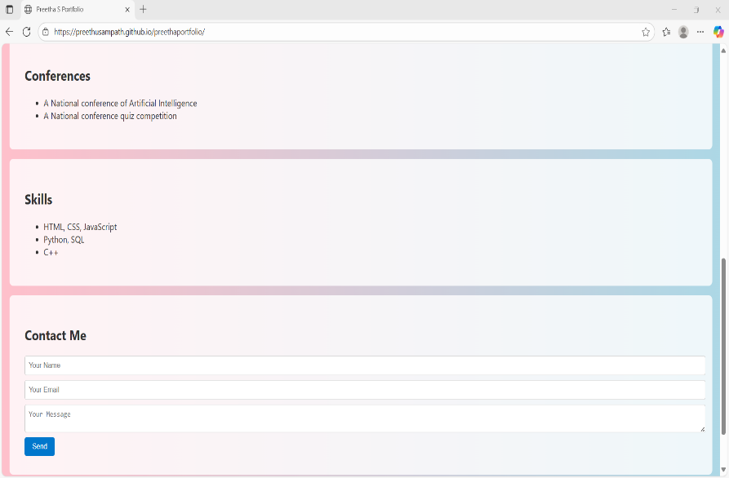
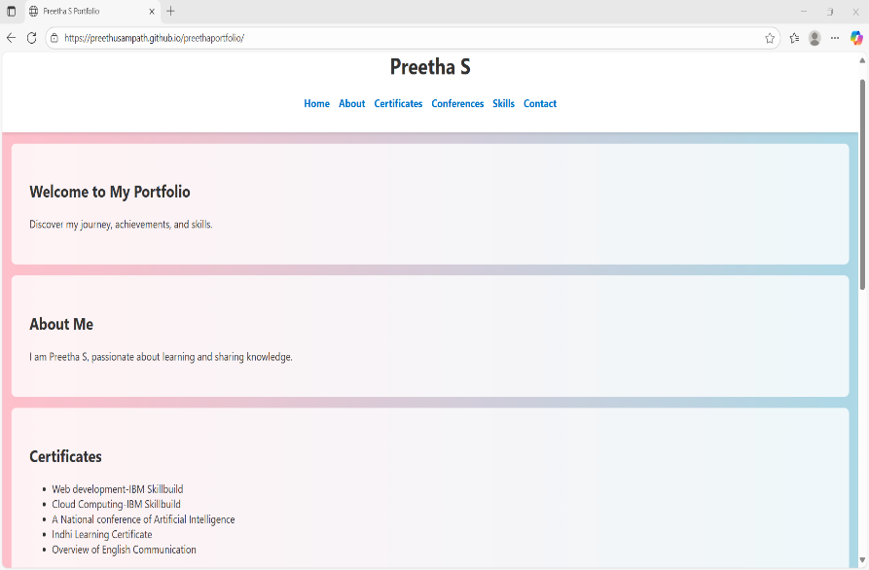

RESULT AND SCREENSHOT
10

Slide 11


GITHUB AND PORTFOLIO LINK
This is my profile and my ditgital portfolio link.
https://preethusampath.github.io/preethaportfolio/
MY GITHUB URL
https://github.com/preethusampath
11

Slide 12


CONCLUSION
This digital portfolio serves as a comprehensive showcase of my skill ,experiences , And accomplishments. It reflects my growth , learning journey, and commitment to continuous improvement in my field . By presenting my work in an organized and visually appealing format , I aim to make a strong impression on potential employers , collaborators , or academic institutions . this portfolio not only highlights what I have achieved so far but also sets the foundation for future opportunities and professional development.
12

