Slide 1
DEEP LEARNING FOR CLOTH RECOGNITION AND GENDER PREDICTION
Preethy Ann Thomas
INMCA
Guide: Ms. Sruthimol Kurain

Slide 2
INDEX
Introduction
Objectives
Literature Review
Stages of Model Development
Model Architecture
Model Training Essentials
Training Process
Evaluation
Result
Future Scope
Conclusion
References

Slide 3
INTRODUCTION
Focus: Revolutionizing the fashion industry through computer vision and deep learning.
Significance: Offers automation for product detection, description, and valuable insights.
Technologies: Utilizes ResNet-50 and a multi-phase approach for superior performance.

Slide 4
OBJECTIVES
Automated Cloth Recognition
Utilize computer vision and deep learning to automate the recognition of cloth type in images.
Gender Prediction
Implement gender prediction from images using DeepFace library.
Color Analysis
Develop a system for color analysis, including detection of prominent garment colors.
Product Descriptions
Generate descriptions of recognized fashion products using random function in python.

Slide 5
LITERATURE REVIEW
Hidayati et al. [1]: Achieved 88% accuracy in clothing genre recognition, with a focus on improving face recognition and attractiveness evaluation for real-world applications.
Bossard et al. [2]: Introduced a clothing recognition pipeline with 41.38% average accuracy for e-commerce, event recognition, and advertising.
Hong Chen et al. (2006) [3]: Developed a method for creating realistic cloth models from drawings, bridging art and computer graphics.

Slide 6
LITERATURE REVIEW
DeepFashion [4]: Offers a large-scale apparel dataset and FashionNet for garment attribute learning, along with benchmark datasets for apparel recognition and retrieval.
Automated clothing genre recognition [5]: Achieved high accuracy (92.04% precision, 92.45% recall, and 92.25% F-score) using feature extraction, tag assignment, and face & upper-body detection.

Slide 7
STAGES OF MODEL DEVELOPMENT
Data Collection
Data Preprocessing
Diverse Sources:
E-commerce platforms, and public datasets
Ensures a broad spectrum of fashion product images.
Meticulous Annotations:
Information including product image and category.
Crucial for accurate image classification.
Quality Enhancement:
Noise reduction, background removal, color correction, resolution, and size standardization.
Optimizes data quality for machine learning.
Metadata Handling:
Efficient management of image metadata.
Key for organization and retrieval of images.

Slide 8
Data Augmentation
Data augmentation is employed to increase the diversity of the training dataset for machine learning models.
It introduces variations in the data to help the model generalize better to real-world scenarios.

Slide 9
Data Augmentation
Image Rotation
Simulate different angles at which fashion products appear in photographs. Aids the model in becoming invariant to object rotation.
Horizontal and Vertical Flipping
Introduce variations in the orientation of fashion products. Helps the model learn from images with different orientations.
Random Cropping
Simulate different perspectives and zoom levels. Allows the model to adapt to variations in image composition.

Slide 10
Data Augmentation
Brightness and Contrast Adjustments
Handle different lighting conditions in real-world images. Improve the model's adaptability to varying lighting environments.
Gaussian Noise
Simulate noise present in real photographs. Enhance the model's robustness to noisy input data.
Color Jitter
Adjust hue, saturation, and brightness randomly. Diversify the color palette the model is exposed to during training.

Slide 11
Data Augmentation
Scaling and Resizing
Scaling and resizing images to different dimensions helps the model learn from clothing items of varying sizes and resolutions.
This augmentation ensures that the model can recognize products regardless of their scale in images.
Shearing
Shearing introduces distortions that mimic perspective changes in images.
This technique is valuable for training the model to recognize clothing items photographed from different angles.

Slide 12
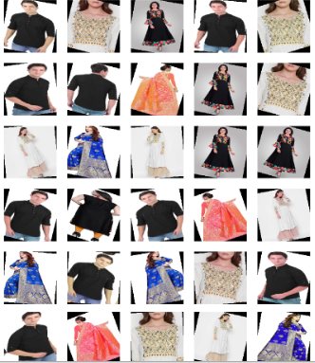
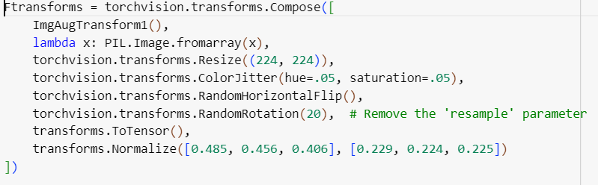
Data Augmentation
Applying augmentation on train data

Slide 13
MODEL ARCHITECTURE
ResNet-50 is the selected deep neural network model for our system.
Convolutional Layers
These layers apply convolutional filters to input images.
Detect various visual patterns like edges, textures, and shapes.
Pooling Layers
Pooling layers reduce spatial dimensions of feature maps.
Help to reduce computational complexity and enhance model robustness.
Fully Connected Layers
Flatten output from convolutional layers.
Process data through fully connected (dense) layers for final classification.

Slide 14
Model Training Essentials
Loss Function:
We employ the categorical cross-entropy loss function to train our model which measures the dissimilarity between predicted class probabilities and true class labels.
Minimizing this loss during training enables the model to make precise predictions and classify fashion products accurately.

Slide 15
Model Training Essentials
Optimization Algorithm:
Stochastic Gradient Descent (SGD) serves as the optimization algorithm in the training process.
SGD iteratively updates the model's weights to minimize the loss function, driving the model towards an optimal solution.
The choice of learning rate, a critical hyperparameter in SGD, is thoughtfully selected and tuned for efficient and effective training.

Slide 16
TRAINING PROCESS
Data loaders efficiently load and batch data for deep learning
batch_size is set to 128, so that during training and testing, data will be divided into mini-batches, each containing 128 images.
shuffle=True for the trainloader means that the training data will be shuffled randomly at the beginning of each epoch

Slide 17
TRAINING PROCESS
The training process involves multiple epochs, during which the model is exposed to the augmented training dataset.
The model iteratively learns from the data, adjusting its internal parameters to improve its ability to recognize and classify fashion products accurately.
Training for multiple epochs allows the model to refine its representations and learn complex patterns present in the images.

Slide 18
EXTENDED FEATURES …
Gender Prediction
DeepFace, a potent deep learning library, is used for accurate gender prediction from facial traits in photos.
DeepFace is renowned for its remarkable precision.
It employs sophisticated algorithms to classify gender based on key facial features.

Slide 19
EXTENDED FEATURES …
color Detection
Color Detection
Transfer learning with pre-trained deep learning models like ResNet-50 enables it to identify a wide variety of items and their characteristics.
Accurate color analysis is achieved using the CIEDE2000 color difference concept.
The algorithm also separates garment colors from the backdrop using clustering algorithms and the LAB (L*, a*, b*) color space.

Slide 20
EXTENDED FEATURES …
color Detection
color Detection
Caption Generation
It generates color-based captions like 'A [color] [product category]' for different fashion goods.
The function builds a pool of intriguing descriptions by combining the color-based and random captions, from which a random option is chosen.
This dynamic caption generation method improves the way fashion goods are presented and marketed.

Slide 21
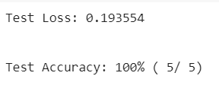
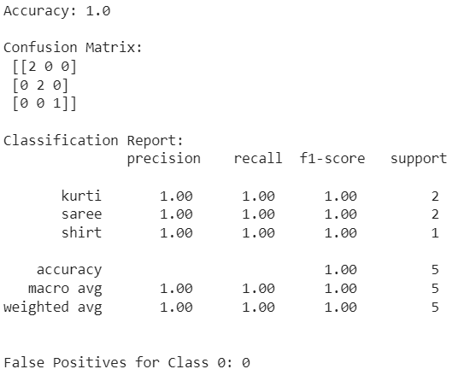
EVALUATION

Slide 22
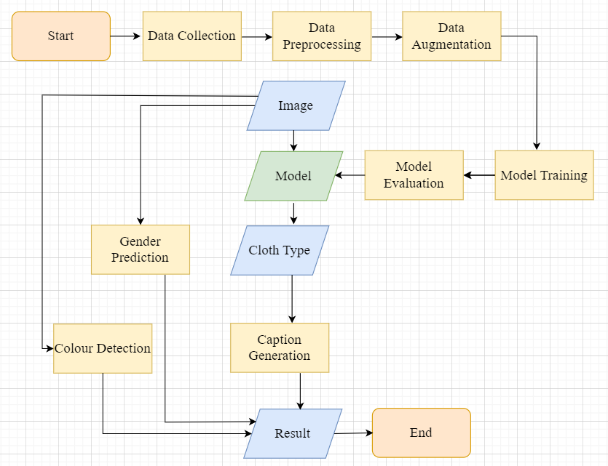

Slide 23

RESULT

Slide 24
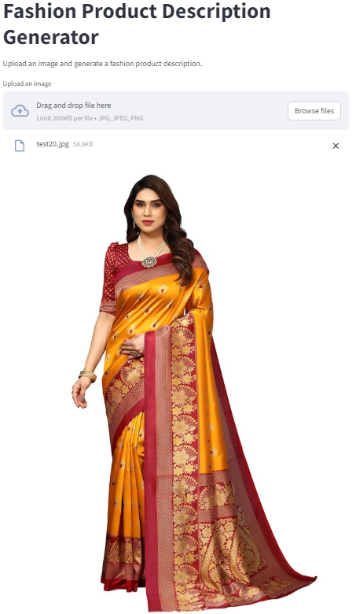
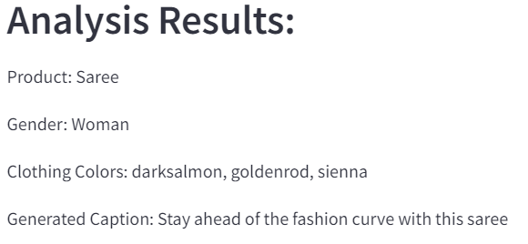

Slide 25
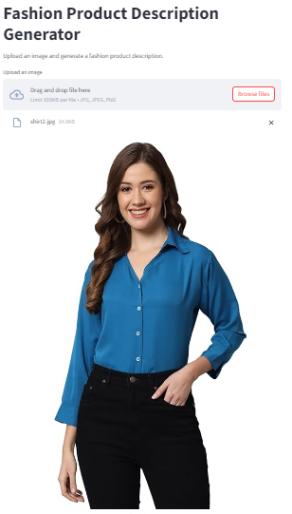
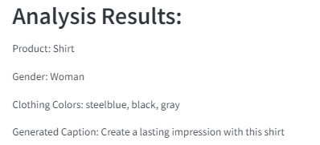

Slide 26
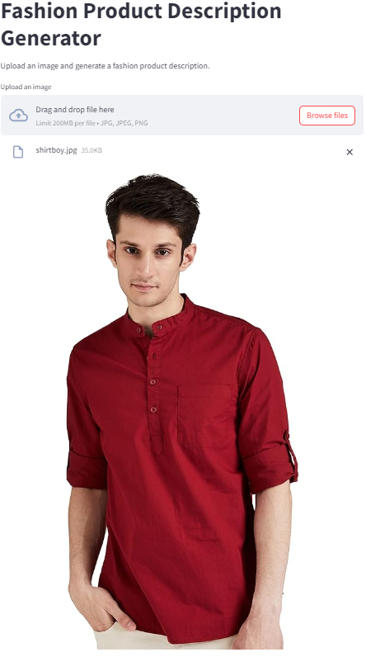
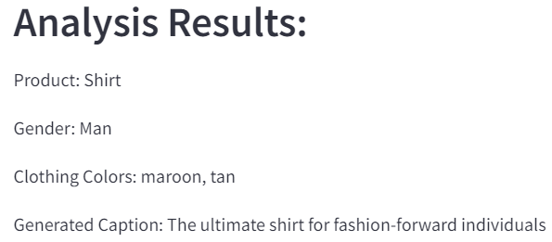

Slide 27
FUTURE SCOPE
Real-time Fashion Recommendation
Integrating the developed algorithm with real-time fashion recommendation systems can provide personalized fashion suggestions to users based on their preferences, current trends, and the clothing items they have.
Enhanced Virtual Fashion Shows
Virtual fashion shows and events can become more interactive and personalized. Users can virtually attend shows and try on clothing items in real time.
3D Clothing Models
Develop 3D models of recognized clothing items to enable virtual fitting and visualization. This can be valuable in gaming, virtual reality, and e-commerce.

Slide 28
CONCLUSION
This study offers a novel method that improves the detection and description of fashion products in images by fusing computer vision and deep learning.
The algorithm is quite good at recognizing and describing fashion products with sophisticated methods.

Slide 29
REFERENCES
S. C. Hidayati, W.-H. Cheng, and K.-L. Hua, “Learning and Recognition of Clothing Genres from full body images” in IEEE Transactions on Cybernetics, May 2018.
Lukas Bossard, Matthias Dantone, Christian Leistner, Christian Wengert, Till Quack, Luc Van Gool, “Apparel Classification with Style”, in “Asian Conference on Computer Vision”, Daejeon, Korea, November 5-9, 2012.
Hong Chen, Zi Jian Xu, Zi Qiang Liu, Song Chun Zhu, “Composite Templates for Cloth Modelling and Sketching” in IEEE Conference, June 2006.

Slide 30
REFERENCES
S. C. Hidayati, W.-H. Cheng, and K.-L. Hua, “Learning and Recognition of Clothing Genres from full body images” in IEEE Transactions on Cybernetics, May 2018.
Lukas Bossard, Matthias Dantone, Christian Leistner, Christian Wengert, Till Quack, Luc Van Gool, “Apparel Classification with Style”, in “Asian Conference on Computer Vision”, Daejeon, Korea, November 5-9, 2012.
Hong Chen, Zi Jian Xu, Zi Qiang Liu, Song Chun Zhu, “Composite Templates for Cloth Modelling and Sketching” in IEEE Conference, June 2006.
Liu, Z., Luo, P., Qiu, S., Wang, X., Tang, X, “Deepfashion: Powering robust clothes recognition and retrieval with rich annotations”, in Proceedings of the IEEE conference on computer vision and pattern recognition, Las Vegas, NV, USA, 2016, pp.1096-1104.
S. C. Hidayati, W.-H. Cheng, and K.-L. Hua, “Clothing genre classification by exploiting the style elements” in Proceedings of ACM International conference on Multimedia, Nara, Japan, 2012, pp. 1137–1140.

Slide 31

Thank you

