Slide 1



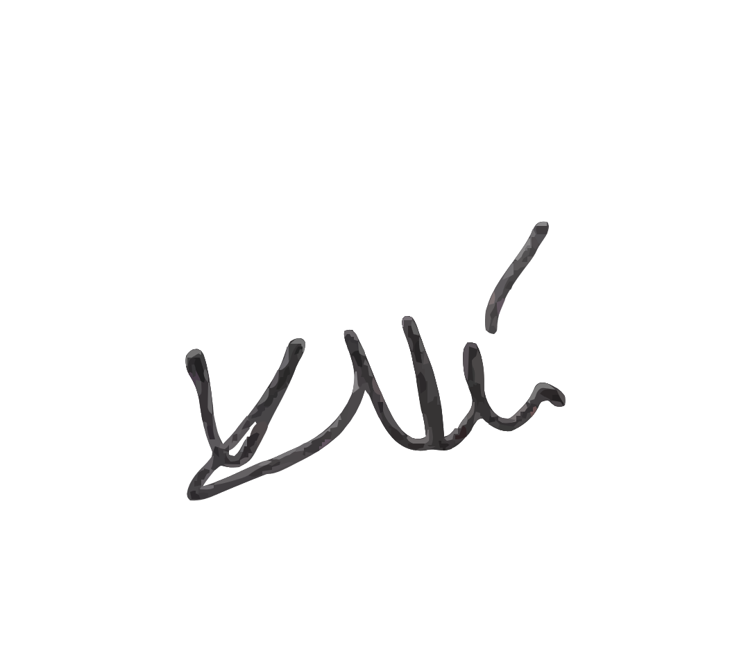

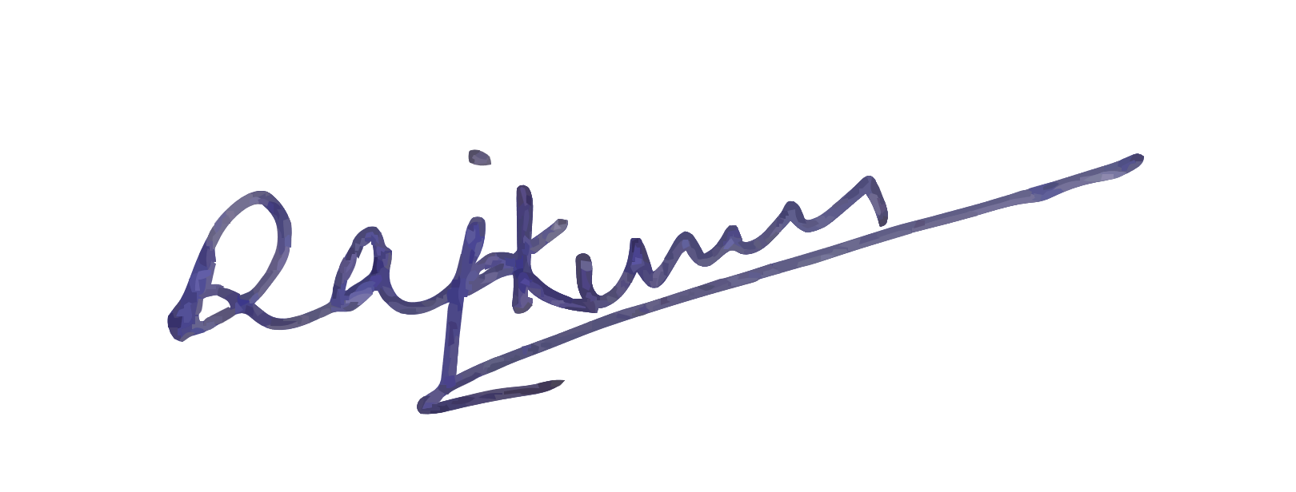
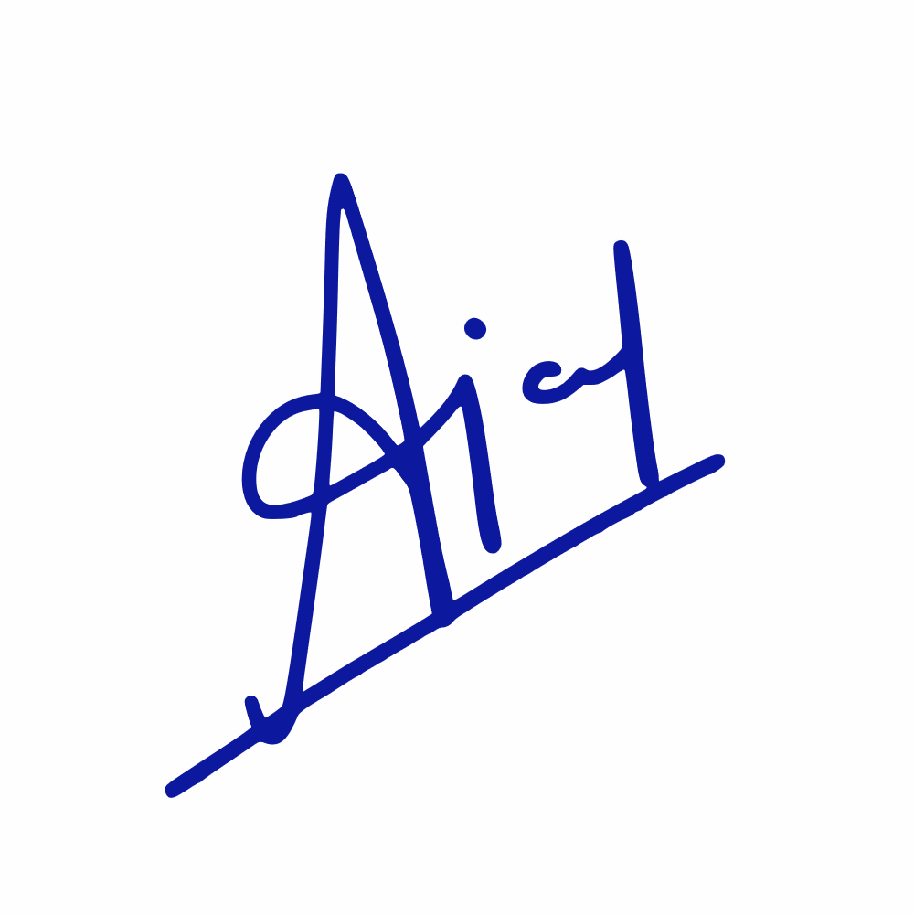
RIMT University
Certificate
grants and certifies this certificate on
Of Participation
11 March 2026
Manpreet
This certificate is awarded to student of Law department for Participating in the event organized on the occasion of Fusion Fest 2026, by the School of Engineering, Department of Computer Applications at RIMT University, Mandi Gobindgarh.
Dr. Raj Kumar
Dr. Ajay Singh Rana
Dr. Kartik K Gupta
Fusion Fest
HOD - DoCA
Associate Dean - SoET
Dean - SoET

