Slide 1

Submitted by:
Preeti Kumari
M170528CA
(MCA)
Under Guidance of:
Dr. Vinod Pathari
DEPARTMENT OF COMPUTER SCIENCE AND ENGINEERING
National Institute of Technology Calicut NIT
TROUBLESHOOT
(Design and Development of an application for immediate local assistance)

Slide 2
Introduction
Troubleshoot is a network on which people can help each other, share their problems, issues and queries send and receive comments and notifications, get different solutions and suggestions etc. This application handles two type of problems ie., Normal and Emergency. At the time of emergency the people connected to certain organisation (like: police, hospital, fire brigade) are responsible to give immediate response to the seeker. Whereas in normal time users can post feed. In addition to these, system features such as selecting range, save post, stories etc.

Slide 3
Definitions
Helper: Any user who is going to answer the question/queries.
Seeker: Any User who is going to raise the question/queries.
Emergency: At the time of emergency the people connected to certain organisation (like: police, hospital, fire brigade) are responsible to give immediate response to the seeker.

Slide 4
Functional Requirements
Functional requirement 1:
Description: Login
Input: Email and password are entered
Processing: verifying the email
Output: Login Successful
Functional requirement 2:
Description: Register
Input: Email, password, name, specialization and number are entered
Processing: Verifying the email and phone number
Output: Register Successful

Slide 5
Functional Requirements
Functional requirement 3:
Description: Questioning phase
Input: Questions asked must have a brief description
Processing: verifying question and removing any restricted content
Output: Question displays
Functional requirement 4:
Description: Answer
Input: Answering the question
Processing: verifying the answer and removing the explicit content
Output: answer submitted

Slide 6
Functional Requirements
Functional requirement 5:
Description: Search
Input: Search the specific topic or question
Processing: searching the input in database
Output: results shown
Functional requirement 6:
Description: comment
Input: Commenting the answer
Processing: verifying the comment and removing the explicit content
Output: comment submitted

Slide 7
Functional Requirements
Functional requirement 7:
Description: Profile
Input: Uploading the profile picture and writing bio
Processing: Uploading the pic
Output: Profile Updated
Functional requirement 8:
Description: emergency
Input: Specify the emergency authority
Processing: Getting connected with specific authority
Output: Receiving call or acknowledgment for the authorised personal

Slide 8
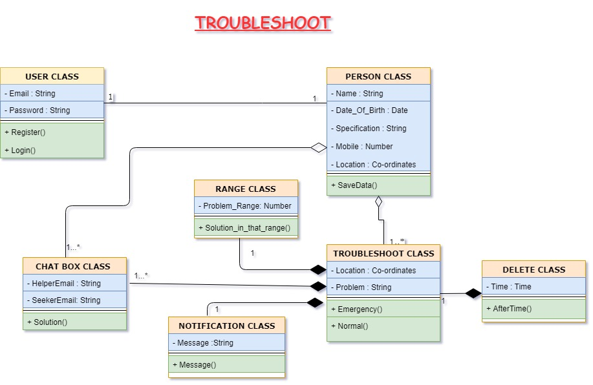
Class Diagram

Slide 9
Activity Diagram

Slide 10
Use-Case Diagram

Slide 11
ER-Diagram

Slide 12
Sequence Diagram

Slide 13
CONCLUSION
The software solution explained in this report has been devised to provide assistance to individuals from people who are near-by. While general purpose support sites and forums are available, there are not many applications focusing on providing local support. Thus the "Troubleshoot" software is a novel solution and has been developed using latest technologies. The interfaces are also intuitive to assist easy adoption.
We hope to popularise this android application and work on the iOS version next.

Slide 14
REFERENCES
"How To Create XML in android studio ... - Developers." 29 Mar. 2018, https://developer.android.com/ guide/topics/ui/declaring-layout. Accessed 18 May. 2020.
"How To build Google Map in android studio ... - Android - Google Maps." 29 Mar. 2018, https:// www.tutorialspoint.com/android/android_google_maps.htm. Accessed 20 May. 2020.
Ramez Elmasri, Shamkant B. Navathe: Fundamentals of Database Systems sixth edition - 2016. Accessed 25 May. 2020. Pages[359-555, 841-848, 915-930]
“Java Android coding ... -Android Studio .”Java CompleteReference by Herbert Schildt , 9th Edition. Accessed 3 June. 2020. Pages[455-485, 751-755 ]
https://www.tutorialspoint.com/firebase/index.htm. Accessed 15 June. 2020.
"UML Use Case Diagram Tutorial - YouTube." 8 Feb. 2018, https://www.youtube.com/watch? v=zid-MVo7M-E. Accessed 16 June. 2020.
"Entity-Relationship Diagram Tutorial | ER Diagram ... - YouTube." 27 Nov. 2013, https:// www.youtube.com/watch?v=SDsJG-a4WAI. Accessed 17 June. 2020.
Android Installation link-“https://drive.google.com/file/d/1HXPrsbxM6Z8fP-hh8IX6b08-zsM6VEWR/view?usp=sharing". Accessed 14 June. 2020.

Slide 15
Thanks

