Slide 1



Slide 2
What is meilix??
A beautiful and customizable Linux build for out of the box features for an Internet Kiosk.
Meilix is a light weight, beautiful and fast Linux with all the features of Ubuntu/Debian distro.
Meilix is based on Ubuntu/Debian architecture. Meilix uses LXQT as the standard Desktop Environment.

Slide 3
Need of Meilix
Meilix serves as a solution for those who wish to have a pre-configured custom Linux, with all the needed apps/features already installed. An example of its use case is events. Every event organizer needs to have all their systems configured equally, and need some specific apps to run the event. Configuring each system one by one can be a time taking and difficult task, but using Meilix, they can create their own custom Linux ISO and run/live boot on as many systems as they want. It will not just save countless hours, but also make the process more cost-efficient.

Slide 4

Meilix-generator

Slide 5
What is meilix-generator??
A Webapp to generate customized iso live images of Meilix Linux. You can use the Meilix Generator (Web app) to make a Linux for your own brand/event, also add apps and features you need pre-installed, it will create an ISO Image of your Linux, which you can use as a live boot or install on PCs.

Slide 6
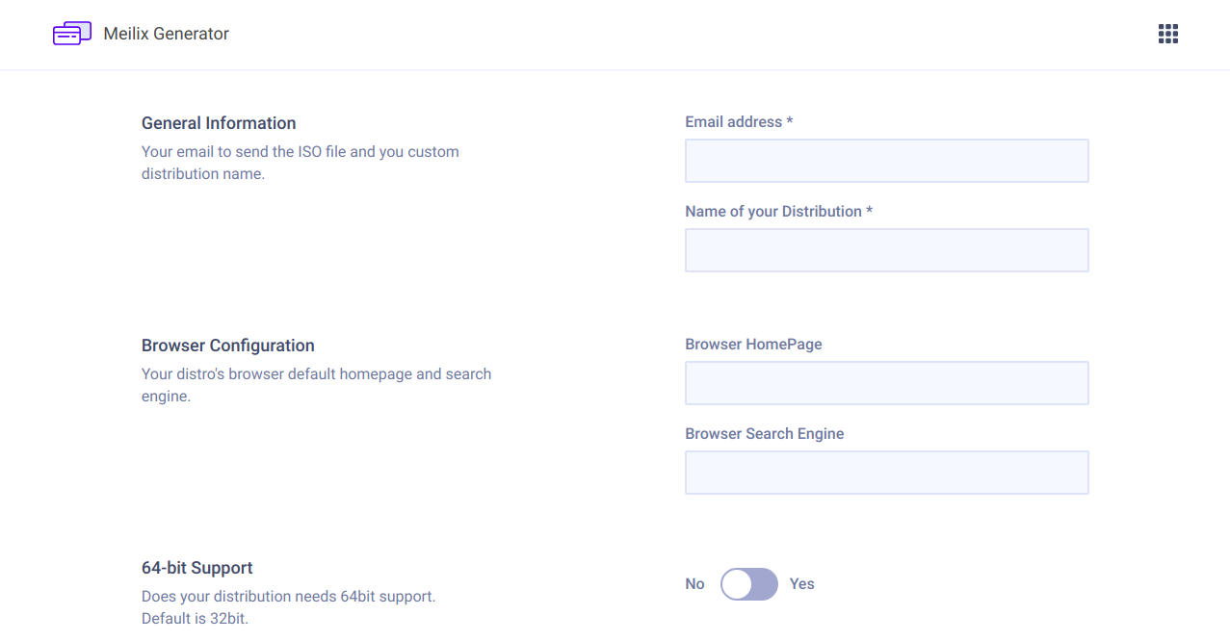

Slide 7
Features available in meilix-generator
Default browser homepage and browser search engine.
32 bit or 64 bit support
Packages like notifications, screensaver etc.
Third party software like chromium, firefox, git, etc.
Default logo
Default wallpaper

Slide 8
Languages and tech. used
HTML
CSS
JAVASCRIPT
PYTHON
FLASK
Heroku – used to host the webapp
Travis – where builds are made

Slide 9
Developers of meilix linux and generator
André Rebentisch (tebesin)
Nicco Kunzmann (niccokunzmann)
Harsh Lathwal (xeon-zolt)
Tarun Kumar (meets2tarun)
Abishek V Ashok (abishekvahok)

Slide 10
Thank you
by- Rohit Potter

