Slide 1
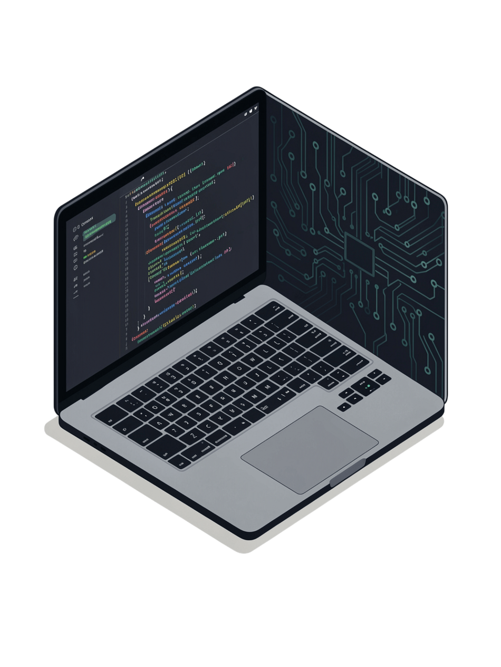

Python Full Stack Development
AICTE – EDUSKILLS VIRTUAL INTERNSHIP
Presented By
Program Details
Preeti Kumari
B.Tech Computer Science and Engineering
IILM University, Greater Noida, Uttar Pradesh
Duration: January 2026 – March 2026
Format: Virtual Internship
Duration: 10 Weeks
Provider: AICTE – EduSkills
Notes:
1

Slide 2

Contents
A structured 10-week curriculum spanning the complete Python full stack development lifecycle — from frontend interfaces to backend logic, databases, and version control.
01
06
Introduction & Internship Overview
Python Programming
02
07
Internship Objectives
Django Web Development
03
08
Full Stack Development Architecture
Database Management
04
09
Frontend Development
Git & Version Control
05
10
JavaScript & jQuery
Learning Journey
Notes:
2

Slide 3
Introduction & Internship Overview
A 10-week structured virtual internship providing comprehensive learning and practical exposure in Python Full Stack Development, delivered by AICTE – EduSkills from January to March 2026.
Frontend Development
Backend Development
HTML, CSS, Bootstrap, JavaScript, jQuery — building responsive and interactive user interfaces
Python and the Django framework — application logic, routing, authentication, and server-side processing
Database Management
Version Control
SQL and MySQL — relational schema design, CRUD operations, and Django ORM integration
Git and GitHub — source code management, branching, and collaborative development workflows
Program Structure: Week-wise learning modules with assessments, practical exercises, and project documentation requirements designed to build progressive competency.
Duration: January – March 2026
Provider: AICTE – EduSkills
Format: Virtual, 10 Weeks
Notes:
3

Slide 4
Internship Objectives
Ten clearly defined learning outcomes spanning the full spectrum of modern web development — from UI design principles to production-ready backend systems.
1
Web Development Fundamentals
6
SQL & MySQL Database Management
Understand modern web development principles and industry best practices
Master relational databases, schema design, and efficient data retrieval techniques
2
Responsive Web Interfaces
Develop user-friendly, mobile-first web interfaces using HTML, CSS, and Bootstrap
7
Git & Version Control Workflows
Understand Git branching, merging, and collaborative development via GitHub
3
JavaScript & DOM Manipulation
8
Full Stack Integration
Learn dynamic interactions, event handling, and client-side scripting with jQuery
Develop end-to-end competency connecting frontend, backend, and database layers
4
Python & OOP Mastery
Strengthen core Python skills including object-oriented programming concepts
9
Assessment & Documentation
Complete weekly assessments, practical exercises, and project documentation
5
Django Backend Development
Build server-side applications using the Django framework and MVC architecture
10
Industry Readiness
Build confidence and skills aligned with current industry expectations for junior developers
Notes:
4

Slide 5
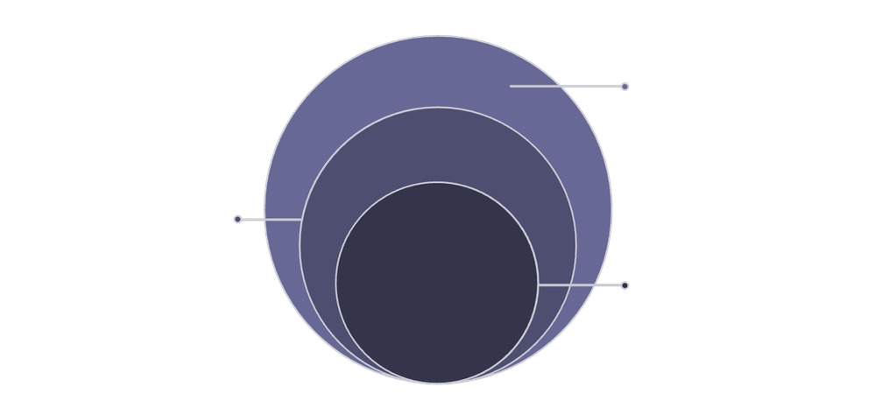

Full Stack Development Architecture
A modern web application is built across four interdependent layers — each serving a distinct role in delivering seamless, data-driven user experiences.
Backend & DB
Python/Django with SQL/MySQL
Frontend Layer
HTML, CSS, Bootstrap, JavaScript, jQuery
User Interface
Interactive UI and layout
Frontend Layer
Backend Layer
Database Layer
Version Control
User interface, layout, visual styling, and interactive elements rendered in the browser
Application logic, business rules, URL routing, and server-side request processing
Persistent structured data storage, retrieval, and management via SQL and MySQL
Source code versioning, collaboration, and change tracking via Git and GitHub
Notes:
5

Slide 6
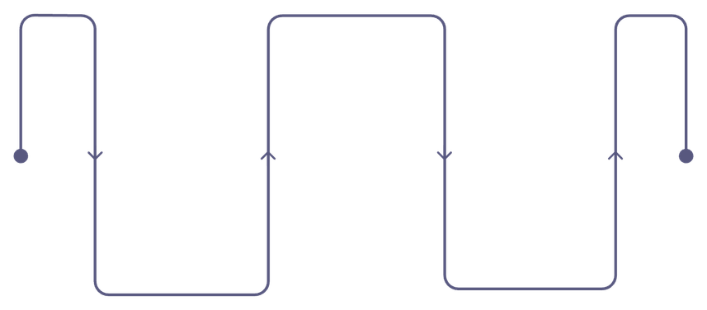
Frontend Development
The frontend layer defines how users see and interact with a web application. Three core technologies work in sequence — from raw structure to styled, responsive interfaces.
HTML — Page Structure
  Semantic elements and document structure
  Forms, tables, and input elements
  Accessibility best practices
  Document Object Model (DOM) foundations
CSS — Styling & Layout
Bootstrap — Responsive Framework
  Selectors, box model, and positioning
  Flexbox and CSS Grid layouts
  Media queries for mobile-first design
  Visual hierarchy and typography
  12-column responsive grid system
  Pre-built UI components and utilities
  Mobile-first design approach
  Rapid interface prototyping
CSS
Visual styling and layout
HTML
Bootstrap
Document structure and semantics
Responsive UI and components
Notes:
6

Slide 7

JavaScript & jQuery
JavaScript adds logic and interactivity to static HTML pages. jQuery simplifies DOM manipulation and AJAX calls, enabling dynamic, responsive user experiences with reduced code complexity.
JavaScript — Core Scripting
Language Fundamentals
jQuery — Simplified Client-Side
Variables, data types, operators, and control flow structures
DOM Traversal & Selection
Animations
Functions & Scope
Built-in effects and custom transitions
Concise selectors and tree navigation
Function definition, closures, and execution context management
DOM Manipulation
Selecting, modifying, and responding to document elements in real time
AJAX Calls
Reduced Complexity
Asynchronous data loading without page refresh
Cross-browser compatible, concise syntax
Event Handling
Listening and responding to user actions — clicks, inputs, and form submissions
Interaction Flow: User Action → JavaScript / jQuery Event Handler → DOM Update → Dynamic Web Page Response
Notes:
7

Slide 8






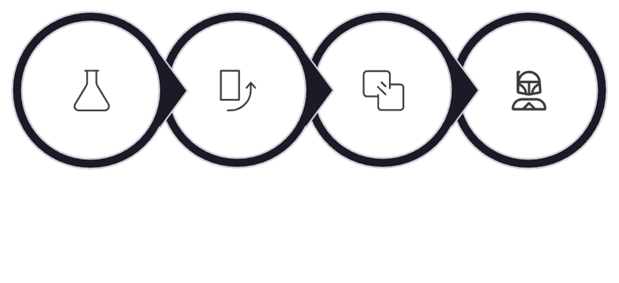
Python Programming
Python serves as both a standalone scripting language and the foundational layer for backend web development via Django. The curriculum covers core syntax through advanced OOP and module usage.
Syntax & Fundamentals
Control Flow
Functions
Variables, data types, operators, and Python's clean, readable syntax conventions
Conditional statements, loops, iteration, and logical flow control structures
Function definition, parameters, return values, default arguments, and scope management
Object-Oriented Programming
Data Structures
Modules & Libraries
Classes, objects, inheritance, polymorphism, and encapsulation principles
Lists, dictionaries, tuples, and sets — selection and usage patterns for efficient data handling
Importing, using, and organising external Python modules to extend functionality
Fundamentals
Control Flow
OOP
Django Backend
Notes:
8

Slide 9
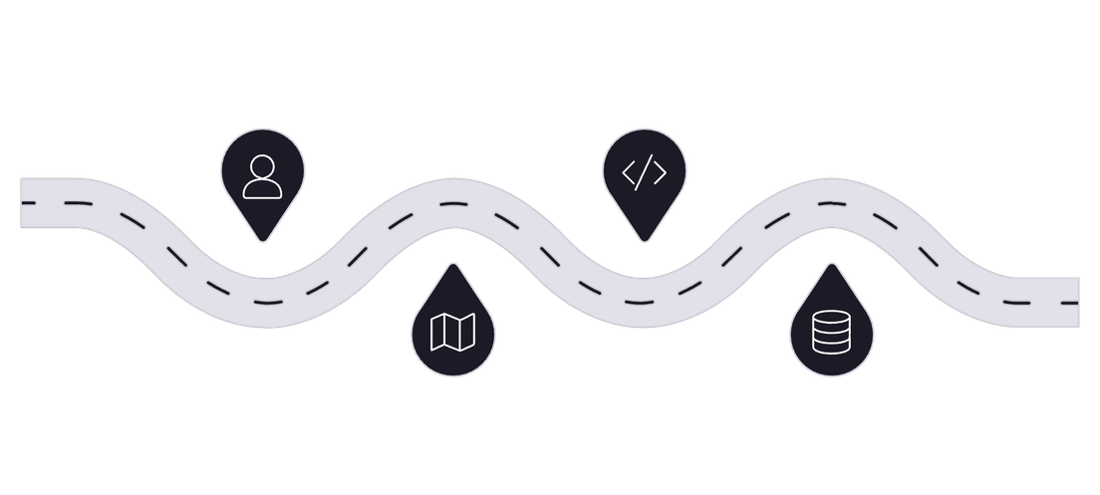






Django Web Development
Python + Django forms the backbone of the backend — a high-level web framework that encourages rapid development, clean design, and secure application architecture.
Core Django Components
Django Request–Response Lifecycle
User Request
View
Client sends HTTP request
Process request logic
Project Structure
Models & ORM
Apps, settings, and configuration management
Database schema definition and object-relational mapping
Views & Logic
Templates
URL Routing
Model & DB
Business logic processing and HTTP request handling
HTML rendering with dynamic content injection
Resolve URL to view
Query or update database
Every web request travels through Django's MVT (Model–View–Template) pipeline, ensuring clean separation of concerns between data, logic, and presentation layers.
URL Routing
Authentication
Mapping incoming requests to appropriate view functions
Built-in user management, sessions, and security
Notes:
9

Slide 10


SQL & MySQL Database Management
Relational databases underpin every full stack application. The curriculum covers schema design, core SQL operations, and seamless integration with Django's ORM for efficient data management.
Core Concepts & SQL Operations
CRUD Operations — The Data Lifecycle
Relational Databases
SQL Queries
CREATE
Tables, relationships, primary/foreign keys, and normalization principles
SELECT, INSERT, UPDATE, DELETE — the four foundational data manipulation statements
INSERT new records into tables
READ
SELECT and retrieve stored data
Database Design
Data Retrieval
Schema design, data integrity constraints, and relational modelling
Filtering with WHERE, sorting with ORDER BY, and joining multiple tables
UPDATE
Modify existing records in place
Django ORM Integration
DELETE
Interacting with MySQL through Django's ORM — abstracted, Pythonic database access
Remove records from the database
Integration Flow: Django Application ↔ Django ORM ↔ SQL / MySQL ↔ Stored Data
MySQL serves as the production-grade relational database management system, with Django's ORM providing a Pythonic abstraction layer that eliminates the need for raw SQL in routine operations.
Notes:
10

Slide 11




Assessment & Documentation
Tracking Learning Progress Throughout the 10-Week Internship
WEEKLY PRACTICAL EXERCISES
MODULE-WISE ASSESSMENTS
Weekly practical exercises and coding assignments based on the learning modules
Module-wise assessments and quizzes to evaluate conceptual understanding
PROJECT DOCUMENTATION
FINAL ASSESSMENT
Project-related documentation where required, maintaining relevant learning and development records
Final assessment in Week 10, evaluation of overall internship learning
Assessment and documentation supported progressive learning throughout the Python Full Stack Development curriculum.
Notes:
11

Slide 12
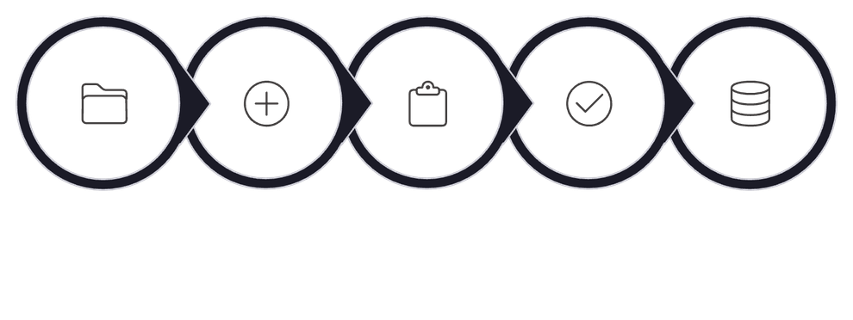
Git & Version Control
Key Concepts
Git Workflow Diagram
  Repository management
  Commits and change tracking
  Branching
  Merging
  Version history
  Collaboration workflows
  GitHub integration
Working Directory
git add
Staging Area
git commit
Git Repository
Git enables developers to track code changes, maintain version history and collaborate efficiently.
Notes:
12

Slide 13
10-Week Learning Journey
Structured Python Full Stack Development Curriculum
WEEK 1: HTML
WEEK 3: BOOTSTRAP
WEEK 5: JQUERY
WEEK 7: DJANGO FRAMEWORK
WEEK 9: GIT & VERSION CONTROL
Page structure, elements, forms, tables and semantic tags
Responsive and mobile-first web design
DOM traversal, animations, event handling and AJAX
Models, views, templates, routing and authentication
Repositories, commits, branching, merging and GitHub
1
2
3
4
5
6
7
8
9
10
WEEK 2: CSS
WEEK 4: JAVASCRIPT
WEEK 6: PYTHON PROGRAMMING
WEEK 8: MYSQL & DATABASE MANAGEMENT
WEEK 10: FINAL ASSESSMENT
Selectors, box model, positioning, Flexbox, Grid and responsive styling
Programming fundamentals, DOM manipulation and event handling
Final internship assessment
Syntax, data types, loops, functions and OOP concepts
SQL, database design, CRUD operations and Django integration
Notes:
13

Slide 14
Learning Outcomes & Future Scope
Learning Outcomes
Conclusion
Future Scope
Frontend
  Strengthened web development fundamentals
  Developed knowledge of responsive frontend development
  Improved Python programming fundamentals
  Understood Django-based web application development
  Learned SQL/MySQL database concepts
  Understood Git and version-control practices
  Developed an overall understanding of the full-stack development workflow
Future learning areas:
  HTML
  CSS
  Bootstrap
  JavaScript
  jQuery
  Advanced Django development
  Django REST Framework
  REST API development
  Advanced database management
  Cloud deployment
  Docker and DevOps
  Software testing and debugging
  AI/ML integration with Python web applications
Backend
  Python
  Django
Database
  SQL
  MySQL
  CRUD
Version Control
  Git
  GitHub
Notes:
14

Slide 15
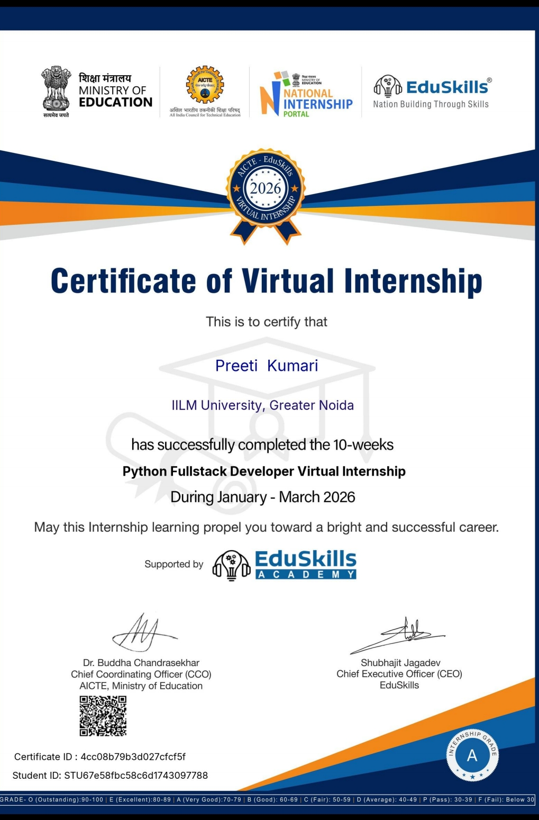
Internship Completion Certificate
Notes:
15

