Slide 1
Instagram Automation

Slide 2
Introduction
It is an automation script written using Puppeteer and Node.Js which is automating Instagram.
This project will help the user to automatically login into Instagram, search NAME or a specific TAG.
Open the searched account and automatically like given number of pictures.

Slide 3
Puppeteer
Puppeteer is an open-source JavaScript library written by Google, providing a high-level API to control Chromium, which is an open-source version of chrome.
The main purpose of creating this library is for testing.
end-to-end tests.
front-end tests.
The biggest drawback is that Puppeteer only works with Chrome.

Slide 4
Node.js
Node.js is an open source, cross-platform runtime environment for developing server-side and networking applications.
It is a JavaScript runtime environment that executes JavaScript code outside a web browser.

Slide 5
Actions
Login through given username and password
Search the USER and Tag
Like the given number of post

Slide 6
Advantages
Saves User’s Time
Lets You Focus on Other Tasks
Easy to use
Easy Maintain
Consistent Content

Slide 7
Disadvantages
The main disadvantage in this script is that some time class name and attributed is changed from the website then you should check and again correct your script accordingly.

Slide 8
Application
Automate the Instagram.
Login into the Instagram with username and password.
Search the user.
Like the post.

Slide 9
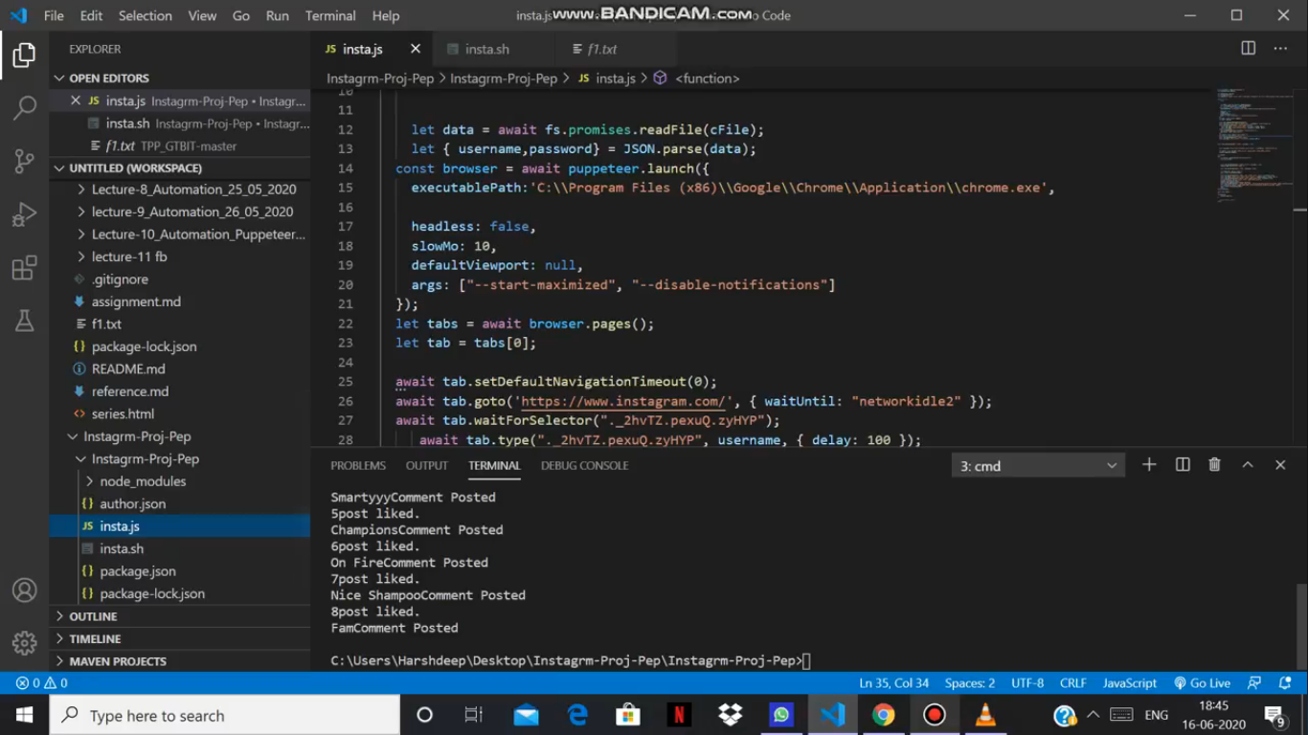
SCREENSHOTS

Slide 10
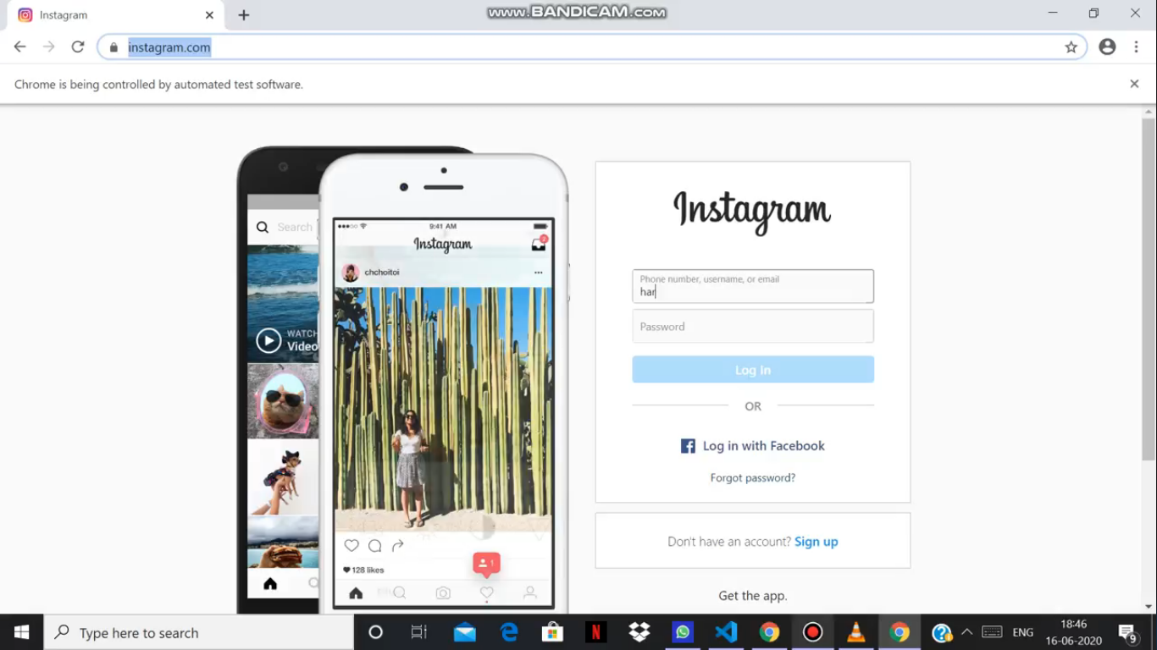
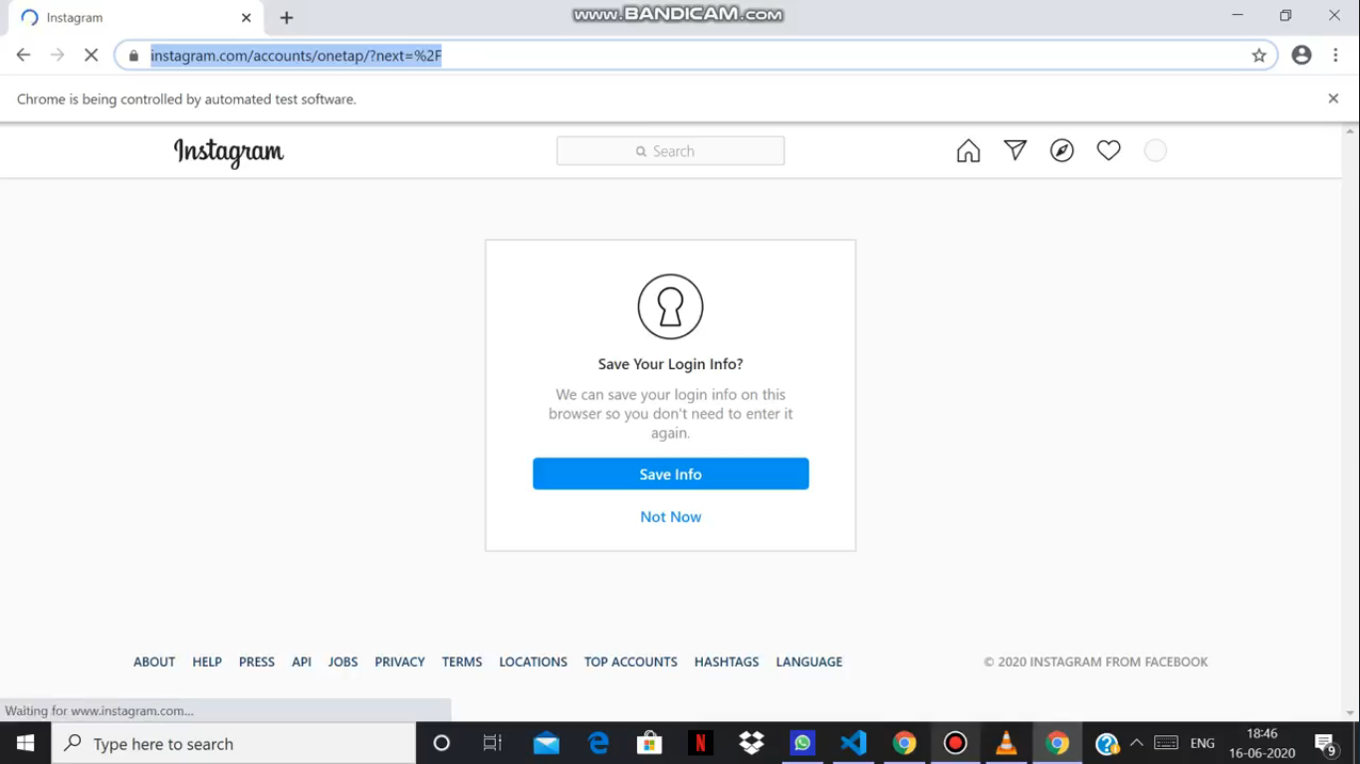

Slide 11
REFERENCES
[1] https://javascript.info/
[2]https://pptr.dev/
[3] https://www.npmjs.com/package/promises/
[4] https://github.com/puppeteer/puppeteer/
[5] https://javascript.info/async/
[6] https://stackoverflow.com/questions/55112690/puppeteer-/setdefaultnavigationtimeout-to-0-still-times-out
[7] https://developers.google.com/web/tools/puppeteer/

Slide 12
THANKYOU

