Slide 1
Lending_club_case_study
Introduction:
In this case study, apart from applying the techniques a developer learns EDA, develops a basic understanding of risk analytics in banking and financial services and understands how data is used to minimize the risk of losing money while lending to customers.
Business Objectives:
This banking company is the largest online loan marketplace, facilitating personal loans, business loans, and financing of medical procedures. Borrowers can easily access lower interest rate loans through a fast online interface.
Like most other lending companies, lending loans to ‘risky’ applicants is the largest source of financial loss (called credit loss). Credit loss is the amount of money lost by the lender when the borrower refuses to pay or runs away with the money owed. In other words, borrowers who default cause the largest amount of loss to the lenders. In this case, the customers labelled as 'charged-off' are the 'defaulters'.
If one is able to identify these risky loan applicants, then such loans can be reduced thereby cutting down the amount of credit loss. Identification of such applicants using EDA is the aim of this case study.

Slide 2
Data Understanding:
” Loan Data set” is the file which contains the complete loan data for all loans issued through the time period 2007 to 2011.
Many variable values are empty, so we will remove all 100% empty columns in data cleaning.
Based on actual income, loan_amnt and loan_status and term of loan months, we will analyze and reduce the risk of not having defaulters.
Univariate Analysis:
Analyze individual features to understand their distribution and characteristics.
Identify key metrics like mean, median, mode, skewness, and kurtosis for numerical features.
Bivariate Analysis:
Explore relationships between different pairs of variables, especially focusing on how they correlate with the target variable (loan default).
Use correlation matrices, pair plots, and other techniques to identify patterns.
Multivariate Analysis:
Investigate interactions between multiple variables to uncover more complex relationships.
Use techniques like Principal Component Analysis (PCA) if necessary.
Visualization:
Analyze data and represent in the form of bar or scatter chart ets..

Slide 3
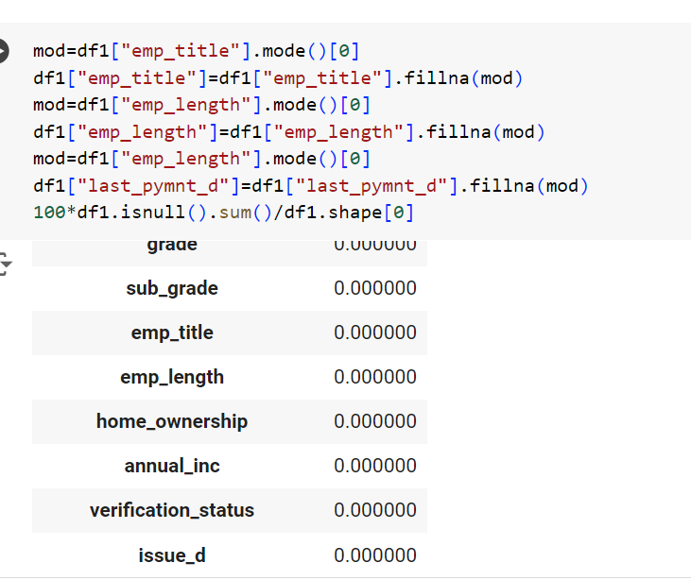
Univariate Analysis:
To fill values in empty cells on emp_title col by below commands.

Slide 4
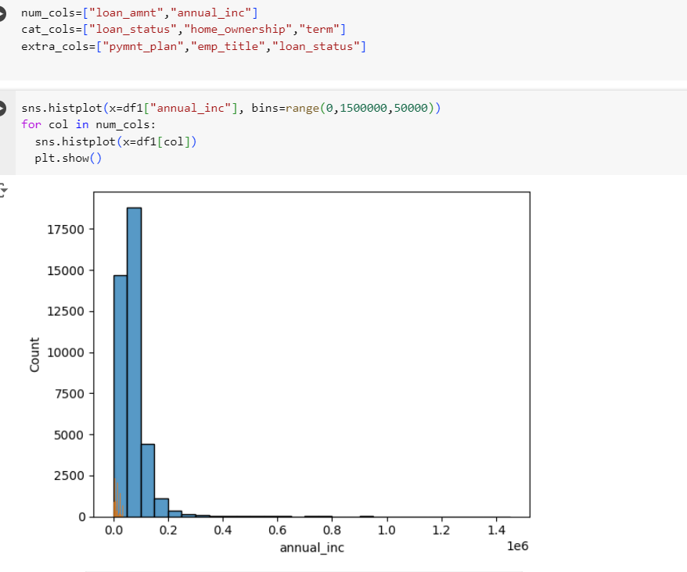
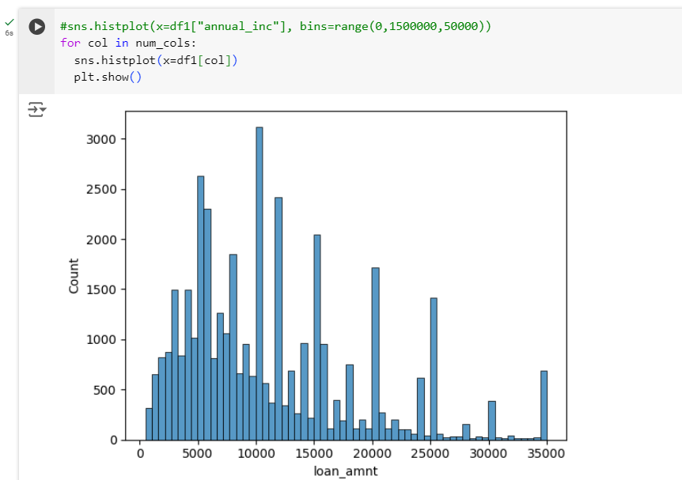
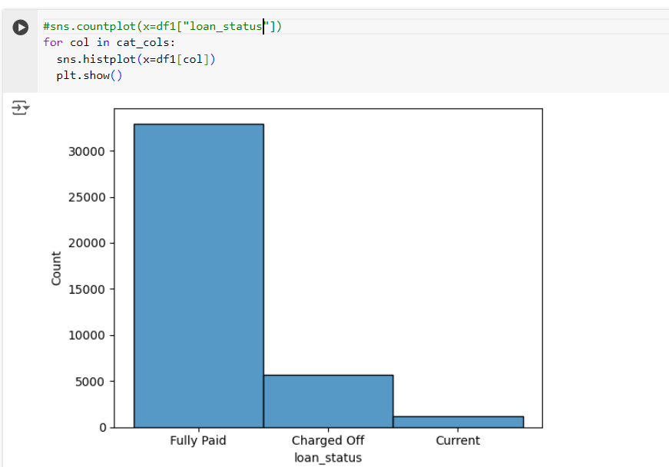
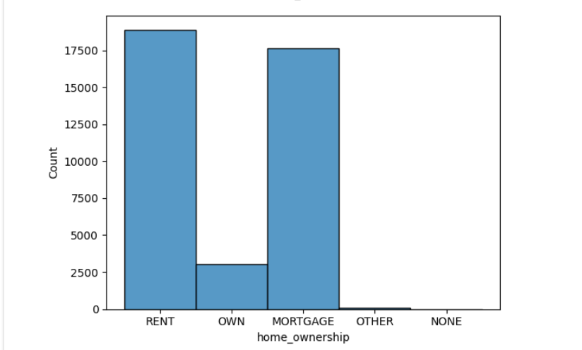

Slide 5
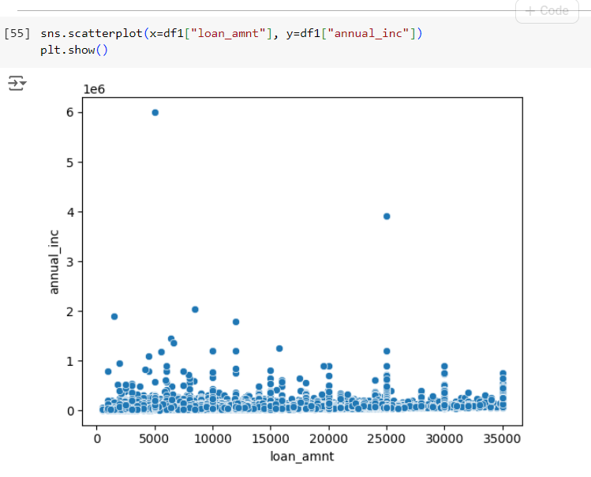
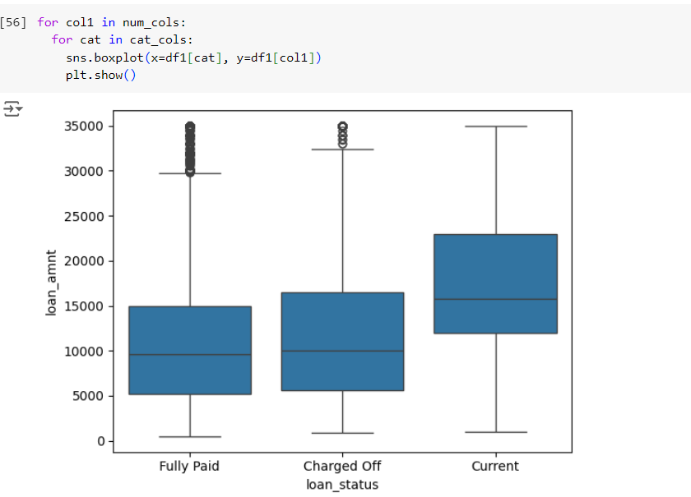
Bivariate: scatterplot between loan_amt and annual_inc

Slide 6
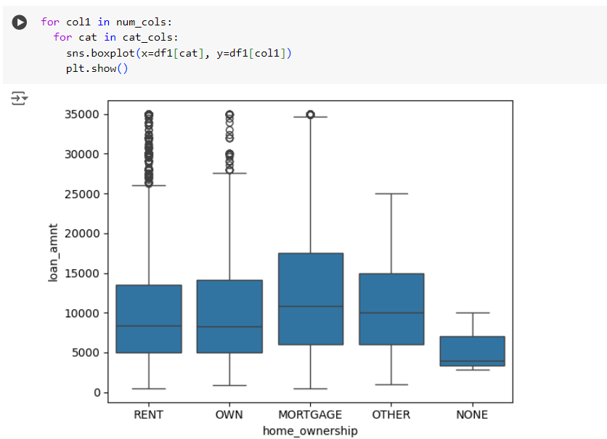
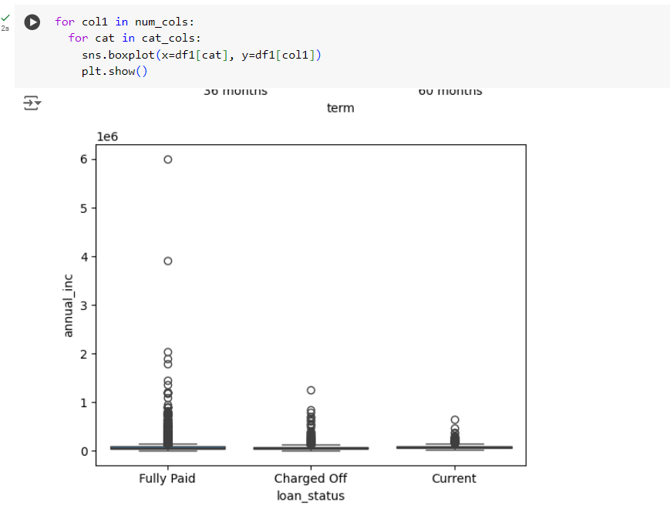
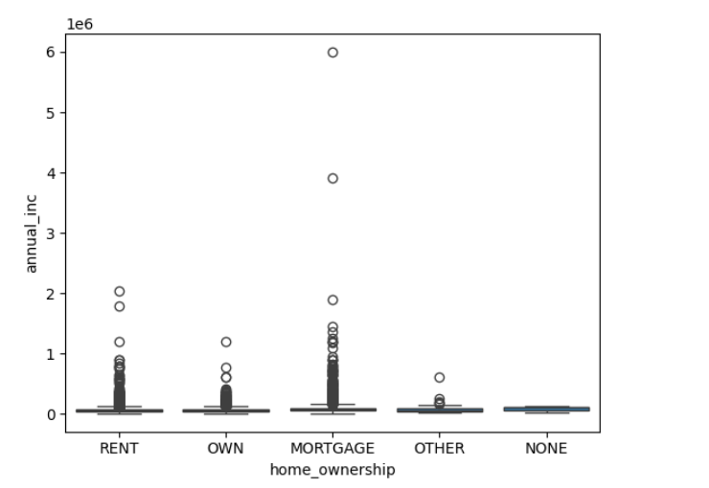

Slide 7
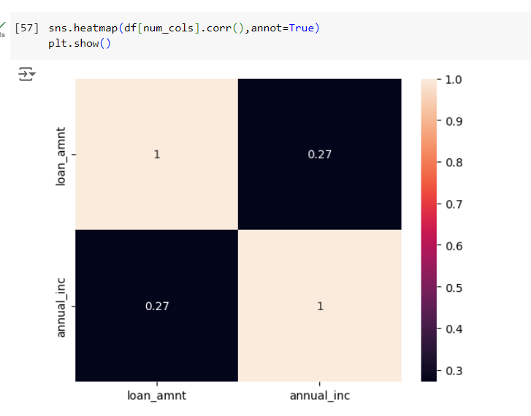
Multivariate: positive correlation shows direct relationship.

Slide 8
Python code structure:
Data Loading:
import numpy as np
import pandas as pd
import matplotlib.pyplot as plt
import seaborn as sns
df= pd.read_csv("/content/loan.csv")
df.head() # displays first 5 rows of the data from file.
df.info() #gives information of the data about RangeIndex, Columns, dtypes..
df.shape #gives number of rows and cols.
100*df.isnull().sum()/df.shape[0]
100*df.isnull().sum()/len(df)
100*df.isnull().mean()
Data cleaning:
df_cleaned = df.dropna(axis=1, how='all’)
df_cleaned
df1=df_cleaned.drop(columns=["next_pymnt_d","mths_since_last_record"],axis=1)
100*df1.isnull().mean()
mod=df1["emp_title"].mode()[0]
df1["emp_title"]=df1["emp_title"].fillna(mod)
mod=df1["emp_length"].mode()[0]
df1["emp_length"]=df1["emp_length"].fillna(mod)
mod=df1["emp_length"].mode()[0]
df1["last_pymnt_d"]=df1["last_pymnt_d"].fillna(mod)
100*df1.isnull().sum()/df1.shape[0]

Slide 9
Segmantation:
num_cols=["loan_amnt","annual_inc"]
cat_cols=["loan_status","home_ownership","term"]
extra_cols=["pymnt_plan","emp_title","loan_status"]
Univariate:
mod=df1["emp_title"].mode()[0]
df1["emp_title"]=df1["emp_title"].fillna(mod)
mod=df1["emp_length"].mode()[0]
df1["emp_length"]=df1["emp_length"].fillna(mod)
mod=df1["emp_length"].mode()[0]
df1["last_pymnt_d"]=df1["last_pymnt_d"].fillna(mod)
100*df1.isnull().sum()/df1.shape[0]

Slide 10
Bivariate:
for col in num_cols:
sns.boxplot(x=df1[col])
plt.show()
sns.boxplot(x=df1["loan_amnt"],y=df1["annual_inc"])
plt.show()
sns.scatterplot(x=df1["loan_amnt"], y=df1["annual_inc"])
plt.show()
for col1 in num_cols:
for cat in cat_cols:
sns.boxplot(x=df1[cat], y=df1[col1])
plt.show()
Multivariate:
sns.heatmap(df[num_cols].corr(),annot=True)
plt.show()

Slide 11
Platform and Libraries used:
Platform: Google Colab.
Libraries:
import numpy as np
import pandas as pd
import matplotlib.pyplot as plt
import seaborn as sns
Business should focus on the loan amount with respect to the actual income and the home ownership of an employee before providing the loan. This analyse can be helpful in analysing the risk and avoiding credit loss to the bank.

