Slide 1
Capstone Project Global COVID-19 Trends and New Case Prediction for the USA
Presented by:
Preeti Dubey
Email: preetiup28@gmail.com
Link for the final Jupyter notebook:
https://github.com/preetikumar20/Capstone_Covid19/blob/a871861f8f05c0c51227f05e58bcdd50e33ce2d5/final_capstone_preetidubey.ipynb

Slide 2
Problem Statement:
The COVID-19 pandemic has profoundly impacted public health and the economy, necessitating forecasting and risk prediction models to help decision-making.
In this application, I will explore a dataset from Kaggle. This dataset, provided by the World Health Organization (WHO), contains weekly reported COVID-19 cases and deaths worldwide.
The primary goal of this project is to explore the COVID-19 trends around the globe and to develop a machine learning model to predict new cases in the United States.
Time Series Forecasting: Predicting the number of new cases over the next few weeks in the USA.

Slide 3
Dataset:
This is WHO COVID-19 global dataset from Kaggle. This provides a comprehensive time-series view of reported cases and deaths globally, crucial for time series forecasting and identifying broader trends.
Dataset: WHO COVID-19 dataset
Source: Kaggle
Time Period: Covers cases from early 2020 to 2023
Target Variable: New COVID-19 cases reported daily
Data Size: It consists of 57,840 entries and 8 columns.
Data Preprocessing: Handled missing values, ensured stationarity and applied log transformation for stabilization

Slide 4
Methods/Techniques
Data visualization to visualize the spread of the virus across countries over time
Data analysis techniques to analyze and process the data.
Time Series algorithms to predict the new cases in the USA.
ARIMA and SARIMA
Exog SARIMA
Random Forest and XGboost
LSTM

Slide 5
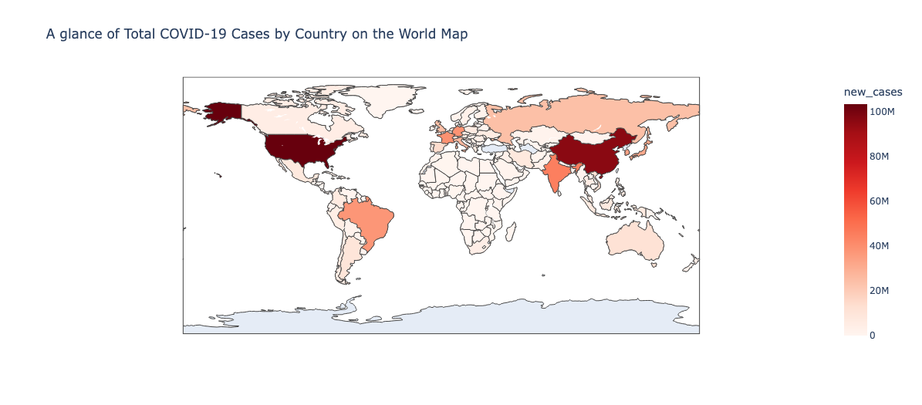
COVID-19 New Cases Global Trends

Slide 6
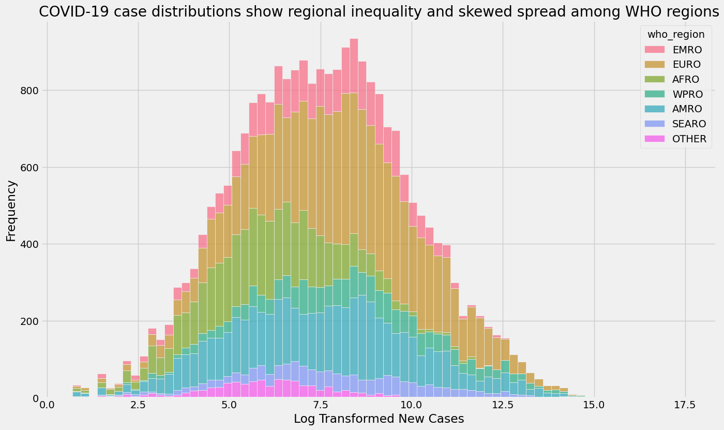

Slide 7
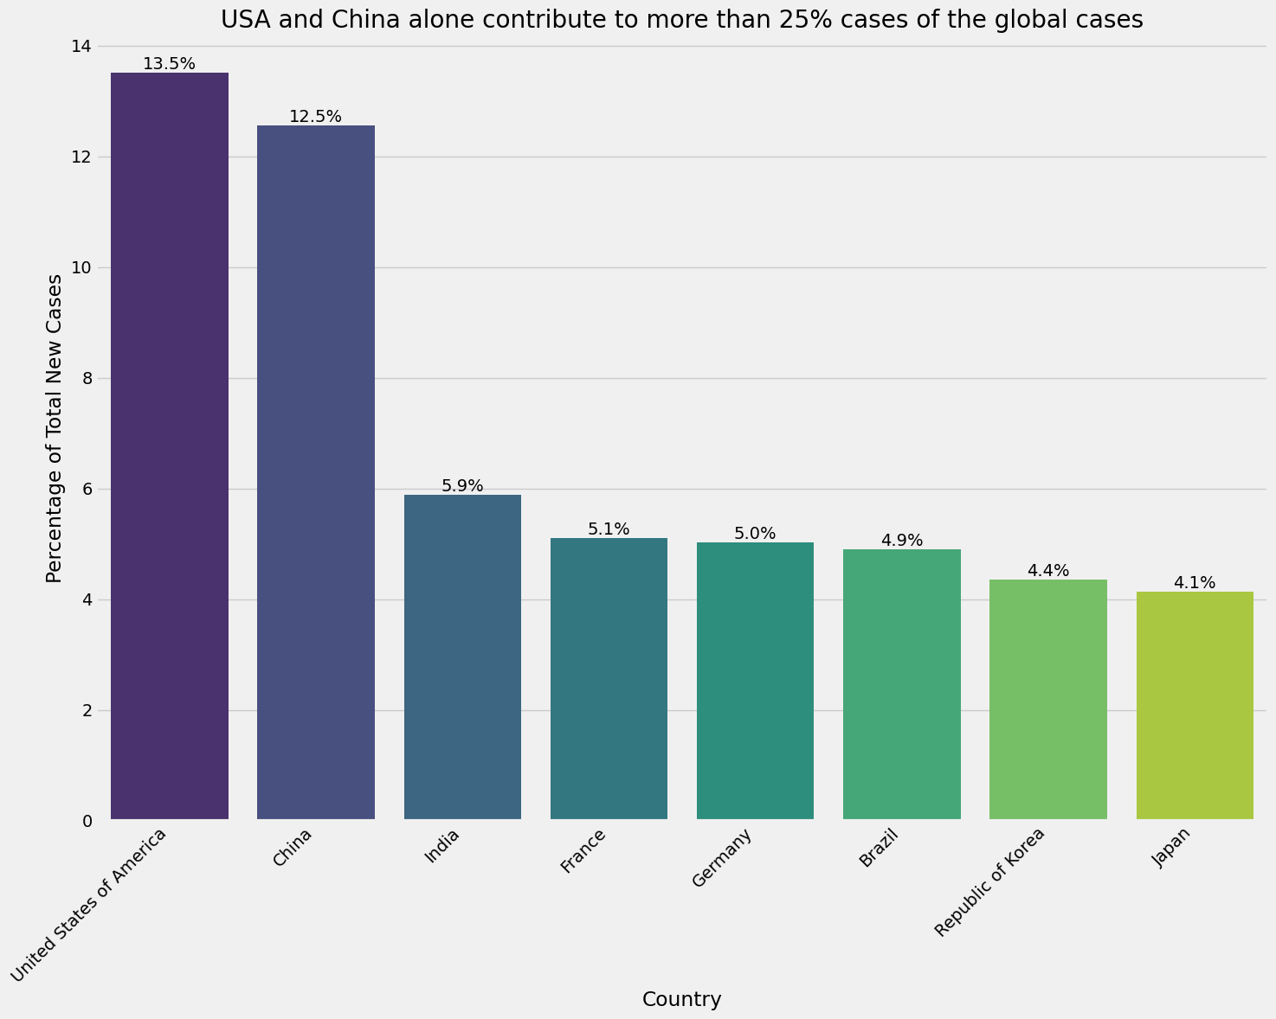

Slide 8
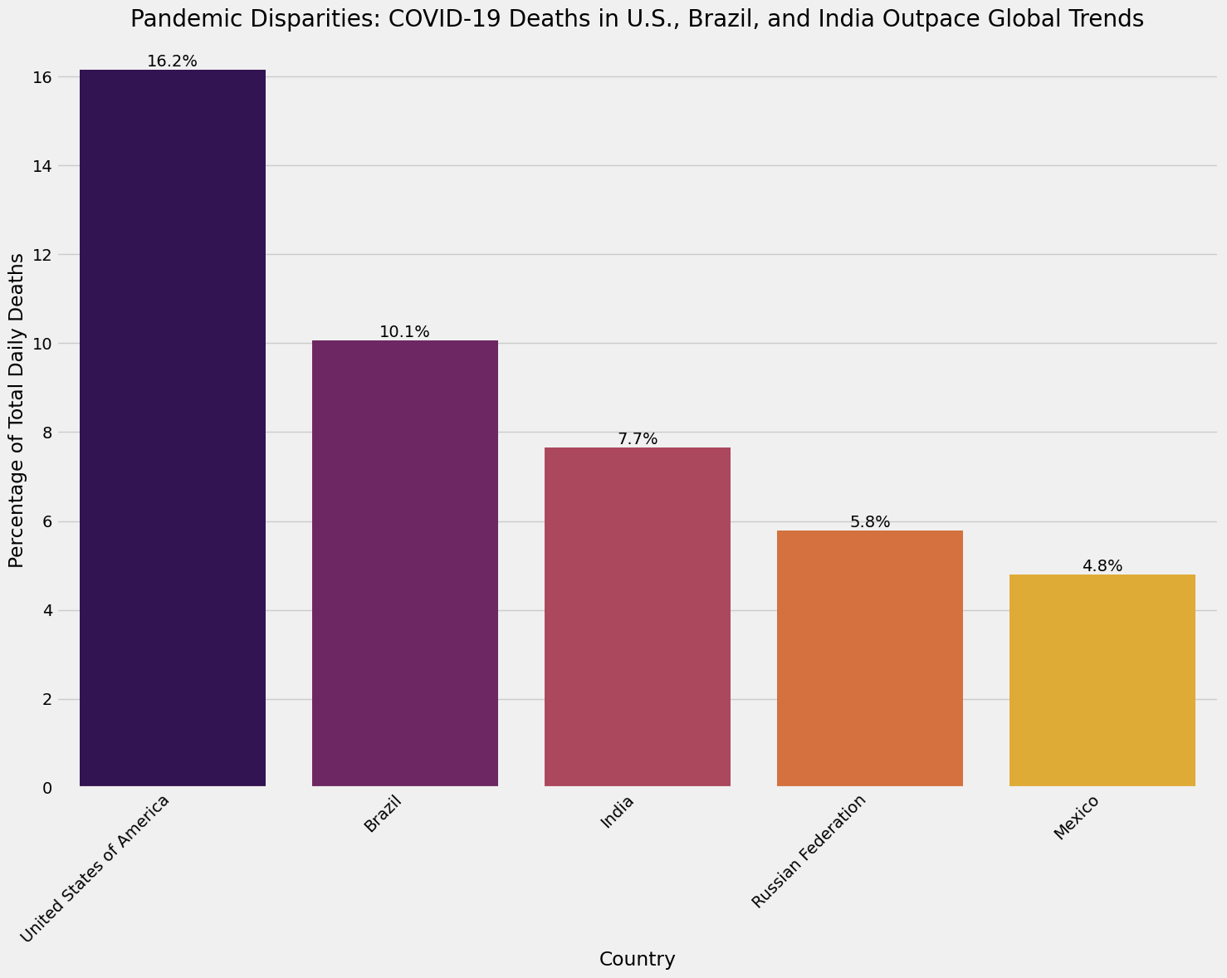

Slide 9
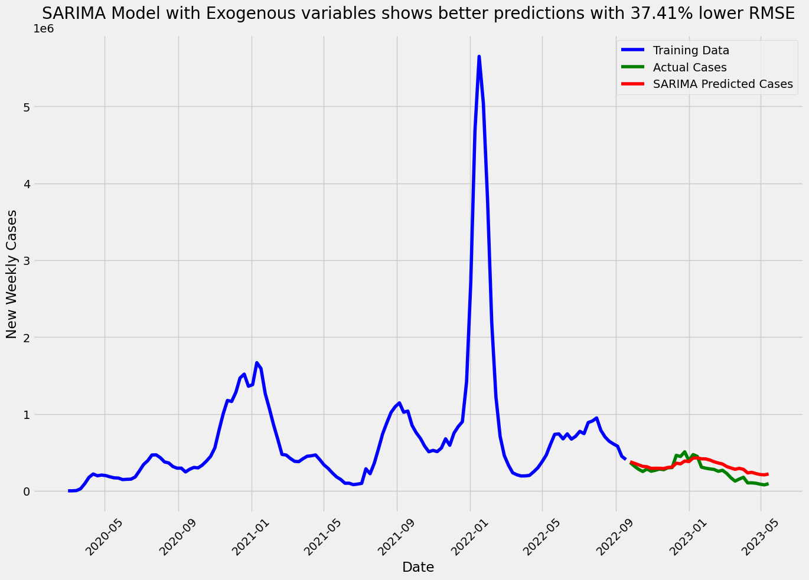

Slide 10
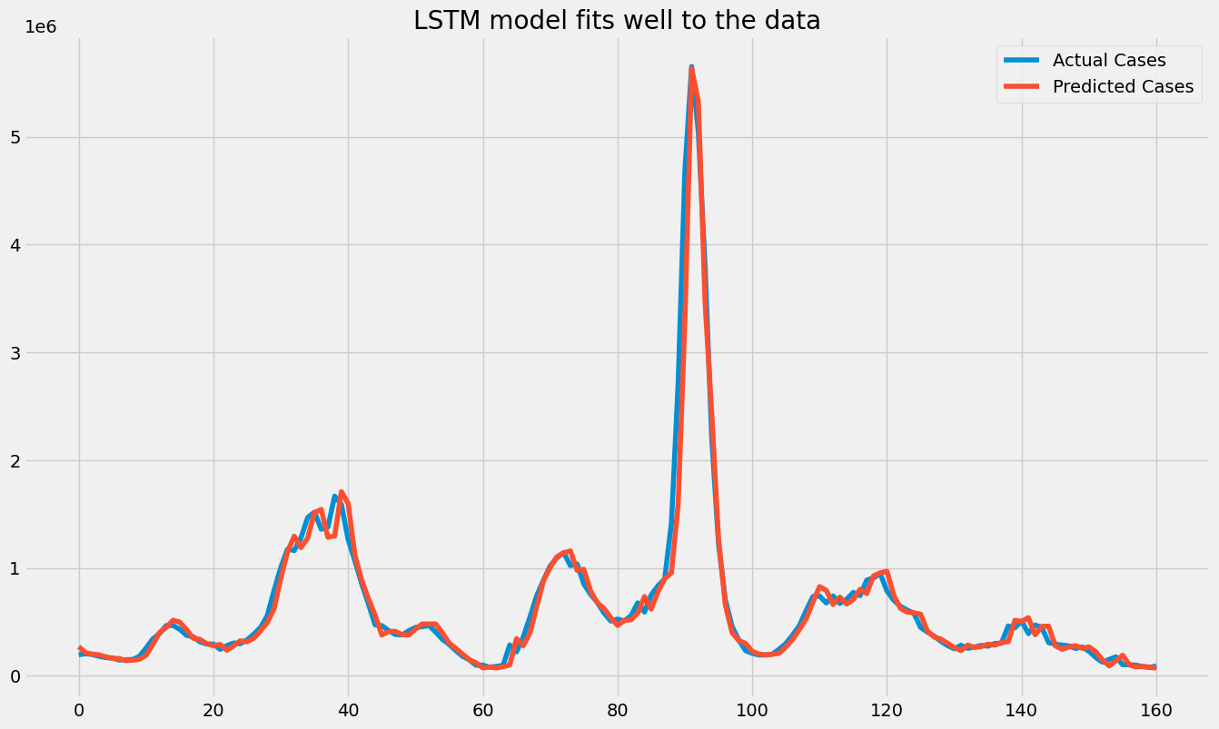

Slide 11
Model Performance Comparison Chart: LSTM is the best model
Model | MAE | MSE | RMSE | AIC | BIC
ARIMA | 134,360.86 | 2.48e+10 | 157,527.53 | 3380.63 | 3397.55
SARIMA | 97,100.10 | 1.64e+10 | 128,000.76 | 3462.81 | 3474.15
EXOG SARIMA | 79,852.14 | 8.67e+9 | 93,150.65 | 3669.55 | 3689.84
Random Forest | 68,322.60 | 6.6e+9 | 81348.77 | N/A | N/A
XGBoost | 122,012.04 | 3.28e+10 | 181259.3 | N/A | N/A
LSTM (Training) | 81,126.04 | 3.43e+10 | 185,258.85 | N/A | N/A
LSTM (Test) | 38,242.36 | 5.6e+7 | 56,711.65 | N/A | N/A

Slide 12
Key Takeaways:
SARIMA and EXOG SARIMA provide strong baseline forecasts.
Random Forest minimizes MAE better than ARIMA and SARIMA but shows higher RMSE.
LSTM (Test) outperforms all other models, making it the top-performing model.
XGBoost shows weaker performance, likely needing tuning or different feature engineering.

