Slide 1
Capstone Project Global COVID-19 Trends and New Case Prediction for the USA
Presented by:
Preeti Dubey
Email: preetiup28@gmail.com
Link for the final Jupyter notebook:
https://github.com/preetikumar20/Capstone_Covid19/blob/1870bf100bfb913c0640cc201552ca0caa0072d4/final_capstone_preetidubey_03272025.ipynb

Slide 2
Executive Summary – COVID-19 Case Forecasting
📌 Objective: Explore the COVID-19 trends around the globe and predict daily new COVID-19 cases in the U.S. using machine learning and time-series models.
📊 Key Findings: ✅ Best Models: Random Forest & exogSARIMA – Lowest error, capturing complex trends & external factors (e.g., mobility, vaccination).
❌ Worst Model: LSTM – Poor performance due to high MAE, struggling with COVID-19 fluctuations.
⚖️ Moderate Performance: SARIMA > ARIMA – Handles seasonality but fails to adapt to sudden changes.
⚡ XGBoost: Better than ARIMA/SARIMA but weaker than Random Forest.
🚀 Next Steps & Recommendations:
🔹 Enhance Feature Engineering – Add real-time hospitalizations, variant-specific data. 🔹 Hybrid Models – Combine SARIMA with ML models for better accuracy. 🔹 Automate Data Pipelines – Enable real-time forecasting & dashboard integration. 🔹 Policy Impact – Use Random Forest & exogSARIMA for public health decision-making.
📢 Takeaway: Random Forest & exogSARIMA provide the most reliable COVID-19 forecasts, guiding policy & healthcare interventions.

Slide 3
WHO COVID-19 Global Dataset
📌 Overview:
Comprehensive time-series dataset covering global COVID-19 cases & deaths.
Crucial for forecasting trends and informing public health decisions.
📊 Dataset Details:
Source: Kaggle
Period: 2020 – 2023
Size: 57,840 entries, 8 columns
Target Variable: Daily new COVID-19 cases
🛠 Data Preprocessing: ✔ Checked data statistics & handled missing values ✔ Removed duplicates & ensured data integrity ✔ Prepped dataset for time-series modeling

Slide 4
Methods/Techniques
Data visualization to visualize the spread of the virus across countries over time
Data analysis techniques to analyze and process the data.
Time Series algorithms to predict the new cases in the USA.
ARIMA and SARIMA
Exog SARIMA
Random Forest and XGboost
LSTM

Slide 5
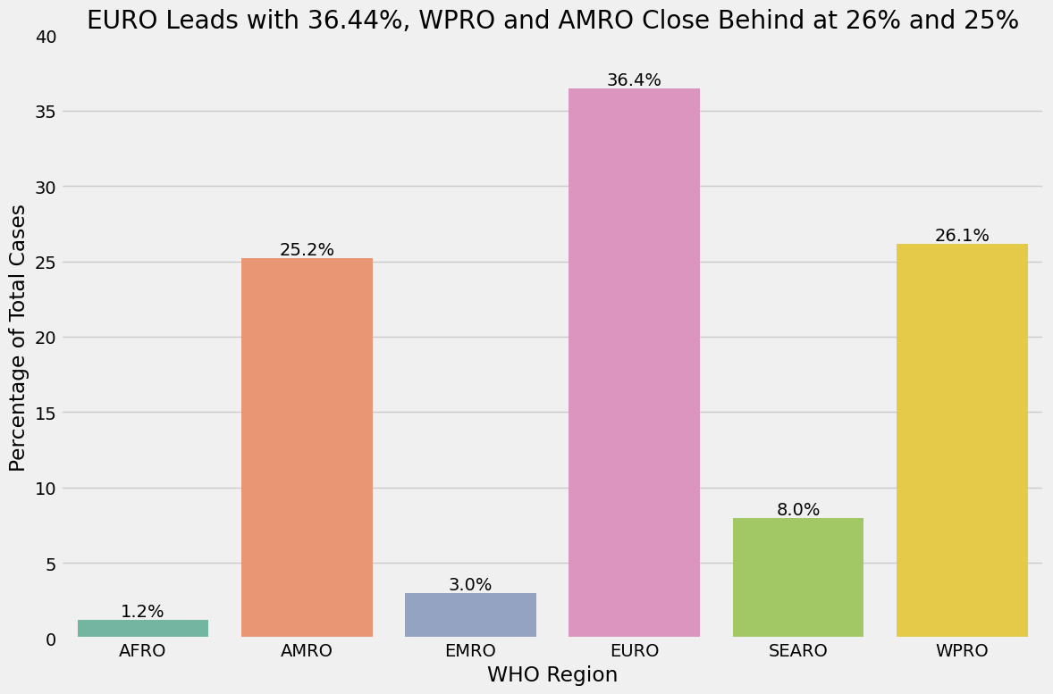
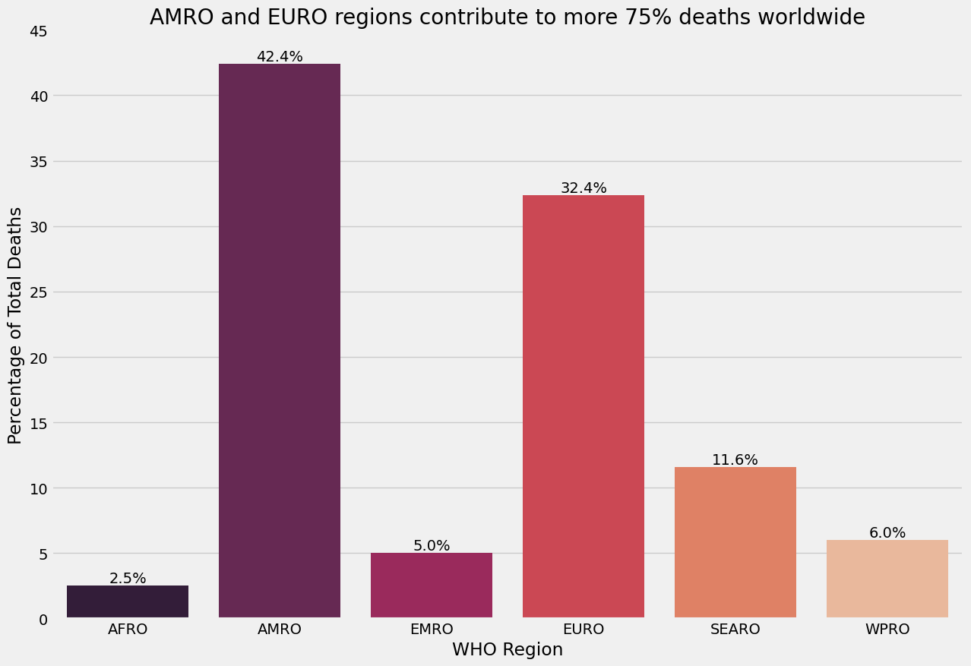
Percentage of COVID-19 cases and deaths across six WHO regions
Hardest- hit region in cases → EURO
Deadliest-hit regions → AMRO and EURO

Slide 6
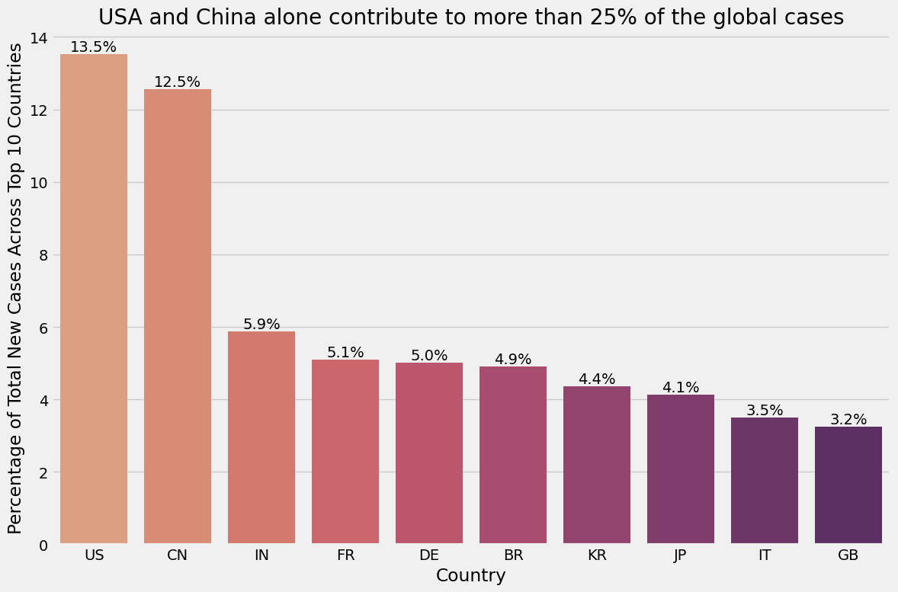

Slide 7
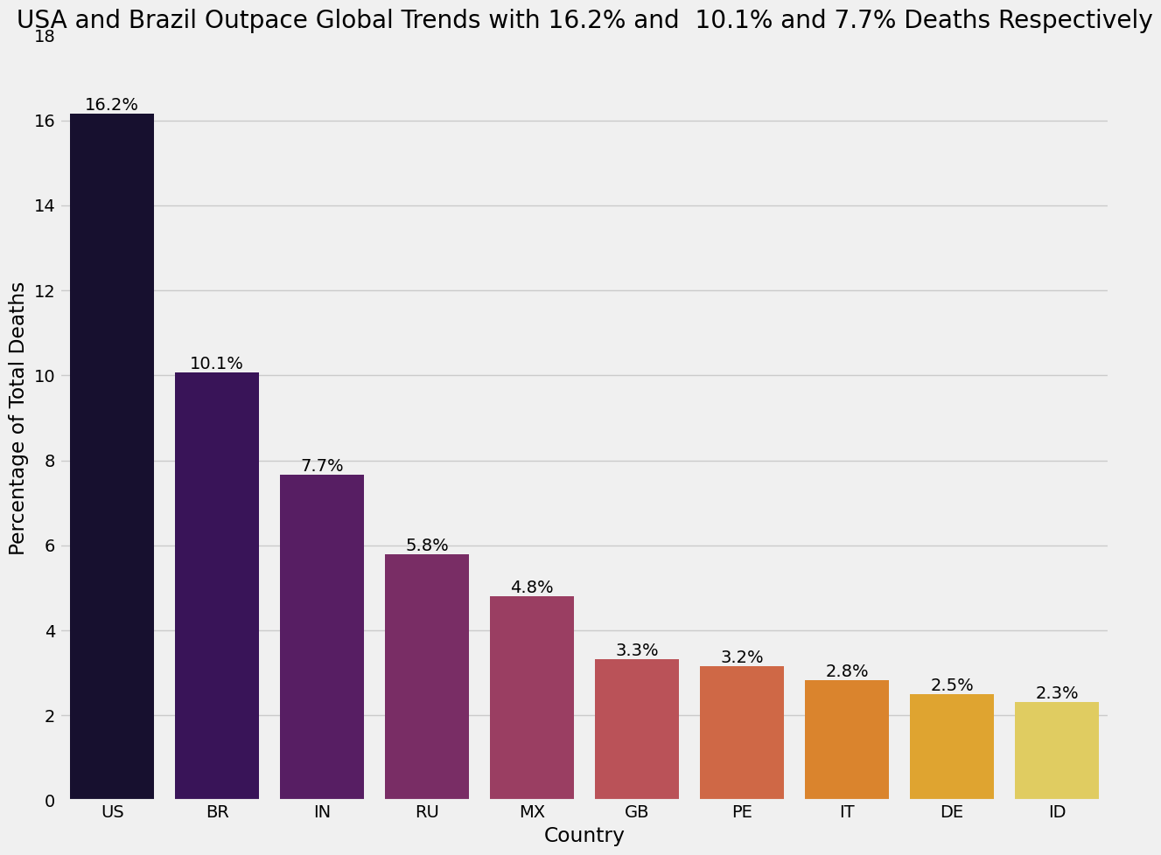

Slide 8
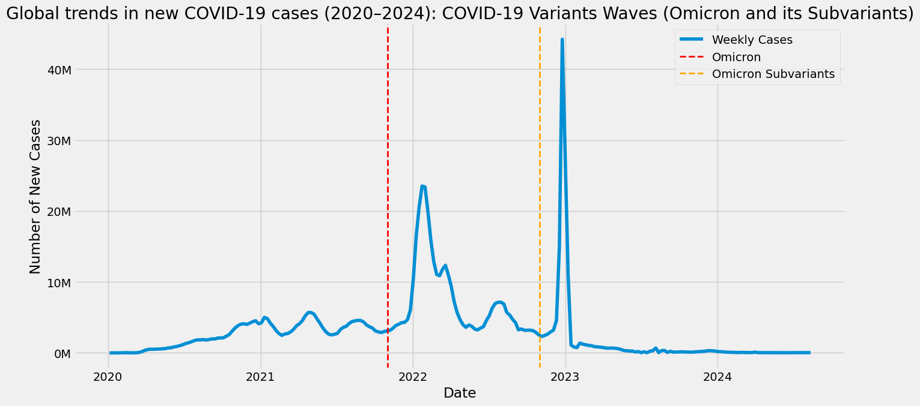
The two peaks in 2022 and 2023 suggest different waves of infection (e.g., the Omicron variant and its subvariants waves).
The other small peaks suggest the first outbreak started at the end of 2020, subsided slightly, and then again started increasing in mid-2021, declining slightly due to the interventions.

Slide 9
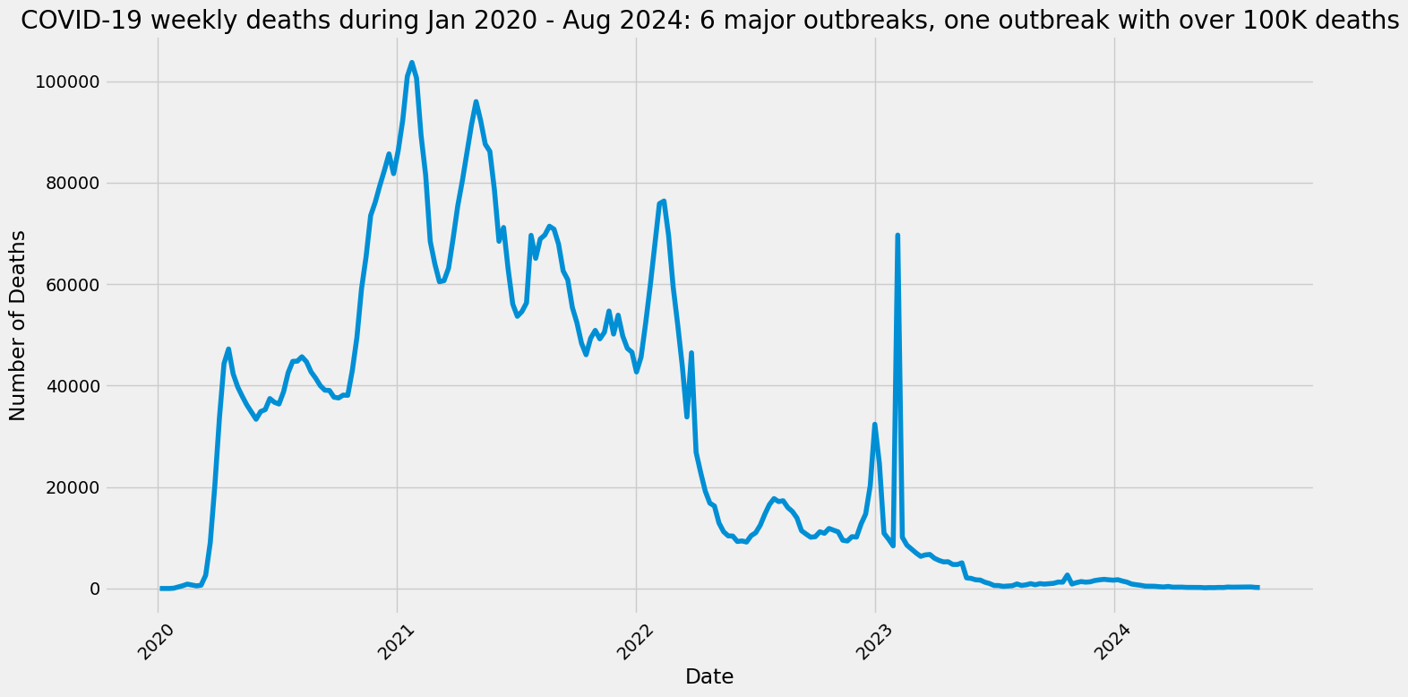

Slide 10
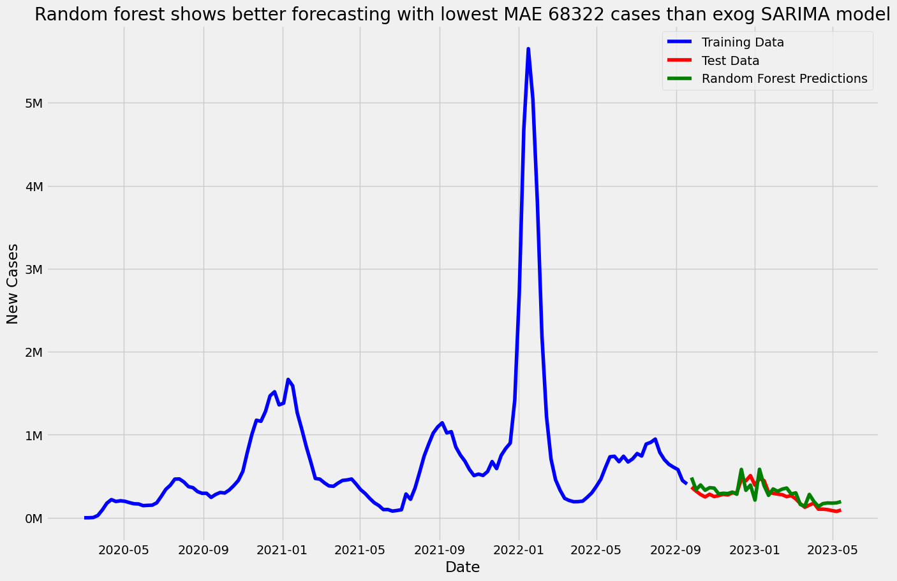

Slide 11
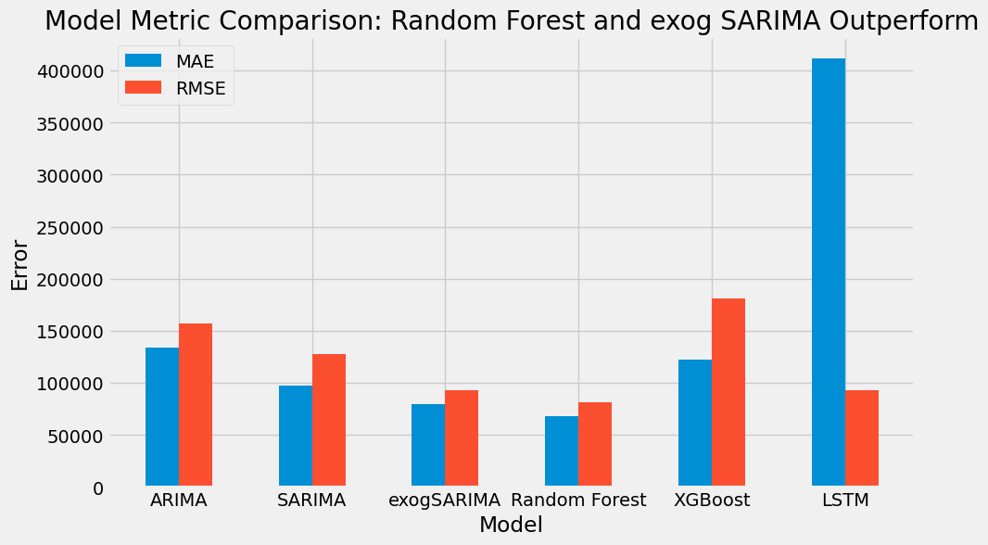
Random Forest is the best model, slightly better than exog SARIMA

Slide 12
Key Takeaways:
Random Forest and exogSARIMA outperform other models
LSTM performs poorly
Traditional Time-Series Models Show Moderate Performance
XGBoost shows mixed results

Slide 13
Recommendations and Next Steps
Improve exogSARIMA by incorporating additional external factors such as hospitalizations, variant-specific data, and real-time mobility patterns.
Combine machine learning and statistical models (e.g., Hybrid SARIMA-RF) for improved performance.
Improve LSTM by adjusting hyperparameters, increasing training data size, and using attention mechanisms.
Automate data collection pipelines for continuous model retraining to maintain forecasting accuracy.
Integrate these models with real-time dashboards to detect potential surges and mitigate outbreaks.

