Slide 1
Recommendation System to help New Expats to start Restaurant Business in New York
Capstone Project for IBM Data Science
By:
Preeti Sarin

Slide 2
Problem Statement
Shifting demographics and changing lifestyles are driving the surge in food-service businesses. Busy consumers don't have the time or inclination to cook. They want tasty, nutritious meals without dishes to wash. The cuisine of New York City comprises many cuisines belonging to various ethnic groups that have entered the United States through the city. So, it is evident that to survive in such competitive market it is very important to strategically plan. Various factors need to be studied in order to decide on location such as:
Are there any Farmers Markets, Wholesale markets etc. nearby so that the ingredients can be purchased fresh to maintain quality and cost?
Are there any venues like Tourist attractions, Entertainment zones, Parks etc., nearby where floating population is high
Requirement : to choose the correct location to start its first venture.

Slide 3
Data acquisition
New York City Dataset:
This New York City Neighborhood Names point file was created as a guide to New York City’s neighborhoods that appear on the web resource, “New York: A City of Neighborhoods.” Link: https://geo.nyu.edu/catalog/nyu_2451_34572
Foursquare API:
Foursquare API, a location data provider, will be used to make RESTful API calls to retrieve data about venues in different neighborhoods.

Slide 4
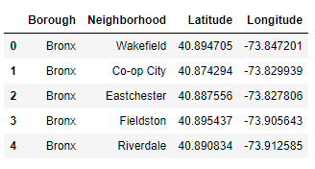
Download and Explore New York Dataset
New York Dataset (downloadable json format file :
https://cocl.us/new_york_dataset/newyork_data.json, ) is required that contains the 5 boroughs and the neighbourhoods, that exist in each borough, with respective latitude and longitude coordinates.

Slide 5
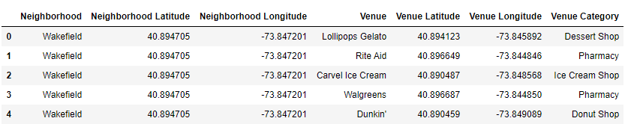
Exploring New York Venues using Foursquare
Our aim is to segment the neighbourhoods of New York and venues in its vicinity. To proceed further, we create a getNearbyVenues() function to repeat the following process to all the neighbourhoods in New York:
Loop through neighbourhoods
Create the API request URL with radius=500, LIMIT=100
Make the GET request to the ‘api.foursquare.com/v2/venues/explore?’
For each neighbourhood, return only relevant information for each nearby venue
Append all nearby venues to a list
Unfold the list & append it to data-frame being returned

Slide 6
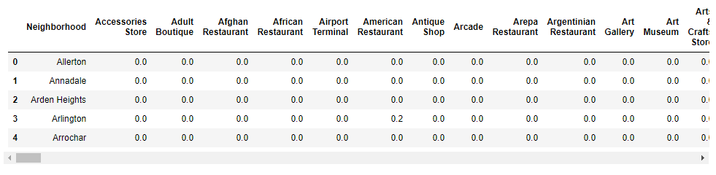
One hot encoding
One hot encoding is a process by which categorical variables are converted into a form that could be provided to Machine learning algorithms to do a better job in prediction
Create a data-frame with occurrence of each venue present (1) or not (0) under each Neighbourhood
Later grouped the rows by neighbourhood and the mean of the frequency of occurrence of each category was calculated and included in a new data-frame.

Slide 7
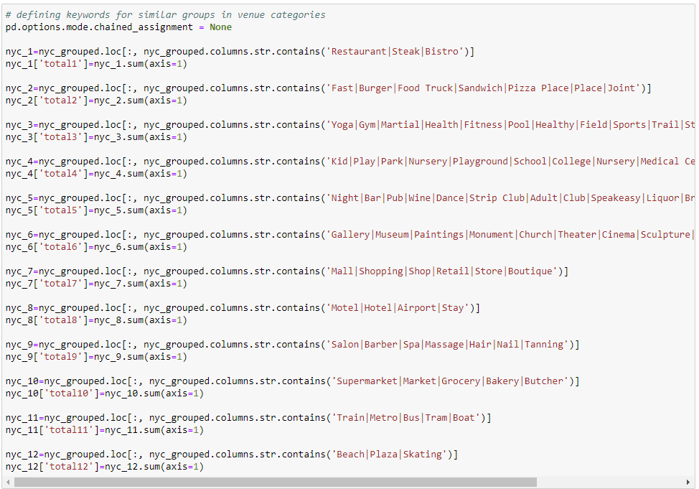
Feature selection
Grouping similar venue categories in the dataset into the same logical group.
Venues are filtered through a key words search so to create a number of higher level categories.

Slide 8
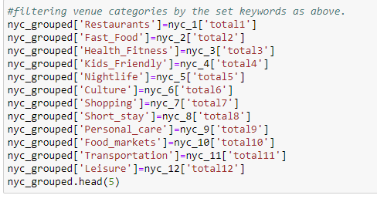
Feature selection
Filtering on the basis of keywords

Slide 9
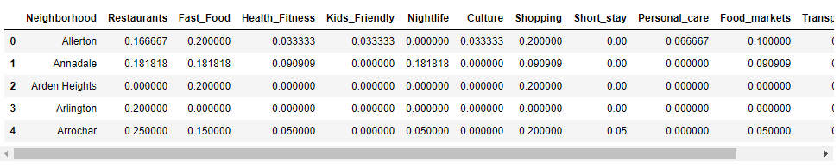
Feature selection
New data-frame with 12 key categories as columns and the corresponding mean frequencies per Neighbourhood as sums of the values.

Slide 10
Modelling
K-means clustering is one of the simplest and popular unsupervised machine learning algorithms. A cluster refers to a collection of data points aggregated together because of certain similarities.
Elbow Method: Calculate the Within-Cluster-Sum of Squared Errors (WSS) for different values of k, and choose the k for which WSS becomes first starts to diminish. In the plot of WSS-versus-k, this is visible as an elbow. Unfortunately, we do not always have clearly clustered data.
Silhouette Method: The silhouette value measures how similar a point is to its own cluster (cohesion) compared to other clusters (separation).
We choose k-clusters =7 after Silhouette method is applied

Slide 11
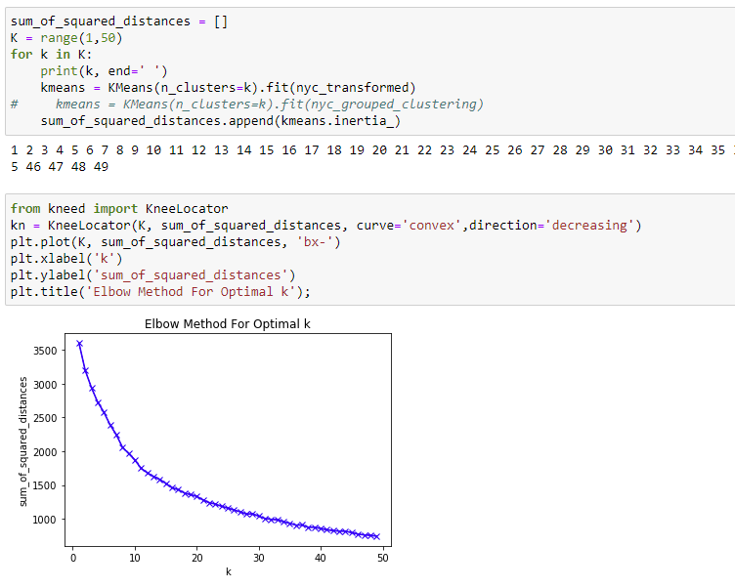
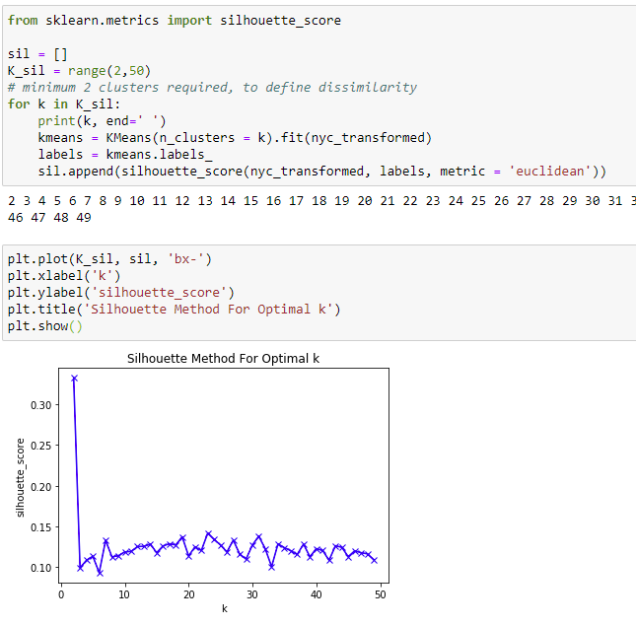
K-mean Clustering
Elbow Method
Silhouette Method

Slide 12
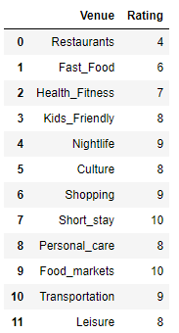
Recommendation System
For this project use Content-based recommenders system. It treats recommendation as a user-specific classification problem and learn a classifier for the user's likes and dislikes based on product features.
We feed the system with user ratings for each of the 12 categories we created depending on how important each was for the user in a scale of 1–10.
For the testing purpose we used a “persona” of a user who wants to open restaurant at a place where it has less competition moreover to attract more customers he want a location which has shopping areas, transportation facilities, nightlife / leisure activities/ college & university etc.

Slide 13
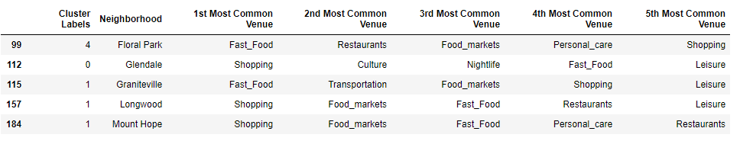
Results
After we create user preferences matrix by calculating the weighted average of the user ratings against the frequency of each category and for all New York neighbourhoods in our data-frame.
The result was sorted to a top 5 list of recommended Neighbourhoods basis user profile which was then plotted on the map of New York.

Slide 14
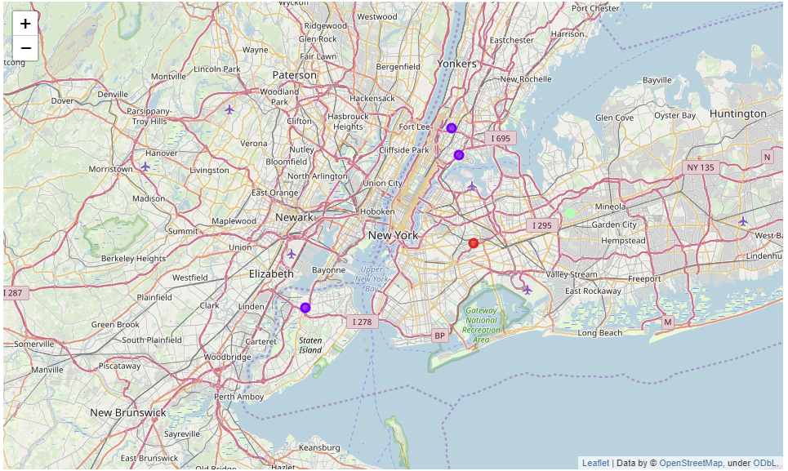
Result
By using recommendation system we could clearly identify the neighbourhoods which meet the customer specification.
Top 5 neighbours are mapped using folium library

Slide 15
Future Directions
This analysis is performed on limited data. If good amount of data is available there is scope to come up with better results.
This problem can be further enhanced by considering population and demographics of New York, cuisine served.

