Slide 1
ADMINISTRATIVE
SERVICES
WEBPAGE

Slide 2
LOGIN
The Administrator needs to have a id and password to login to the database.
The administrator will verify all the documents before issuing the pass.
The administrator is solely responsible for the document verification and the pass generation.

Slide 3
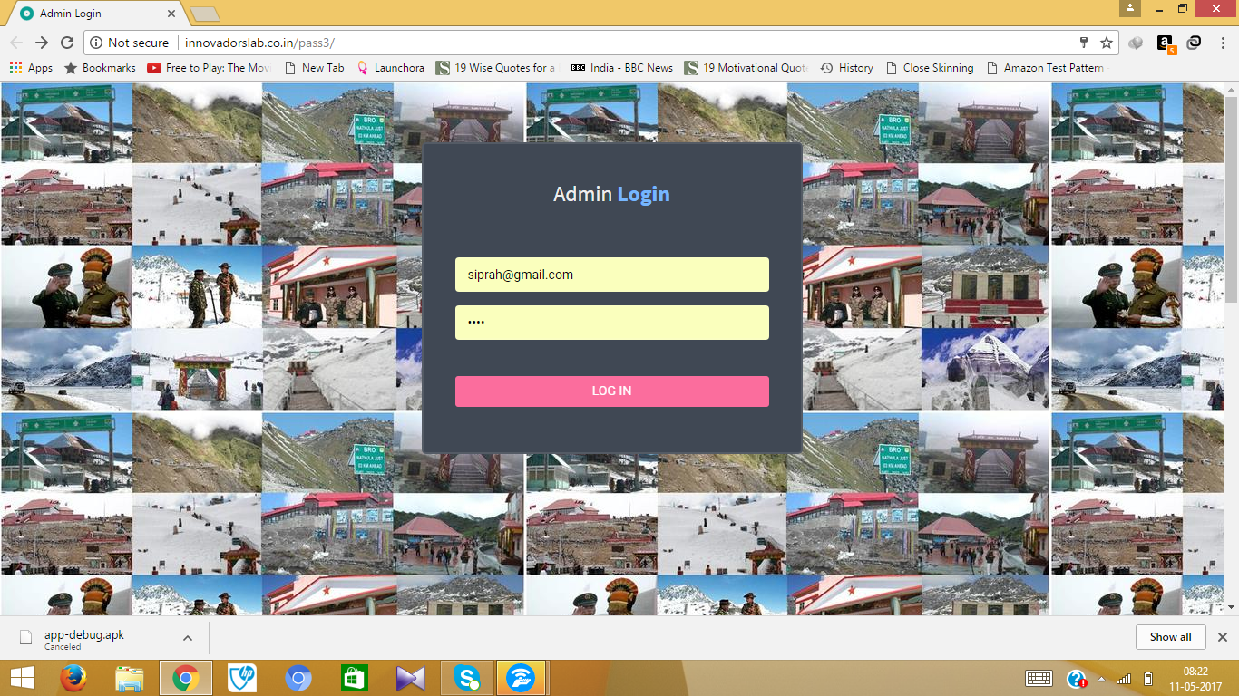

Slide 4
INTERFACE
(DASHBOARD)
MANAGE LOCATION
View and Add Visiting Location
View and Add Gate To Location
APPLICATION FOR PASS
Pending Application
Received Application
1St Level Approved
Generate Pass

Slide 5
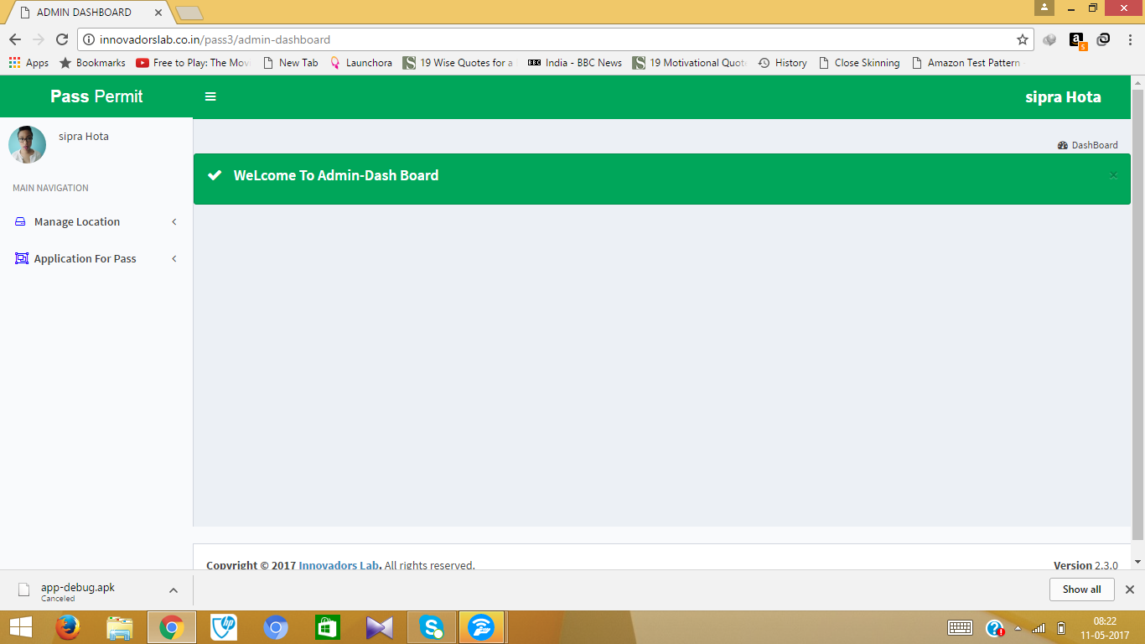

Slide 6
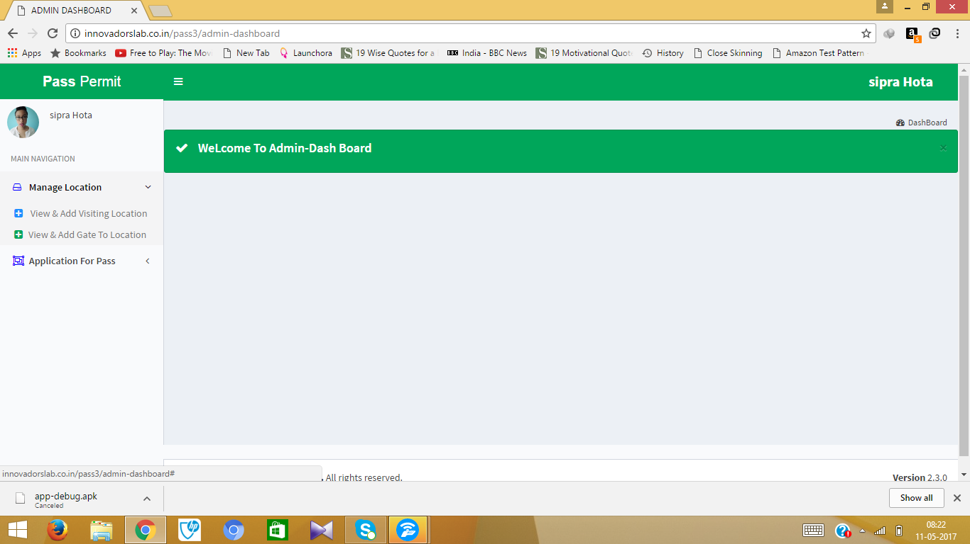

Slide 7
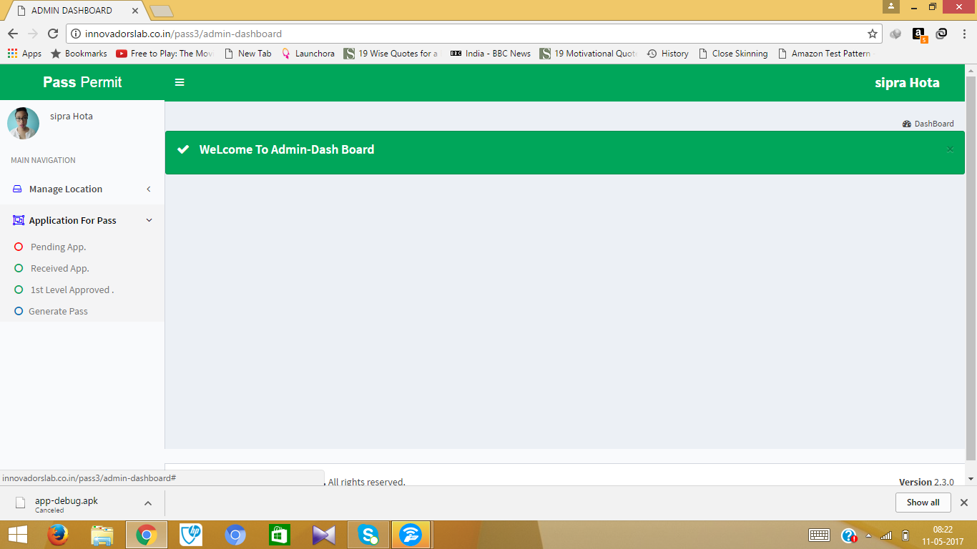

Slide 8
Admin View &
ADD Location
Here the admin can allocate the locations available for visits during a particular time.
Admin can add Locations and provide the fees required.
Admin has the right to activate or deactivate any visiting location.
The rescheduled charges are also fixed over here.

Slide 9
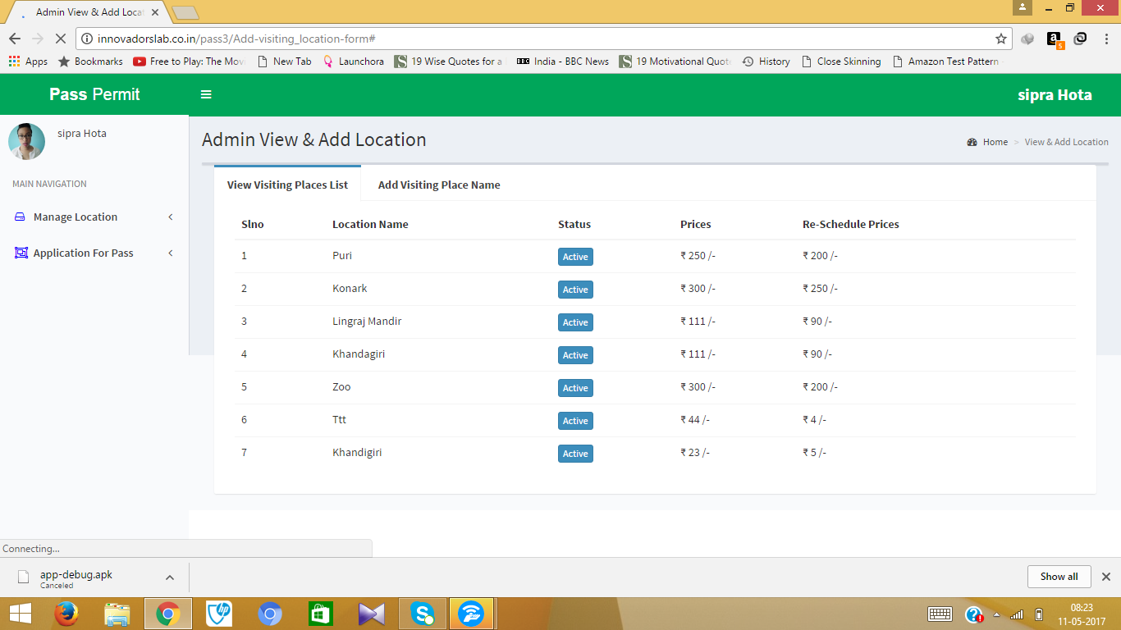
Visiting places list

Slide 10
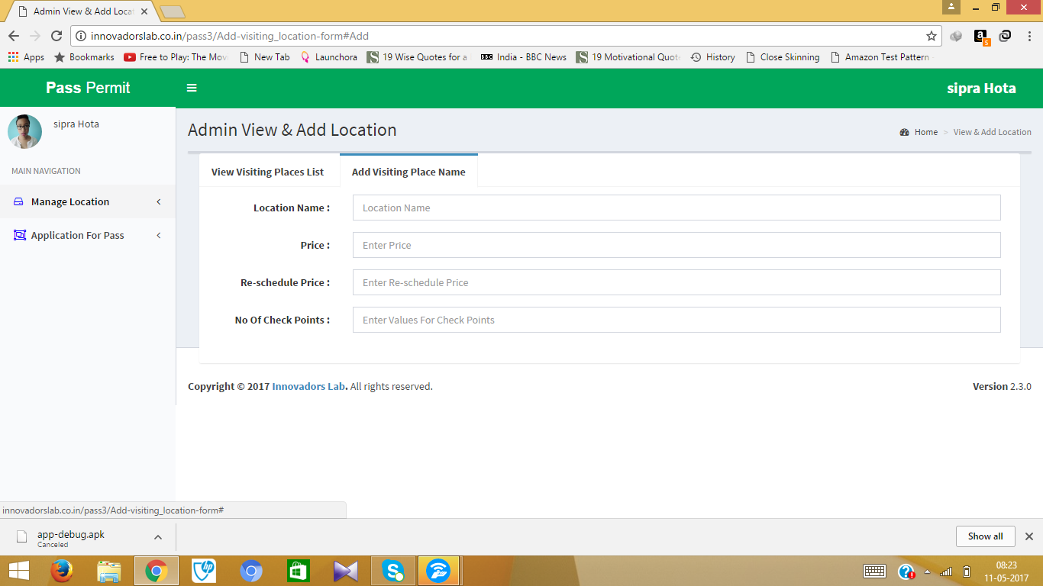
ADD LOCATION

Slide 11
LIST OF PENDING APPLICATIONS
There are many applications which are incompletely filled.
There are many applications whose payment is pending which results in them being stored under the pending list col.
These help in categorizing the applications for faster service.

Slide 12
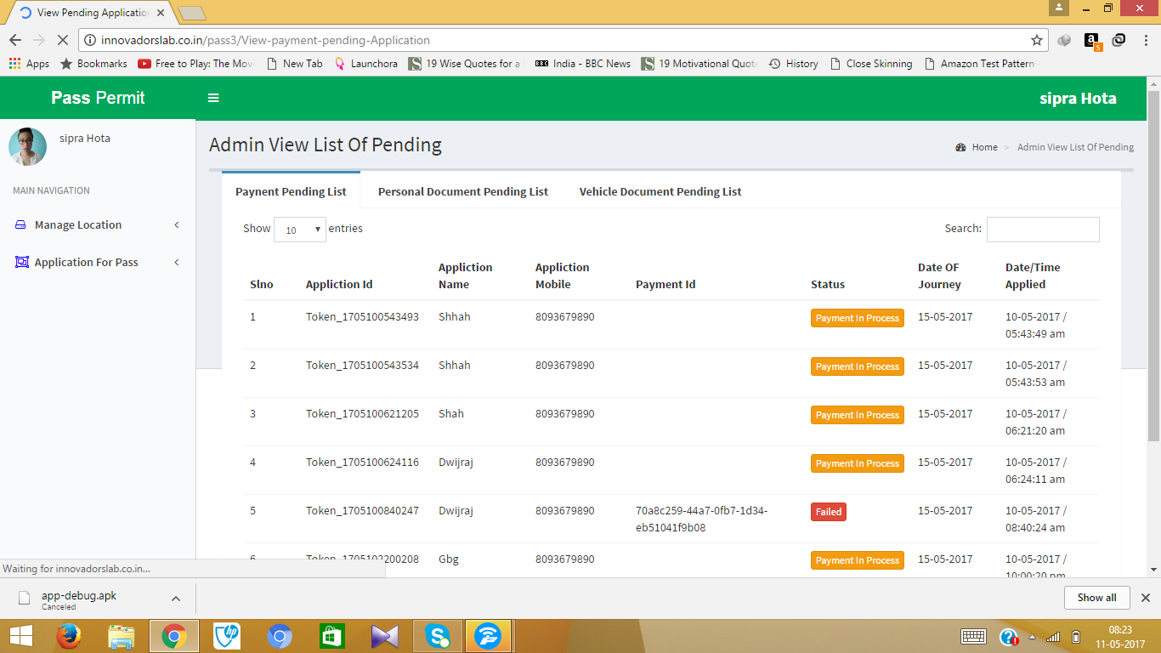
LIST OF PENDING APPLICATIONS

Slide 13
Received application
After the payment is successfully completed the application is processed to the received application
In the received application a payment id is kept which is generated when there is a transaction.
This transaction id helps in the tracking of the payment.

Slide 14
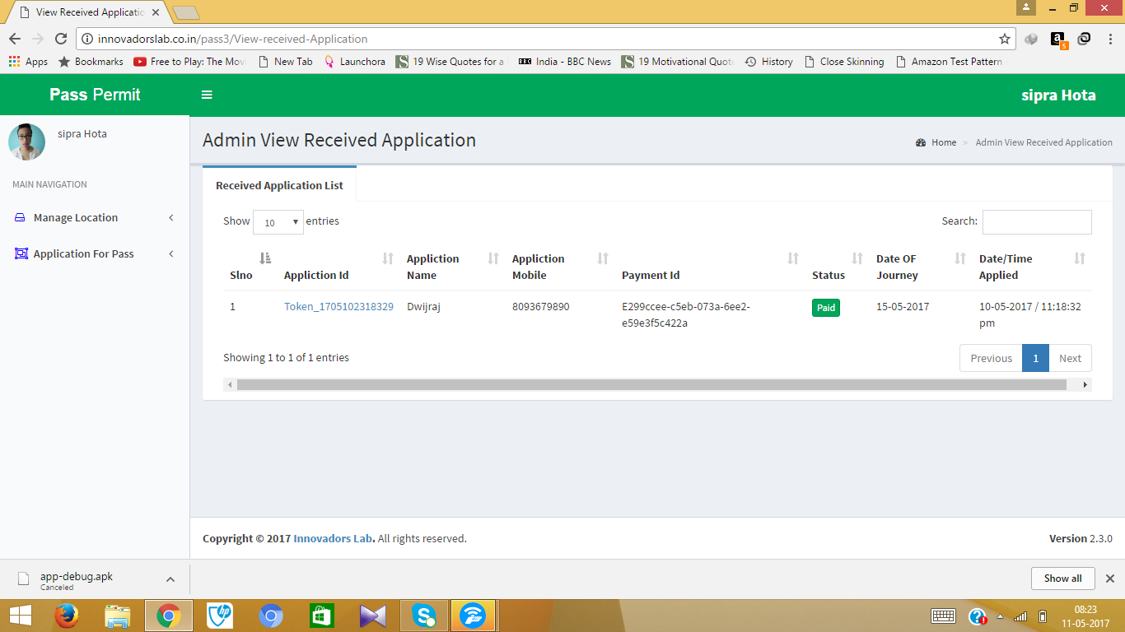

Slide 15
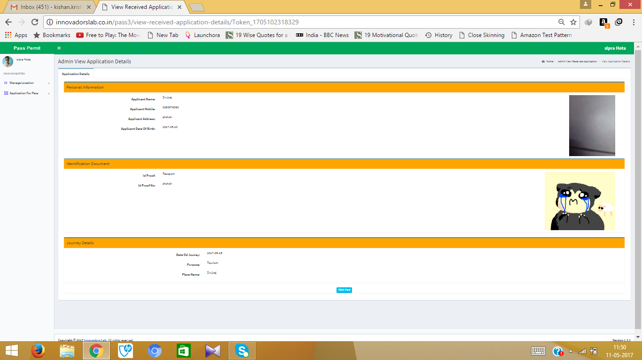
VIEW THE APLICATION

Slide 16
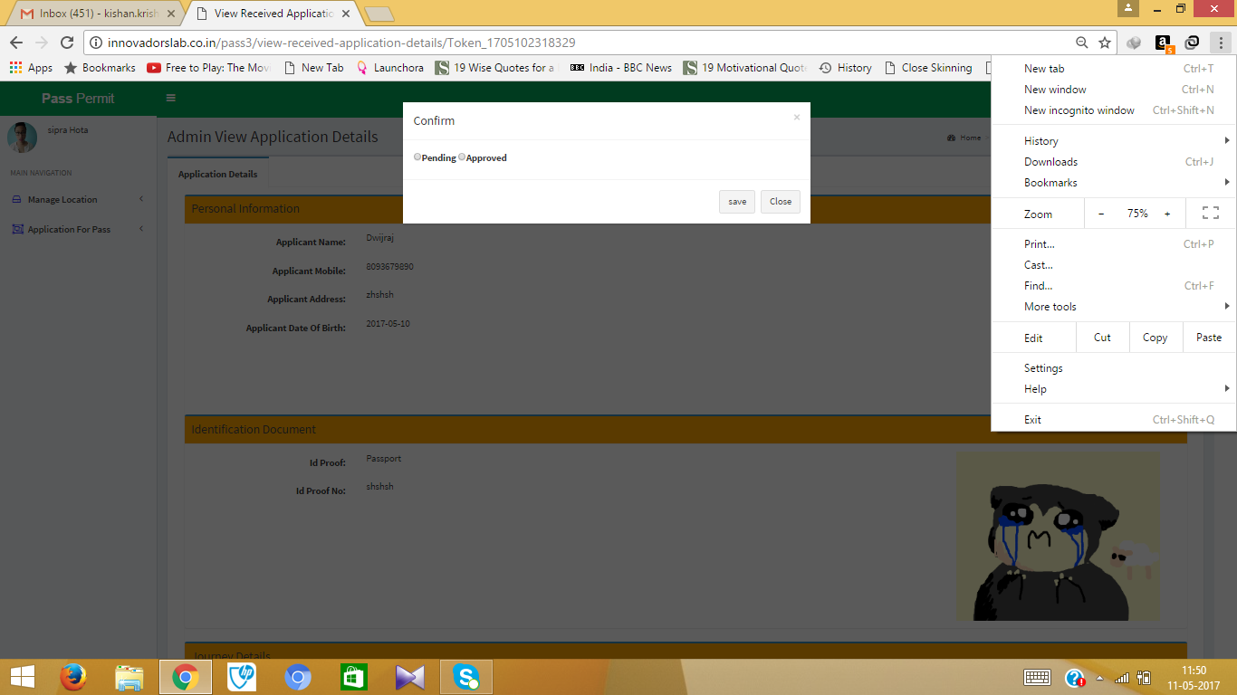
CHANGE THE STATUS OF THE PASS

Slide 17
1ST LEVEL APPROVED
Here the admin has verified the initial details.
All the documents are also verified with the information provided in the application form.
The admin proceeds the application to be verified so that the user can book the vehicle required.

Slide 18
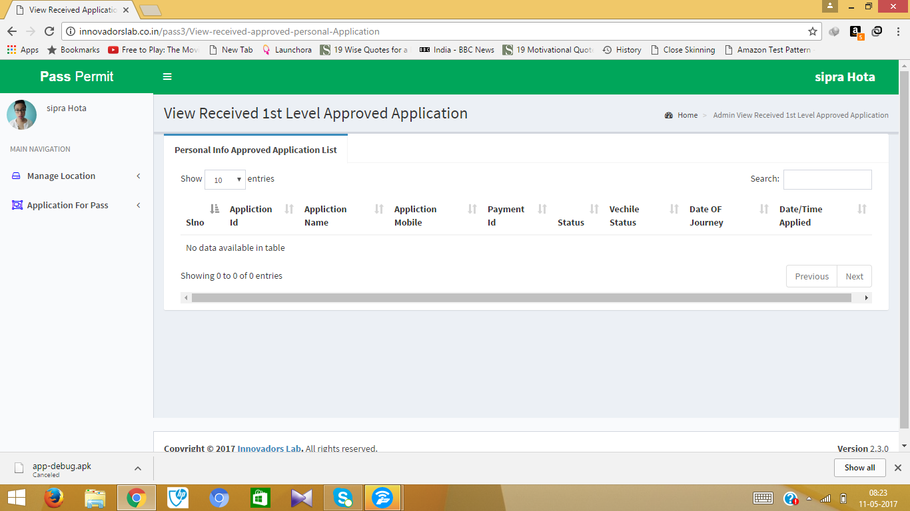
1ST LEVEL APPROVED

Slide 19
PASS GENERATION
The user books vehicle after the 1st Level is approved.
After the verification of the vehicle and driver the pass is finally generated for the user.
All the details are verified and the user can now receive the pass.

Slide 20
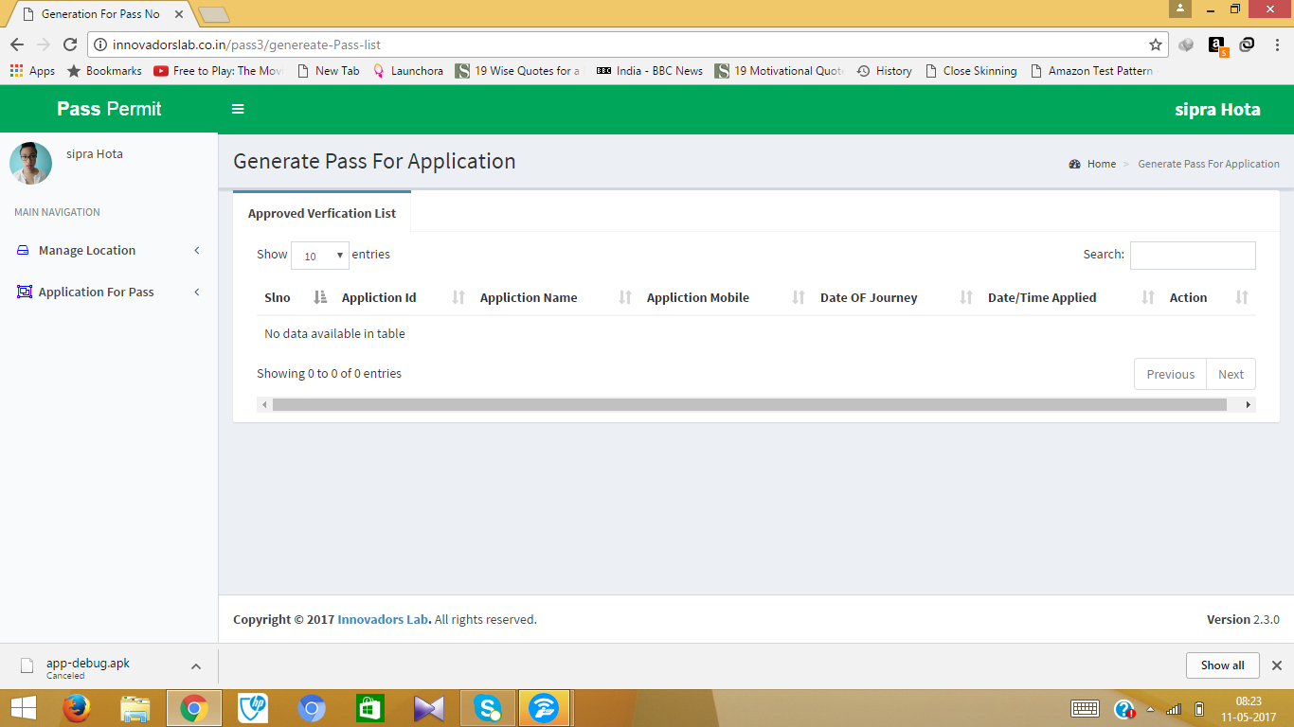
PASS GENERATION

