Slide 1



An overview of Vue.js
Preetish H S
preetish.in
/in/preetishhs

Slide 2
What is Vue.js
Vue Is a progressive JavaScript framework
Easy to pick up and integrate with other libraries
Simple and flexible
Fast and small in size
Reactive
Component based
Notes:
What is progressive? It can be used only in part of the application, for a few pages also
Why is it easy? No tight typescript coupling like angular, no JSX like React, just normal HTML CSS and JavaScript.
Just import from CDN and that’s it. If you want the full SPA setup you can use official CLI to create the project.
Reactive -> Vue uses virtual DOM like react to update the changes and also supports 2 way binding even for custom elements.
Component based to make the code modular

Slide 3
Pre-requisites?
Intermediate level of knowledge in
HTML
CSS
JavaScript (ES6 Syntax)

Slide 4
Supporting libraries
Vuex – (Official state management library)
Vue-router – (Official router library)
Vue-i18n – (Internationalization library )
Vue-test-utils – (Unit testing library)
Vue-CLI – (Official CLI tool to bootstrap the project)
Notes:
1. Vuex to maintain state on client side such as keep user data, authentication data, or the data that is being used by multiple components
2. Vue router which is official routing library which we use to create a Single Page application
3. Vue i18n was initially a 3rd party library but is a part of official Vue ecosystem
4. Vue-test-utils again was initially 3rd party library but now being maintained by Vue core team.

Slide 5
Installation
CDN
CLI

Slide 6
Course Contents - Day 1
Getting started
Template syntax
Data properties, computed properties, watchers, methods
Data binding (One way and two way)
Directives, loops and conditional syntax
Components (global and local)
Notes:
Start simple by importing it via CDN on codepen
We’ll see reactivity

Slide 7
Course Contents - Day 2
Setting up project from CLI (node.js, vue-cli)
Folder Architecture
Lifecycle hooks
Component communication (props and emit)
Event Bus (Deprecated)

Slide 8
Course Contents - Day 3
Dynamic components
Slots and named Slots
Binding classes and styles (CSS)
Form input binding (Radio, Checkbox etc)
Events and event modifiers
Keyboard events and modifiers

Slide 9
Course Contents - Day 4
Making API Calls
Introduction to Mixins and code sharing

Slide 10
Course Contents - Day 5
Introduction to Vue router
Creating routes and navigation
Navigating via code
Dynamic routing

Slide 11
Course Contents - Day 6
Child routes / Nested routes
Introduction to Vuex and State management
Storing and manipulating data in Vuex
Using Vuex in Components
Namespaced store and modules

Slide 12
Course Contents - Day 7
Route guards
Introduction to Vue-i18n and Internationalization
Creating translation files
Using translation in templates and JavaScript
Switching languages
Number localization
Singular/plural localization
Date and time localization

Slide 13
Course Contents - Day 7 - 8
Introduction to Vue-test-utils and JEST
Mocking Data
Testing component output
Testing events
Testing Vuex
Building the application

Slide 14
Let’s See some code!

Slide 15
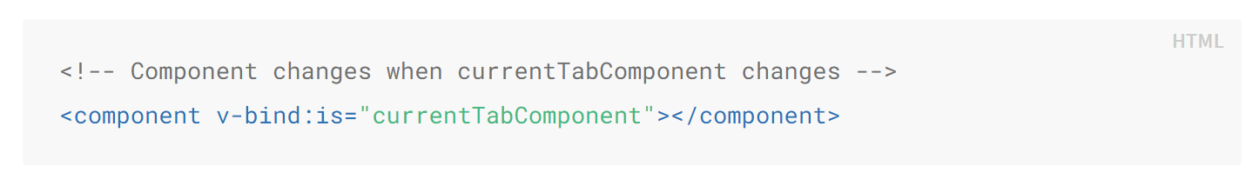
Dynamic Components
Sometimes, it’s useful to dynamically switch between multiple components
Eg: For building tabs component, user profile section

Slide 16
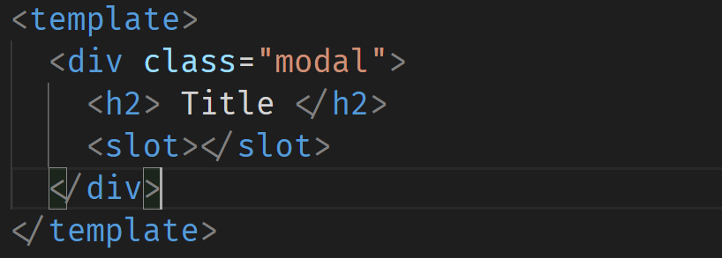
Slots
Slots are a mechanism for Vue components that allows you to compose your components and place content in new places or make components more generic.
Eg: For building Modals
Modal.vue

Slide 17
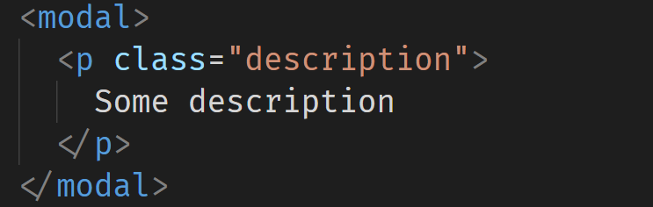
Slots
In the parent component

Slide 18
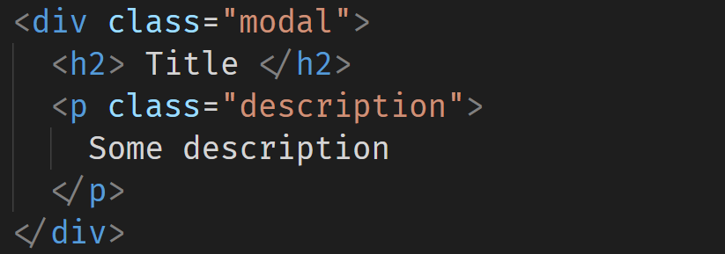
Slots
Final Rendered structure

Slide 19
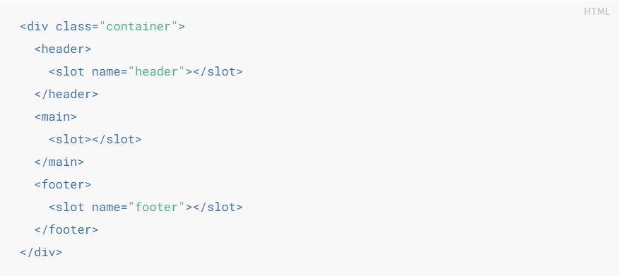
Named Slots
We can have multiple such slots in our components with each having different names

Slide 20
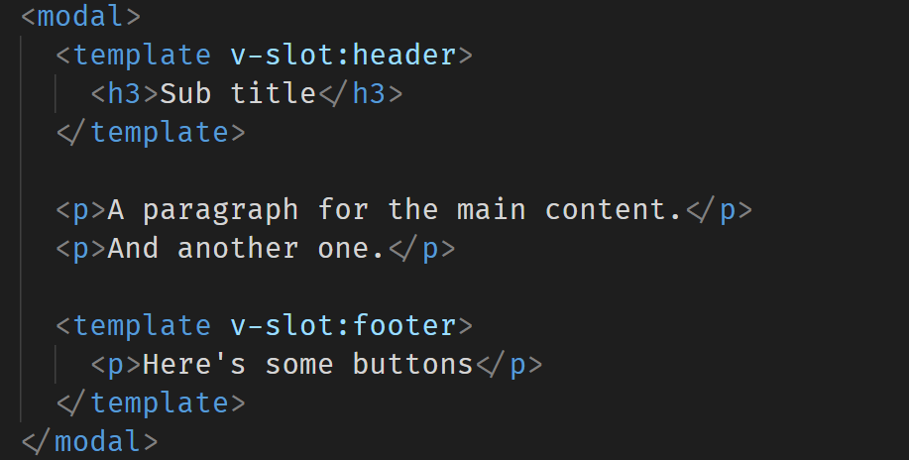
Named Slots
We use v-slot:<slot-name> on the wrapper template tag to pass the items into that particular slot.

Slide 21
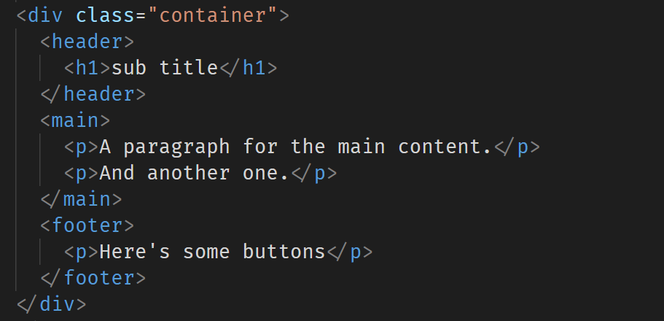
Named Slots
Final rendered structure

Slide 22
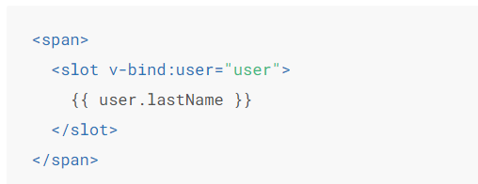
Scoped Slots
The content inside the slots by default can only access parent data and not child data. To give these slots access to child data we have pass props called as slot props

Slide 23
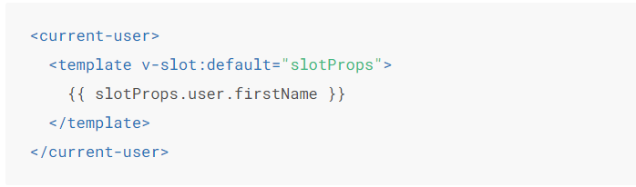
Scoped Slots
Accessing these slot props (the data passed from child component) In our component
We use v-slot:<slot-name>=“anyName”

Slide 24

Class Binding
We can bind reactive properties or computed properties to ‘class’ attribute to apply different CSS styles dynamically.
Binding Single classes
Binding class object

Slide 25
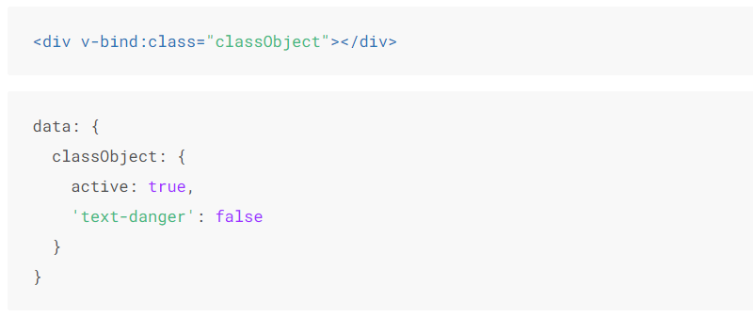
Class Binding

Slide 26
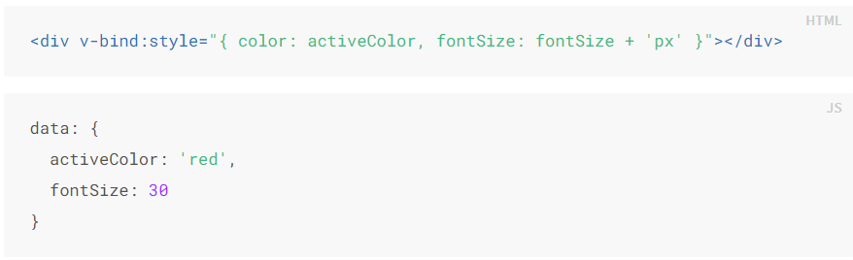
Style Binding
We can bind reactive properties or computed properties to ‘style’ attribute to apply different CSS styles dynamically.
Binding Single style
Binding style object

Slide 27
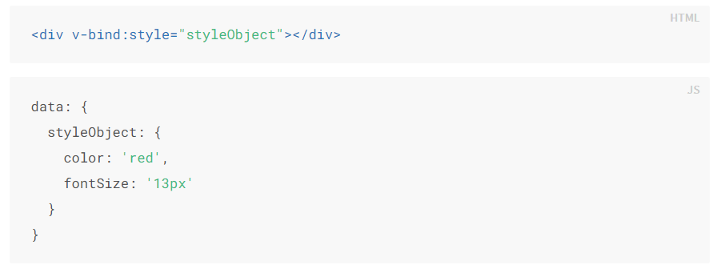
Style Binding

Slide 28
Form Binding
Different input elements different kinds of data type bindings
Input: string, number
Textarea: String
Checkbox/s: Boolean, Array, String
Radio: string, number
Select: string, number
Multi Select: Array

Slide 29

Event Modifiers
It is a very common need to call event.preventDefault() or event.stopPropagation() inside event handlers. Although we can do this easily inside methods, it would be better if the methods can be purely about data logic rather than having to deal with DOM event details.
Commonly used event modifiers:
.stop
.prevent
.once
.self
.left, .right, .middle

Slide 30
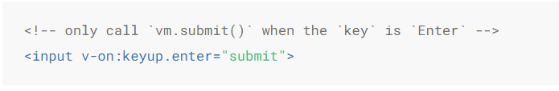
Key Modifiers
Commonly used key modifiers:
.enter
.tab
.left, right, .down, .up
.ctrl
.alt

Slide 31
Mixins
Mixins are a flexible way to distribute reusable functionalities for Vue components. A mixin object can contain any component options.
When a component uses a mixin, all options in the mixin will be “mixed” into the component’s own options.
The component’s options will take priority during conflicts

Slide 32
Mixins
Mixins are a flexible way to distribute reusable functionalities for Vue components. A mixin object can contain any component options.
When a component uses a mixin, all options in the mixin will be “mixed” into the component’s own options.
The component’s options will take priority during conflicts

Slide 33
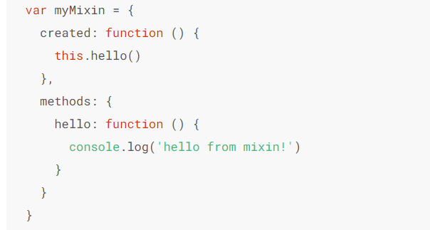
Mixins
Mixins/index.js – We export an object which consists of shared Vue options such as data, methods, life cycle hooks etc

Slide 34
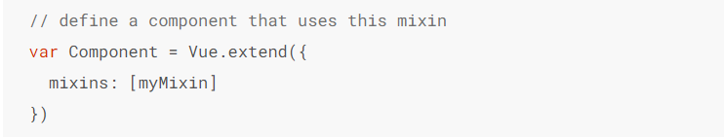
Mixins
We can import these exported mixins in any component that requires these options

Slide 35
API Calls
We use ‘Axios’ library to make API calls.
Axios is a promise based JavaScript library to make REST API calls.
Install Axios as a production dependency using the command below:
npm install –save axios

Slide 36
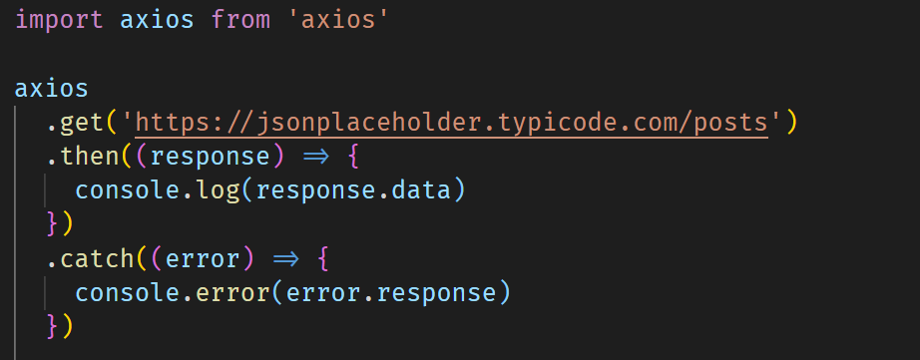
GET Request

Slide 37
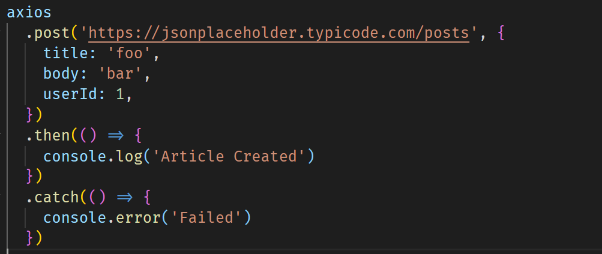
Passing Body to Requests

Slide 38
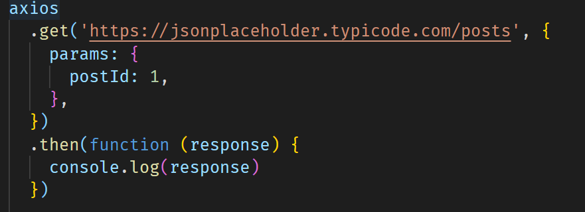
Passing Query Params

Slide 39
Custom Axios Instance
We can create custom axios instance with predefined values for that instance such as
Base URL
Headers
Timeouts
Auth Tokens
And more -> https://github.com/axios/axios#creating-an-instance

Slide 40
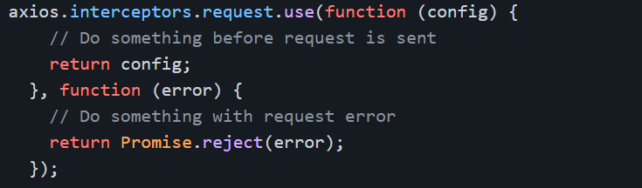
Axios Interceptors
We can intercept each and every requests or responses from Axios to make any kind of operations
Eg: Intercept all failed requests and show an error toast

Slide 41
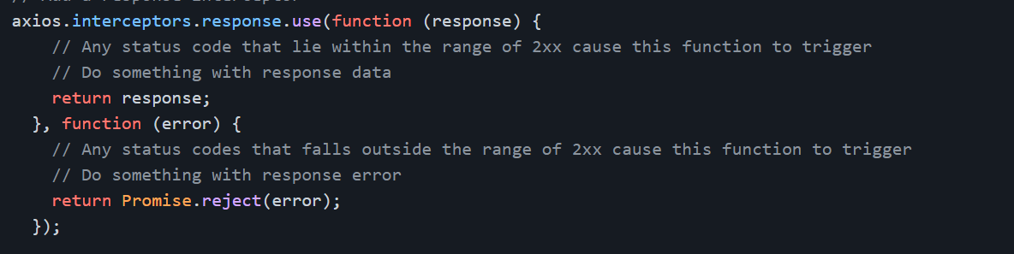
Axios Interceptors
Intercepting Reponses

Slide 42
Vue Router
Vue-router is the official router library for Vue.js
It is used to mainly to navigate between the pages.
To install Vue-router, You can either select it while creating the project or install it later with the command below:
npm install vue-router --save

Slide 43
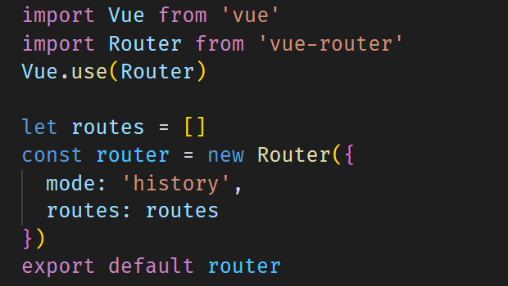
Importing Vue Router to our Project

Slide 44
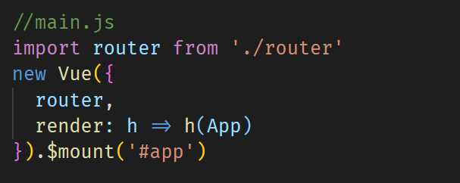
Importing Vue Router to our Project

Slide 45
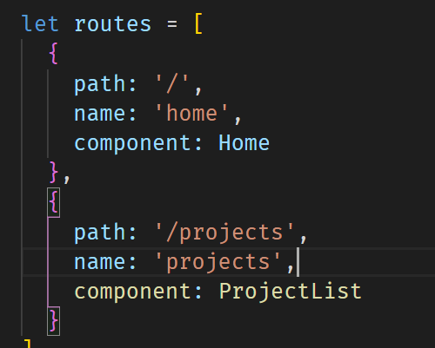
Importing Vue Router to our Project
Each route should have:
Path (unique)
Name (unique)
Component

Slide 46
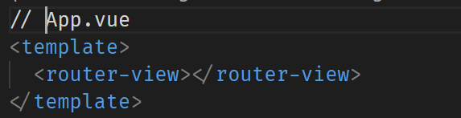
Router Entry point
<router-view> component is the main entry point and should be placed in App.vue

Slide 47
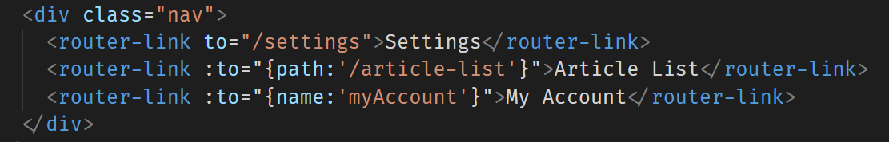
Router Links
<router-link> component is used to create links. ‘to’ attribute takes the path to which the link should be directed to.

Slide 48
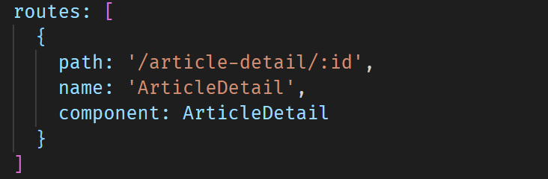
Dynamic Routing
Routes can dynamic URL Parameters which can then accessible in the pages. In the below example ‘id’ is the dynamic parameter.

Slide 49
Accessing Router Data in Components
Vue-router injects two useful objects $route and $router which can be accessed in any Vue components.
$route gives us information about the dynamic parameters, query params, current route etc.
$router is used to programmatically navigate to different routes.

Slide 50
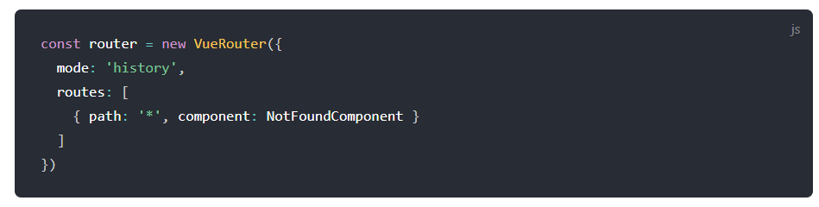
404 route
When the URL doesn’t match to any routes defined we can show a 404 page.

Slide 51
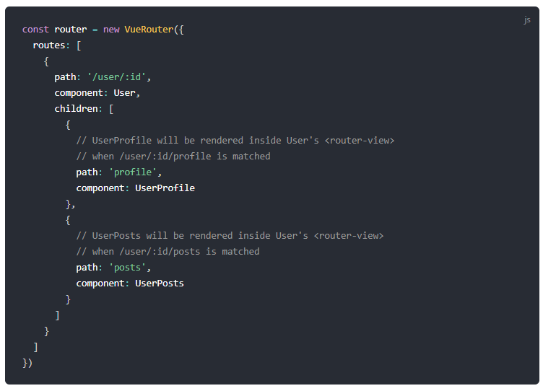
Child Routes
We can also nest one route inside the other using the concept of child routes.

Slide 52
Route / Navigation Guards
As the name suggests, the navigation guards provided by vue-router are primarily used to guard navigations either by redirecting it or canceling it. 1. Global Navigation guards
2. Component Navigation guards

Slide 53
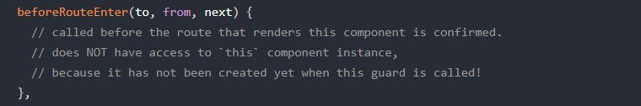
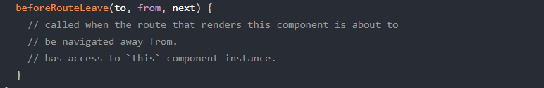
Navigation Guards - Components
These are component specific guards, (basically like a router lifecycle hook) Its important to call next() after we do any operations

Slide 54
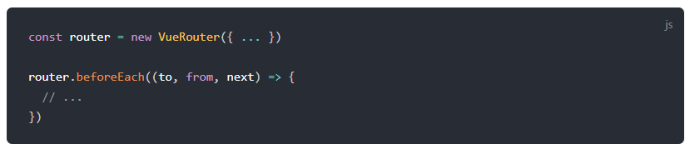
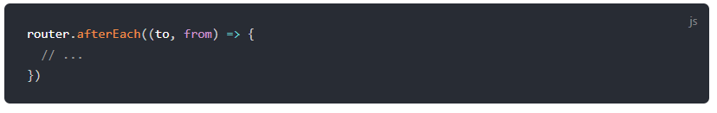
Navigation Guards - Global
These guards are written in our router file itself and can be applicable to all the routes. Its important to call next() after we do any operations.
Next() is not required for afterEach() as the route has already been changed.

Slide 55
Vuex
Vuex is a state management pattern + library for Vue.js applications.
It serves as a centralized store for all the components in an application, with rules ensuring that the state can only be mutated in a predictable fashion.
We can install Vuex using the command below:
npm install --save vuex

Slide 56
Vuex
Vuex is a state management pattern + library for Vue.js applications.
It serves as a centralized store for all the components
Vuex stores are reactive.
You cannot directly mutate the store's state. The only way to change a store's state is by explicitly committing mutations.
Notes:
Vuex is liked a frontend

Slide 57
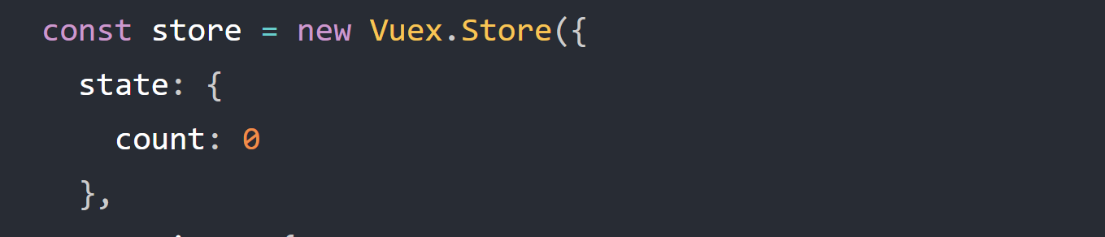
Vuex - State
State: It’s a single object contains all your application level state and serves as the "single source of truth". This also means usually you will have only one store for each application.

Slide 58
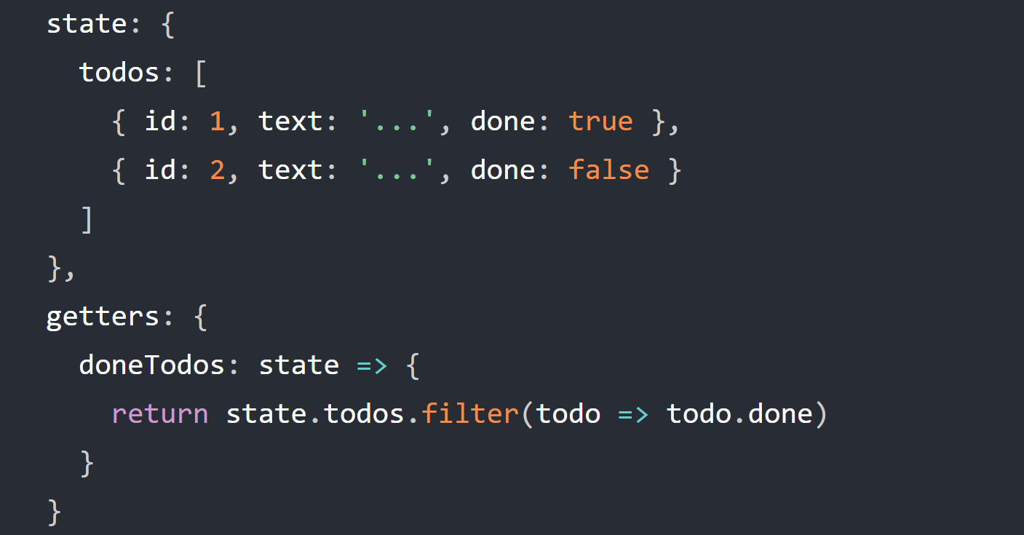
Vuex - Getters
Getters: Sometimes we may need to compute derived state based on store state.
Eg: Getting the tasks that are completed from the list of tasks

Slide 59
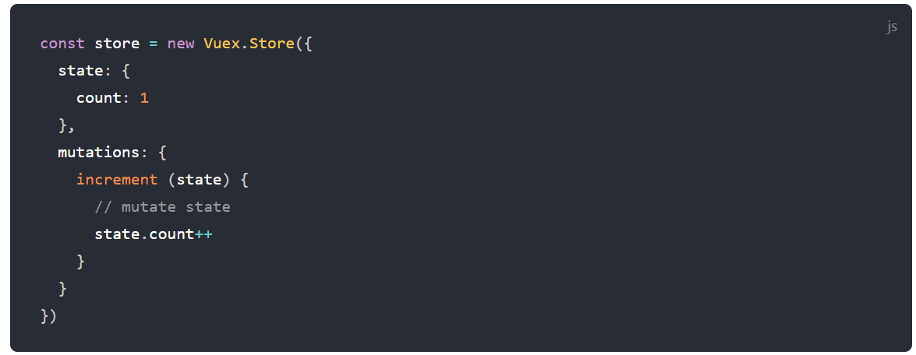
Vuex - Mutations
Mutations: The only way to actually change state in a Vuex store is by committing a mutation. It’s a synchronous function is where we perform actual state modifications, and it will receive the state as the first argument

Slide 60
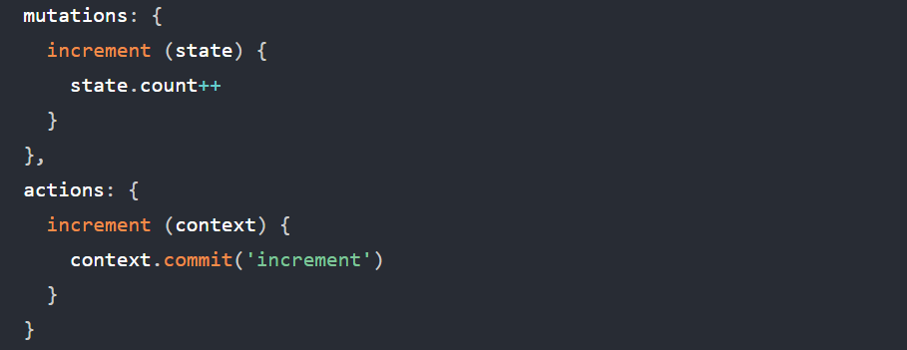
Vuex - Actions
Actions: Actions are used to perform async operations. Actions can also commit mutations.

Slide 61
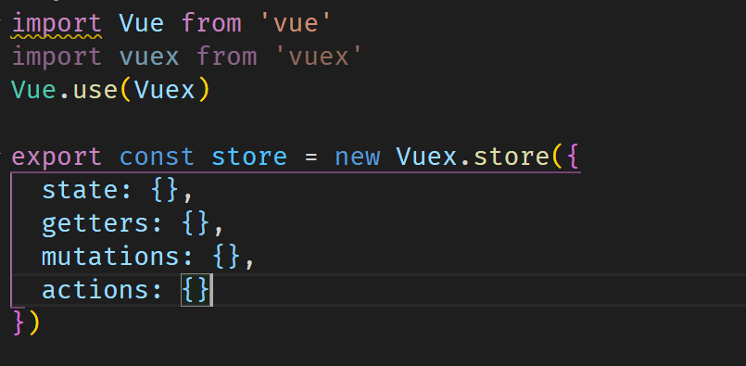
Vuex

Slide 62
Using Vuex in Components
Using the injected store (this.$store)
State: this.$store.state
Getters: this.$store.getters
Mutations: this.$store.commit(‘<mutation-name’>, payload)
Actions: this.$store.dispatch(‘<action-name’>, payload)
Using Helpers ( mapState, mapGetters, mapMutations, mapActions )

Slide 63
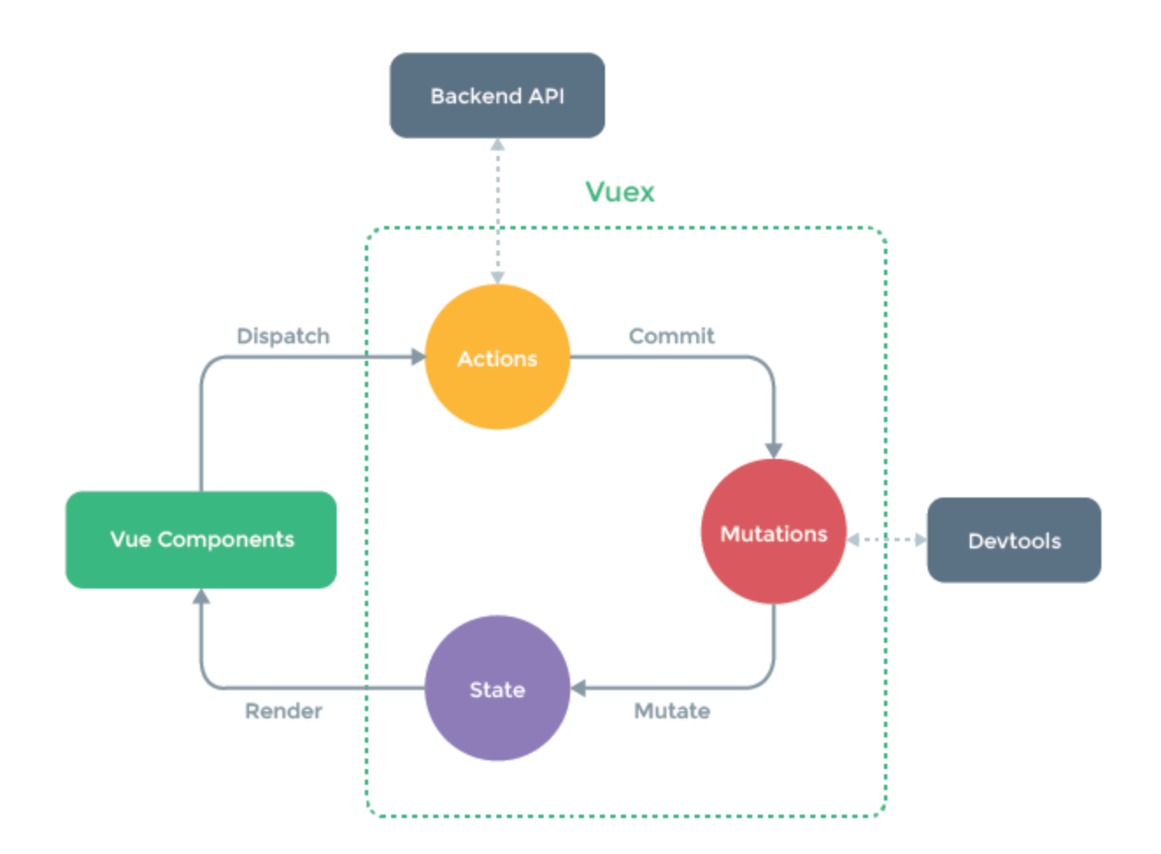
Vuex

Slide 64
Vuex - Modules
As our application grows in scale, the store can get really bloated. To help with that, Vuex allows us to divide our store into modules. Each module can contain its own state, mutations, actions, getters

Slide 65
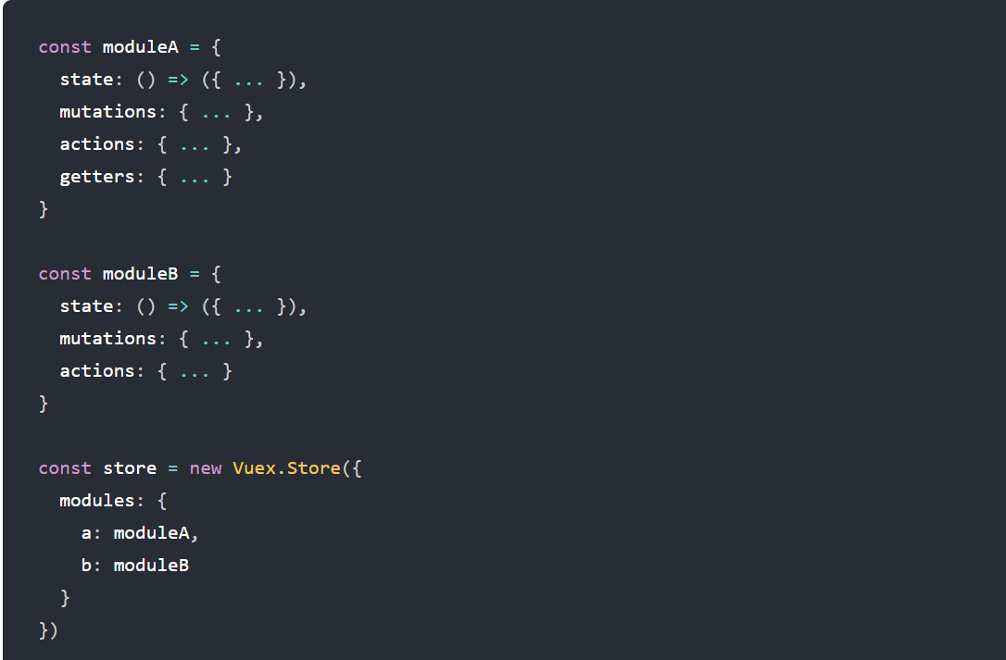
Vuex - Modules

Slide 66
Vue Localization
Localization is process of adopting the software to support multiple languages or translations.
To localize a Vue application we need ‘vue-i18n’ library
Npm install --save vue-i18n

Slide 67
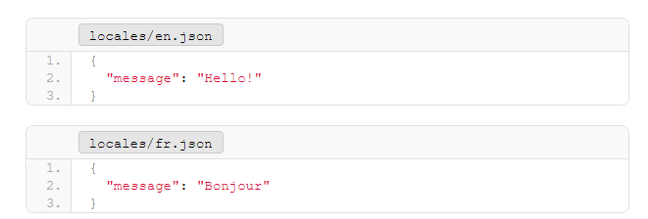
Vue Localization
We need to have src/locales folder in which we add our JSON files.

Slide 68
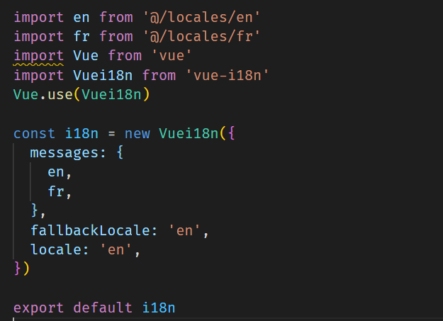
Vue Localization - setup

Slide 69
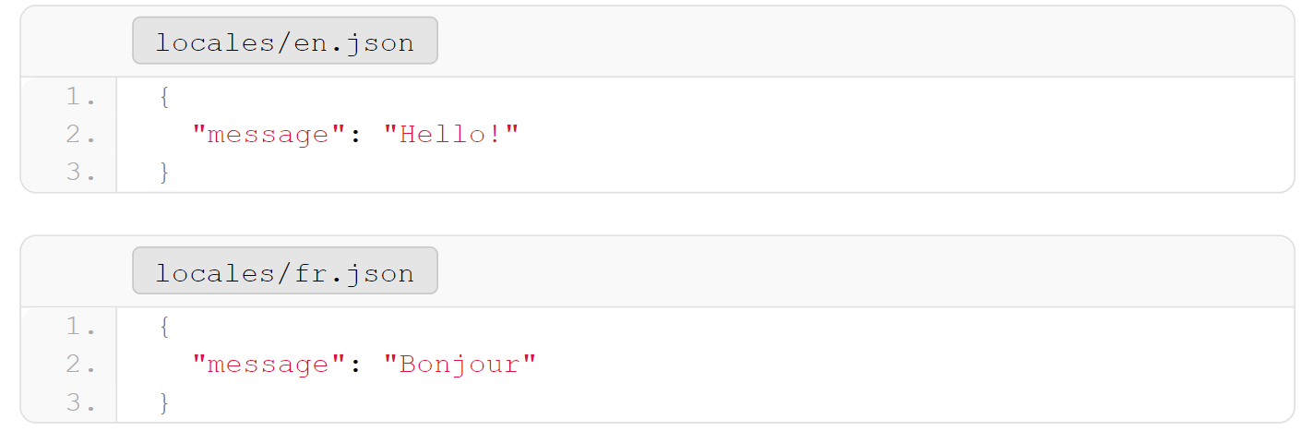
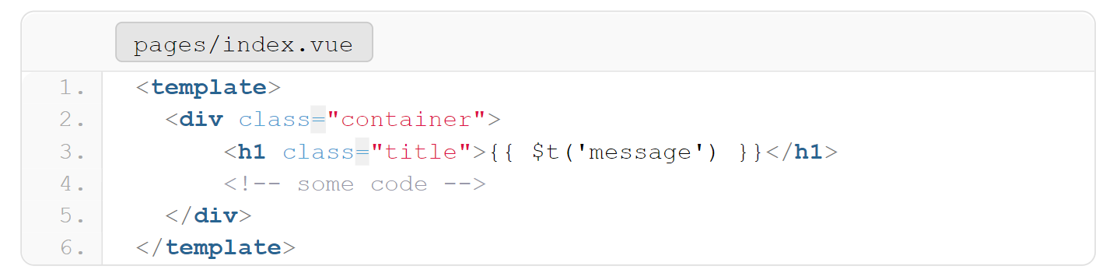
Using the locale strings in Components

Slide 70
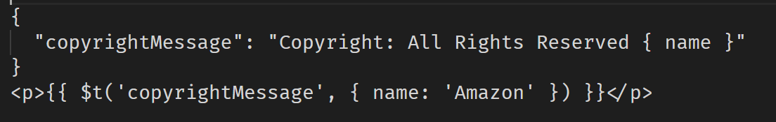
Named Formatting
There are instances where not every word would need to be translated, such as proper nouns (first or family names, places), URLs, etc. To avoid duplicating them all in every locale file, we can apply the name-formatting technique.

Slide 71
Building locale switcher
Vue-i18n will inject the property $i18n we can access that using
this.$i18n in JavaScript or directly $i18n on our <template>
$i18n.locale -> Gives the currently selected locale

Slide 72
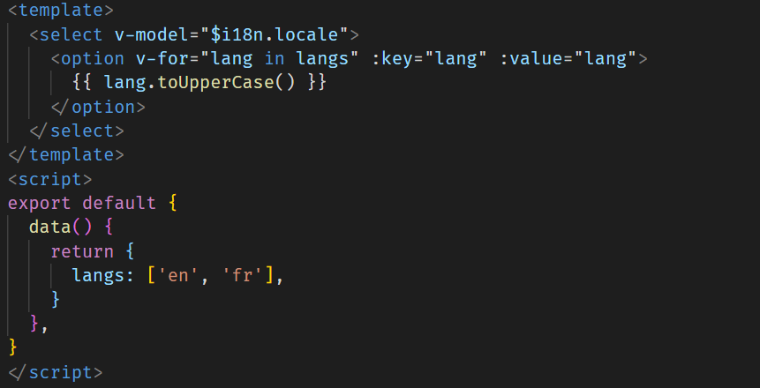
Building locale switcher

Slide 73
Named Formatting
There are instances where not every word would need to be translated, such as proper nouns (first or family names, places), URLs, etc. To avoid duplicating them all in every locale file, we can apply the name-formatting technique.

Slide 74
Pluralization
It is oftentimes difficult to predict quantity without actual data. To achieve Pluralization, we can pass the quantity value, and the package will send the appropriate translation.
We have to use $tc() method

Slide 75
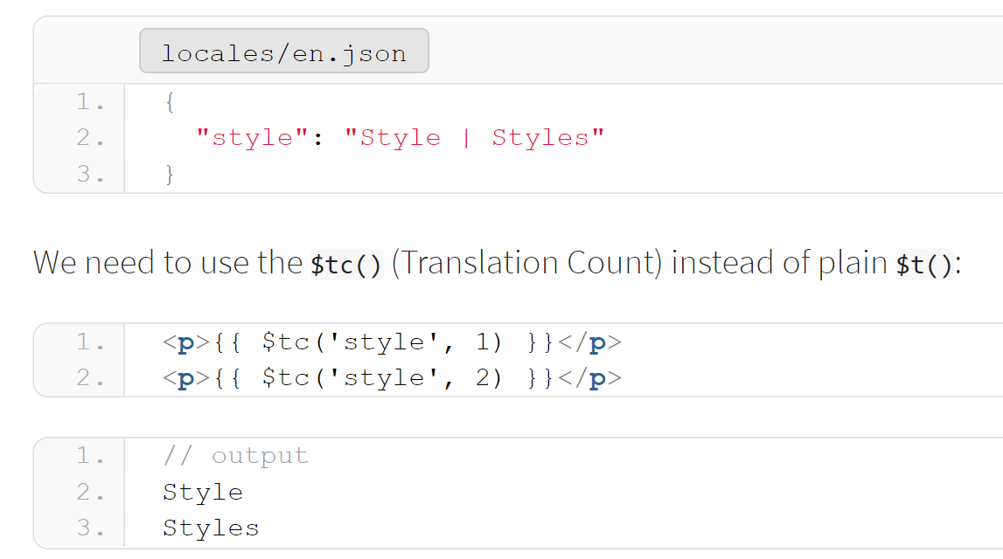
Pluralization

Slide 76
Number localization
Different languages and regions represent numbers in different ways.
Currency
Date-time
We have to pass numberFormats object to the vue-i18n instance where we can define all our number formats.
We use $n() method

Slide 77
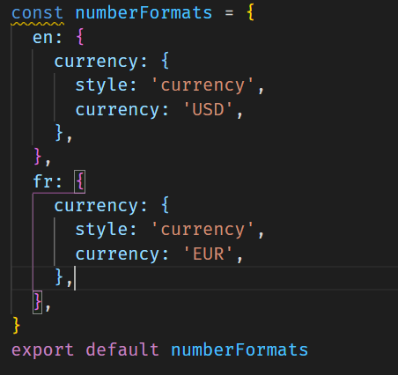

Number localization - Currency

Slide 78
Date localization
Different languages and regions represent date and time in different ways.
We have to pass dateTimeFormats object to the vue-i18n instance where we can define all our number formats.
We use $d() method

Slide 79
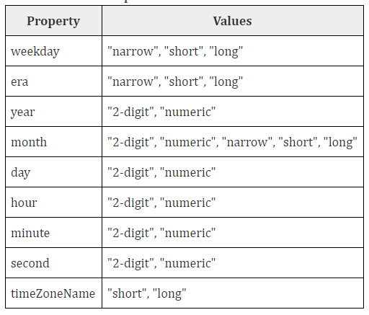
Date localization

Slide 80
Unit Testing
UNIT TESTING is a type of software testing where individual units or components of a software are tested. The purpose is to validate that each unit of the software code performs as expected.
Testing is done during the development (coding phase) of an application by the developers.

Slide 81
Purpose of writing Unit Tests
Unit test is written to verify expected behavior
It avoids breaking existing functionalities.
Unit tests act as documentation
Improves Confidence of developers
Notes:
So what is the purpose of writing unit tests?
Remember unit tests are not written to find bugs
If you make some changes which breaks existing functionality, your unit tests break, you can easily find out by examining the failed unit tests without manually testing all the features
In large apps it would be hard to figure out what the component does by just going through it, but a good unit test suite will help in understanding the functionality easily
When developers don’t have to worry about their changes breaking existing features, they’ll have more confidence in coding

Slide 82
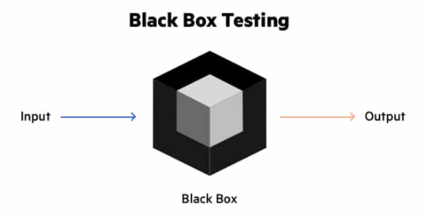
Knowing What to Test
Black Box Testing is a software testing method in which the functionalities of software applications are tested without having knowledge of internal code structure. We only test for the output rather the internal implementation

Slide 83
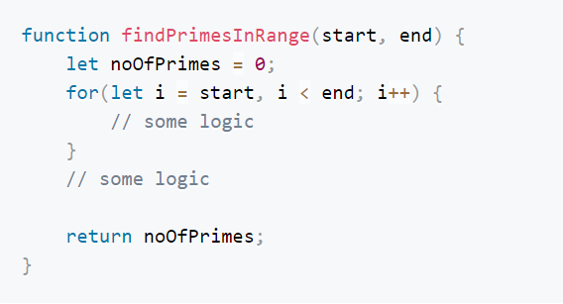
How to approach Unit Testing in Vue
We test using the concept of a component contract ( a.k.a Blackbox testing )
Notes:
A contract is like an agreement, something like you provide me this input and I’ll provide you this output
You are only interested in output and not the way in which the output is arrived.
Here is a simple function which returns the prime numbers in a given range, we can write different logics to arrive at the solution
To test this function, you should see only the input and output and a black box covering the implementation.
In this way, we don’t test any implementation details so developers will have more freedom to refactor without breaking the test

Slide 84
Installing Packages
Vue-test-utils: Vue Test Utils is the official unit testing utility library for Vue.js. This library gives us Vue specific helper functions.
Jest: JavaScript Testing Framework that gives us useful generic built-in functions such as assertions, matchers etc.
npm install --save-dev jest @vue/test-utils
Additional Packages: babel-jest, vue-jest@4.0.0, jest-transform-stub, axios-mock-adapter, @babel/core, @babel/preset-env
VS-Code extensions: Jest, Jest Runner

Slide 85


How does a Unit Test looks like?
Notes:
Here is a simple add function which takes two numbers as input and returns the sum
To test this
First we import our test subject, i.e. our add function
We write a meaningful description as to what we are testing
We pass two numbers to our add function, in this case 3 and 4 and expect the output 7

Slide 86


How a Unit Test looks like?
Notes:
When we run this test, we see that our test pass successfully

Slide 87

What is code Coverage?
Notes:
So what exacly is this code coverage? We got 100% coverage in our test application, does it mean it is fully tested and bug free?
Lets assume our small application is ready for production and we pass it to QA
Will the QA test for 3 and 4? Never, their test case would be something like this and you’ll get a big list of bug reports.

Slide 88
Code Coverage Gotchas
Coverage just says that x % of lines in test document is covered in your unit test scripts.
A 100% coverage doesn’t mean it’s 100% bug free

Slide 89
How to approach Unit Testing in Vue
Possible Inputs: props, store, user actions
Possible Outputs: state, action ( function call etc.), UI Change

Slide 90
Vue test utils
mount() -> Mount method renders the entire component all with all of its child and all the nested components.
shallowMount() -> shallowMount method only renders the component and its 1st level child component only

Slide 91

Vue test utils
mount() ->

Slide 92

Vue test utils
shallowMount() ->

Slide 93
Things to Note
Test have to be independent of each other
Use local Vue instance mount your test components
Never Make API or Web Service calls in Unit Tests

Slide 94
Unit Test terms
Mocks: A mock is concerned with create a fake object/item which has almost all the properties or methods like the real one.
Stub: Stub is like mock, but can only have what is required instead of the whole object
Spy: A Spy is a object that generally wraps your original object or your fake object and give out some useful methods where you can access the behavior such as if the spy was called, how many times, etc

