Slide 1
TRANSFORMERS
Team Members:
Preet Raval
Yana Batsuk
Jack Helmer
Dany Babikerali
Carlota Najera Alvarez

Slide 2
Project Description
Project Overview
Content (high-level):
Purpose: Centralized inventory and packing slip management system for clients and engineering teams.
Frontend: HTML, CSS → Next JS (as needed)
Backend: Python (FastAPI), PostgreSQL
Deployment: Docker Containers
Core Deliverables:
Password-protected links
Audit logs for upload/edit/access events
Role-based access (client, engineer, manager)
Client Side:
Order Submission Portal
Auto-generate tracking links
Engineering Team:
Pack Slip Repository
Incoming Inventory Tracker
Stretch Goals (if time permits):
Shipment Status Dashboard
Low-Stock & Reorder Alert
Barcode Scanning & Tagging

Slide 3
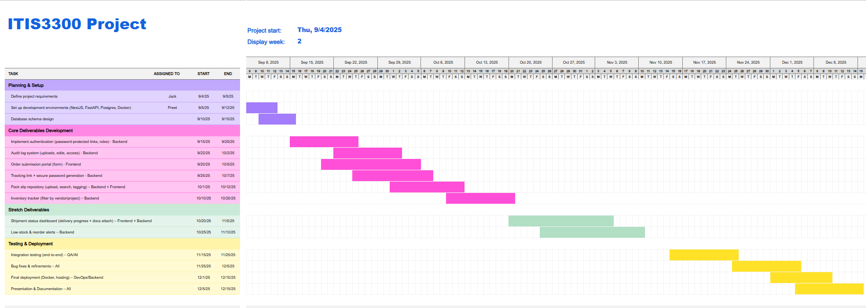
GANTT CHART

Slide 4
Risk Management
Top 3 Risks & Mitigation
Scope Creep & Feature Overload
Monitor in Trello weekly; prioritize core features.
Push stretch goals to final sprint if time allows.
Integration & System Reliability Issues
Monitor API connections and database queries.
Develop mock APIs for frontend testing.
Team Coordination & Time Constraints
Weekly stand-ups; clear task assignments.
Reallocate tasks if a member falls behind; simplify non-essential features.

Slide 5
Team Member Roles & Responsibilities
Member | Role & Responsibilities | % Contribution
Preet Raval | Docker & Deployment, Backend (FastAPI + Postgres), Project Management | 20%
Yana Batsuk | Frontend Development (HTML, CSS, NextJS), UX/UI Design, Testing | 20%
Jack Helmer | Documentation, Frontend Support, QA & Testing | 20%
Dany Babikerali | Backend Programming, Debugging, API Integration | 20%
Carlota Najera Alvarez | Database Management, Security & Access Features, Stretch Features | 20%

Slide 6
Next Steps / Deliverables
Complete detailed design & API endpoints (Week 2-3)
Start development for core features (Week 4-6)
Integration & Testing (Week 6-8)
Stretch features (Week 7-9)
Deployment & final review (Week 9-10)

