Slide 1
FULL-STACK PROJECT
Student Management
System (SMS)
A Secure, Scalable & Cloud-Deployed Web Platform with Real-Time Analytics
Modern Architecture
• Node.js, Express 5 & MySQL
• Cloud TiDB & Render CI/CD
Production Security
• Bcrypt + Rate Limiting Shield
• Role-Based Access Control
Universal Interface
• Glassmorphism Design Tokens
• 100% PC & Android Responsive

Slide 2
EXECUTIVE SUMMARY
Introduction & Project Vision
What is the Project?
• An automated, cloud-based platform designed to streamline student administration.
• Replaces slow manual paper registers and single-PC legacy desktop tools.
• Equips educational institutions with a high-performance, real-time web portal.
• Provides seamless student enrollment, course breakdown, and teacher assignments.
Core Value Proposition
• Universal Access: Manage records from any browser, laptop, or mobile phone worldwide.
• High Data Accuracy: Enforces age bounds, course whitelists, and unique emails.
• Zero Server Cost: Powered by modern serverless database and free-tier cloud hosting.
• Bank-Grade Security: Passwords protected by cryptographic Bcrypt hashes.

Slide 3
COMPARISON
Existing System vs. Proposed Platform
❌ Legacy / Traditional Systems
• Paper & Excel Files: Prone to accidental loss, overwriting, and corruption.
• Single-Device Lock: Desktop software is inaccessible outside the office.
• Zero Access Control: Anyone with file access can view or modify records.
• Slow Searches: Finding a single student takes significant manual searching.
• No Mobile UX: Unreadable on modern smartphones and touch screens.
✅ Proposed Modern SMS Platform
• Cloud Database: Real-time synchronization across all users on TiDB Cloud.
• Multi-Role Access: Distinct Owner vs. Teacher roles gated with invite codes.
• Instant Live Search: Filter by ID, name, or course in milliseconds.
• Batch CSV Tools: 1-Click Roster Export and automated Bulk CSV Upload.
• Responsive Touch UI: Fluid interface optimized for PC and Android phones.

Slide 4
SYSTEM SPECIFICATIONS
Comprehensive Technology Stack
Frontend Layer
• Semantic HTML5 Markup
• Vanilla CSS3 Design System
• Glassmorphism Backdrop Blur
• Vanilla JavaScript (ES6+)
• SweetAlert2 Modal Popups
• FontAwesome 6.4 Icon Library
• Outfit Google Font Typography
Backend & Security
• Node.js Runtime Engine
• Express.js 5.x Web Framework
• Helmet (HTTP Header Shield)
• Express-Rate-Limit (DDoS Guard)
• Express-Session (24h Cookie)
• Multer (5MB Image File Filter)
• Bcrypt (10 Salt Rounds Hash)
• Sanitize-HTML (XSS Defense)
Database & Cloud
• TiDB Cloud Serverless (MySQL)
• MySQL2 Pool & TLS Encryption
• Automated Schema Migration
• Render.com Web Service Hosting
• GitHub Desktop Version Control
• Continuous Deployment (CI/CD)
• 100% Free Hosting Architecture

Slide 5
ARCHITECTURE
3-Tier System Architecture
Tier 1: Presentation Layer
• Client Devices: PCs, Android, iOS.
• Technologies: HTML5, CSS3, ES6 JS.
• Interactive Components: Live Search, Modal Popups, CSV Download.
• Protocol: Asynchronous HTTPS REST API requests via Fetch.
Tier 2: Application Layer
• Server Framework: Node.js & Express.
• Reverse Proxy: Render TLS termination.
• Security: Rate Limiter, XSS Sanitizer.
• Business Logic: Age validation, Course whitelisting, Photo file handling, Session management.
Tier 3: Data Storage Layer
• Database Engine: TiDB Cloud (MySQL).
• Tables: `teachers`, `students`, `settings`.
• File Storage: `/public/uploads/` directory.
• Security: Encrypted TLSv1.2 connection with parameterized SQL.

Slide 6
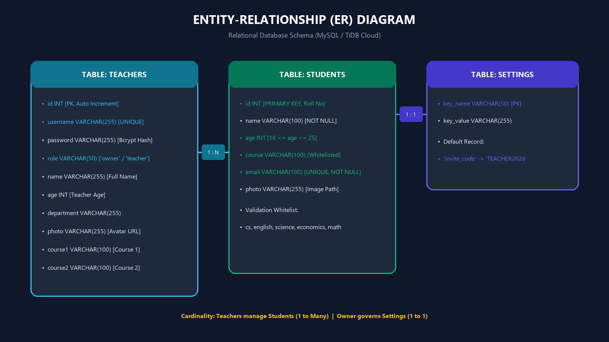
DATABASE DESIGN
Entity-Relationship (ER) Diagram
Database Architecture
• TEACHERS Table: Stores login accounts, hashed passwords, roles (`owner`/`teacher`), and profile bios.
• STUDENTS Table: Primary key is explicit Roll ID; enforces unique email and age bounds (16-25).
• SETTINGS Table: Stores system-wide configuration keys (e.g. `invite_code`).
• Cardinality: 1 Teacher oversees Many Students; 1 Owner manages Settings.

Slide 7
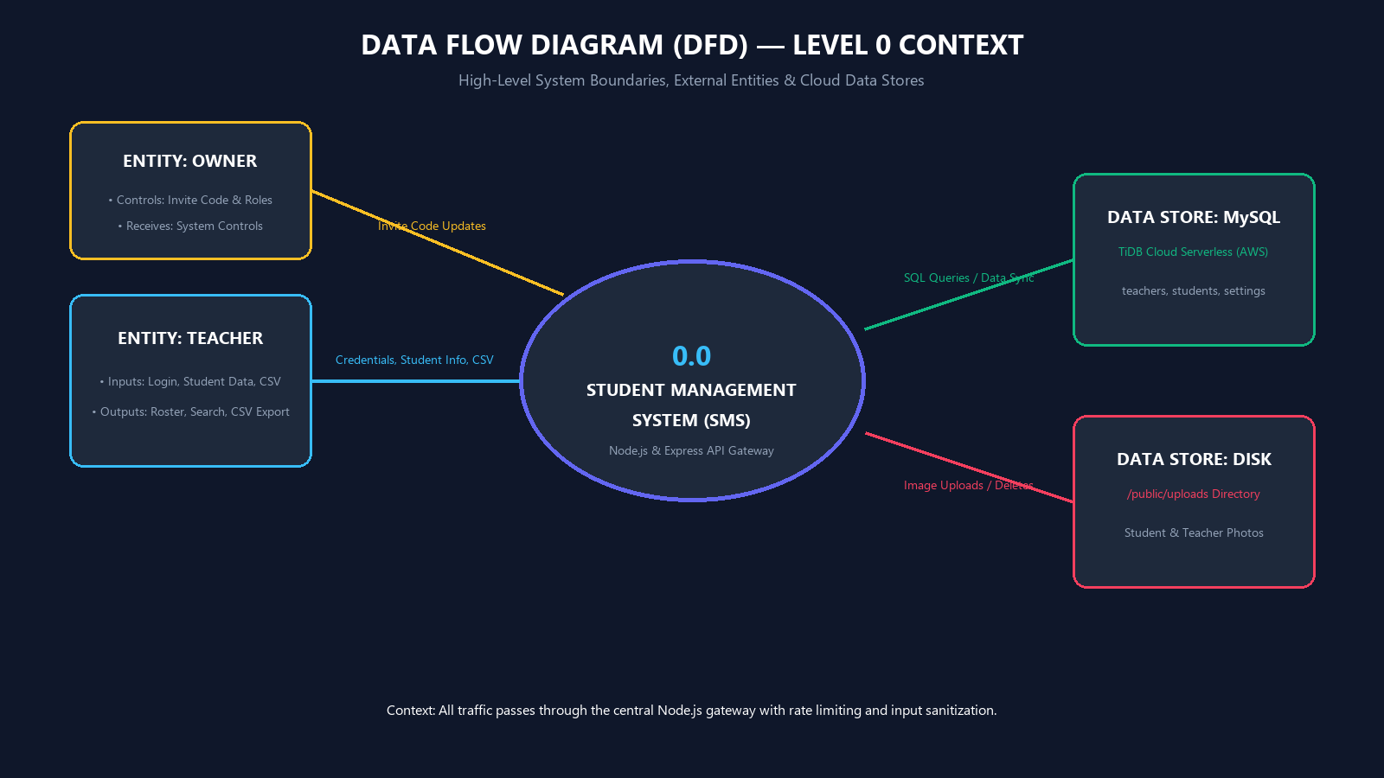
DATA FLOW
Data Flow Diagram — Level 0 (Context Diagram)
Context Boundaries
• Central Process (0.0): SMS Node.js/Express Web Gateway.
• External Entities: Teacher and Owner (Admin) actors.
• Teacher Inputs: Login credentials, Student records, CSV roster files, Avatar photos.
• Teacher Outputs: Auth cookies, Live roster, CSV exports.
• Data Stores: TiDB Cloud MySQL & Local `/public/uploads/` disk.

Slide 8
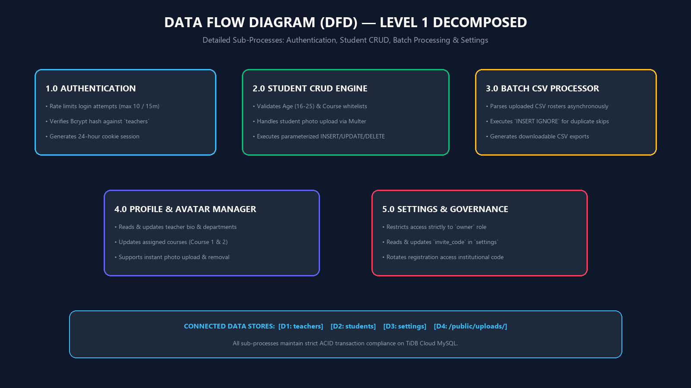
DATA FLOW
Data Flow Diagram — Level 1 (Sub-Processes)
Core Sub-Processes
• Process 1.0 (Auth): Rate-limited login verification & 24h session creation.
• Process 2.0 (Student CRUD): Age & course validation; database read/write.
• Process 3.0 (Batch CSV): Parses `.csv` files; runs `INSERT IGNORE`.
• Process 4.0 (Profile Manager): Updates teacher bio, courses & avatar.
• Process 5.0 (Governance): Owner-only invite code rotation.

Slide 9
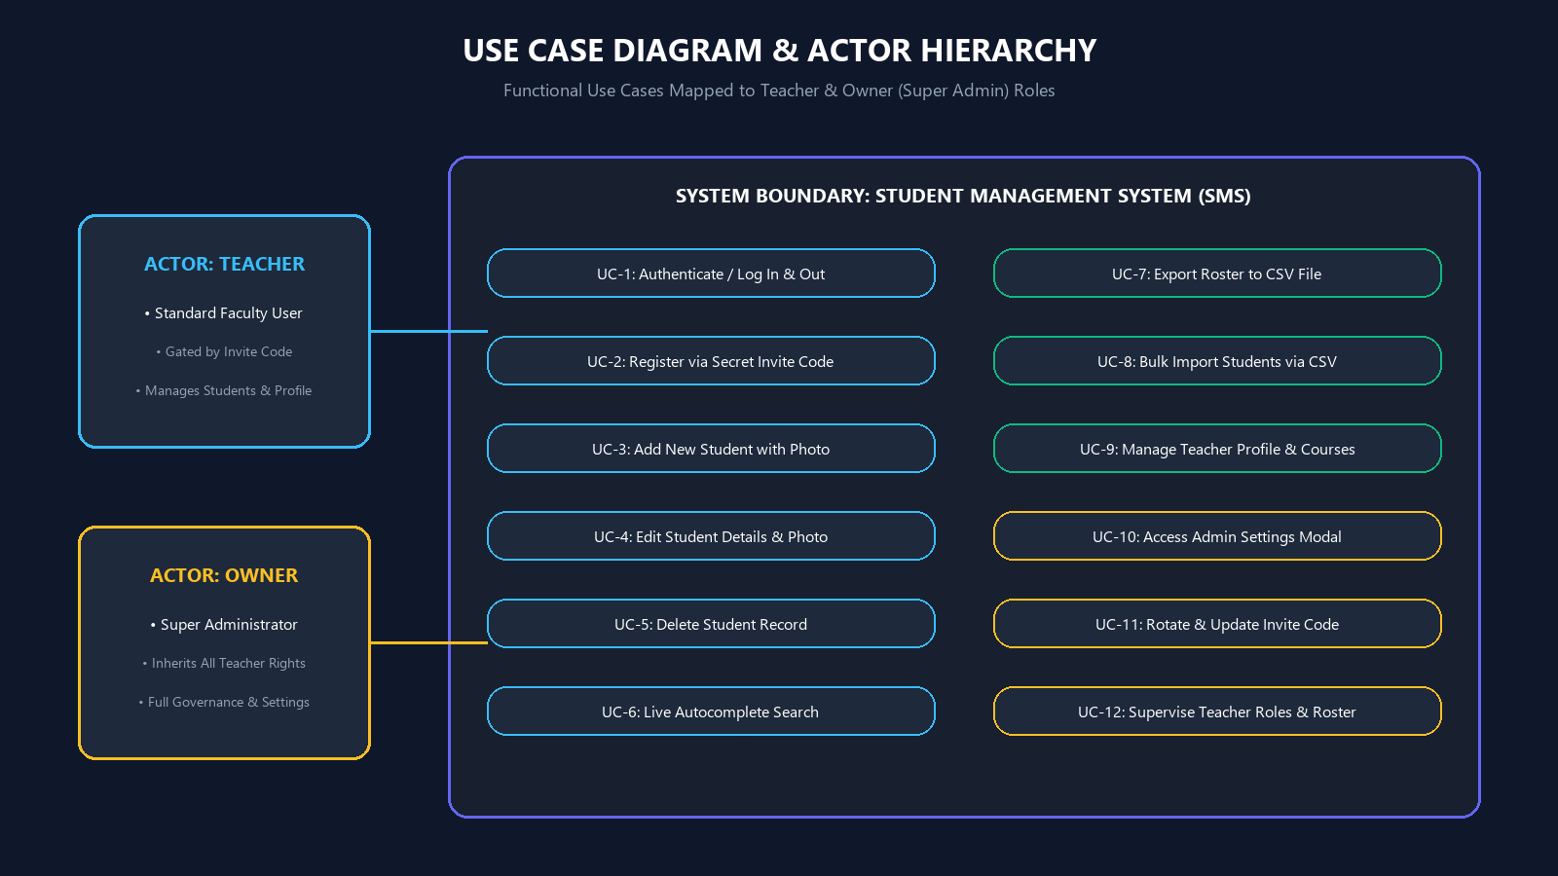
USE CASES
Use Case Diagram & Actor Permissions
Actor Hierarchy
• Teacher Actor (UC 1-9): Login, Signup with code, Add/Edit/Delete students, Live search, Batch CSV export/import, Edit profile.
• Owner Actor (UC 10-12): Inherits ALL teacher capabilities + Accesses Admin Settings modal, rotates invite code, and governs roles.
• Security Barrier: Role-based authorization middleware prevents unauthorized access.

Slide 10
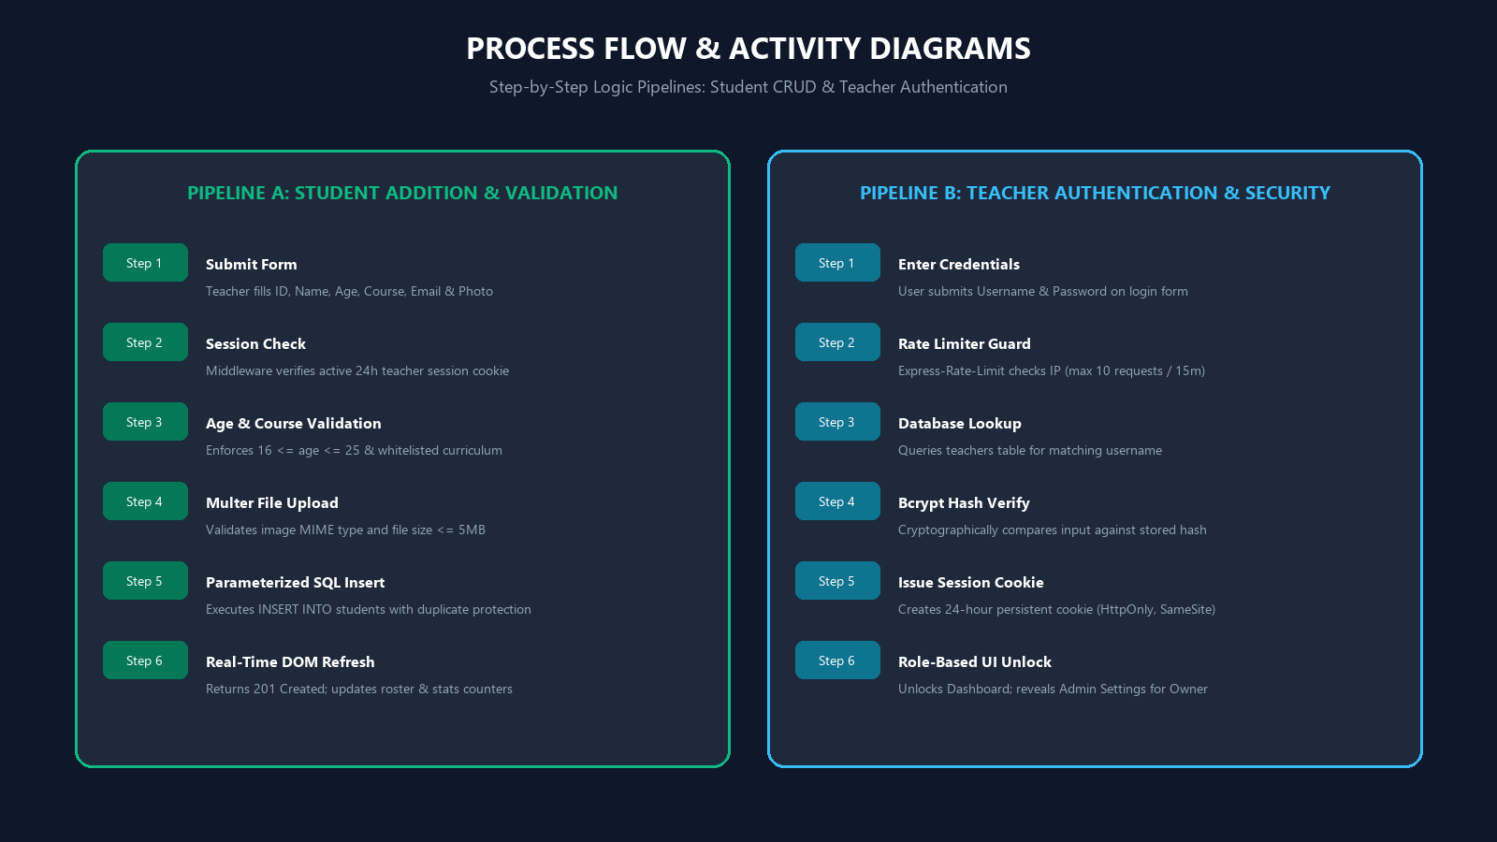
PROCESS FLOW
Process Flow & Activity Logic Pipelines
Execution Logic
• Pipeline A (Student Addition): Form Submit -> Session Check -> Age (16-25) & Course Whitelist -> Multer Image Upload -> Parameterized SQL Insert -> DOM Refresh.
• Pipeline B (Authentication): Enter Login -> Rate Limiter Guard -> Database Query -> Bcrypt Hash Verify -> Issue 24h Session -> Role UI Unlock.

Slide 11
SECURITY
Production Security Engineering
🛡️ Brute-Force & Rate Limiting
• Express-Rate-Limit restricts `/login` endpoint to 10 requests per 15 minutes per IP.
• Prevents credential stuffing and automated dictionary attacks.
🔒 Cryptographic Password Hashing
• Bcrypt algorithm with 10 salt rounds used for all teacher accounts.
• Unique password enforcement across all teachers prevents shared credentials.
🧼 XSS & SQL Injection Immunity
• Sanitize-HTML middleware strips all malicious script tags automatically.
• 100% Parameterized MySQL queries eliminate SQL Injection vulnerability.
📁 Secure File Upload Shield
• Multer restricts uploads strictly to image MIME types (`image/*`).
• Strict 5MB ceiling prevents disk exhaustion and denial-of-service.

Slide 12
USER EXPERIENCE
Universal Responsive Design (PC vs. Android)
💻 Desktop Experience (Widescreen)
• Dual-Panel Glassmorphism: 92vh height side-by-side layout.
• Left Panel: Real-time student roster, courses overview accordion, teacher directory.
• Right Panel: Profile trigger dropdown & Action Controls (Add, Update, Search, Delete).
• Floating Physics: Smooth keyframe mesh gradient background.
📱 Mobile Experience (Android & iOS)
• Vertical Stacking: Seamlessly converts to natural vertical scrolling cards.
• 4-Column Touch Grid: Compact Action Tabs that never wrap awkwardly.
• Swipeable Tables: `-webkit-overflow-scrolling: touch` allows smooth roster scrolling.
• No Auto-Zoom: Form inputs locked at 16px to prevent forced mobile browser zooming.

Slide 13
DEVOPS
Cloud Deployment & Continuous Delivery
1. Source Control
• GitHub repository tracking.
• GitHub Desktop integration for seamless push workflow.
• Clean `.gitignore` configuration preserving directory structures.
2. Database Cloud
• TiDB Cloud Serverless instance deployed on AWS.
• TLS-encrypted MySQL connection string.
• Automated table setup on connect (`initDatabase()`).
3. Web Service
• Render.com Node.js Web Service.
• Automated builds triggered on GitHub push.
• 100% Free architecture active 24/7.

Slide 14
FUTURE SCOPE
Future Enhancements Roadmap
Academic Feature Extensions
• 📅 Attendance Tracking Module: Daily check-in system with monthly attendance percentage calculations.
• 📊 GPA & Marksheet Generator: Automatic calculation of GPA with downloadable PDF report cards.
• 💳 Fee Payment Gateway: Stripe / Razorpay integration with automated fee receipts.
• 🔔 SMS & Email Alerts: Notifications for attendance deficits and exam schedules.
Technical & Architecture Upgrades
• ☁️ AWS S3 / Cloudinary: Offload image assets to high-speed global CDN buckets.
• 📱 Progressive Web App (PWA): Offline caching and installable home-screen mobile app.
• 🛡️ Two-Factor Auth (2FA): Authenticator app support for teachers and administrators.
• 📈 Interactive Analytics: Chart.js graphs showing grade distributions and enrollment trends.

Slide 15
Thank You!
Student Management System (SMS) — Ready for Demonstration & Q&A
Project Deliverables
• Production-ready Full-Stack Node.js & MySQL Web Application.
• High-Resolution ER, DFD, Use Case & Process Diagrams.
• Multi-Role Security, Rate Limiting & Input Sanitization.
• Universal Mobile & Desktop Responsive Design.
• 100% Free Live Cloud Deployment on Render & TiDB.
Live Project Resources
• Live Web Application:
• student-management-system-u2xc.onrender.com
•
• Default Admin Login:
• Username: teacher | Password: 12345
• Teacher Invite Code: TEACHER2026
•
• GitHub: preetx17/student-management-system

