Slide 1
FULL-STACK ACADEMIC PROJECT
Student Management
System (SMS)
Complete System Architecture & Technical Presentation Deck
Modern Tech Stack
• Node.js, Express & MySQL
• Cloud TiDB & Render CI/CD
Enterprise Security
• Bcrypt + Rate Limiter Shield
• Role-Based Access Control
Universal Interface
• Glassmorphism Design
• 100% Mobile & PC Responsive

Slide 2
EXECUTIVE SUMMARY
Project Vision & Core Strategic Objectives
What is the SMS Project?
• An automated, cloud-native web platform built for modern academic institutions.
• Replaces slow manual paper registers and single-PC desktop legacy software.
• Provides real-time centralized administration for student records and teacher profiles.
• Delivers instant automated analytics, CSV batch import/export, and live search.
Core Strategic Goals
• Universal Accessibility: Seamless access across desktop PCs, tablets, and smartphones.
• High Data Integrity: Strict database-level age bounds, whitelists, and unique constraints.
• Zero Software Maintenance: Powered by cloud serverless MySQL and free CI/CD web hosting.
• Institutional Governance: Multi-tenant protection with secret registration invite keys.

Slide 3
PROBLEM & SOLUTION
Legacy Systems vs. Modern SMS Web Platform
❌ Legacy Paper & Desktop Software
• File Corruption: Excel files and physical registers suffer permanent data loss.
• Device Locked: Single desktop software is completely inaccessible outside the office.
• Zero Access Control: Unrestricted file access exposes private student records.
• Tedious Lookup: Finding specific student details requires minutes of searching.
• Static UX: Incapable of rendering on modern mobile devices or tablets.
✅ Modern SMS Cloud Platform
• Real-Time Sync: Cloud TiDB database synchronizes changes instantly for all users.
• Multi-Role Security: Owner vs. Teacher privileges gated by cryptographic password hashing.
• Instant Autocomplete: Sub-millisecond filtering by student name, ID, or course.
• Batch Automation: 1-Click bulk CSV uploading and automated roster CSV exporting.
• Responsive Touch UI: Glassmorphism interface optimized for all screens.

Slide 4
TECHNOLOGY STACK
Complete Multi-Tier Technology Stack
Frontend UI Engine
• HTML5 & CSS3: Semantic markup styled with custom Glassmorphism design tokens.
• Vanilla JavaScript ES6+: Ultra-fast client-side execution with zero framework bloat.
• SweetAlert2: Beautiful animated modals for destructive confirm dialogs.
• FontAwesome 6.4: Vector icons for intuitive visual cues across the entire dashboard.
Backend & Cloud Persistence
• Node.js & Express 5: High-throughput event loop with REST API routing middleware.
• Bcrypt & Express-Session: Cryptographic password hashing and 24-hour cookie sessions.
• TiDB Cloud (MySQL): Serverless distributed SQL database hosted on AWS.
• Render.com CI/CD: Automated continuous deployment pipeline integrated with GitHub.

Slide 5
SYSTEM ARCHITECTURE
3-Tier System Architecture Layering
Tier 1: Presentation
• Client Browsers & Mobile Devices.
• Tech: HTML5, CSS3, ES6 JS.
• Features: Live Search, Dynamic Cards, CSV Export, Modal Dialogs.
• Protocol: Asynchronous JSON & FormData HTTP requests.
Tier 2: Application
• Node.js & Express 5 Server.
• Reverse Proxy: Render TLS Proxy.
• Features: Rate Limiting, Input Sanitization, Bcrypt Auth, Session Guard, Multer Storage.
• Logic: Age verification & Course whitelist enforcement.
Tier 3: Data Persistence
• Cloud SQL & Disk Storage.
• Engine: TiDB Cloud (MySQL).
• Tables: `teachers`, `students`, `settings`.
• Assets: `/public/uploads/` photo files.
• Security: TLS Encrypted SSL Connection.

Slide 6
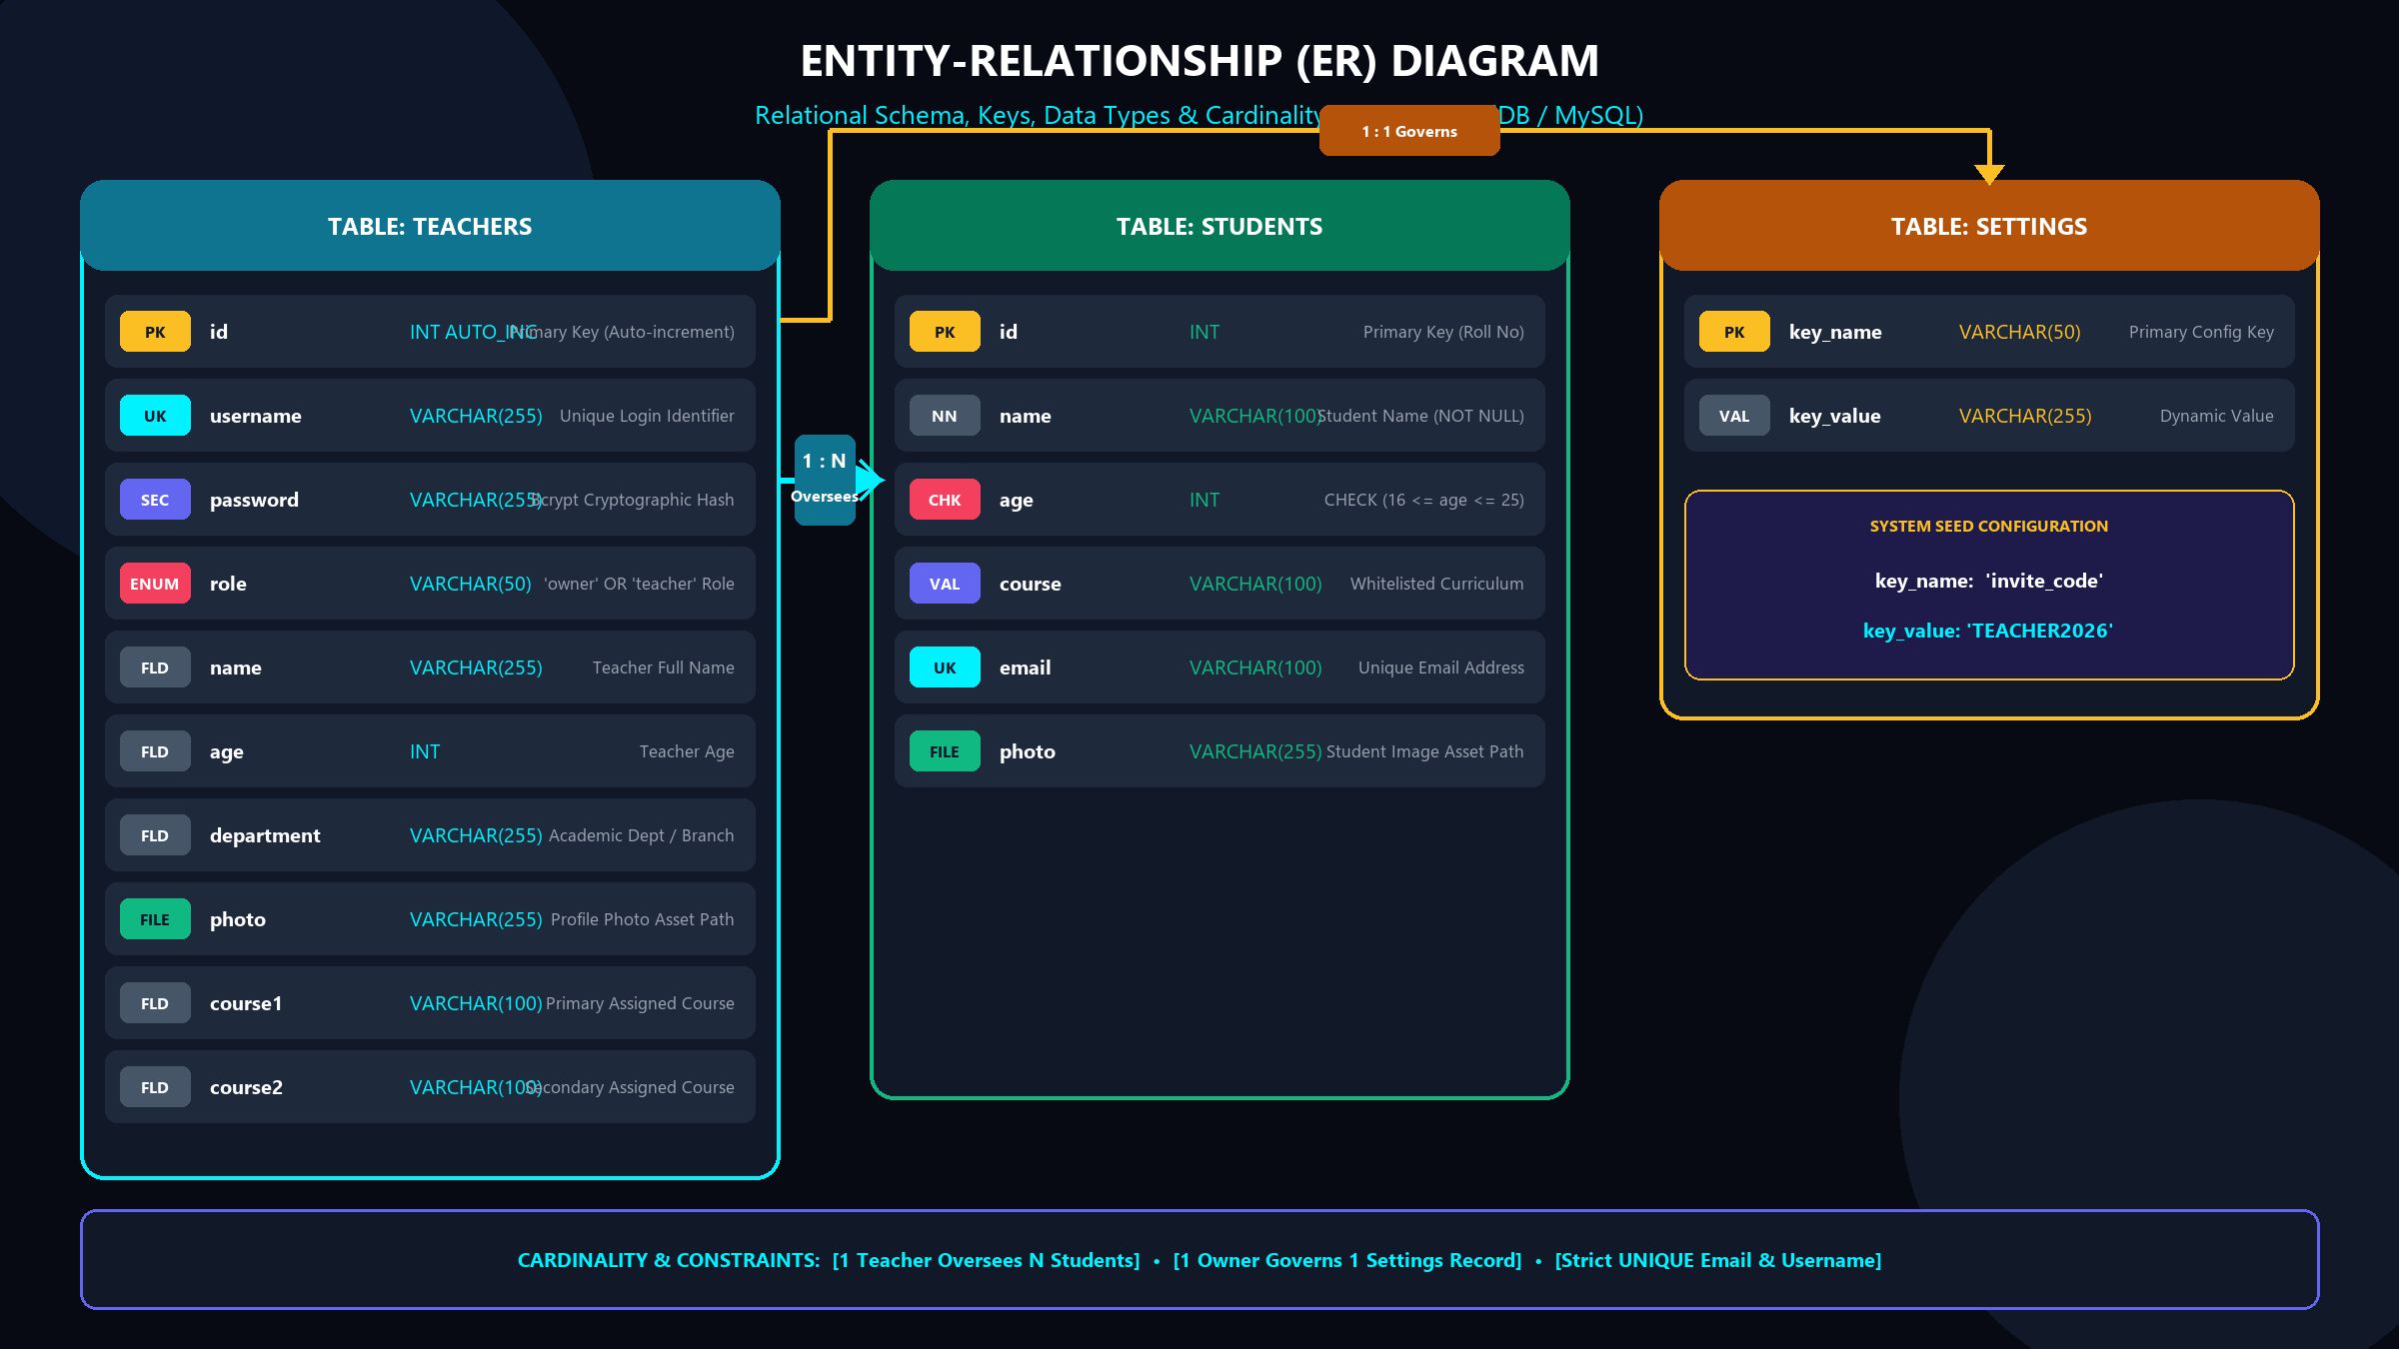
DATABASE DESIGN
Entity-Relationship (ER) Diagram — Full Schema Map

Slide 7
DATABASE DESIGN
Database Schema Deep-Dive: TEACHERS Table
Table Structure & Attributes
• `id`: INT AUTO_INCREMENT PRIMARY KEY (Unique teacher ID).
• `username`: VARCHAR(255) UNIQUE NOT NULL (Login ID).
• `password`: VARCHAR(255) NOT NULL (Bcrypt hash with 10 salt rounds).
• `role`: VARCHAR(50) DEFAULT 'teacher' ('owner' or 'teacher').
• `name`, `age`, `department`: Faculty biographical information.
Key Features & Constraints
• `photo`: File path string referencing custom uploaded avatar in `/public/uploads/`.
• `course1`, `course2`: Primary & secondary academic courses assigned to teacher.
• Authentication: `username` uniqueness prevents duplicate account creation.
• Security: Raw passwords are NEVER saved in plaintext; only Bcrypt hashes.

Slide 8
DATABASE DESIGN
Database Schema Deep-Dive: STUDENTS Table
Table Structure & Fields
• `id`: INT PRIMARY KEY (Institutional Roll Number).
• `name`: VARCHAR(100) NOT NULL (Student full legal name).
• `age`: INT CHECK (age >= 16 AND age <= 25) (Enforces valid student age range).
• `course`: VARCHAR(100) NOT NULL (Must match whitelisted department curriculum).
• `email`: VARCHAR(100) UNIQUE NOT NULL (Student contact email).
Integrity & Storage Rules
• `photo`: File path to uploaded student profile picture.
• Validation: Rejects out-of-range student ages on server and database level.
• Uniqueness: Duplicate student Roll IDs or Emails trigger SQL duplicate key errors.
• 1-to-N Relationship: Multiple students managed per active faculty teacher.

Slide 9
DATABASE DESIGN
Database Schema Deep-Dive: SETTINGS Table
System Configuration Store
• `key_name`: VARCHAR(50) PRIMARY KEY (System configuration parameter name).
• `key_value`: VARCHAR(255) NOT NULL (Dynamic setting value string).
• Key Setting: `key_name = 'invite_code'`, `key_value = 'TEACHER2026'`.
• Default Seed: Auto-created during self-healing database initialization.
Governance & Access Rules
• Role Restriction: Modification strictly restricted to `owner` (Super Admin) role.
• Registration Gate: New teachers MUST supply active `invite_code` to register.
• Dynamic Rotation: Owner can update the invite code anytime via Admin Settings modal.
• 1-to-1 Control: Single system settings record governs institutional security.

Slide 10
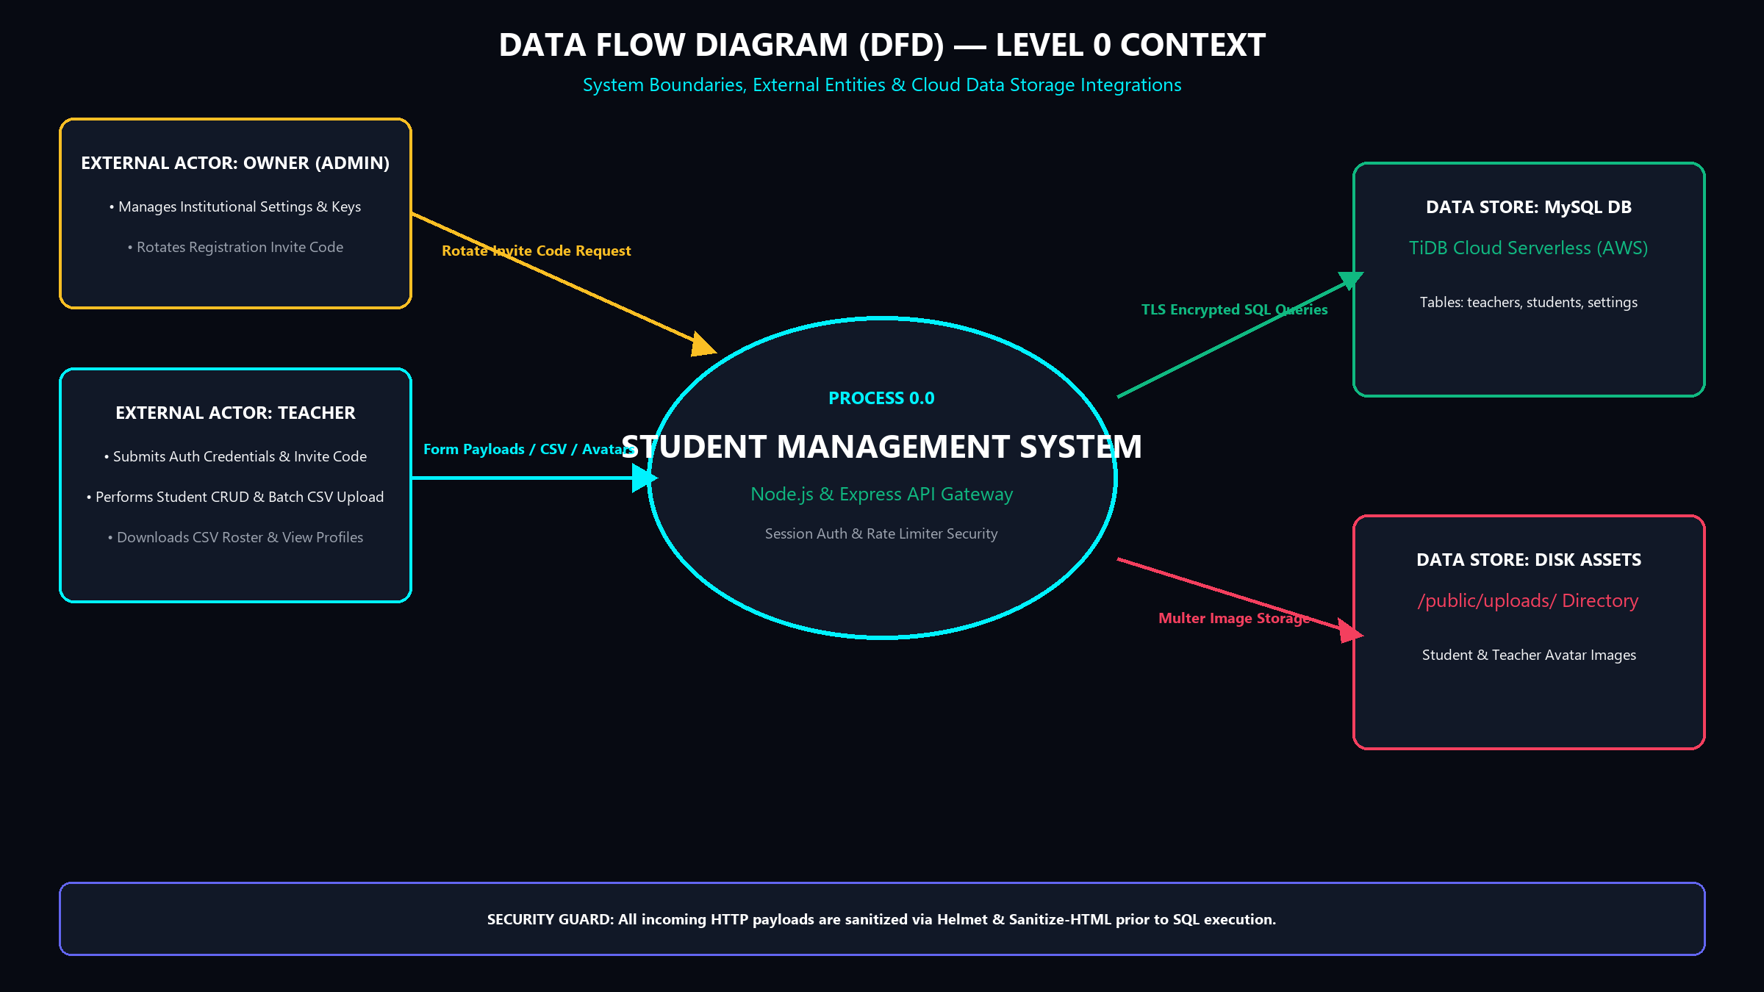
DATA FLOW ANALYSIS
Data Flow Diagram — Level 0 Context Diagram

Slide 11
DATA FLOW ANALYSIS
DFD Level 0: System Boundaries & Actors
Central Process (Process 0.0)
• Node.js & Express API Engine orchestrating all incoming client requests.
• Acts as security barrier enforcing Session Authentication & Rate Limiting.
• Receives HTTP REST payloads (JSON & Multipart FormData).
• Dispatches sanitized SQL transactions over TLS to Cloud TiDB.
External Actors & Entities
• Teacher Actor: Submits login/signup requests, CRUD student forms, CSV files & avatars.
• Owner Actor: Manages system settings, rotates invite codes, supervises teacher roles.
• MySQL TiDB Store: Persistent cloud database storing relational records.
• Disk Store: Server filesystem `/public/uploads/` storing avatar image assets.

Slide 12
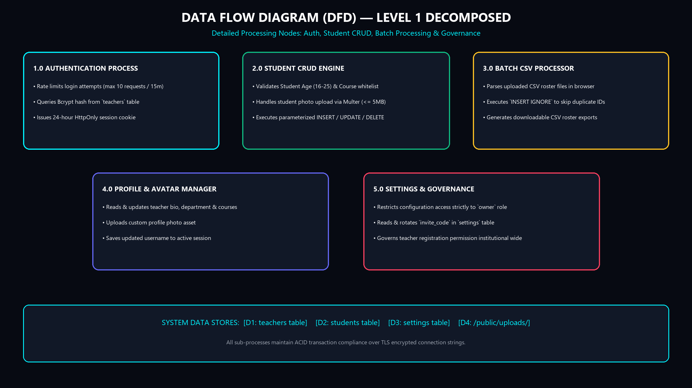
DATA FLOW ANALYSIS
Data Flow Diagram — Level 1 Decomposed Process Map

Slide 13
DATA FLOW ANALYSIS
DFD Level 1: Sub-Processes & Data Flow Nodes
Core Sub-Processes 1.0 to 3.0
• 1.0 Authentication: Validates credentials, checks Bcrypt hash, issues 24h session cookie.
• 2.0 Student CRUD Engine: Enforces age (16-25) & course whitelist; handles Multer photo uploads.
• 3.0 Batch CSV Processor: Parses CSV client-side; runs `INSERT IGNORE` for duplicate safety.
Sub-Processes 4.0 & 5.0
• 4.0 Profile & Avatar Manager: Updates teacher bio, assigned courses, and photo asset.
• 5.0 Settings & Governance: Restricts invite code updates strictly to `owner` role.
• Data Store Security: All database flows utilize parameterized queries over TLS.

Slide 14
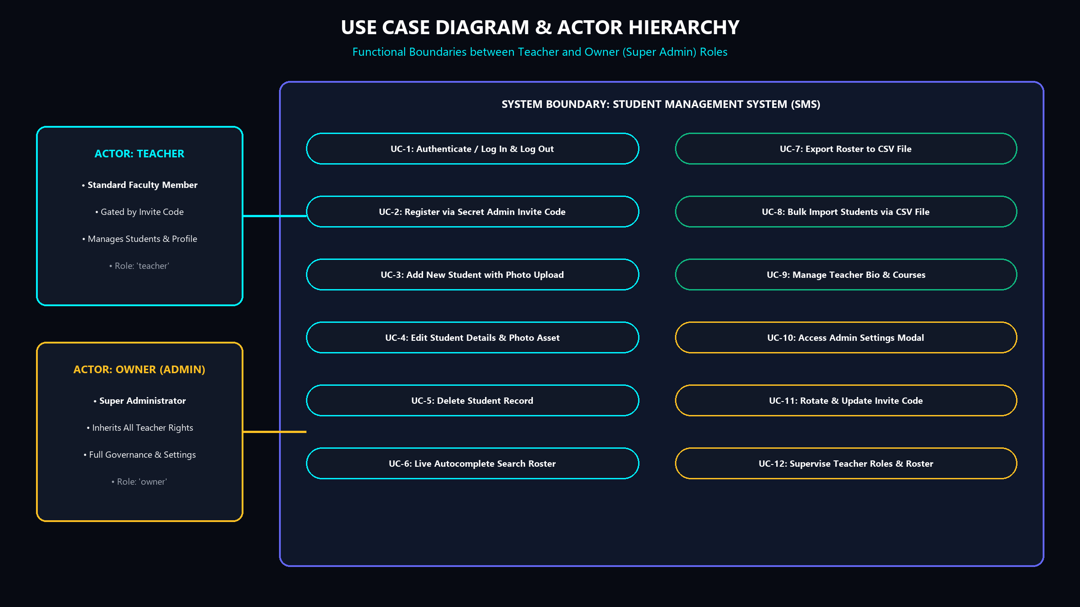
FUNCTIONAL REQUIREMENTS
Use Case Diagram & Functional Matrix

Slide 15
FUNCTIONAL REQUIREMENTS
Functional Matrix: Teacher Role Capabilities
Authentication & Roster Use Cases
• UC-1: Authenticate / Log In & Log Out securely.
• UC-2: Register new account via secret admin invite code.
• UC-3: Add New Student with custom photo asset.
• UC-4: Edit existing student information & update photo.
• UC-5: Delete student record with instant DOM cleanup.
Search & Roster Tools Use Cases
• UC-6: Live Autocomplete search across student names, IDs & courses.
• UC-7: Export student roster to structured `.csv` file.
• UC-8: Bulk Import multiple students via CSV file upload.
• UC-9: Manage teacher personal profile bio and assigned courses.

Slide 16
FUNCTIONAL REQUIREMENTS
Functional Matrix: Owner (Super Admin) Governance
Administrative Governance Use Cases
• UC-10: Access Admin Settings Modal with secret privilege controls.
• UC-11: Rotate & Update institutional registration `invite_code`.
• UC-12: Supervise Teacher Accounts & view institutional roster.
• Full Inheritance: Owner inherits ALL standard Teacher capabilities.
Security & Privilege Guards
• Server-Side Authorization: Middleware verifies session role === 'owner'.
• Registration Protection: Disabling or changing invite code blocks unauthorized signups.
• Single Super Admin: Default seed automatically creates owner account on boot.
• Audit Trail: Administrative setting changes are persisted to Cloud TiDB.

Slide 17
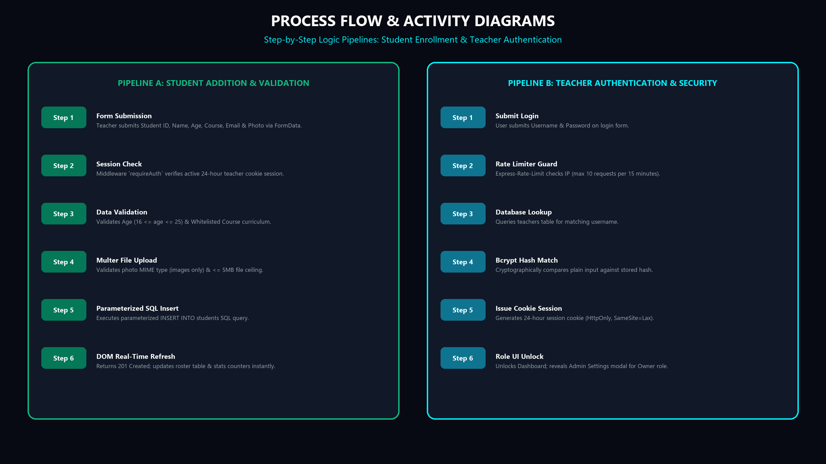
LOGIC & WORKFLOWS
Process Flow & Step-by-Step Activity Pipelines

Slide 18
LOGIC & WORKFLOWS
Process Logic: Pipeline A (Student Enrollment)
Execution Steps 1 to 3
• Step 1: Form Submit $\rightarrow$ Teacher inputs student ID, name, age, course, email & photo.
• Step 2: Session Check $\rightarrow$ Middleware `requireAuth` verifies active 24h session cookie.
• Step 3: Validation $\rightarrow$ Verifies Age (16 <= age <= 25) & Whitelisted Course curriculum.
Execution Steps 4 to 6
• Step 4: Multer Upload $\rightarrow$ Filters photo MIME type (images only) & <= 5MB file limit.
• Step 5: SQL Insert $\rightarrow$ Executes parameterized `INSERT INTO students` query.
• Step 6: UI Refresh $\rightarrow$ Returns 201 Created; updates table DOM & stats counters instantly.

Slide 19
LOGIC & WORKFLOWS
Process Logic: Pipeline B (Teacher Authentication)
Execution Steps 1 to 3
• Step 1: Submit Credentials $\rightarrow$ User inputs username & password on login form.
• Step 2: Rate Limiter Guard $\rightarrow$ `express-rate-limit` enforces max 10 requests / 15 mins.
• Step 3: Database Lookup $\rightarrow$ Queries `teachers` table for matching username.
Execution Steps 4 to 6
• Step 4: Bcrypt Hash Match $\rightarrow$ Cryptographically verifies input password against stored hash.
• Step 5: Session Cookie $\rightarrow$ Generates 24-hour HttpOnly session cookie (`SameSite=Lax`).
• Step 6: Dashboard Unlock $\rightarrow$ Redirects to dashboard; unlocks Owner Admin modal if role === 'owner'.

Slide 20
SECURITY & COMPLIANCE
Security Hardening: Cryptography & Access Control
Bcrypt Cryptographic Hashing
• 10 Salt Rounds: Enforces high compute cost protecting against rainbow table attacks.
• Zero Plaintext Storage: Raw user passwords are NEVER written to disk or logs.
• One-Way Function: Passwords cannot be reverse engineered even if database is leaked.
• Automated Password Migration: `migrate_passwords.js` upgrades legacy hashes seamlessly.
Session & Rate Limiting Guards
• HttpOnly Session Cookies: Prevents JavaScript XSS cookie theft (`httpOnly: true`).
• Brute-Force Shield: `express-rate-limit` throttles login attempts (10 req / 15 min).
• Invite Code Access Gate: New teachers require secret institutional invite key.
• Role-Based Middlewares: `requireOwner` enforces Super Admin privilege barriers.

Slide 21
SECURITY & COMPLIANCE
Security Hardening: SQL Injection & XSS Defense
Parameterized SQL Query Protection
• 100% Parameterized Statements: Uses `db.execute('SELECT * FROM students WHERE id = ?', [id])`.
• Zero String Concatenation: Input parameters are sent out-of-band to MySQL query engine.
• Eliminates SQLi Risks: Blocks payload injections like `' OR '1'='1` automatically.
• Strict Type Enforcement: Integers and strings are cast before binding to SQL.
XSS & Header Defense Controls
• Helmet HTTP Headers: Configures secure CSP, HSTS, X-Frame-Options, and nosniff headers.
• HTML Input Sanitization: Strips executable script tags using `sanitize-html` middleware.
• Multer Image Filtering: Enforces image MIME verification and 5MB maximum file size.
• SameSite Cookie Policies: Protects against Cross-Site Request Forgery (CSRF) attacks.

Slide 22
API ARCHITECTURE
RESTful API Endpoints Specification
Authentication & Settings Routes
• `POST /api/login`: Authenticate teacher credentials & set 24h session cookie.
• `POST /api/register`: Register new account with verified `invite_code`.
• `GET /api/check-auth`: Returns active user session identity & role.
• `GET /api/settings`: Returns institutional settings (Owner only).
• `POST /api/settings`: Rotates registration invite code (Owner only).
Student Management Routes
• `GET /api/students`: Fetch all student records or filter by search query.
• `POST /api/students`: Create new student with age/course validation & photo.
• `PUT /api/students/:id`: Update existing student details & image asset.
• `DELETE /api/students/:id`: Remove student record with cascading asset cleanup.
• `POST /api/students/batch`: Bulk import array of student records.

Slide 23
USER INTERFACE
Frontend Design System & Glassmorphism UI
Visual Aesthetics & Styling Tokens
• Glassmorphism Cards: Translucent frosted glass effect (`backdrop-filter: blur(24px)`).
• Aurora Mesh Background: Keyframe animated multi-color ambient radial gradients.
• High-Contrast Palette: Deep Slate (`#070a12`), Electric Cyan (`#00f2fe`), Indigo (`#6366f1`).
• Google Outfit Font: Premium geometric typography engineered for high legibility.
Micro-Interactions & Responsiveness
• Live Autocomplete Search: Instant client-side filtering without reloading the page.
• Interactive Stats Badges: Real-time calculation of total students, courses & teachers.
• SweetAlert2 Confirmations: Smooth modal dialogs for destructive actions.
• Mobile First Grid: Fluid CSS Grid scaling from smartphones up to 4K monitors.

Slide 24
DEPLOYMENT & HOSTING
Cloud Deployment & Continuous Integration
TiDB Cloud Database Infrastructure
• Serverless MySQL Architecture: Managed distributed SQL cluster hosted on AWS.
• Auto-Scaling Storage: Handles millions of queries with zero manual DBA intervention.
• TLS SSL Encryption: Enforces encrypted SSL connection strings in `db.js` pool.
• Self-Healing Migration: Automatically provisions tables on server startup.
Render.com Web Service Hosting
• Automated Webhook Deployments: Triggers instant production rebuilds on git push.
• Zero-Downtime Deployment: Traffic switches seamlessly once new build passes health checks.
• Environment Secret Management: Securely injects `DB_HOST`, `DB_USER`, `DB_PASSWORD`.
• 100% Free Forever Stack: Zero hosting cost for institutional deployment.

Slide 25
TESTING & QUALITY
System Verification & Integration Testing
Automated Test Scripts
• `test_server.js`: Automated HTTP REST API suite testing auth & student CRUD routes.
• `test_api.js`: Validates JSON schema payloads, error status codes & age boundary checks.
• `check_admin.js`: Verifies super admin initialization & Bcrypt password hash integrity.
• `check_db.js`: Validates Cloud TiDB network connectivity & table structure.
Manual UX & Edge Case Tests
• Boundary Testing: Verified student age rejection below 16 or above 25 years.
• Uniqueness Testing: Attempted duplicate Roll ID and Email inserts; confirmed 409 Conflict.
• File Size Testing: Attempted uploading 10MB non-image file; confirmed Multer 400 error.
• Cross-Browser Testing: Verified seamless operation on Chrome, Firefox, Safari & Edge.

Slide 26
FUTURE ROADMAP
Future Enhancements & Scalability Roadmap
Feature Roadmap (Phase 2)
• Student Attendance Module: Daily barcode scanning & digital attendance registers.
• Grade & Marksheet Portal: GPA tracking, exam marks management & PDF transcript generation.
• Automated Email Alerts: Send enrollment confirmations & fee reminders via Nodemailer.
• PWA Support: Offline access and desktop installation as a Progressive Web App.
Architectural Scalability
• Redis Caching Layer: Cache active student rosters in Redis memory for zero DB latency.
• Cloudinary Photo Storage: Offload local image uploads to global Cloudinary CDN.
• OAuth2 / Single Sign-On (SSO): Enable Google Workspace & Microsoft 365 logins.
• Multi-Tenant Isolation: Support multiple school branches under unified organization ID.

Slide 27
CONCLUSION
Summary & Key Project Takeaways
Technical Accomplishments
• Full-Stack Integration: Successfully connected Node.js, Express, MySQL TiDB & HTML5 UI.
• Enterprise Security: Implemented Bcrypt hashing, Rate limiting, and RBAC authorization.
• Cloud Deployment: Fully deployed live web application with zero hosting cost.
• Comprehensive Diagrams: Delivered complete ER, DFD L0, DFD L1, Use Case & Flow diagrams.
Institutional Impact
• Efficiency Boost: Replaces tedious paper registers with sub-second digital management.
• Data Accuracy: Guarantees strict validation rules and zero duplicate student entries.
• Universal Access: Empowers faculty teachers to work from anywhere on any device.
• Production Ready: Solid foundation ready for immediate deployment in academic institutions.

Slide 28
Thank You!
Student Management System (SMS) Technical Presentation
Questions & Discussion
• Open for Questions & Technical Discussion
Live Presentation File
• Interactive Browser Slide Deck: presentation.html

