Slide 1
FINAL PRESENTATION
Student Management System
Modern, Fast, Secure

Slide 2
THE OLD WAY
Key Pain Points
→ Data Loss (Paper & Excel)
→ Device Locked (No Cloud)
→ No Role Security
→ Slow Manual Workflow
Why Upgrade?
Legacy limitations

Slide 3
BEFORE
Previous Dashboard UI
Please insert screenshot here:
before_dashboard.png

Slide 4
BEFORE
Previous Forms & Tables
Please insert screenshot here:
before_forms.png

Slide 5
Major Upgrades
→ Cloud Sync (Real-time)
→ Owner vs Teacher Roles
→ 1-Click CSV Bulk Actions
→ Modern Glassmorphism UI
THE NEW WAY
A Modern Solution
What's New?

Slide 6
WHAT CHANGED
UI & UX Overhaul
Single Page App
→ No page reloads
→ Instant navigation
→ Smooth transitions
Integrated Dashboards
→ Teacher Profiles
→ Student Roster
→ Course filtering
Quick Modals
→ Add/Edit without leaving page
→ Instant visual feedback

Slide 7
TECH STACK
Under The Hood
Frontend
→ HTML5 & Vanilla JS
→ Glassmorphism UI
Backend
→ Node.js API
→ Express 5
Database
→ Serverless MySQL
Hosting
→ CI/CD Pipeline

Slide 8
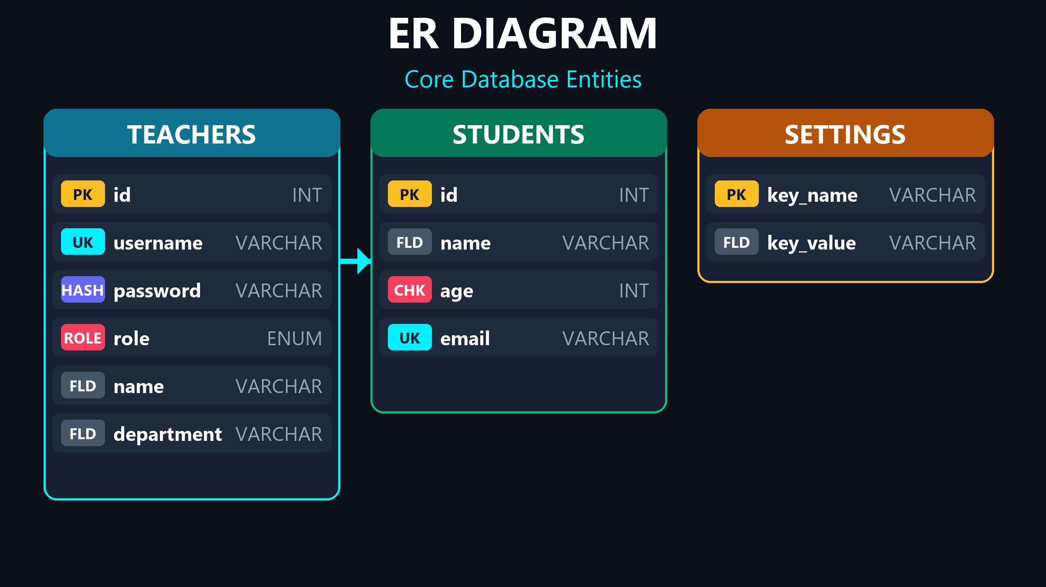
DATABASE
Database Entities

Slide 9
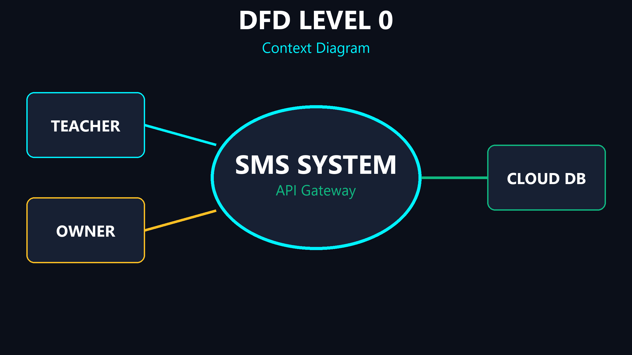
DFD 0
System Boundaries

Slide 10
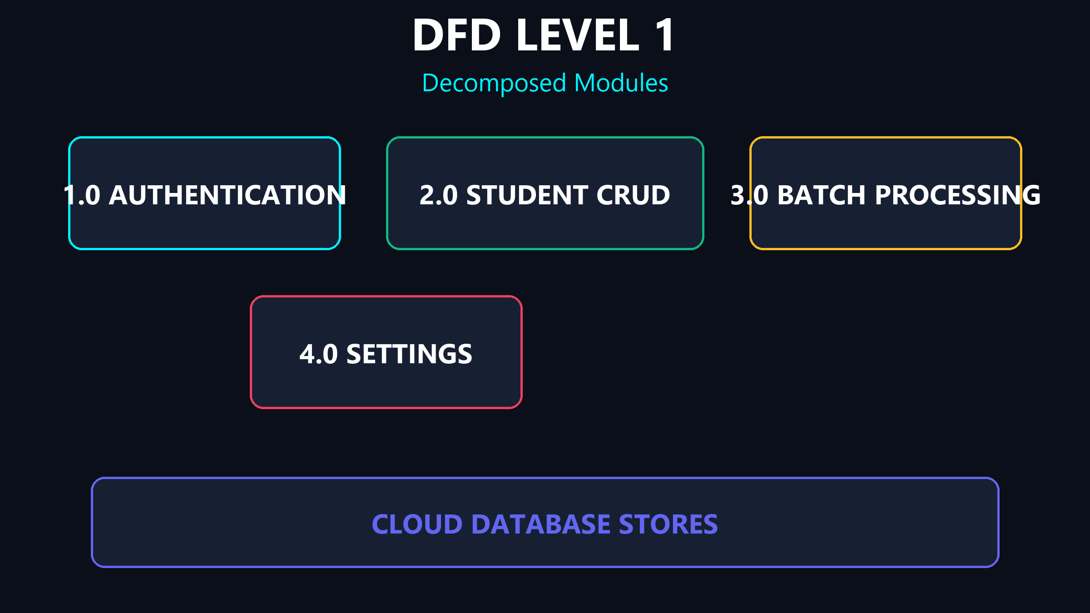
DFD 1
Modules

Slide 11
SECURITY
Defenses
→ Bcrypt Password Hashing
→ IP Rate Limiting
→ SQL Injection Protection
Rock Solid
Protection at every layer.

Slide 12
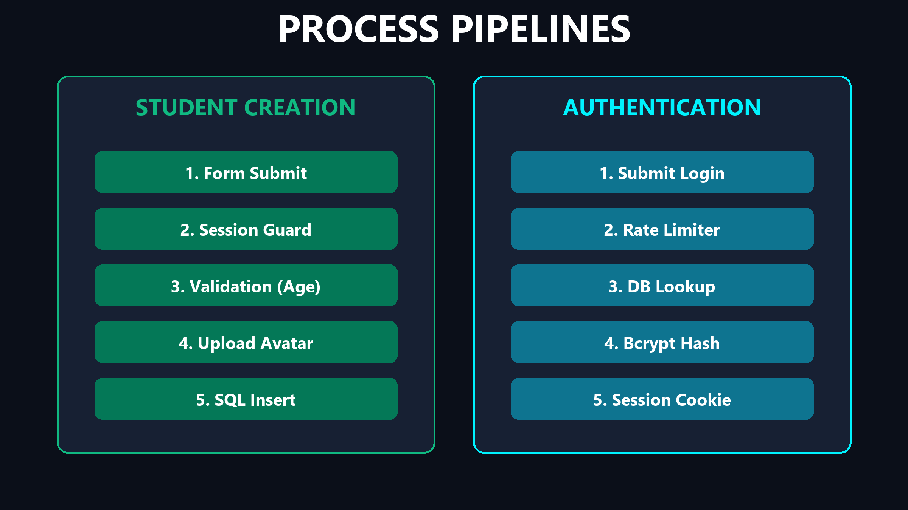
WORKFLOWS
Process Logic

Slide 13
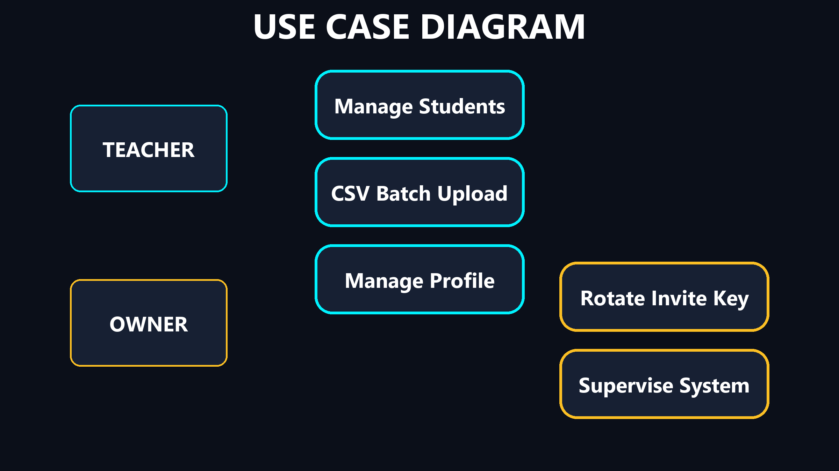
USE CASE
Privileges

Slide 14
SUMMARY
Built for the Future
Secure, Automated, Scalable.

Slide 15
Q & A
Thank You
Questions?

