Slide 1
FINAL PRESENTATION
Student Management System
A Secure, Scalable, and Modern Platform

Slide 2
THE OLD WAY
Key Limitations
→ Vulnerable Data: Excel and paper logs lead to data loss and corruption.
→ Device Locked: No cloud access meant being stuck to one office PC.
→ Zero Role Security: Everyone had unrestricted access to all sensitive data.
→ Slow Manual Workflow: Searching and updating records was extremely tedious.
Why Upgrade?
Legacy systems were holding operations back with fragmented data and slow UI.

Slide 3
Major Upgrades
→ Real-time Cloud Sync: Access records securely from any device.
→ Strict Role Hierarchies: Owner vs Teacher privileges ensure data safety.
→ Bulk Automation: 1-Click CSV Import and Export for hundreds of records.
→ Elegant SPA Design: Glassmorphism UI that feels premium and responsive.
THE NEW WAY
A Modern Solution
We built an automated, secure, and beautiful centralized platform.

Slide 4
TECH STACK
Under The Hood
Frontend
→ HTML5 & CSS3 Modules
→ Vanilla JS for lightning speed
→ Premium Glassmorphism
Backend
→ Node.js Environment
→ Express 5 API Router
→ Stateless Session Management
Database
→ Serverless MySQL Engine
→ Bcrypt Hash Security
→ Normalized Tables
Deployment
→ Automated CI/CD Pipeline
→ Zero-downtime Rollouts
→ Environment Secrets

Slide 5
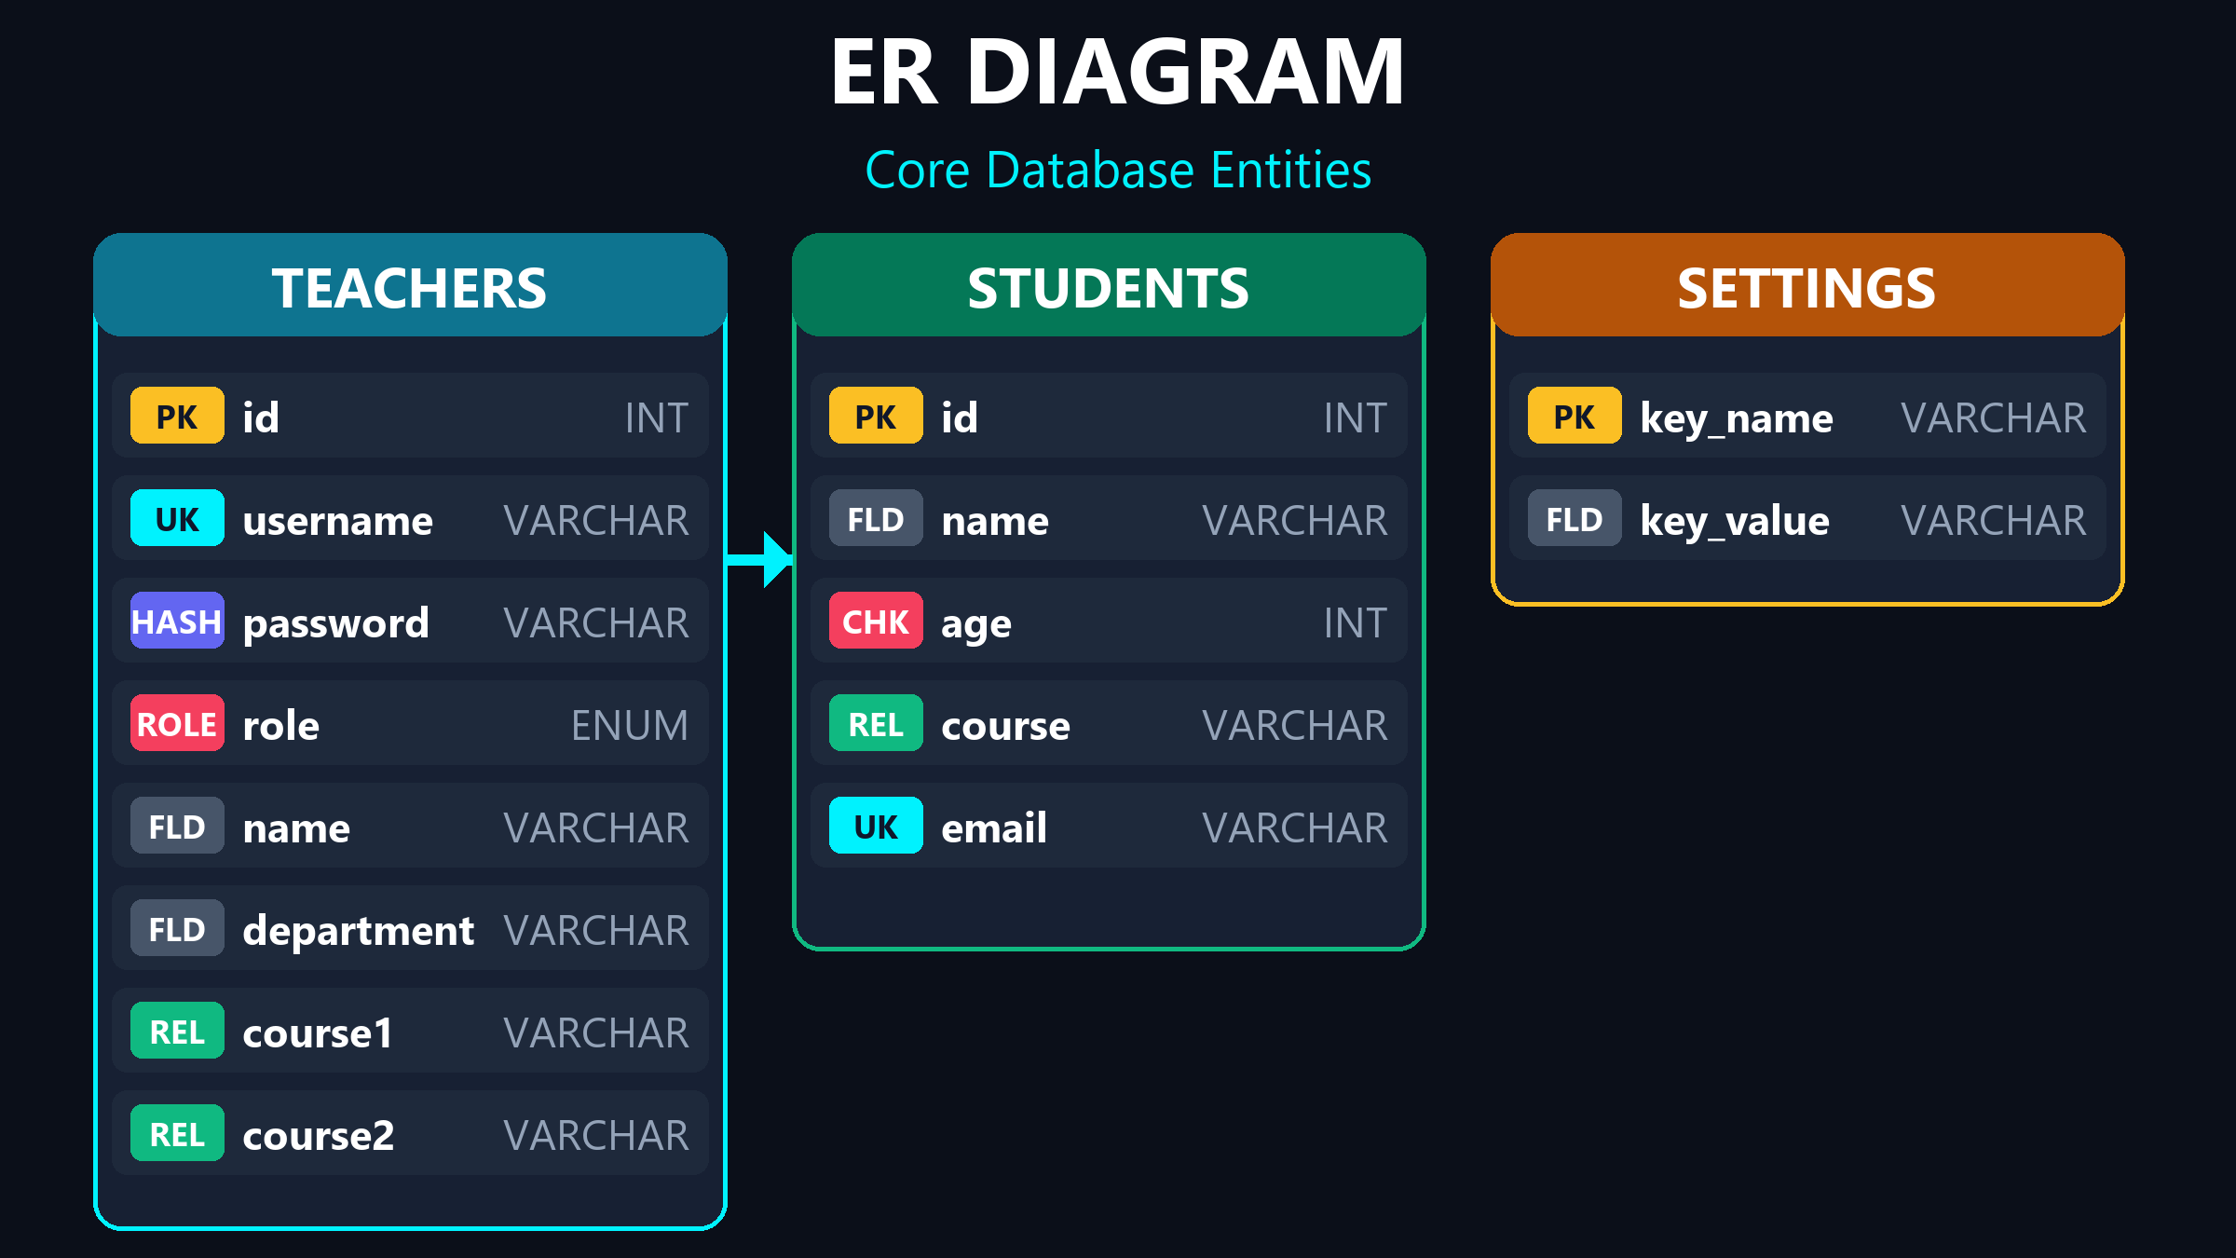
DATABASE
Database Entities & Relationships

Slide 6
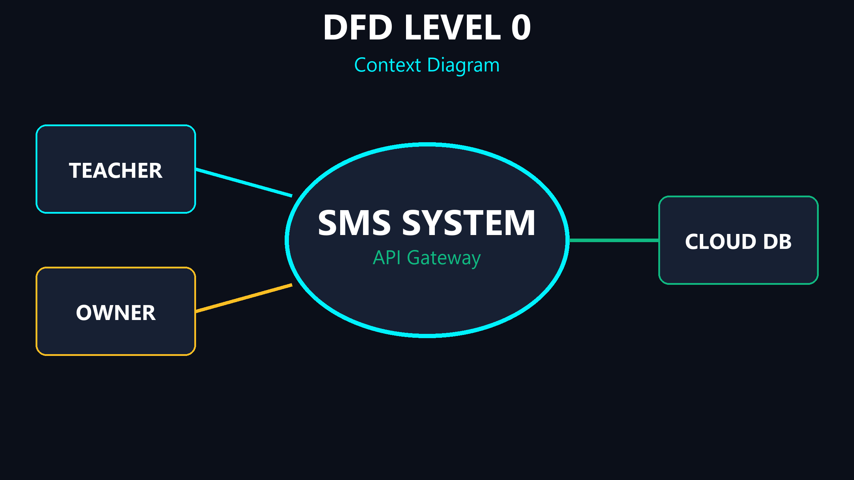
DFD 0
System Boundaries (Context)

Slide 7
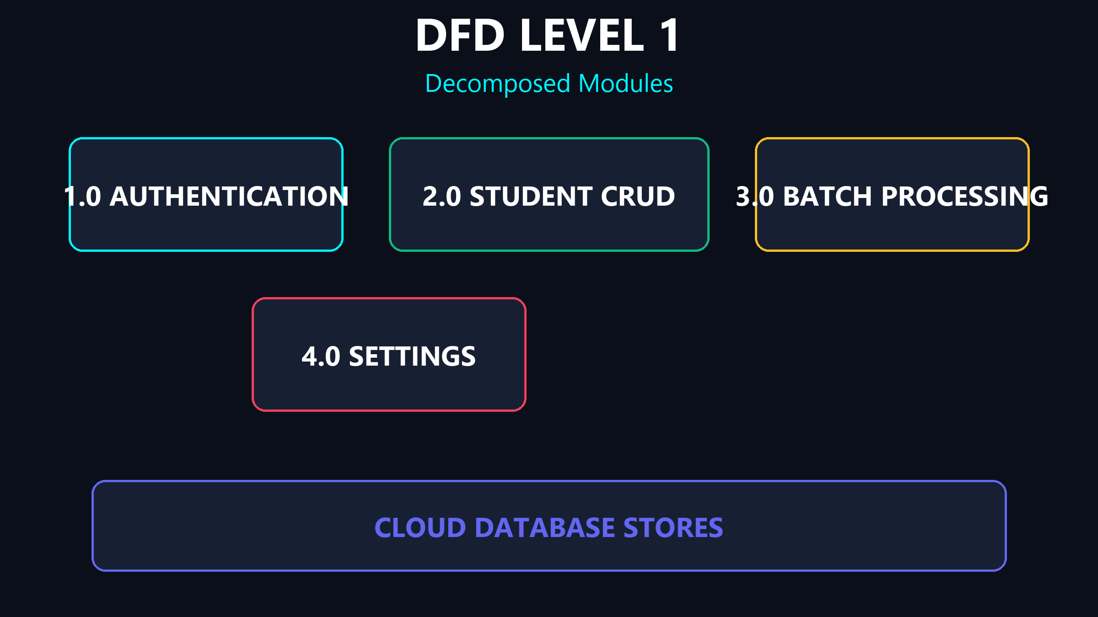
DFD 1
Core Processes & Decomposed Modules

Slide 8
BEFORE EVOLUTION
The Previous Dashboard UI
Please insert screenshot here:
before_dashboard.png

Slide 9
BEFORE EVOLUTION
Previous Form Inputs & Tables
Please insert screenshot here:
before_forms.png

Slide 10
THE TRANSFORMATION
What Did We Actually Change?
Single Page App
→ Complete rewrite to remove page reloads.
→ Provides an 'App-like' instant feel.
→ Dynamic DOM manipulation.
Integrated Views
→ Created unified Teacher and Student rosters.
→ Advanced course filtering added.
→ Clean, modern data tables.
Quick Modals
→ Add/Edit records without leaving the page.
→ Real-time visual toast notifications.
→ Responsive on all screen sizes.

Slide 11
SECURITY
Defense Mechanisms
→ Cryptographic Hashing: Bcrypt prevents reverse-engineering of passwords.
→ Network Guards: Session tokens and IP rate limiting block brute-force attacks.
→ Data Sanitization: Malicious SQL payloads are neutralized instantly via prepared statements.
Rock Solid Defense
Enterprise-grade protection was built into every layer.

Slide 12
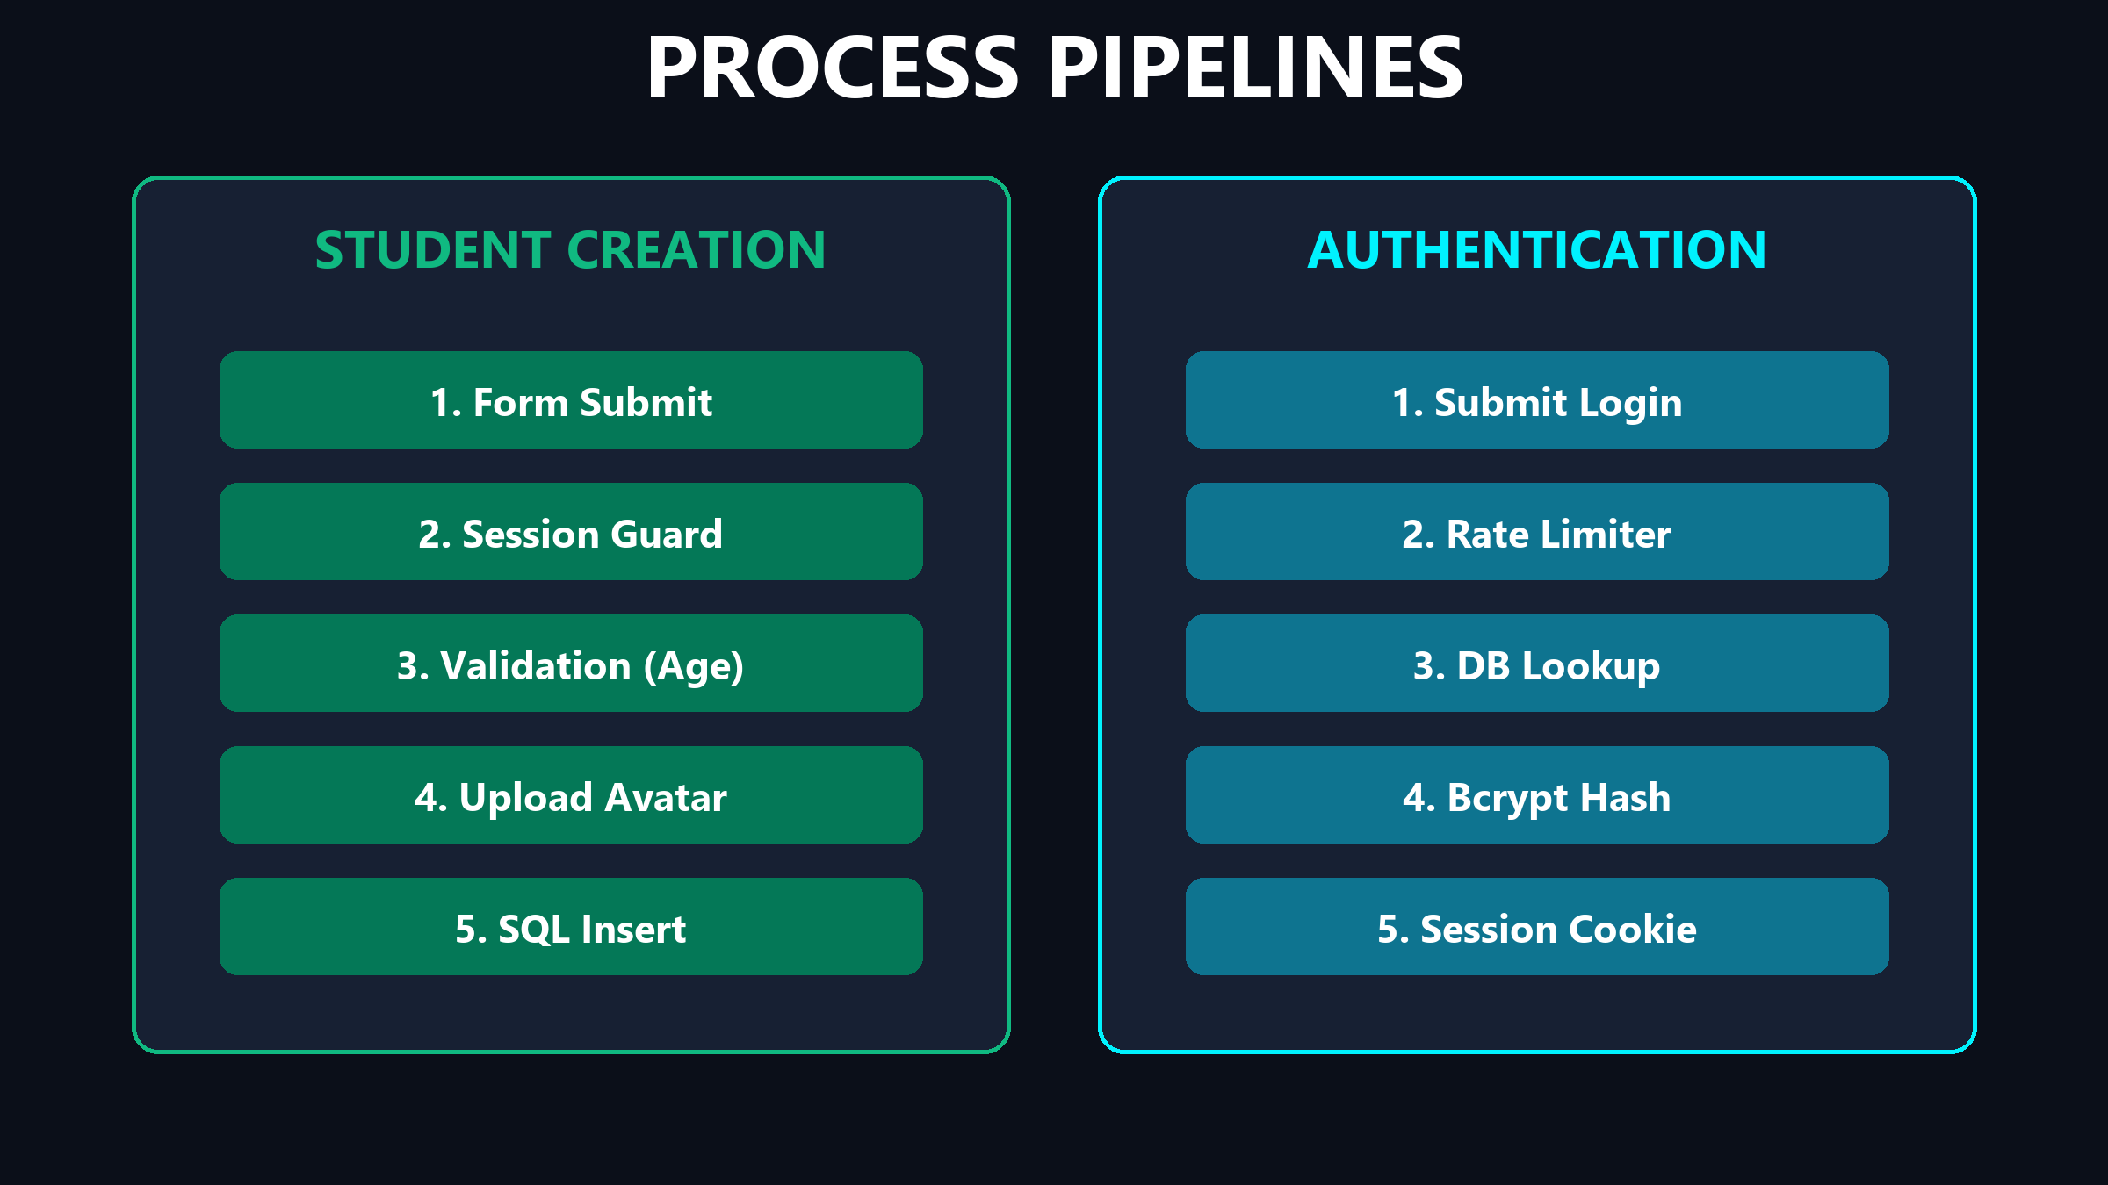
WORKFLOWS
Process Logic & Validations

Slide 13
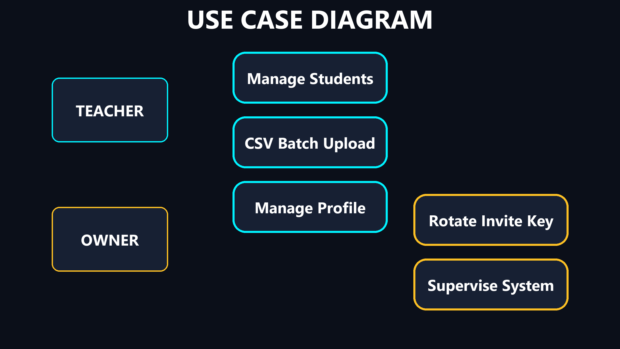
USE CASE
Actor Privileges & Access

Slide 14
SUMMARY
Built for the Future
A massive leap to a secure, automated, scalable platform.

Slide 15
Q & A
Thank You
Open for Questions & Discussion

