Slide 1
Optimizing User Engagement For App Subscription Conversion
Presented By: Preeya S. Chauhan

Slide 2


Business Challenge
CASE STUDY: we are working with the “Financial company” that wants to provide its customers with a paid mobile app subscription that will allow them to track all of their finances in one place. So to attract customers, the company releases a free version of their app with some of their main features unlocked.
The company has asked us to identify which users will most likely NOT enroll in the paid product, so that additional offers can be given to them. Because of the cost of these offers, the company doesn’t want to offer them to everybody, especially customers who were going to enrol anyways.
Banking App

Slide 3

Objective
The objective of this model is to predict which users is not likely subscribe to the paid membership , so that greater marketing efforts can go into trying to “convert” them to “paid users”. This prediction serves as a strategic tool, allowing businesses to channel marketing efforts more efficiently.

Slide 4
Data Visualisation
https://public.tableau.com/app/profile/preeya.singh.chauhan/viz/Customer_App_Subscription/Dashboard1?publish=yes

Slide 5
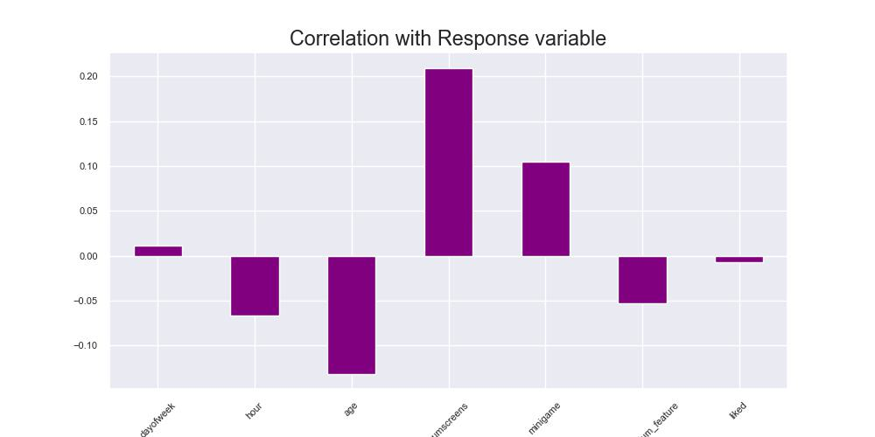
Correlation with Response Variable
Observations:
dayofweek is least positively correlated & says that if you join the app in day 0(sunday) then their is most likely to get enrolled to the premium features
Hour is negatively correlated with target variable shows the earlier the hour(in night) the most likely to get enrolled
Age is also negatively correlated reflects that the younger users are most likely to get enrolled
Numscreen is positively correlated with target shows that more the no. of screen user visits more chances of getting enrolled
Minigame also shows that more the minigame user play more chances of getting enrolled
Liked is very least negative which does not have much impact in target
Interestingly used_premium_feature is negatively correlated with response meaning that if user used the premium feature in 1st 24 hour that he/she might not enroll after the trial version of premium features

Slide 6
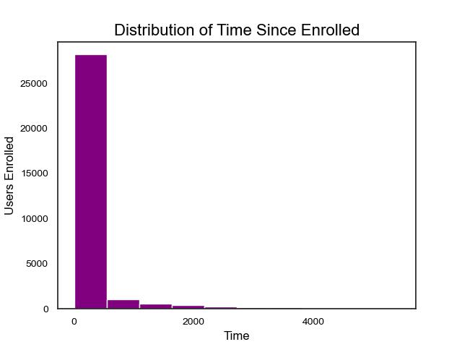
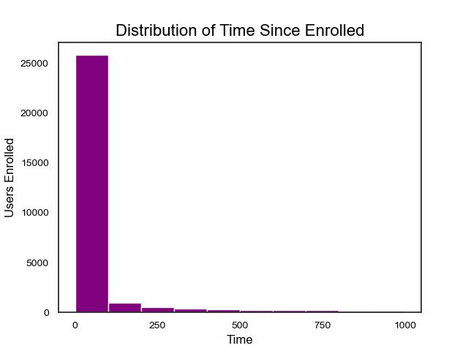

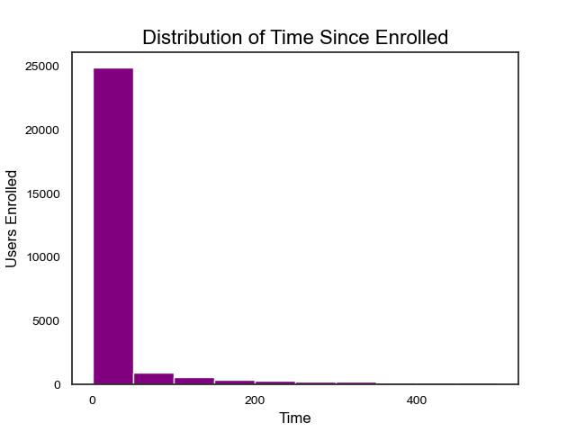
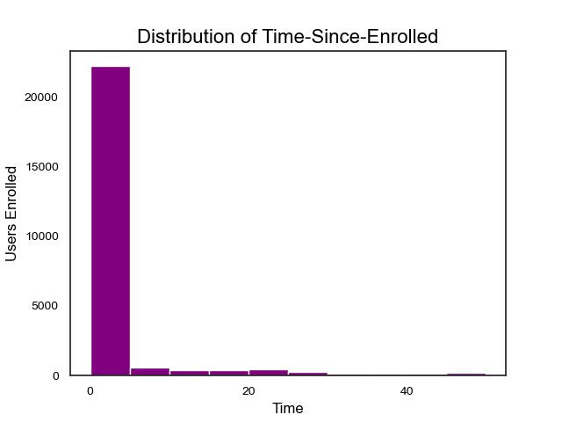
Distribution of Time Since Screen Enrolled

Slide 7
Model Building
Logistic Regression
Random Forest
XGBoost Classifier
Accuracy Score: 76%
Precision Score: 76%
Recall_score: 76%
F1 Score: 75%
Accuracy Score: 77%
Precision Score: 75%
Recall_score: 76%
F1 Score: 76%
.
Accuracy Score: 78%
Precision Score: 75%
Recall_score: 76%
F1 Score: 75%
.

Slide 8
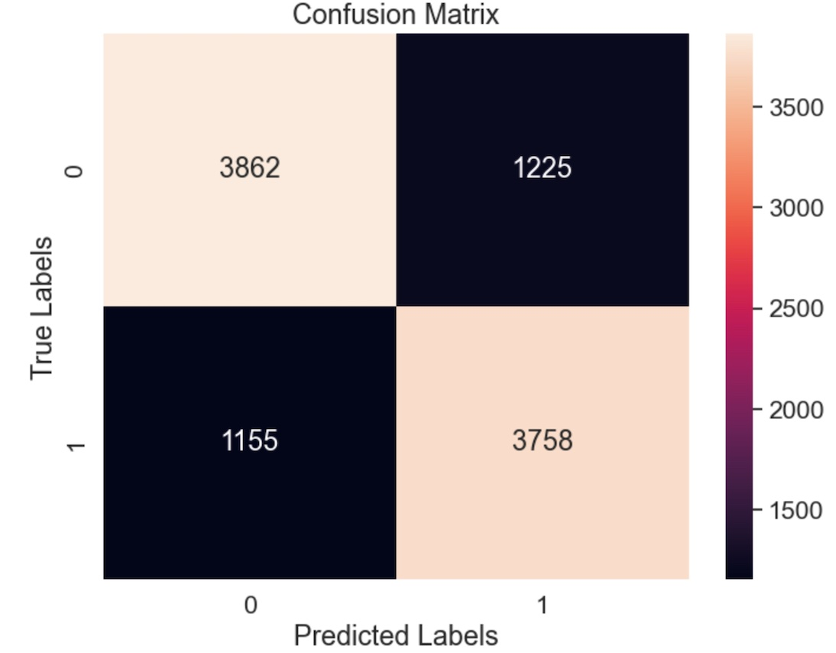
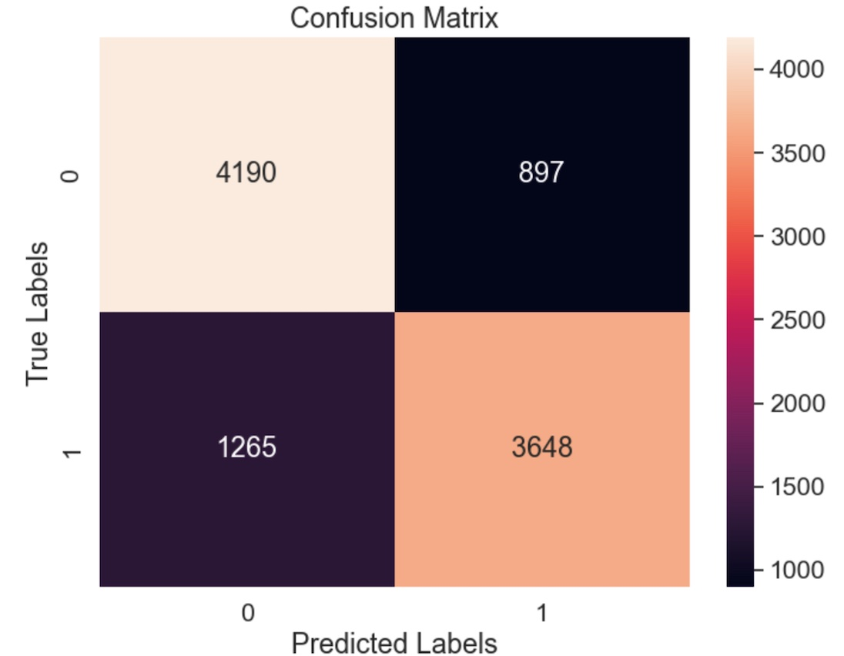
Heatmap Visualisation of Confusion Matrix
Logistic Regression Model
XGBoost Model
K-Fold cross Validation: we got 77% accuracy and very less standard deviation which is 0.010 which tells us that the model is consistent and accurate
K-Fold cross Validation: we got 78% accuracy and very less standard deviation which is 0.007 which tells us that the model is consistent and accurate

Slide 9


Next…..
Analyzing Coefficients
Hyperparameter Tuning
Banking APP
Format the final Results
Sreamlit App
https://customer-app-subscription-prediction.onrender.com/

Slide 10
Thank You

Slide 11
Questions?

