Slide 1

Competitive Landscape

Slide 2
Agenda
Introduction
Entity Relationship Diagram
Data Analysis/Sentimental Analysis
Summary
What should Ironhack do?

Slide 3

Introduction
Our team is excited to present the results of our comprehensive analytics consulting project, where we delved into the dynamic world of coding schools to gain a deeper understanding of Ironhack's competitive landscape.
we have conducted an in-depth examination of student reviews. Our goal is not just to interpret data but to catalyze strategic initiatives for Ironhack's sustained growth and success.

Slide 4
Process
GET DATA
DATA CLEANING
ERD
SQL Interaction
Sentiment and Improvement Analysis
Gathered data for Ironhack and some other schools as well
Clean and prepare the data for the analysis including sentimental analysis
Understand the database schema and the relationship between the tables
Creating a functional data base scheme and uploading our scrapped data
Getting comments with improvements and sentiment analysis on our IRONHACK comments

Slide 5
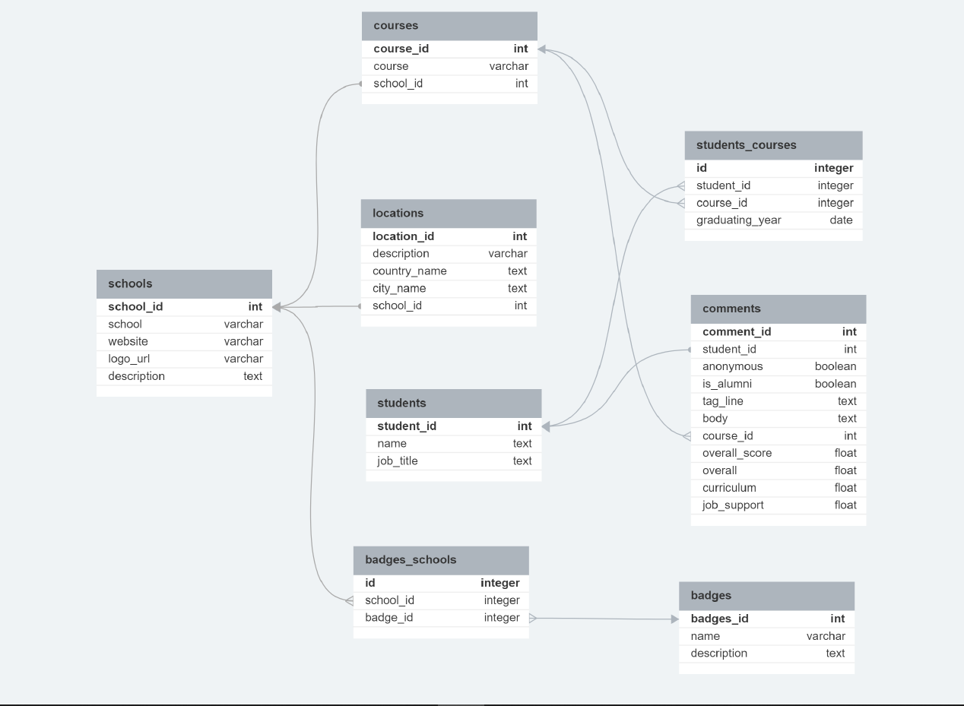
Entity Relationship Diagram

Slide 6
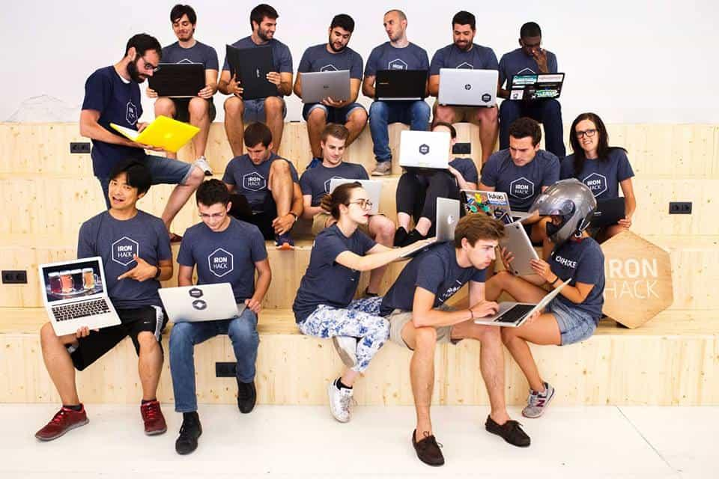
Ironhack Data
Improvement Spotter
Function that goes through every IRONHACK comment
Gets the comments that have synonyms with our target words
We use for target the words Improvement, Better and Prefer

Slide 7
Ironhack Data
Improvement Spotter
Results:
Positive and Negative reviews on the same comments
Many PROS and CONS
A lot to work with…

Slide 8

Ironhack Data
Sentiment Analyzer
VADER - Sentiment Analyzer
Pre-built, lexicon and rule-based sentiment analysis tool designed for social media text
Gives score for Negative, Positive and Neutral for every comment and a Overall score

Slide 9
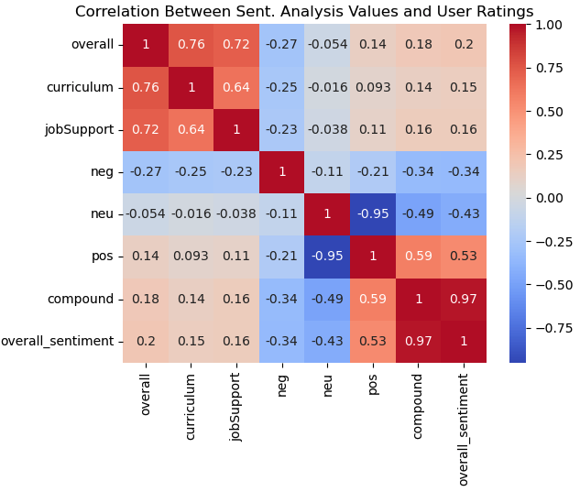
Ironhack Data
Sentiment Analyzer

Slide 10
Ironhack Data
Sentiment Analyzer
We can say there is no particular correlation with the model results and the user ratings
However, we cannot rule out the model itself
Even if the course was negative or positive for the student, It may have just met expectations
We can have a 5 star rating with neutral feeling

Slide 11
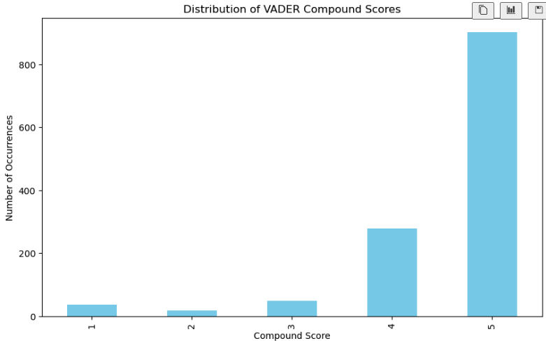
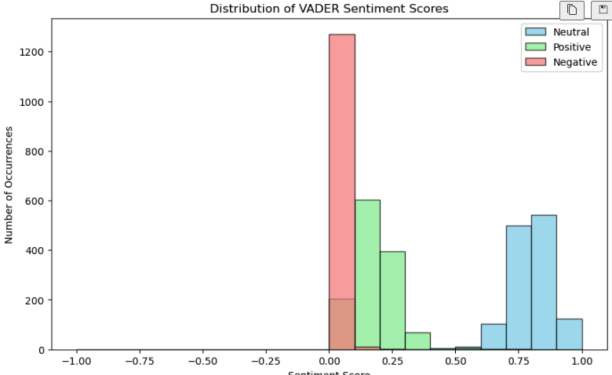
Ironhack Data
Sentiment Analyzer

Slide 12

Recommendations
Use feedback of Alumni and professionals
Improve Job support
Get more students to review
Share our Internal review to switch up
Focus on the average students

Slide 13
Thanks

