Slide 1







INSTITUTION'S INNOVATION COUNCIL
x
DJSCE
Abstract :
Team Name: Team Preflight
Product: Preflight. Should you believe this ML paper?
Preflight re-runs every number in an ML paper over ten seeds, explains each gap with a counterfactual re-run, and flags results inflated by leakage, unfair baselines, wrong metrics or lucky seeds.
Claude reads the paper; re-runs decide. 13/13 planted issues caught, 0 false alarms.
PS ID : EL-01
PS Name : AI-Powered ML Paper Reproducibility Platform
Open the live demo
DWARKADAS J SANGHVI COLLEGE OF ENGINEERING, VILE PARLE(W)
Notes:
Preflight answers one question for any ML paper: should you believe it? It re-runs every reported number and explains every gap with a re-run, not an opinion.

Slide 2

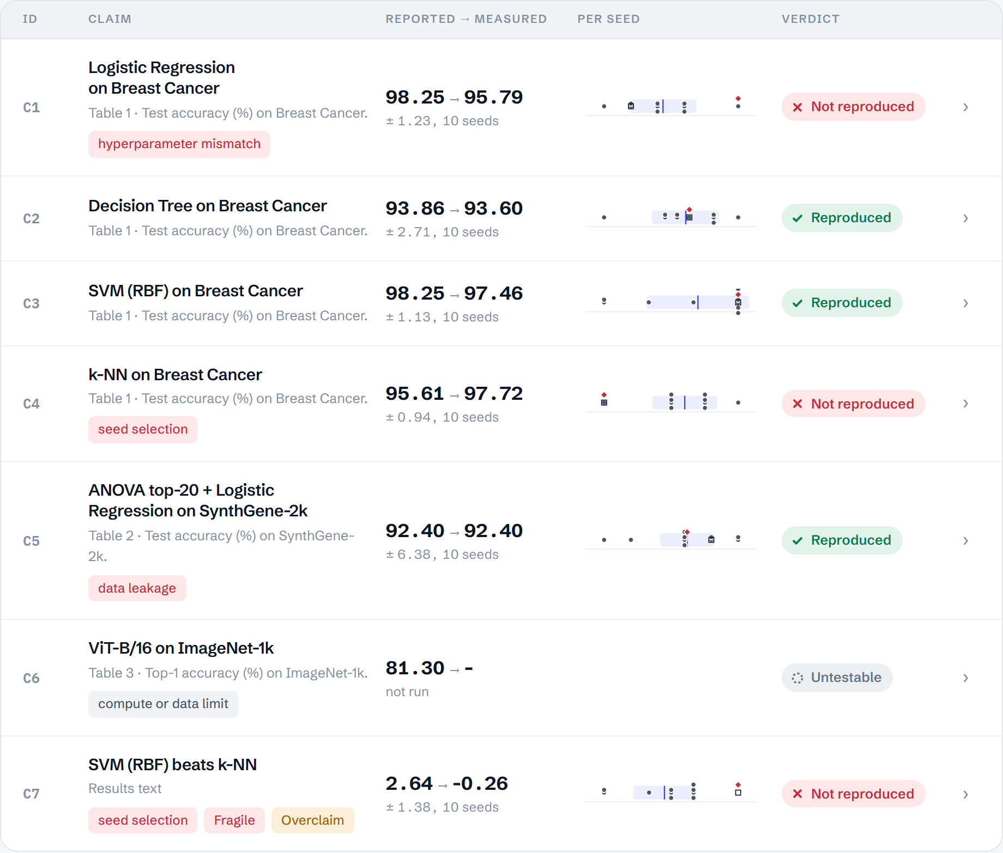
THE POINT
PROPOSED SOLUTION
Reproducing is not enough. We show whether to believe a result, and prove it with a re-run.
DEP
ARR
The problem: ML results can reproduce and still mislead: leaked test data, untuned baselines, lucky seeds.
Today's tools stop at “does it run?”. Preflight asks “should you believe it?”
1
2
3
4
5
Paper + repo
Claims
Runs
Verdicts
Why
PDF read by Claude; repo by folder or GitHub
every table cell and comparison
sandboxed, over 10 seeds
four levels, seed-aware
re-runs that explain each gap
What EL-01 asks for | What Preflight does
Understand the methodology | AI reader extracts claims and stated settings; you confirm
Find the implementation and config | README, config and AST mapping down to file:line
Execute in a controlled environment | Sandbox: browser WASM, subprocess or Docker; 10 seeds
Compare with reported results | Seed-aware verdict with a k-seed tolerance
Explain why results differ | Shapley gap attribution and missing-detail inference
Go beyond code exists | Leakage, metric, fair-baseline and fragility re-runs
Evidence-backed, per experiment | Claim Ledger: table cell, code line, command, log, hash
Lightweight CPU-only papers | CPU triage: full, scaled or untestable, with the reason
Claim Ledger for Paper A: every number, its verdict and its cause
Open this ledger live →
Notes:
Five steps from paper to verdict to why. The table maps every objective in the problem statement to a feature.

Slide 3
THE POINT
TECHNICAL APPROACH
One AI step. Everything after it is deterministic, sandboxed and repeatable.
DEP
ARR
AI paper reader
Parse
Map repo
CPU triage
Static audit
Execute
Claude Opus 5.5 · PDF → claims
tables, settings, comparisons
README · config · AST
full / scaled / untestable
diff · leakage · metric · budget
sandbox · 10 seeds · self-heal
Compare
Attribute
Infer
Validity re-runs
Fragility
Report
k-seed tolerance
Shapley over re-runs
GRIM + sweep
leak · dupes · metric · baseline
seeds · splits · ±10%
ledger · card · issues · badge
Dashed = the only AI step (claim extraction, checked by a person). Everything after it is deterministic: static analysis, sandboxed execution, statistics and counterfactual re-runs.
Verdict rule
Gap attribution
Sandbox
Stack
tol = max(2σ/√k, 0.5 pt)
k = seeds paper averaged
Partial: ≤ 3σ/√k
or a scaled run
φᵢ = Σ |S|!(n−|S|−1)!/n!
· [v(S∪{i}) − v(S)]
v(S): 10-seed mean,
S set to paper values
fresh repo copy, hashed
seed set at the code's seed site
Docker: no network, CPU/RAM caps
probe: fits, splits, row hashes
Python 3.14 · scikit-learn 1.8
Pyodide (WASM), Web Worker
FastAPI · queue · Docker
Claude Opus 5.5, JSON output
The same 11 stages, live in the app
Notes:
One Python engine, three runtimes: the browser via Pyodide, a CLI, and a FastAPI server with Docker workers. The LLM only reads the paper.

Slide 4
THE POINT
INNOVATION AND UNIQUENESS
Others say whether. Preflight shows why, and catches results that reproduce but mislead.
DEP
ARR
 | Runs code | Per-claim verdict | Explains why (re-run) | Leakage check | Fragility / seeds | False-alarm control | Metric & baseline audit
VERITAS (2026) | Yes | Yes | Partly | No | No | No | No
CORE-Bench agents | Yes | Partly | No | No | No | No | No
REPRO-Bench agents | Yes | Partly | Partly | No | No | No | No
Code Ocean | Yes | No | No | No | No | No | No
SciCoQA / Dude | No | Partly | Partly | No | No | LLM | No
Preflight | Yes | Yes | Yes | Yes | Yes | Re-run | Yes
96%
−28.8 pt
of a 2.46-pt gap explained by one config value (C), via Shapley re-runs
a result that reproduces, but only because feature selection saw the test set
+1.52 → −0.56
15 / 30
a claimed win that flips once the baseline gets the same tuning budget
conditions where “significantly outperforms” still holds
Based on each tool's published description. Partly: covers part of the column.
“How is this different from VERITAS?”
VERITAS tells you whether a claim replicates. Preflight tells you why it failed, whether a passing result is inflated, and how fragile it is, and backs each finding with a counterfactual re-run.
Original: a GRIM check rules out split ratios that cannot produce the reported accuracy before anything runs; seeds are injected at the code's own seed site; every flag must survive a re-run (Dude's false-positive problem).
13 / 13
planted issues caught across the test papers, with 0 false alarms on the clean control. One real 1993 paper audited end to end.
Notes:
Every competitor stops at whether. We go to why, and to whether a passing number deserves trust.

Slide 5
THE POINT
FEASIBILITY AND VIABILITY
Built and running today. Every demo audit finishes within a minute, on a CPU, in the browser.
DEP
ARR
Every demo audit runs on a CPU in seconds
Three ways to deploy, one engine
Run Paper A live →
Paper | Sandboxed runs | From cache | CPU-s (laptop) | Live in browser
A · planted (7 claims) | 242 | 94 | 3.7 | 6 s
B · clean control | 22 | 2 | 1.5 | 2.6 s
C · planted (6 claims) | 151 | 66 | 24.4 | 55 s
R · real, Street et al. 1993 | 82 | 49 | 8.6 | 13.3 s
Browser
Pyodide in a Web Worker. Zero server cost, nothing leaves the laptop. Works today.
Server
FastAPI, job queue, one Docker container per run, result cache by content hash. Tested.
Browser: Pyodide 314.0.7 in Chrome. Live and recorded runs match exactly.
CI / author mode
The CLI writes a GitHub Action that re-audits on every push, plus a README badge.
Risks and mitigations
Risk | Mitigation
PDF tables misread | Claude with a JSON schema, then a person confirms the claims
LLM hallucination | LLM only extracts; every finding is a re-run
Repo breaks on new libraries | self-heal rules, patch shown, logged as impediment
Experiment too big for CPU | triage: scale rows to the RAM budget, verdict ≤ Partial
Hostile code | Docker: no network, CPU/RAM/PID caps, read-only root
Venue wifi fails | recorded replay, labelled as recorded
Sustainability
Open-source core (MIT) so labs can self-host and trust the checks.
Hosted tier for conferences and journals: batch audits of artifact submissions, badge issuing, reviewer reports.
Compute cost scales with papers audited, and small papers cost nothing because they run in the visitor's browser.
Notes:
All numbers on this slide are measured. Paper C takes about a minute in the browser because it tunes an SVM 12 ways per run.

Slide 6
THE POINT
IMPACT AND SCALING
Success is cheap. Audits run in the user's browser, so 10× users is mostly static hosting.
DEP
ARR
Who it is for
YC says yes tomorrow. Can it handle success next week?
Reviewers & repro chairs
Students & MLRC
triage artifact submissions in minutes, with evidence to cite
reproduce a paper for coursework and learn why it differs
Users
Most audits run in the visitor's browser, so 10× traffic is mostly static file hosting.
ML teams
Authors
Load
Stateless API + queue; autoscaled Docker workers; one container per run.
check a paper's claims before building on them
pre-submission check and a README badge
Repeat work
Runs cached by hash of files, command and library versions; duplicate submissions are free.
Tested, not promised
✓ 13/13 planted issues caught, 0 false alarms (clean control: 0 findings)
✓ 11 automated tests: planted, clean, live edits, real paper, server API
✓ Browser and laptop runs give identical numbers
✓ Live edits re-audited: fixing C turns C1 green; a new scaler leak is caught
✓ Server mode: HTTP submit, poll, idempotent cache, rate limits
✓ Real 1993 paper: one claim exact, one flagged with the paper's own reason
Breaks
Per-run CPU, RAM, PID and time caps; network off; rate limit per client.
Crashes
Self-heal known API breaks; failed jobs keep their events; static audit still reports.
Robustness
Idempotent jobs and retries; recorded replay if live compute is down.
Notes:
Our scaling story is unusual: compute moves to the visitor's browser by default, and the server path is a classic queue plus workers with a content-hash cache.

Slide 7
THE POINT
RESEARCH AND REFERENCES
Still unsolved. Top agents replicate under a third of papers; top LLMs find under half the discrepancies.
DEP
ARR
21–27%
46.7%
Try it
best agents on PaperBench vs 41% for ML PhDs: replication is still hard (OpenAI, 2025)
of real paper–code discrepancies found by the best LLMs (SciCoQA, ACL 2026)
Live demo
preflight-el01.github.io/preflight
Code (MIT)
github.com/preflight-el01/preflight
294+
68%
Video
Watch the 90-second walkthrough
papers in 17 fields affected by leakage (Kapoor & Narayanan, Patterns 2023)
full replication by VERITAS after automated fixes; it reports whether, not why (arXiv 2607.02931)
Test kit
A test paper with planted bugs
In the app: press Tour for a guided walkthrough, Ctrl K to search, Audit your own to upload a PDF.
Sources
Kapoor & Narayanan. Leakage and the reproducibility crisis in ML-based science. Patterns, 2023
Starace et al. PaperBench. OpenAI, 2025 · Siegel et al. CORE-Bench, 2024 · REPRO-Bench, ACL 2025
SciCoQA: paper–code alignment, ACL 2026 (arXiv 2601.12910) · Dude, arXiv 2609.03416
VERITAS: a general-purpose replication tool, arXiv 2607.02931
Brown & Heathers. The GRIM test. Social Psychological and Personality Science, 2017
Pineau et al. ML Reproducibility Checklist, 2021 · Kapoor et al. REFORMS, 2023
Street, Wolberg & Mangasarian. Nuclear feature extraction for breast tumor diagnosis. SPIE, 1993
Datasets
Bundled with scikit-learn: Wisconsin Diagnostic Breast Cancer (569 cases), Digits. Generated: SynthGene-2k, SynthMed, SynthHD, SynthKNN-Aug, SynthLarge-2M.
Papers
Three fictional test papers with an answer key (A, B, C) and one real paper (Street et al., 1993). Every number shown comes from a logged sandbox run.
Notes:
Every number in this deck is measured. The competitor numbers come from their papers.

Slide 8
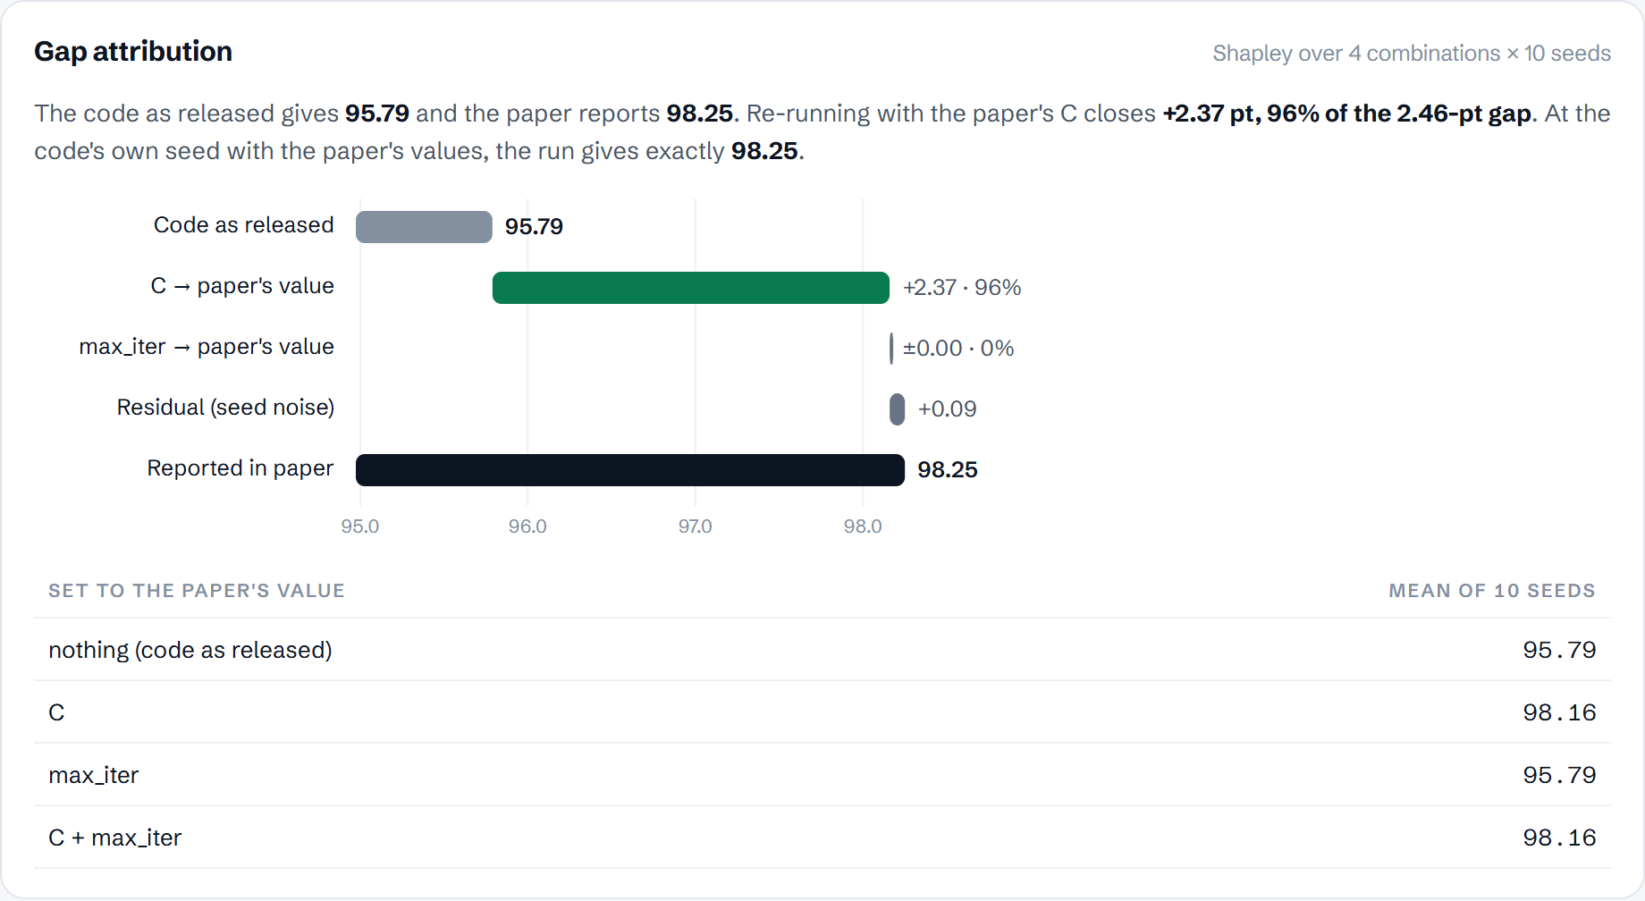
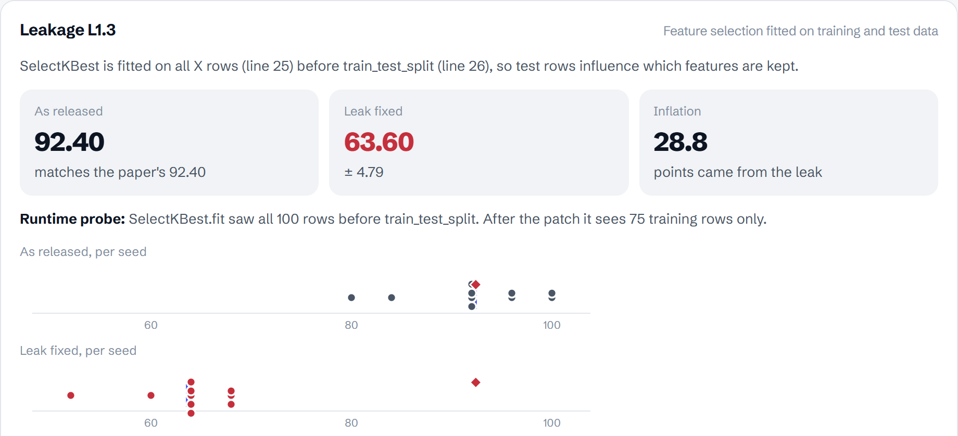
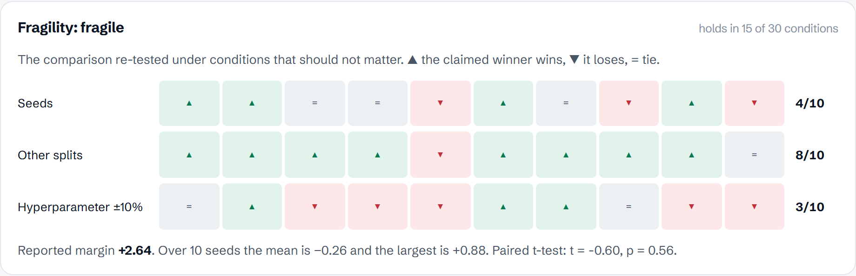
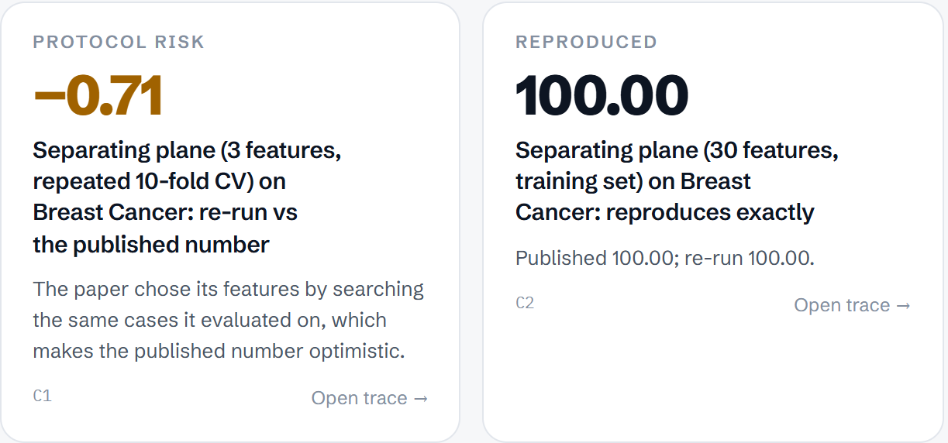
THE POINT
LIVE PROOF
Proof, not promises. Four findings from the real app, each backed by a re-run.
DEP
ARR
Each screen is a re-run, not an opinion. Click any one to open it live in the app.
Why C1 fails: one config value explains 96% of the gap →
Why C5 cannot be trusted: the leak, the patch, the drop →
Real paper
Street, Wolberg & Mangasarian, 1993.
The authors released no code, so the repo is our reproduction.
Why C7 is fragile: 15 of 30 conditions →
A real paper: one claim exact, one optimistic, and its reason →
Notes:
These are screenshots of the real app. The full report exports as Markdown and JSON with run hashes.

