Slide 1
FADGI’s MXF AS-07: Lessons Learned
No Time To Wait Symposium/Berlin
July 19, 2016
Kate Murray, Library of Congress

Slide 2
What I’ll Talk About:
Brief FADGI overview
AS-07: A short history of a long document
To MXF or not to MXF?
Significant features of AS-07
Path to standardization
Next steps and lessons learned

Slide 3
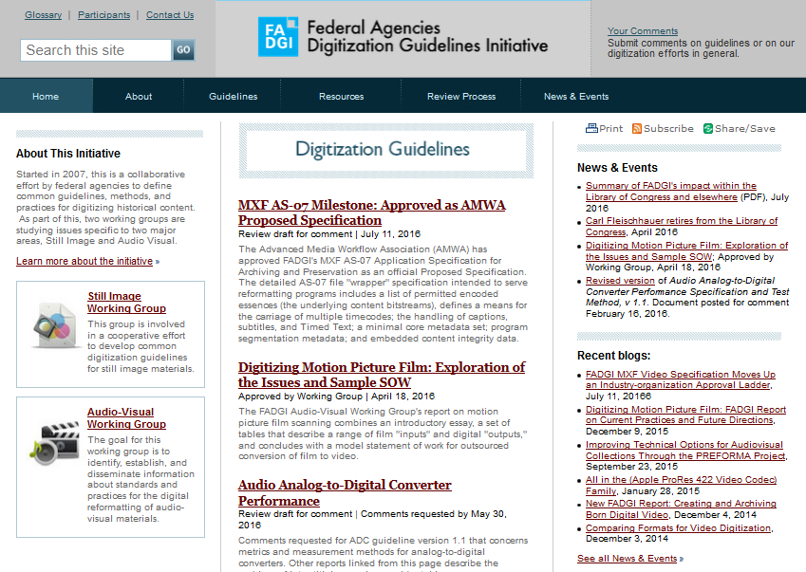
http://www.digitizationguidelines.gov/

Slide 4
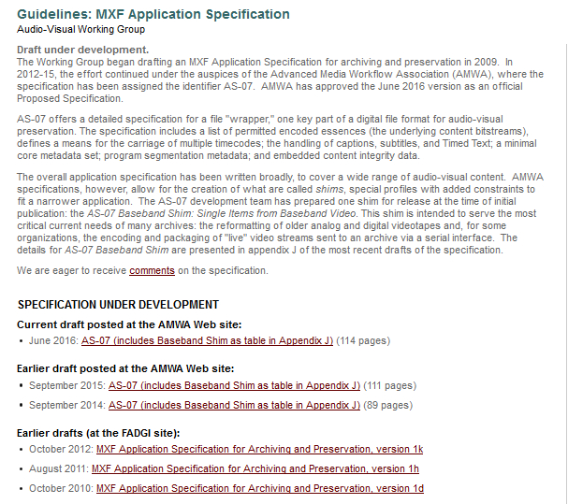
MXF AS-07: A Short History of a Long Document
http://www.digitizationguidelines.gov/guidelines/MXF_app_spec.html

Slide 5
MXF Application Specification is a “Profile”
Not a capital-S standard but a statement from the community and the industry
Pin down preferred options, reduce the variables: constraints
Support greater interoperability
Increase the comfort level for users
Increase vendor competition
More adoption means better sustainability

Slide 6
Is MXF for Everyone? (Spoiler alert: No)
No one size fits all
AS-07 development team has strong Library of Congress presence
Like national libraries and archives everywhere, broadcast materials are an important part of the collection
Elements like multiple timecodes, captions or subtitles, etc., are more prevalent in broadcast collections
If you have simple oral history tapes, your problem may allow of a simpler solution
User Needs and MXF Options: Preservation Planning and the AS-07 Specification
http://www.digitizationguidelines.gov/guidelines/AS-07_userNeeds_MXFoptions_20150910.pdf

Slide 7
AS-07 in a Nutshell
The AS-07 Application Specification specifies a vendor-neutral subset of the MXF file format for the long-term archiving and preservation of moving image and other audiovisual content, including all forms of Ancillary Data, together with Associated Materials. Among other features, AS-07 defines a means for the carriage and labeling of multiple timecodes and audio tracks; the handling of captions, subtitles, and Timed Text; a minimal core metadata set; program segmentation metadata; and embedded content integrity data.

Slide 8
Timecode
Source recordings may have multiple timecodes (VITC, LTC, etc.), some on purpose, some by accident, all may provide forensic help for future researchers.
Meanwhile, users of the master file that you produce will benefit from the presence of a high integrity, continuous timecode, sometimes called a synthetic timecode.

Slide 9
Timecode
AS-07 specifies:
Master Timecode: continuous, high integrity
Retention of Historical Source Timecode: the EBU term for “legacy” timecodes
Tagging for the multiple timecodes in the file
Working with SMPTE TC-31FS (SG Timecode in MXF) to adopt AS-07’s new timecode subdescriptors

Slide 10




Timecode Metadata in OP1a
UMID
UMID
UMID
Material Package
File Package
Lower Level Source Package
DM_AS
Slate
V1
V1
DM_Seg
A1
A1
V1
A2
A2
A1
D1
D1
A2
TC 28 29 00 01 02 03 04 05 06 07 08 09
TC 28 29 00 01 02 03 04 05 06 07 08 09
D1
LTC
TC 28 29 00 01 02 03 04 05 06 07 08 09
Multiple
10 11 12 13 14 15
29 00 01 02 03
VITC
V1
Picture
CDCI
MPEG
13 14 15 16 17 18
03 04 05 06
A1
Sound
Wave
Left
Multiple
A2
Sound
Wave
Right
-
Tape
D1
Data
TC
DateTime
TC
DateTime
Sys1 (0)
LTC
DateTime
A3
MTC
DateTime
Sys1 (1)
VITC
DateTime
Line 14
LTC
DateTime
VITC
DateTime
Sys1 (2)
Multiple Timecodes As an array in GC SysItems; arrays from SMPTE ST 405
Label Timecodes Use existing ST 385 DateTimeDescriptor Use SubDescriptor from ST 377
UMID
Essence Data
00:59:28
00:59:29
01:00:00
01:00:01
01:00:02
01:00:03
01:00:04
01:00:05
01:00:06
01:00:07
01:00:08
01:00:09
02:13:10
02:13:11
02:13:12
02:13:13
02:13:14
02:13:15
02:13:15
03:45:29
03:46:00
03:46:01
03:46:02
03:46:03
15:05:13
15:05:14
15:05:15
15:05:16
15:05:17
15:05:18
00:00:00
00:00:00
16:18:03
16:18:04
16:18:05
16:18:06
Slate
Diagram (c) MetaGlue

Slide 11
Timecode Metadata in OP1a
UMID
UMID
UMID
Material Package
File Package
Lower Level Source Package
DM_AS
Slate
V1
V1
DM_Seg
A1
A1
V1
A2
A2
A1
D1
D1
A2
TC 28 29 00 01 02 03 04 05 06 07 08 09
TC 28 29 00 01 02 03 04 05 06 07 08 09
D1
LTC
TC 28 29 00 01 02 03 04 05 06 07 08 09
Multiple
10 11 12 13 14 15
29 00 01 02 03
VITC
V1
Picture
CDCI
MPEG
13 14 15 16 17 18
03 04 05 06
A1
Sound
Wave
Left
Multiple
A2
Sound
Wave
Right
-
Tape
D1
Data
TC
DateTime
TC
DateTime
Sys1 (0)
LTC
DateTime
A3
MTC
DateTime
Sys1 (1)
VITC
DateTime
Line 14
LTC
DateTime
VITC
DateTime
Sys1 (2)
Multiple Timecodes As an array in GC SysItems; arrays from SMPTE ST 405
Label Timecodes Use existing ST 385 DateTimeDescriptor Use SubDescriptor from ST 377
UMID
Essence Data
00:59:28
00:59:29
01:00:00
01:00:01
01:00:02
01:00:03
01:00:04
01:00:05
01:00:06
01:00:07
01:00:08
01:00:09
02:13:10
02:13:11
02:13:12
02:13:13
02:13:14
02:13:15
02:13:15
03:45:29
03:46:00
03:46:01
03:46:02
03:46:03
15:05:13
15:05:14
15:05:15
15:05:16
15:05:17
15:05:18
00:00:00
00:00:00
16:18:03
16:18:04
16:18:05
16:18:06
Slate
Diagram (c) MetaGlue

Slide 12
Text-based and binary data
We see a need to carry extra information, beyond the basic picture and sound
MXF offers a special kind of “partition”
Generic Stream Partitions (SMPTE ST 410:2008) carry generic "streams“
Can be text-based (e.g., XML) or binary (e.g., still image)

Slide 13
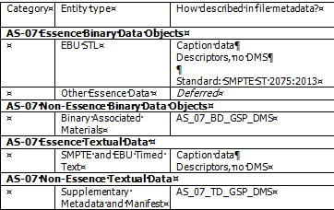
Generic Stream Partitions in AS-07

Slide 14
Supplementary Metadata
Parametrics metadata not an issue, goes in MXF essence descriptors
Needed: specified options for embedding additional technical metadata:
process (like METS digiprov),
about the source item
about quality review outcomes
preservation (like PREMIS),

Slide 15
Supplementary Metadata
And some descriptive metadata
Confusing because MXF has what they call “Descriptive Metadata Schemes” (DMS)
might carry something like what librarians call descriptive metadata
however, AS-07 is very minimal with its “Core DMS” – most important is identifier(s), responsible organization, and a few other elements
Within FADGI descriptive metadata is tremendously varied
“put whatever you want in a GSP and label it”

Slide 16
Closed captioning and subtitles
Captions and (video) subtitles - big issue with broadcast collections, less so with other classes of content
US broadcast standards – evolving from binary data on line 21 toward SMPTE Timed Text
Parallel evolution in Europe as EBU binary subtitles (STL) give way to EBU Timed Text
Timed Text is XML derived from the W3C Timed Text standard – XML very desirable for long-term management and access-searching
In AS-07, XML is carried in a Generic Stream Partitions, following SMPTE RP 2057:2011

Slide 17
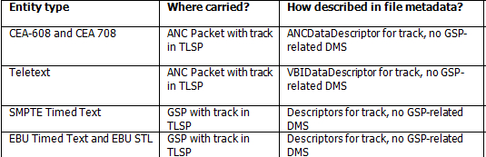
CC, subtitles and Timed Text in AS-07

Slide 18
Audio tracks
Audio may have multiple tracks
May be a desire to tag language
AS-07 offers track allocation and language metadata options in AS-07 Core DMS

Slide 19
Content Integrity
Not file-based
That’s the job for the repository
Frame level
Generally on the “V” part of the KLV unit that carries frame-level information
AS-07 approach strongly influenced by design of BBC MXF archive file
Consistent with approaches in digital cinema, some ffmpeg implementations, and others

Slide 20
Note on Encodings
AS-07 allows a range of encodings
MXF itself (not AS-07) is limited to encodings that have a “mapping” standard
Alas, at this time there is no SMPTE mapping of ffv1 to MXF but could happen with time/effort.
AS-07’s first constrained subtypes effectively recommends uncompressed streams or JPEG 2000.

Slide 21
Sample Files
Sample files exist! EVS, CubeTec, Telestream all interested
Uncompressed, j2k encodings
Not all features – no content integrity

Slide 22
Standardization through AMWA
Advanced Media Workflow Association (AMWA)
Broadcast-industry group
AVID, BBC, Front Porch Digital (SAMMA), NARA, PBS, SONY, Discovery Communications, Fox, NBC Universal, Turner, & others
Vendor neutral
International
Open standard
Creative commons license (yay!)
although other underlying standards may not be (not yay)

Slide 23
Hiccups in Standardization Process
Changing project deliverables
Changing standardization process rules
Timeliness

Slide 24
To Do
Vendor testing
Community vetting
Release sample files (they do exist! honestly!)
Machine-readable implementation
PR campaign – we’ve built it, now will anyone use it?
Develop new profiles for scanned film and other material

Slide 25
Do Overs
More constrained scope
More iterative process and publication schedule
More interaction with wider community (including you all)
Rigor and completeness is good (but not the only thing)

Slide 26
Thank you
Kate Murray kmur@loc.gov

