Slide 1
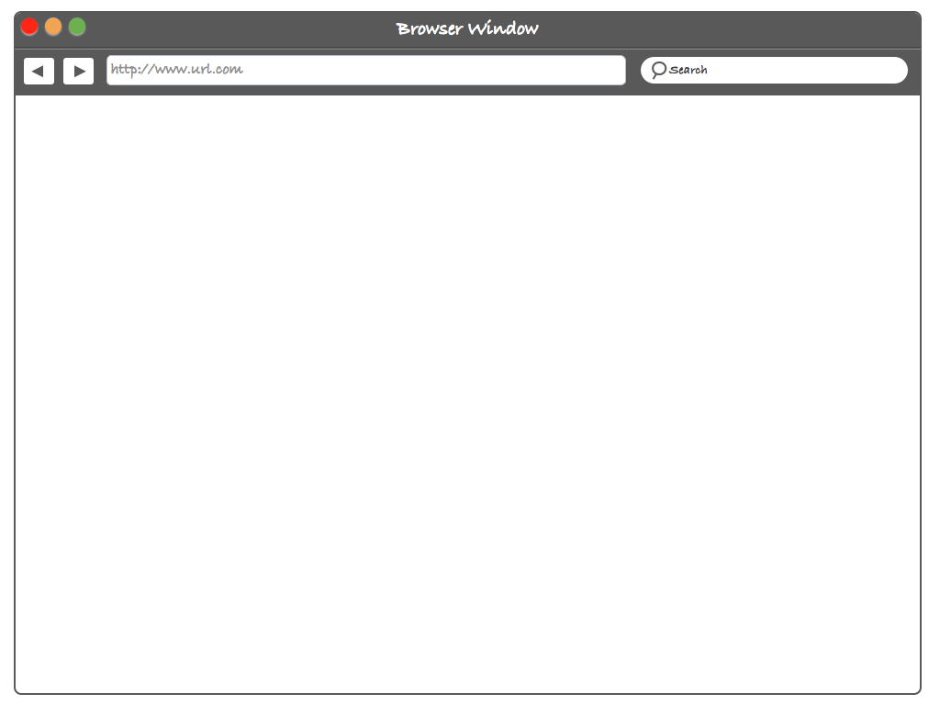





Drag and drop files here or click to upload.

Slide 2

Icon
Document Name
First Seen
Document1.pdf
06/06/15
Click to Timestamp
Document2.pdf
Submitted
Document3.pdf
27/06/14

Slide 3

Icon
Document Name
First Seen
Document1.pdf
06/06/15
Document2.pdf
Never Seen
Document3.pdf
27/06/14

Slide 4
Comparisons
 | Current COOL System | Blockchain Timestamping
Registering process | A few minutes | Immediate ( Drag and drop )
Cost | Dependent on document size | <1 cent/ document
Time it takes to retrieve timestamp | Days / weeks depending on ticket queue | Immediate

