Slide 1


Slide 2
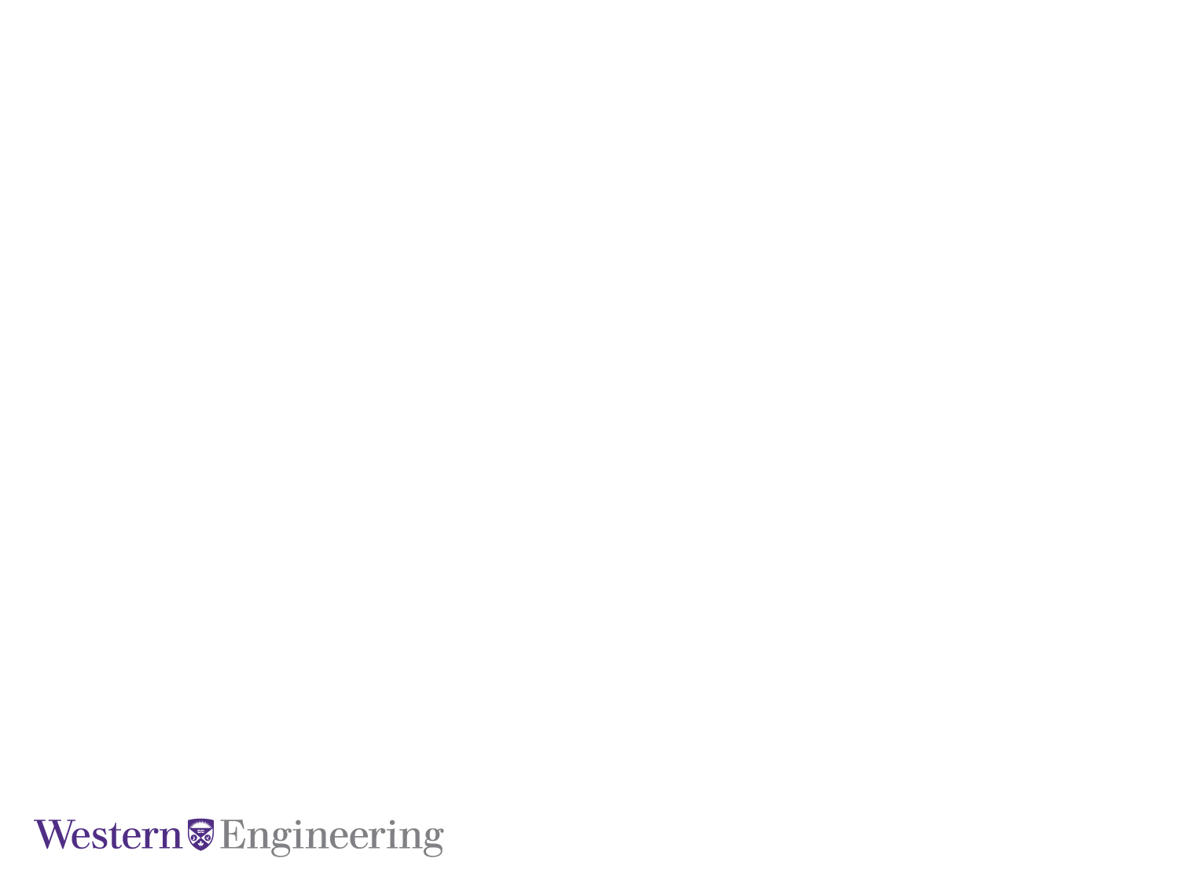
Feature Encoding Strategies for Multi-View Image Classification
M.E.Sc Candidate: Kyle Doerr
Supervisor: Dr. Samarabandu
Co-Supervisor: Dr. Wang
January 26, 2016
Electrical and Computer Engineering

Slide 3
Outline
Motivation
Contributions
Background on image classification
Feature Encoding techniques
Triangulation Embedding
Results
Conclusion
Future Work
Presentation Title Here
Notes:
find better names or something

Slide 4
Motivation
Qui vel estrum faccaep udiorit atieatio et, veris consect ionesecest.
Qui vel estrum faccaep udiorit atieatio et, veris consect ionesecest.
Qui vel estrum faccaep udiorit atieatio et, veris consect ionesecest.
Presentation Title Here
Notes:
-Past several years there has been considerable advances in CV with respect to image classificaiton & retreival
-Limited work applying CV to MV
- …. ....
-Many <industry, factory? > rely solely on humans for tasks such as identification and defect detection which is error prone
- ….. ... . ..

Slide 5
Title Here
Qui vel estrum faccaep udiorit atieatio et, veris consect ionesecest.
Qui vel estrum faccaep udiorit atieatio et, veris consect ionesecest.
Qui vel estrum faccaep udiorit atieatio et, veris consect ionesecest.
Presentation Title Here

Slide 6
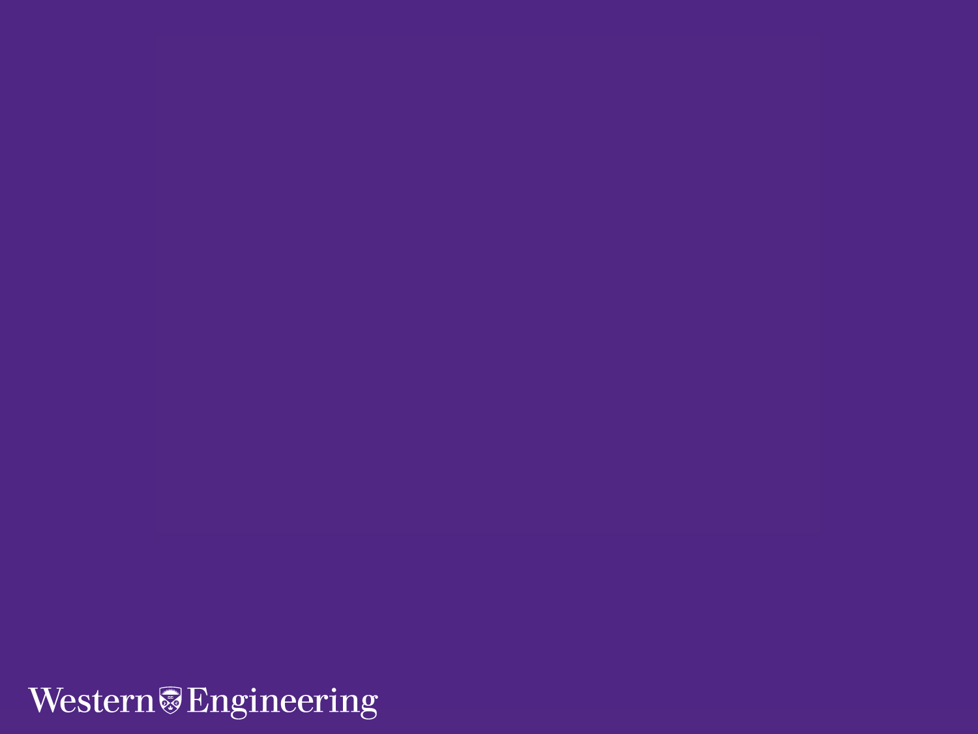
New Topic
Theme Area
Presentation Title Here

Slide 7
Title Here
Qui vel estrum faccaep udiorit atieatio et, veris consect ionesecest.
Qui vel estrum faccaep udiorit atieatio et, veris consect ionesecest.
Qui vel estrum faccaep udiorit atieatio et, veris consect ionesecest.
Presentation Title Here

Slide 8
Title Here
Presentation Title Here

Slide 9
Title Here
Presentation Title Here

Slide 10
Qui vel estrum faccaep udiorit atieatio et, veris consect ionesecest.
Qui vel estrum faccaep udiorit atieatio et, veris consect ionesecest.
Qui vel estrum faccaep udiorit atieatio et, veris consect ionesecest.
Presentation Title Here

Slide 11
Title Here
Qui vel estrum faccaep udiorit atieatio et, veris consect ionesecest.
Qui vel estrum faccaep udiorit atieatio et, veris consect ionesecest.
Qui vel estrum faccaep udiorit atieatio et, veris consect ionesecest.
Presentation Title Here

