Slide 1
CLASSIFICATION TECHNIQUES

Slide 2
DECISION TREE

Slide 3
Decision Tree:
As a loan manager, you need to identify risky loan applications to achieve a lower loan default rate. This process of classifying customers into a group of potential and non-potential customers or safe or risky loan applications is known as a classification problem.
Classification is a two-step process, learning step and prediction step.
In the learning step, the model is developed based on given training data.
In the prediction step, the model is used to predict the response for given data.
Decision Tree is one of the easiest and popular classification algorithms to understand and interpret. It can be utilized for both classification and regression kind of problem.
CONTENTS:
Decision Tree Algorithm
How does the Decision Tree algorithm work?
Attribute Selection Measures
Information Gain
Gain Ratio
Gini index
Optimizing Decision Tree Performance
Classifier Building in Scikit-learn
Pros and Cons
Conclusion

Slide 4
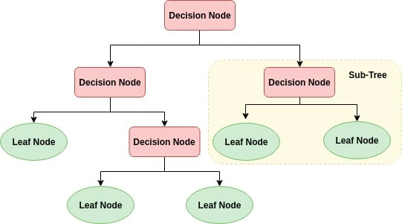
Decision Tree Algorithm:
A decision tree is a flowchart-like tree structure where an internal node represents feature(or attribute), the branch represents a decision rule, and each leaf node represents the outcome.
The topmost node in a decision tree is known as the root node.
It learns to partition on the basis of the attribute value.
It partitions the tree in recursively manner call recursive partitioning.
This flowchart-like structure helps you in decision making.
It's visualization like a flowchart diagram which easily mimics the human level thinking. That is why decision trees are easy to understand and interpret.

Slide 5
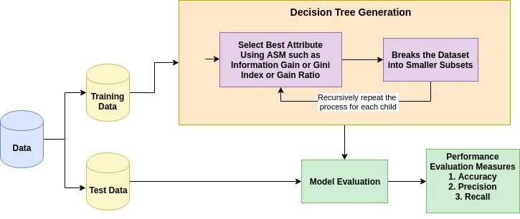
How Does The Decision Tree Algorithm Work:
The basic idea behind any decision tree algorithm is as follows:
Select the best attribute using Attribute Selection Measures(ASM) to split the records.
Make that attribute a decision node and breaks the dataset into smaller subsets.
Starts tree building by repeating this process recursively for each child until one of the condition will match:
All the tuples belong to the same attribute value.
There are no more remaining attributes.
There are no more instances.

Slide 6
Attribute Selection Measure:
Attribute selection measure is a heuristic for selecting the splitting criterion that partition data into the best possible manner.
It is also known as splitting rules because it helps us to determine breakpoints for tuples on a given node.
ASM provides a rank to each feature(or attribute) by explaining the given dataset.
Best score attribute will be selected as a splitting attribute. Most popular selection measures are Information Gain, and Gini Index
Information Gain:
Shannon invented the concept of entropy, which measures the impurity of the input set.
In physics and mathematics, entropy referred as the randomness or the impurity in the system.
In information theory, it refers to the impurity in a group of examples.
Information gain is the decrease in entropy.
Information gain computes the difference between entropy before split and average entropy after split of the dataset based on given attribute values.
ID3 (Iterative Dichotomiser) decision tree algorithm uses information gain.

Slide 7
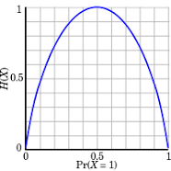



More Random ness
Shannon Entropy
Entropy More
More Impurity
Where,
Pi is the probability that an arbitrary tuple in D belongs to class Ci.
Info(D) is the average amount of information needed to identify the class label of a tuple in D.
|Dj|/|D| acts as the weight of the jth partition.
InfoA(D) is the expected information required to classify a tuple from D based on the partitioning by A.

Slide 8
Example: Table1
Id | age | income | student | Credit_rating | Class: Buys computer
1 | Youth | High | No | Fair | No
2 | Youth | High | No | Excellent | No
3 | Middle_aged | High | No | Fair | Yes
4 | Senior | Medium | No | Fair | Yes
5 | Senior | Low | Yes | Fair | Yes
6 | Senior | Low | Yes | Excellent | No
7 | Middle_aged | Low | Yes | Excellent | Yes
8 | Youth | Medium | No | Fair | No
9 | Youth | Low | Yes | Fair | Yes
10 | Senior | Medium | Yes | Fair | Yes
11 | Youth | Medium | Yes | Excellent | Yes
12 | Middle_aged | Medium | No | Excellent | Yes
13 | Middle_aged | High | Yes | Fair | Yes
14 | senior | Medium | no | Excellent | No

Slide 9
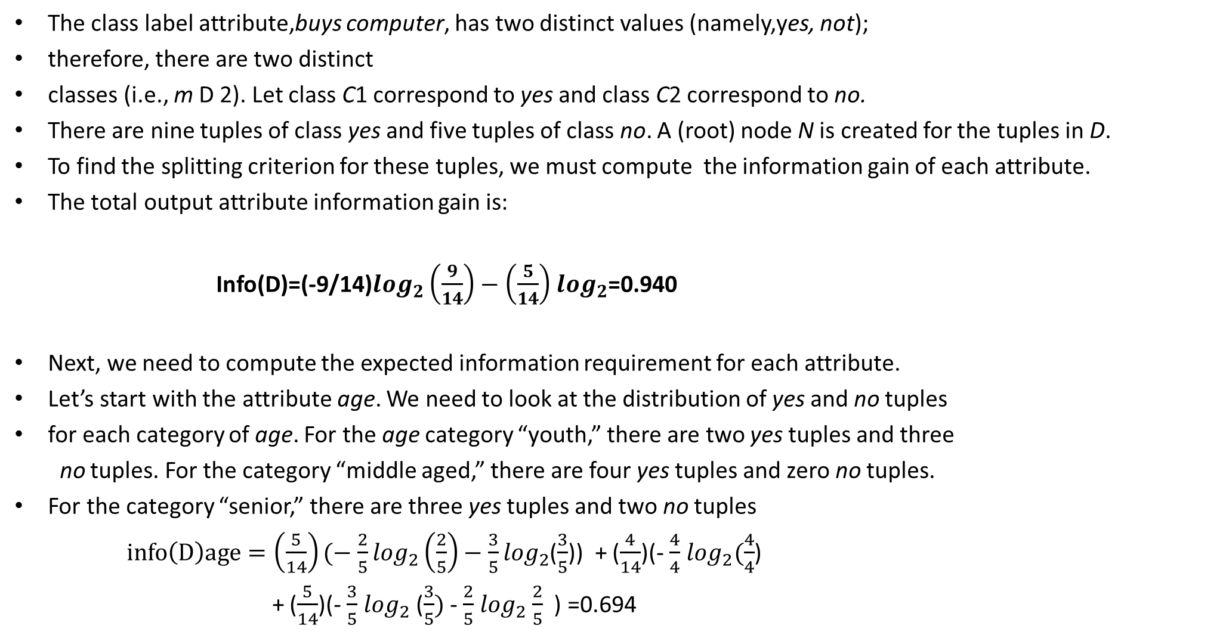
The class label attribute,buys computer, has two distinct values (namely,yes, not);
therefore, there are two distinct
classes (i.e., m D 2). Let class C1 correspond to yes and class C2 correspond to no.
There are nine tuples of class yes and five tuples of class no. A (root) node N is created for the tuples in D.
To find the splitting criterion for these tuples, we must compute the information gain of each attribute.
The total output attribute information gain is:
Info(D)=(-9/14)$\log_{2}\left(\frac{9}{14}\right)−\left(\frac{5}{14}\right)$ $\log_{2}$=0.940
Next, we need to compute the expected information requirement for each attribute.
Let’s start with the attribute age. We need to look at the distribution of yes and no tuples
for each category of age. For the age category “youth,” there are two yes tuples and three
no tuples. For the category “middle aged,” there are four yes tuples and zero no tuples.
For the category “senior,” there are three yes tuples and two no tuples
$info\left(D\right)age=\left(\frac{5}{14}\right)(−$ ${\frac{2}{5}log}_{2}\left(\frac{2}{5}\right)−\frac{3}{5}\log_{2}$($\frac{3}{5}$)) + ($\frac{4}{14}$)(- $\frac{4}{4}$ $\log_{2}(\frac{4}{4}$)
+ ($\frac{5}{14}$)(- $\frac{3}{5}$ $\log_{2}$ ($\frac{3}{5})$ - $\frac{2}{5}$ $\log_{2}$ $\frac{2}{5}$ ) =0.694

Slide 10


Therefore
Gain(age)=Info(D)-Info(D)age=0.940-0.694=0.246bits
Similarly, we can compute Gain(income) = 0.029 bits,
Gain(student)= 0.151 bits,
and Gain(credit rating)= 0.048 bits.
Because age has the highest information gain
among the attributes, it is selected as the splitting attribute. Node N is labeled with age,
and branches are grown for each of the attribute’s values.
Gain Ratio:
Information gain is biased for the attribute with many outcomes.
It means it prefers the attribute with a large number of distinct values.
For instance, consider an attribute with a unique identifier such as ID has zero info(D) because of pure partition.
This maximizes the information gain and creates useless partitioning.
C4.5, an improvement of ID3, uses an extension to information gain known as the gain ratio.
Gain ratio handles the issue of bias by normalizing the information gain using Split Info.

Slide 11



Gini Index:
Another decision tree algorithm CART (Classification and Regression Tree) uses the Gini method to create split points.
Where, pi is the probability that a tuple in D belongs to class Ci.
The Gini Index considers a binary split for each attribute.
You can compute a weighted sum of the impurity of each partition.
If a binary split on attribute A partitions data D into D1 and D2, the Gini index of D is:
The attribute with minimum Gini index is chosen as the splitting attribute.

Slide 12
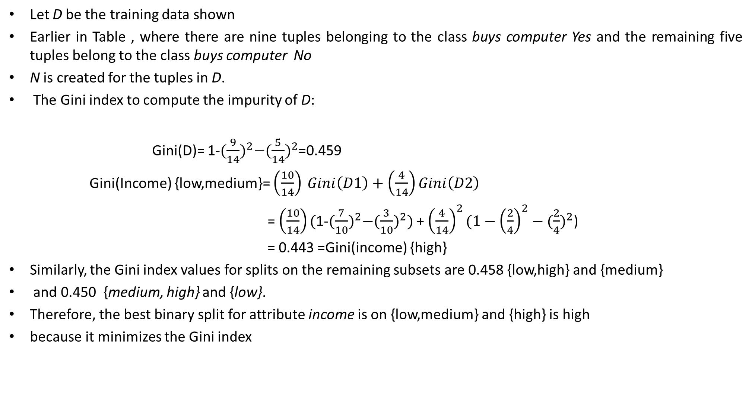
Let D be the training data shown
Earlier in Table , where there are nine tuples belonging to the class buys computer Yes and the remaining five tuples belong to the class buys computer No
N is created for the tuples in D.
The Gini index to compute the impurity of D:
Gini(D)= 1-${(\frac{9}{14})}^{2}−{(\frac{5}{14})}^{2}$=0.459
Gini(Income) {low,medium}= $\left(\frac{10}{14}\right) Gini\left(D1\right)+\left(\frac{4}{14}\right)Gini\left(D2\right)$
= $\left(\frac{10}{14}\right)($1-${(\frac{7}{10})}^{2}−({\frac{3}{10})}^{2})$ + ${\left(\frac{4}{14}\right)}^{2}(1−{\left(\frac{2}{4}\right)}^{2}−{(\frac{2}{4})}^{2}$)
= 0.443 =Gini(income) {high}
Similarly, the Gini index values for splits on the remaining subsets are 0.458 {low,high} and {medium}
and 0.450 {medium, high} and {low}.
Therefore, the best binary split for attribute income is on {low,medium} and {high} is high
because it minimizes the Gini index

Slide 13
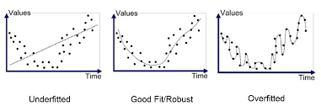
Decision Tree-Over fitting(Tree Pruning):
Machine learning is a problem of trade-offs. The classic issue is overfitting versus underfitting. Overfitting happens when a model memorizes its training data so well that it is learning noise on top of the signal. Underfitting is the opposite: the model is too simple to find the patterns in the data.

Slide 14
If you observe the diagram suppose x-axis is =Size, y-axis is =Values
During train time if you increases x(size) value increases our model fits the data very well,
that means the accuracy will increase, by adding variables
In the diagram
The first picture has less Attributes(X) it leads to underfit
The second picture has slightly more Attributes( X) it leads to Good fit
The Third Picture has a lot Attributes (X) it leads to Overfit
As X=============➔Increases
Our model becomes Brainless for Training data , It nothing but just Byhearting outputs
When you given a test data or unseen data to this model it leads High variance
That means it get more error for test data
More X
Overfit
low Bias for Train data
Trian error is less
Unseen data
Model
High variance for unseen data
Test error is more

Slide 15
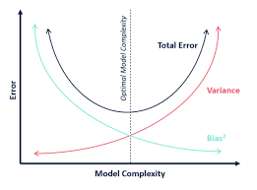
Bias –Variance Trade Off:
Key points:
Y-axis= Mean error
X-axis = Model complexity
As model increases the bias will decrease and variance will
Increase For unseen data(test) data
When bias is more variance is less
High Bias= Low variance
Low Bias= High Variance
Total Error= Bias^2 + Variance + var(error)
The above formulae should reduce to get model
As the model complexity increases ,training error decreases corresponding test error is decreases.

Slide 16
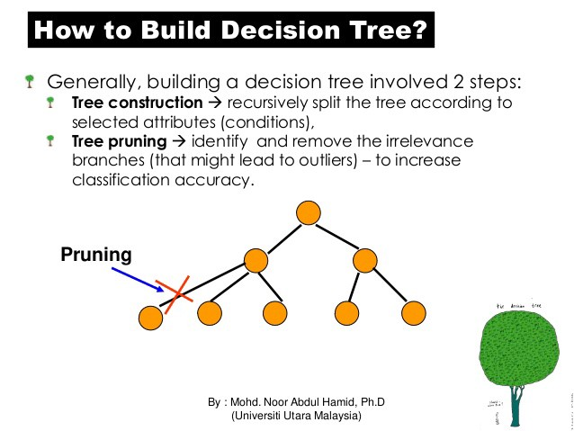
The CART algorithm will repeatedly partition data into smaller and smaller subsets until those final subsets are homogeneous in terms of the outcome variable. In practice this often means that the final subsets (known as the leaves of the tree) each consist of only one or a few data points. The tree has learned the data exactly, but a new data point that differs very slightly might not be predicted well.
Two approaches to Picking up Simpler trees:
Early stopping(Pre-pruning):
Stop the learning algorithm before the tree becomes too complex
Post-Pruning:
Pruning is a technique in machine learning and search algorithms that reduces the size of decision trees by removing sections of the tree that provide little power to classify instances. Pruning reduces the complexity of the final classifier, and hence improves predictive accuracy by the reduction of overfitting.
simplify the tree after the learning algorithm terminates

Slide 17
Steps To follow Tree Pruning:
We first make the decision tree to a large depth.
Then we start at the bottom and start removing leaves which are giving us negative returns when compared from the top.
Suppose a split is giving us a gain of say -10 (loss of 10) and then the next split on that gives us a gain of 20. A simple decision tree will stop at step 1 but in pruning, we will see that the overall gain is +10 and keep both leaves.

Slide 18
Naive Bayes

Slide 19
Naive Bayes':
Bayesian classifiers are statistical classifiers.
They can predict class membership probabilities such as the probability that a given tuple belongs
to a Particular-class.
Bayesian classification is based on Bayes’ theorem.
Studies comparing classification algorithms have found a simple Bayesian classifier
known as the naive
Bayesian classifier to be comparable in performance with decision tree and selected neural
network classifiers.
Bayesian classifiers have also exhibited high accuracy and speed when applied to large databases.
Assumption:
Naive Bayesian classifiers assume that the effect of an attribute value on a given class
is independent of the values of the other attributes.
This assumption is called class conditional independence.
It is made to simplify the computations involved and, in this sense, is considered “naive.”

Slide 20
Bayes' Theorem:
Bayes’ theorem is named after Thomas Bayes
Let X be a data tuple.
Let H be some hypothesis such as that the data tuple X belongs to a specified class C.
For classification problems, we want to determine P(H/X)
Some Definitions:
Posterior Probability:
P(H/X) is the posterior probability, or a posteriori probability, of H conditioned on X
Example:
that X is a 35-year-old customer with an income of $40,000.
Suppose that H is the hypothesis that our customer will buy a computer.
Then P(H/X) reflects the probability that customer X will buy a computer given that we know the customer’s age and income.
Prior Probability Of H:
P(H) is the prior probability, or a priori probability, of H.
For our example, this is the probability that any given customer will buy a computer, regardless of age,
income, or any other information, for that matter.
The posterior probability, P(H/X)is based on more information (e.g., customer information) than the prior probability,
P(H) which is independent of X.

Slide 21
Posterior probability:
P(X/H) is the posterior probability of X conditioned on H.
That is, it is the probability that a customer, X, is 35 years old and earns $40,000, given that we know the
customer will buy a computer.
Prior Probability Of X:
P(X) is the prior probability of X.
Using our example, it is the probability that a person from our set of customers is 35 years old and earns $40,000.
“How are these probabilities estimated?”
P(H), P(X/H), and P(X) may be estimated from the given data
Bayes’ theorem is useful in that it provides a way of calculating the posterior probability,
P(H/X), from P(H), P(X/H), and P(X).
Bayes’ theorem is
P(X/H)P(H)
P(X)
P(H/X) =

Slide 22
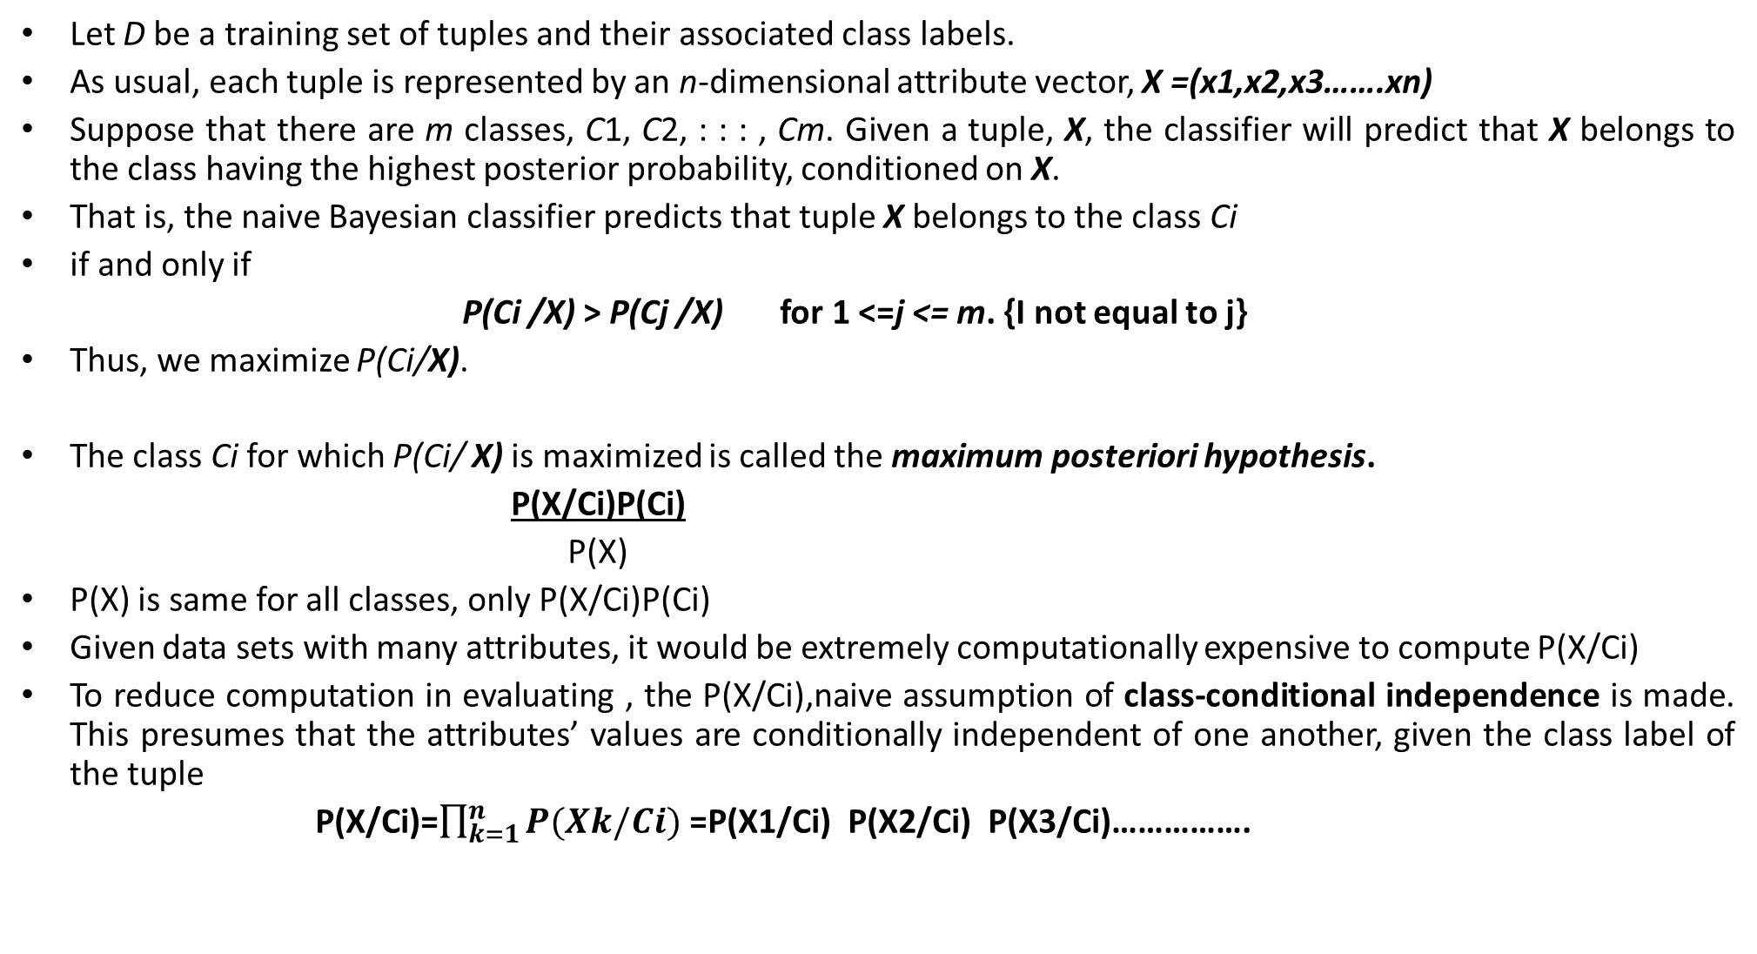
Naive Bayes' Classification:
Let D be a training set of tuples and their associated class labels.
As usual, each tuple is represented by an n-dimensional attribute vector, X =(x1,x2,x3…….xn)
Suppose that there are m classes, C1, C2, : : : , Cm. Given a tuple, X, the classifier will predict that X belongs to the class having the highest posterior probability, conditioned on X.
That is, the naive Bayesian classifier predicts that tuple X belongs to the class Ci
if and only if
P(Ci /X) > P(Cj /X) for 1 <=j <= m. {I not equal to j}
Thus, we maximize P(Ci/X).
The class Ci for which P(Ci/ X) is maximized is called the maximum posteriori hypothesis.
P(X/Ci)P(Ci)
P(X)
P(X) is same for all classes, only P(X/Ci)P(Ci)
Given data sets with many attributes, it would be extremely computationally expensive to compute P(X/Ci)
To reduce computation in evaluating , the P(X/Ci),naive assumption of class-conditional independence is made. This presumes that the attributes’ values are conditionally independent of one another, given the class label of the tuple
P(X/Ci)=$\prod_{k=1}^{n}{P(Xk/Ci})$=P(X1/Ci) P(X2/Ci) P(X3/Ci)…………….
P(Ci/X)=

Slide 23
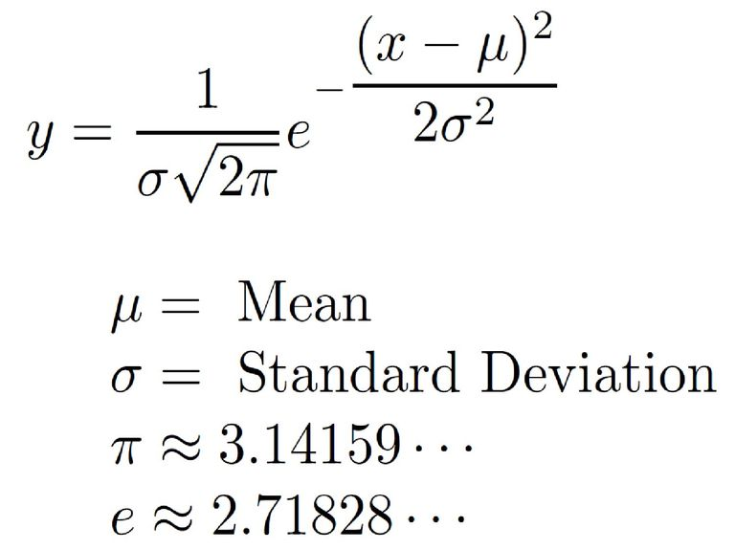
We can easily estimate the probabilities P(X1/Ci), P(X2/Ci), ….. , P(Xn/Ci) from the training tuples.
Recall that here Xk refers to the value of attribute Ak for tuple X.
For each attribute, we look at whether the attribute is categorical or continuous-valued.
For instance, to compute P(X/Ci), we consider the following:
If Ak is categorical, then P(Xk/Ci) is
the number of tuples of class Ci in D having the value Xk for Ak,
divided by the number of tuples of class Ci in D.
(b) If Ak is continuous-valued,
Then we need to do a bit more work, but the calculation is pretty straightforward.
A continuous-valued attribute is typically assumed to have a Gaussian distribution with a mean and standard deviation
P(Xk/Cj)=y(Xk,Mean(Ci),Sd(Ci))

Slide 24
Look at The Previous example Table that we solved for Decision Tree, Now same problem
we will do for Naive Bayes.
The data tuples are described by the attributes age, income, student, and credit rating.
The class label attribute, buys computer, has two distinct values namely(yes, no).
Let C1 correspond to the class buys computer =yes and C2 correspond to buys computer = no.
Question:
The tuple we wish to classify is
X =(age = youth, income = medium, student = yes, credit_rating = fair)
Step1:
Calculate P(Ci) The prior probability of each class
P(buys computer = yes) = 9/14 = 0.643
P(buys computer = no) = 5/14 = 0.357
Step2:
Compute P(X/Ci)
P(age = youth |buys computer = yes) = 2/9 = 0.222
P(age = youth | buys computer = no) = 3/5 = 0.600
P(income = medium | buys computer = yes) = 4/9 = 0.444
P(income = medium | buys computer = no) = 2/5 = 0.400
P(student = yes | buys computer = yes) = 6/9 = 0.667

Slide 25
P(student = yes | buys computer = no) = 1/5 = 0.200
P(credit rating = fair | buys computer = yes) = 6/9 = 0.667
P(credit rating = fair | buys computer = no) = 2/5 = 0.400
Using these probabilities, we obtain
P(X|buys computer = yes) = P(age = youth | buys computer = yes)X
P(income = medium | buys computer = yes)X
P(student = yes | buys computer = yes)X
P(credit rating = fair | buys computer = yes)
= (0.222)(0.444)(0.667)(0.667) = 0.044.
Similarly,
P(X|buys computer = no)= (0.600)(0.400)(0.200)(0.400) = 0.019.
Step3:
To find the class, Ci , that maximizes P(X|Ci)P(Ci),
we compute
P(X|buys computer = yes)P(buys computer = yes) = (0.044)(0.643)= 0.028
P(X|buys computer = no)P(buys computer = no) = (0.019)(0.357) = 0.007
Therefore, the naive Bayesian classifier predicts buys computer D yes for tuple X.

Slide 26
Laplacian Correction:
“What if I encounter probability values of zero?”
Suppose that for the class buys computer = yes
In some training database, D, containing 1000 tuples,
we have 0 tuples with income =low,
990 tuples with income = medium, and
10 tuples with income = high.
The probabilities of these events, without the Laplacian correction, are
0, 0.990 (from 990/1000), and 0.010 (from 10/1000), respectively
If we apply the above values into before problem P(X|buys computer = yes) it becomes Zero
Laplacian correction is used to avoid computing probability values of zero.
Correction:
Laplacian correction for the three quantities, we pretend that we have 1 more tuple
for each income-value pair. In this way, we instead obtain the following probabilities (rounded up to three decimal places):
1/1003= 0.001,991/1003= 0.988, and 11/1003=0.011, respectively.
The “corrected” probability estimates are close to their “uncorrected” counterparts, yet the zero probability value is avoided.

Slide 27
Questions For You:
Find out the difference between Decision Tree and Naive Bayes?
What are the Hyperparameters of both algorithms?

Slide 28
Model Evaluation Metrices

Slide 29
Model Evaluation and Selection:
Now that you may have built a classification model, there may be many questions going
through your mind.
For example, suppose you used data from previous sales to build A classifier to predict customer purchasing behavior.
You would like an estimate of how accurately the classifier can predict the purchasing behavior of future customers,
That is, future customer data on which the classifier has not been trained.
You may even have tried different methods to build more than one classifier and now wish to compare
their accuracy.
But what is accuracy? How can we estimate it?
Are some measures of a classifier’s accuracy more appropriate than others?
How can we obtain a reliable accuracy estimate? These questions are addressed in this section.

Slide 30
Confusion Matrix:
Predicted
 | Yes | No
Yes | TP | FN
No | FP | TN
Actual
P
N
Total P’ N’
=(P+N) or (P’+N’)
True positives (TP):
These refer to the positive tuples that were correctly labeled by the classifier. Let TP be the number of true positives.
True negatives (TN):
These are the negative tuples that were correctly labeled by the classifier. Let TN be the number of true negatives.
False positives (FP):
These are the negative tuples that were incorrectly labeled as positive (e.g., tuples of class buys computer =no for which the classifier predicted buys computer = yes). Let FP be the number of false positives.
False negatives (FN):
These are the positive tuples that were mislabeled as negative
(e.g., tuples of class buys computer =yes for which the classifier predicted buys computer = no). Let FN be the number of false negatives.

Slide 31
Accuracy:
The accuracy of a classifier on a given test set is the percentage of test set tuples that are
correctly classified by the classifier. That is
Accuracy= TP+TN
P+N
This is also referred to as the overall recognition rate of the classifier
Error Rate:
error rate or misclassification rate=(1-accuracy)= P+N
Class Imbalance Problem:
Suppose you are working on a problem to detect the cancer patient, you labeled that
if the patient has cancer =1, if the patient has not cancer=0
that means your target variable is 1, generally in public rate of the disease is very low. So you will get more zeros(0) and less ones(1), this type of data is called data or class imbalance problem.
FP+FN

Slide 32
What is the problem:
suppose you have data set of 100 observations in that
one person has cancer i.e 1, rest of all 99 persons has no cancer i.e 0
Now you are building a model ,If your model is good to identified who are has not cancer, but unable to identified who actually has cancer. Suppose out of 100 members 99 are not has cancer and 1 person has cancer.
if you apply your model it will find all 99 members has not cancer correctly, but it will not identified one person who actually gas cancer.
Then what is accuracy?
Yes….99% because your model identified 99 members correctly out off 100
But is this worth?
NO…..Because your model is missing target, here your target is identify cancer patient that are low actually .
So accuracy fails in imbalance problem
The sensitivity and specificity measures can be used, respectively, for this purpose

Slide 33
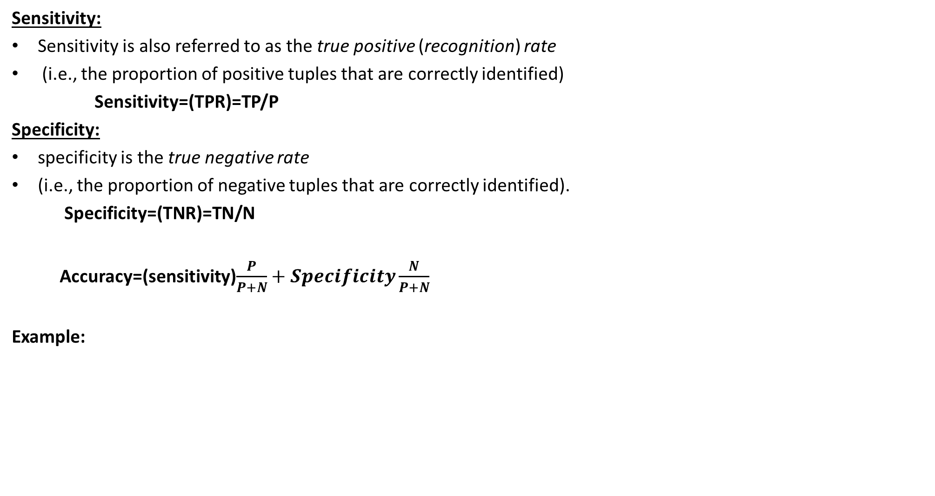
Sensitivity:
Sensitivity is also referred to as the true positive (recognition) rate
(i.e., the proportion of positive tuples that are correctly identified)
Sensitivity=(TPR)=TP/P
Specificity:
specificity is the true negative rate
(i.e., the proportion of negative tuples that are correctly identified).
Specificity=(TNR)=TN/N
Accuracy=(sensitivity)$\frac{P}{P+N}+Specificity\frac{N}{P+N}$
Example:
Predicted
Classes | Yes | No | Total | Recognition
Yes No | 90 140 | 210 9560 | 300 9700 | 30.00% 98.56%
Total | 230 | 9770 | 10,000 | 96.40
Actual

Slide 34
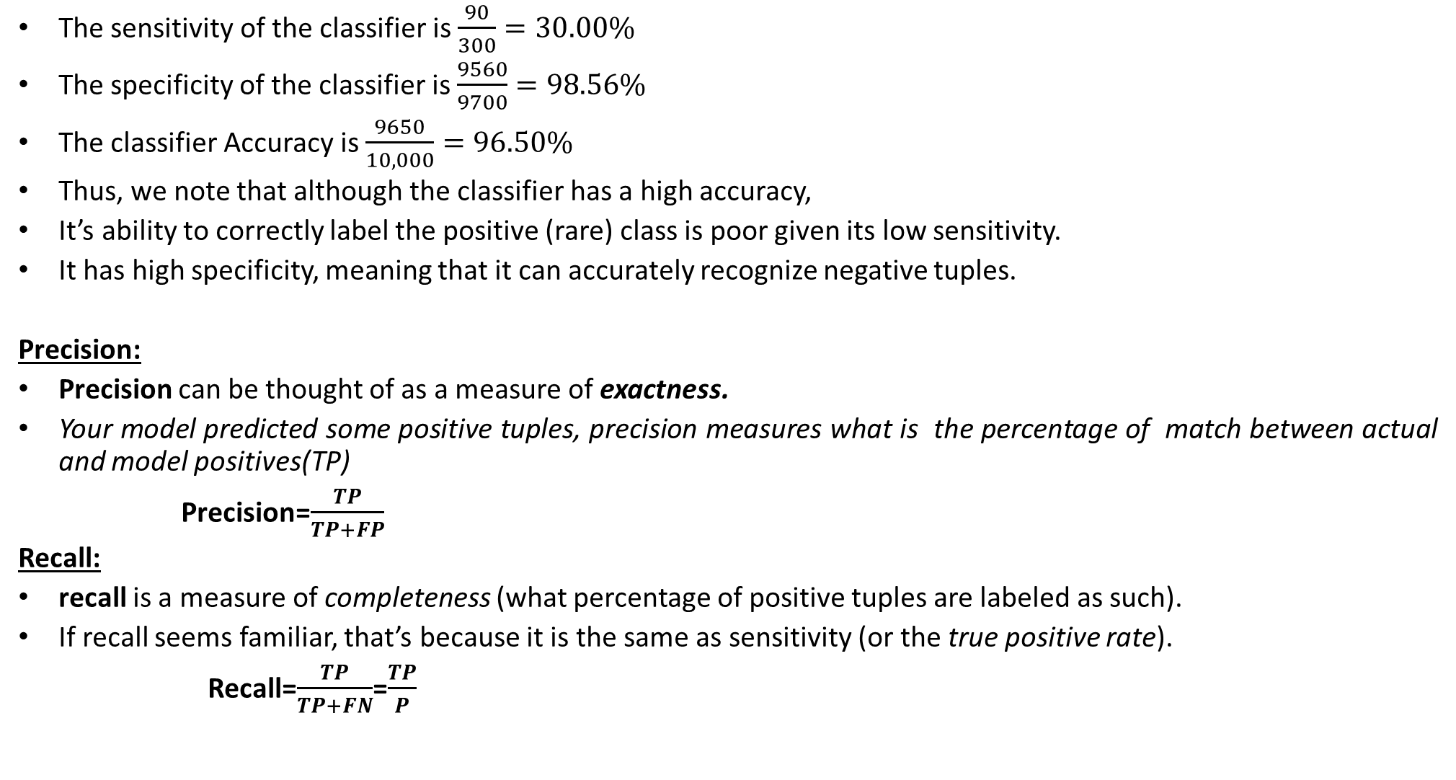
The sensitivity of the classifier is $\frac{90}{300}=30.00\%$
The specificity of the classifier is $\frac{9560}{9700}=98.56\%$
The classifier Accuracy is $\frac{9650}{10,000}=96.50\%$
Thus, we note that although the classifier has a high accuracy,
It’s ability to correctly label the positive (rare) class is poor given its low sensitivity.
It has high specificity, meaning that it can accurately recognize negative tuples.
Precision:
Precision can be thought of as a measure of exactness.
Your model predicted some positive tuples, precision measures what is the percentage of match between actual and model positives(TP)
Precision=$\frac{TP}{TP+FP}$
Recall:
recall is a measure of completeness (what percentage of positive tuples are labeled as such).
If recall seems familiar, that’s because it is the same as sensitivity (or the true positive rate).
Recall=$\frac{TP}{TP+FN}$=$\frac{TP}{P}$

Slide 35

From the figure of example
The Precision is =$\frac{90}{230}=39.13\%,$
The Recall is= $\frac{90}{300}=30.00\%$
Questions For YOU:
What is meant by if Precision=1 and 0
What is meant by if Recall =1 and 0

Slide 36
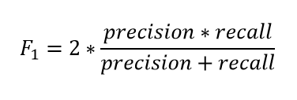
A perfect precision score of 1.0 for a class C means that every tuple that the classifier
labeled as belonging to class C does indeed belong to class C.
However, it does not tell us anything about the number of class C tuples that the classifier mislabeled.
A perfect recall score of 1.0 for C means that every item from class C was labeled as such,
but it does not tell us how many other tuples were incorrectly labeled as belonging to class C.
There tends to be an inverse relationship between precision and recall, where it is possible
to increase one at the cost of reducing the other.
F1score:
Simply F1-score is harmonic average of precision and recall
why:?
Suppose classifier A has precision(p)=95%, Recall(r)=90%
Suppose classifier A has precision(p)=98%, Recall(r)=85%
if you compare precision and recall individually on both classifiers….
Classifier A is good on Recall, Classifier B is good on Precision so which classifier you will choose….?
Confusion occurs:
That's why we go for F1 score its like Harmonic mean of two numbers

Slide 37
KEY POINTS:
Do not confuse about confusion matrix
Follow your own method to remember confusion matrix
Then derive TP,TN,FP,FP
Sensitivity deals about only True Positives(TP)
Specificity deals with only True Negative(TN)
Precision and recall both are deal with True Positive(TP)
See numerator for precision and recall only denominator will change
That’s why there is a trade off between them
F1 score give trade of both

Slide 38
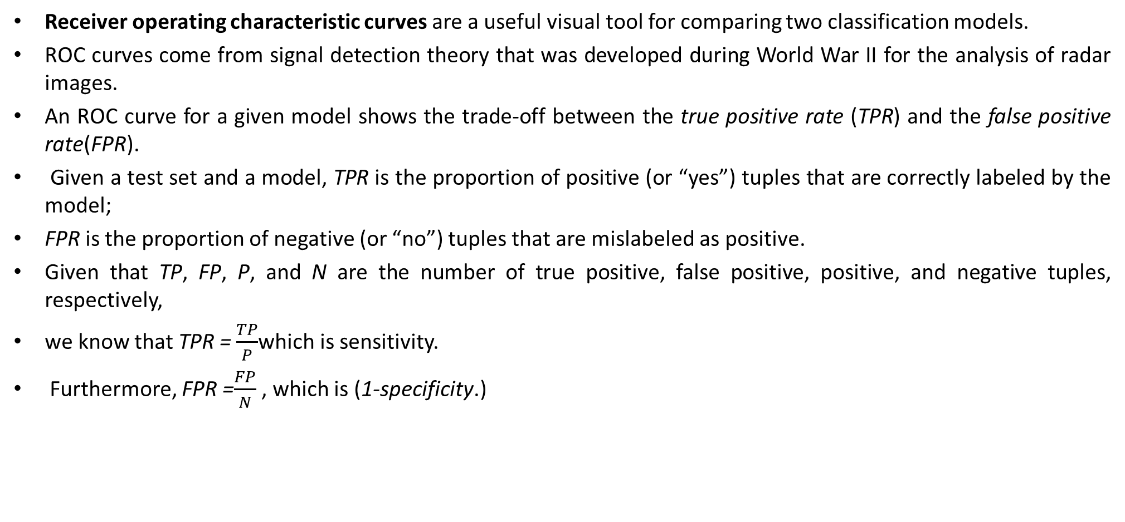
Receiver Operative Characteristics(ROC)
Receiver operating characteristic curves are a useful visual tool for comparing two classification models.
ROC curves come from signal detection theory that was developed during World War II for the analysis of radar images.
An ROC curve for a given model shows the trade-off between the true positive rate (TPR) and the false positive rate(FPR).
Given a test set and a model, TPR is the proportion of positive (or “yes”) tuples that are correctly labeled by the model;
FPR is the proportion of negative (or “no”) tuples that are mislabeled as positive.
Given that TP, FP, P, and N are the number of true positive, false positive, positive, and negative tuples, respectively,
we know that TPR = $\frac{TP}{P}$which is sensitivity.
Furthermore, FPR =$\frac{FP}{N}$ , which is (1-specificity.)

Slide 39
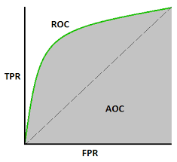
For a two-class problem, An ROC curve allows us to visualize the trade-off between
the rate at which the model can accurately recognize positive cases versus the rate at
which it mistakenly identifies negative cases as positive for different portions of the test set.
ROC curve is a measure of the accuracy of the model.

Slide 40
Example:
Tuple | CLASS | Prob | TP | FP | TN | FN | TPR | FPR
1 | P | 0.90 | 1 | 0 | 5 | 4 | 0.2 | 0
2 | P | 0.80 | 2 | 0 | 5 | 3 | 0.4 | 0
3 | N | 0.70 | 2 | 1 | 4 | 3 | 0.4 | 0.2
4 | P | 0.60 | 3 | 1 | 4 | 2 | 0.6 | 0.2
5 | P | 0.55 | 4 | 1 | 4 | 1 | 0.8 | 0.2
6 | N | 0.54 | 4 | 2 | 3 | 1 | 0.8 | 0.4
7 | N | 0.53 | 4 | 3 | 2 | 1 | 0.8 | 0.6
8 | N | 0.51 | 4 | 4 | 1 | 1 | 0.8 | 0.8
9 | P | 0.50 | 5 | 4 | 1 | 0 | 1.0 | 0.8
10 | N | 0.40 | 5 | 5 | 0 | 0 | 1.0 | 1.0

Slide 41
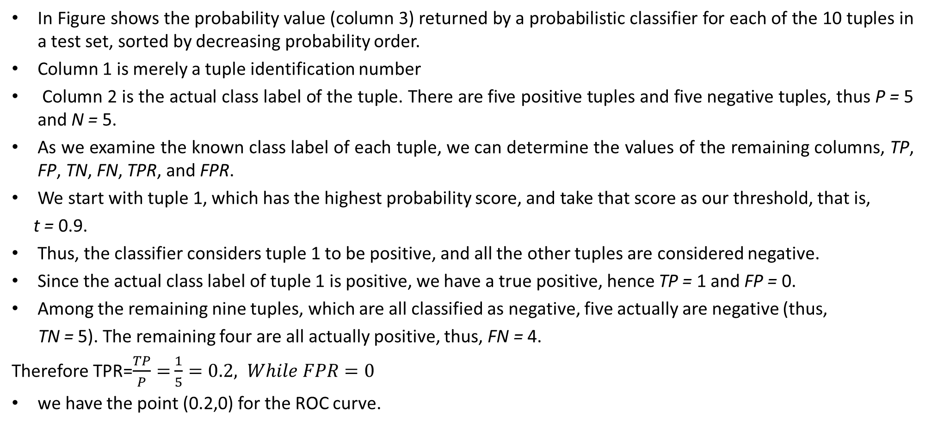
In Figure shows the probability value (column 3) returned by a probabilistic classifier for each of the 10 tuples in a test set, sorted by decreasing probability order.
Column 1 is merely a tuple identification number
Column 2 is the actual class label of the tuple. There are five positive tuples and five negative tuples, thus P = 5 and N = 5.
As we examine the known class label of each tuple, we can determine the values of the remaining columns, TP, FP, TN, FN, TPR, and FPR.
We start with tuple 1, which has the highest probability score, and take that score as our threshold, that is,
t = 0.9.
Thus, the classifier considers tuple 1 to be positive, and all the other tuples are considered negative.
Since the actual class label of tuple 1 is positive, we have a true positive, hence TP = 1 and FP = 0.
Among the remaining nine tuples, which are all classified as negative, five actually are negative (thus,
TN = 5). The remaining four are all actually positive, thus, FN = 4.
Therefore TPR=$\frac{TP}{P}=$ $\frac{1}{5}=0.2, While FPR=0$
we have the point (0.2,0) for the ROC curve.

Slide 42
Next, threshold t is set to 0.8, the probability value for tuple 2, so this tuple is now
also considered positive,
The actual class label of tuple 2 is positive, thus now TP = 2. The rest of the row can easily be
computed, resulting in the point (.0.4,0).
Next, we examine the class label of tuple 3 and let t be 0.7, the probability value returned by the classifier for that tuple.
Thus, tuple 3 is considered positive, yet its actual label is negative, and so it is a false positive. Thus, TP stays the same and FP increments so that FP = 1.
The rest of the values in the row can also be easily computed, yielding the point (0.4, 0.2)

Slide 43
Cohen’s Kappa:
Cohen's kappa coefficient (κ) is a statistic that is used to measure inter-rater reliability
for qualitative (categorical) items.
Example:
Suppose that you were analyzing data related to a group of 50 people applying for a grant. Each grant proposal was read by two readers and each reader either said "Yes" or "No" to the proposal. Suppose the disagreement count data were as follows, where A and B are readers, data on the main diagonal of the matrix (a and d) count the number of agreements and off-diagonal data (b and c) count the number of disagreements:
B
B
 | Yes | NO
YES | a | B
NO | c | d
 | Yes | No
Yes | 20 | 5
No | 10 | 15
A
A

Slide 44
Steps to calculate cohen’s kappa:
K=( p_{o}- p_{e})/(1- p_{e})
p_{o}= is the relative observed agreement among raters identical to accuracy
p_{e} is the hypothetical probability of chance agreement, using the observed data to calculate the probabilities of each observer randomly seeing each category.
p_{o = (a+d)/(a+b+c+d)}
Pyes=[(a+b)/(a+b+c+d)] [(a+c)/(a+b+c+d)
Pno=[(c+d)/(a+b+c+d)] [(b+d)(a+b+c+d)]
p_{e = Pyes+ Pno}
_{So from example:}
po =(20+15)/50=0.7 Pyes=(0.5)(0.6)=0.3 Pno=(0.5)(0.4)=0.2 p_{e= 0.3+0.2=0.5}
_{K=(0.7-0.5)/(1-0.5)=0.4}

Slide 45
The Kappa statistic varies from 0 to 1, where.
0 = agreement equivalent to chance.
0.1 – 0.20 = slight agreement.
0.21 – 0.40 = fair agreement.
0.41 – 0.60 = moderate agreement.
0.61 – 0.80 = substantial agreement.
0.81 – 0.99 = near perfect agreement
1 = perfect agreement

Slide 46
K-Nearest Neighbors

Slide 47
KNN:
we will talk about another widely used machine learning classification technique called K-nearest neighbors (KNN) . Our focus will be primarily on how does the algorithm work and how does the input parameter affect the output/prediction.
The KNN algorithm assumes that similar things exist in close proximity. In other words, similar things are near to each other.
When do we use KNN algorithm?
KNN can be used for both classification and regression predictive problems. However, it is more widely used in classification problems in the industry. To evaluate any technique we generally look at 3 important aspects:
1. Ease to interpret output
2. Calculation time
3. Predictive Power

Slide 48
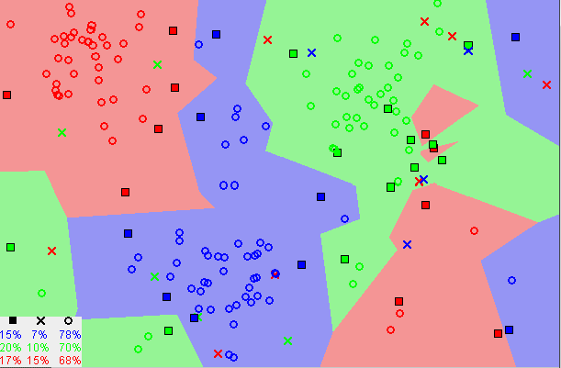
Notice in the image above that most of the time, similar data points are close to each other.
KNN captures the idea of similarity (sometimes called distance, proximity, or closeness) with some mathematics we might have learned in our childhood— calculating the distance between points on a graph.
There are other ways of calculating distance, and one way might be preferable depending on the problem we are solving. However, the straight-line distance (also called the Euclidean distance) is a popular and familiar choice.

Slide 49
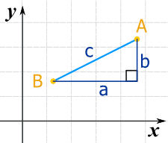
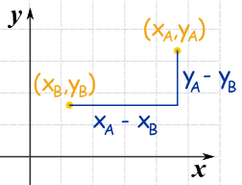
We can run lines down from A, and along from B, to make a Right-Angled Triangle.
And with a little help from Pythagoras we know that:
a² + b² = c²
Now label the coordinates of points A and B.
x_{A} means the x-coordinate of point A y_{A} means the y-coordinate of point A
The horizontal distance a is (x_{A} − x_{B})
The vertical distance b is (y_{A} − y_{B})
Start with:c² = a² + b²
Put in the calculations for a and b:c² = (x_{A} − x_{B})² + (y_{A} − y_{B})²
Square root of both sides:

Slide 50
Steps To Follow KNN:
The KNN Algorithm
Load the data
Initialize K to your chosen number of neighbors
For each example in the data
Calculate the distance between the query example and the current example from the data.
Add the distance and the index of the example to an ordered collection
Sort the ordered collection of distances and indices from smallest to largest (in ascending order) by the distances
Pick the first K entries from the sorted collection
Get the labels of the selected K entries
If regression, return the mean of the K labels
If classification, return the mode or take majority votes of the K labels

Slide 51
Example:
Step 1:
Data:
We have from the people survey and objective testing with two attributes x1=acid durability
X2=strength to classify whether a special paper tissue is good or not.
X1 | X2 | Y
7 | 7 | Bad
7 | 4 | Bad
3 | 4 | Good
1 | 4 | Good
Question:
If new tuple X1=3, and X2=7 what is Y?

Slide 52
Step2: Determine K value, assume k=3
Step3: Calculate distance between Query tuple with all training tuple
Query tuple (3,7)
X1 | X2 | Distance(Euclidian)
7 | 7 | (7-3)^2+(7-7)^2=16
7 | 4 | (7-3)^2+(4-7)^2=25
3 | 4 | (3-3)^2+(4-7)^2=9
1 | 4 | (1-3)^2+(4-7)^2=13
Step4: Sort the distance and determine nearest neighbors based on k-th minimum distance
X1 | X2 | Distance(in square) | Rank | Is it including k<=3
7 | 7 | 16 | 3 | Yes
7 | 4 | 25 | 4 | No
3 | 4 | 9 | 1 | Yes
1 | 4 | 13 | 2 | Yes

Slide 53
Step5: Gather the Y category of training data examples
X1 | X2 | Distance | Rank | Is it includes k<=3 | Y
7 | 7 | 16 | 3 | Yes | Bad
7 | 4 | 25 | 4 | No | ---------
3 | 4 | 9 | 1 | Yes | Good
1 | 4 | 13 | 2 | Yes | Good
Row 2, rank is 4
That means it is not in nearest neighbors so we will not consider corresponding Y value
Step6: Use simple majority of nearest neighbors we have Two Goods and One Bad
Therefore X1=3,X2=7 will goes into Good category

Slide 54
Choosing the right value for K:
To select the K that’s right for your data, we run the KNN algorithm several times with different values of K and choose the K that reduces the number of errors we encounter while maintaining the algorithm’s ability to accurately make predictions when it’s given data it hasn’t seen before.
Here are some things to keep in mind:
As we decrease the value of K to 1, our predictions become less stable. If K=1 our query will deal with only one neighbor it leads to overfit the data.
Inversely, as we increase the value of K, our predictions become more stable due to majority voting / averaging, and thus, more likely to make more accurate predictions (up to a certain point). Eventually, we begin to witness an increasing number of errors. It is at this point we know we have pushed the value of K too far.
In cases where we are taking a majority vote (e.g. picking the mode in a classification problem) among labels, we usually make K an odd number to have a tiebreaker.

Slide 55
Advantages:
The algorithm is simple and easy to implement.
There’s no need to build a model, tune several parameters, or make additional assumptions.
The algorithm is versatile. It can be used for classification, and regression.
Disadvantages:
The algorithm gets significantly slower as the number of examples and/or predictors/independent variables increase.

Slide 56
Ensemble Methods

Slide 57
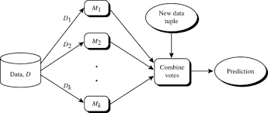
Ensemble Methods:
Ensemble Methods are used for increasing classification accuracy
An ensemble for classification is a composite model, made up of a combination of classifiers.
The individual classifiers vote, and a class label prediction is returned by the ensemble based on the collection of votes.
Ensembles tend to be more accurate than their component classifiers.

Slide 58
Bagging, boosting, and random forests are examples of ensemble methods
In figure An ensemble combines a series of k learned models (or base classifiers),M1, M2, …., Mk,
with the aim of creating an improved composite classification model, M.
A given data set, D, is used to create k training sets, D1, D2, …. , Dk, Di(1<=i<=k-1) is used to generate classifier Mi .
Given a new data tuple to classify, the base classifiers each vote by returning a class prediction.
The ensemble returns a class prediction based on the votes of the base classifiers.
An ensemble tends to be more accurate than its base classifiers.
For example, consider an ensemble that performs majority voting.
That is, given a tuple X to classify, it collects the class label predictions returned from the base classifiers and outputs the class
in majority.
The base classifiers may make mistakes, but the ensemble will misclassify X only if over half of the base classifiers are in error. Ensembles yield better results when there is significant diversity among the models.
That is, ideally, there is little correlation among classifiers.
The classifiers should also perform better than random guessing. Each base classifier can be allocated to a different CPU and so ensemble methods are parallelizable.

Slide 59
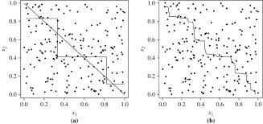
Decision boundary by (a) a single decision tree and (b) an ensemble of decision trees for a
linearly separable problem (i.e., where the actual decision boundary is a straight line). The
decision tree struggles with approximating a linear boundary. The decision boundary of the
ensemble is closer to the true boundary

Slide 60
Bootstrap:
The bootstrap method samples the given training tuples uniformly with replacement.
That is, each time a tuple is selected, it is equally likely to be selected again and re-added to the training set.
For instance, imagine a machine that randomly selects tuples for our training set.
In sampling with replacement, the machine is allowed to select the same tuple more than once.
There are several bootstrap methods. A commonly used one is the .632 bootstrap, which works as follows.
Suppose we are given a data set of d tuples. The data set is sampled d times, with replacement, resulting in a bootstrap sample or training set of d samples.
It is very likely that some of the original data tuples will occur more than once in this sample.
The data tuples that did not make it into the training set end up forming the test set.
Suppose we were to try this out several times. As it turns out, on average, 63.2% of the original data tuples will end up in the bootstrap sample, and the remaining 36.8% will form the test set (hence, the name, .632 bootstrap).

Slide 61
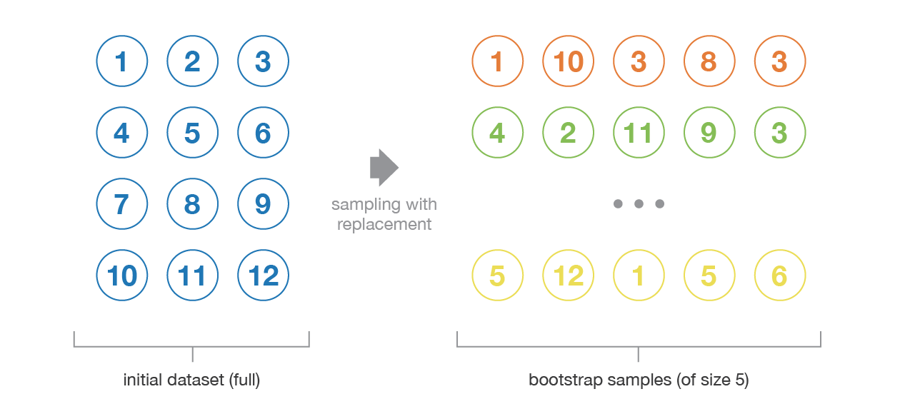
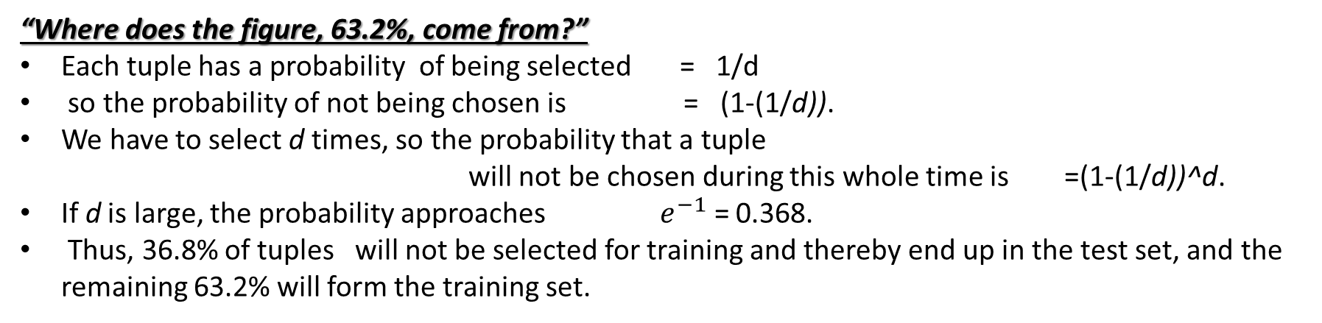
“Where does the figure, 63.2%, come from?”
Each tuple has a probability of being selected = 1/d
so the probability of not being chosen is = (1-(1/d)).
We have to select d times, so the probability that a tuple
will not be chosen during this whole time is =(1-(1/d))^d.
If d is large, the probability approaches ${ e}^{−1}$ = 0.368.
Thus, 36.8% of tuples will not be selected for training and thereby end up in the test set, and the remaining 63.2% will form the training set.

Slide 62
Bagging:
We now take an intuitive look at how bagging works as a method of increasing accuracy.
Suppose that you are a patient and would like to have a diagnosis made based on your symptoms.
Instead of asking one doctor, you may choose to ask several.
If a certain diagnosis occurs more than any other, you may choose this as the final or best diagnosis.
That is, the final diagnosis is made based on a majority vote, where each doctor gets an equal vote.
Now replace each doctor by a classifier, and you have the basic idea behind bagging.
Intuitively, a majority vote made by a large group of doctors may be more reliable than a majority vote made
by a small group.
Given a set, D, of d tuples, bagging works as follows.
For iteration i (i= 1, 2, ….. , k) a training set, Di , of d tuples is sampled with replacement from the original set of
tuples, D. Note that the term bagging stands for bootstrap aggregation.
Each training set is a bootstrap sample,
Because sampling with replacement is used, some of the original tuples of D may not be included in Di , whereas others may occur more than once. A classifier model, Mi , is learned for each training set, Di .
To classify an unknown tuple, X, each classifier, Mi , returns its class prediction, which counts as one vote.
The bagged classifier, M, counts the votes and assigns the class with the most votes to X.
Bagging can be applied to the prediction of continuous values by taking the average value of each prediction for a given test tuple. The

Slide 63
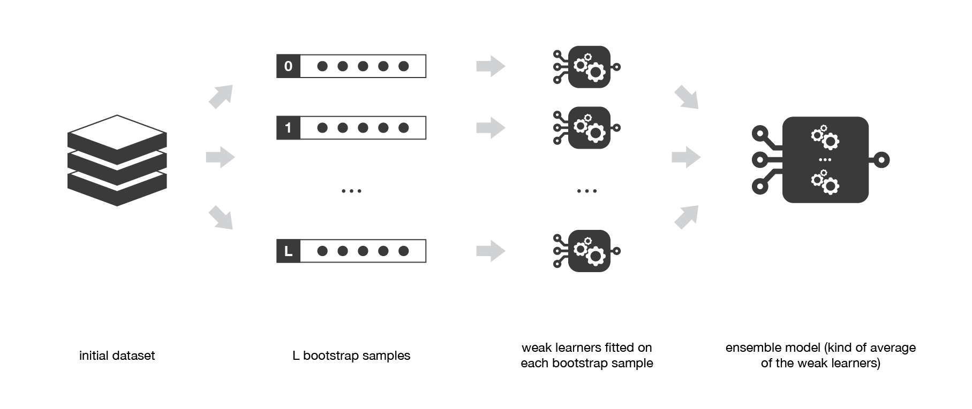
Finally, we can mention that one of the big advantages of bagging is that it can be parallelised. As the different models are fitted independently from each others, intensive parallelisation techniques can be used if required.

Slide 64
Boosting:
The term ‘Boosting’ refers to a family of algorithms which converts weak learner to strong learners.
Let’s understand this definition in detail by solving a problem of spam email identification:
How would you classify an email as SPAM or not? Like everyone else, our initial approach would be to identify ‘spam’ and ‘not spam’ emails using following criteria. If:
Email has only one image file (promotional image), It’s a SPAM
Email has only link(s), It’s a SPAM
Email body consist of sentence like “You won a prize money of $ xxxxxx”, It’s a SPAM
Email from our official domain “metu.edu.tr” , Not a SPAM
Email from known source, Not a SPAM
Above, we’ve defined multiple rules to classify an email into ‘spam’ or ‘not spam’. But, do you think these rules individually are strong enough to successfully classify an email? No.
Individually, these rules are not powerful enough to classify an email into ‘spam’ or ‘not spam’. Therefore, these rules are called as weak learner.

Slide 65
To convert weak learner to strong learner, we’ll combine the prediction of each weak learner using methods like: • Using average/ weighted average • Considering prediction has higher vote
For example: Above, we have defined 5 weak learners. Out of these 5, 3 are voted as ‘SPAM’ and 2 are voted as ‘Not a SPAM’. In this case, by default, we’ll consider an email as SPAM because we have higher(3) vote for ‘SPAM’.
How Boosting Algorithms works?
To find weak rule, we apply base learning algorithms with a different distribution. Each time base learning algorithm is applied, it generates a new weak prediction rule. This is an iterative process. After many iterations, the boosting algorithm combines these weak rules into a single strong prediction rule.
For choosing the right distribution, here are the following steps:
Step 1: The base learner takes all the distributions and assign equal weight or attention to each observation.
Step 2: If there is any prediction error caused by first base learning algorithm, then we pay higher attention to observations having prediction error. Then, we apply the next base learning algorithm.
Step 3: Iterate Step 2 till the limit of base learning algorithm is reached or higher accuracy is achieved.
Finally, it combines the outputs from weak learner and creates a strong learner which eventually improves the prediction power of the model. Boosting pays higher focus on examples which are misclassiﬁed or have higher errors by preceding weak rules.

Slide 66
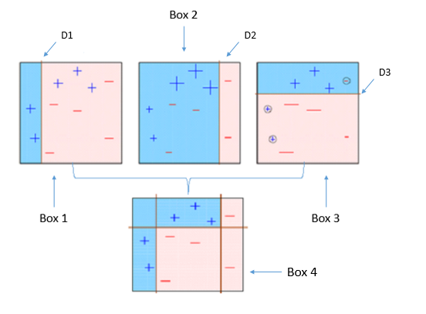
AdaBoost(Adaptive Boosting):
Box 1: You can see that we have assigned equal weights to each data point and applied a decision stump to classify them as + (plus) or – (minus). The decision stump (D1) has generated vertical line at left side to classify the data points. We see that, this vertical line has incorrectly predicted three + (plus) as – (minus). In such case, we’ll assign higher weights to these three + (plus) and apply another decision stump.

Slide 67
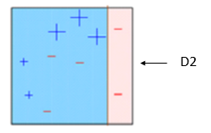
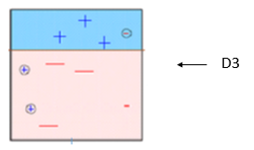
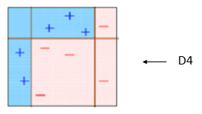
Box 2: Here, you can see that the size of three incorrectly predicted + (plus) is bigger as compared to rest of the data points. In this case, the second decision stump (D2) will try to predict them correctly. Now, a vertical line (D2) at right side of this box has classified three misclassified + (plus) correctly. But again, it has caused misclassification errors. This time with three -(minus). Again, we will assign higher weight to three – (minus) and apply another decision stump.
Box 3: Here, three – (minus) are given higher weights. A decision stump (D3) is applied to predict these misclassified observation correctly. This time a horizontal line is generated to classify + (plus) and – (minus) based on higher weight of misclassified observation.
Box 4: Here, we have combined D1, D2 and D3 to form a strong prediction having complex rule as compared to individual weak learner. You can see that this algorithm has classified these observation quite well as compared to any of individual weak learner.

Slide 68


Math's Behind this Algo:
How do we assign weight to observations?
We always start with a uniform distribution assumption. Lets call it as D₁ which is 1/n for all n observations.
Step 1 . We assume an alpha(t)
Step 2: Get a weak classifier h(t)
Step 3: Update the population distribution for the next step
where
Output the final hypothesis

Slide 69
Gradient Boosting:
In gradient boosting, it trains many models sequentially. Each new model gradually minimizes the loss function (y = ax + b + e, e needs special attention as it is an error term) of the whole system using Gradient Descent method. The learning procedure consecutively fit new models to provide a more accurate estimate of the response variable.
The principle idea behind this algorithm is to construct new base learners which can be maximally correlated with negative gradient of the loss function, associated with the whole ensemble.
Assume, you are given a previous model M to improve on. Currently you observe that the model has an accuracy of 80% (any metric). How do you go further about it?
One simple way is to build an entirely different model using new set of input variables and trying better ensemble learners. On the contrary, I have a much simpler way to suggest. It goes like this:
Y = M(x) + error
What if I am able to see that error is not a white noise but have same correlation with outcome(Y) value. What if we can develop a model on this error term? Like,
error = G(x) + error2

Slide 70
Probably, you’ll see error rate will improve to a higher number, say 84%. Let’s take another step and regress against error2.
error2 = H(x) + error3
Now we combine all these together :
Y = M(x) + G(x) + H(x) + error3
This probably will have an accuracy of even more than 84%. What if I can find an optimal weights for each of the three learners,
Y = alpha * M(x) + beta * G(x) + gamma * H(x) + error4

Slide 71
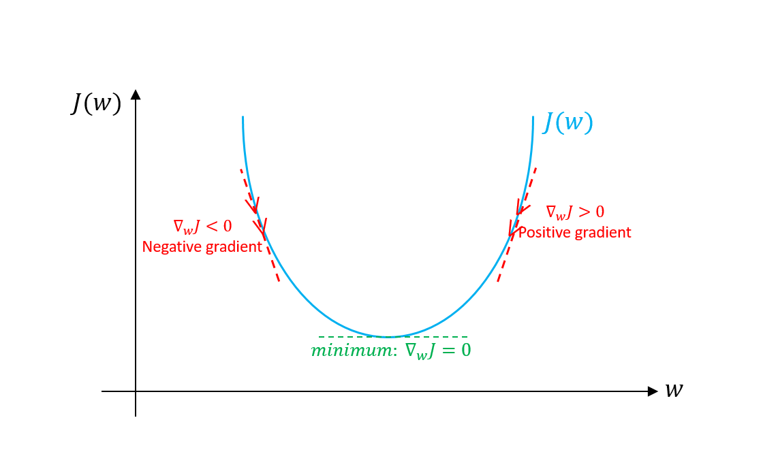
Gradient Descent:
Gradient descent is an optimization algorithm used to minimize some function by iteratively moving in the direction of steepest descent as defined by the negative of the gradient. In machine learning, we use gradient descent to update the parameters of our model. Parameters refer to coefficients in Linear Regression and weights in neural networks.
Learning rate(p):
The size of these steps is called the learning rate. With a high learning rate we can cover more ground each step, but we risk overshooting the lowest point since the slope of the hill is constantly changing. With a very low learning rate, we can confidently move in the direction of the negative gradient since we are recalculating it so frequently. A low learning rate is more precise, but calculating the gradient is time-consuming, so it will take us a very long time to get to the bottom.

Slide 72
Bagging vs Boosting
No clear winner; usually depends on the data
Bagging is computationally more efficient than boosting (note that bagging can train the M models in parallel, boosting can’t)
Both reduce variance (and overfitting) by combining different models
The resulting model has higher stability as compared to the individual ones
Bagging usually can’t reduce the bias, boosting can (note that in boosting, the training error steadily decreases)
Bagging usually performs better than boosting if we don’t have a high bias and only want to reduce variance (i.e., if we are overfitting)

Slide 73
XGBoosting (Extreme Gradient Boosting)
Ever since its introduction in 2014, XGBoost has been lauded as the holy grail of machine learning hackathons and competitions. From predicting ad click-through rates to classifying high energy physics events, XGBoost has proved its mettle in terms of performance – and speed.
Execution Speed: Generally, XGBoost is fast. Really fast when compared to other implementations of gradient boosting. But newly introduced LightGBM is faster than XGBoosting.
Model Performance: XGBoost dominates structured or tabular datasets on classification and regression predictive modeling problems. The evidence is that it is the go-to algorithm for competition winners on the Kaggle competitive data science platform
The XGBoost library implements the gradient boosting decision tree algorithm.
This algorithm goes by lots of different names such as gradient boosting, multiple additive regression trees, stochastic gradient boosting or gradient boosting machines.
Boosting is an ensemble technique where new models are added to correct the errors made by existing models. Models are added sequentially until no further improvements can be made. A popular example is the AdaBoost algorithm that weights data points that are hard to predict.
Gradient boosting is an approach where new models are created that predict the residuals or errors of prior models and then added together to make the final prediction. It is called gradient boosting because it uses a gradient descent algorithm to minimize the loss when adding new models.
This approach supports both regression and classification predictive modeling problems.

Slide 74


Boosting consists of three simple steps:
An initial model F₀ is defined to predict the target variable y. This model will be associated with a residual (y – F₀)
A new model h₁ is fit to the residuals from the previous step
Now, F₀ and h₁ are combined to give F₁, the boosted version of F₀. The mean squared error from F₁ will be lower than that from F₀:
To improve the performance of F₁, we could model after the residuals of F₁ and create a new model F₂:
This can be done for ‘m’ iterations, until residuals have been minimized as much as possible:
Here, the additive learners do not disturb the functions created in the previous steps. Instead, they impart information of their own to bring down the errors.

Slide 75
Unique features of XGBoost
XGBoost is a popular implementation of gradient boosting. Let’s discuss some features of XGBoost that make it so interesting.
Regularization: XGBoost has an option to penalize complex models through both L1 and L2 regularization. Regularization helps in preventing overfitting
Handling sparse data: Missing values or data processing steps like one-hot encoding make data sparse. XGBoost incorporates a sparsity-aware split finding algorithm to handle different types of sparsity patterns in the data

Slide 76
Support Vector Machines

Slide 77
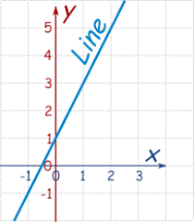

Little Math's:
Line:
When we talk about 2-Dimensional ,let assume x,y forms 2D space
Then the line equation is $y=mx+c$ where m=slope, c=constant
We can write another form of equation ax+by+c=0===> y= -( $\frac{b}{a}) x −\left(\frac{c}{a}\right)$
Suppose if we take x1,x2 are forms 2D space

Slide 78
Omkar N

