Slide 1
ESRI’s JavaScript API
By
Paul Reichart; Nick Erlacker

Slide 2
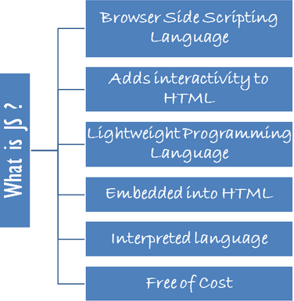
What is JavaScript
an object-oriented computer programming language commonly used to create interactive effects within web browsers.

Slide 3
ArcGIS API for JavaScript
The ArcGIS API for JavaScript is a lightweight way to embed maps and tasks in web applications. You can get these maps from ArcGIS Online, your own ArcGIS Server or others' servers.
Version 3.12

Slide 4
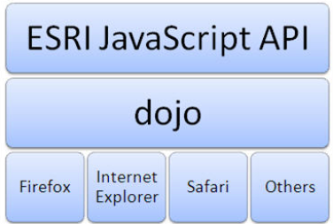

Slide 5
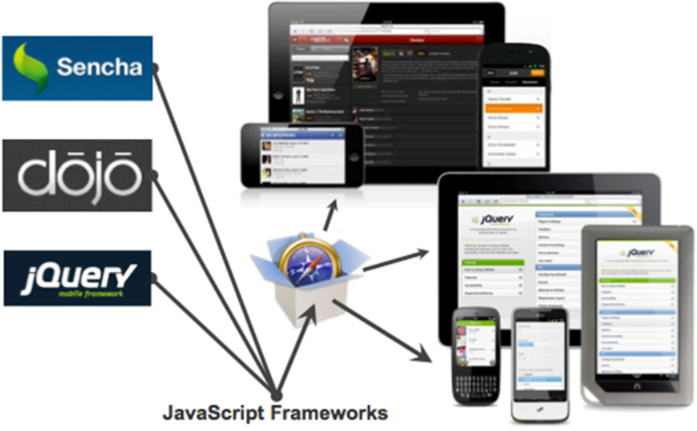

Slide 6
Let’s dive in
https://developers.arcgis.com/javascript/

Slide 7
Debugging
Developer Tools
Console
Net Traffic
Element Inspector

Slide 8
Developer Tools
Firebug for Firefox or built in
Chrome (ctrl+shift+i)
IE (F12)
Safari - Web Inspector (ctrl+alt+i)

Slide 9
Console
Shows errors
Add console.log(“Text here”); to your JavaScript
Enter commands in command editor
dojo.toJson(map.extent.toJson());
map.geographicExtent.getCenter();
Enter variable names to check value (if it’s global)

Slide 10
Net Traffic
See what’s slowing it down
Shows speed of everything being loaded

Slide 11
Element Inspector
See style of selected element
Change values to see what looks good
Copy and put it in your html or css file
display: none;

Slide 12
Debugging Walkthrough
Copy to your editor
github.com/preichart/BrokenJSMap
Run and enable debugging

Slide 13
In the beginning…..
Author
Create Resources
ArcGIS Desktop
Publish
Uses Resource
Creates service
Consume
Use service
Web or desktop

Slide 14
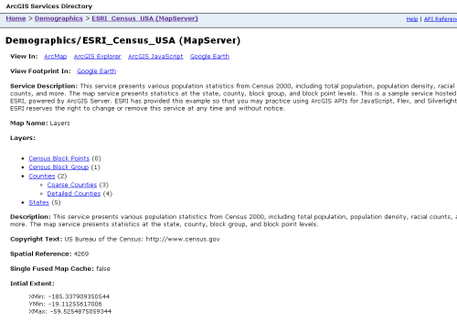
Which takes us too….
Browse contents
This is where you will
get your information

Slide 15
Service Directories
http://msdisweb-nn.col.missouri.edu:6080/arcgis/rest/services/
http://sampleserver6.arcgisonline.com/arcgis/rest/services
http://gis.srh.noaa.gov/arcgis/rest/services

Slide 16
Different types of layers
ArcGISDynamicMapServiceLayer
ArcGISTiledMapServiceLayer
FeatureLayer
GraphicsLayer

Slide 17
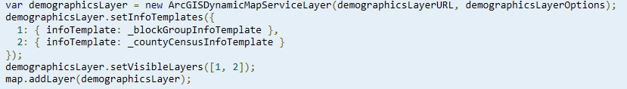
ArcGISDynamicMapServiceLayer
Create maps
Query data from layers in the service
Set layer definitions
Control layer visibility
Time related information
Export map as an image
Control transparency

Slide 18
ArcGISTiledMapServiceLayer
Works with cached map services exposed by ArcGIS Server
Performance can be improved with this type map service layer
Constructor
url = URL to ArcGIS Server map service
options?
id = ID to assign to the layer
opacity = transparency of layer
visible = initial visibility of layer (true = visible)

Slide 19
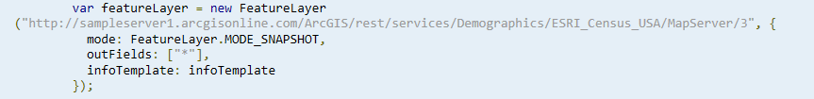
FeatureLayer
This is the layer you would want to use if you want to edit the data
It (unlocks) the features behind the service

Slide 20
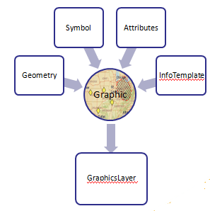
GraphicsLayer
Points, lines, or polygons drawn on top of the existing map layers
Created by the user or application
Graphic is a container for four things (optional)
Geometry
Where the graphic is located
Symbol
How the graphic looks
Attributes
Name-value pairs that describe the graphic
Info Template
Defines the format of the InfoWindow
that appears when a graphic is clicked

Slide 21
Helpful links
JavaScript Beautifier (http://jsbeautifier.org/)
ArcGIS API (https://developers.arcgis.com/javascript/)
ESRI out on GitHub (http://esri.github.io/)
JSONLint (http://jsonlint.com/)
Code Generator (http://swingley.github.io/arg/)
Additional Material
The Configurable Map Viewer (https://github.com/cmv/cmv-app)

