Slide 1
Personality-affected Empathetic Chatbot
Zhiyuan Wen

Slide 2
Overview
Background and Motivation
Problem Formulation
Current Progress & Plan
Demonstration

Slide 3
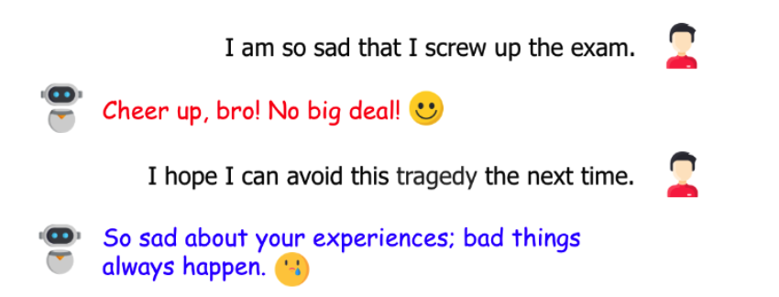
Background and Motivation
During the pandemic and the economic recession in recent years, the need for empathetic chatbots to alleviate mental health issues is emerging.
Most existing empathetic chatbots fail to obtain users’ trust due to inconsistent conversation skills. The reason is they are trained with massive anonymous dialogues from different speakers.

Slide 4
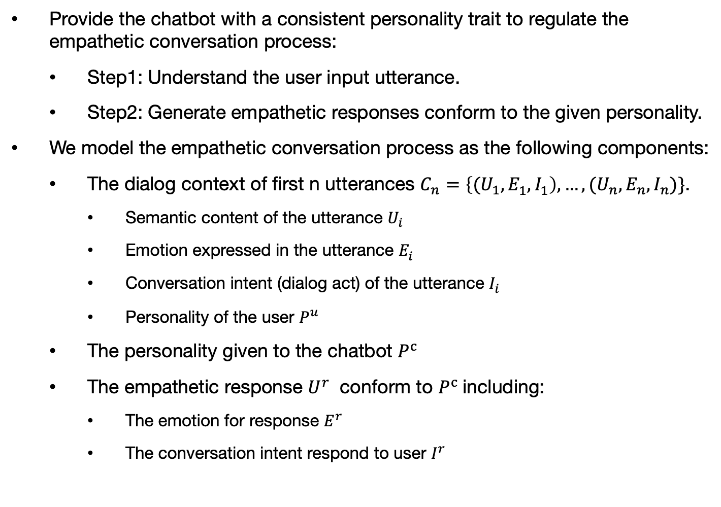
Problem Formulation
Provide the chatbot with a consistent personality trait to regulate the empathetic conversation process:
Step1: Understand the user input utterance.
Step2: Generate empathetic responses conform to the given personality.
We model the empathetic conversation process as the following components:
The dialog context of first n utterances $C_{n}=\left\{{(U}_{1}, E_{1}^{ },I_{1}^{ }\right),…,{(U}_{n}, E_{n}^{ },I_{n}^{ })\}$.
Semantic content of the utterance $U_{i}$
Emotion expressed in the utterance $E_{i}^{ }$
Conversation intent (dialog act) of the utterance $I_{i}^{ }$
Personality of the user $P^{u}$
The personality given to the chatbot $P^{c}$
The empathetic response $U^{r}$ conform to $P^{c}$including:
The emotion for response $E^{r}$
The conversation intent respond to user $I^{r}$

Slide 5
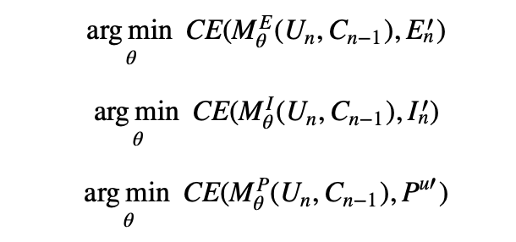
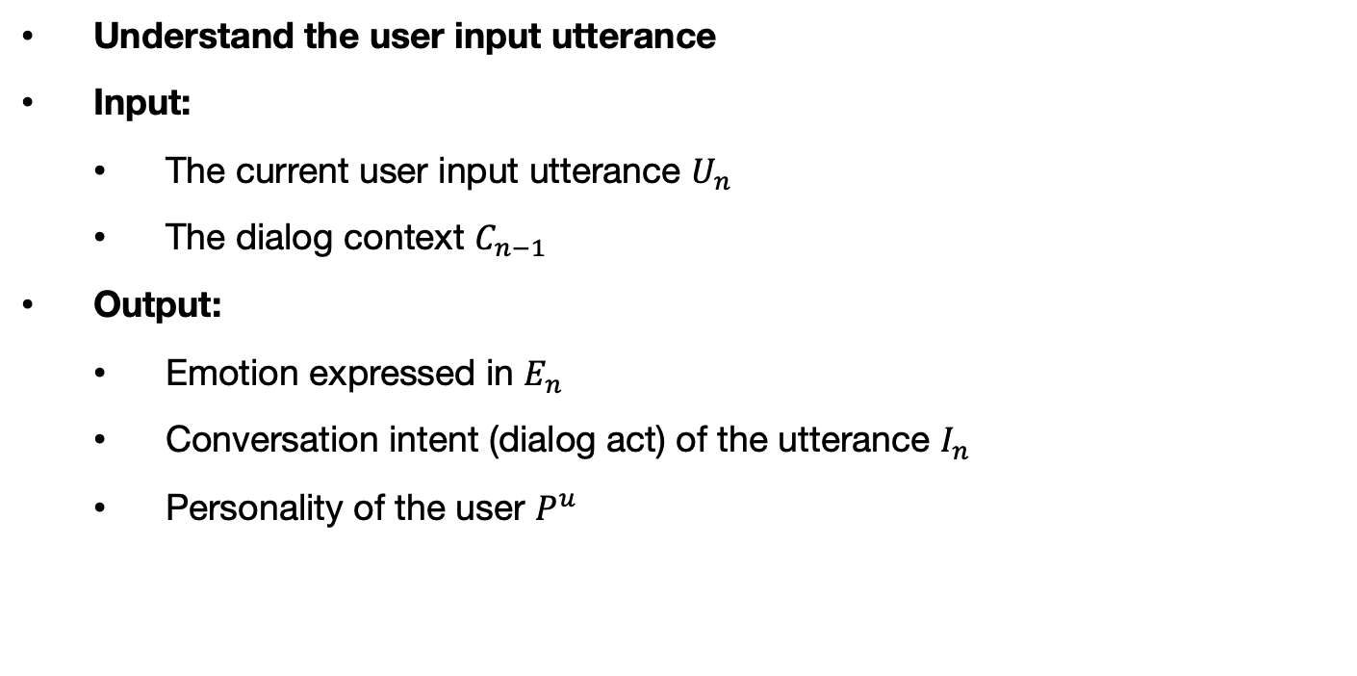
Problem Formulation
Understand the user input utterance
Input:
The current user input utterance $U_{n}$
The dialog context $C_{n−1}$
Output:
Emotion expressed in $E_{n}^{ }$
Conversation intent (dialog act) of the utterance $I_{n}^{ }$
Personality of the user $P^{u}$

Slide 6
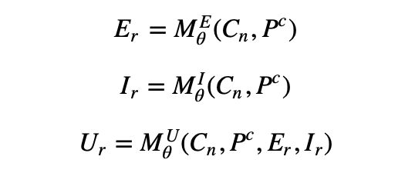
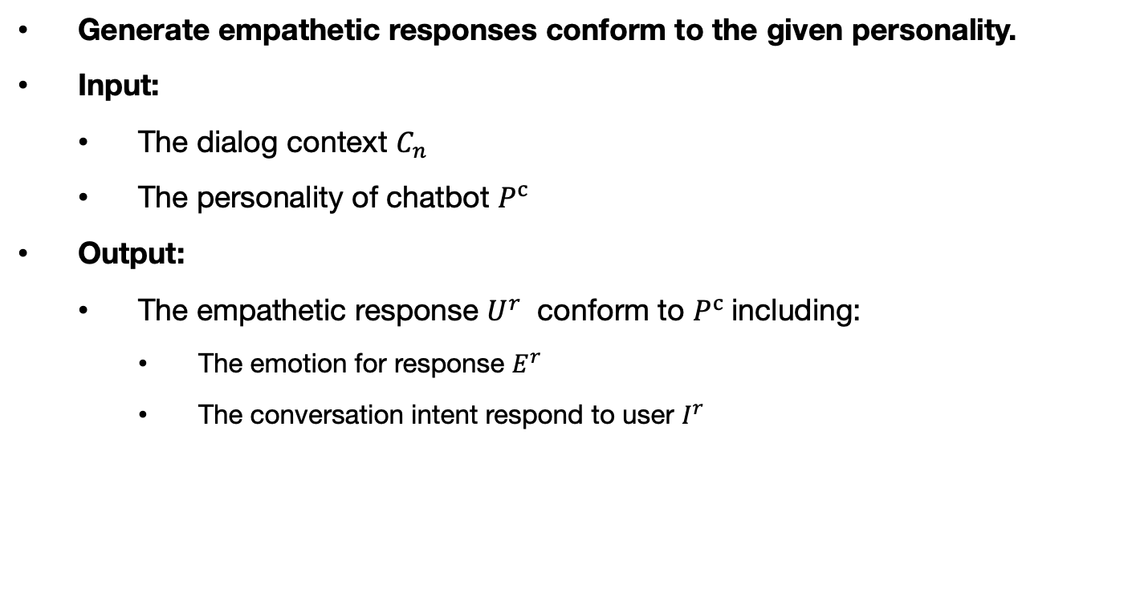
Problem Formulation
Generate empathetic responses conform to the given personality.
Input:
The dialog context $C_{n}$
The personality of chatbot $P^{c}$
Output:
The empathetic response $U^{r}$ conform to $P^{c}$including:
The emotion for response $E^{r}$
The conversation intent respond to user $I^{r}$

Slide 7
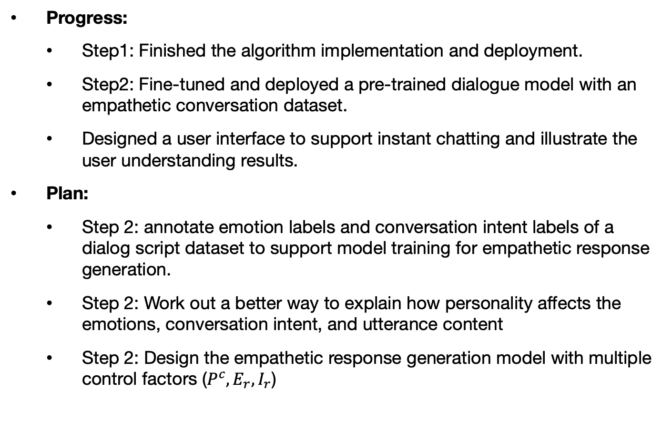
Current Progress & Plan
Progress:
Step1: Finished the algorithm implementation and deployment.
Step2: Fine-tuned and deployed a pre-trained dialogue model with an empathetic conversation dataset.
Designed a user interface to support instant chatting and illustrate the user understanding results.
Plan:
Step 2: annotate emotion labels and conversation intent labels of a dialog script dataset to support model training for empathetic response generation.
Step 2: Work out a better way to explain how personality affects the emotions, conversation intent, and utterance content
Step 2: Design the empathetic response generation model with multiple control factors ($P^{c}, E_{r}, I_{r}$)

Slide 8
Thanks!

Slide 9
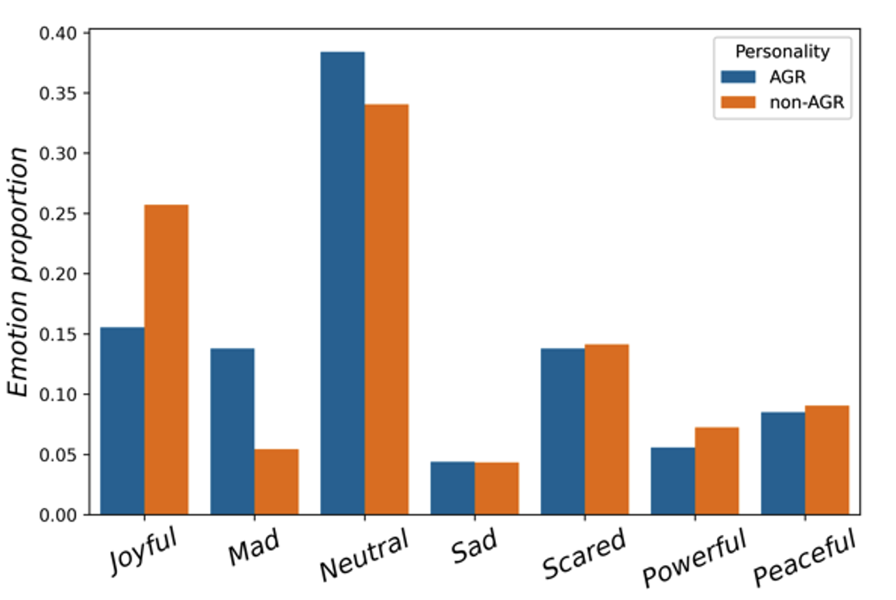
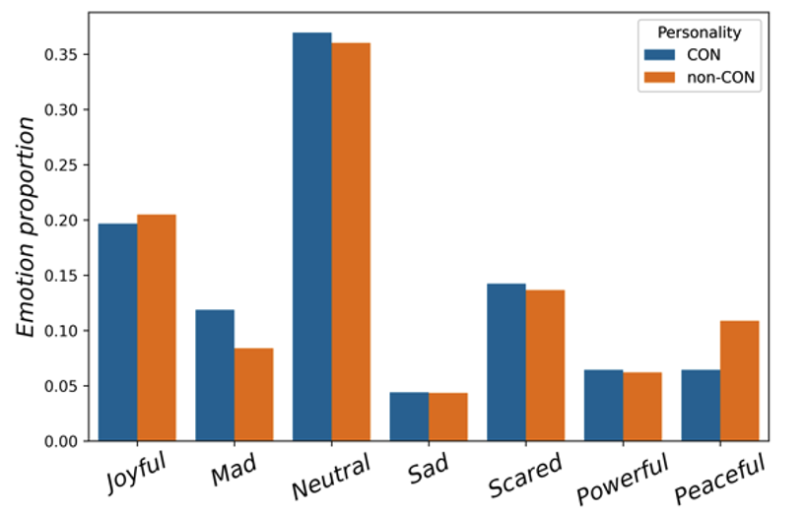
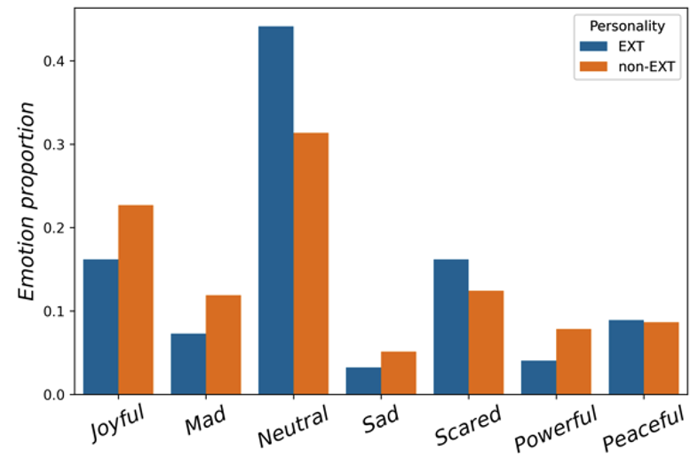
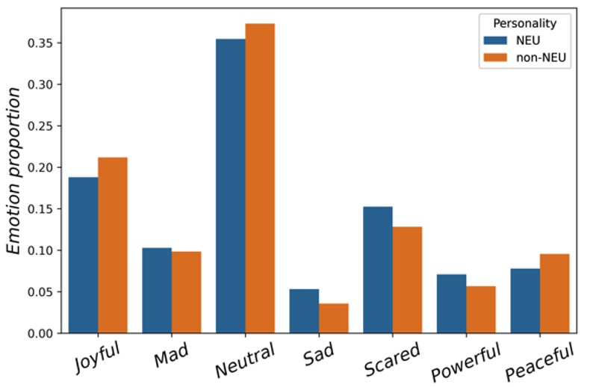
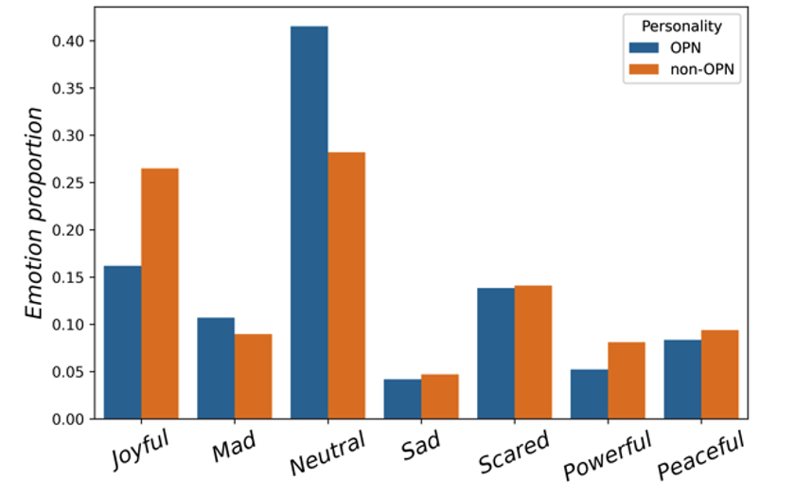
Personality Emotion Patterns

Slide 10
How to model Personality
A pattern of relatively permanent traits and unique characteristics that give both consistency and individuality to a person’s behavior (Feist & Feist, 2006, p. 4).
Traits are unique characteristics that influence our behavior
Traits describe meaningful differences of individuals
Traits are stable and consistent, objective behavior (No good or bad)
Traits are usually displayed as dimensions or spectrums with extremes at both ends
Traits rely on language
Lexical Hypothesis

Slide 11
Trait theory
Gorden Allport: 4,500 words to describe people
Cattell: 4,500 words -> 170 traits -> 16 most influential traits (dimension)
Factor analysis for spectrums of traits
Eysenck: PEN (Psychoticism, Extraversion, Neuroticism) Model
OCEAN Model (The big-five)
Openness, Conscientiousness, Extraversion, Agreeableness, Neuroticism

Slide 12
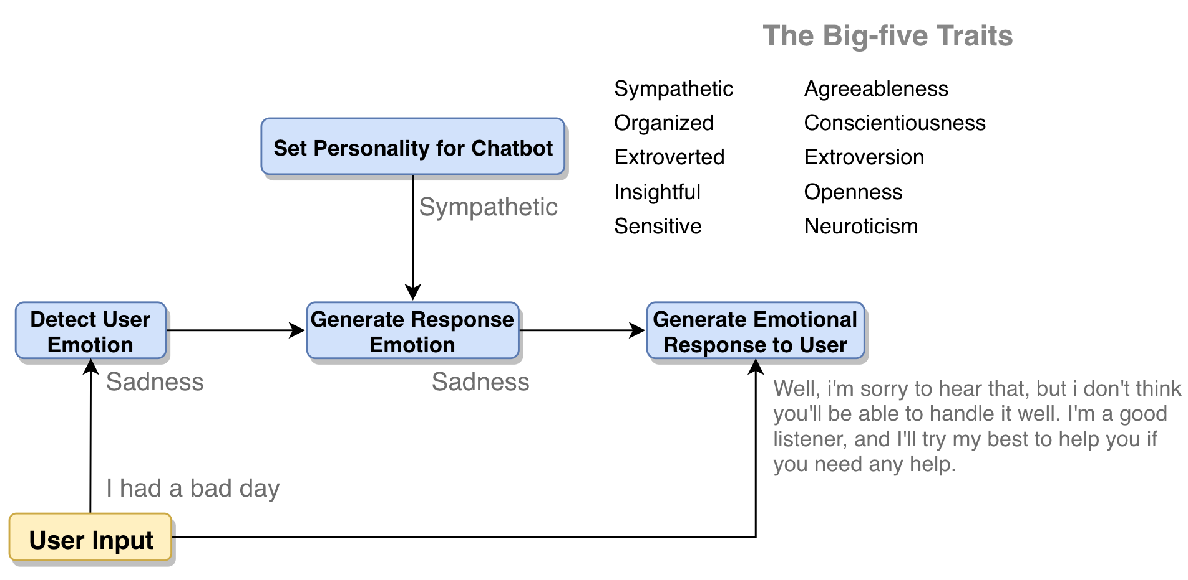
Demo Workflow

Slide 13
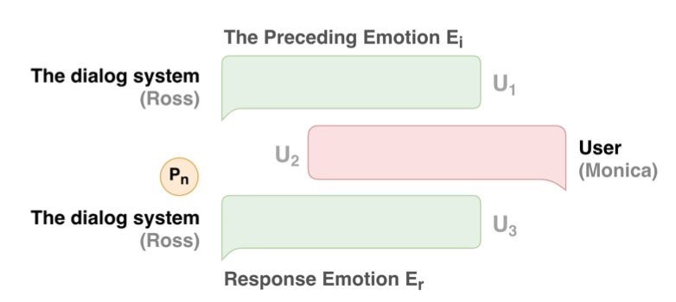
Personality-affected Emotion Generation
We raise the problem of automatically generating the emotion for response in conversation.
Emotion expressions in conversation are affected by multiple complex factors (e.g., dialog context, personalities), making the emotion generation is challenging.
We specify a personality to the dialog system and then generate the emotion for the dialog system based on the given personality and the dialog context.

Slide 14
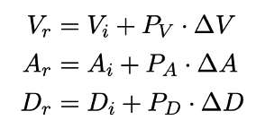
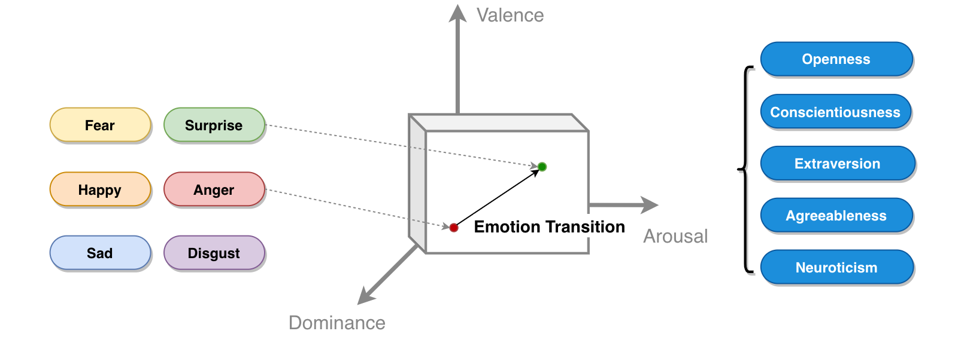
Personality-affected Emotion Generation
In psychology, both emotions and personality traits can be projected to the Valence-Arousal-Dominance (VAD) space. The transition between the preceding emotion to the next emotion is affected by the personality.
Wen Z, Cao J, Yang R, et al. Automatically Select Emotion for Response via Personality-affected Emotion Transition[C]//Findings of the Association for Computational Linguistics: ACL-IJCNLP 2021. 2021: 5010-5020.

Slide 15
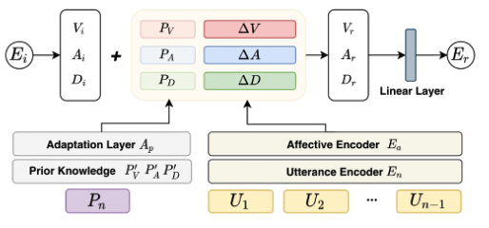
Personality-affected Emotion Generation
We propose the Personality Emotion Transition model (PET-CLS) to generate the emotion for the dialog system by:
encoding the dialog context with pre-trained language model as the variance of emotion
modeling the personality as the weights of the emotion variance
Personality Emotion Transition model (PET-CLS)
Wen Z, Cao J, Yang R, et al. Automatically Select Emotion for Response via Personality-affected Emotion Transition[C]//Findings of the Association for Computational Linguistics: ACL-IJCNLP 2021. 2021: 5010-5020.

Slide 16
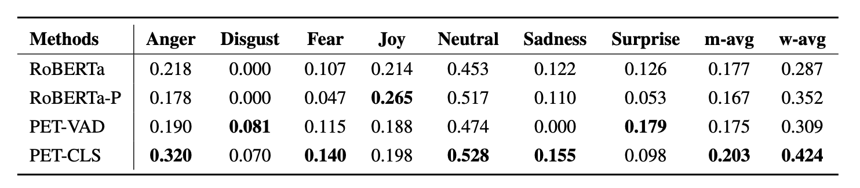
Personality-affected Emotion Generation
Experiment results
Emotion Prediction Results (F-score)
Wen Z, Cao J, Yang R, et al. Automatically Select Emotion for Response via Personality-affected Emotion Transition[C]//Findings of the Association for Computational Linguistics: ACL-IJCNLP 2021. 2021: 5010-5020.

Slide 17
Related Research Papers
Wen Z, Cao J, Yang R, et al. Automatically Select Emotion for Response via Personality-affected Emotion Transition[C]//Findings of the Association for Computational Linguistics: ACL-IJCNLP 2021. 2021: 5010-5020.
Wen Z, Cao J, Yang R, et al. Decode with template: Content preserving sentiment transfer[C]//Proceedings of the 12th Language Resources and Evaluation Conference. 2020: 4671-4679.
Wen Z, Cao J, Yang R, et al. HADE: Hierarchical and Affective Dialog Encoder for Personality Recognition in Conversation. Submitted to The 2022 Conference on Empirical Methods in Natural Language Processing.
Wen Z, Cao J, Yang R, et al. Personality-affected Emotion Generation in Dialog Systems Submitted to Transactions on Information Systems.

Slide 18
Personality Emotion Patterns
尝试了bert 和 EmoBERTa 的分类，big-five各个人格的emotion特征区别不明显，担心是标签不准，有些隔靴搔痒…
索性再次尝试与MELD的标签做对齐
结果：
与 EmoryNLP 重合率28.4%
与MELD几乎没有重合

Slide 19
Personality Word-usage Patterns

