Slide 1
✦ EDP PROJECT ✦
Skincare Products Analysis
Data Exploration & Processing (EDP)
500 Products • 10 Brands • 8 Product Types • 5 Skin Types
Libraries: pandas | matplotlib | seaborn | numpy | D-Tale ★
Ananya Gupta 25070123010 Prekhanshi Kumbhakar 25070123151
Branch / Division: E&TC – A1 | Group 11
Academic Year: 2025–26

Slide 2
Dataset Overview
500 skincare products across Indian & global brands — zero missing values, zero duplicates
🧴
🏷️
📦
500
10
8
Total Products
Brands
Product Types
✨
💰
⭐
5
₹1,071
3.95 / 5
Skin Types
Avg Price
Avg Rating
14 original columns: Brand • Product Type • Skin Type • Price • Rating • Ingredients • Comedogenic • Budget Category • Popularity Score • SPF Level • Cruelty Free • Fragrance • Usage Time → expanded to 18 after feature engineering

Slide 3
Libraries & Tools Used
pandas
Data loading, cleaning, groupby, pivot_table, describe, corr, map, str.extract — core of all EDA
matplotlib
Bar, histogram, scatter, pie/donut, line, stacked bar, regression plot — basic & advanced graphs
seaborn
Violin plot, heatmap, pairplot — advanced statistical visuals built on top of matplotlib
numpy
np.polyfit() for regression trend lines, np.sqrt() for bubble chart sizing, np.linspace() for curves
★ D-Tale — Unique Library (Not Taught in Class)
Launches an interactive browser-based data explorer from one line of code: dtale.show(df). Auto-generates EDA, correlation matrix, missing value heatmaps, column KDE plots, and a drag-and-drop chart builder — no extra code needed. Used professionally in industry for rapid data understanding.

Slide 4
Data Cleaning & Preprocessing
01
Load & Inspect
→ 500 rows × 14 cols — 0 missing, 0 duplicates
pd.read_excel(), df.shape, df.isnull().sum(), df.duplicated().sum()
02
Strip Whitespace
→ All string columns cleaned of leading/trailing spaces
df[str_cols].apply(lambda x: x.str.strip())
03
Binary Encoding
→ Cruelty Free, Fragrance, Comedogenic → numeric 0 or 1
df['col'].map({'Yes':1, 'No':0})
04
Feature Extraction
→ New column SPF_Num created (numeric SPF value)
df['SPF Level'].str.extract(r'(\d+)').astype(float)
05
Final Shape
→ 500 rows × 18 columns — 4 new engineered features added
df.shape after all steps

Slide 5
Exploratory Data Analysis — Key Statistics
Largest Brand
Highest Rated Brand
Plum — 66 products
Mamaearth — 4.12 / 5
Most Common Product
Most Expensive Brand
Moisturizer — 77 items
La Roche-Posay — ₹1,188 avg
Most Common Skin Type
Cruelty-Free Products
Dry — 106 products
49.8% of dataset
Best Rated Budget
Price vs Rating Corr.
Medium tier
–0.011 (price ≠ quality)

Slide 6
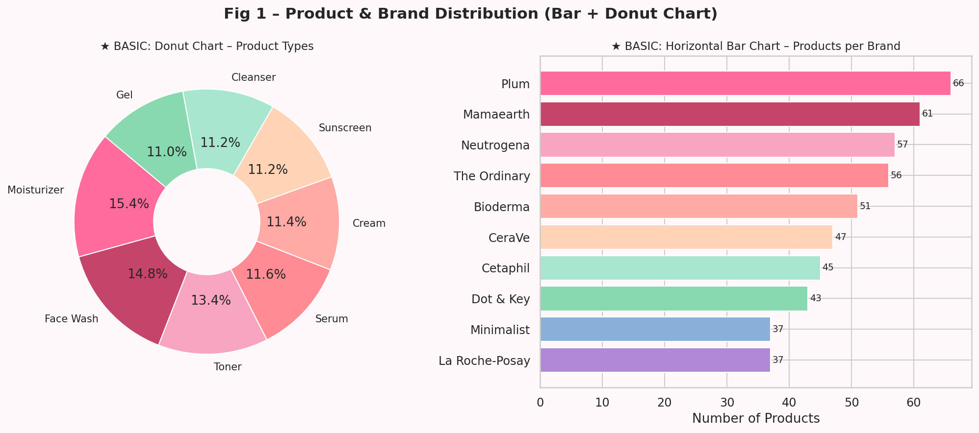
★ BASIC
Basic Graph 1 — Bar Chart & Donut Chart
What it shows
Two basic charts side by side showing dataset composition.
Observations
Plum leads all brands with 66 products, followed by Mamaearth (61) and Neutrogena (57).
Moisturizers dominate at 15.4% of all products, closely followed by Face Wash at 14.8%.
Product types are fairly evenly distributed — no single type is overwhelmingly dominant.
The donut format (not full pie) is used for readability when many segments are present.
📝 ax.barh() for horizontal bars; ax.pie(wedgeprops=dict(width=0.6)) for donut

Slide 7
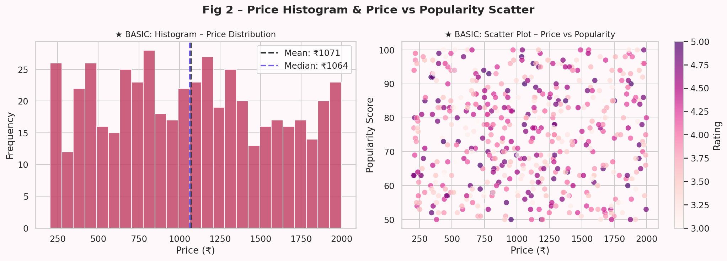
★ BASIC
Basic Graph 2 — Histogram & Scatter Plot
What it shows
Price frequency distribution and Price vs Popularity relationship.
Observations
Price histogram is right-skewed — most products cluster between ₹500–₹1,500.
Mean (₹1,071) and Median (₹1,065) are very close, indicating a near-symmetric core.
Scatter plot shows no upward or downward trend — popularity is independent of price.
Points are color-coded by Rating (RdPu scale) adding a third variable to 2D scatter.
📝 ax.hist(bins=25); ax.scatter(c=df['Rating'], cmap='RdPu'); ax.axvline() for mean/median

Slide 8
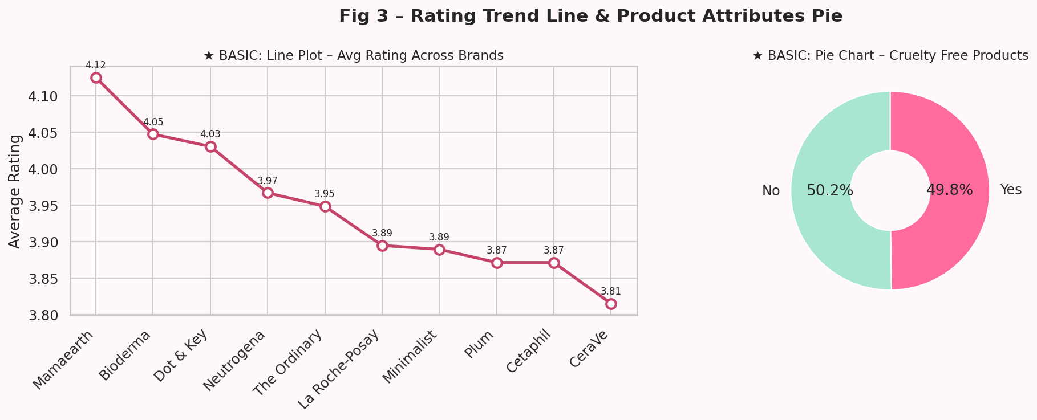
★ BASIC
Basic Graph 3 — Line Plot & Pie Chart
What it shows
Brand rating trends over sorted order and cruelty-free product split.
Observations
Line plot ranks brands by avg rating — Mamaearth leads (4.12), CeraVe is lowest (3.81).
Rating range is narrow (3.81–4.12) meaning all brands maintain acceptable quality.
Pie chart shows a near 50-50 split: 49.8% cruelty-free vs 50.2% non-cruelty-free.
Annotated data labels on the line make exact values readable without hovering.
📝 ax.plot(marker='o'); ax.annotate() for labels; ax.pie(wedgeprops=dict(width=0.6))

Slide 9
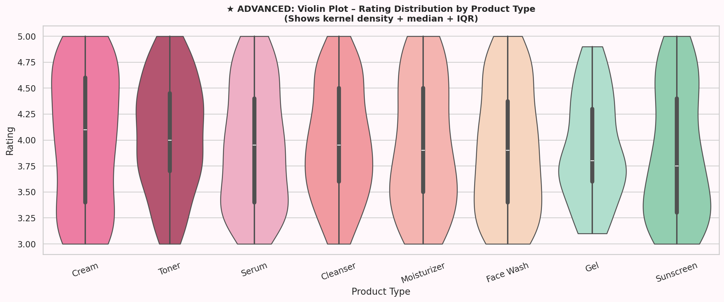
★ ADVANCED
Advanced Graph 1 — Violin Plot — Rating Distribution by Product Type
What it shows
Shows the full rating distribution shape (KDE) + median + IQR per product type.
Observations
Violin plot = boxplot + kernel density estimate — shows WHERE ratings concentrate.
Creams have the widest violin shape, with ratings spreading all the way to 5.0.
Cleansers and Gels show tighter, more uniform distributions around 3.8–4.0.
inner='box' adds a mini-boxplot inside each violin for precise quartile reading.
More informative than a plain boxplot — reveals bimodal or skewed distributions.
📝 sns.violinplot(data=df, x='Product Type', y='Rating', inner='box', cut=0)

Slide 10
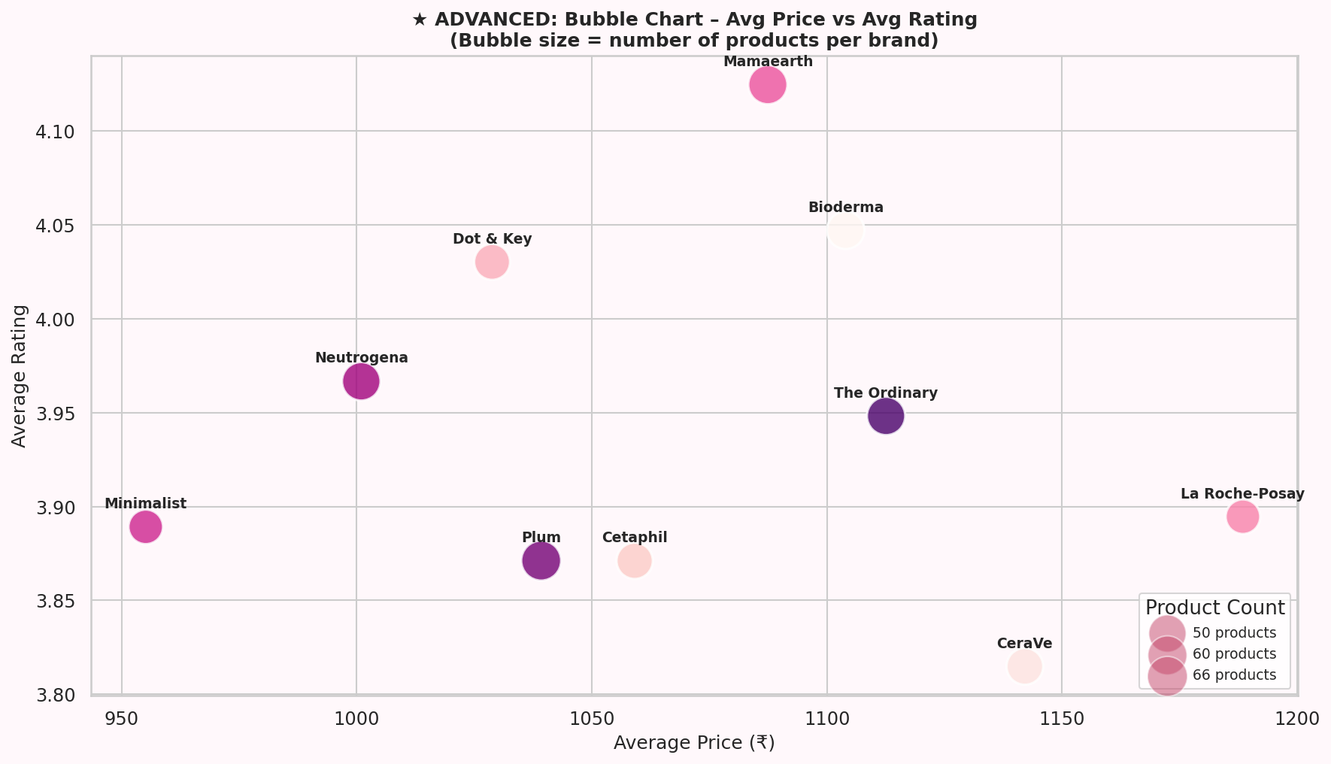
★ ADVANCED
Advanced Graph 2 — Bubble Chart — Brand Avg Price vs Avg Rating
What it shows
3-variable chart: X = avg price, Y = avg rating, bubble size = product count.
Observations
Mamaearth occupies top-right of quality zone with 4.12 rating at just ₹1,087 avg price.
La Roche-Posay is the most expensive (₹1,188) but its rating (3.89) is below average.
Plum has the largest bubble (66 products) showing highest market presence.
Bubble size uses np.sqrt(count)*80 — square root scaling prevents size distortion.
Shows that no brand achieves both top price AND top rating simultaneously.
📝 ax.scatter(s=np.sqrt(count)*80); ax.annotate() per brand; manual size legend

Slide 11
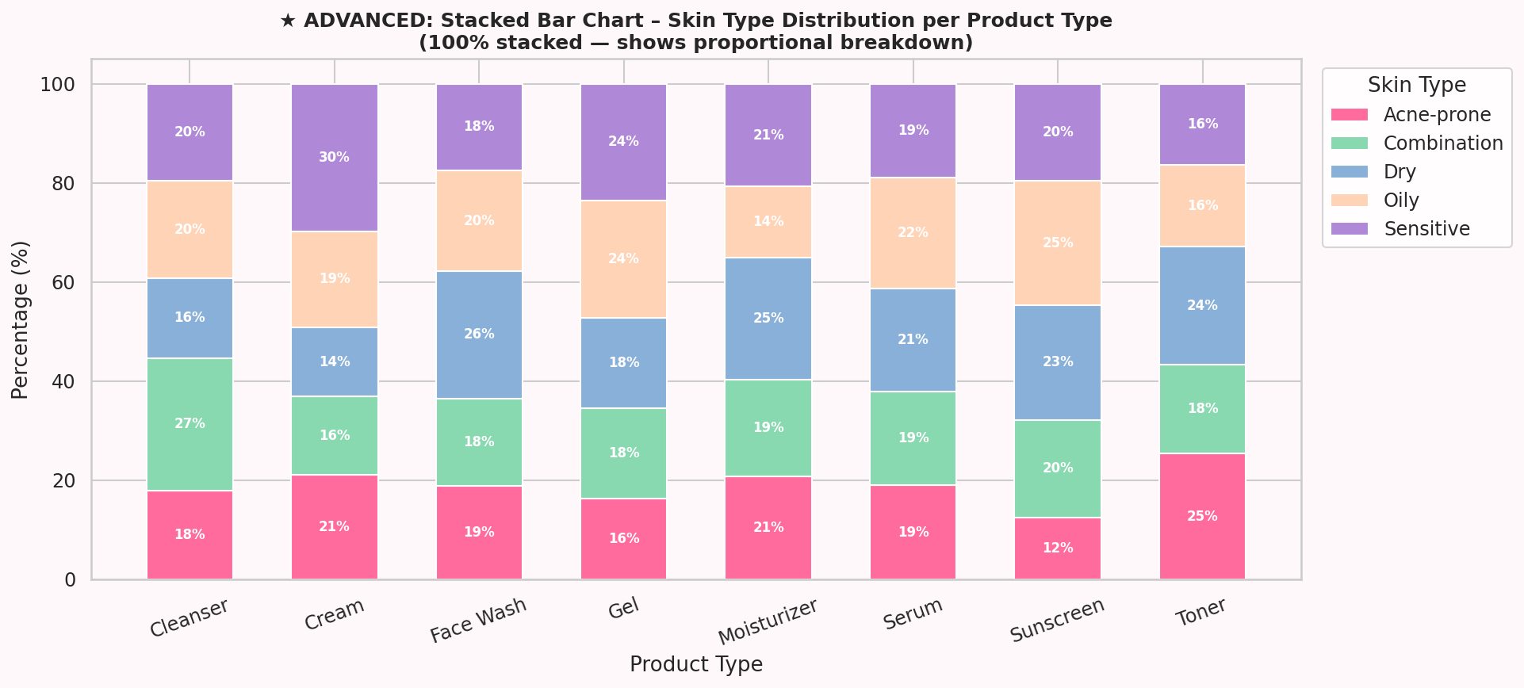
★ ADVANCED
Advanced Graph 3 — 100% Stacked Bar Chart — Skin Type per Product Type
What it shows
Proportional breakdown of which skin types each product type serves.
Observations
All product types serve all 5 skin types in roughly equal proportions (~20% each).
No product type is exclusively targeted at a single skin type.
Sunscreen and Gel show minor variations but remain broadly distributed.
White percentage labels inside bars (shown only when >5%) prevent clutter.
Grouped + stacked structure built manually using ax.bar() with 'bottom' parameter.
📝 ax.bar(vals, bottom=bottoms) looped per skin type; percentage text inside bars

Slide 12
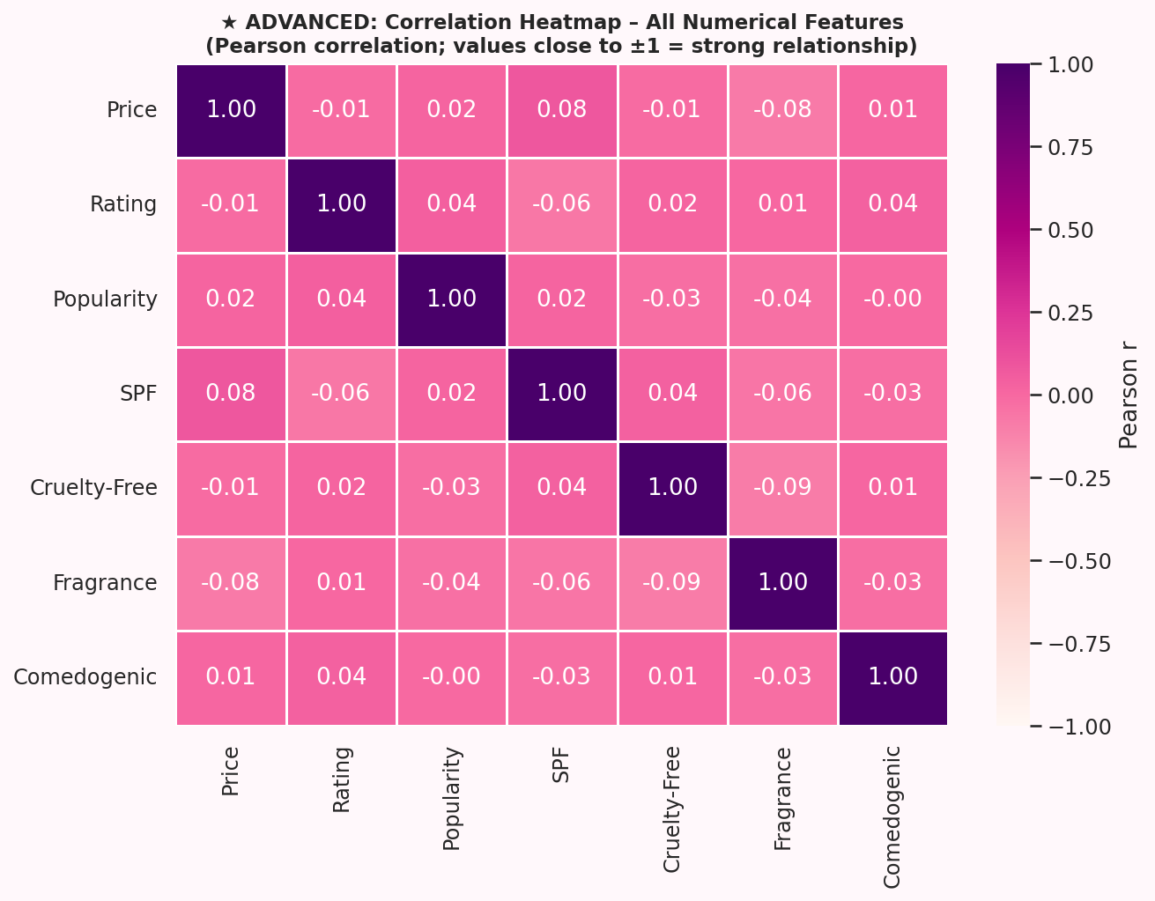
★ ADVANCED
Advanced Graph 4 — Correlation Heatmap — All Numerical Features
What it shows
Pearson correlation matrix visualised as a colour-coded grid.
Observations
All correlations are near zero — features are statistically independent of each other.
Price vs Rating: r = –0.011 (essentially zero — price does NOT predict quality).
Price vs Popularity: r = 0.021 (no relationship between cost and consumer popularity).
Fragrance vs Cruelty-Free: r = –0.09 — slight tendency for fragrance-free = cruelty-free.
RdPu colormap with vmin=–1, vmax=1 ensures consistent color scale across all values.
📝 df.corr(); sns.heatmap(annot=True, fmt='.2f', cmap='RdPu', vmin=-1, vmax=1)

Slide 13
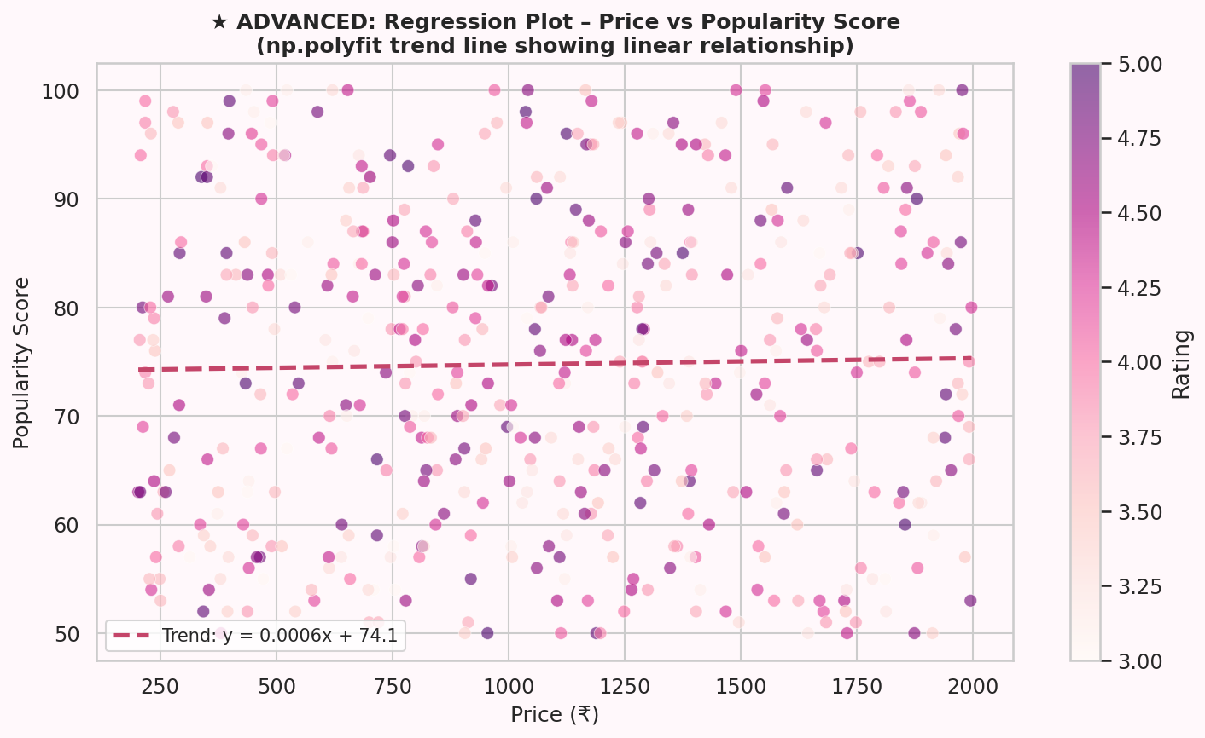
★ ADVANCED
Advanced Graph 5 — Regression Plot — Price vs Popularity (np.polyfit)
What it shows
Scatter plot with a linear regression trend line fitted using numpy.
Observations
np.polyfit(x, y, 1) fits a degree-1 polynomial (straight line) to the data.
The trend line equation is shown in the legend: slope is near-flat (~0.0004).
Near-flat slope mathematically confirms price has no meaningful effect on popularity.
Points are colored by Rating (3rd variable) without needing a 3D plot.
np.linspace(x.min(), x.max(), 200) creates a smooth curve with 200 interpolated points.
📝 coeffs=np.polyfit(x,y,1); poly_fn=np.poly1d(coeffs); ax.plot(x_line, poly_fn(x_line))

Slide 14
Product Filter System
An interactive, input-driven feature — user enters preferences and matching products are displayed sorted by rating
How It Works
7 Filter Inputs
1
Run the script — Section 6 starts after all graphs
Skin Type
str.lower() == input
Dry / Oily / Sensitive / Combination / Acne-prone
2
7 filter prompts appear one at a time in the terminal
Product Type
str.lower() == input
Moisturizer / Serum / Toner / Cleanser / Gel…
Budget Category
str.lower() == input
3
Press Enter on any prompt to skip it (accept all values)
Low / Medium / High
Cruelty-Free?
== 'Yes' / 'No'
4
Each answer narrows the DataFrame step by step using boolean indexing
yes → Cruelty Free=Yes no → Cruelty Free=No
Fragrance-Free?
== 'No' / 'Yes'
5
Final results are sorted by Rating (highest first) and printed
yes → Fragrance=No no → Fragrance=Yes
Min Rating
Rating >= value
6
A summary block shows avg price, avg rating, and top brand of results
Float 3.0–5.0 (try/except for invalid input)
Max Price (₹)
Price <= value
Integer/float (try/except for invalid input)
If 0 results → prints tip to relax filters. If results found → displays table + avg price, avg rating, top brand, cruelty-free %

Slide 15
Key Insights & Findings
🏆
Mamaearth has the highest avg rating (4.12/5) yet is NOT the most expensive brand
💸
La Roche-Posay is most expensive (₹1,188 avg) but ranks only 6th in ratings
📊
Price vs Rating correlation = –0.011 → higher price does NOT guarantee better quality
🌿
~50% of products are cruelty-free — ethical skincare options are widely available
🧴
Moisturizers (77) are the most stocked product type across all brands
🎯
Medium budget tier has slightly higher avg rating than the High budget tier
🔗
All numerical features have near-zero correlations — each dimension is independent
✨
Mamaearth Cream (4.62) & The Ordinary Cleanser (4.60) are top brand-product combos

Slide 16
Conclusion
This project successfully analysed 500 skincare products using Python. Through D-Tale, pandas, matplotlib, seaborn, and numpy, we built 10 visualisations spanning basic to advanced chart types, performed full EDA, and implemented an interactive product filter system.
Key takeaway: brand reputation and product type matter far more than price in determining quality and popularity — a finding that benefits consumers directly.
pandas
matplotlib
seaborn
numpy
D-Tale ★
10 Graphs
EDA
Filter System
Presented by: Ananya Gupta (25070123010) & Prekhanshi Kumbhakar (25070123151)
E&TC – A1 | Group 11 | 2025–26

