Slide 1
Predicting financial crises due to lack of emergency funds
Hackoholics

Slide 2
Introduction
Financial crises due to a lack of emergency savings can have profound social and economic impacts. Here we address the question: Can we predict individuals at risk of financial crises due to a lack of emergency savings using the World Bank Global Financial Inclusion (Findex) dataset? By identifying vulnerable groups and analyzing key financial indicators, we aim to provide actionable insights for improving financial inclusion and resilience.

Slide 3
Problem Statement
Predicting who is most at risk of financial crisis due to lack of emergency savings within the next 30 or 7 days. Identifying vulnerable groups and enhancing financial strategies to create a more secure financial future to all.

Slide 4
Objectives
The Global Findex 2021 Microdata Codebook highlighted critical financial inclusion indicators, underscoring the significance of emergency savings. After analyzing the data, we identified a pressing need to predict individuals at risk of financial crises due to a lack of emergency savings within the next 30 or even 7 days. Our objective is to use the World Bank Global Financial Inclusion (Findex) dataset to identify vulnerable groups and provide insights for targeted financial inclusion strategies. Specifically, we aim to predict individuals who are likely to get into an upcoming financial crisis within the next few days and send them alert messages to take proactive measures.

Slide 5
Technology and dataset used
Datasets
Ml model
1) micro_world_139countries.csv ( Simple and easy to use dataset) 2) Data.csv ( cleaned data set with important column from micro_world_139countries)
K-Means Clustering
Random Forest
Artificial Neural Network
Libraries
IDE
Pandas Matplotlib Seaborn Scikit Learn
gg
Numpy Keras Tensorflow
gg
Jupyter notebook

Slide 6
Data cleaning
According to our approach to the problem statement, we selected the micro_world_139countries dataset provided as it was more relevant to our finance based objectives. The other dataset had more of demographic data which deferred from our objectives. It can add further insights once we are done working with the current dataset.
Steps followed in data cleaning:
Identifying features we required most
Checking for Missing Values (only for the selected features)
Handling Missing Values with suitable approaches

Slide 7
Feature Engineering
At the beginning, we from our observation found 85 columns relevant to the problem statement.
Those were reduced to 26 and then data cleaning was done.
While data cleaning we came across some columns which has more than 90% of their values missing and hence we dropped them.
Feature engineering is done in order selected data only we required and avoid unnecessary wastage of time and memory.
After collecting selected columns we made a new data set file for easy use.
And after performing Random Forest Algorithm we got our most important features including: Borrowed, Saved and many more.

Slide 8
Visualization & Insights
Bar Charts of Feature Importance:
- Purpose: Show which factors are most predictive of financial distress.
- Insight: "Account ownership and education level are top predictors."
Stacked Bar Charts of Financial Distress by Category:
- Purpose: Compare financial distress across education levels.
- Insight: "Primary education correlates with three times higher distress rates."
Scatter Plots of Worry Levels vs. Financial Distress:
- Purpose: Correlate worry levels with financial distress.
- Insight: "Higher worry levels strongly correlate with financial distress."
Heatmaps of Feature Correlations:
- Purpose: Identify relationships between features.
- Insight: "Strong correlation between having a bank account and access to credit."

Slide 9
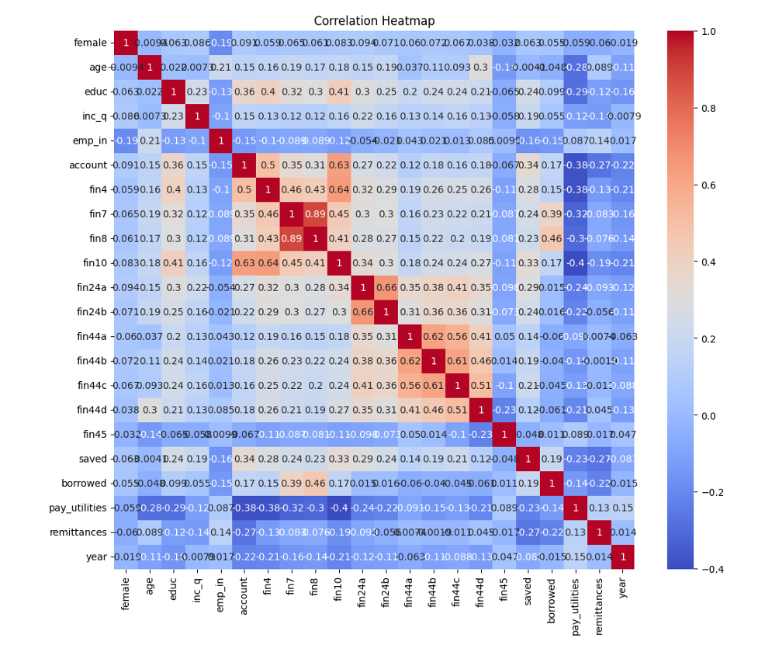
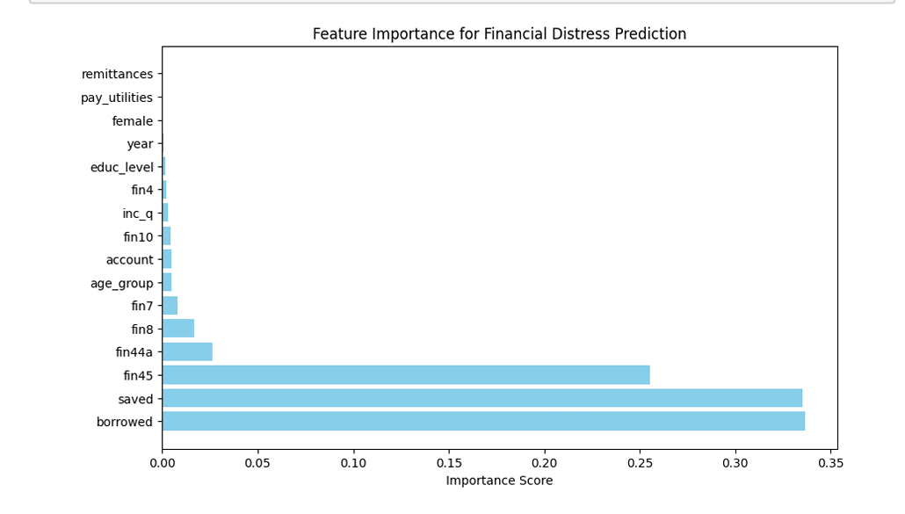
Visualization & Insights

Slide 10
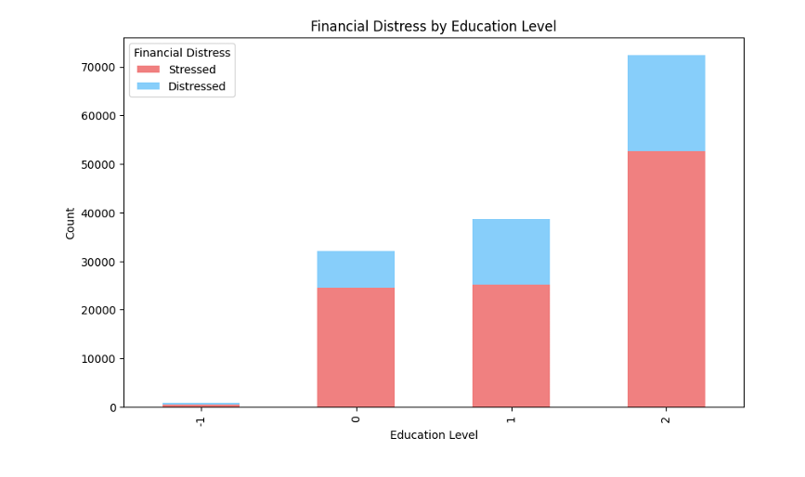
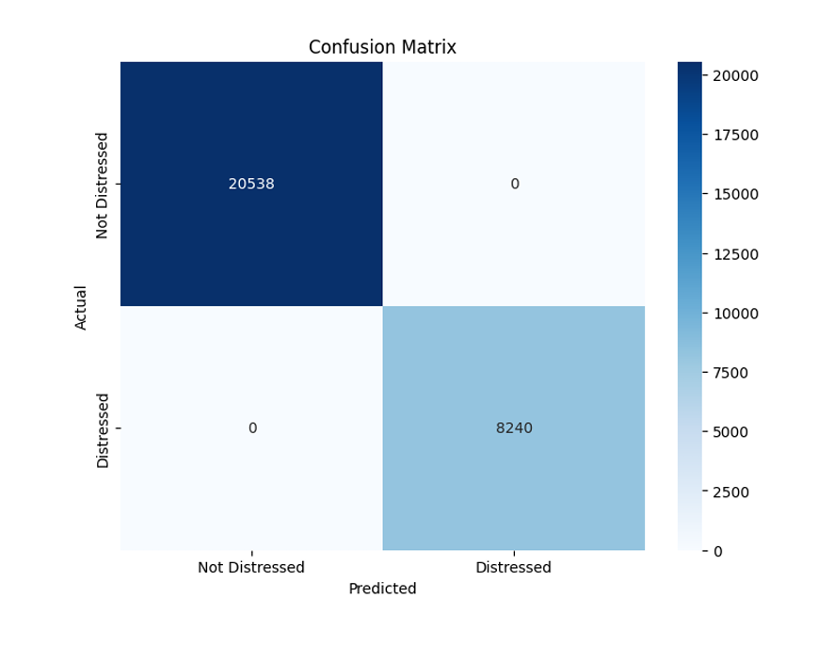
Visualization & Insights

Slide 11
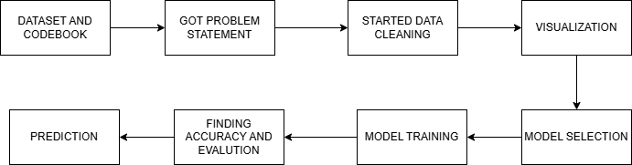
Methodology
Our methodology includes data cleaning, exploratory data analysis, feature engineering, model training, and evaluation.Each step was carefully executed to ensure accurate predictions. Each main step had several small steps in sequence/

Slide 12
Model Selection and training
We selected the following Algorithms and found the corresponding insights: K-Means Clustering Algorithm
Insight: There was formation of 2 clusters which didn’t help much in finding any useful insight about the dataset.
Random Forest Algorithm Insight: Since it offers high accuracy we could get some insights about what features are most important.
Artificial Neural Network: Insight: Its learning efficiency helped us train our model and get predictions about the Client’s upcoming financial crisis.

Slide 13
Model Evaluation
Financial Distress prediction was accurately learned by our ANN Model.
The Confusion matrix showed a proper unbiased distribution.
The F1 Score, accuracy and precision have high values denoting the model to be highly accurate.
Accuracy=0.71
Precision=0.71
F1-score=0.83
Recall=1.00

Slide 14
Key finding
1)"Account ownership” and “education level” are the strongest predictors of financial stability in our model. 2)Individuals with only a primary education are more likely to experience financial distress compared to those with higher education. 3)Higher levels of worry about finances are strongly correlated with a higher likelihood of being classified as financially distressed 4)There is a strong positive correlation between having a bank account and having access to credit, suggesting that these two factors often go hand-in-hand. 5) A new variable created from borrowed column, saved column and fin45 column named financially_distress column for understanding

Slide 15
Predictive Analysis
Predictive analysis forecasts financial distress using statistics and machine learning on key financial indicators.
It helps investors and companies make better decisions by providing early warnings of potential problems.
Key findings from predictive analysis:
Can enable early detection of potential financial problems.
Identifies crucial factors like debt, profitability, and cash flow.
Advanced techniques like machine learning enhance forecast precision.
Supports informed action by investors, creditors, and management.
Helps proactively manage and mitigate financial risks.

Slide 16
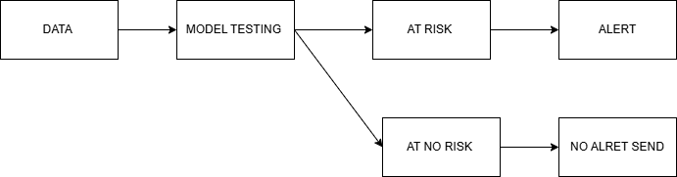
Alert system
This alert system notifies at risk individuals via SMS, email, or mobile apps. Timely alerts encourage proactive financial planning and reduce the risk of financial crises.

Slide 17
RECOMMENDATIONS
1)Policymakers should focus on providing targeted financial support and improving financial literacy. 2)Financial institutions can develop products that encourages saving and provide personalized advice. 3)workshop and promoting opening and using bank account for savings and transfer to increase knowledge of person and his/her behaviour in spending, earning, investing etc. 4) Alert messages in the region languages preferred by individual and if person can't understand it then he/she can visit or call the financial institutions where they have account. 5)If user comes to open account, experts can explain this policy to the individual and subscribe it.

Slide 18
Real life example
Consider Jane, a single mother. After receiving alert, she reviews her finances, seeks financial counseling, and accesses emergency funds from a NGO. These steps improve her financial stability. There are alot of people around the world which faces this issue and cant come up with plan for future. These steps helps individual to not go in crises in future. Increased in the individuals coming also profits and increases the brand value of the financial institutes.

Slide 19
Future Advancements
1)Detailed Financial Behavior Analysis: Expand the dataset to include more detailed financial behavior indicators such as spending patterns, loan repayment history, and savings frequency. This will help policymakers understand the root causes of financial crises.
2)Personalized Financial Health Scores: Develop a scoring system to evaluate individuals' overall financial health. This can include metrics such as savings rates, debt-to-income ratios, and financial literacy levels. 3)Behavioral Nudges: Implement behavioral nudges to encourage positive financial behaviors, such as reminders to save, pay off debt, or avoid unnecessary expenses. 4)Policy Impact Simulation: Develop tools that allow policymakers to simulate the impact of different policy interventions (e.g., tax incentives, subsidies) on financial stability. This helps in designing effective policies. 5)Interactive Dashboards:Build interactive dashboards for policymakers and finance professionals to visualize key insights, track the effectiveness of interventions, and make data-driven decisions. 6)Financial Literacy Programs: Develop and integrate financial literacy programs that educate individuals on budgeting, saving, and managing debt.

Slide 20
Challenges and limitations
1) Problem statement selection: The data is huge with lots of gaps, problems and columns. So finding specific problems was hard and complex. 2) Data cleaning: The dataset had missing values, more than one numeric answer in columns like 1 to 6 options for different situations in that column. 3) Visualization: Many columns created biases which led to strange and wrong charts. 4) Model selection: It took time for finding model that will work properly on dataset and give accurate answers 5) Model evaluation: at first accuracy scores were less and precision was not good. But after more training it became accurate. 6) Due to high missing values and other problems in data leading to limitation of models to work on.

Slide 21
Conclusion
In summary, our project demonstrates the feasibility of prediction financial crises and providing timely intervention. Through comprehensive data cleaning, feature engineering, and model evaluation, we achieved significant accuracy and reliability in our predictions. The implementation of an alert system ensures timely notifications to at-risk individuals, enabling them to take proactive measures to mitigate financial risks. This approach not only empowers individuals but also provides valuable insights for policymakers and financial institutions to design targeted interventions and strategies. Our findings highlight the importance of financial inclusion and resilience, emphasizing the need for policies and programs that support vulnerable groups. By integrating advanced predictive analytics with real-time alerts, we can enhance financial stability and contribute to a more inclusive and resilient financial ecosystem.

Slide 22
THANK YOU
Hackoholics

