Slide 1
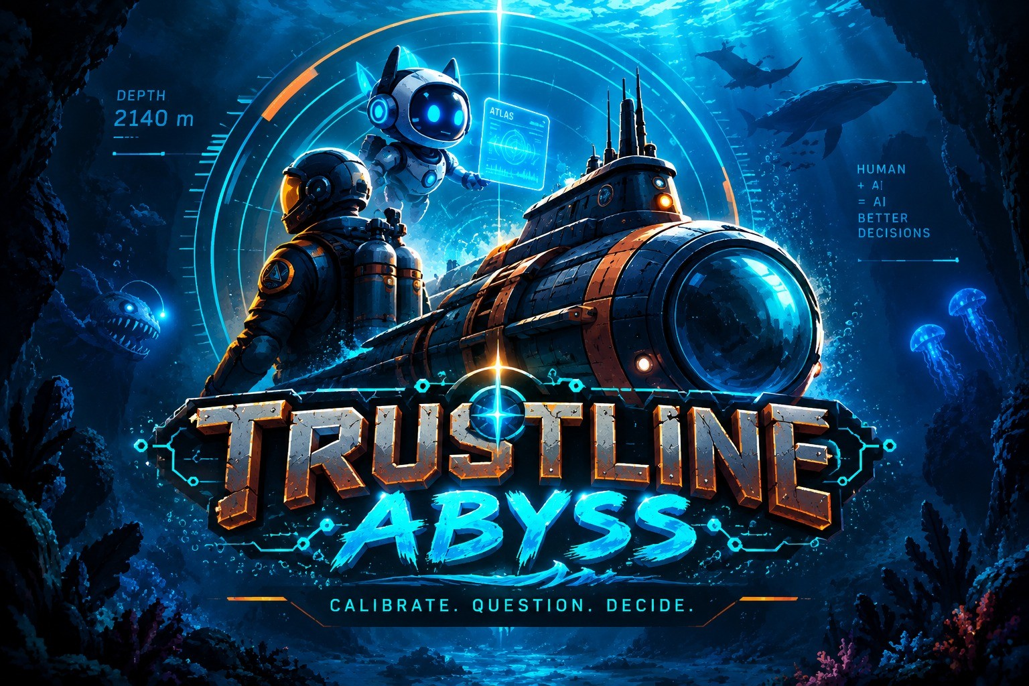
TEAM 1 HACKOHOLICS · CHALLENGE 02 · TRUST YOUR SYNTHETIC TEAMMATES
TRUSTLINE: ABYSS
Know when to trust your synthetic teammate.
Preksha Dewoolkar
Chirag Patankar
Purvesha Kolhe
Raj Yadav
A browser game about calibrated trust in an imperfect AI teammate
Sponsor: Naval Air Warfare Center Training Systems Division (NAWCTSD)
Notes:
Team 1 Hackoholics. Challenge 02, Trust Your Synthetic Teammates, sponsored by NAWCTSD. Our game is TRUSTLINE: ABYSS.

Slide 2
The AI trust dilemma
THE PROBLEM WE SET OUT TO SOLVE
🤖
Over-trust
⚠️
The AI sounds certain, so we stop checking. Confidence gets mistaken for correctness.
"Failure to trust critical
system outputs could be
catastrophic in time-
critical contexts."
🚫
Under-trust
The AI is wrong once, so we ignore it forever. A useful teammate is thrown away.
— Challenge 02 brief
The skill nobody trains:
🎯
Calibration
knowing WHEN
Reliance that moves with the evidence. Neither reflex — judgement.
02
Notes:
Two failure modes. The brief itself warns that failing to trust a correct system can be catastrophic — that is the under-trust half people forget.

Slide 3
CALIBRATE. QUESTION. DECIDE.
Ten checkpoints. 2,140 metres down. One AI you cannot fully trust.
03
Notes:
This is the game.

Slide 4
What is TRUSTLINE: ABYSS?
THE STORY · SUBMARINE · ATLAS · TEN WAYPOINTS TO THE SAFE ZONE
1
The storm
Your route is gone. Comms are offline. Most of the crew with them. You are 2,140 metres down in a damaged boat.
2
ATLAS survives
The Autonomous Tactical and Logistics Assistance System is the one package still running. It reads what is left of the sensor array.
3
It warns you it is fallible
"My readings are incomplete. My recommendations are not guaranteed to be correct. And I will sometimes be wrong."
4
Ten checkpoints
At each one ATLAS recommends a course of action. Six times it is right. Four times it is not. Your call, Commander.
04
Notes:
Storm, ATLAS survives, it admits it is fallible, ten checkpoints to the safe zone.

Slide 5
How Challenge 02 aligns
QUOTED FROM THE NAWCTSD BRIEF, MAPPED TO WHAT WE SHIPPED
"...knowing when to rely on an AI teammate,
when to question its recommendation, and
when human judgment must lead."
Our three core verbs, literally:
TRUST · QUESTION · OVERRIDE
→
"...reward effective trust calibration while
mitigating complacency, misuse, disuse,
mistrust, and distrust."
Trust Calibration is the only scored resource.
The five ending profiles name those failures.
→
"Show both a useful and an unreliable AI
recommendation, and how the player learns
to respond appropriately."
CP1: 88% and right. CP8: 94% and wrong.
The debrief diagnoses which way you erred.
→
"Functional AI agents are not required;
non-player characters may simulate AI
behavior."
ATLAS is authored, not a live model — so the
same checkpoint teaches the same lesson.
→
05
Notes:
Four direct quotes from the Challenge 02 brief, each mapped to a shipped feature.

Slide 6
How it educates, and why defence
WHAT THE PLAYER LEARNS · WHO BENEFITS
🎓 What the player learns
🛡️ Why this is a defence problem
1
High confidence does not guarantee correctness
Automation bias is a known killer
Operators follow confident systems past the point the evidence supports. It has cost lives in aviation and at sea.
2
Low confidence does not mean the AI is wrong
3
Several quiet, independent signals beat one loud one
Advisory AI is arriving regardless
Crews will be handed decision-support tools whether or not they were trained to appraise them.
4
A track record informs judgement — never replaces it
The brief names the beneficiaries
5
When the evidence is thin, go and get more
"Military command, space, health care, emergency response, commerce, and other decision-intensive domains."
Trust calibration is a practised judgement, not a personality trait — and a safe sandbox is where you practise it.
06
Notes:
Five lessons. Three defence arguments. The beneficiaries line is quoted from the brief.

Slide 7
How a checkpoint works
OBSERVE → EVALUATE → ADVICE → DECIDE
👁️
📊
🤖
⚖️
OBSERVE
EVALUATE
ADVICE
DECIDE
▸
▸
▸
Fly the leg. Scan three clue beacons in the water. Scan power is limited — what you miss, you will not know.
Read five sensor dials and their reliability. A degraded sensor cannot tell you either way.
ATLAS recommends, states its confidence, and names the sensors it used.
Trust, question, investigate or override. Two of those commit you.
The evidence is scarce by design — how well you fly decides how much you know when ATLAS asks for your trust.
07
Notes:
Four stages. Scarcity of evidence is what ties the flying to the deciding.

Slide 8
Your four choices
TWO GIVE YOU INFORMATION · TWO COMMIT YOU
TRUST
Correct when the instruments back it. Expensive when they do not.
1
—
COMMITS
Accept the recommendation
QUESTION
It names the sensors it leaned on. Cheap, and never the wrong move.
2
15 s
FREE INFO
Ask ATLAS to justify itself
INVESTIGATE
Reveals the truth. Four uses across ten checkpoints.
3
25% power
FREE INFO
Launch the recon drone
OVERRIDE
Full credit ONLY if you gathered evidence first.
4
—
COMMITS
Reject it, decide yourself
08
Notes:
Trust, Question and Override are the brief's own three verbs. Investigate is the cost of certainty.

Slide 9
What the game is like
EVERY CHECKPOINT IS TWO HALVES: FLY, THEN DECIDE
◈ HALF ONE — TRANSIT
◉ HALF TWO — DECIDE
▸
You fly the submarine yourself, third person
▸
Arriving switches you to the console automatically
▸
Three clue beacons; one is live at a time, burning amber
▸
You see only the clues you actually scanned
▸
Fly into the pillar of light to scan it
▸
Unscanned ones read NOT SCANNED — No data
▸
Scan power drains as you thrust — a clean line just fits
▸
Five sensor dials; the ones ATLAS used are ringed amber
▸
Sea life is hazardous: contact costs 6% hull
▸
ATLAS states its recommendation and confidence aloud
▸
The checkpoint stays locked until the sweep is done
▸
Choose an action — then the next leg begins
09
Notes:
Fly, then decide. The player never presses a key to switch views — the game does it.

Slide 10
Rules and resources
THREE THINGS YOU ARE MANAGING AT ONCE
TRUST CALIBRATION
HULL INTEGRITY
DRONE POWER
50 / 100
100%
100%
Rises when your reliance tracks the evidence. Falls when you follow ATLAS blindly or fight it out of habit.
Drains on miscalibrated calls and on collisions. At zero you lose the boat.
25% per investigation — four across ten checkpoints, and seven where it would pay.
The rules that create the tension
■
Agreement alone is never rewarded
■
Override needs evidence
Trusting ATLAS where the sensors contradict it costs as much as rejecting it where they support it.
Full credit only if you QUESTIONed or INVESTIGATEd first. Being right for no reason is not judgement.
■
You cannot check everything
■
What you did not scan, you do not know
Four drone charges, seven checkpoints worth investigating. Choosing is the game.
Unscanned clues stay blank at the console. Flying badly means deciding blind.
10
Notes:
Three resources, four rules.

Slide 11
Trust calibration in practice
THE BRIEF ASKS FOR A USEFUL AND AN UNRELIABLE RECOMMENDATION — HERE ARE BOTH
CP1
RIGHT
CP8
WRONG
CP9
RIGHT
USEFUL AI
CONFIDENT MISTAKE
LOW-CONFIDENCE TRUTH
88%
94%
41%
ATLAS CONFIDENCE
ATLAS CONFIDENCE
ATLAS CONFIDENCE
Four healthy sensors all agree. Static mass, no heat, no current disturbance.
The loudest, most certain call in the game. But it cites sonar alone, and three healthy sensors see nothing.
ATLAS can barely see it and says so. But four weak channels all point the same way.
TRUST it. This is not blind faith — it is reading the evidence.
OVERRIDE it. Its confidence described its signal, not the water.
TRUST it. Low confidence described its data quality, not the odds it is wrong.
11
Notes:
88 and right, 94 and wrong, 41 and right. Confidence tells you about the model, not the water.

Slide 12
Example situation: Checkpoint 4
THE FALSE STRUCTURE — 78% CONFIDENT, AND WRONG
🤖 ATLAS SAYS
📡 WHAT THE INSTRUMENTS SAY
"Possible hazardous structure.
Recommend emergency reroute."
SONAR 89%
Large object, hard edges, static
THERMAL 41%
Flat. No heat signature at all
CONFIDENCE 78%
Cites: SONAR only
CURRENT 78%
Undisturbed. Not moving water
The calibrated play
QUESTION
INVESTIGATE
OVERRIDE
It admits it is citing sonar alone
▸
Drone finds an abandoned research hull. Long dead. Inert.
▸
+13 calibration — full credit, because you gathered evidence first
12
Notes:
Trusting costs 15 calibration. Overriding with evidence gains 13. A 28-point swing on one checkpoint.

Slide 13
How we built it
NO BUILD STEP · NO FRAMEWORK · RUNS OFFLINE FROM A USB STICK
~6,800
16
1
0
lines of code
source files
dependency
build steps
◆
Vanilla JavaScript + Three.js r128
The only vendored file. npm install failing on a teammate's laptop at 2am is a real failure mode; static files are not.
◆
Everything procedural
Textures, the submarine, the sea life and the whole synthesised sound kit are generated at load. No asset pipeline.
◆
Custom post-processing
Bloom, vignette, grade and grain written directly against render targets — Three's EffectComposer is not in the core bundle.
◆
Graceful degradation everywhere
No WebGL? A 2D canvas world with an identical API. No video? The typed briefing. Nothing can stop the game opening.
◆
Content is pure data
All ten checkpoints live in scenarios.js with no code, so design and engineering moved in parallel.
◆
Synthetic data only
Every scenario, sensor reading and ground truth is invented for this exercise — meeting the jam's data safeguard.
13
Notes:
Deliberately dependency-free so it cannot break at the venue. Synthetic data only, per the jam data safeguard.

Slide 14
Who built what
FOUR WORKSTREAMS, SPLIT SO WE COULD WORK IN PARALLEL
PD
Preksha Dewoolkar
CP
Chirag Patankar
SYSTEMS & GAME LOGIC
3D WORLD & GRAPHICS
·
State machine and the two-phase checkpoint loop
·
Underwater environment and the flight model
·
Scan-power scarcity and the evidence gate
·
Post-processing chain and deep-water grade
·
Scoring, hull model and debrief profiles
·
Submarine, sea life and procedural textures
·
Integration across every module
·
Deployment and repository
PK
Purvesha Kolhe
RY
Raj Yadav
UI, UX & TUTORIAL
CONTENT & NARRATIVE
·
Cockpit layout and the instrument panels
·
All ten checkpoint scenarios and their clues
·
Indicator bank, HUD and the clue cards
·
ATLAS dialogue, reasoning and confidence values
·
18-step guided tutorial
·
Scoring notes and the difficulty curve
·
Visual identity and key art
·
Intro film, script and documentation
14
Notes:
Four workstreams. Separate files by discipline meant no merge conflicts.

Slide 15
Benefit, evidence and limitations
"EXPLAIN THE BENEFIT, EVIDENCE, AND LIMITATIONS" — WEEKEND GUIDE
✅
BENEFIT
📊
EVIDENCE
⚠️
LIMITATIONS
·
A player finishes with a named diagnosis of HOW they err
·
Blanket TRUST → OVERTRUST, hull 41%
·
Single player — the brief allows "one or more"
·
Both failure modes are punished, so neither reflex is learnable
·
Blanket OVERRIDE → HULL BREACH at CP10
·
No learning-transfer study yet; benefit is designed, not measured
·
Runs anywhere, offline, in under 5 minutes
·
Ten authored checkpoints, deterministic every run
·
Headline score still nets positive for blanket trust
Next steps
→
Two-player mode
→
Rebalance the headline score
→
Measure it
One commander, one analyst — the brief invites multiplayer
So blanket agreement cannot end above the starting value
Pre/post trust-calibration testing with real operators
15
Notes:
The weekend guide asks every team to explain benefit, evidence and limitations. Being honest about the limits is worth more than pretending there are none.

Slide 16
THE TAKEAWAY
The goal was never to
make you trust the AI.
It was to make you good at deciding when to.
Trust is a skill
Confidence ≠ correctness
Judgement stays human
Not a setting. It is practised, and it can be trained.
A number about the model, not about the world.
The AI advises. The commander decides. That is the point.
TRUSTLINE: ABYSS · Team 1 Hackoholics · Fictional synthetic training prototype. Not an operational decision-support system.
16
Notes:
Close here. Not trust the AI — know when to.

