Slide 1
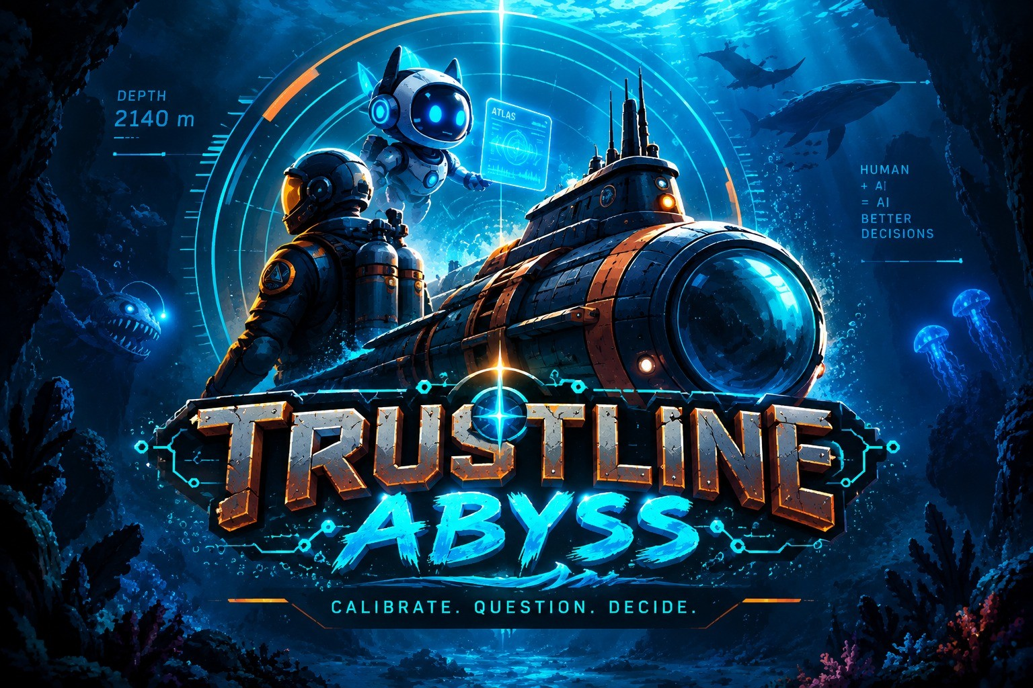
TEAM CREDITS
Meet the team
TRUSTLINE: ABYSS · HUMAN–AI TRUST CALIBRATION
CP
Chirag Patankar
RR
Raj Ranjit Yadav
GAME DEVELOPMENT · LEAD DEVELOPER
DEVELOPER · 3D / GAMEPLAY & TECHNICAL INTEGRATION
Led core game development and implementation. Built the gameplay systems, checkpoint and scenario logic, AI teammate behaviour, sensor and evidence mechanics, interaction flow, and the browser-based playable experience. Worked with Raj on architecture, integration, debugging, testing and the final build.
Focused on development, gameplay implementation, 3D environment integration, interaction systems, technical polish, testing and performance. Worked closely with Chirag to connect the submarine exploration, sensor systems, checkpoint logic and the decision-making experience.
✉ patankar.c@northeastern.edu
in linkedin.com/in/chiragpatankar/
✉ yadav.rajr@northeastern.edu
in linkedin.com/in/rajx463/
PD
Preksha Dewoolkar
PK
Purvesha Kolhe
VISUALS · MUSIC · THEME
UI/UX + FRONTEND · CONTENT, AUDIO & DOCUMENTATION
Led the visual direction, music and overall theme. Shaped the underwater sci-fi identity, the HUD aesthetic, visual assets and game presentation, and drove the audio and music that carry the mood of TRUSTLINE: ABYSS.
Contributed to both design and technical implementation: the player-facing UI and HUD, screen layouts, interaction flow, content and scenario integration, presentation assets and testing. Supported audio integration, and led project documentation, game narrative, challenge framing and final deliverables.
✉ dewoolkar.p@northeastern.edu
in linkedin.com/in/preksha-prashant-dewoolkar-2224512a/
✉ kolhe.pur@northeastern.edu
in linkedin.com/in/purvesha-kolhe
1
Notes:
Four members. Chirag on game development, Raj on 3D and technical integration, Preksha on visuals, music and theme, Purvesha on UI/UX, content and documentation.

Slide 2
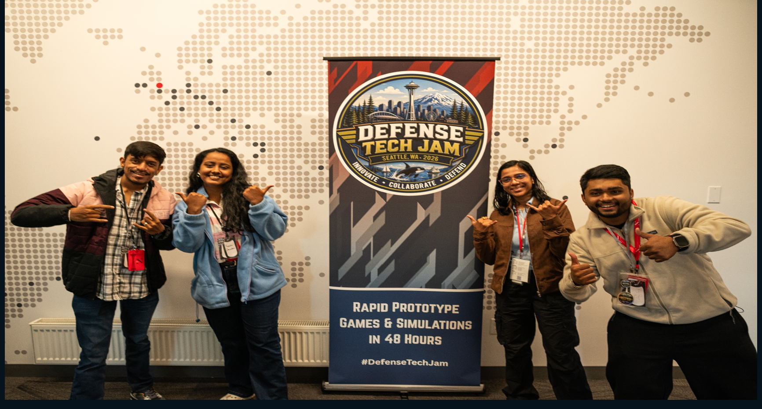
THE TEAM
FOUR PEOPLE · ONE PROTOTYPE · ONE QUESTION
📷
Team contribution split
■
Core development
Chirag + Raj
Gameplay systems, technical architecture, 3D and gameplay integration, AI behaviour, sensor and evidence logic, testing and build integration.
■
Technical design & UI
Purvesha
Player-facing HUD and UI, interaction flow, content and scenario integration, testing and iteration.
TEAM PHOTOGRAPH
■
Visuals, music & theme
Preksha + Purvesha
Delete this frame, then Insert ▸ Picture into the same space
Visual direction, underwater sci-fi identity, presentation, audio and music, and the overall player experience.
■
Documentation & narrative
Purvesha
Challenge framing, game narrative, project documentation, demo materials and final written deliverables.
WHEN SHOULD YOU TRUST YOUR AI TEAMMATE?
Team-wide: ideation, playtesting, iteration, integration and the final presentation.
2
Notes:
Team photo goes on the left. Contribution split on the right. Close on the question the whole prototype is built around.

