Slide 1

K S Institute of Technology, Bangalore
Department of Electronics and Communication Engineering
Presentation of Major Project
on
DAM AUTOMATION
by
PRAJWAL R (1KS21EC065)
PRATHAM R (1KS21EC066)
PREKSHA S (1KS21EC069)
SANJANA V (1KS21EC084)
UNDER THE GUIDANCE OF
Dr. ANITA P
ASSISTANT PROFESSOR, ECE DEPT.
K S I T, ECE DEPT, Bangalore

Slide 2

Dams play a critical role in water resource management, electricity generation (hydropower), flood control, and irrigation.
Ensuring their safety and efficient operation is crucial for preventing catastrophic failures and optimizing water management
Dam Automation the use of sensors, control systems, and advanced software to automate dam operations. Through automation, dam operators can efficiently manage water levels, regulate outflows, and optimize hydropower generation.
Structural integrity is a major concern for dams, and cracks can signal potential weaknesses that, if left unattended, could lead to dam failure.
K S I T, ECE DEPT, Bangalore

Slide 3

Sl.No | Author | Paper | Methodology | Drawbacks
1. | Mr. Pramukh J S, Mr. Prajwal H B, Mr. Prajwal S B, Mr. Sagar K M. | Review on Different Methods for Smart Dam Operation and Water Monitoring[IJRASET] 2024 | IoT sensors, Microcontrollers, Actuators | No Crack detection. No alarm.
2. | Dhananjali Singh, Ansh Jadaun, Ashish Sharma, Mohit Pratap Singh | Arduino Based Dam Automation[IJARCCE] 2024 | Arduino microcontroller, Level sensor, Blynk app | No Crack detection. No alarm. No pH level monitoring.
3. | Prof. Atul Atalkar, Shivajiroa S, Harshvardhan Rethrekar, Kunal Bauskar, | Dam Automation using IoT [JETIR] 2024 | ESP32 microcontroller, Level sensors, Turbidity sensors, Cloud integration (Thing Speak), Android App | No pH Level monitoring. No GSM Module used.
K S I T, ECE DEPT, Bangalore

Slide 4

Sl.No | Author | Paper | Methodology | Drawbacks
4. | Yang Chao, Chaoning Lin, Tongchun Li, Huijun Qi, Dongming Li | An Automated Framework for the Health Monitoring of Dams Using Deep Learning Algorithms and Numerical- Applied Sciences Journal [2023] | structural health of dams using a combination of deep learning techniques and numerical simulations | Deep learning concepts like CNN are difficult to calibrate and compute.
5. | Yandamuri Sai Prudhvi, K. Santhoshi, K. Umesh, C. | Water Level Monitoring And Dam Gate Control Over IoT-IRJMETS [2023] | Ultrasonic sensor, Flex sensor, Arduino, Servo motor, IoT module for data transmission | No Dam Automation. No alarm given and images aren’t monitored.
6. | Watanabe Naoki, Takago Ryuei, Suzuki Masako. | AI Utilized Dam Optimal Operation System-JFE Technical Report[2022] | AI algorithms, Machine learning models, Historical data, Weather forecast models, Water flow sensors | No crack detection. No usage of GSM Module.
K S I T, ECE DEPT, Bangalore

Slide 5

Sl.No | Author | Paper | Methodology | Drawbacks
7. | Dr. Nagesha Shivappa, Aishwarya S Rao, Aishwarya | Dam Automation and Application Using IOT[IJERT] June 2021 | Raspberry Pi, Water flow sensors, Turbidity sensor, Metal corrosion sensor. | No crack detection. GSM Module isn’t used.
8. | Vishal Wankhade, Aniket Thakker, Dishant Vakte | Smart Dam System [IJEAST] 2021 | Arduino, Temperature sensor, Ultrasonic sensor, Piezo sensor, LCD display, Micro servo motor, LEDs | No Dam Automation. No Crack detection
9. | Kesthara V, Chandan Sharma B R K, Suhas S Kashyap | Automated Dam Controlling System Using Draught Analysis-[IJCRT]2021 | Arduino UNO R3, Soil moisture sensors, Ultrasonic sensors, Solenoid valve, Wi-Fi module (ESP8266) | No crack detection. No crack detection
K S I T, ECE DEPT, Bangalore

Slide 6

Current dam monitoring systems rely on manual inspections, leading to delayed hazard detection. A real-time, automated system with early warning capabilities is crucial for preventing failures and ensuring safety.
K S I T, ECE DEPT, Bangalore

Slide 7

To detect water levels and control dam gates automatically using sensors and motors connected to ESP 32.
To provide emergency alerts to authorities in case of crack.
K S I T, ECE DEPT, Bangalore

Slide 8

The system begins by collecting data from various sensors placed across the dam for water levels, detecting cracks, and rainfall.
The laptop-based application processes images captured by the camera for crack detection. The images are analyzed to identify structural issues.
The sensor data is transmitted to ESP32 microcontrollers, which process the data and hence allows the dam gates to open or close and reads the turbidity value.
K S I T, ECE DEPT, Bangalore

Slide 9

Ultra sonic sensor
ESP 32
GSM Module
Turbidity Sensor
Water Pump
Rain sensor
Motor Driver
LCD
Camera
Servo Motors
Power Supply
K S I T, ECE DEPT, Bangalore

Slide 10

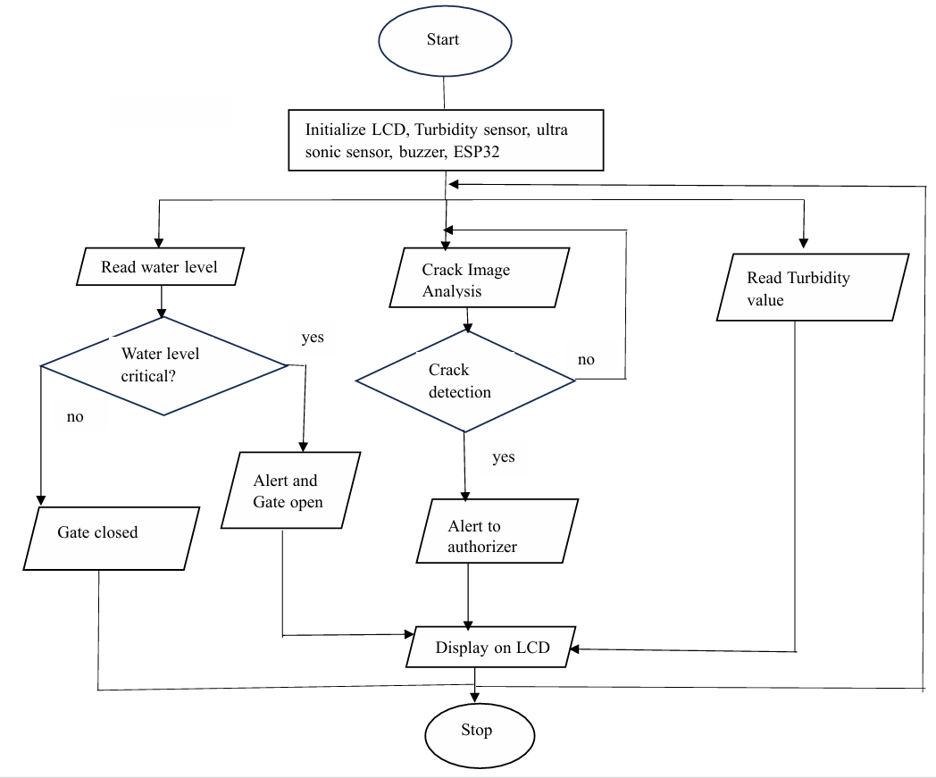
K S I T, ECE DEPT, Bangalore

Slide 11

  Hardware Software
  ESP 32 Arduino IDE
  Ultrasonic Sensor
  Rain Sensor
  Turbidity Sensor
  Water Pump
  GSM Module
  LCD Display
  Buzzer
  Servo Motor.
K S I T, ECE DEPT, Bangalore

Slide 12

Predictive Flood Management: automated systems can adjust water release to prepare for upcoming heavy rains or potential floods.
IoT-Enabled Crack Sensors: crack sensors on dam structures can detect early signs of cracking, and other structural weaknesses
Water Quality Sensors: IoT sensors for measuring water quality parameters can detect changes in water quality.
K S I T, ECE DEPT, Bangalore

Slide 13

The system’s ability to detect structural cracks and water levels in real-time minimizes human dependency and ensures responses to critical situations.
The automation of dam gate control, combined with emergency alert mechanisms, significantly improves efficiency and safety.
This project provides a reliable, and efficient solution for modern dam infrastructure management.
K S I T, ECE DEPT, Bangalore

Slide 14

In critical cases water when polluted can be further filtered or cleaning procedures to maintain pH level.
Real-time weather data can be incorporated to anticipate potential flooding events more accurately.
K S I T, ECE DEPT, Bangalore

Slide 15

https://iarjset.com/papers/literature-survey-on-dam-automation/
IJRTI
K S I T, ECE DEPT, Bangalore

Slide 16

Our project has been funded by 48th series of Student programme (SPP) 24-25 with series no 48S_BE_2340 under the guidance of Dr. Anita P.
K S I T, ECE DEPT, Bangalore

Slide 17

Prof. Atul Atalkar, Mr. Harshvardhan Rethrekar, Mr. Kunal Bauskar - Dam Automation Using IOT-Journal of Emerging Technologies and Innovative Research - March 2024
Amit Kumar Singh, Harshitaa Mahajan, kshitij Arun - Automate The Functioning Of Dams Using IoT Research Gate May 2023
Amit Kumar Singh, Harshitaa Mahajan, kshitij Arun.- Automate The Functioning Of Dams Using IoT- International Journal of Engineering Applied Sciences and Technology May 2023- Vol. 5-Pages 147-150
Prof. Shital kakad, Ms. Rutuja Bhale, Ms. Musakn Shaikh, Ms. Nikita Shintre Dam Monitoring System using IOT- July 2022
Prof. Shital kakad, Ms. Rutuja Bhale, Ms. Musakn Shaikh.-Dam Monitoring System using IOT[IJRASET] July 2022
K S I T, ECE DEPT, Bangalore

Slide 18
Dr. Nagesha Shivappa Dam Monitoring System using IOT- International Journal of Engineering Research & Technology Vol. 9 Issue 05, May-2020
Yingchi Mao, Jing Chen, Ping Ping-Crack Detection with Multi-task Enhanced Faster R-CNN Model- IEEE Sixth International Conference on Big Data Computing Service and Applications- Aug 2020 Pg120
Jianghong Tang, Yingchi Mao, Longbao Wang- Multi-task Enhanced Dam Crack Image Detection Based on Faster R-CNN- Research gate and International Conference 2019
Omaryabrata Bharatiya-PLC-Based Dam Automation System-International Journal for Scientific Research & Development-2018
K S I T, ECE DEPT, Bangalore

Slide 19
Thank You
K S I T, ECE DEPT, Bangalore

