Slide 1


WELCOME
TWO DAYS
INTERNATIONAL CONFERENCE on
“Recent Challenges and Innovations in Engineering Science and Technology”
9th and 10th MAY 2025
Organized by
K.S. INSTITUTE OF TECHNOLOGY
Bangalore – 560 109, India
A Article Presentation on
DAM AUTOMATION
Paper Id: 182
Presenting Peers:
Ms. Preksha S, Student, email: prekshas_ece@ksit.edu.in

Slide 2

CONTENT
1
Introduction
2
Literature Review
3
SUMMARY of Literature Review
4
Objectives/ Need for the study
5
Methodology
6
Results and Discussions
7
Conclusions
8
Future Scope and Industry Relevance
7
References
2 of 14

Slide 3
About the Institute
INTRODUCTION
Dams play a critical role in water resource management, electricity generation (hydropower), flood control, and irrigation.
The titled project interfaces ESP32 microcontroller with ultra sonic, turbidity, rain, flow sensors for the automation and dam condition monitoring. The crack detection process involves interfacing of camera with the microcontroller where an image is fed to detect the crack.

Slide 4
About the Institute
LITERATURE REVIEW
Sl.No | Author | Paper | Methodology | Drawbacks
1. | Mr. Pramukh J S, Mr. Prajwal H B, Mr. Prajwal S B, Mr. Sagar K M. | Review on Different Methods for Smart Dam Operation and Water Monitoring[IJRASET] 2024 | IoT sensors, Microcontrollers, Actuators | No Crack detection. No alarm.
2. | Dhananjali Singh, Ansh Jadaun, Ashish Sharma, Mohit Pratap Singh | Arduino Based Dam Automation[IJARCCE] 2024 | Arduino microcontroller, Level sensor, Blynk app | No Crack detection. No alarm. No pH level monitoring.
3. | Prof. Atul Atalkar, Shivajiroa S, Harshvardhan Rethrekar, Kunal Bauskar, | Dam Automation using IoT [JETIR] 2024 | ESP32 microcontroller, Level sensors, Turbidity sensors, Cloud integration (Thing Speak), Android App | No pH Level monitoring. No GSM Module used.

Slide 5
About the Institute
LITERATURE REVIEW
Sl.No | Author | Paper | Methodology | Drawbacks
4. | Yang Chao, Chaoning Lin, Tongchun Li, Huijun Qi, Dongming Li | An Automated Framework for the Health Monitoring of Dams Using Deep Learning Algorithms and Numerical- Applied Sciences Journal [2023] | structural health of dams using a combination of deep learning techniques and numerical simulations | Deep learning concepts like CNN are difficult to calibrate and compute.
5. | Yandamuri Sai Prudhvi, K. Santhoshi, K. Umesh, C. | Water Level Monitoring And Dam Gate Control Over IoT-IRJMETS [2023] | Ultrasonic sensor, Flex sensor, Arduino, Servo motor, IoT module for data transmission | No Dam Automation. No alarm given and images aren’t monitored.

Slide 6

About the Institute
SUMMARY of LITERATURE REVIEW
Most papers focus on using microcontrollers like Arduino and ESP32 integrated with sensors (e.g., level, ultrasonic, turbidity, flex) and IoT platforms (Blynk, Thing-Speak) for automated dam control. Some studies incorporate mobile apps for user control. It also explores structural health monitoring using deep learning and simulations. Overall, the works emphasize real-time data transmission, automation, and enhanced monitoring through sensor networks and cloud integration.

Slide 7
About the Institute
OBJECTIVES/ NEED FOR THE STUDY
Current dam monitoring systems rely on manual inspections, leading to delayed hazard detection. A real-time, automated system with early warning capabilities is crucial for preventing failures and ensuring safety.

Slide 8
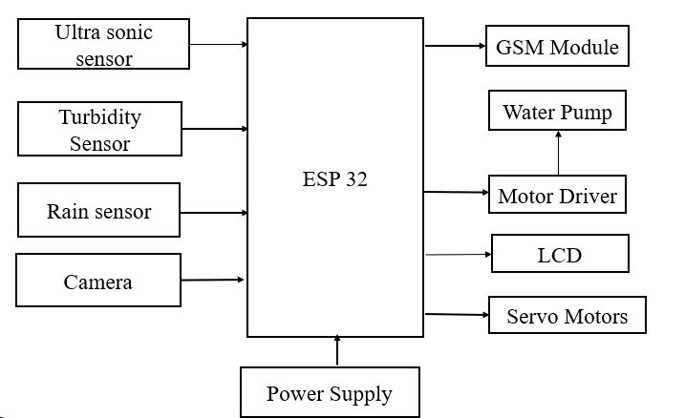
About the Institute
METHODOLOGY
The system begins by collecting data from various sensors placed across the dam for water levels, detecting cracks, and rainfall.
The laptop-based application processes images captured by the camera for crack detection. The images are analyzed to identify structural issues.
The sensor data is transmitted to ESP32 microcontrollers, which process the data and hence allows the dam gates to open or close and reads the turbidity value.
Fig 1: Block Diagram

Slide 9
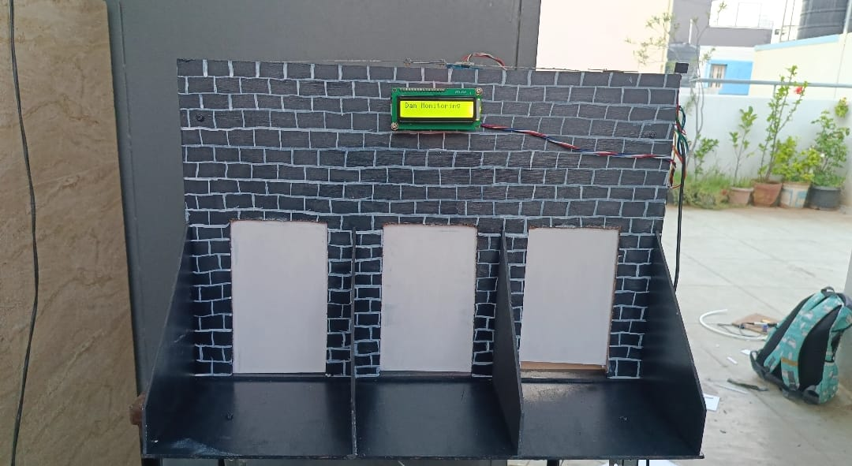
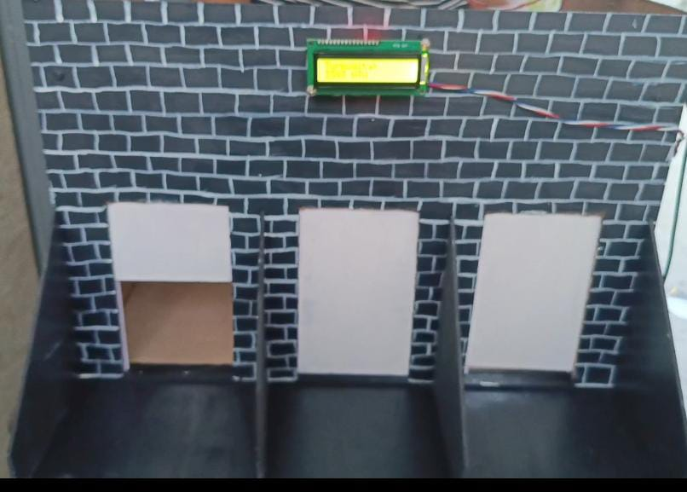
About the Institute
RESULTS and DISCUSSIONS
Fig. 2, Dam Prototype
Fig. 3: Releasing of water through 1 gate
Fig. 2, shows the prototype of a dam, interfacing all the components with the microcontroller
Fig. 3, Represents the Ultra sonic sensor senses the water level and releases of water from 1 gates when the level reaches 10 to 15cm.

Slide 10
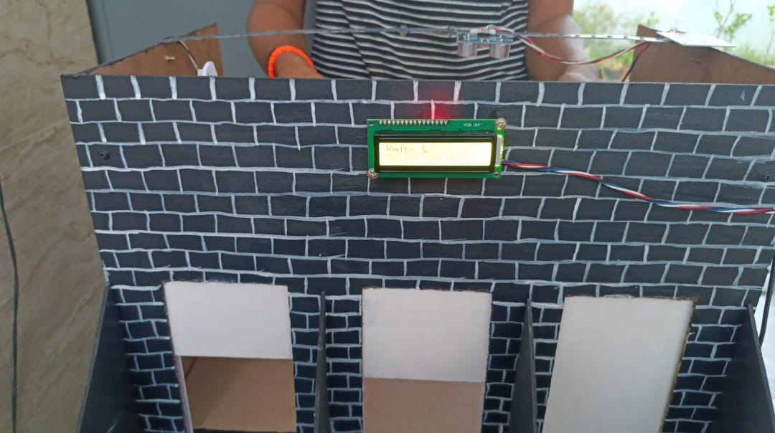
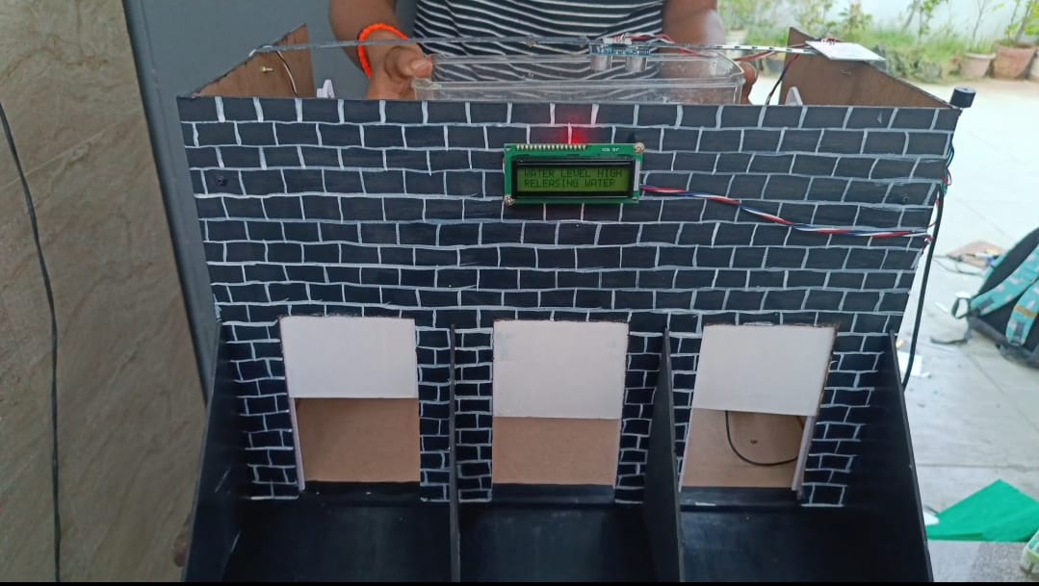
About the Institute
RESULTS and DISCUSSIONS
Fig. 5: Releasing water through 2 gates.
Fig. 6: Releasing of water through 3 gates
Fig. 5, shows the Ultra sonic sensor senses the water level and releases of water from 2 gates when the level reaches 5 to 9cm giving a buzzer in prior.
Fig. 6,shows the Ultra sonic sensor senses the water level and releases of water from 3 gates when the level reaches 0 to 4cm giving a buzzer in prior.

Slide 11
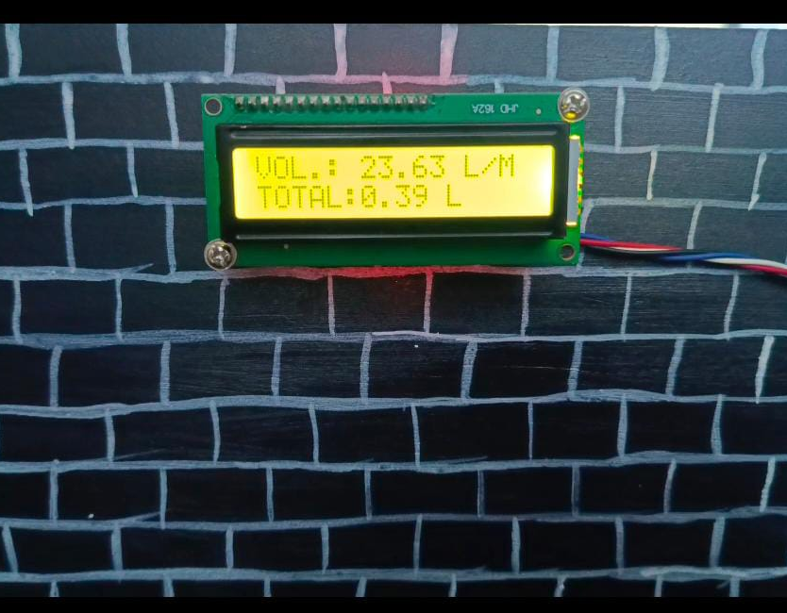
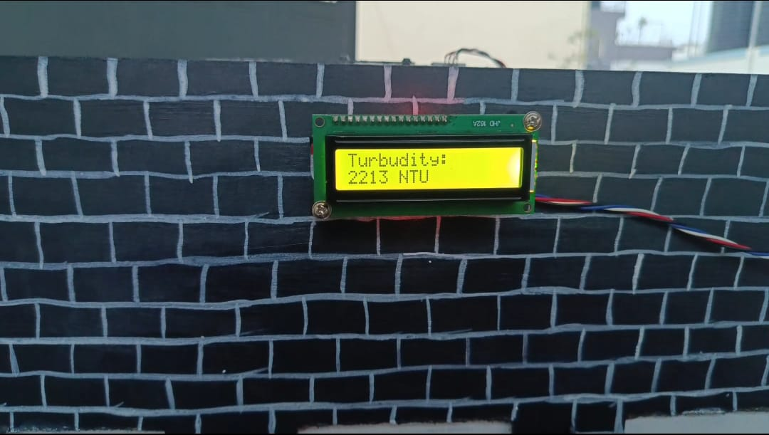
About the Institute
RESULTS and DISCUSSIONS
Fig. 5: Turbidity value is measured.
Fig. 5 shows the turbidity value sensed by the photodiode present in the turbidity sensor.
Fig. 4: Volume is measured.
In Fig 4, The Inflow sensor measures the volumes of water in the dam and is shown in the above figure.

Slide 12
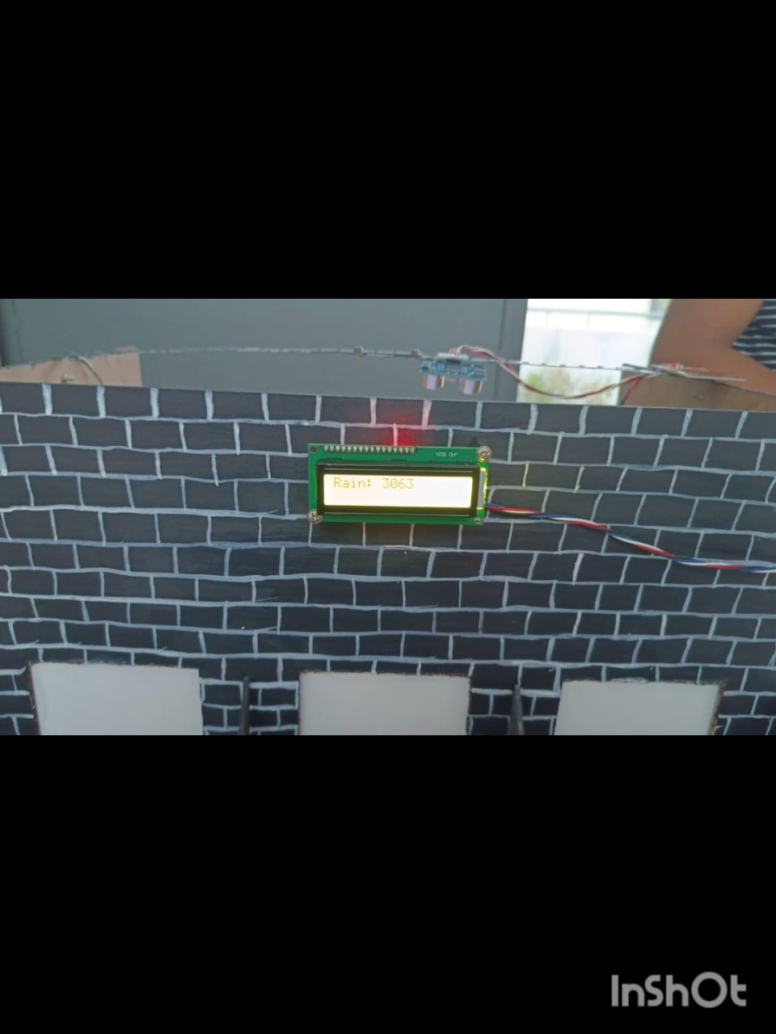
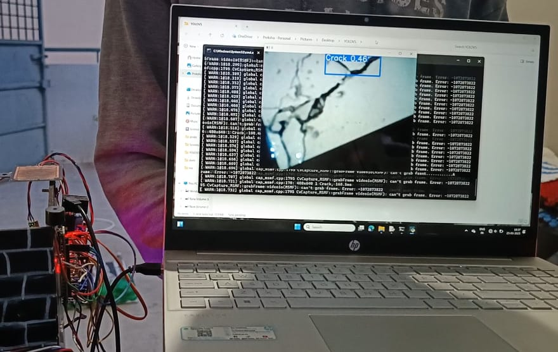
About the Institute
RESULTS and DISCUSSIONS
Fig. 7: Cracked image.
In the Fig. 7, a cracked image is shown to the web camera detecting the crack and hence a message is sent to the phone through a GSM Module.
Fig. 6: Rainfall is measured.
In Fig 6, The rain sensor measures the rainfall and alert is sent to mobile phone via GSM Module.

Slide 13
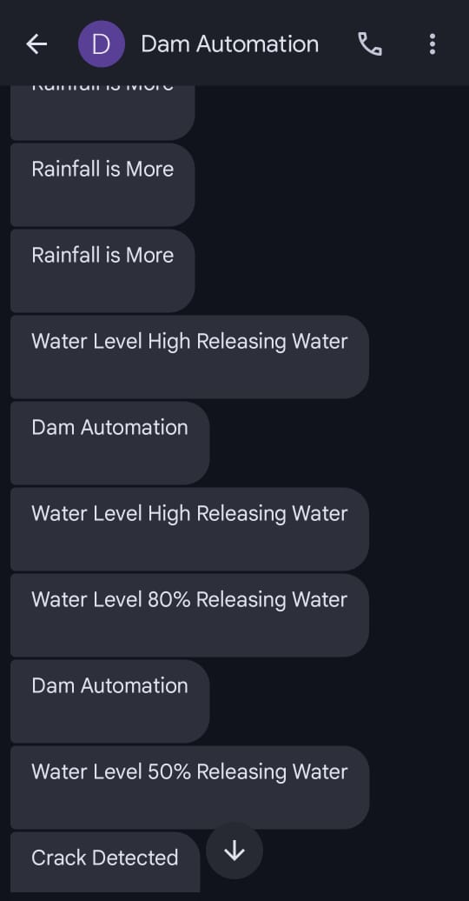
About the Institute
RESULTS and DISCUSSIONS
Fig. 8, GSM Module interfaced in the prototype sends all the alert messages through SMS.
Fig. 8: Messages received through SMS

Slide 14
About the Institute
CONCLUSIONS
The system’s ability to detect structural cracks and water levels in real-time minimizes human dependency and ensures responses to critical situations.
The automation of dam gate control, combined with emergency alert mechanisms, significantly improves efficiency and safety.
This project provides a reliable, and efficient solution for modern dam infrastructure management.

Slide 15
FUTURE SCOPE AND
INDUSTRY RELEVANCE
About the Institute
In critical cases water when polluted can be further filtered or cleaning procedures to maintain pH level.
Real-time weather data can be incorporated to anticipate potential flooding events more accurately.
The project addresses critical industry needs like automated flood control, structural health monitoring, and water quality assessment.
Its integration of IoT and AI mirrors ongoing advancements in smart infrastructure and predictive maintenance. This makes it highly relevant for modern water resource and disaster management sectors.

Slide 16
About the Institute
REFERENCES
[1] Mr. Pramukh J S, Mr. Prajwal H B, Mr. Prajwal S B, Mr. Sagar K M, Dr. Trupti S Tagare “Review on Different Methods for Smart Dam Operation and Water Monitoring” International Journal for Research in Applied Science & Engineering Technology (IJRASET)-2024.
[2] Dhananjali Singh, Ansh Jadaun , Ashish Sharma , Mohit Pratap Singh proposed the paper "Arduino based Dam Automation"- International Journal of Advanced Research in Computer and Communication Engineering (IJARCCE), Volume 13, Issue 6, in June 2024.
[3] Prof. Atul Atalkar, Mr. Shivajiroa. S, Mr. Harshvardhan Rethrekar, Mr. Kunal Bauskar, Mr. Abhishek Chindane Manjare “Dam Automation Using IOT”- Journal of Emerging Technologies and Innovative Research (JETIR), Volume 11, Issue 4, in April 2024.
[4] Yang Chao ORCID, Chaoning Lin, ORCID, Tongchun Li, Huijun Qi ORCID, Dongming Li and Siyu Chen proposed the paper "An Automated Framework for the Health Monitoring of Dams Using Deep Learning Algorithms and Numerical Methods"- Applied Sciences journal, Volume 13, Issue 22, Article 12457, in 2023.
[5] Yandamuri Sai Prudhvi, K. Santhoshi, K. Umesh, C. Nihanth, Yarram Prathyusha “Water Level Monitoring And Dam Gate Control Over Iot”. International Research Journal of Modernization in Engineering Technology and Science (IRJMETS)-2023

Slide 17
About the Institute
ACKNOWLEDGEMENT
The successful project is culmination of efforts of many people who have rendered their unconditional support. we would be dishonest without acknowledging these people
Dr. Dilip Kumar K, Principal, KSIT, who has been a continuous source of inspiration to us .We are indebted to him for his encouragement in making the project a success.
Dr. P.N. Sudha, Head of the Department, Electronics and Communication Engg. Department, KSIT, who has continuously encouraged, motivated and provided us valuable suggestions.
We are also thankful to our internal guide, Dr. Anita P, Assistant Professor, Electronics & Communication Engg. Department, KSIT, for providing valuable support and guidance to make this project a success.
We are thankful to our project Coordinators, Dr. Rekha N Associate Professor, Mrs Suma Santosh, Assistant professor Electronics and Communication Engg. Department, K.S. Institute of Technology, for their coordination and help.
Last but not the least the project would not have been a success without the grace of god and support of our parents and friends.

Slide 18


