Slide 1
Quenching of the Inversion Transition of Ammonia
A Classical or Quantum Problem?
Isabelle Herbauts and David Dunstan
Physical Review A76,062506 (2007)
Background – Chemistry v. Physics
The Inversion Transition and its pressure dependence
Literature theories
“Quantum Molecular Dynamics” model
Broken sinusoids – a mathematical problem
Conclusions

Slide 2
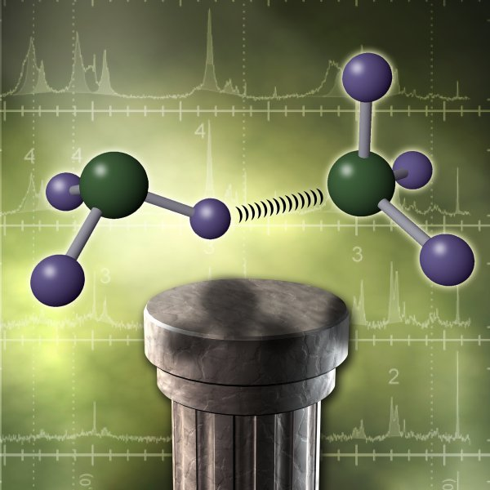
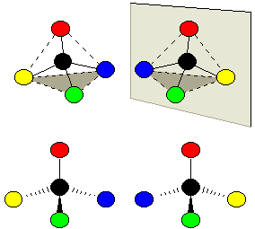
Two ammonia molecules, according to Chemistry
(From http://www.pnl.gov, Pacific Northwest National Laboratory)
The more general case of chiral or enantiomorphic tetrahedral molecules
(From http://www.creative-chemistry.org.uk)

Slide 3
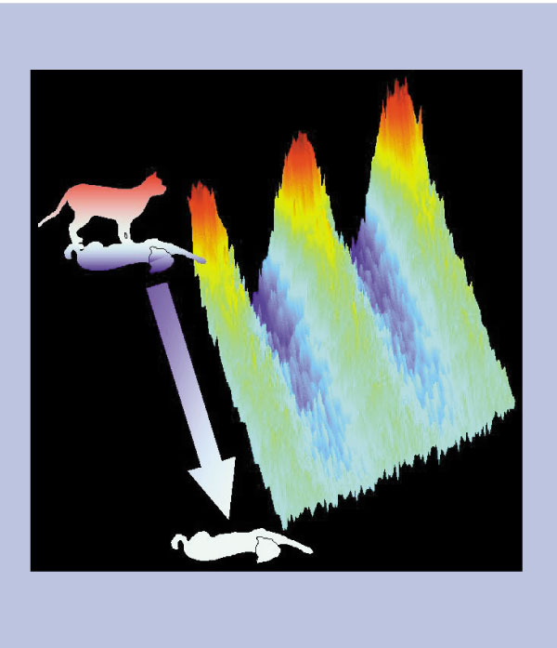
Schrödinger’s cat
From Quantum physics: Engineering decoherence
Wolfgang P. Schleich
Nature 403, 256-257(20 January 2000)

Slide 4
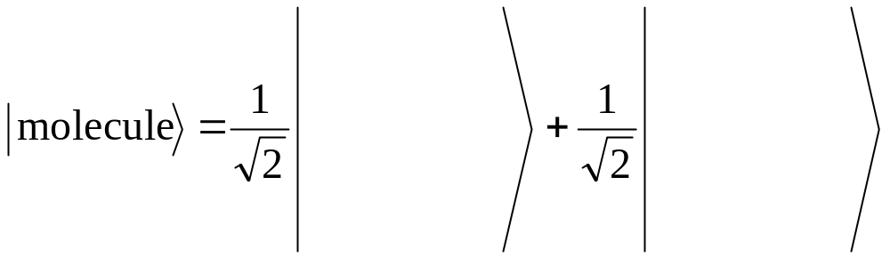
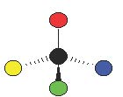
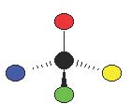

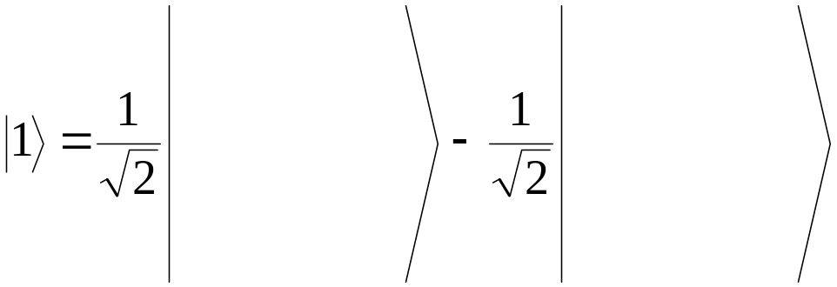
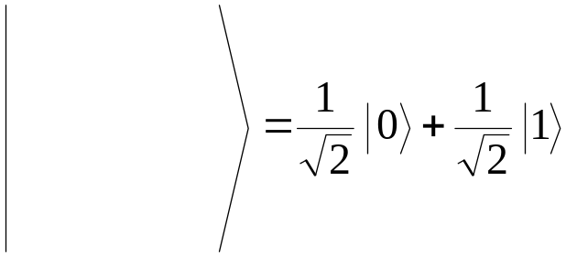
In contrast to Chemistry, the Physics description is
This is the lowest energy state, or ground state,
The first excited state, at higher energy, is
And we can have the molecule in a spatial state,

Slide 5
In Chemistry, the molecule is in a spatial state.
(A bottle in Chemistry Stores may contain pure left-handed or right-handed molecules.)
In Physics, it oscillates between the two spatial states.
(This oscillation in ammonia is the basis of the Maser, the original Laser.)
Physics
= Quantum
Chemistry
= Classical

Slide 6
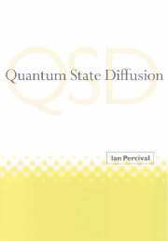

Two books that cite the collapse of the ammonia inversion under pressure as observation of quantum localisation, or of the appearance of the classical (chemical) world from the quantum (physical) world.

Slide 8
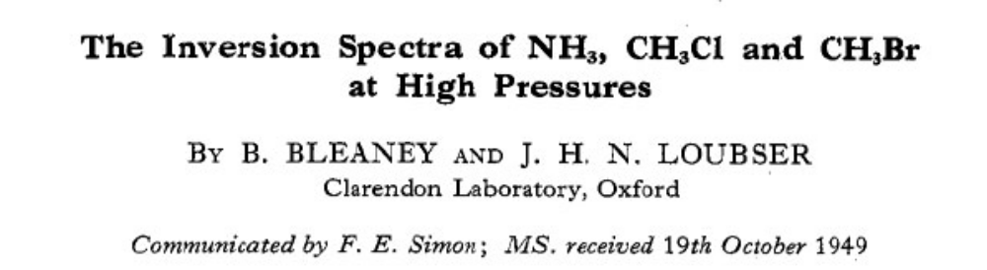
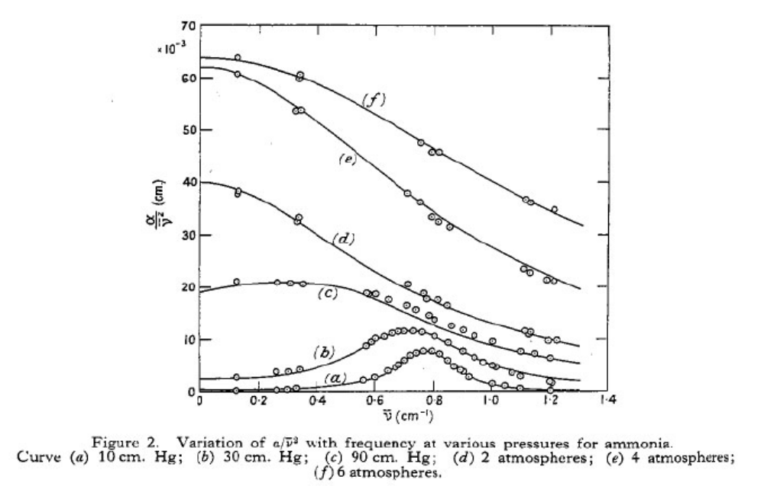
Proc. Phys. Soc. A63, 483 (1950).
Formula from J.H. Van Vleck and V.F. Weisskopf, Rev. Mod. Phys. 17, 227 (1945).

Slide 9
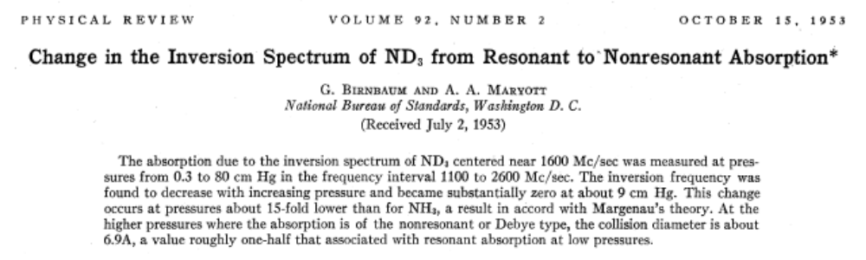
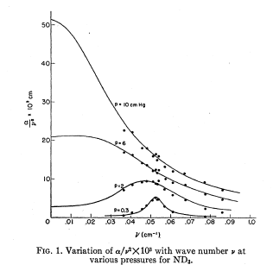
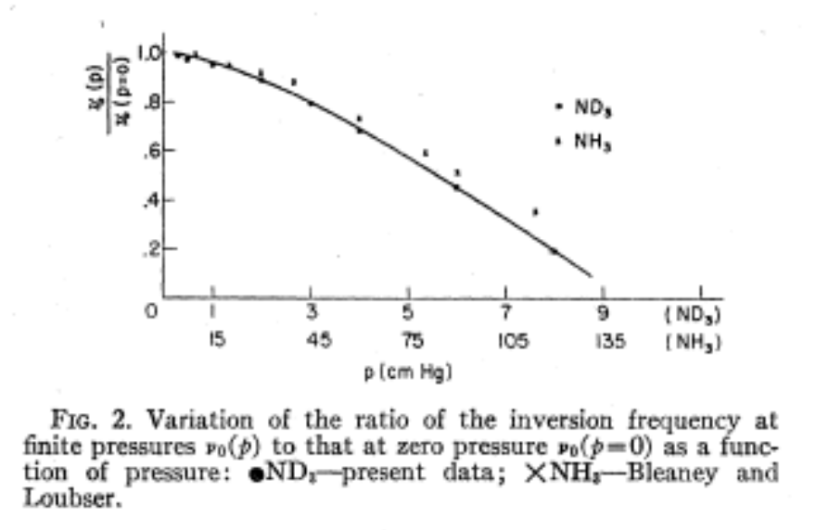

Slide 10
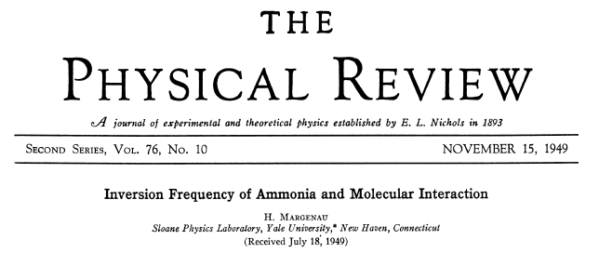
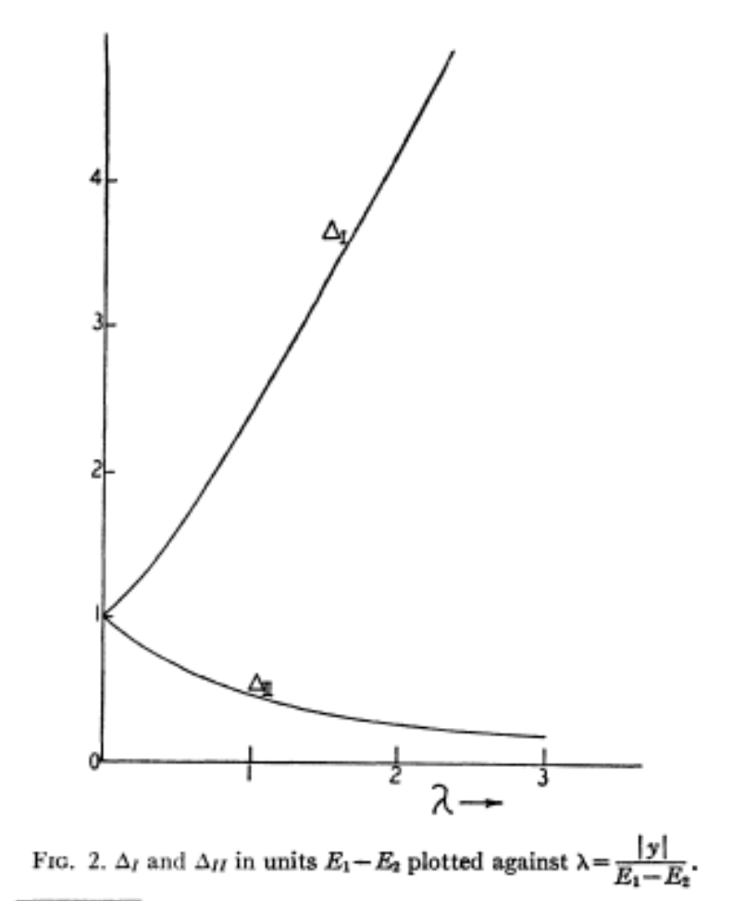

Slide 11
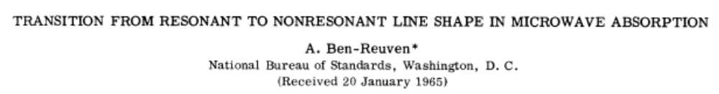
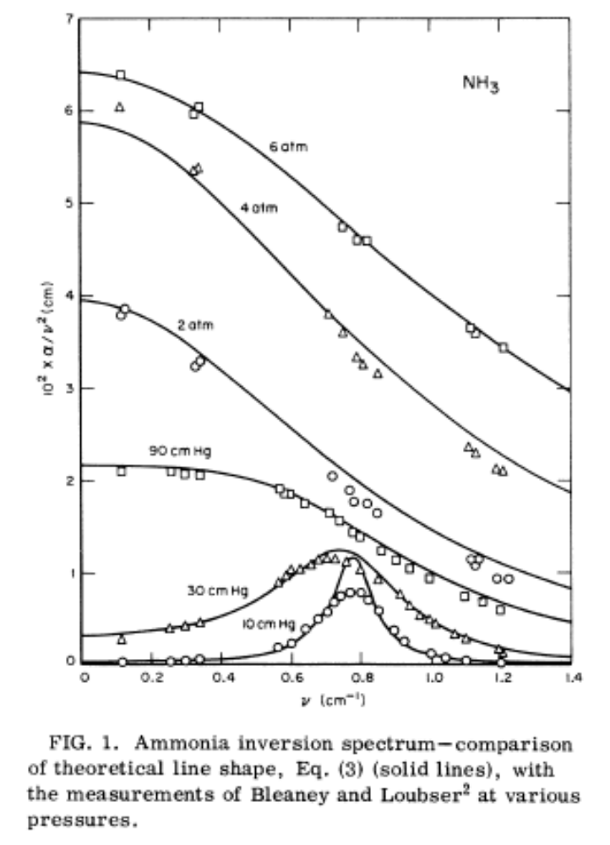

Slide 12
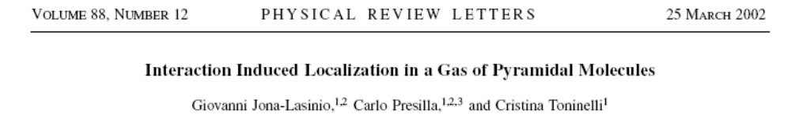
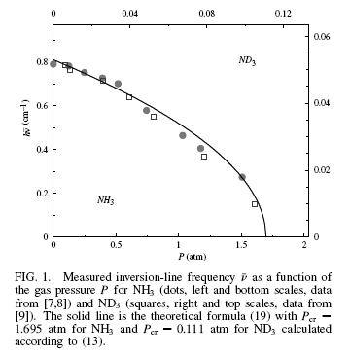

Slide 14
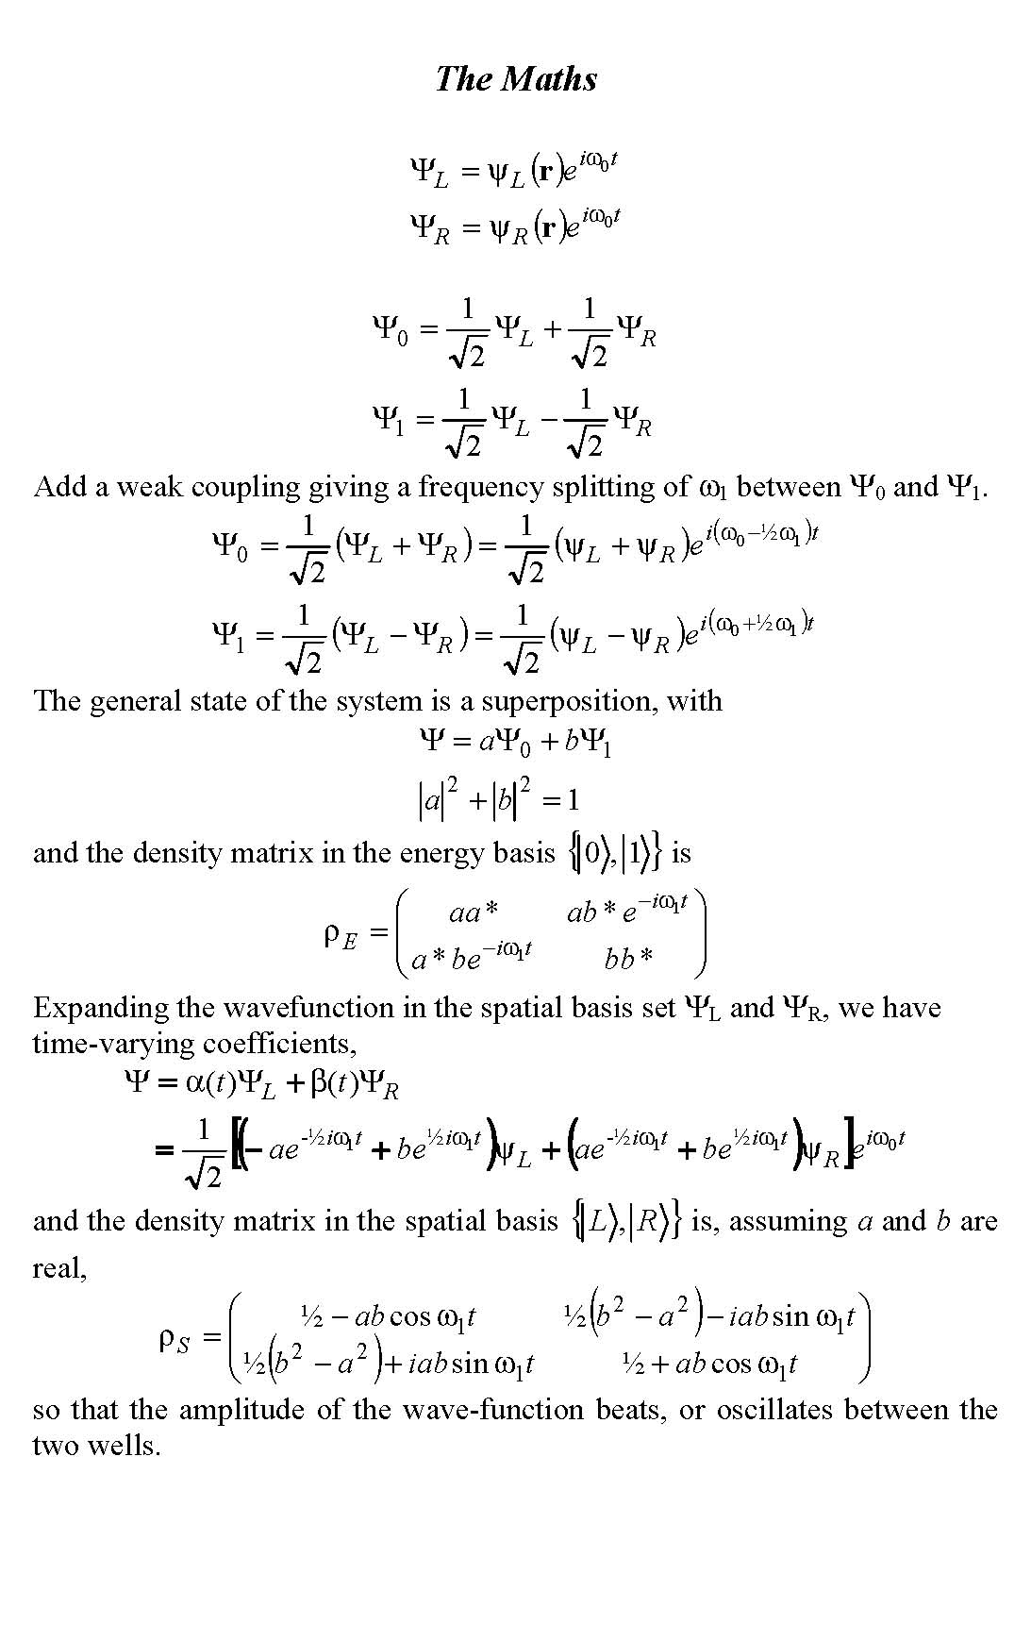

Slide 15
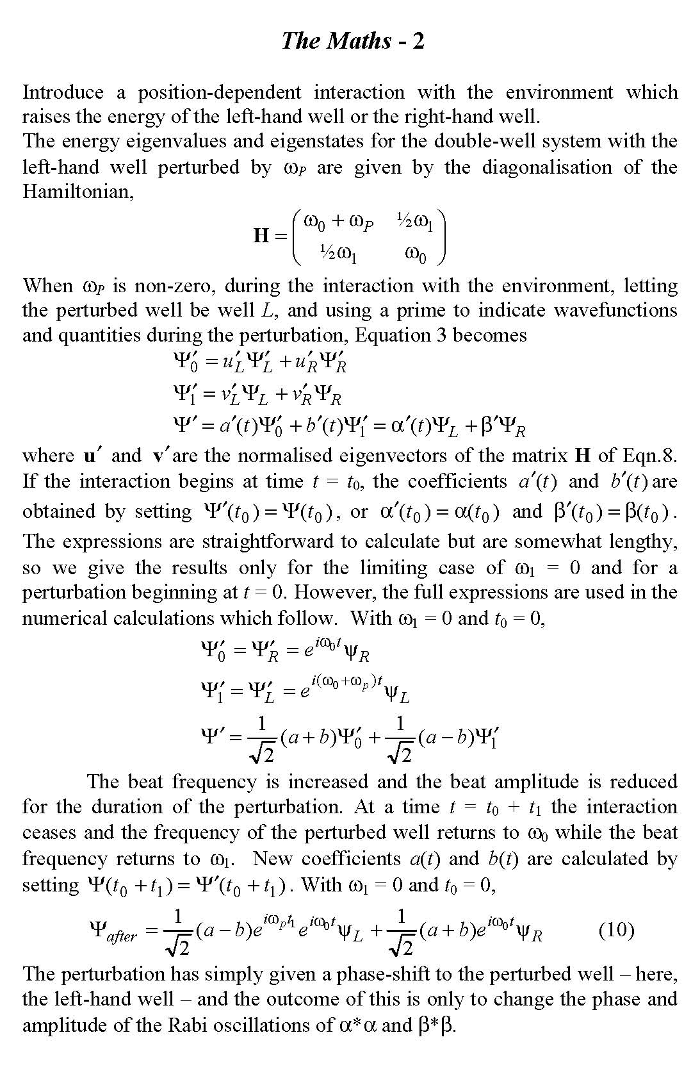

Slide 16
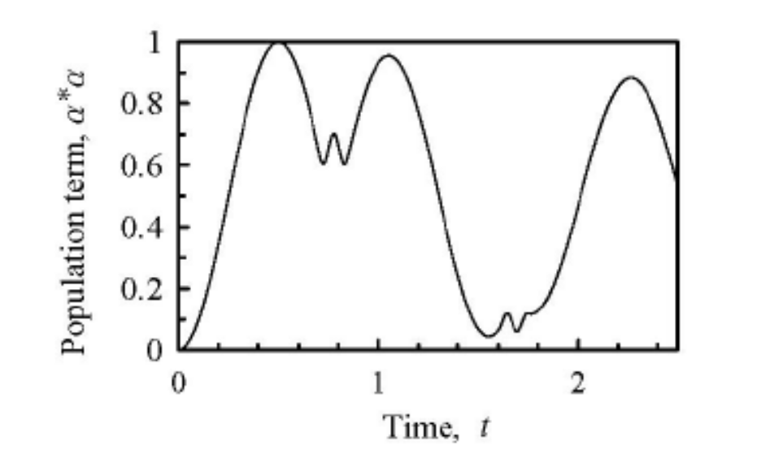
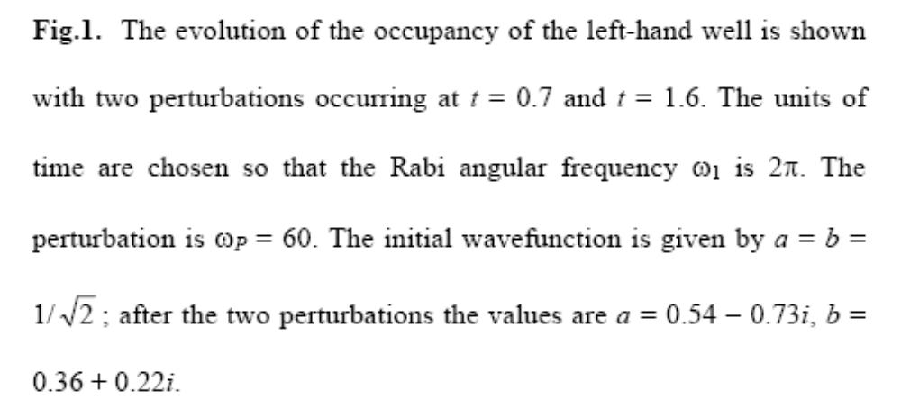

Slide 17
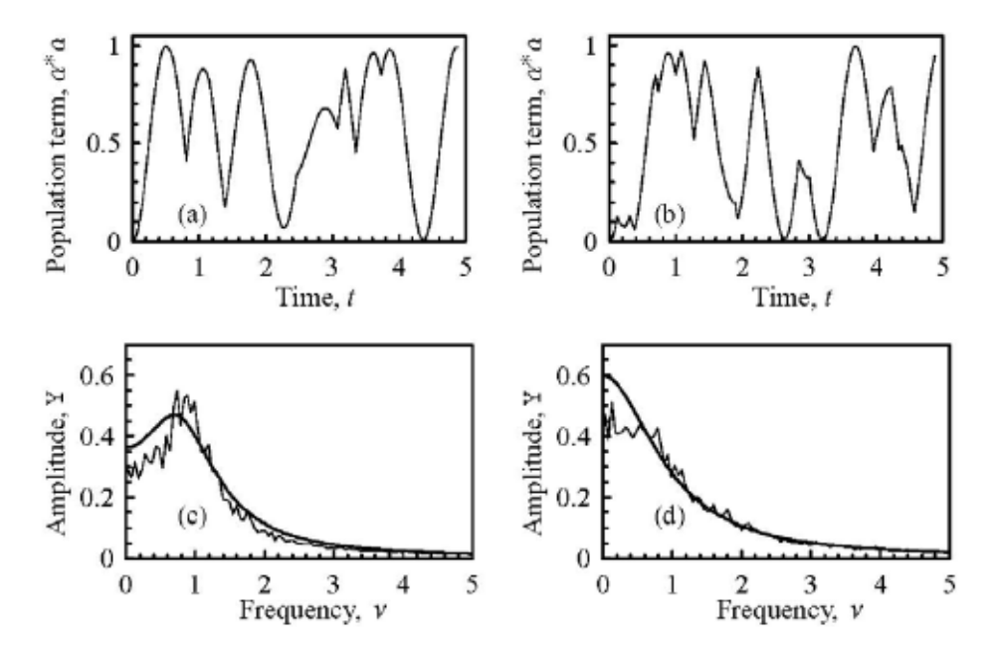
Fitted using variable peak, width and height
Formula from J.H. Van Vleck and V.F. Weisskopf, Rev. Mod. Phys. 17, 227 (1945).

Slide 18
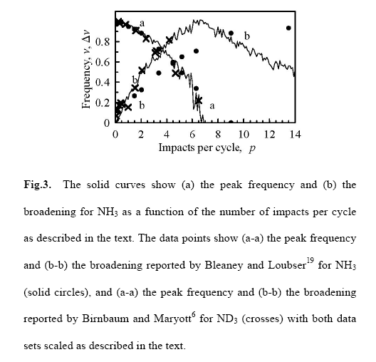

Slide 19
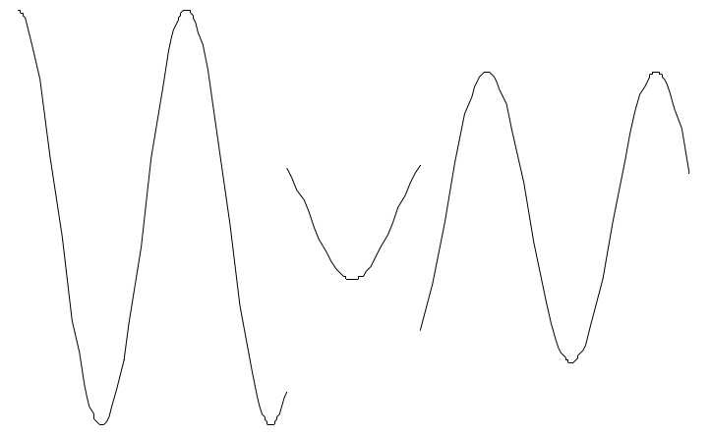
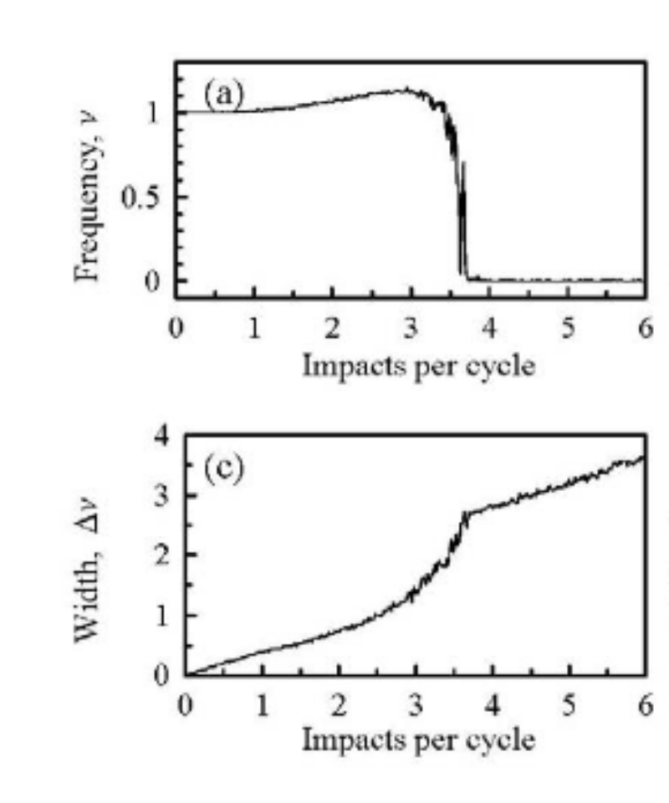
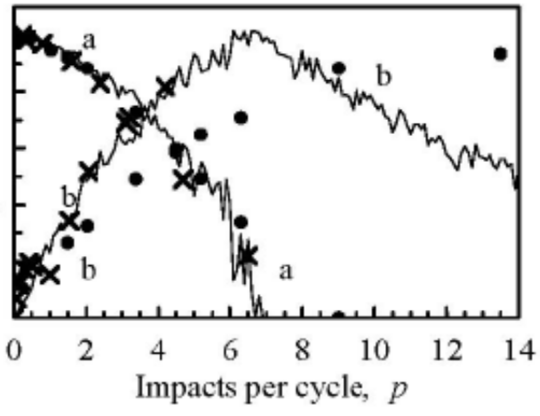
Fully
broken sinusoid

Slide 20
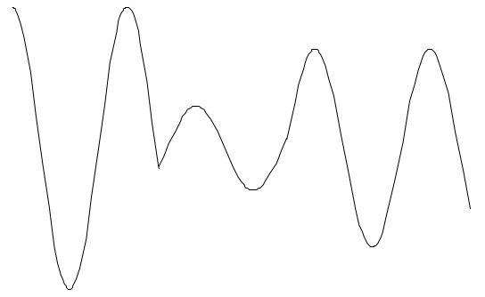
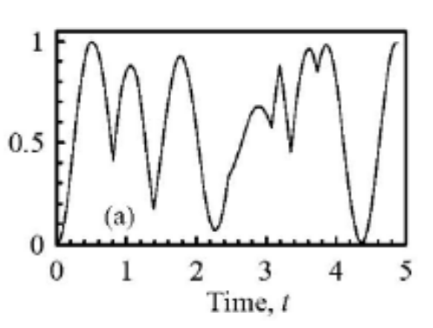
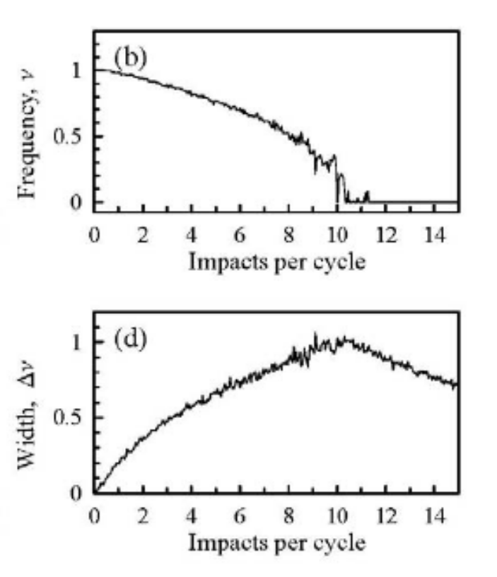
Continuous
broken sinusoid

Slide 21
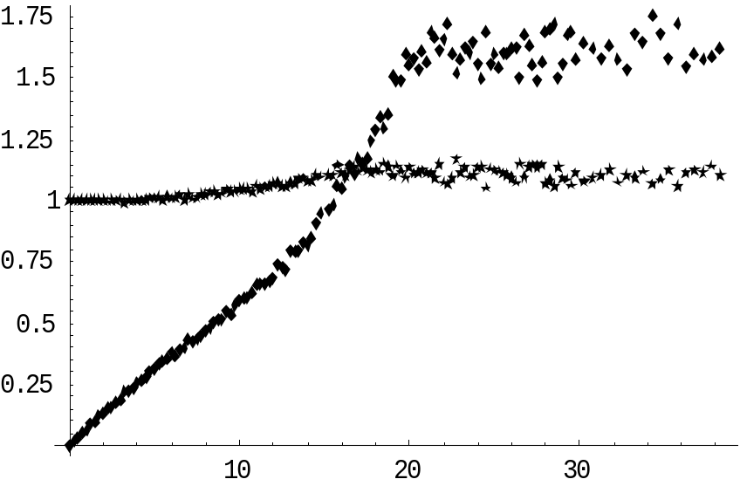
New amplitude chosen randomly in the range -1 to 1.

Slide 22
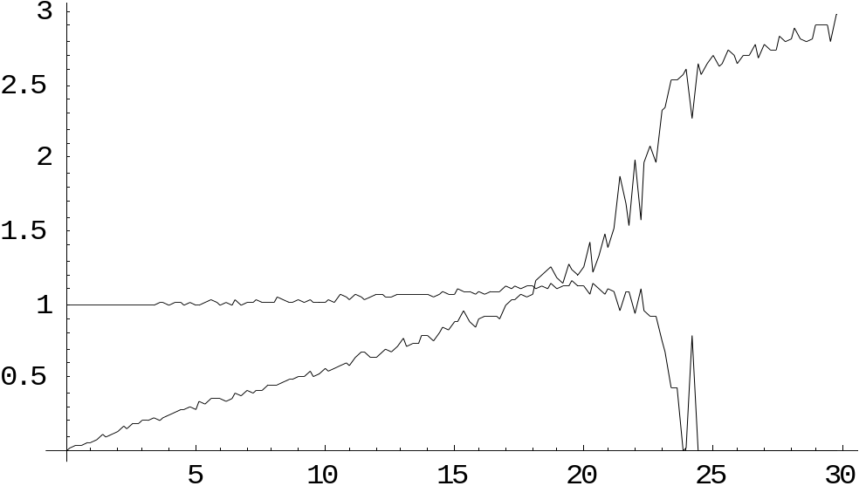
New phase chosen randomly in the range 0 to 2π

Slide 23
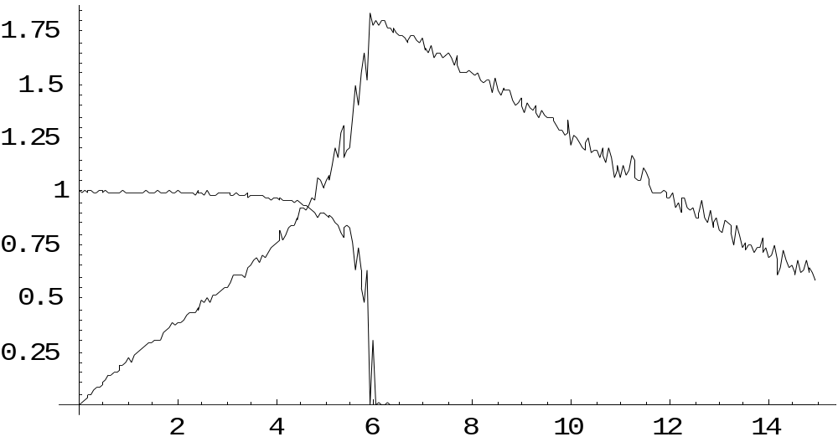
Zeno – as in the quantum Zeno effect, each interaction with the environment forces collapse of the wave-function to a spatial eigenstate – i.e. the sinusoid starts off again from y = ±1

Slide 24
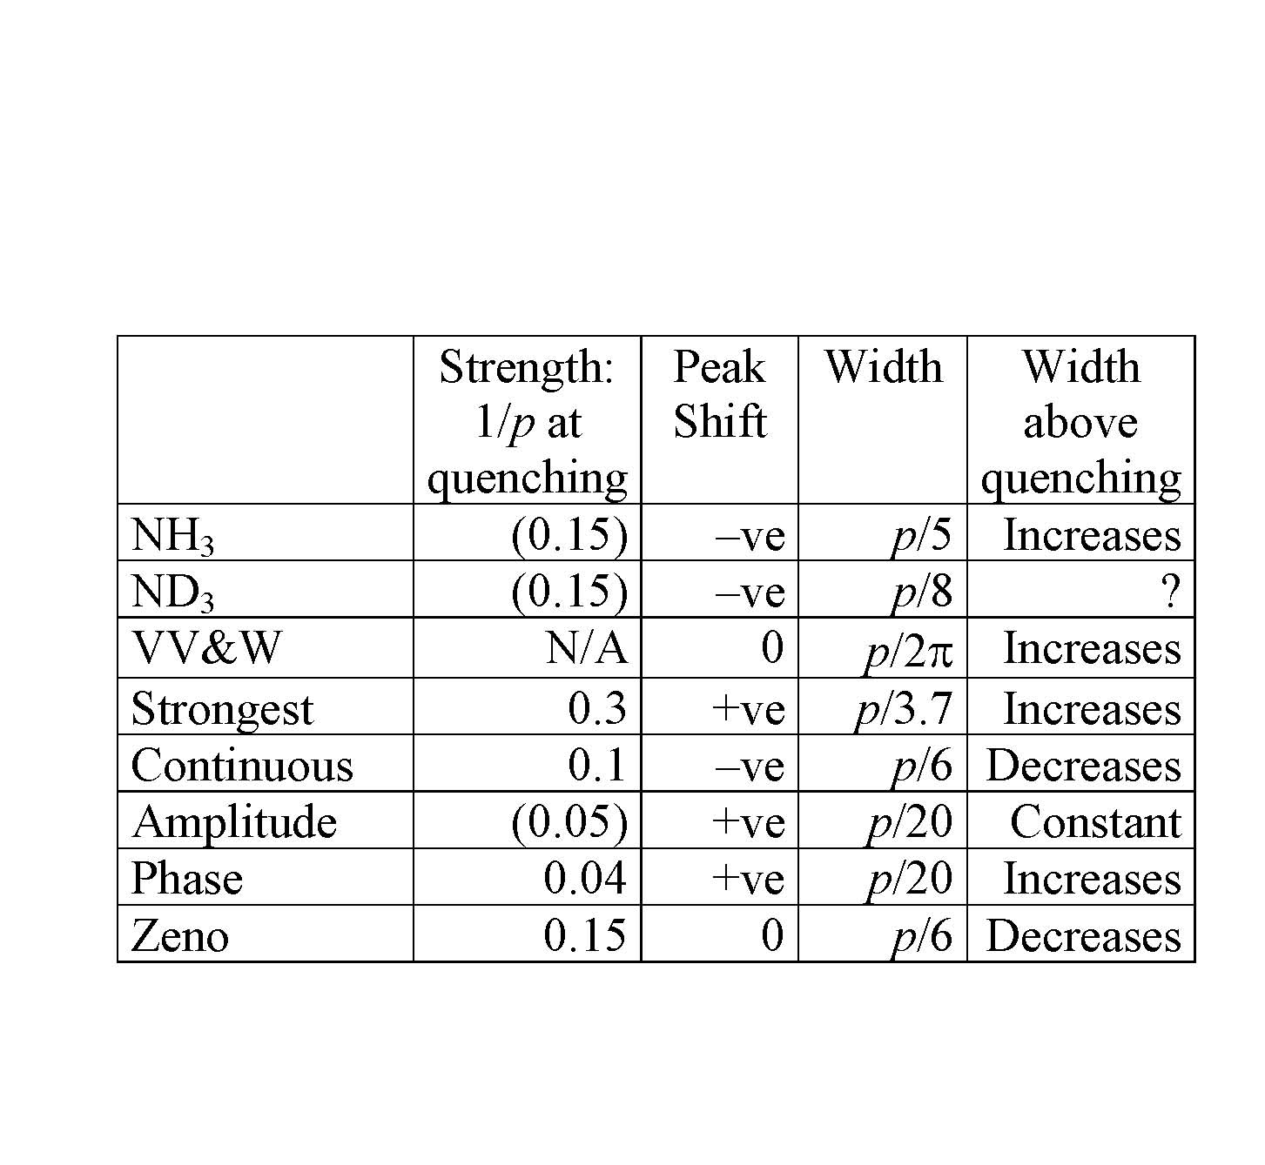
There seem to be three independent quantities:
Value of p at quenching
Peak shift at low p
Peak width at low p
Peak width at high p above quenching
How do these derive from the boundary conditions?

Slide 25
Conclusions
The ammonia inversion transition broadens, shifts and quenches with pressure simply through collisional broadening.
There is no evidence in the data for quantum localisation.
Behaviour of collisional broadening is more complicated than previously thought – depends critically on boundary conditions at collisions.
The mathematics of simple broken sinusoids appears to be an unsolved problem.
Further Questions
We can make the ammonia model show localisation – but is there any point (no experimental evidence for comparison)?
Would it be better to study a different experimental system – e.g. buckyballs, C₆₀ molecules, which in Zeilinger’s lab in Vienna are seen to go through two slits and show interference (quantum) but lose the interference when they are heated (classical)?
Is it worth investigating the mathematics of the simple broken sinusoids?

