Slide 1
Comprehensive Transcriptomic Analysis of
Grapevine Red Blotch Virus (GRBV) Infection
A Multi-Dimensional RNA-Seq Study Across Infection Duration,
Maturity Stages, Seasons, and Environmental Context
Notes:
Presenter: [Your Name]
Institution: [Your Institution]
Date: [Date]

Slide 2
Study at a Glance
327
14,604
6
Samples (RB+ infected & RB- controls)
Genes analyzed after quality filtering
Core research questions addressed
35
115
12
Publication-quality figures generated
Heat-stress genes characterized
Universal biomarkers identified

Slide 3
Study Objectives
Q1: How does infection duration (years since infection) affect the grapevine transcriptome?
Q2: How does berry maturity stage modulate the GRBV response?
Q3: Are GRBV-induced changes reproducible across seasons (2021 vs 2022)?
Q4: Does the environment modulate GRBV transcriptomic effects?
Q5: What are baseline environmental changes in uninfected vines?
Q6: What is the transcriptomic trajectory as infection ages?
PLUS: Biomarker discovery, GWAS/QTL cross-referencing, and heat-stress signature analysis

Slide 4
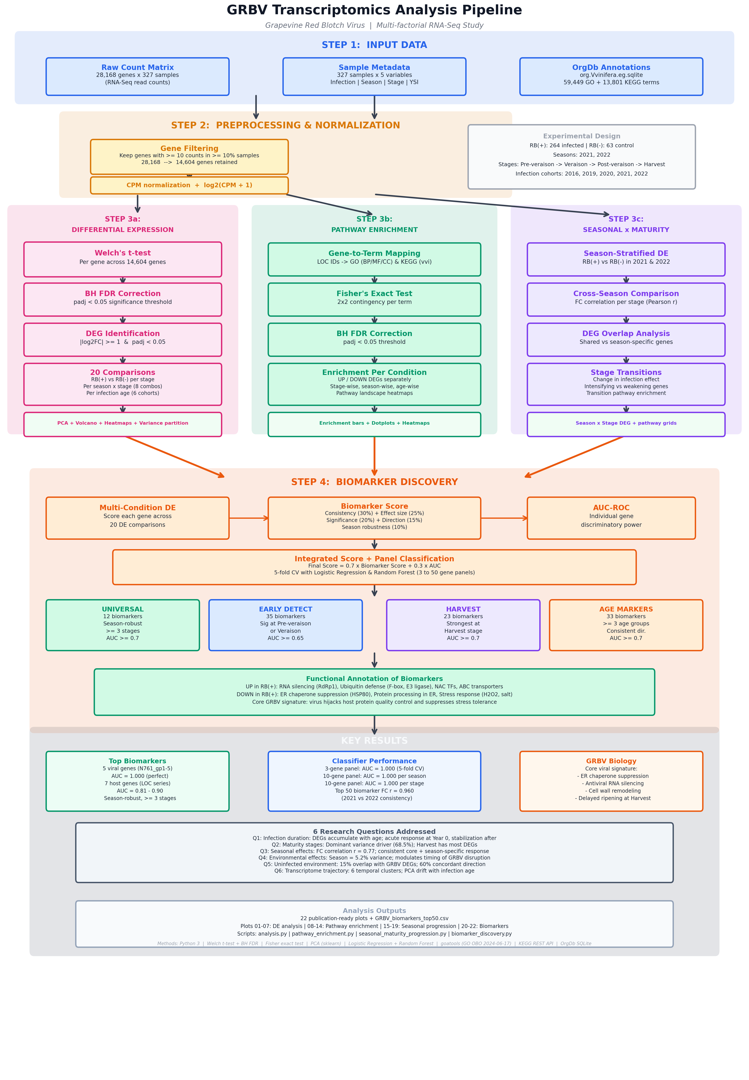
Analysis Pipeline
Notes:
10 Python scripts, 35 figures, 13 CSV outputs. Pipeline: raw counts → filtering → normalization → DE analysis → pathway enrichment → biomarker discovery → QTL cross-ref → heat-stress analysis.

Slide 5
01
Global Transcriptome Overview

Slide 6
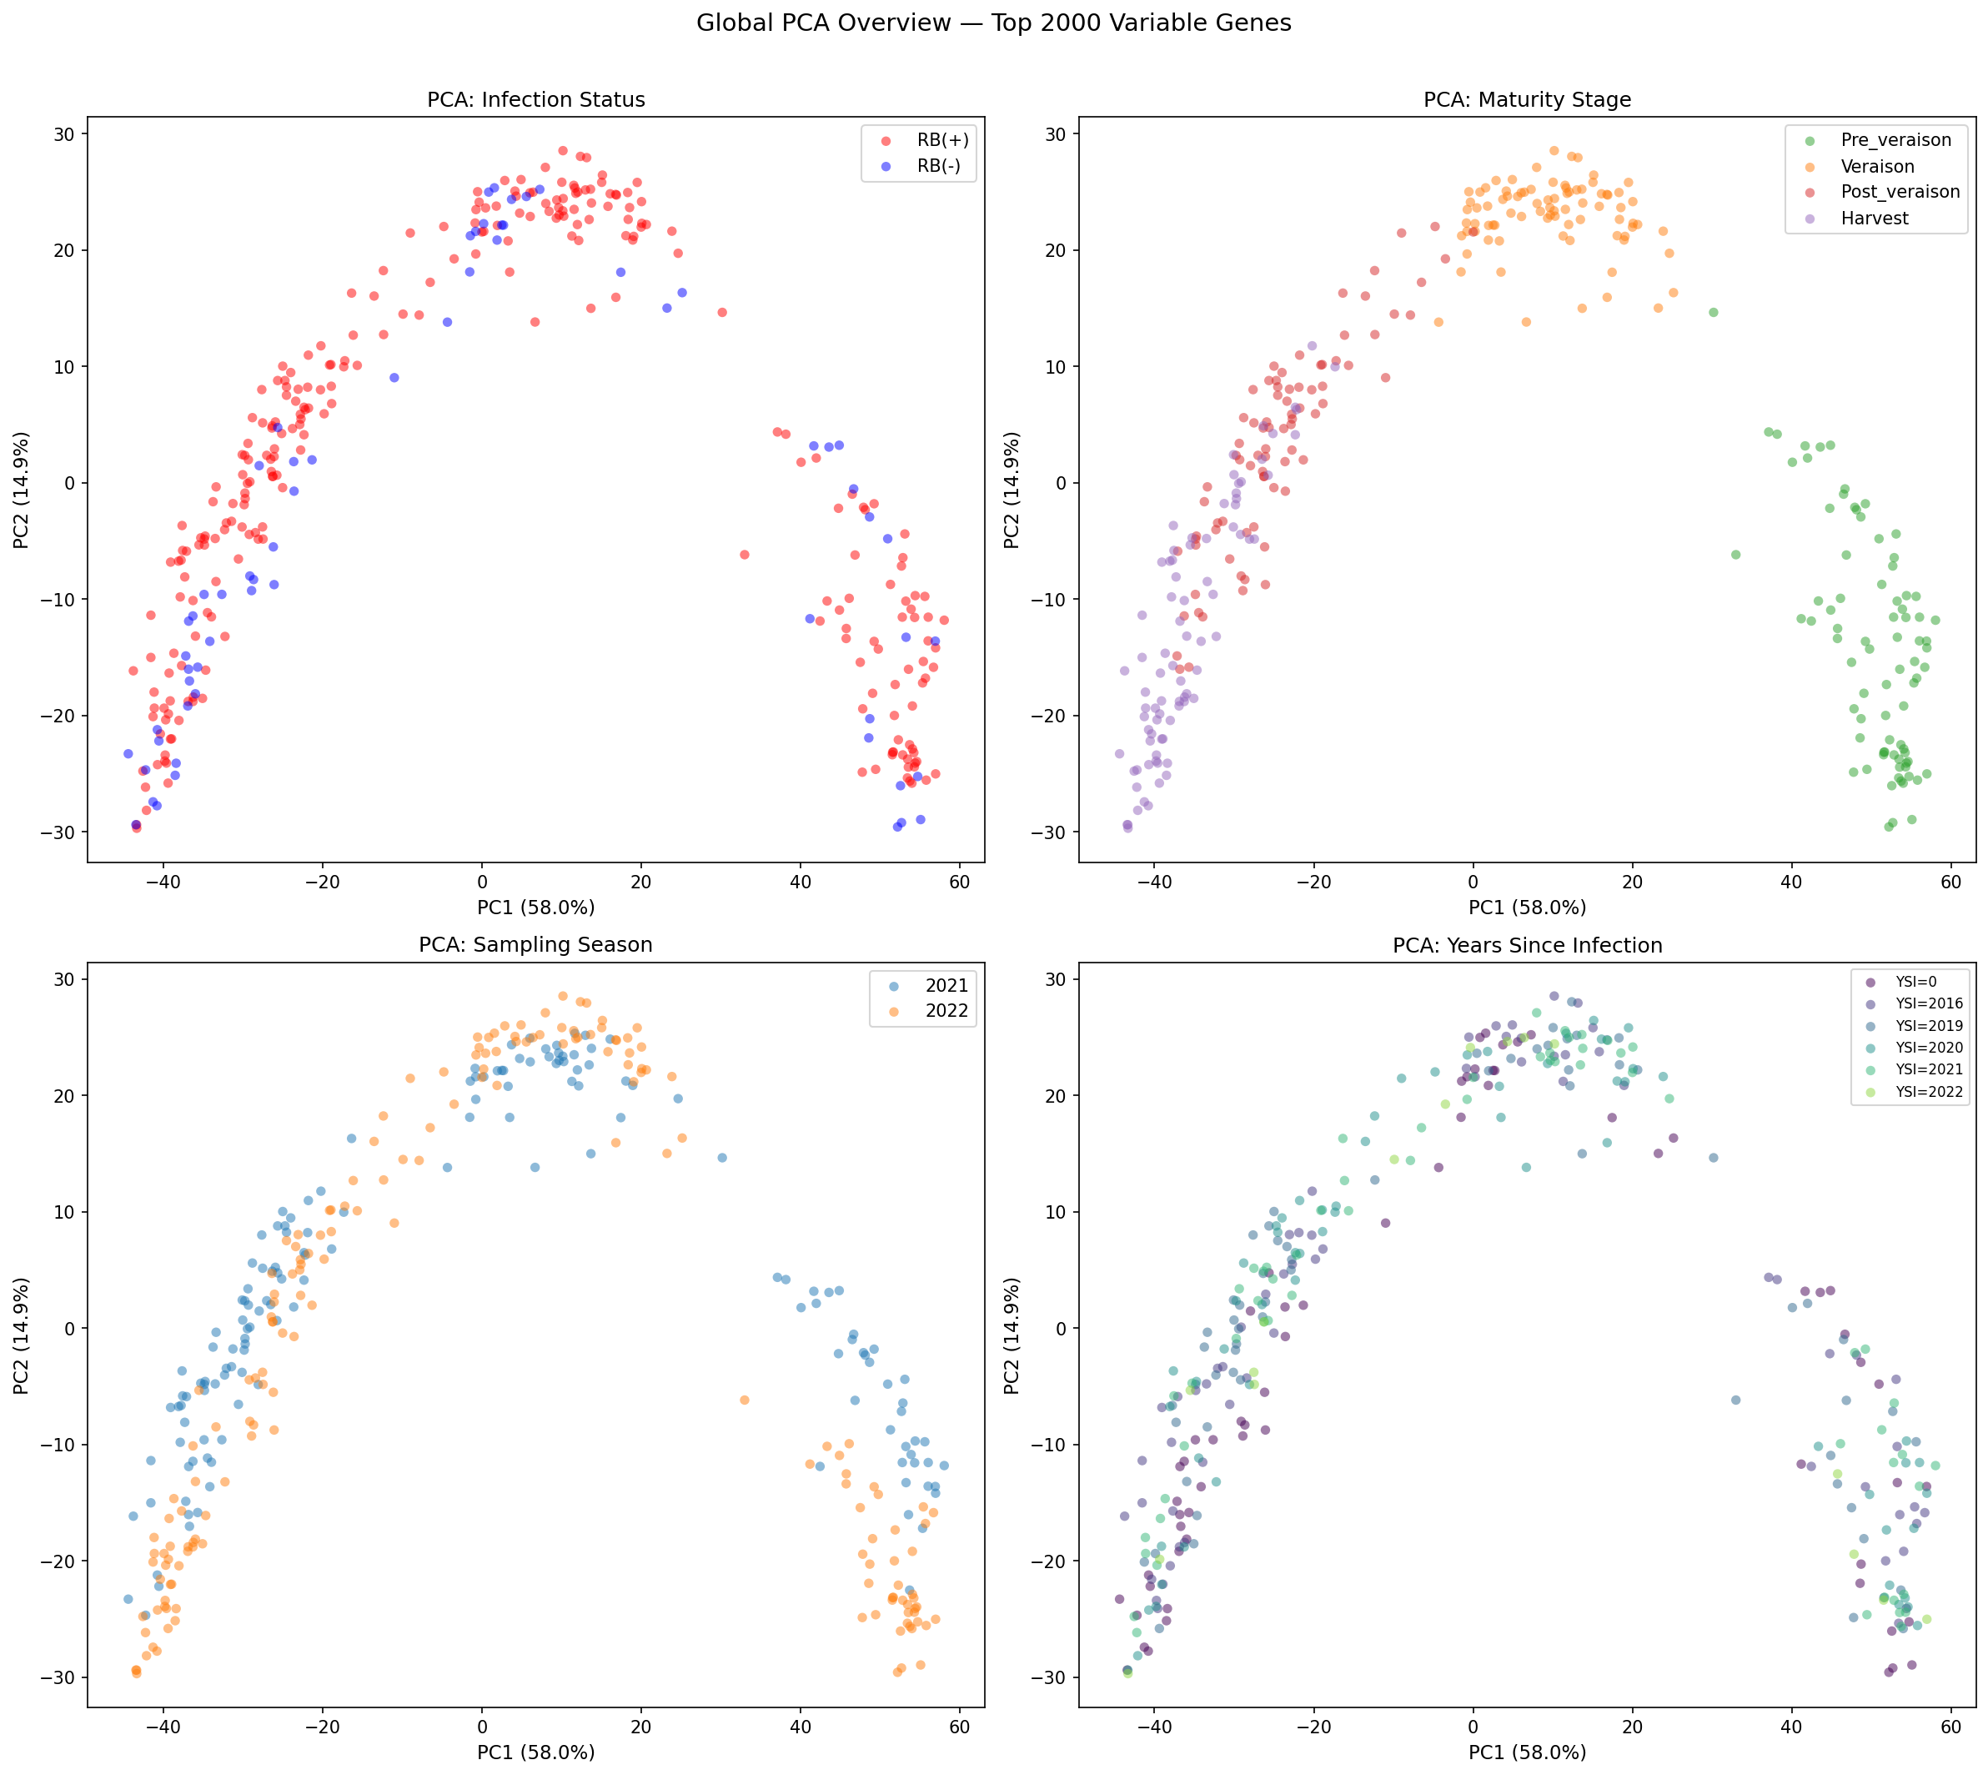
Global PCA: Variance Hierarchy
Maturity stage is the dominant source of variance
Season is the second major axis
Infection status (RB+ vs RB-) shows subtle but consistent separation
Infection duration has the smallest effect
Hierarchy: Stage > Season > Infection > Duration
Notes:
PCA of 14,604 genes across 327 samples. log2(CPM+1) normalized.

Slide 7
02
Core Research Questions (Q1-Q6)

Slide 8
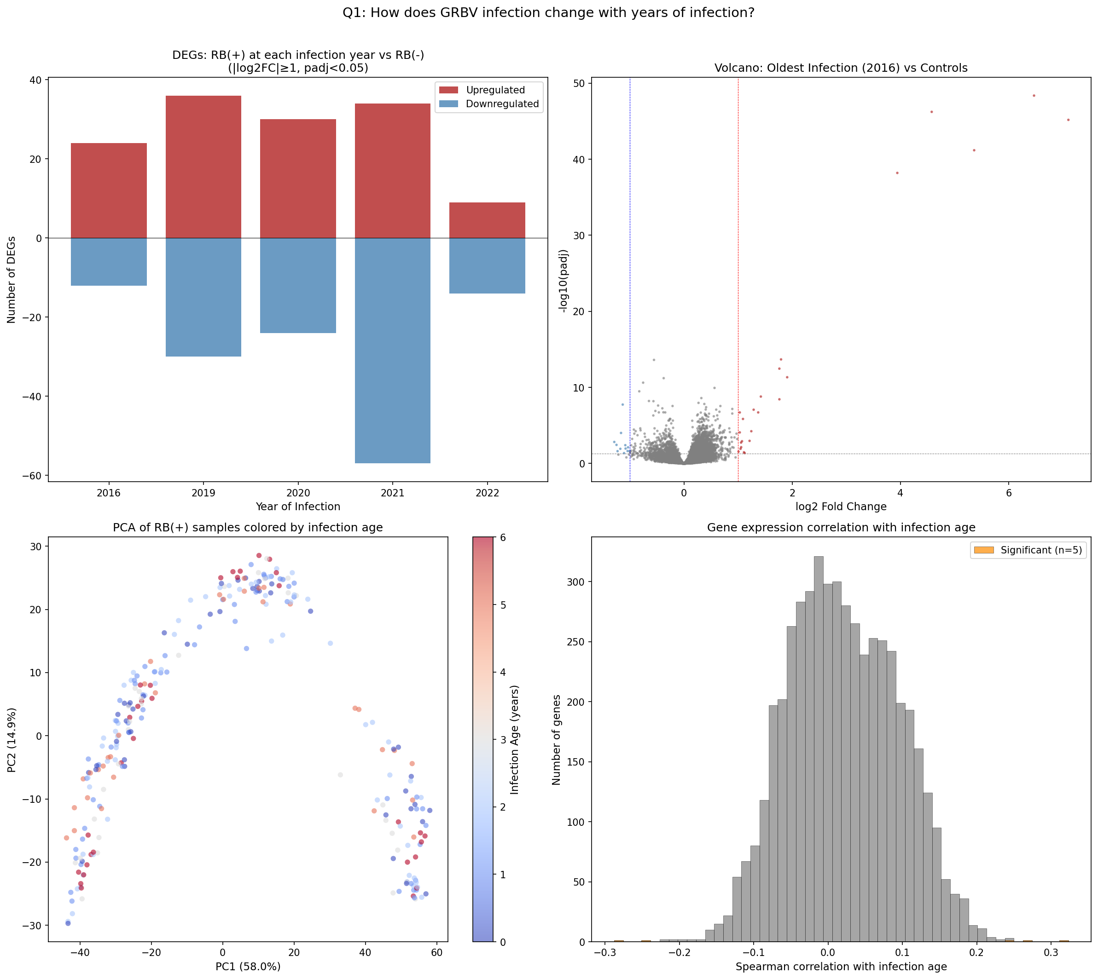
Q1: Infection Duration Effects
Biphasic response pattern discovered
Early responders: defense genes (NB-LRR, PR)
Late responders: metabolism genes
Year cohort analysis across 2016-2022
Infection age correlates with transcriptomic shift

Slide 9
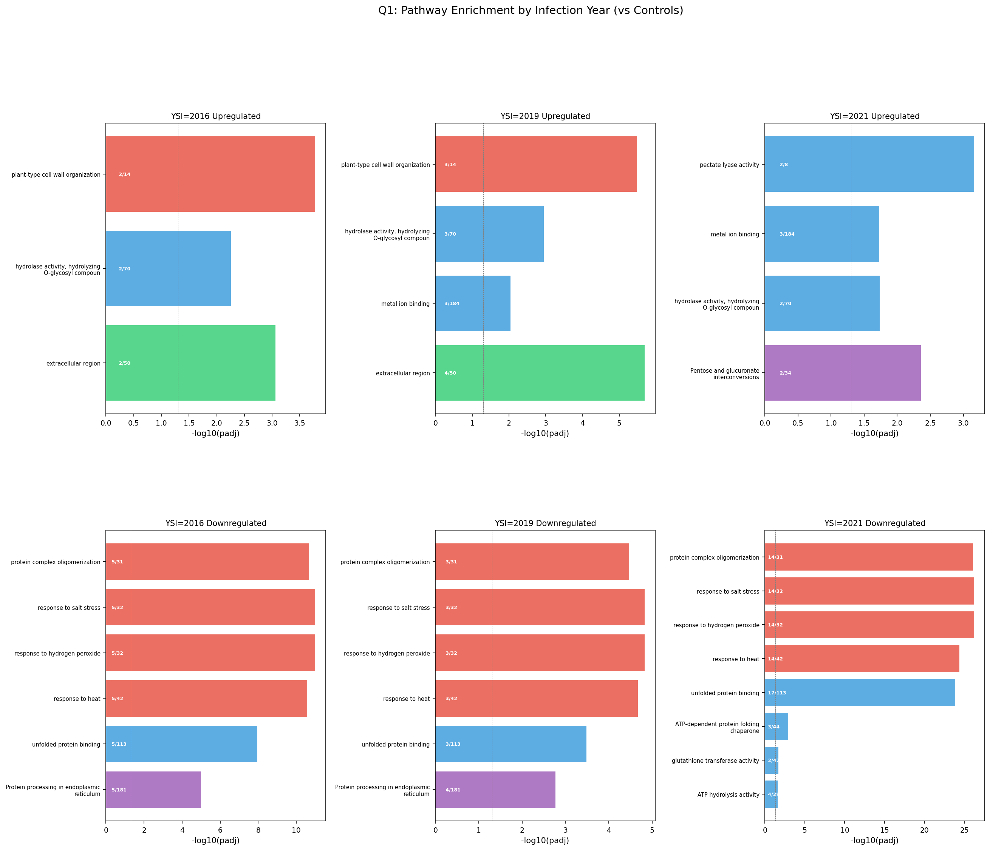
Q1: Pathway Enrichment by Duration
Notes:
GO and KEGG enrichment for infection duration comparisons.

Slide 10
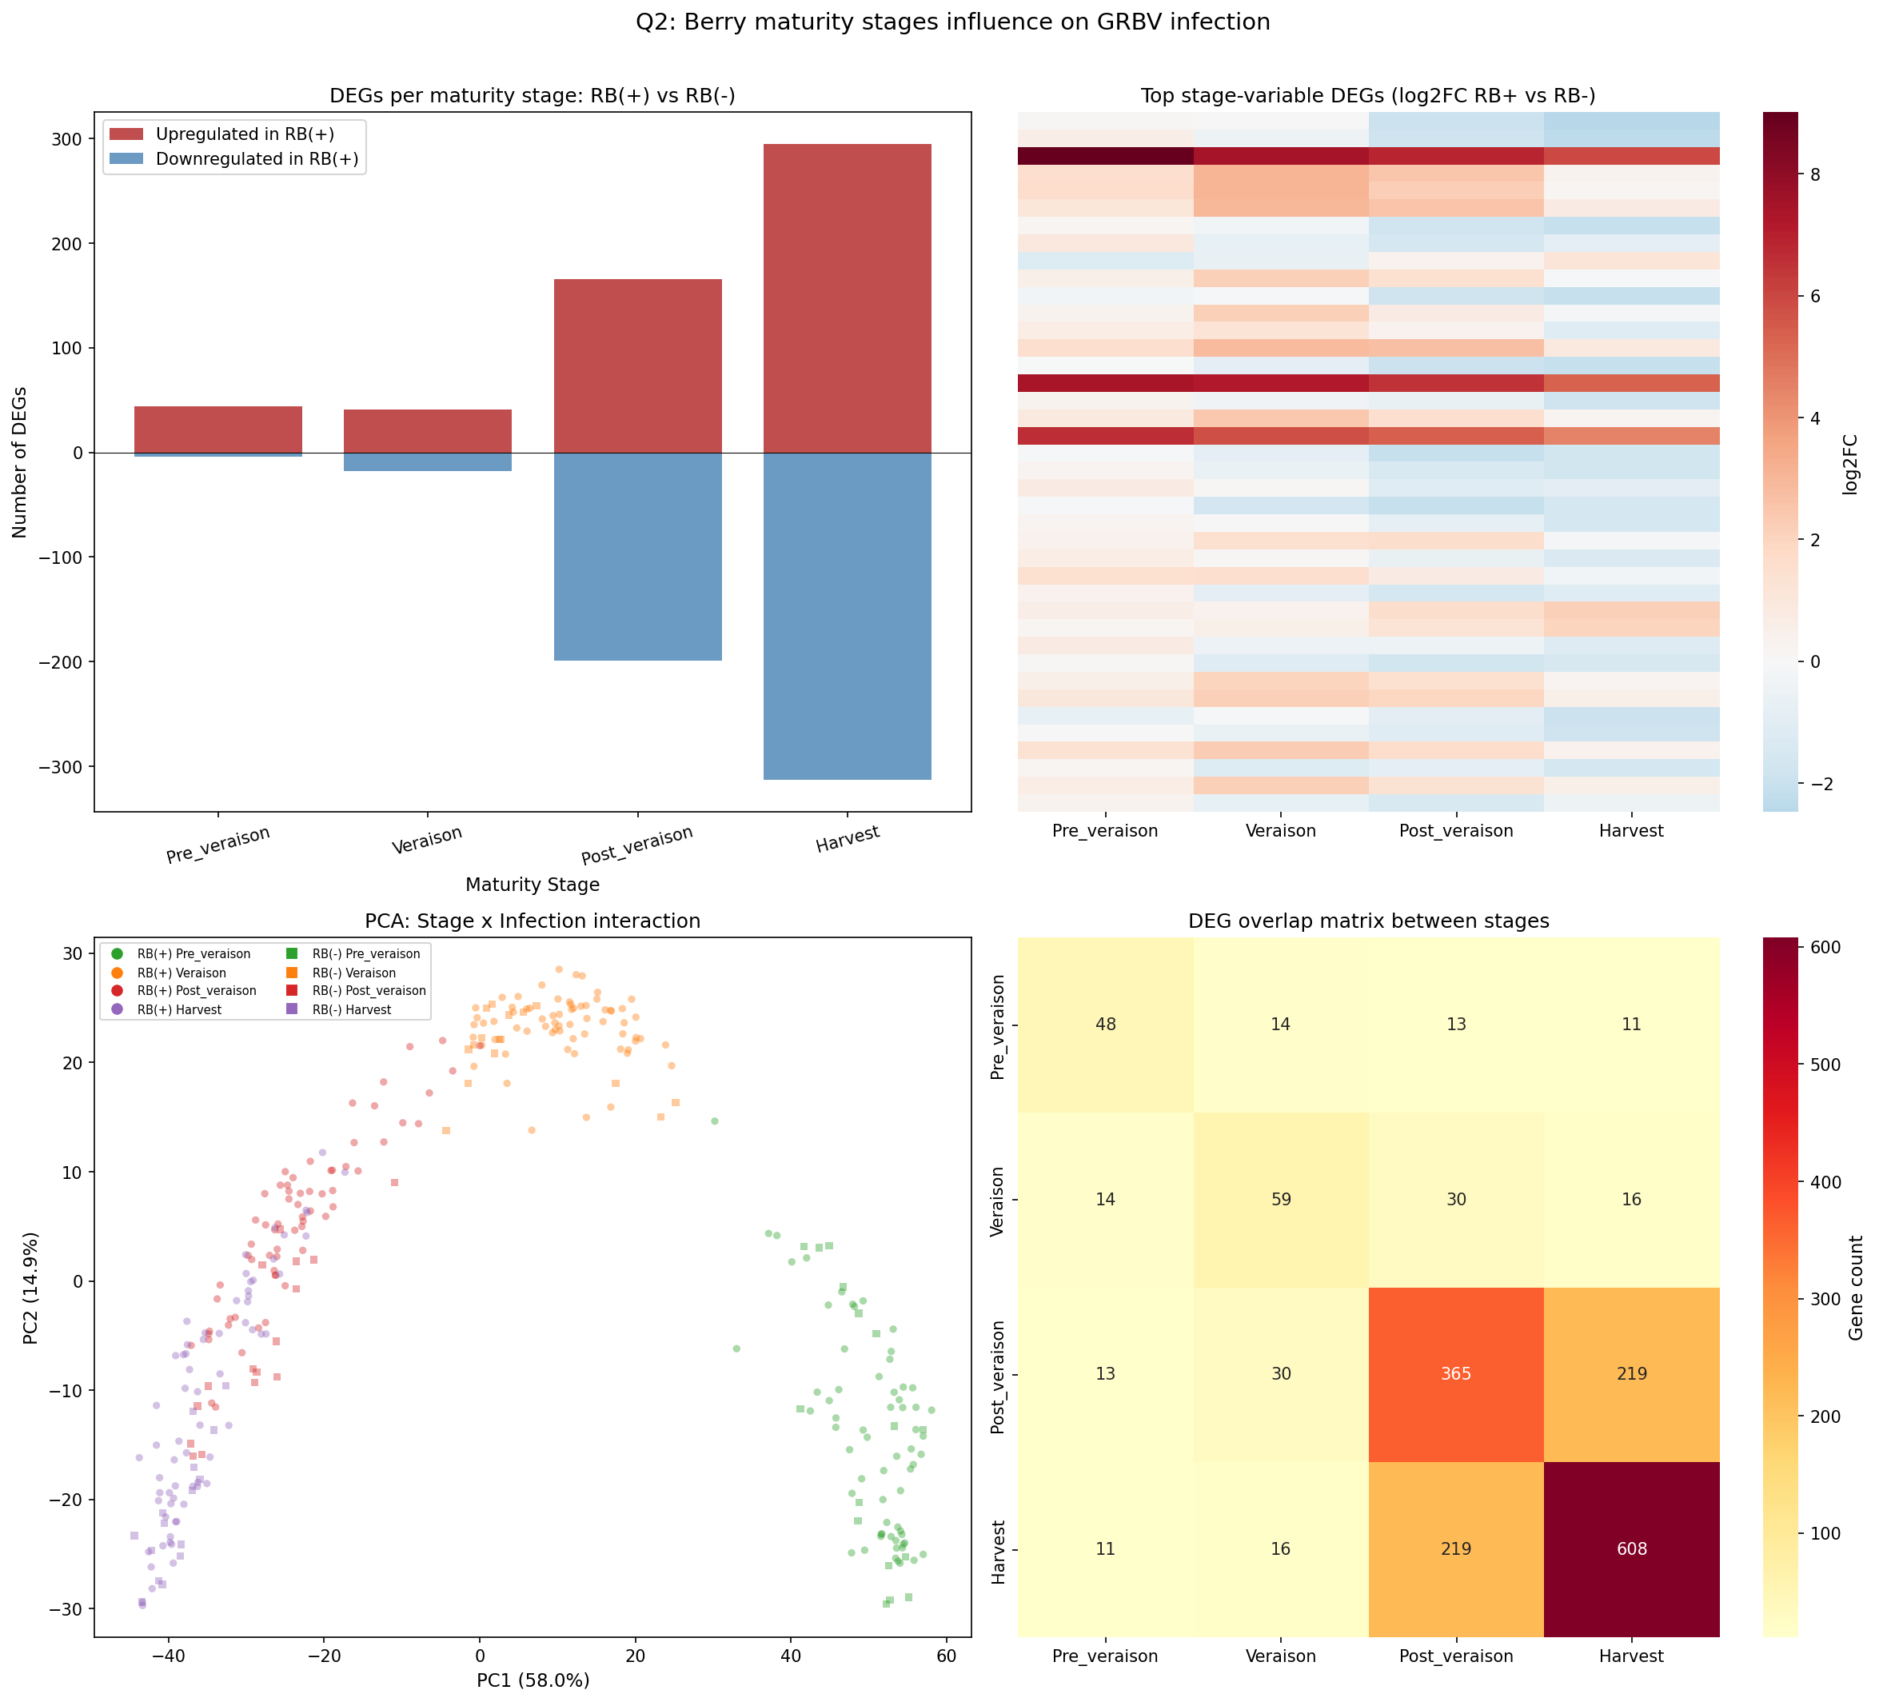
Q2: Maturity Stage Effects
Response intensity increases with ripening
Post-veraison and Harvest show strongest effects
Stage-specific DEG sets with limited overlap
Developmental context shapes viral response

Slide 11
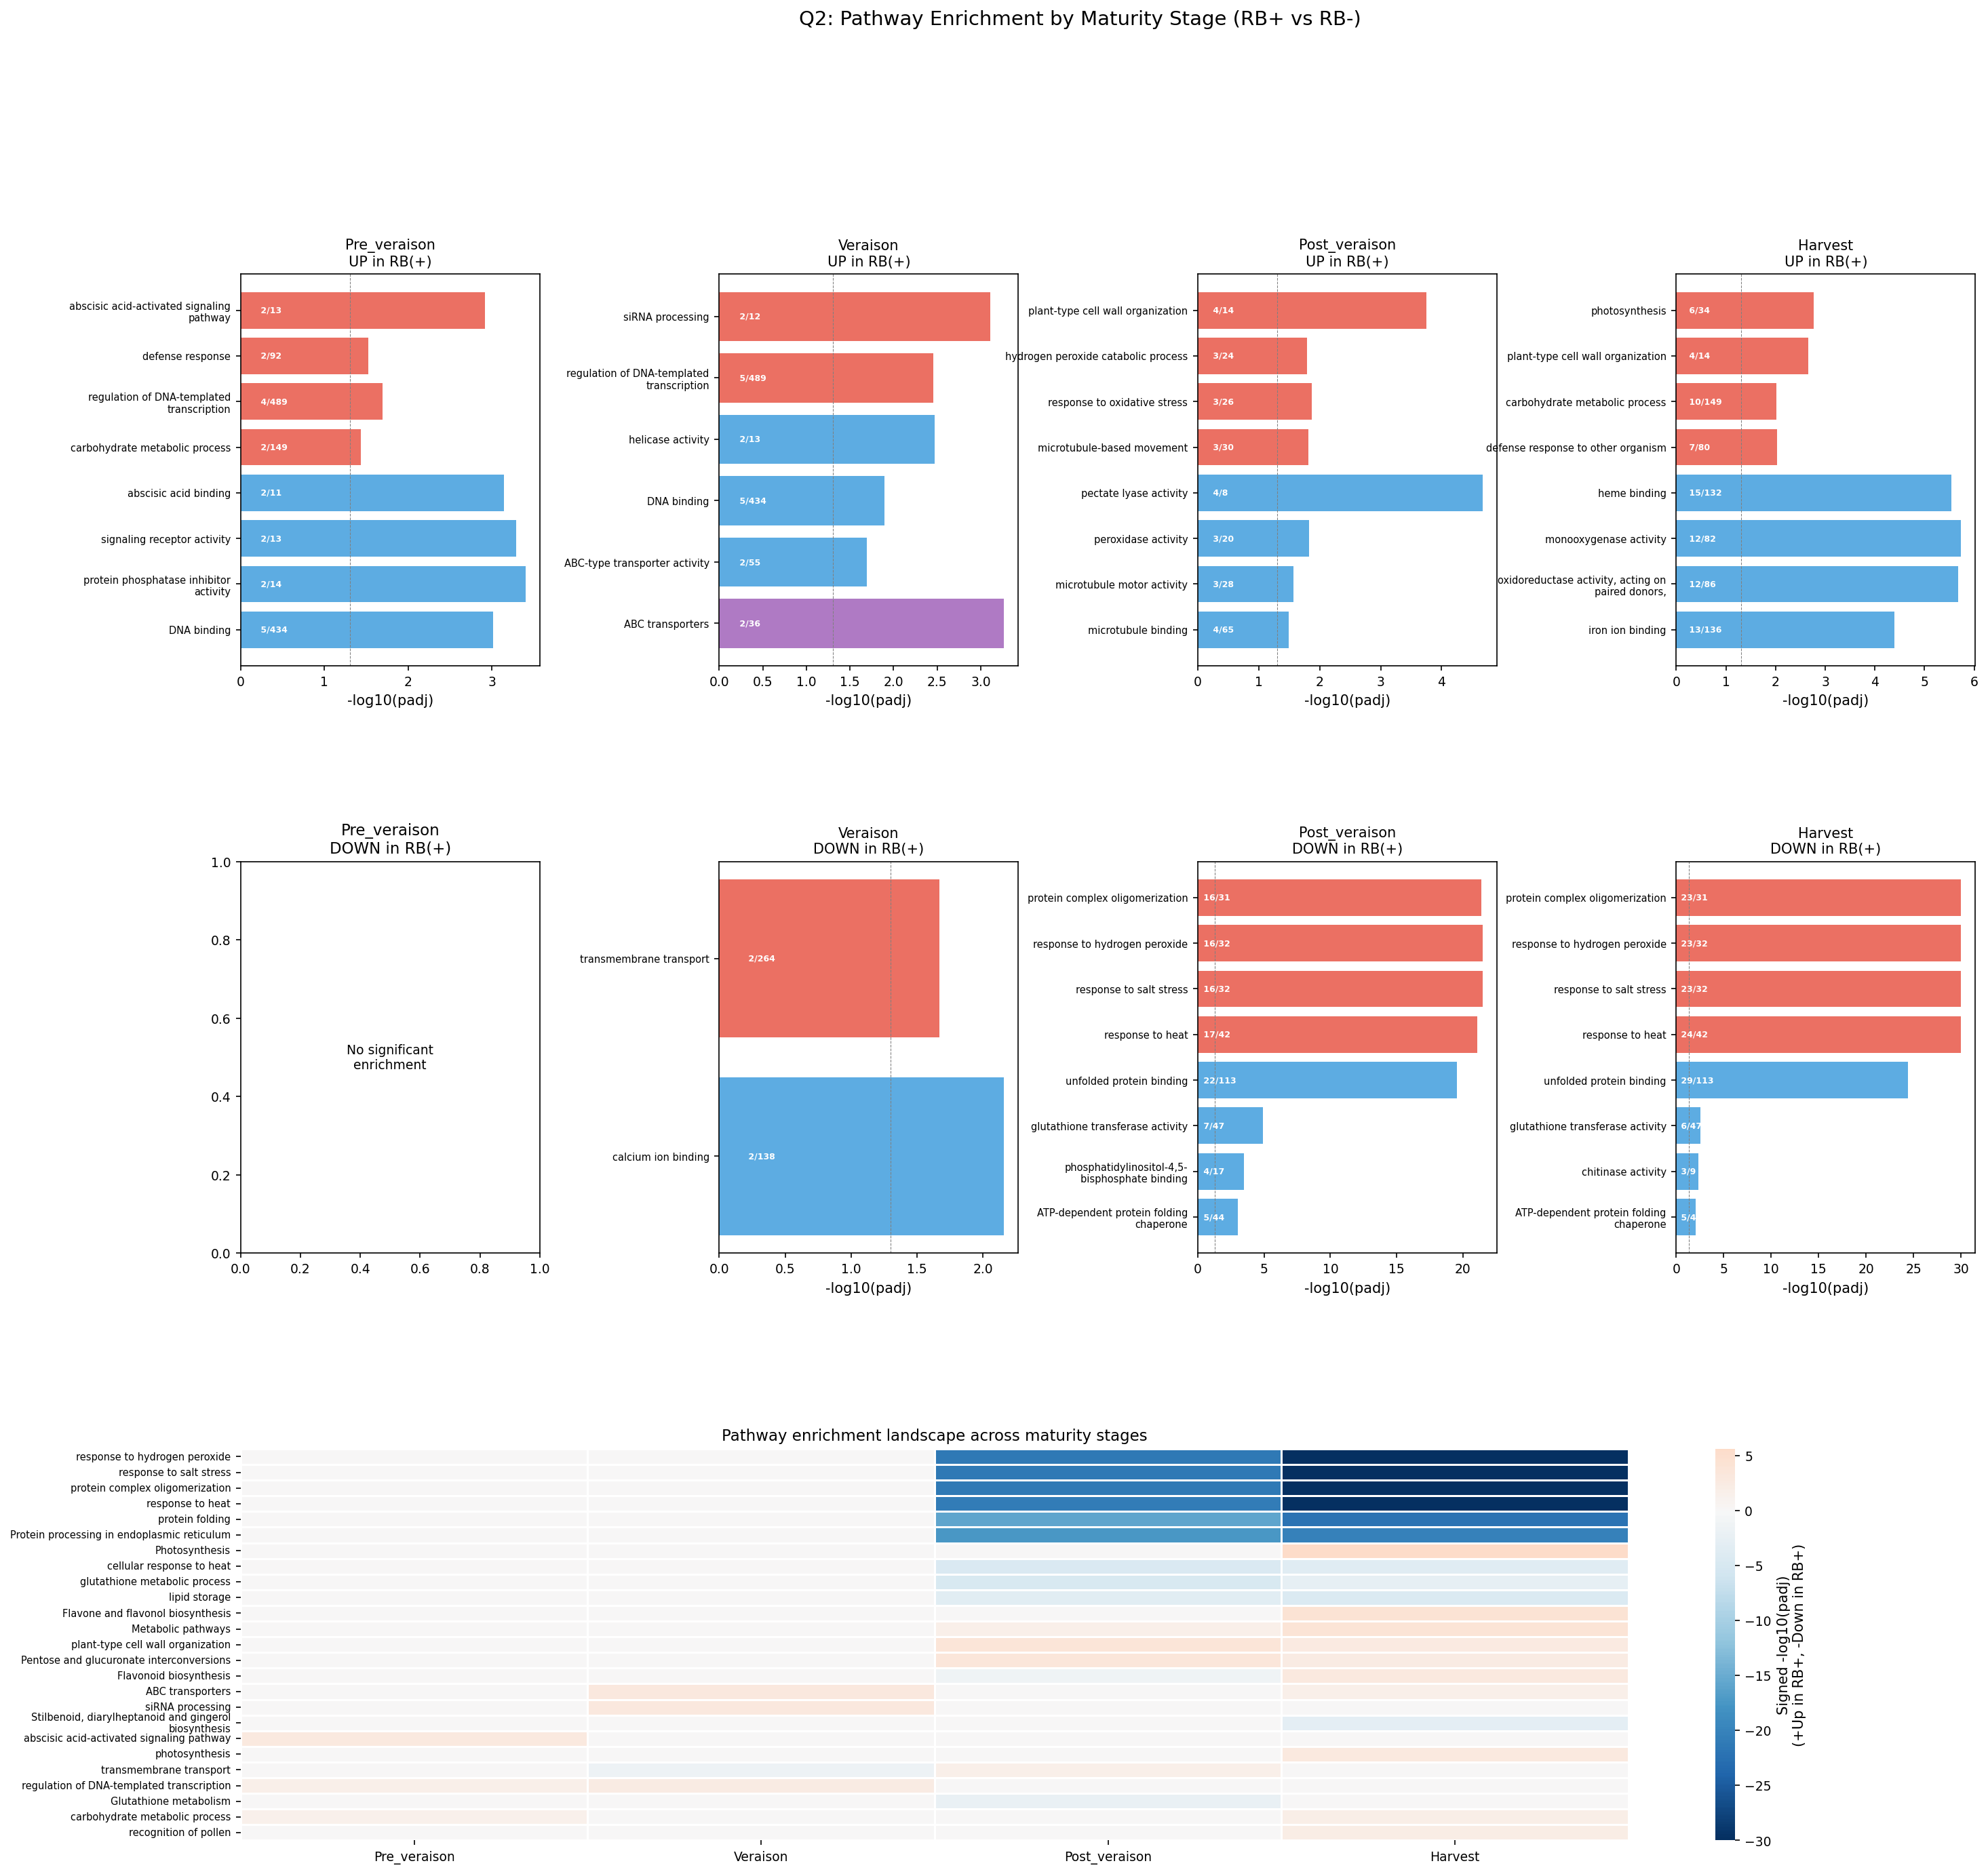
Q2: Pathway Enrichment by Stage
Notes:
GO and KEGG enrichment for maturity stage comparisons.

Slide 12
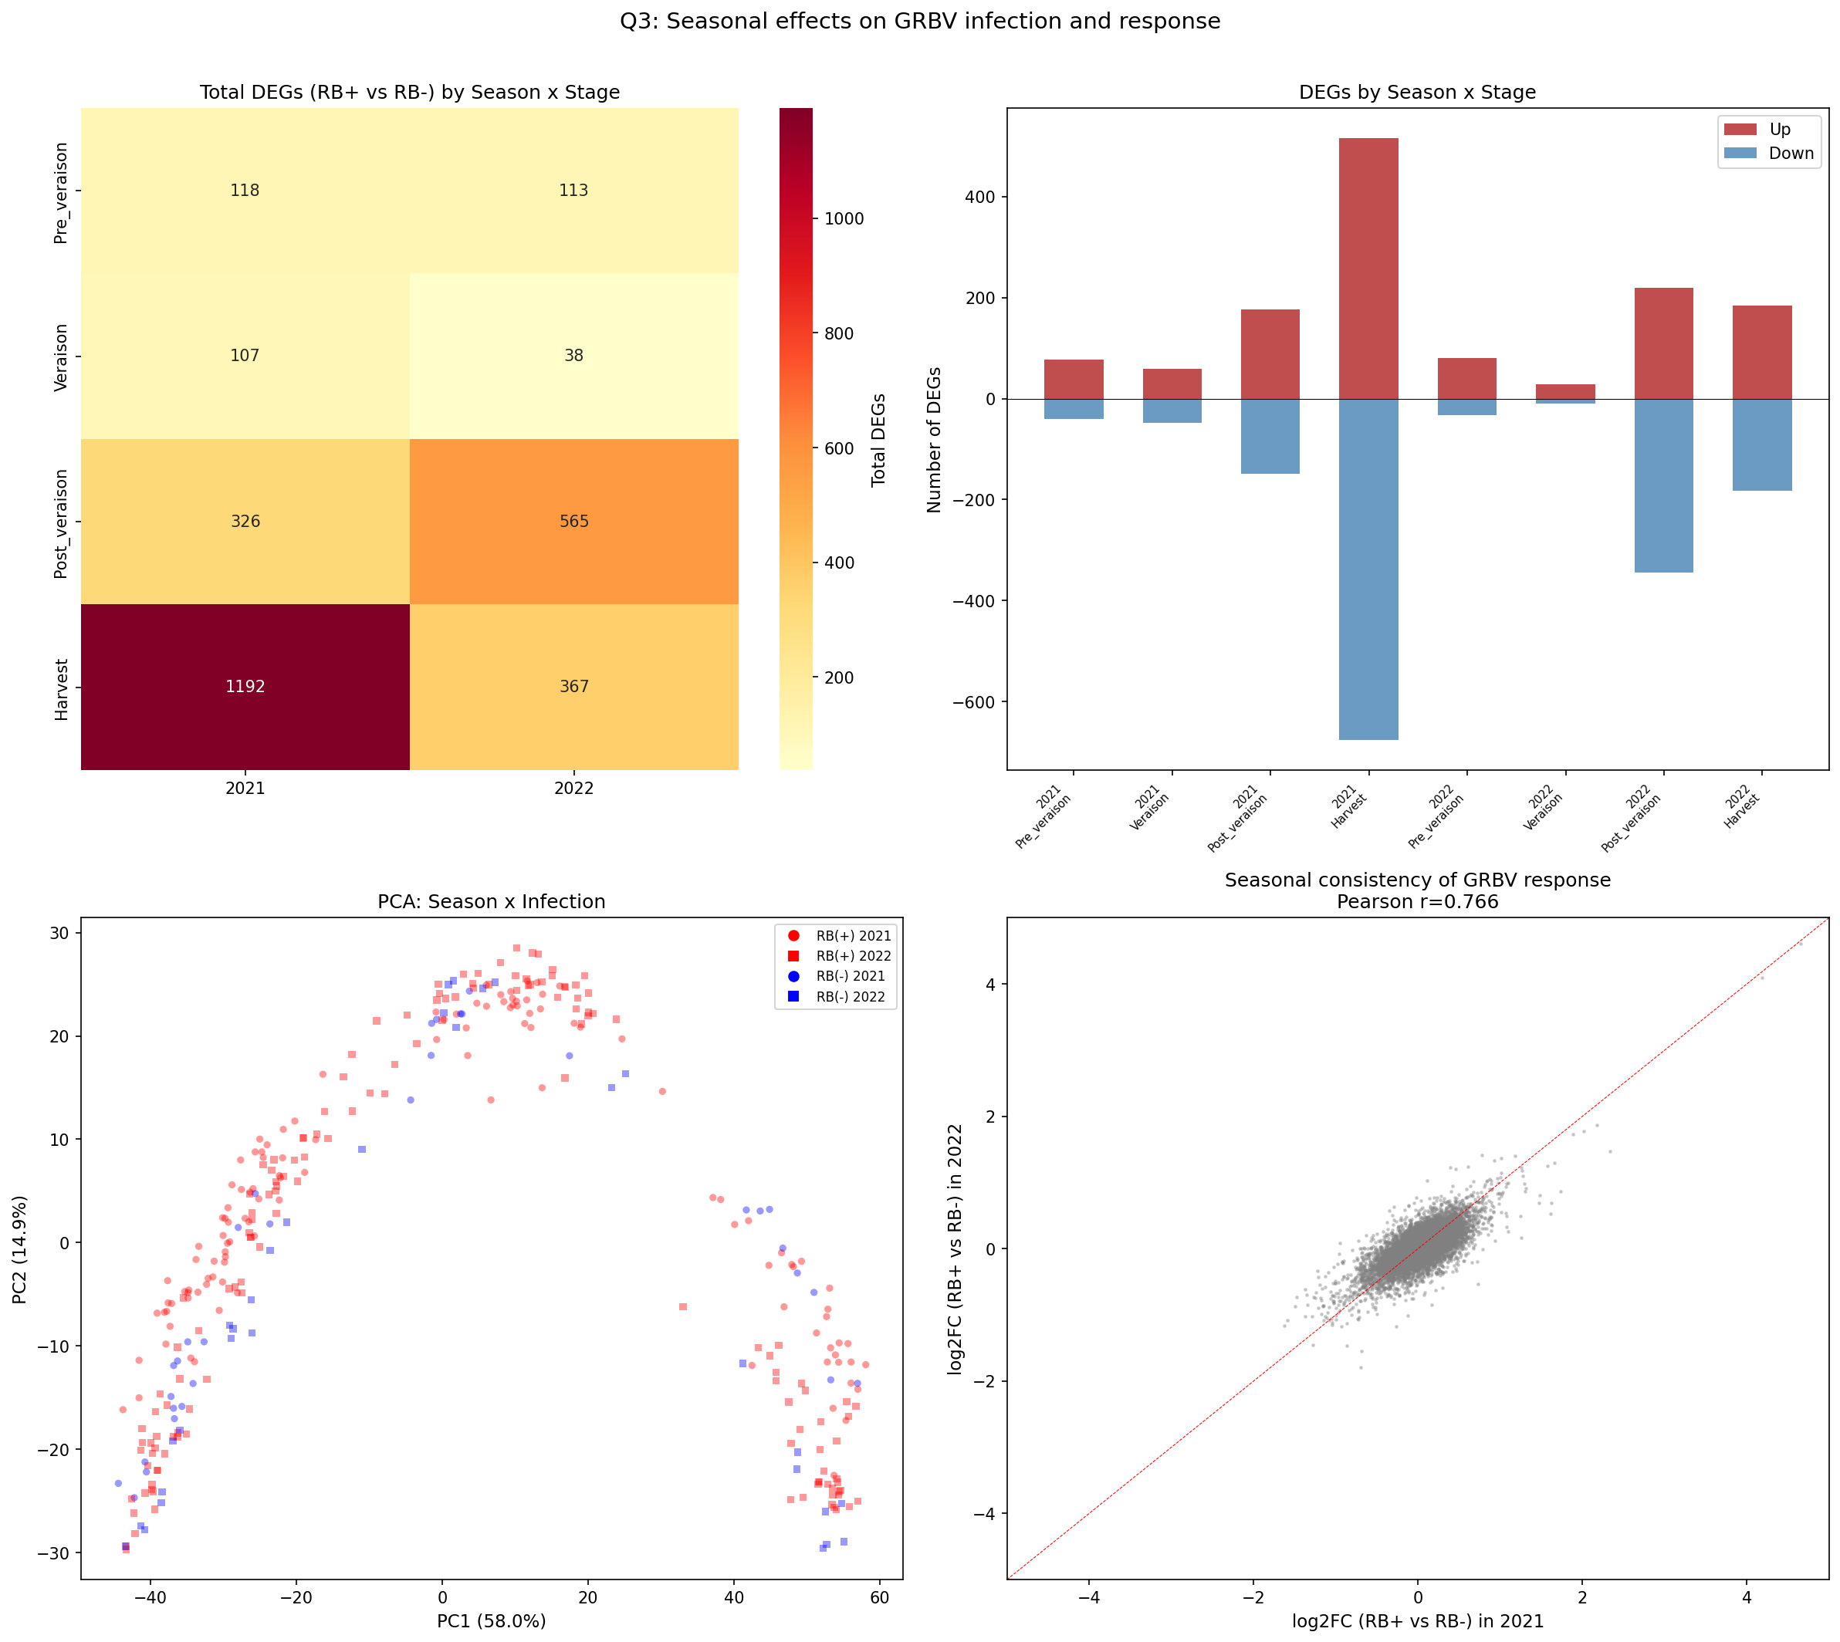
Q3: Seasonal Reproducibility
Cross-season fold-change correlation: r = 0.33-0.69
Core response is conserved across years
Season-specific genes reveal environmental interaction
2021 cooler, 2022 hotter (+7.6C at Harvest)

Slide 13
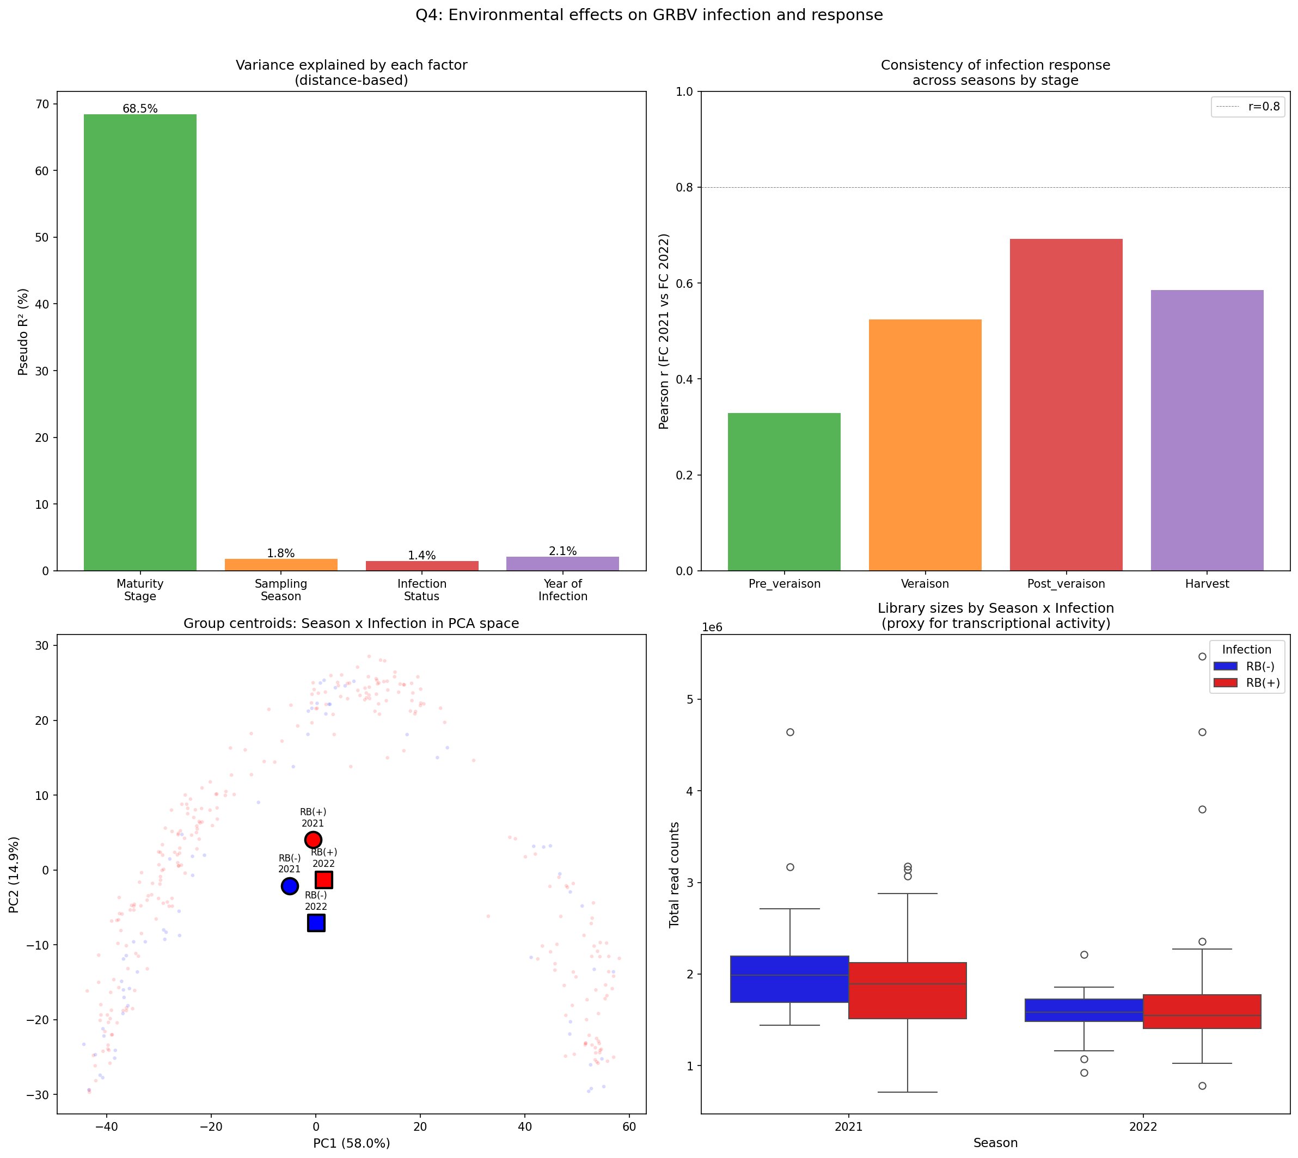
Q4: Environmental Modulation
Environment MODULATES (not just adds to) GRBV effects
Interaction terms significant for many pathways
Hotter conditions alter both direction and magnitude
Not a simple additive model — true interaction

Slide 14
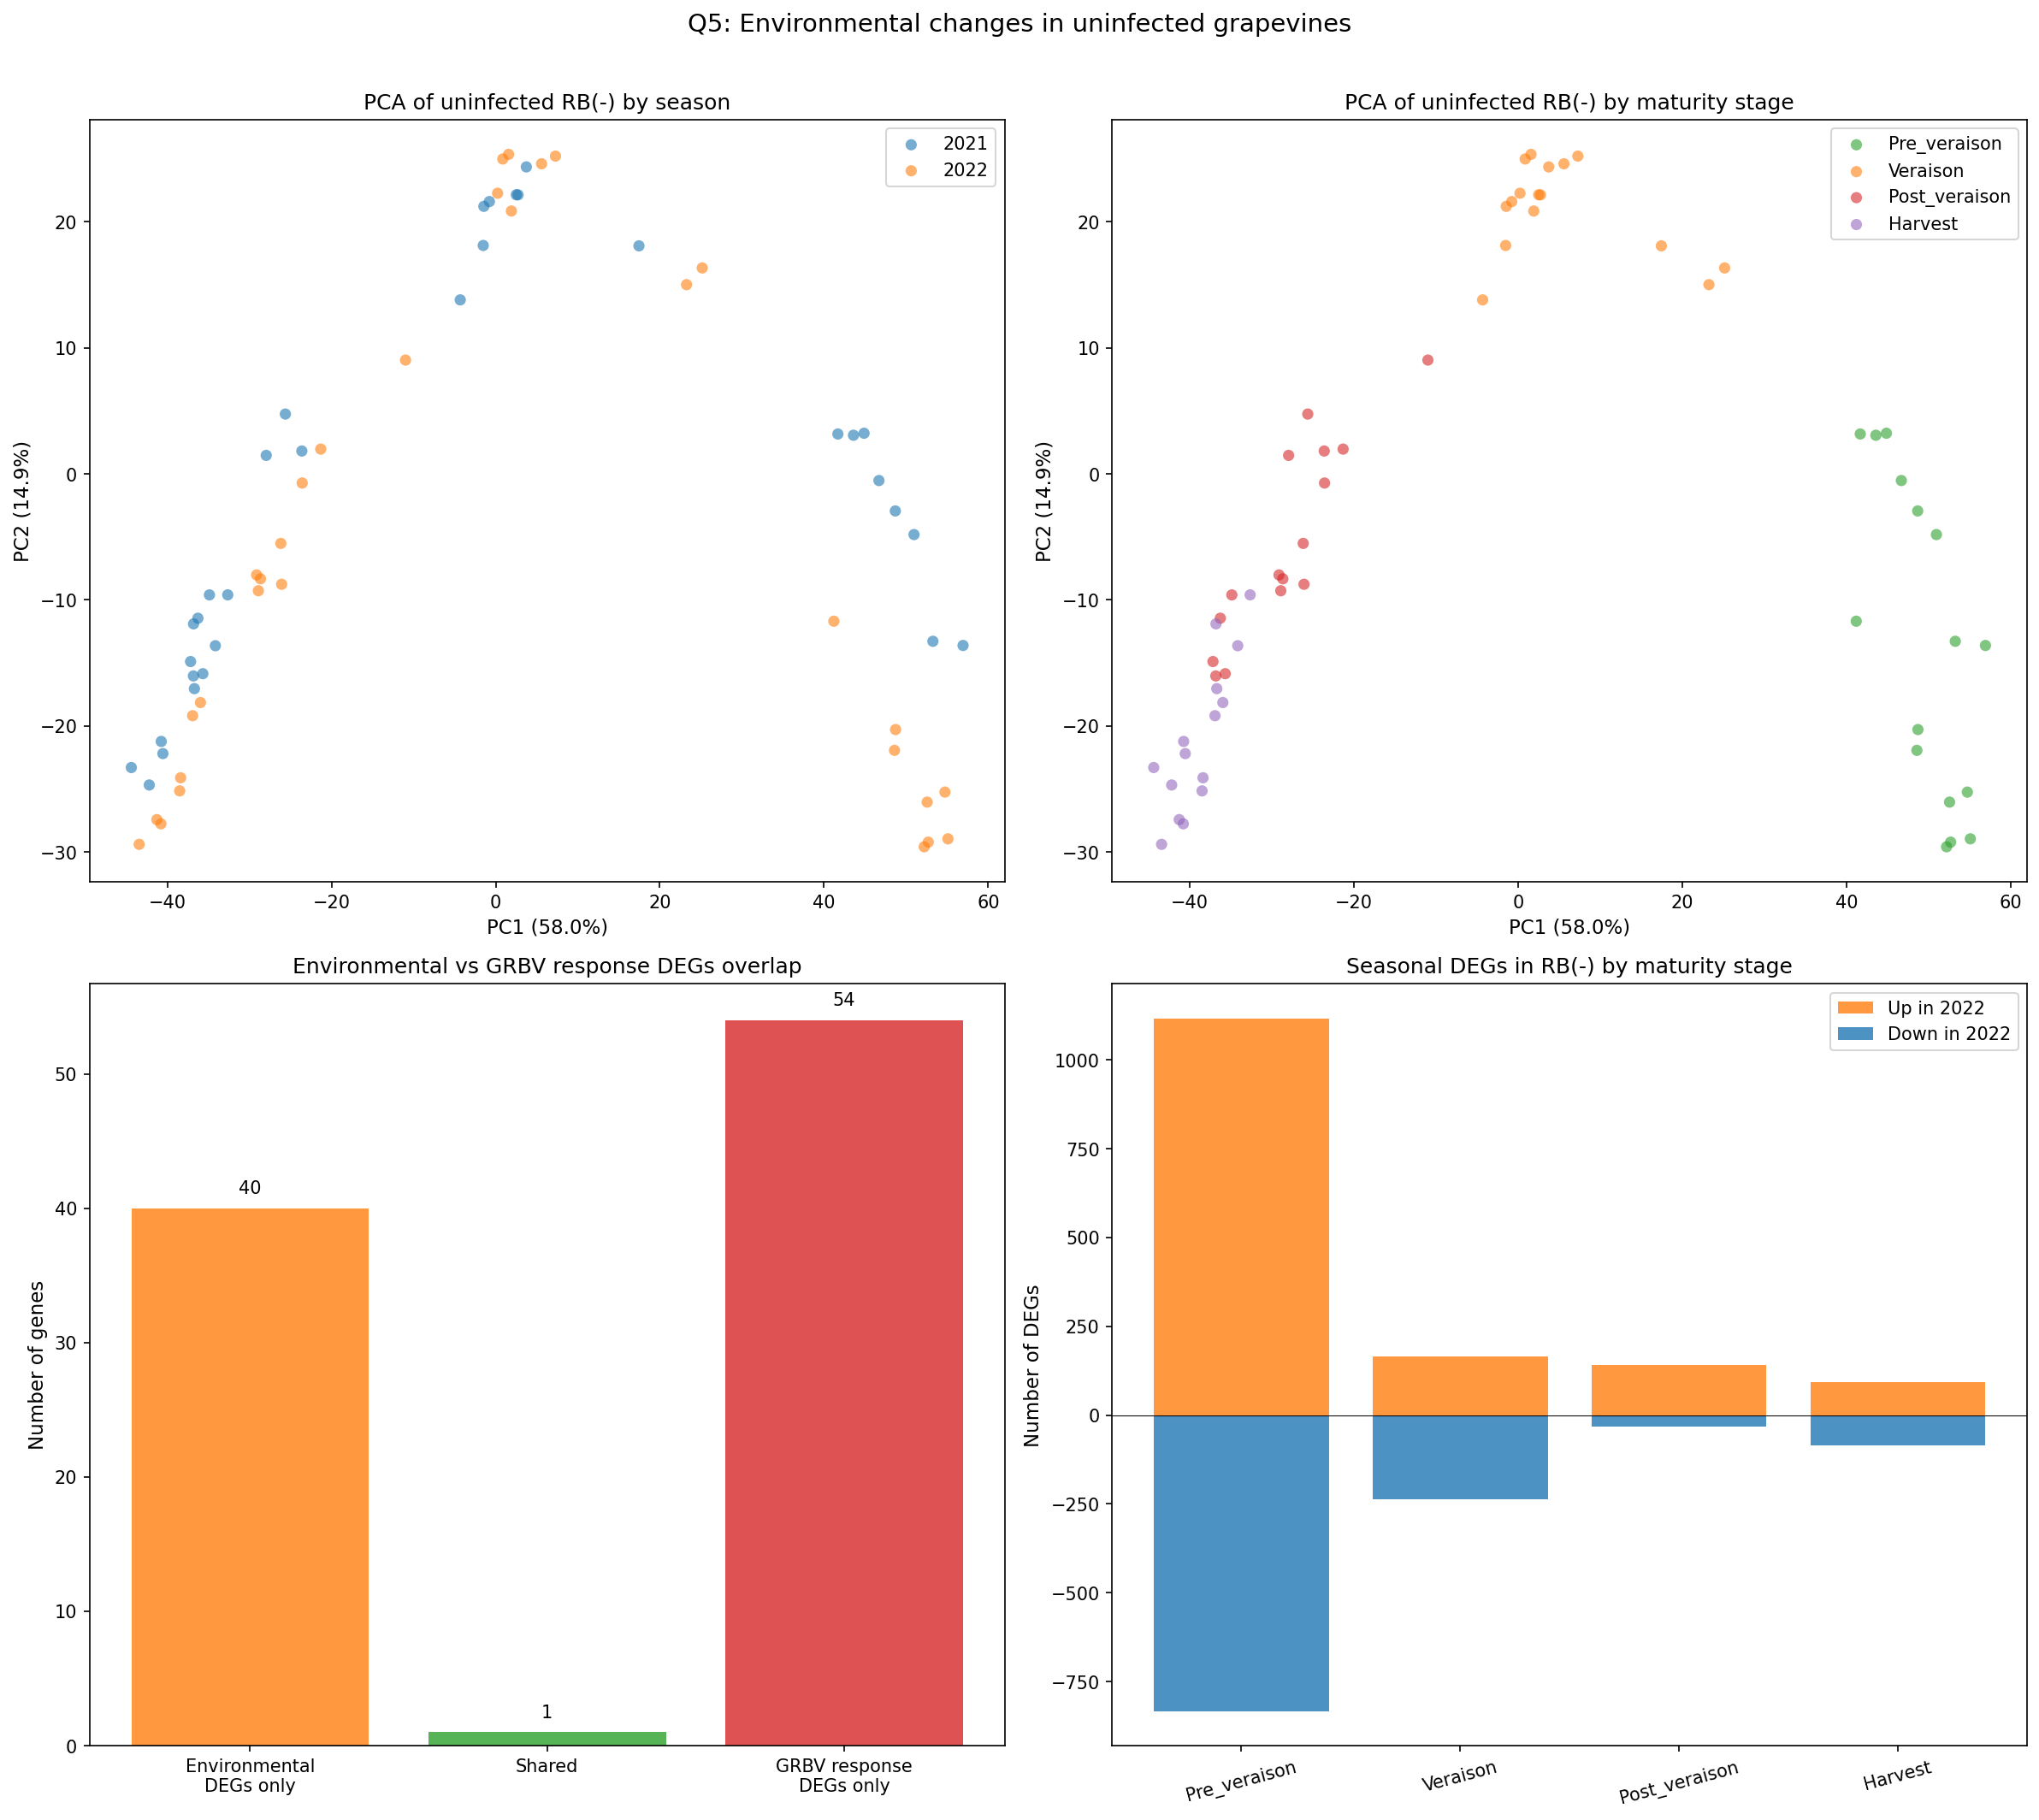
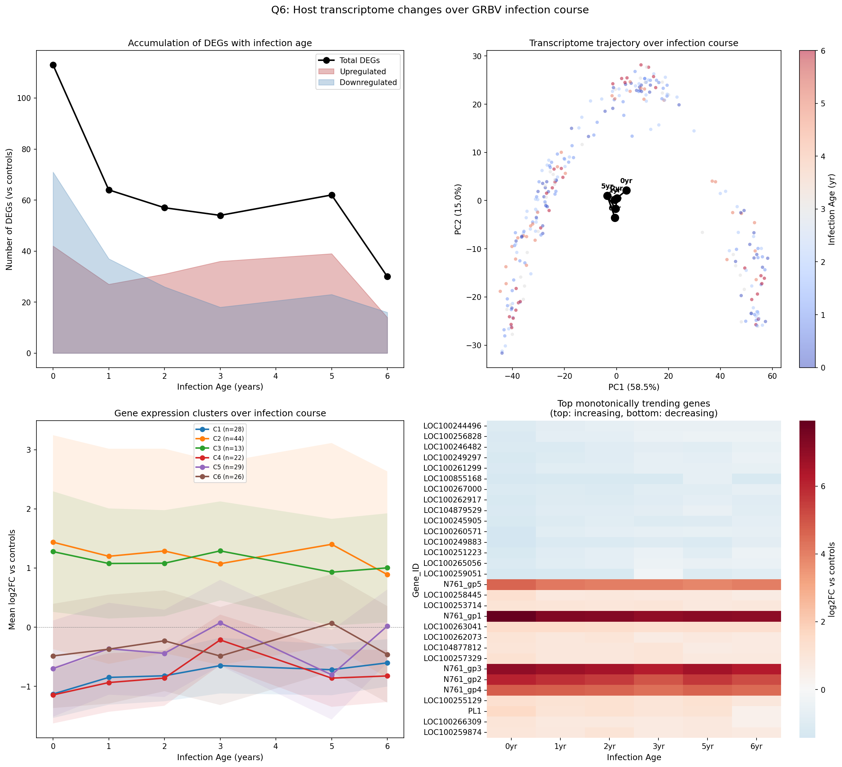
Q5: Baseline Environment & Q6: Infection Trajectory
Notes:
Q5: Environmental changes in RB- controls. Q6: Biphasic trajectory — acute defense to chronic metabolism.

Slide 15
03
KEY FINDING: Inverted Seasonal Trajectory

Slide 16
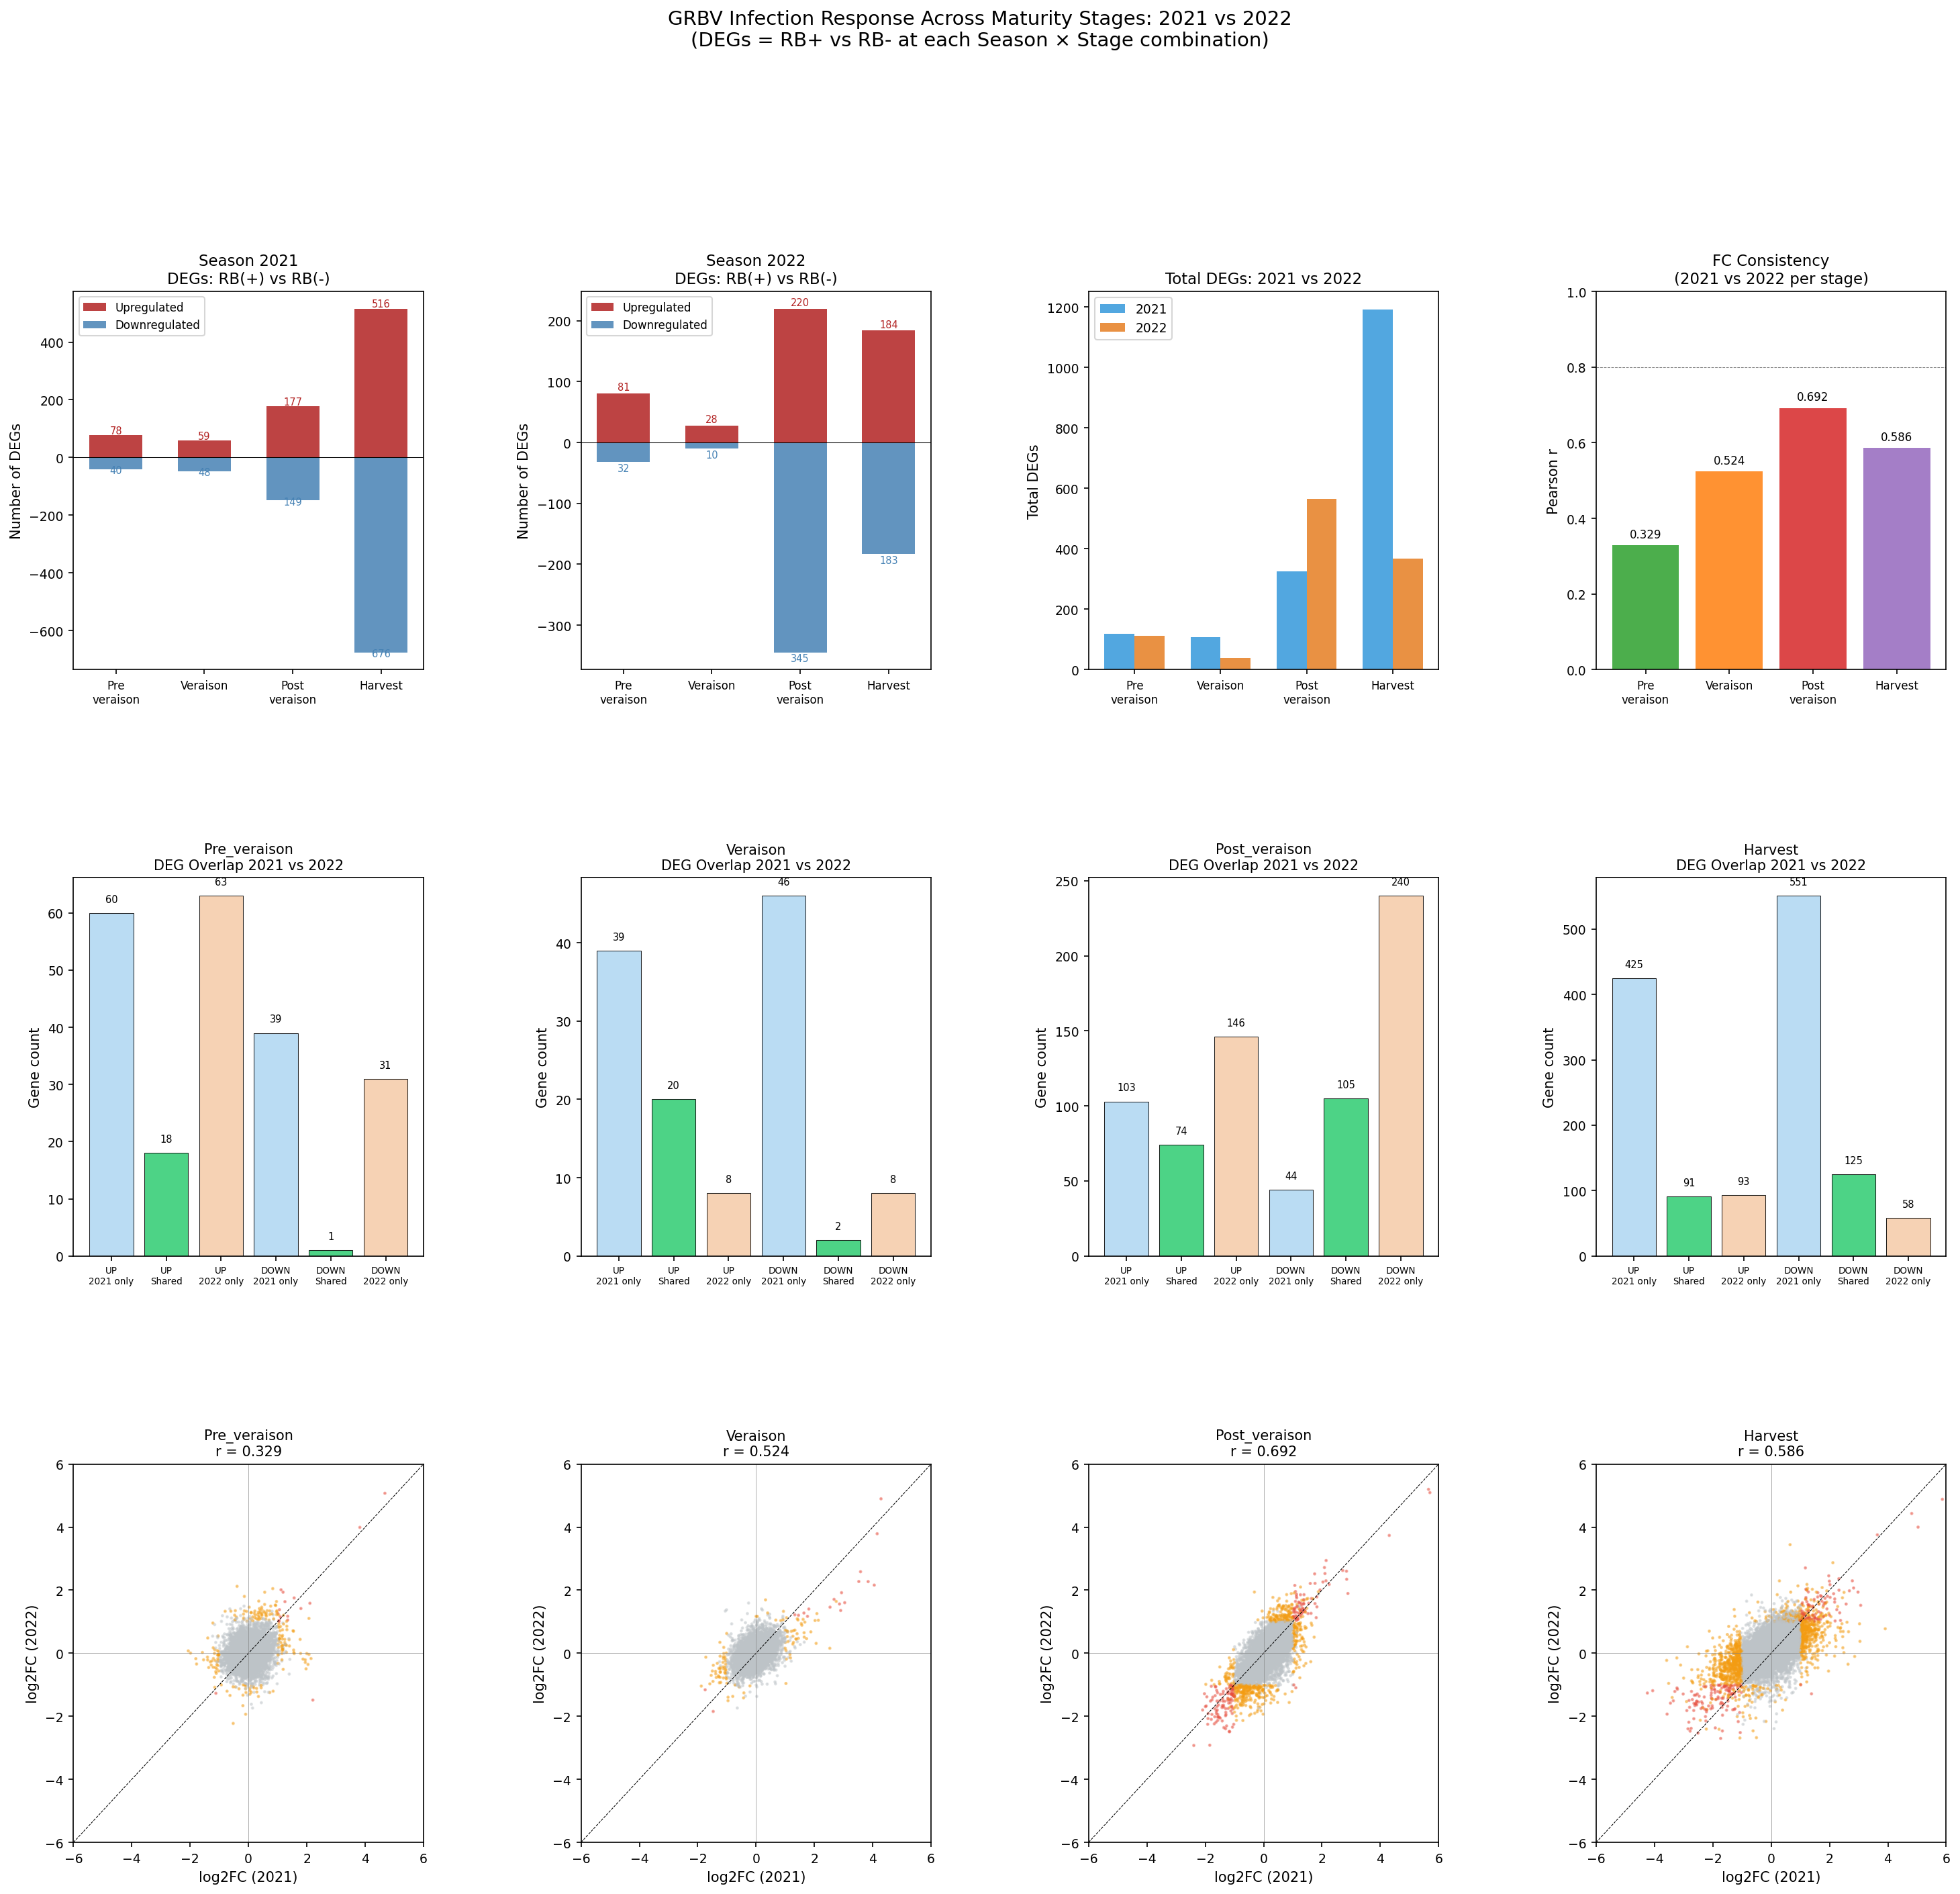
Seasonal x Maturity DEG Landscape
KEY FINDING: Inverted response kinetics
2021 (cooler): Peak at Harvest (1,192 DEGs)
2022 (hotter): Peak at Post-veraison (565 DEGs)
Diagnostic timing must account for season
Environment reshapes GRBV response trajectory
Notes:
This is arguably the most important finding — the seasonal inversion of response timing.

Slide 17
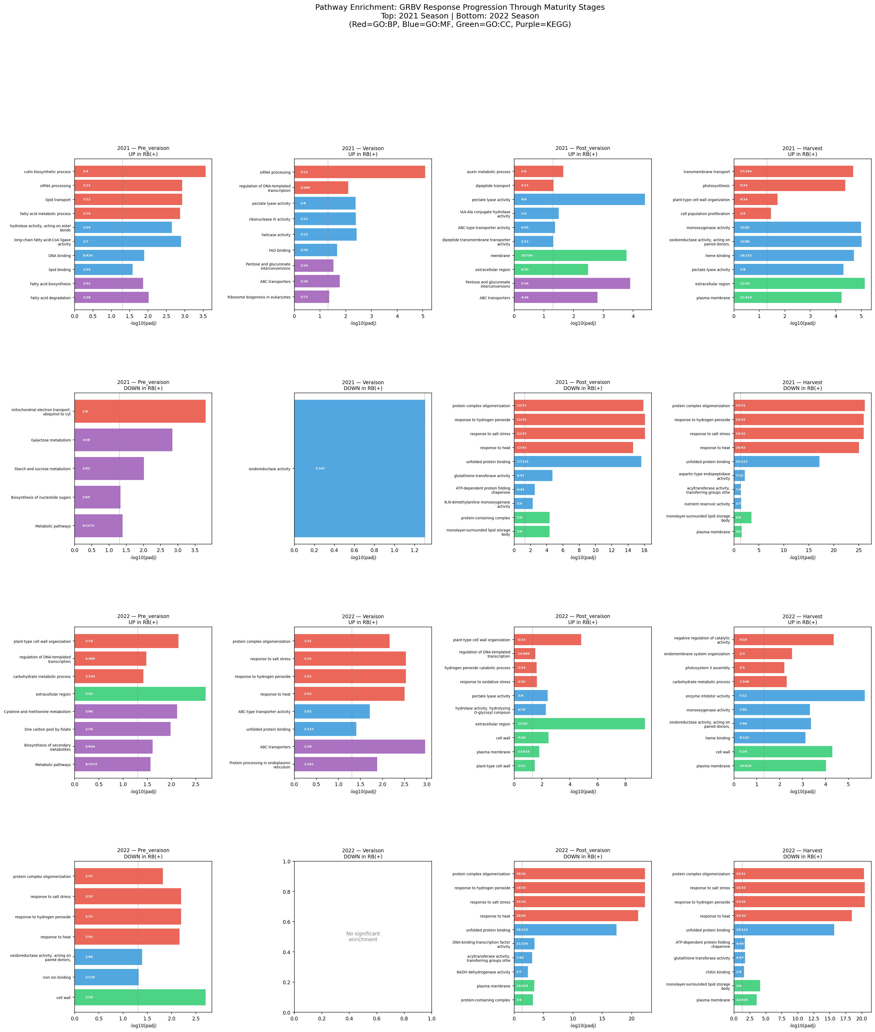
Pathway Dynamics Across Season x Stage
Notes:
Pathway enrichment grid across all 8 season x stage combinations.

Slide 18
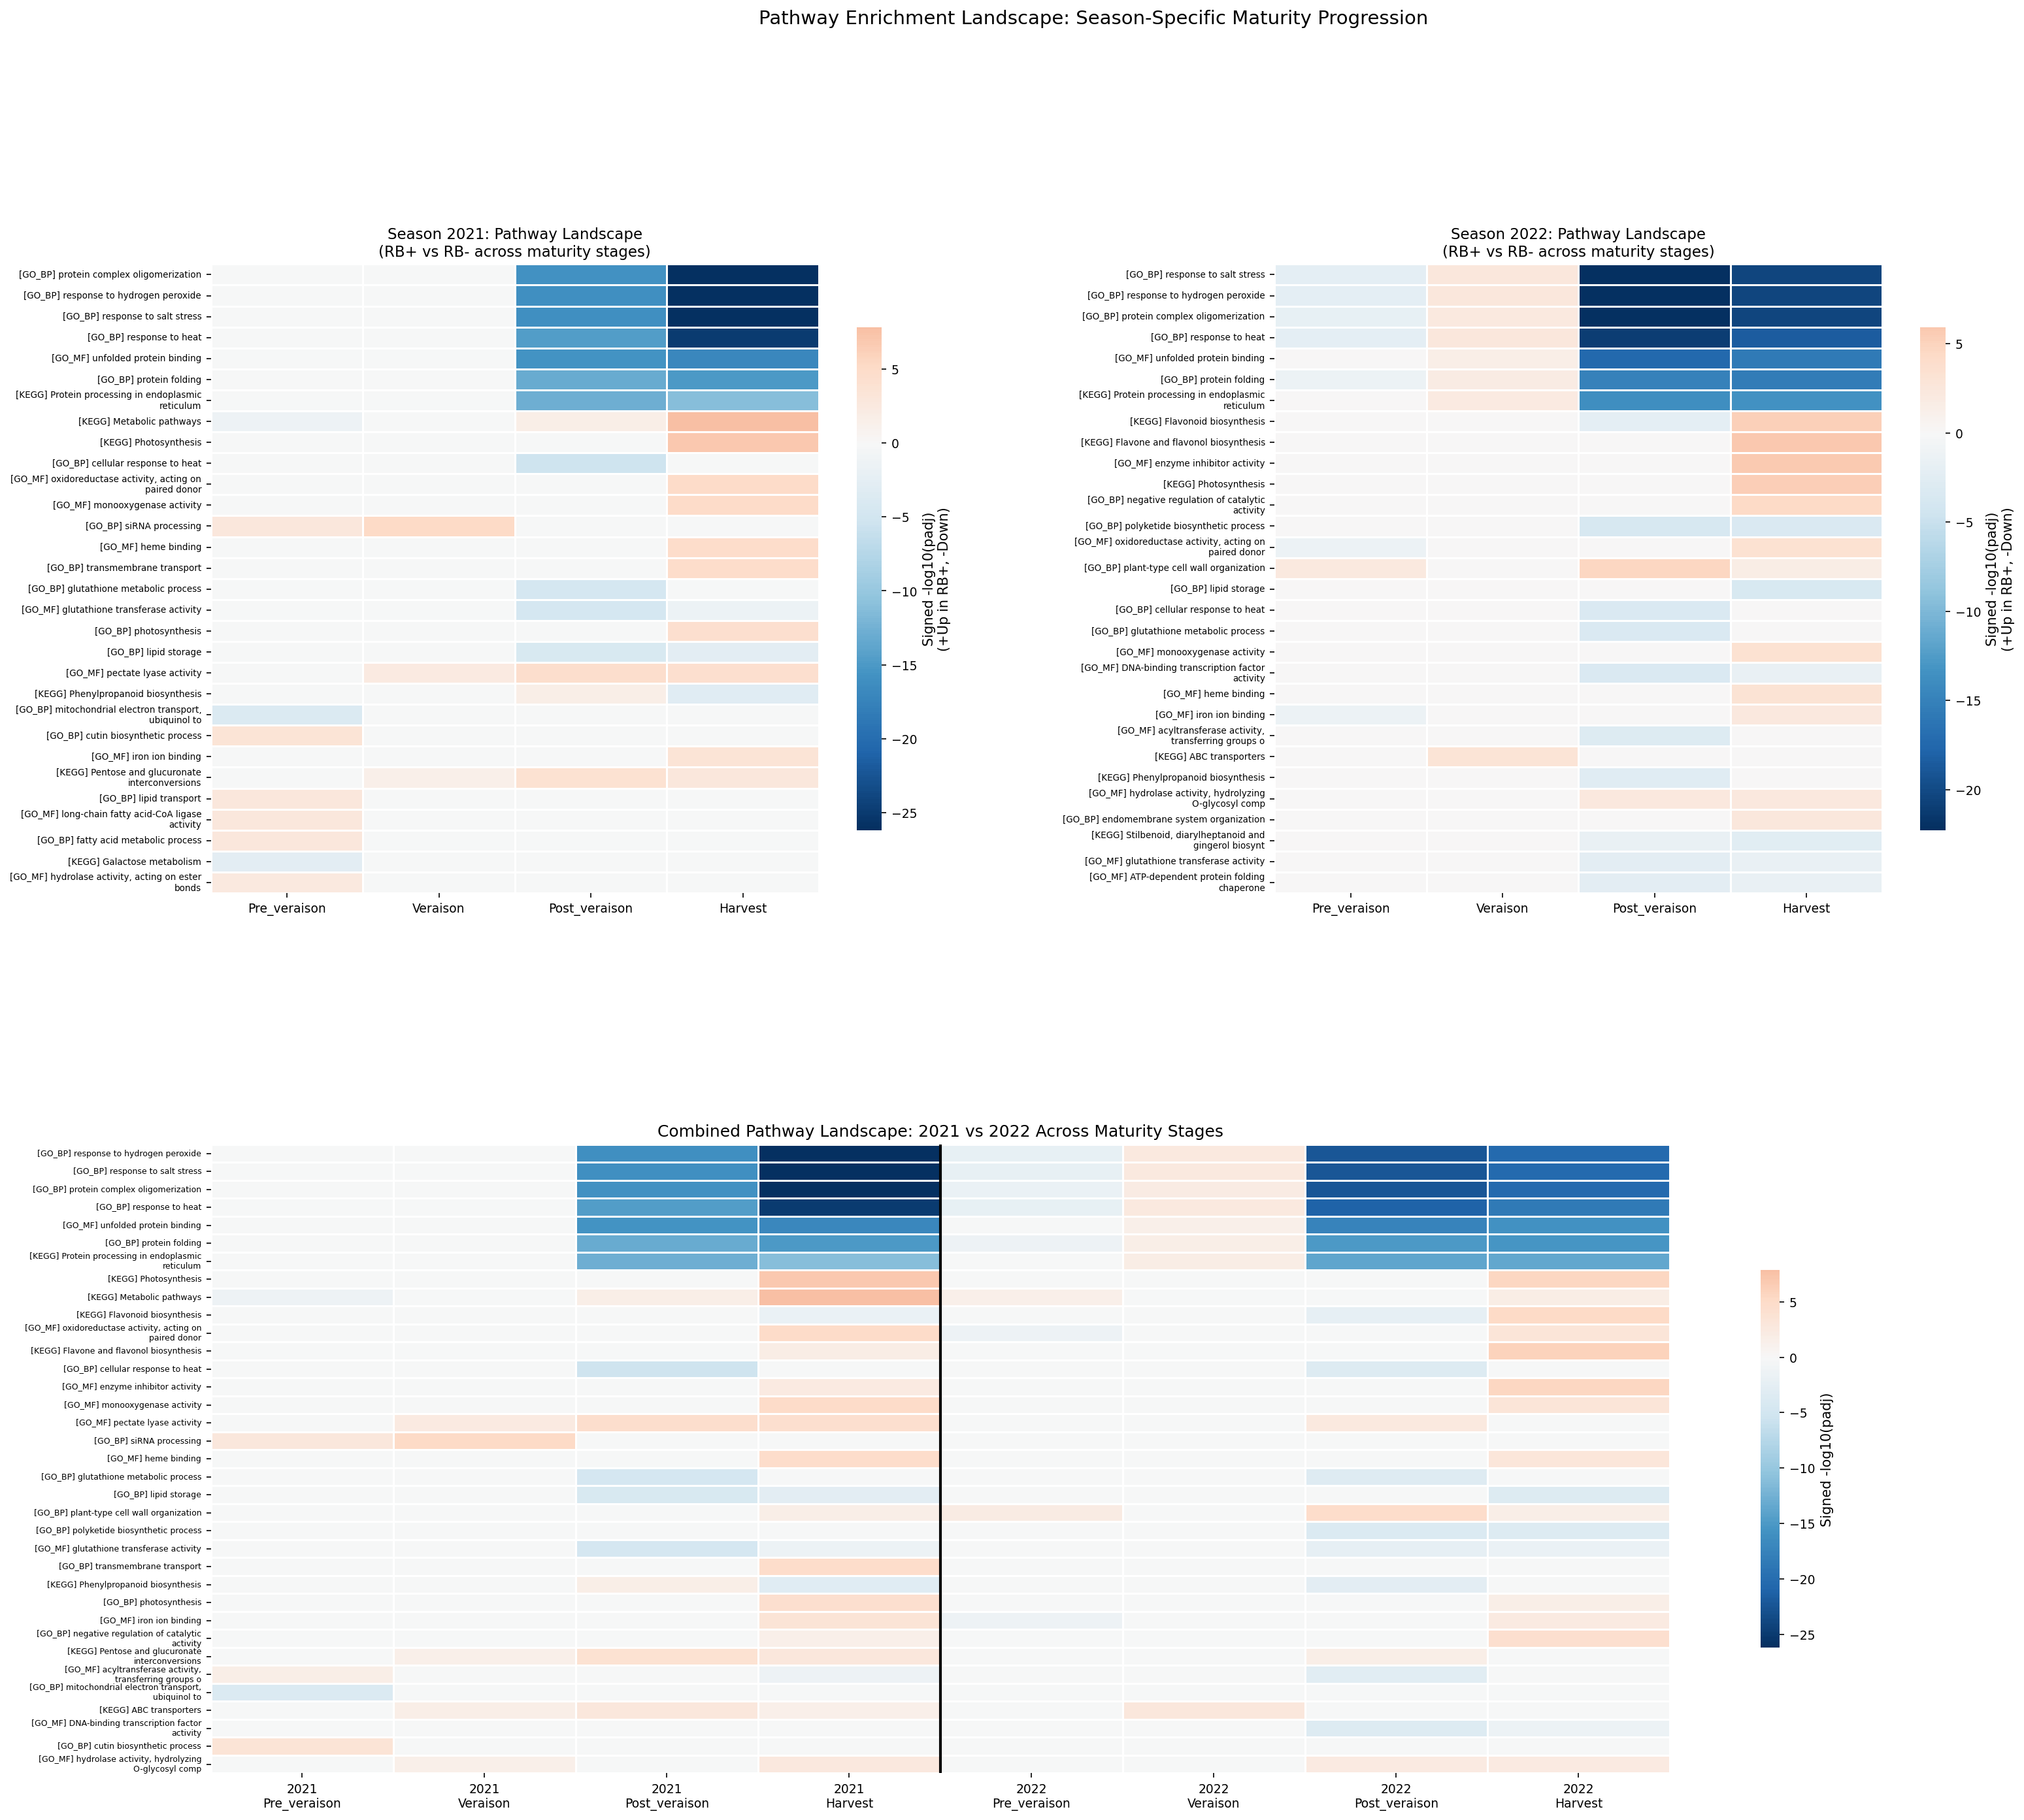
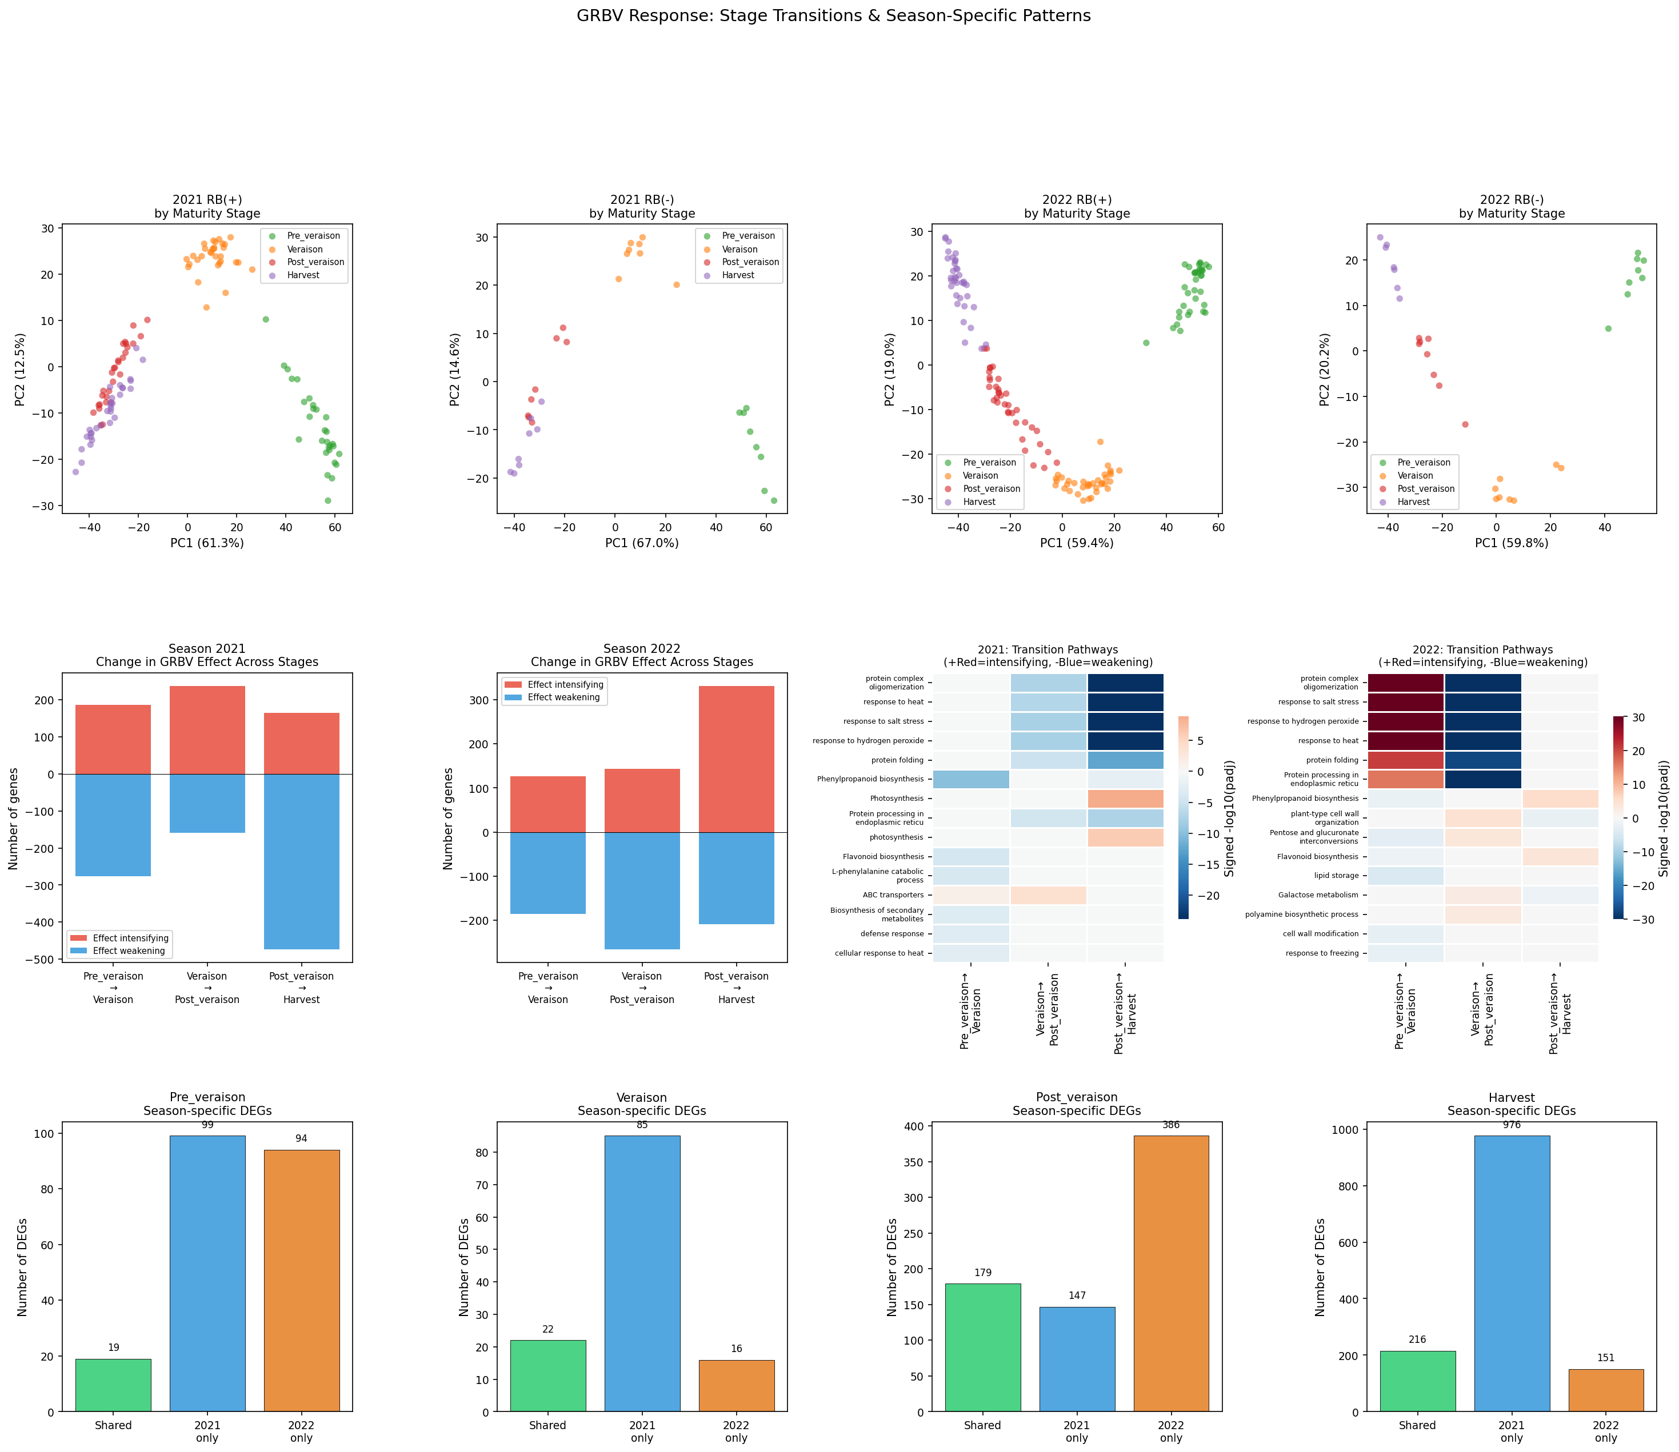
Seasonal Pathway Landscape & PCA Transitions

Slide 19
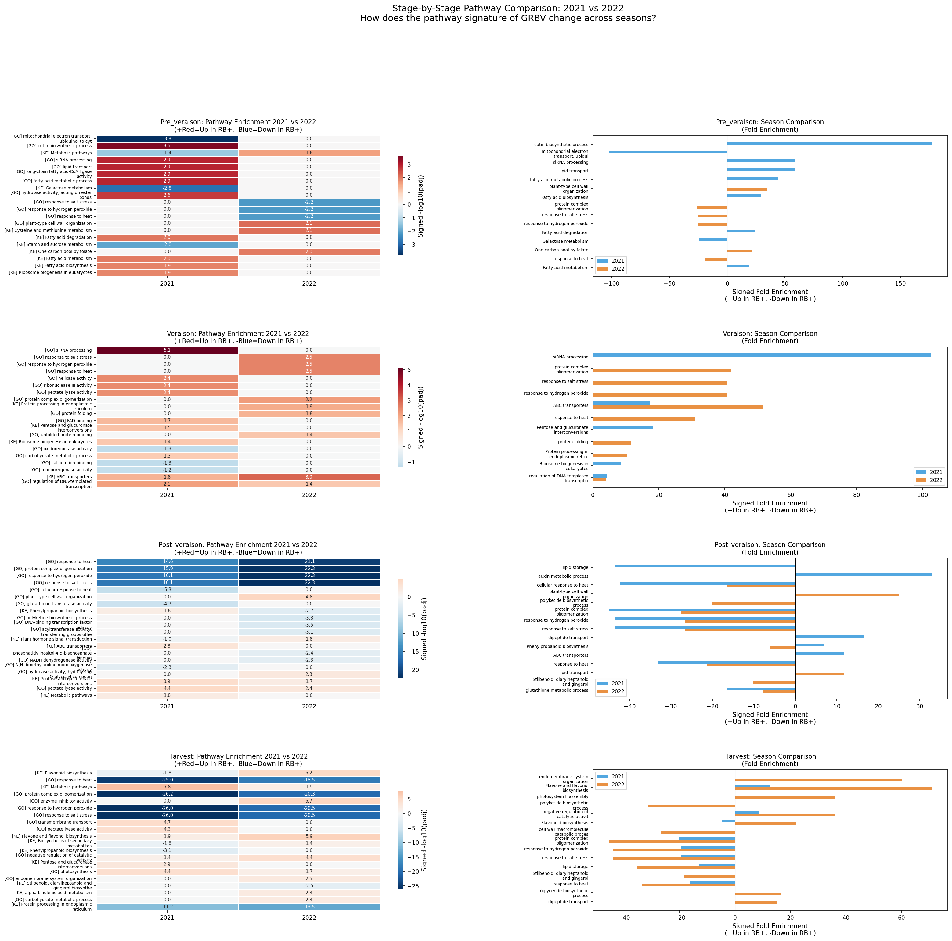
Stage-by-Stage Pathway Detail
Notes:
Detailed pathway progression through ripening for each season.

Slide 20
04
Systems-Level Pathway Analysis

Slide 21
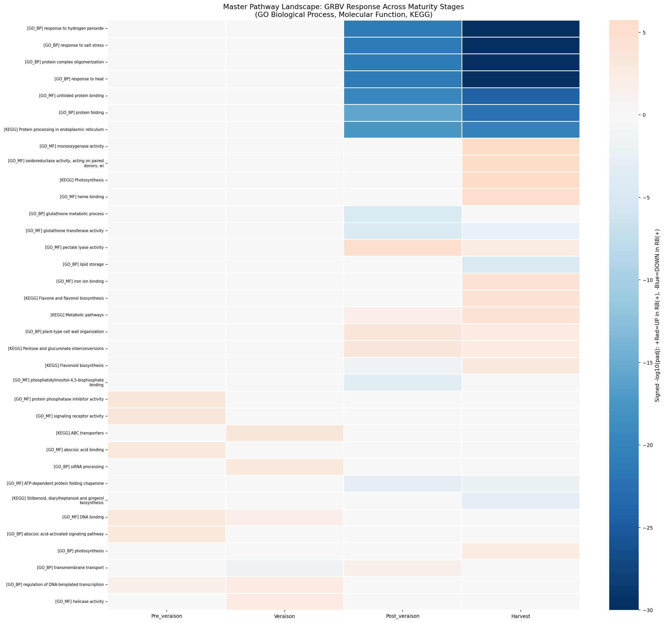
Master Pathway Landscape
Phenylpropanoid biosynthesis: consistently enriched
Plant-pathogen interaction: defense activation
ABC transporters: altered metabolite transport
Starch/sucrose metabolism: sugar accumulation disrupted
Photosynthesis affected at specific stages
Notes:
Master heatmap showing enrichment significance across all 20+ conditions.

Slide 22
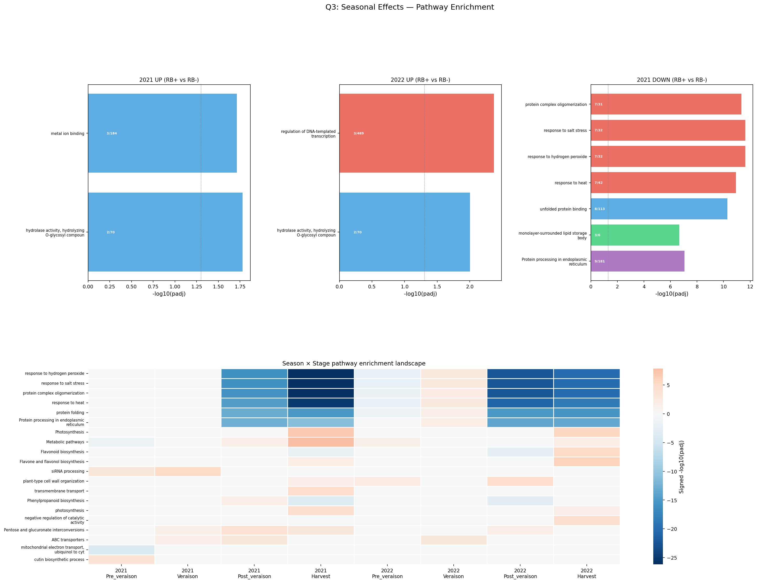
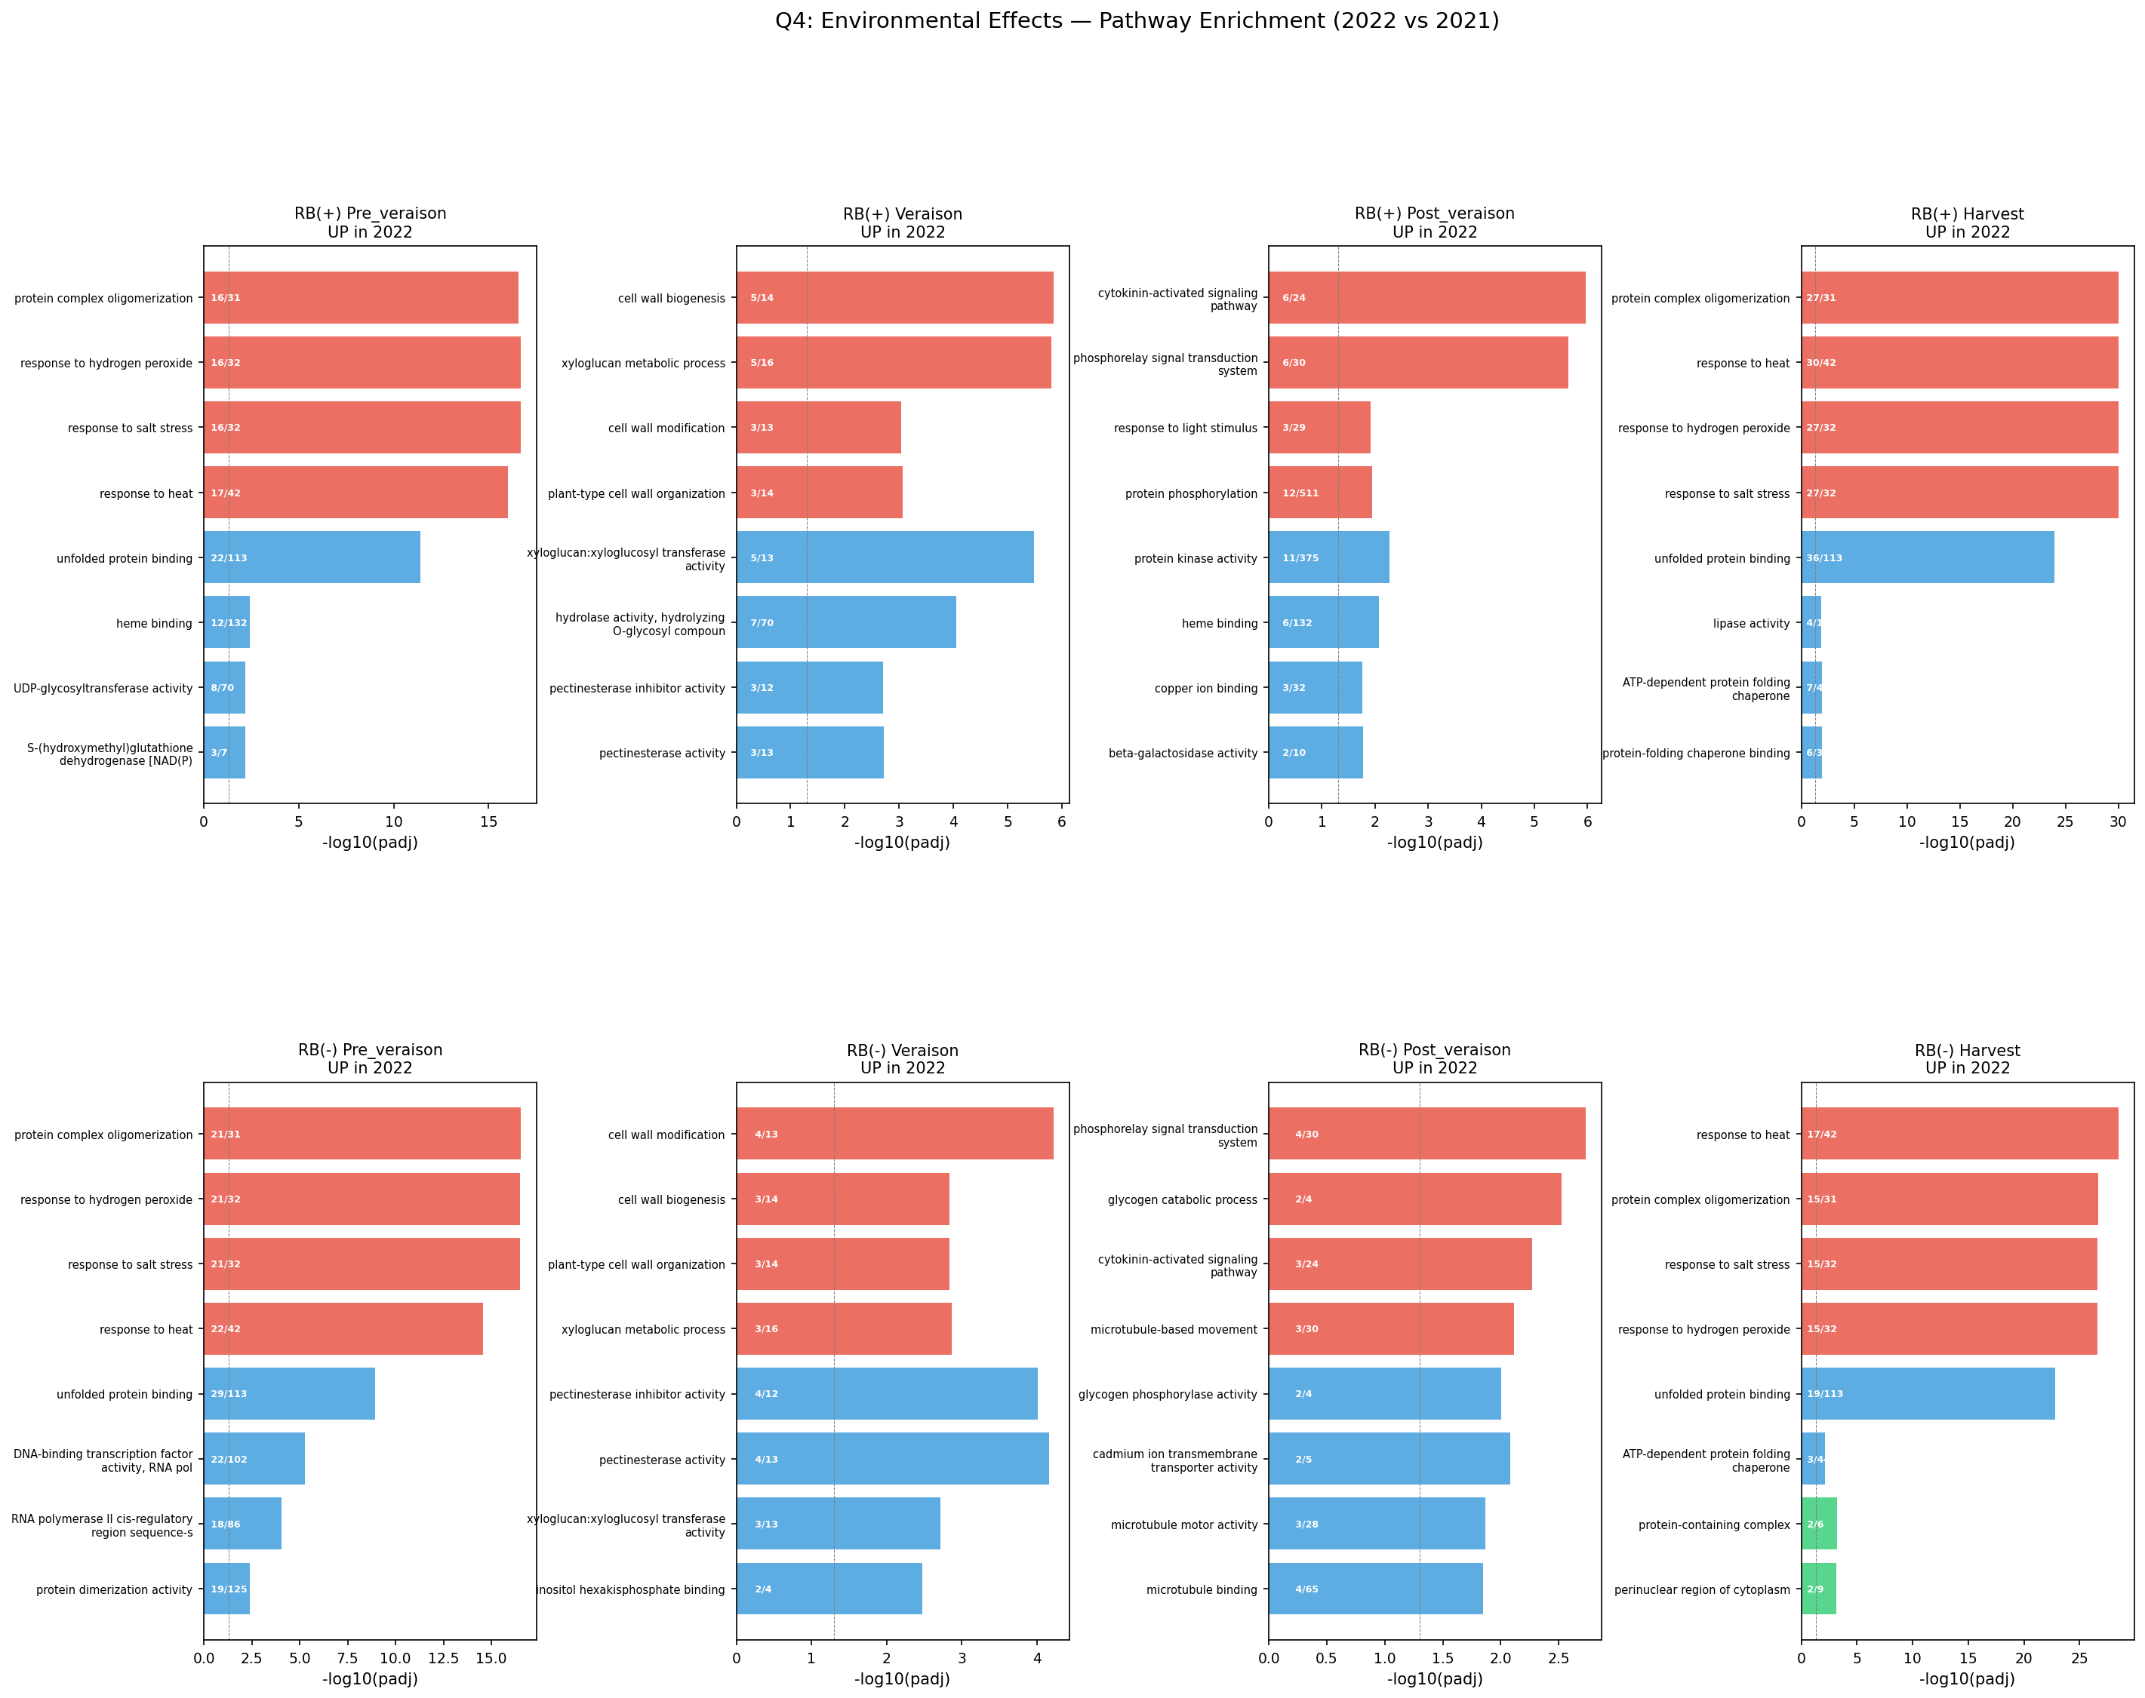
Q3 & Q4 Pathway Enrichment

Slide 23
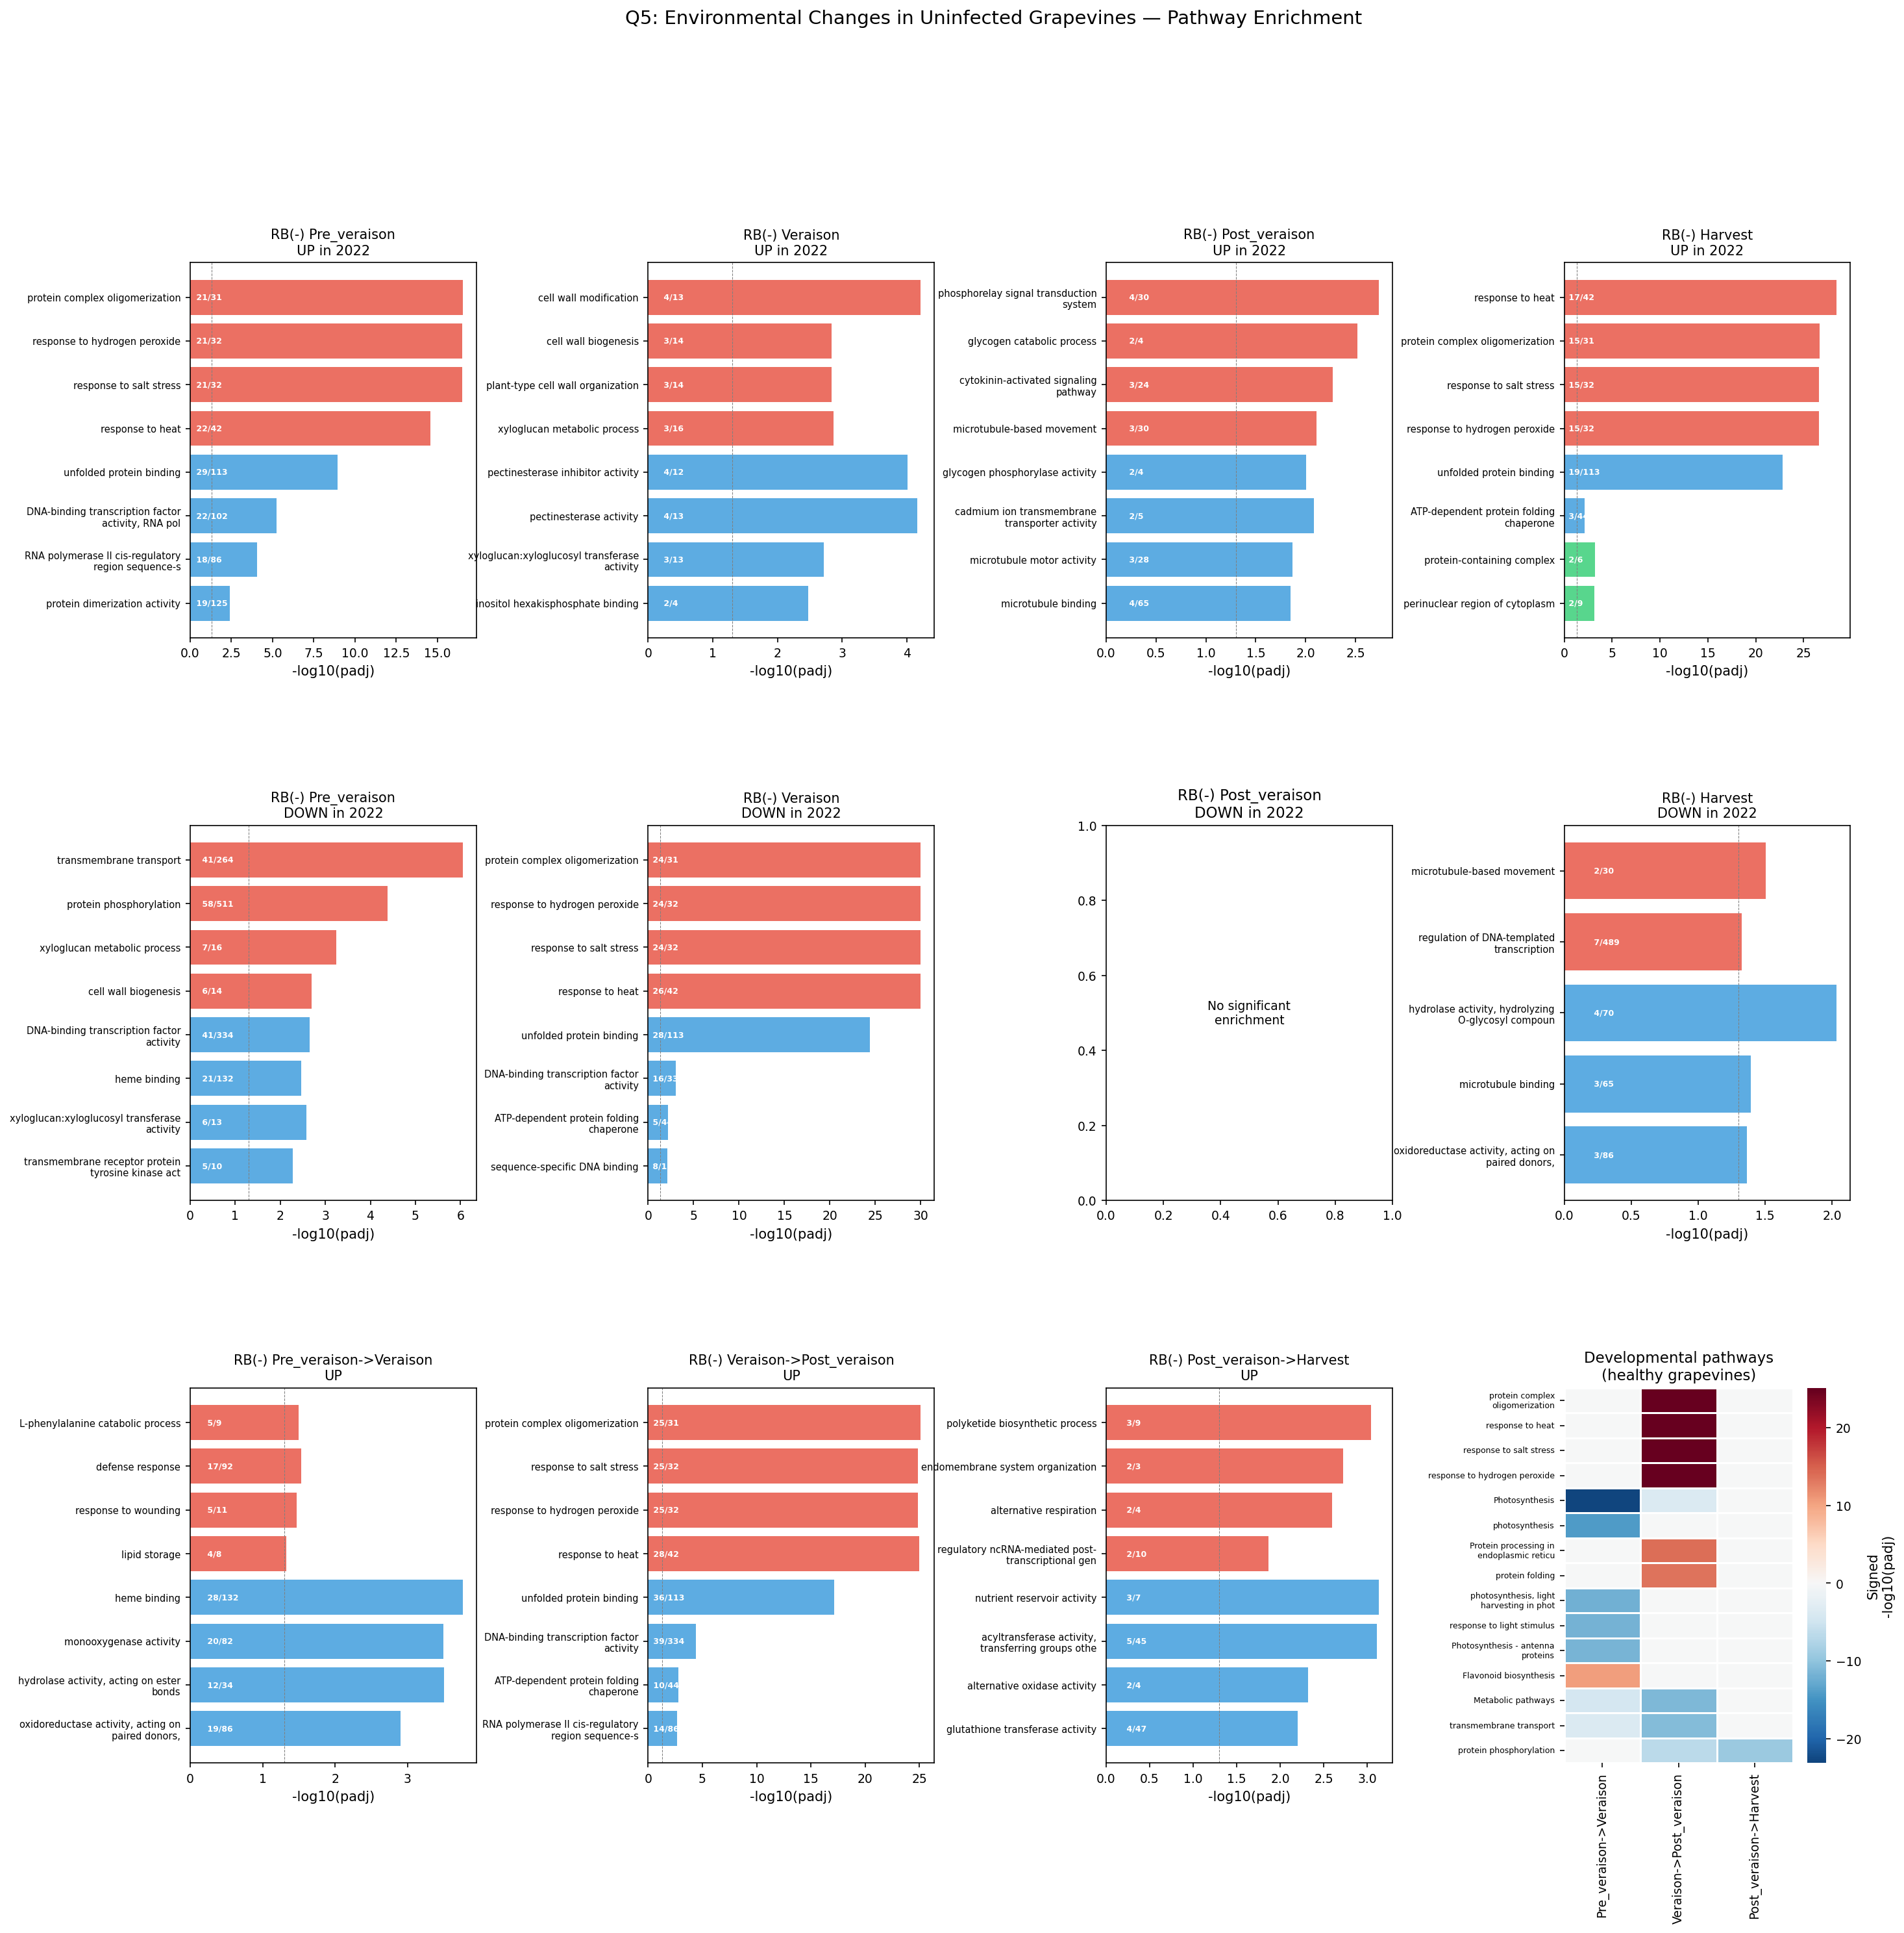
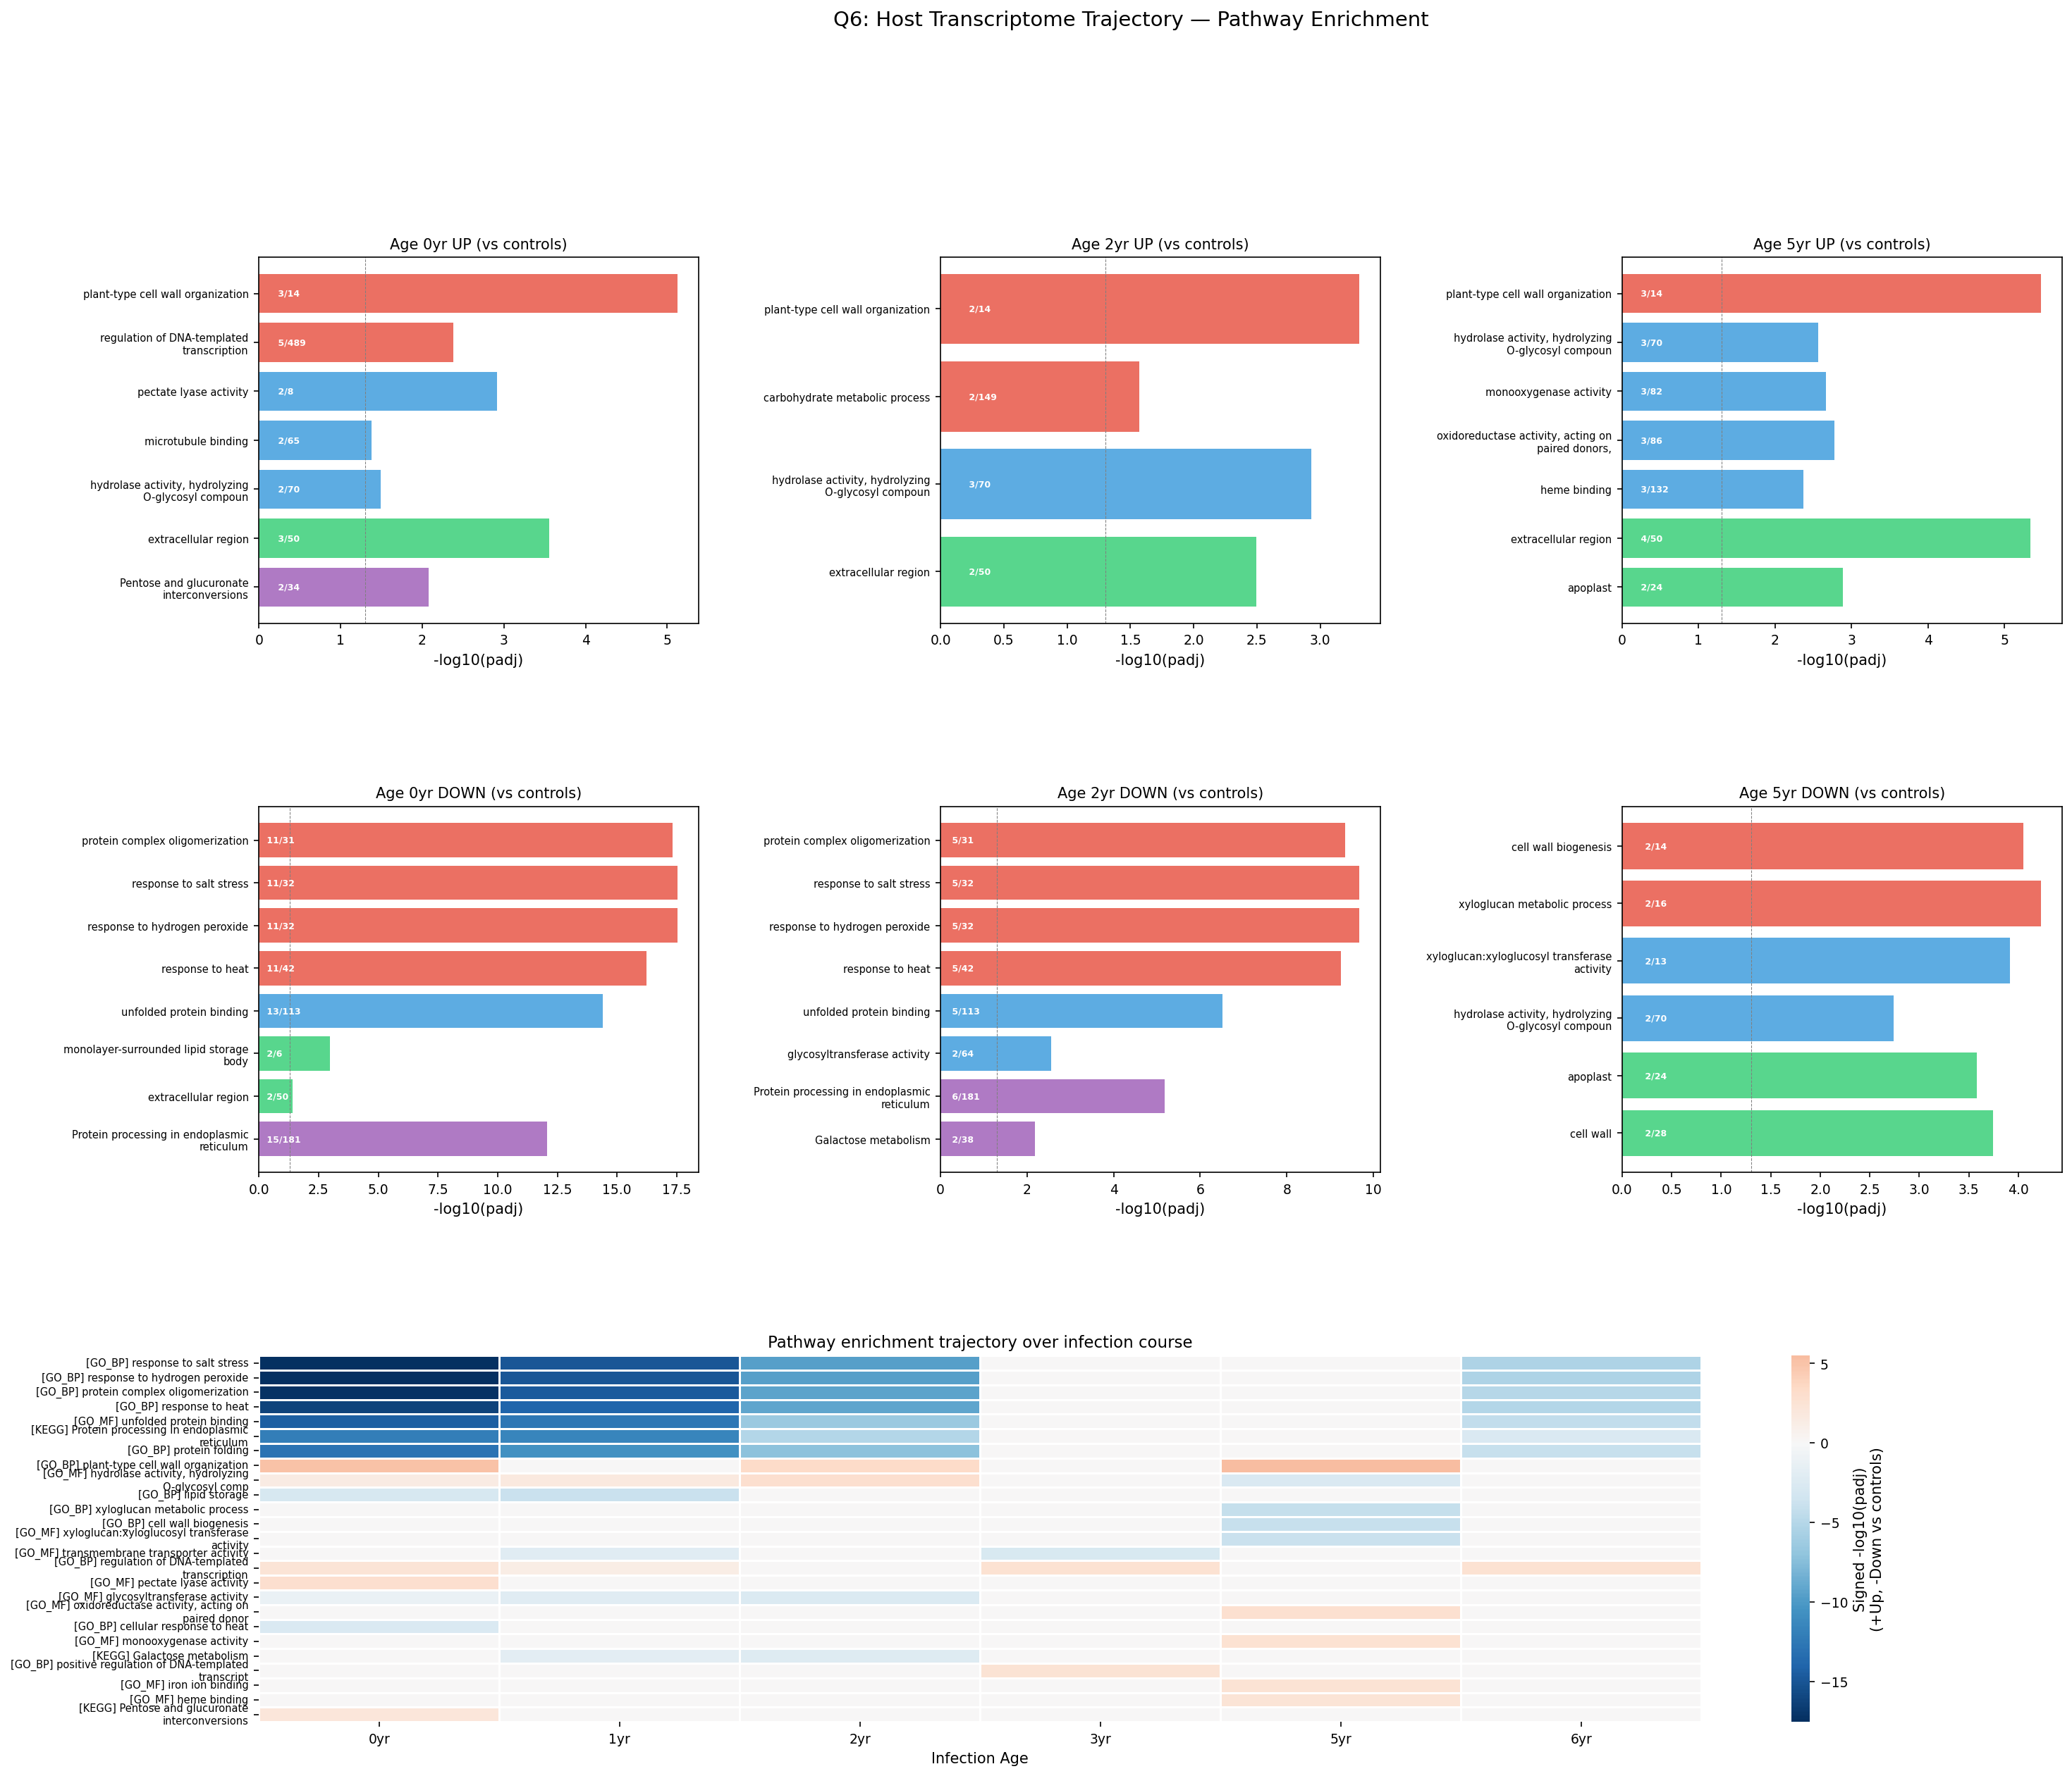
Q5 & Q6 Pathway Enrichment

Slide 24
05
Environmental Context & Viral Titer Integration

Slide 25
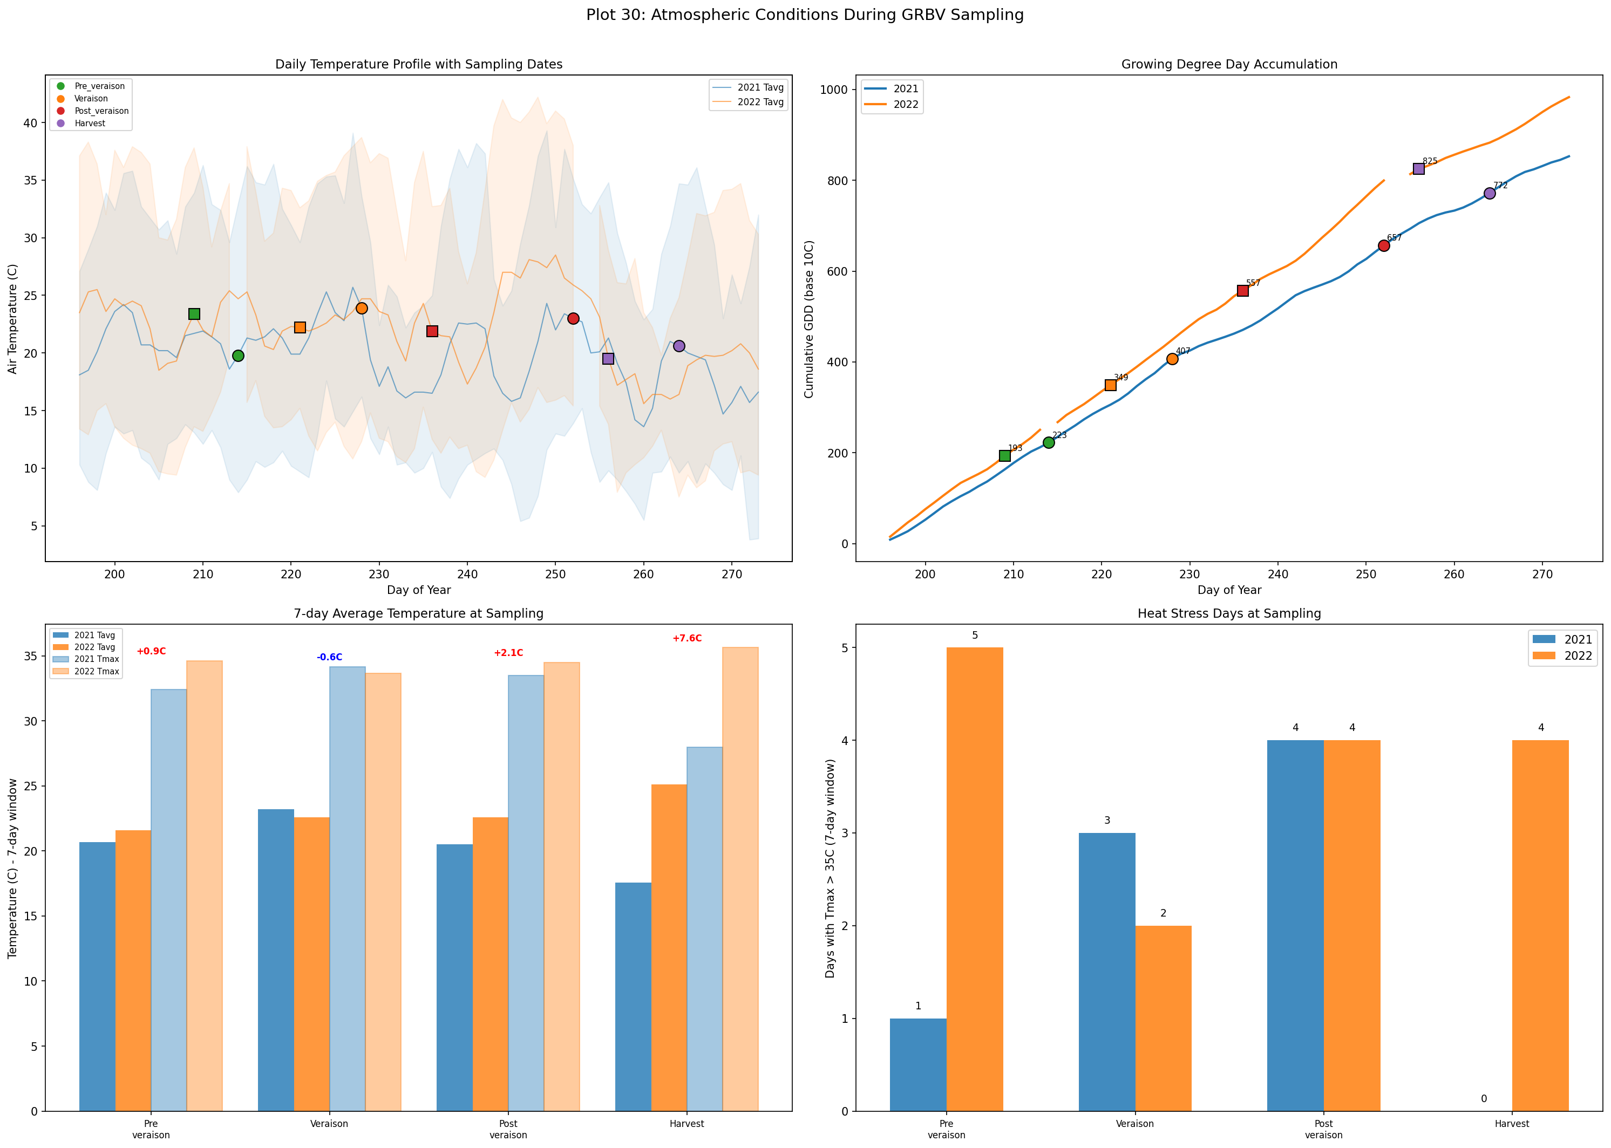
Weather Conditions at Sampling
2021: cooler growing season
2022: significantly hotter (+7.6C at Harvest)
Temperature tracked with daily weather data
GDD accumulation differed between years

Slide 26
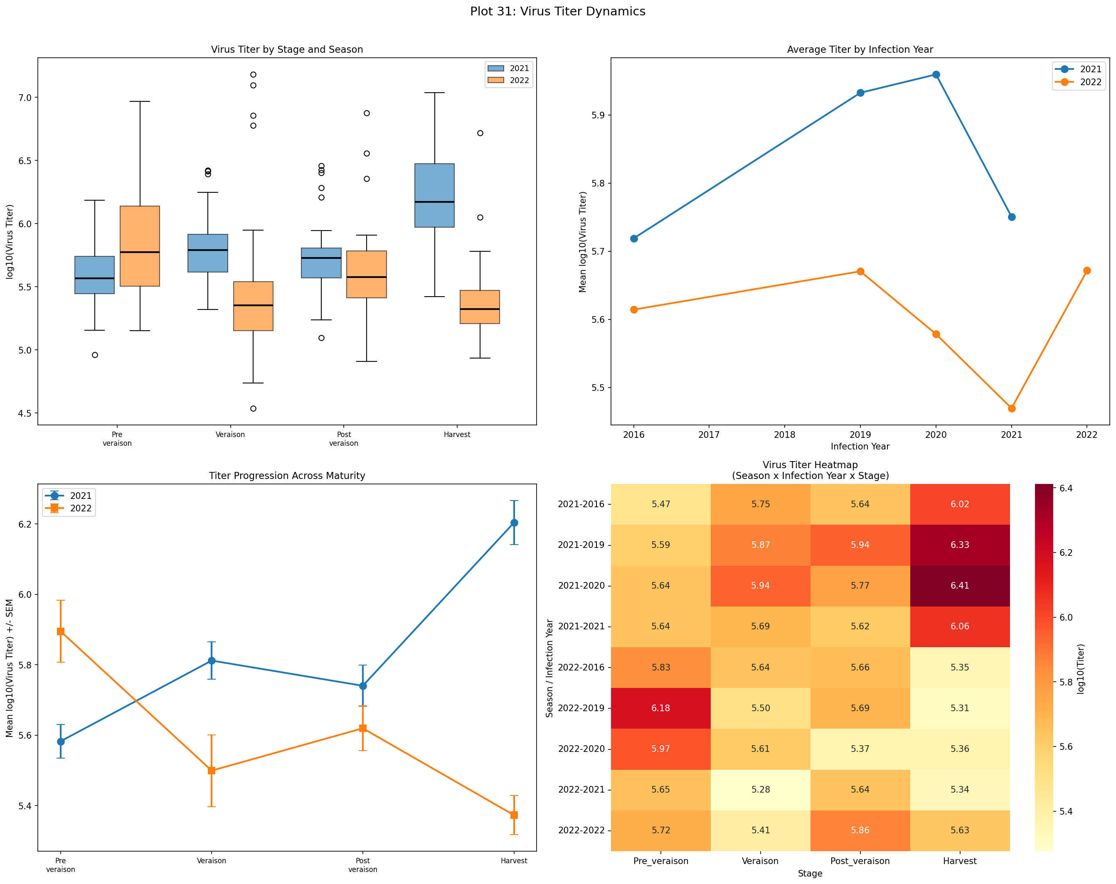
Virus Titer Patterns
Viral load varies by maturity stage
Season affects titer dynamics
Titer correlates with transcriptomic magnitude

Slide 27
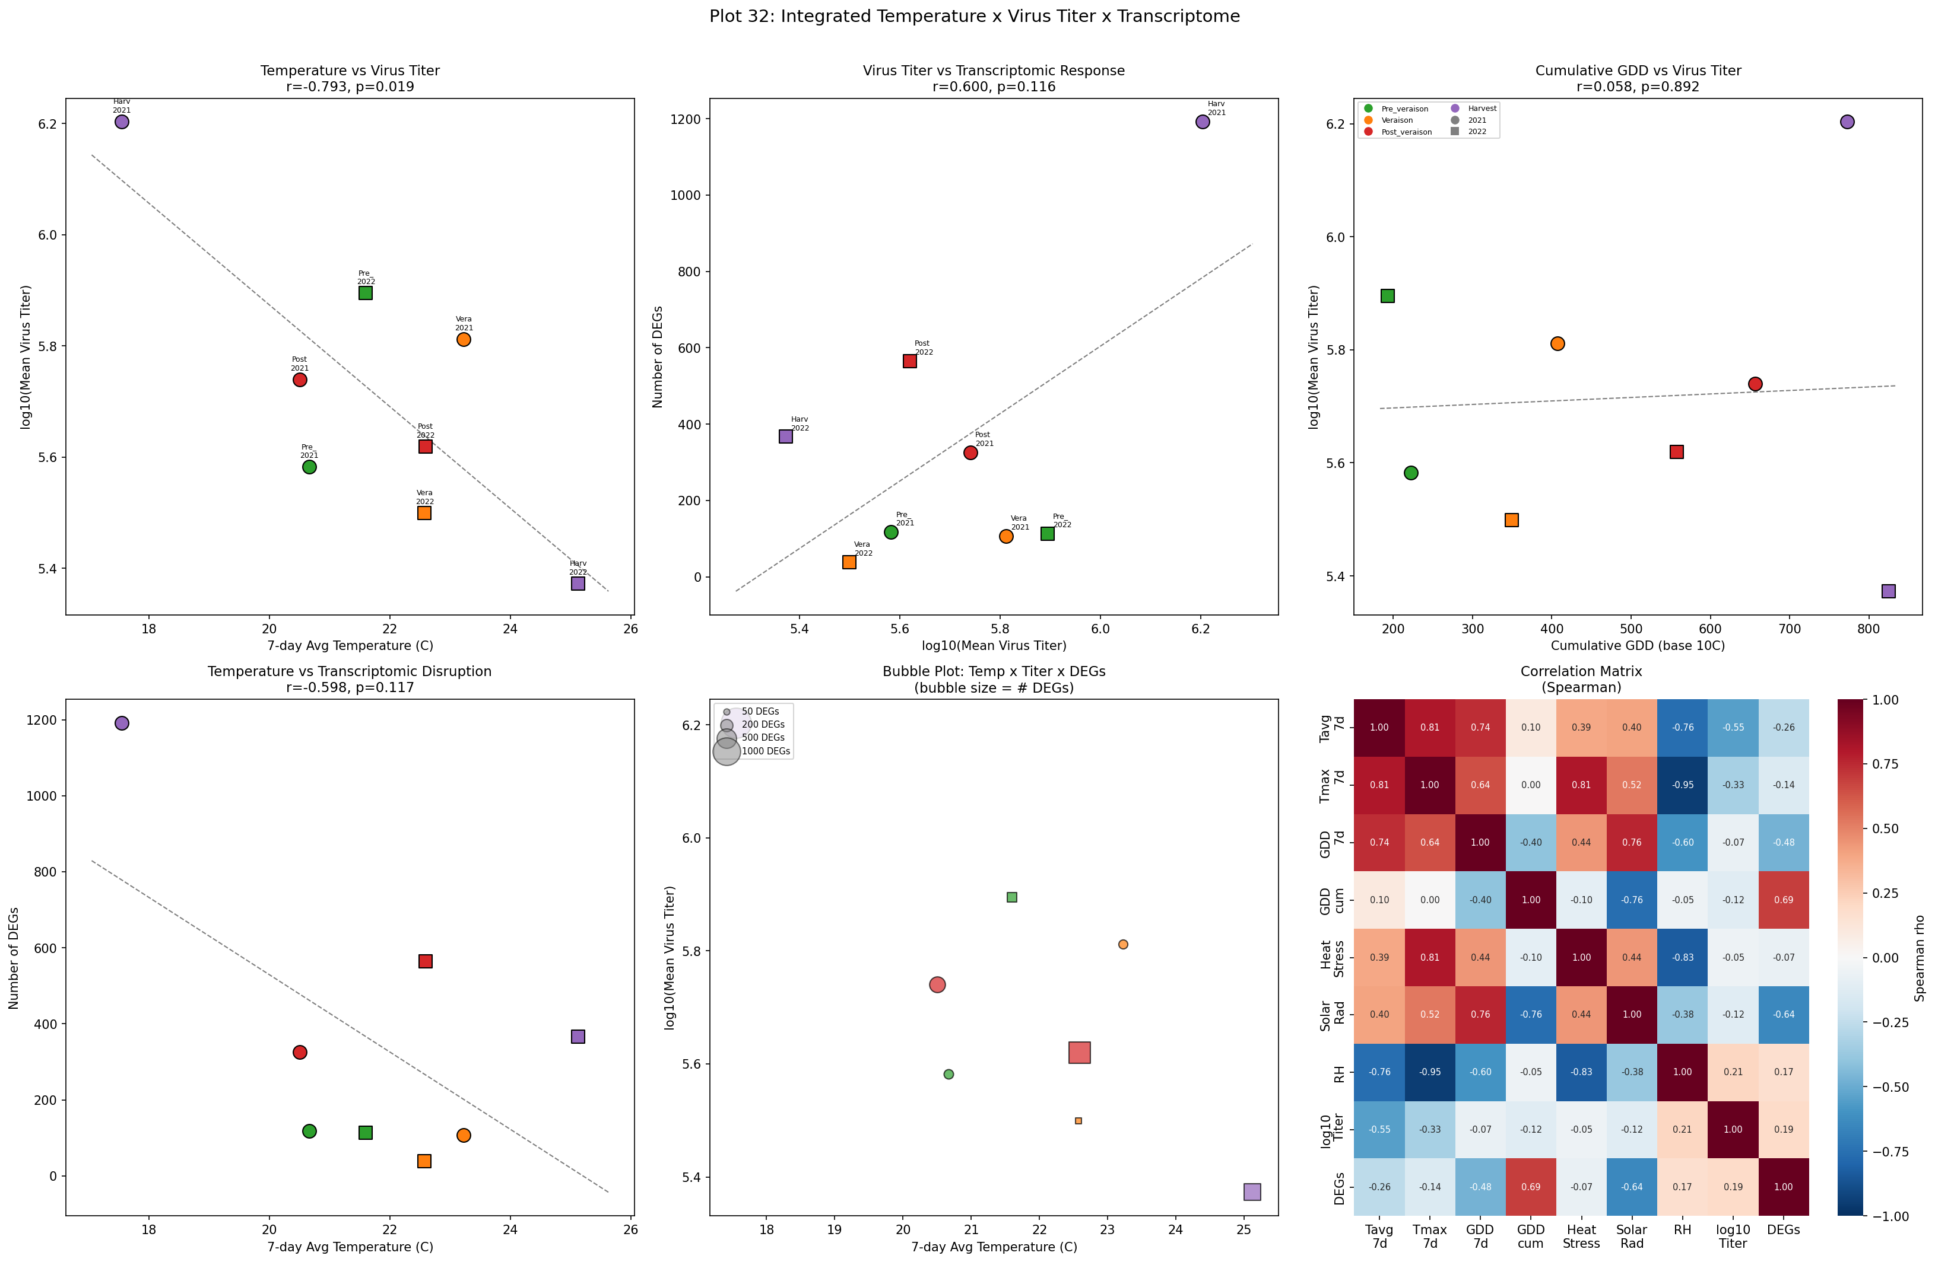
Integrated Temperature-Titer-DEG Analysis
Notes:
Correlations between temperature, viral titer, and DEG counts across conditions.

Slide 28
06
Heat-Stress Signatures & Virus-Heat Disentanglement

Slide 29
Heat-Stress Analysis: Key Numbers
115
57
29/36
Heat-stress genes expressed (9 categories)
Heat genes differentially expressed due to GRBV
sHSPs downregulated at 2021 Harvest (RB+)
23
+7.6C
r = 0.625
Heat genes with BOTH virus + environment effects
Temperature difference at Harvest (2022 vs 2021)
HSF-sHSP module score correlation

Slide 30
Heat-Stress Gene Expression Landscape
9 categories: sHSP, HSP70, HSP90, HSP100, HSF, GolS, LEA, antioxidant, GO:heat
sHSPs show strongest stage- and season-dependent expression
2022 Harvest: highest sHSP module score in controls (+1.64)
GRBV infection REDUCES sHSP module by ~50%
Virus suppresses host proteostasis network
Notes:
Plot 34: 4-panel overview of heat gene categories, DEG counts, correlations, module scores.

Slide 31
Heat vs Virus Effect Disentanglement
At Harvest: 23 genes regulated by BOTH virus AND environment
At Post-veraison: virus effect dominates (42 virus-only DEGs)
FC scatter shows virus OPPOSES environmental heat induction
HSF → sHSP regulatory axis confirmed (r=0.625, p=7.2e-37)
GRBV may compromise vine heat tolerance
Notes:
Plot 35: Classification, FC scatter, gene profiles, HSF-sHSP module correlation.

Slide 32
07
Biomarker Discovery & Diagnostics

Slide 33
Biomarker Scoring & Classification
Composite score: consistency + effect size + significance + direction + robustness
12 universal biomarkers robust across ALL conditions
3-gene panel achieves AUC = 1.000 (perfect classification)
Top host biomarker: F-box/LRR protein (AUC = 0.880)
35 early-detection + 23 harvest-specific biomarkers

Slide 34
Biomarker Expression Profiles
Notes:
Expression profiles of top 16 biomarkers across all season x stage conditions.

Slide 35
Biomarker Robustness Analysis
Fold-change consistency across seasons verified
AUC stability across cross-validation folds
Significance matrix confirms multi-condition robustness
RT-qPCR validation candidates identified

Slide 36
08
GWAS/QTL Cross-Reference & Breeding Implications

Slide 37
Biomarker-QTL Chromosome Map
60% of biomarkers co-localize with known QTLs (1 Mb window)
40% fall directly inside QTL intervals
18 biomarkers in disease-resistance clusters (Rpv, Ren, Run)
8 biomarkers near berry-quality loci
Sugar QTL link: RNA-dep RNA polymerase → sugar accumulation

Slide 38
QTL Cross-Reference Summary
Notes:
Overlap statistics, category breakdown, functional interpretation of co-localization.

Slide 39
09
Analytical Robustness & Integration

Slide 40
Pooled vs Stratified Comparison & Overlap Heatmap

Slide 41
Cross-Question Integration & Summary Dashboard
Notes:
Cross-referencing findings across all research questions. 908 universal DEGs confirmed.

Slide 42
10
Conclusions & Future Directions

Slide 43
Key Conclusions
1. GRBV effects are profoundly stage-dependent, peaking at Post-veraison and Harvest
2. Seasonal response trajectory is INVERTED: 2021 peaks at Harvest, 2022 peaks at Post-veraison
3. GRBV suppresses heat-stress genes (sHSPs), potentially compromising vine thermal tolerance
4. 12 universal biomarkers + 3-gene panel (AUC=1.0) enable robust diagnostics
5. 60% of biomarkers co-localize with known disease-resistance and berry-quality QTLs
6. Sugar accumulation QTL link explains primary GRBV symptom (delayed ripening, reduced Brix)
Future Directions
RT-qPCR validation of top biomarkers in independent vineyards
Functional validation of sHSP suppression mechanism (e.g., VIGS knockdown)
Expand to additional cultivars (Cabernet Sauvignon, Merlot, Zinfandel)
Integrate with metabolomics (anthocyanin, sugar profiling)
Develop field-deployable molecular diagnostic assay
Test biomarker-QTL candidates in breeding populations

Slide 44
Thank You
Questions & Discussion
[Your Name] | [Institution] | [Email]

