Slide 1
Introduction
Centralized Database
Centeralized database management system in which all the data is maintained at a single site and assumed that the processing of individual tranasaction is essential sequential.
Data is located in one place (one server)
• All DBMS functionalities are done by that server
• Enforcing ACID properties of transactions
• Concurrency control, recovery mechanisms
In Distributed databases:
• Data is stored in multiple places (each is running a DBMS)
• New notion of distributed transactions
• DBMS functionalities are now distributed over many machines
• Revisit how these functionalities work in distributed environment
3

Slide 2
Parallel Databases
• Machines are physically close to each other, e.g., same server room
• Machines connects with dedicated high-speed LANs and switches
• Communication cost is assumed to be small
• Can shared-memory, shared-disk, or shared-nothing architecture
Distributed Databases
• Machines can far from each other, e.g., in different continent
• Can be connected using public-purpose network, e.g., Internet
• Communication cost and problems cannot be ignored
• Usually shared-nothing architecture

Slide 3
Distributed Database
Disadvantages:
Complexity of Query opt.
Concurrency control
Recovery
Catalog management
Advantage Reliability
Performance
Growth (incremental)
Local control
Transparency

Slide 4
Parallel DB
Parallel database system seeks to improve performance through. parallelization of various operations such as loading data ,building indexes, and evaluating queries by using multiple CPUs and Disks in Parallel.
Data may be stored in a distributed fashion in such a system ,the distribution is governed solely by performance consideration.
Motivation for Parallel DB
Parallel machines are becoming quite common and affordable
Prices of microprocessors, memory and disks have dropped sharply
Databases are growing increasingly large
large volumes of transaction data are collected and stored for later analysis.
multimedia objects like images are increasingly stored in databases.

Slide 5
Parallel DB
While parallelism is motivated by performance consideration several distinct issues motivate data distribution:
INCREASED AVAILABILITY: If a site containing a relation goes down,the relation continues to be availabe a copy is maintained at another site.
DISTRIBUTED ACCESS TO DATA:
ANALYSIS OF DISTRIBUTED DATA:

Slide 6
Architectures for Parallel Databases
The basic idea behind Parallel DB is to carry out evaluation steps in parallel whenever is possible.
There are many opportunities for parallelism in RDBMS.
3 main architectures have been proposed for building parallel DBMSs.
1 Shared Memory
2 Shared Disk
3 Shared Nothing

Slide 7
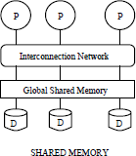
Architectures for Parallel Databases
Advantages:
It is closer to conventional
machine , Easy to program
overhead is low.
OS services are leveraged to utilize the additional CPUs.
Disadvantage:
It leads to bottleneck problem
Expensive to build
It is less sensitive to partitioning

Slide 8
Architectures for Parallel Databases
Shared memory
Every processor has its own disk
• Single memory address-space for
all processors
• Reading or writing to far memory can be slightly more expensive
• Every processor can have its own
local memory and cache as well

Slide 9
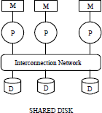
Architectures for Parallel Databases
Advantages:
1. Almost same
Disadvantages:
More interference
Increases N/W band width
Shared disk less sensitive to
partitioning

Slide 10
Architectures for Parallel Databases
Shared Disk
Each cpu has a private memory and direct access to all disk through an interconnection network.
Share disk architecture also has the problem as that of shared memory because large amounts of data are shipped throught interconnection network.
Basic problem with the shared memory and shared disk architecture is interference .
As more disk are added existing CPU’S are slowed down because of increased contention for memory accesses and network bandwidth.
• All machines can access all disks in the system
• Number of disks does not necessarily match the number of processors

Slide 11
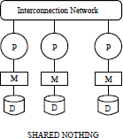
Architectures for Parallel Databases
Advantages:
It provides linear scale up
&linear speed up
Shared nothing benefits from "good" partitioning
Cheap to build
Disadvantage
Hard to program
Addition of new nodes requires reorganizing

Slide 12
Architectures for Parallel Databases
Shared Nothing
Most common architecture nowadays
• Every machine has its own memory and disk.
• Many cheap machines (commodity hardware)
• Communication is done through highspeed
network and switches.
• Usually machines can have a hierarchy
• Machines on same rack and Then racks are connected through highspeed.

Slide 13
Architectures for Parallel Databases
Even an average 1 percent slowdown per additional CPU means that maximum speed-up is a factor of 37 and adding additional CPU slows down the system.
A system with 1000 CPU is only 4% as effective as single CPU system.
The observation motivated the development of shared nothing architecture.
Best consideration for large parallel database systems.

Slide 14
PARALLEL DBMSs
SPEED-UP
Number of transactions/second
Linear speed-up (ideal)
2000/Sec
1600/Sec
Sub-linear speed-up
1000/Sec
5 CPUs
10 CPUs
16 CPUs
Number of CPUs

Slide 15
PARALLEL DBMSs SCALE-UP
Number of transactions/second
Linear scale-up (ideal)
1000/Sec
900/Sec
Sub-linear scale-up
5 CPUs
1 GB Database
10 CPUs
2 GB Database

Slide 16
PARALLEL QUERY EVALUATION
A relational query execution plan is graph/tree of relational algebra operators (based on this operators can execute in parallel)

Slide 17
Different Types of DBMS ||-ism
Parallel evaluation of a relational query in DBMS With shared –nothing architecture
Inter-query parallelism
Multiple queries run on different sites
Intra-query parallelism
Parallel execution of single query run on different sites.
Intra-operator parallelism
get all machines working together to compute a given operation (scan, sort, join).
Inter-operator parallelism
each operator may run concurrently on a different site (exploits pipelining).
In order to evaluate different operators in parallel, we need to evaluate each operator in query plan in Parallel.

Slide 18
Data Partitioning
Types of Partitioning
Horizontal Partitioning: tuple of a relation are divided among many disks such that each tuple resides on one disk.
It enables to exploit the I/O band width of disks by reading & writing them in parallel.
Reduce the time required to retrieve partitioning the relations relations from disk by on multiple disks.
Range Partitioning
Hash Partitioning
Round Robin Partitioning
2. Vertical Partitioning

Slide 19
1.Range Partitioning
Tuples are sorted (conceptually), and n ranges are chosen for the sort key values so that each range contains roughly the same number of tuples;
tuples in range i are assigned to processor i.
Eg:
sailor _id 1-10 assigned to disk 1
sailor _id 10-20 assigned to disk 2
sailor _id 20-30 assigned to disk 3
range partitioning can lead to data skew; that is, partitions with widely varying number of tuples across

Slide 20
2.Hash Partitioning
A hash function is applied to selected fields of a tuple to determine its processor.
Hash partitioning has the additional virtue that it keeps data evenly distributed even if the data grows and shrinks over time.

Slide 21
3.Round Robin Partitioning
If there are n processors, the i th tuple is assigned to processor i mod n in
round-robin partitioning.
Round-robin partitioning is suitable for efficiently evaluating queries that access the entire relation.
If only a subset of the tuples (e.g., those that satisfy the selection condition age = 20) is required, hash partitioning and range partitioning are better than round-robin partitioning

Slide 22


















Range
Hash
Round Robin
O...S T...Z
K...N
A...E
F...J
K...N
A...E
F...J
K...N
O...S
T...Z
A...E
F...J
O...S
T...Z
Good for equijoins, exact-match queries, and range queries
Good for equijoins, exact match queries
Good to spread load

Slide 23
Parallelizing Sequential Operator Evaluation Code
An elegant software architecture for parallel DBMSs enables us to readily parallelize existing code for sequentially evaluating a relational operator.
The basic idea is to use parallel data streams.
Streams are merged as needed to provide the inputs for a relational operator.
The output of an operator is split as needed to parallelize subsequent processing.
A parallel evaluation plan consists of a dataflow network of
relational, merge, and split operators.

Slide 24
PARALLELIZING INDIVIDUAL OPERATIONS
How various operations can be implemented in parallel in a shared- nothing architecture?
Techniques
Bulk loading& scanning
Sorting
Joins

Slide 25
1.Bulk Loading and scanning
scanning a relation: Pages can be read in parallel while scanning a relation, and the retrieved tuples can then be merged, if the relation is partitioned across several disks.
bulk loading: if a relation has associated indexes, any sorting of data entries required for building the indexes during bulk loading can also be done in parallel.

Slide 26
2.Parallel Sorting :
Parallel sorting steps:
First redistribute all tuples in the relation using range partitioning.
Each processor then sorts the tuples assigned to it
The entire sorted relation can be retrieved by visiting the processors in an order corresponding to the ranges assigned to them.
Problem: Data skew
Solution: “sample” the data at the outset to determine good range partition points.
A particularly important application of parallel sorting is sorting the data
entries in tree-structured indexes.

Slide 27
3.Parallel Join
The basic idea for joining A and B in parallel is to decompose the join into a collection of k smaller joins by using partition.
By using the same partitioning function for both A and B, we ensure that the union of the k smaller joins computes the join of A and B.
Hash-Join
Sort-merge-join

Slide 28
Sort-merge-join
partition A and B by dividing the range of the join attribute into k disjoint subranges and placing A and B tuples into partitions according to the subrange to which their values belong.
Each processor carry out a local join.
In this case the number of partitions k is chosen to be equal to the number of processors n .
The result of the join of A and B, the output of the join process may be split into several data streams.
The advantage that the output is available in sorted order

Slide 29
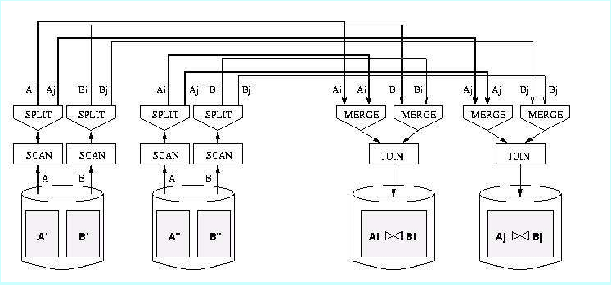
Dataflow Network of Operators for Parallel Join

Slide 30
I.Introduction to DDBMS
Data in a distributed database system is stored across several sites.
Each site is typically managed by a DBMS that can run independently of
the other sites that co-operate in a transparent manner.
Transparent implies that each user within the system may access all of
the data within all of the databases as if they were a single database
There should be „location independence‟ i.e.- as the user is unaware of where the data is located it is possible to move the data from one physical location to another without affecting the user.

Slide 31
DDBMS properties
Distributed data independence: Users should be able to ask queries without specifying where the referenced relations, or copies or fragments of the relations, are located.
Distributed transaction atomicity: Users should be able to write transactions that access and update data at several sites just as they would write transactions over purely local data.

Slide 32
Types of Distributed Databases
Homogeneous distributed database system :
If data is distributed but all servers run the same DBMS software.
Heterogeneous distributed database :
If different sites run under the control of different DBMSs, essentially autonomously, are connected to enable access to data from multiple sites.
The key to building heterogeneous systems is to have well-accepted standards for gateway protocols.
A gateway protocol is an API that exposes DBMS functionality to external applications.

Slide 33
1.Client-Server Systems:
A Client-Server system has one or more client processes and one or more server processes,
A client process can send a query to any one server process.
Clients are responsible for user-interface issues,
Servers manage data and execute transactions.
A client process could run on a personal computer and send queries to a server running on a mainframe.
The Client-Server architecture does not allow a single query to span multiple servers

Slide 34
2.Collaborating Server Systems
The client process would have to be capable of breaking such a query into appropriate subqueries.
A Collaborating Server system can have a collection of database servers, each capable of running transactions against local data, which cooperatively execute transactions spanning multiple servers.
When a server receives a query that requires access to data at other servers, it generates appropriate subqueries to be executed by other servers .
puts the results together to compute answers to the original query.

Slide 35
3.Middleware Systems:
The Middleware architecture is designed to allow a single query to span multiple servers, without requiring all database servers to be capable of managing such multisite execution strategies.
It is especially attractive when trying to integrate several legacy systems, whose basic capabilities cannot be extended.

Slide 36
3.Storing Data in DDBs
In a distributed DBMS, relations are stored across several sites.
Accessing a relation that is stored at a remote site includes message-passing costs.
A single relation may be partitioned or fragmented
across several sites.

Slide 37
Types of Fragmentation:
Horizontal fragmentation: The union of the horizontal fragments must be equal to the original relation. Fragments are usually also required to be disjoint.
Vertical fragmentation: The collection of vertical fragments should be a lossless-join decomposition.

Slide 38
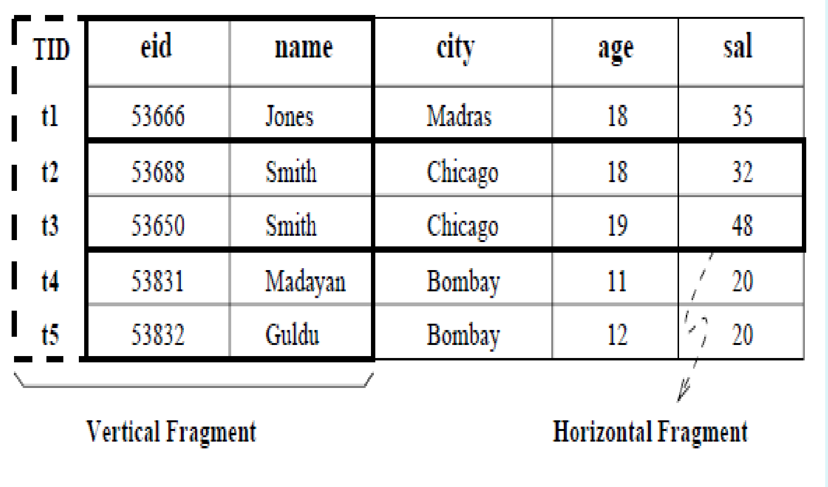

Slide 39
Replication
Replication means that we store several copies of a relation or relation fragment.
The motivation for replication is twofold:
Increased availability of data:
Faster query evaluation:
Two kinds of replications
synchronous replication
asynchronous replication

Slide 40
4.Distributed Catalog Management
1. Naming Objects
If a relation is fragmented and replicated, we must be able to
uniquely identify each replica of each fragment.
A local name field
A birth site field
2. Catalog Structure
A centralized system catalog can be used It is vulnerable to failure of the site containing the catalog).
An alternative is to maintain a copy of a global system catalog. compromises site autonomy,)

Slide 41
4.Distributed Catalog Management
A better approach:
Each site maintains a local catalog that describes all copies of data stored at that site.
In addition, the catalog at the birth site for a relation is responsible for keeping track of where replicas of the relation are stored.

Slide 42
5.Distributed Query Processing
Distributed query processing: Transform a high-level query (of relational calculus/SQL) on a distributed database (i.e., a set of global relations) into an equivalent and efficient lower-level query (of relational algebra) on relation fragments.
Distributed query processing is more complex
– Fragmentation/replication of relations
– Additional communication costs
– Parallel execution

Slide 43
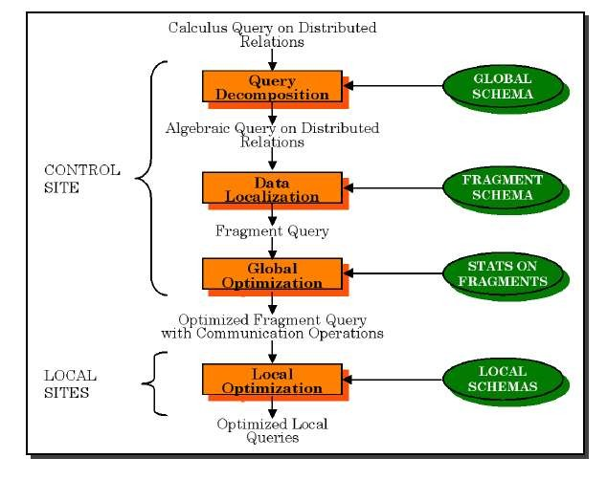
Distributed Query Processing Steps

Slide 44
5.Distributed Query Processing
Sailors(sid: integer, sname: string, rating: integer, age: real)
Reserves(sid: integer, bid: integer, day: date, rname: string)
Assume Reserves and Sailors relations
each tuple of Reserves is 40 bytes long
a page can hold 100 Reserves tuples
1,000 pages of such tuples.
each tuple of Sailors is 50 bytes long
a page can hold 80 Sailors Tuples
500 pages of such tuples
How to estimate the cost?

Slide 45
5.Distributed Query Processing
Criteria for measuring the cost of a query evaluation strategy
For centralized DBMSs number of disk accesses (#
blocks read / written)
For distributed databases, additionally
The cost of data transmission over the network
Potential gain in performance from having several sites processing parts
of the query in parallel

Slide 46
5.Distributed query processing
To estimate the cost of an evaluation strategy, in addition to counting the number of page I/Os.
we must count the number of pages that are shipped is a communication costs.
Communication costs is a significant component of overall cost in a distributed database.
Nonjoin Queries in a Distributed DBMS
Joins in a Distributed DBMS
Cost-Based Query Optimization

Slide 47
5.Distributed Query Processing
1.Nonjoin Queries in a Distributed DBMS
Even simple operations such as scanning a relation, selection, and
projection are affected by fragmentation and replication.
SELECT S.age
FROM Sailors S
WHERE S.rating > 3 AND S.rating < 7
Suppose that the Sailors relation is horizontally fragmented, with all tuples having a rating less than 5 at Mumbai and all tuples having a rating greater than 5 at Delhi.
The DBMS must answer this query by evaluating it at both sites and
taking the union of the answers.

Slide 48
5.Distributed Query Processing
Eg 1:
SELECT avg(age) FROM Sailors S
WHERE S.rating > 3 AND S.rating < 7
taking the union of the answers is not enough
Eg 2:
SELECT S.age
FROM Sailors S WHERE S.rating > 6
taking the union of the answers is not enough
Eg 3: suppose that the Sailors relation is vertically fragmented, with the sid and rating fields at MUMBAI and the sname and age fields at DELHI
This vertical fragmentation would be a lossy decomposition

Slide 49
5.Distributed Query Processing
Eg 4:the entire Sailors relation is stored at both MUMBAI and DELHI sites.
Where should the query be executed?
2 Joins in a Distributed DBMS
Eg: the Sailors relation is stored at MUMBAI, and that the Reserves relation is stored at DELHI.
Joins of relations at different sites can be very expensive.
JOIN STRATEGY
Fetch as needed
Ship whole
Semijoins
Bloomjoins

Slide 50
5.Distributed Query Processing
1.Fetch As Needed
Page-oriented Nested Loops join: For each page of R, get each page of S, and write out matching pairs of tuples <r, s>, where r is in R-page and s is in S-page.
We could do a page-oriented nested loops join in MUMBAI with Sailors as the outer, and for each Sailors page, fetch all Reserves pages from DELHI.
If we cache the fetched Reserves pages in MUMBAI until the join is complete, pages are fetched only once

Slide 51
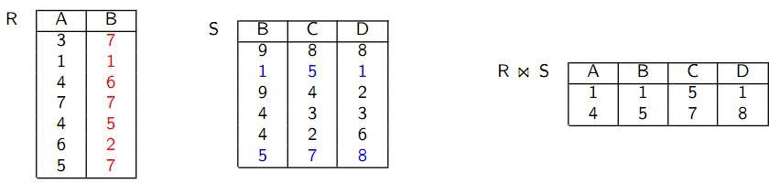

Fetch As Needed: Transferring the relation piecewise
QUERY: The query asks for R S

Slide 52
5.Distributed Query Processing
Assume Reserves and Sailors relations
each tuple of Reserves is 40 bytes long
a page can hold 100 Reserves tuples
1,000 pages of such tuples.
each tuple of Sailors is 50 bytes long
a page can hold 80 Sailors Tuples
500 pages of such tuples
td is cost to read/write page; ts is cost to ship page.
The cost is = 500td to scan Sailors
for each Sailors page, the cost of scanning shipping all of Reserves, which is
=1000(td + ts).
The total cost is = 500td + 500, 000(td + ts).

Slide 53
5.Distributed Query Processing
This cost depends on the size of the result.
The cost of shipping the result is greater than the cost of shipping both
Sailors and Reserves to the query site.
2.Ship to One Site (sort-merge-join)
The cost of scanning and shipping Sailors, saving it at DELHI, and then doing the join at DELHI is
=500(2td + ts) + (Result)td,
The cost of shipping Reserves and doing the join at MUMBAI is
=1000(2td+ts)+(result)td.

Slide 54
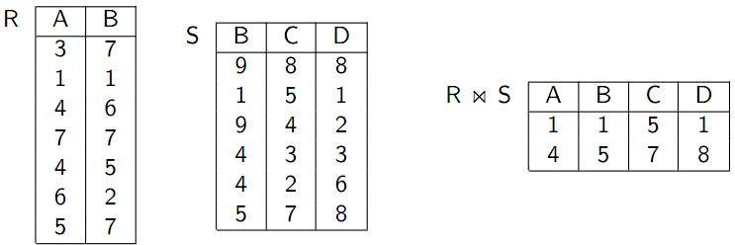

Ship Whole: Transferring the complete relation
QUERY: The query asks for R S

Slide 55
5.Distributed Query Processing
Ship Whole vs Fetch as needed:
Fetch as needed results in a high number of messages
Ship whole results in high amounts of transferred data
Note: Some tuples in Reserves do not join with any tuple in Sailors, we could avoid shipping them.
3.Semijoins and Bloomjoins
Semijoins: 3 steps:
At MUMBAI, compute the projection of Sailors onto the join columns i.e
sid and ship this projection to DELHI.
2. At DELHI, compute the natural join of the projection received from the first site with the Reserves relation.
The result of this join is called the reduction of Reserves with respect to
Sailors. ship the reduction of Reserves to MUMBAI.
3. At MUMBAI, compute the join of the reduction of Reserves with

Slide 56
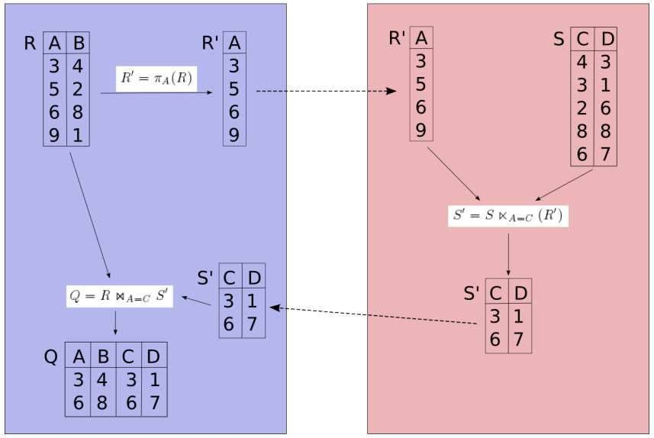
Semijoin:
Semijoin: Requesting all join partners in just one step.

Slide 57
5.Distributed query processing
Bloomjoins: 3 steps:
At MUMBAI, A bit-vector of (some chosen) size k is computed by hashing each tuple of Sailors into the range 0 to k −1 and setting bit i to 1. if some tuple hashes to i, and 0 otherwise then ship this to DELHI
At DELHI, the reduction of Reserves is computed by hashing each tuple of Reserves (using the sid field) into the range 0 to k − 1, using the same hash function used to construct the bit-vector, and discarding tuples whose hash value i corresponds to a 0 bit.ship the reduction of Reserves to MUMBAI.
At MUMBAI, compute the join of the reduction of Reserves with Sailors.

Slide 58
Bloom join:
Bloom join:
Also known as bit-vector join
Avoiding to transfer all join attribute values to the other node
Instead transferring a bitvector B[1 : : : n]
Transformation
Choose an appropriate hash function h
Apply h to transform attribute values to the range [1 : : : n]
Set the corresponding bits in the bitvector B[1 : : : n] to

Slide 59
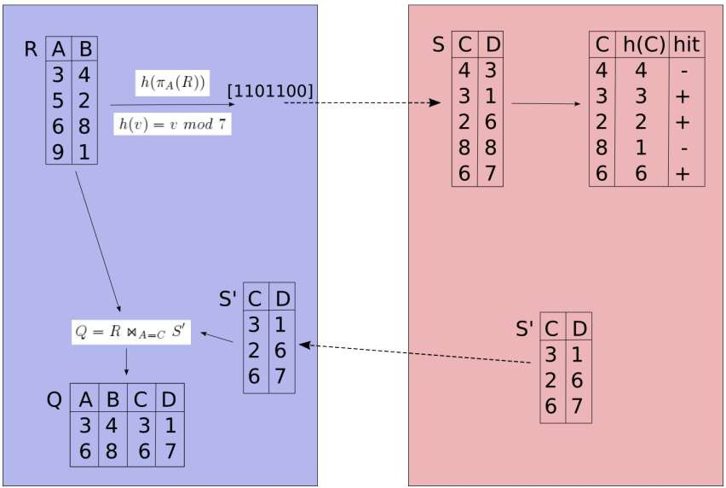
Bloom join:

Slide 60
Cost-Based Query Optimization
optimizing queries in a distributed database poses the following additional challenges:
Communication costs must be considered. If we have several copies of a relation, we must also decide which copy to use.
If individual sites are run under the control of different DBMSs, the autonomy of each site must be respected while doing global query planning.

Slide 61
Cost-Based Query Optimization
Cost-based approach; consider all plans pick cheapest similar to centralized optimization.
Difference 1: Communication costs must be considered.
Difference 2: Local site autonomy must be respected.
Difference 3: New distributed join methods.
Query site constructs global plan, with suggested local plans describing processing at each site.
If a site can improve suggested local plan, free to do so.

Slide 62
6.DISTRIBUTED TRANSACTIONS PROCESSING
A given transaction is submitted at some one site, but it can access data at other sites.
When a transaction is submitted at some site, the transaction manager at that site breaks it up into a collection of one or more subtransactions that execute at different sites.


Slide 63
7.Distributed Concurrency Control
Lock management can be distributed across sites in many ways:
Centralized: A single site is incharge of handling lock and
unlock requests for all objects.
Primary copy: One copy of each object is designated as the primary copy.
All requests to lock or unlock a copy of this object are handled by the lock manager at the site where the primary copy is stored.
Fully distributed: Requests to lock or unlock a copy of an object stored at a site are handled by the lock manager at the site where the copy is stored.

Slide 64
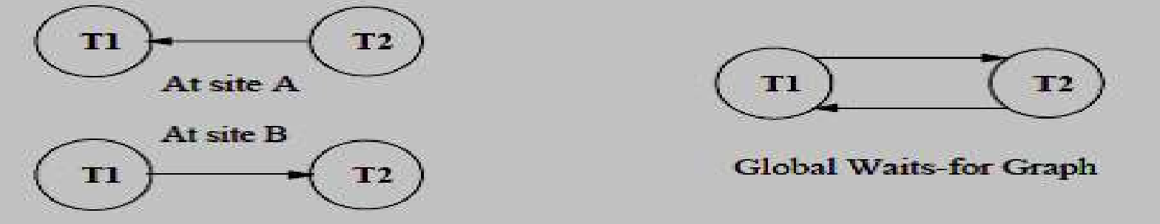
7.Distributed Concurrency Control
Distributed Deadlock Detection:
Each site maintains a local waits-for graph.
A global deadlock might exist even if the local graphs contain no cycles:
Three solutions:
Centralized: send all local graphs to one site ;
Hierarchical: organize sites into a hierarchy and send local graphs to parent
in the hierarchy;
Timeout : abort Xact if it waits too long.

Slide 65
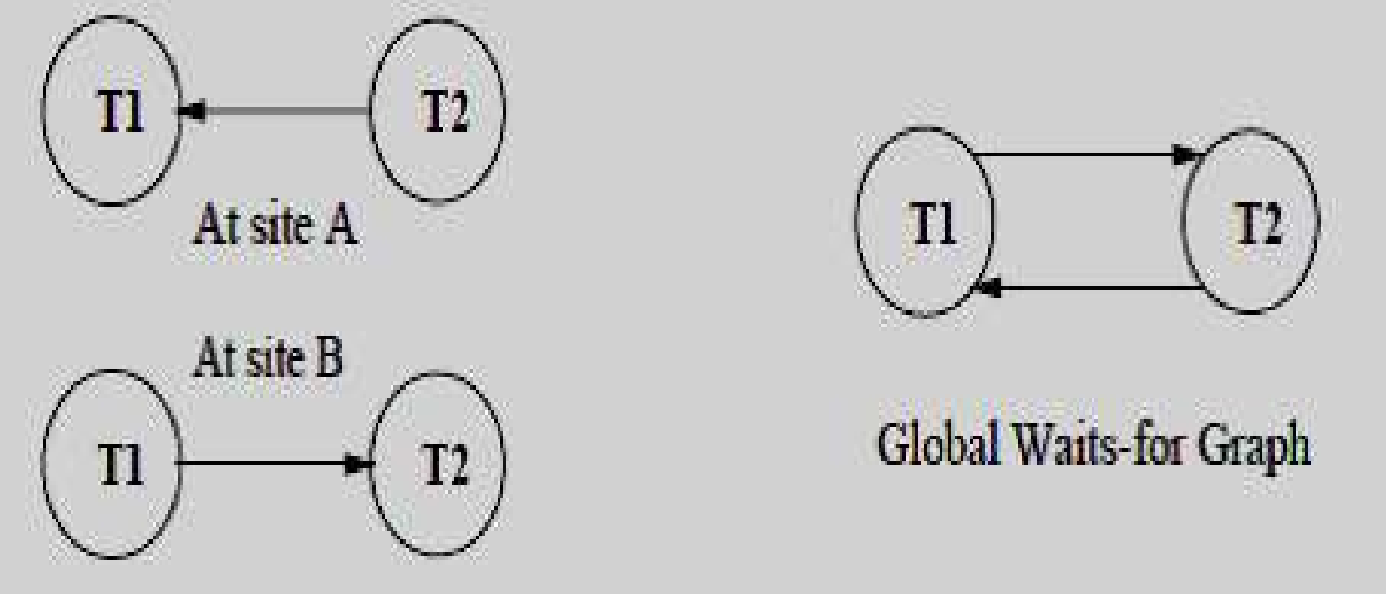
Phantom Deadlocks: delays in propagating local information might cause the deadlock detection algorithm to identify `deadlocks' that do not really exist. Such situations are called phantom deadlocks

Slide 66
7.Distributed Recovery
Recovery in a distributed DBMS is more complicated than in a centralized DBMS for the following reasons:
New kinds of failure can arise:
failure of communication links.
failure of a remote site at which a subtransaction is
executing.
Either all subtransactions of a given transaction must commit, or none must commit.
This property must be guaranteed in spite of any combination of site and link failures.

Slide 67
7.Distributed Recovery
Two-Phase Commit (2PC):
Site at which Xact originates is coordinator;
other sites at which it executes subXact are subordinates.
When the user decides to commit a transaction:
The commit command is sent to the coordinator for the
transaction.
This initiates the 2PC protocol:

Slide 68
7.Distributed Recovery(2pc)
Coordinator sends prepare msg to each subordinate.
Subordinate force-writes an abort or prepare log record and then
sends a no or yes msg to coordinator.
If coordinator gets all yes votes, force-writes a commit log record and sends commit msg to all subs. Else, force-writes abort log rec, and sends abort msg.
Subordinates force-write abort/commit log rec based on msg they get, then send ack msg to coordinator.
Coordinator writes end log rec after getting ack msg from all subs

Slide 69
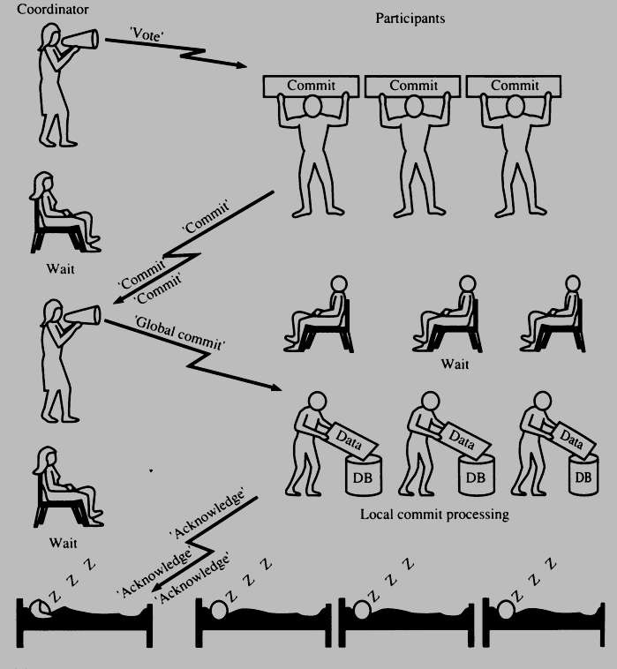
TWO-PHASE COMMIT (2PC) - commit
1. Parallel DB /D.S.Jagli 2/12/20

Slide 70
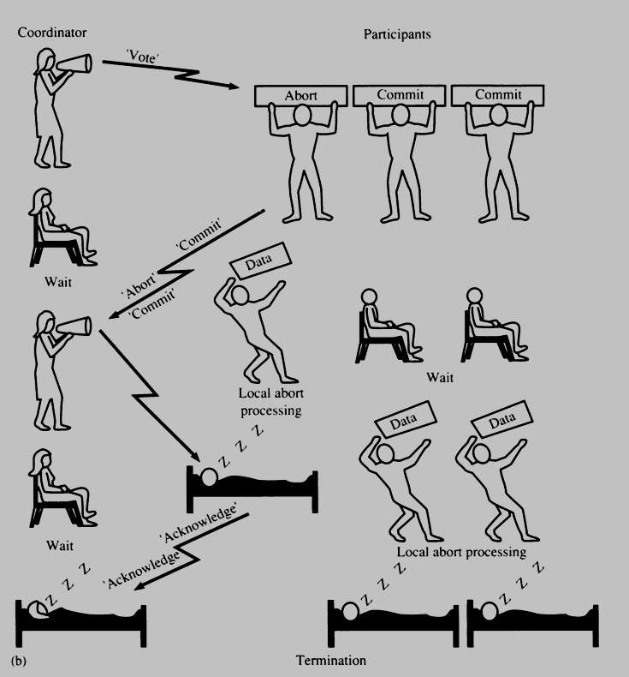

TWO-PHASE COMMIT (2PC) - ABORT

Slide 71
7.Distributed Recovery(3pc)
Three-Phase Commit
A commit protocol called Three-Phase Commit (3PC) can avoid
blocking even if the coordinator site fails during recovery.
The basic idea is that when the coordinator sends out prepare messages and receives yes votes from all subordinates.
It sends all sites a precommit message, rather than a commit message.
When a sufficient number more than the maximum number of failures that must be handled of acks have been received.
The coordinator force-writes a commit log record and sends a commit
message to all subordinates.

