Slide 1
Evolution Of CAD Tools
•Digital circuit design evolved over last three decades
•SSI –Small Scale Integration (Tens of transistors)
•MSI –Medium Scale Integration (Hundreds of transistors)
•LSI –Large Scale Integration –(Thousands of Transistors) -demanded automation of design process –CAD started evolving.

Slide 2
VLSI –Very Large Scale Integration –Tens of Thousands of Transistors –CAD Tools are inevitable
•VLSI chip design forced
–Automation of process
–Automation of Simulation based verification -replacing breadboard techniques –HDL development
–Modular and Hierarchical techniques of design –a natural object orientation approach

Slide 3
CAD Terminologies
•HDL –Hardware Description Language
–Describing a circuit to the computer
–A programming language by all means
–Concurrency constructs to simulate circuit behavior
–Verilogand VHDL
–Simulation for verification and Synthesis
–Synthesizable constructs -RTL

Slide 4
RTL –Register Transfer Level
–Specifying how the data flows between registers and how the design processes data
–Registers store intermediate results
–Logic between any two registers in a data flow determines the speed of the circuit
•Synthesis –Converting RTL to a set of gates and wires connecting them –Ambit of Cadence, Design Compiler of Synopsys, Precisionof Mentor, Blast Fusion from Magma are some of the commercially available synthesis tools.

Slide 5
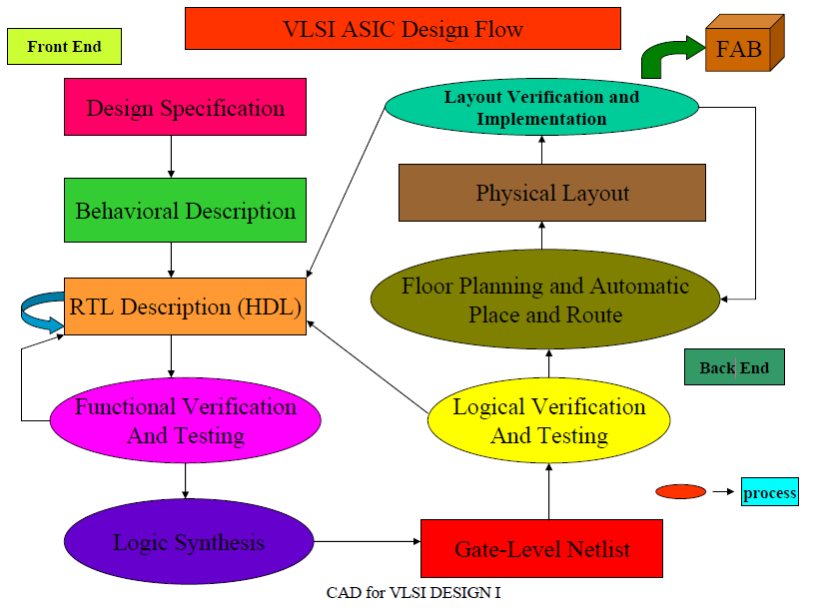

Slide 6
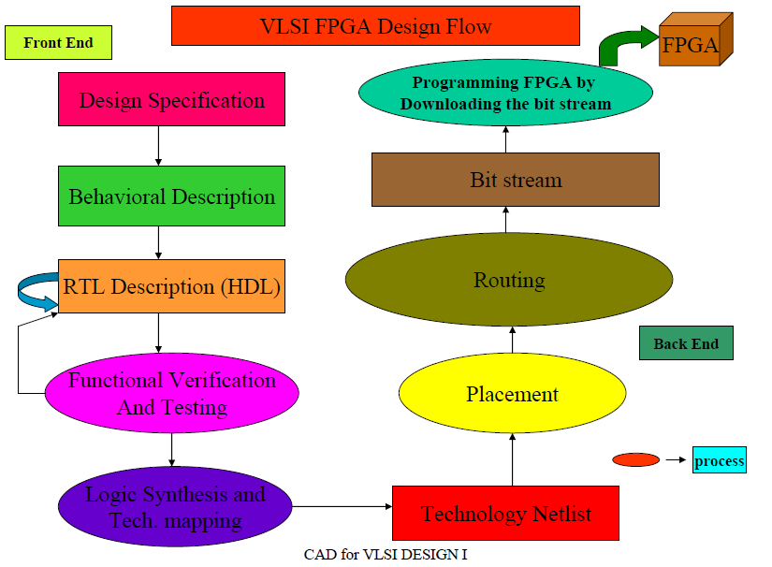

Slide 7
Need for CAD Tools
•Current systems are very complex.
•Design abstraction and decomposition is done to manage complexity.
•Tools automate the process of converting your design from one abstraction level to another.
•Design Automation Tools improve productivity.
•Different tools are required in different steps.

Slide 8
Classification of CAD Tools
Editors
–Allows specification of the design either textually or graphically.
•Simulators
–Models the response of a system to input stimuli.
•Analyzers
–Used at different levels to check for correctness and compliance to rules.
•Synthesis
–Transformation of representation between different abstraction levels.

Slide 9
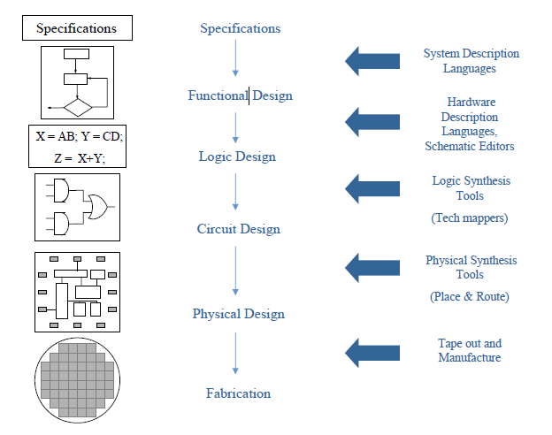
Flow and Tools

Slide 10
CAD Tools –1. Design Entry
Graphical
–Silicon Level –To create layouts
•e.g. Magic
–Other Levels
•e.g. ViewLogic, Protel
•Text
–Natural language specification at system level.
–Hardware Description Languages at Chip, Register and Gate levels.
•e.g. VHDL, Verilog
–Circuit Level
•e.g. SPICE

Slide 11
Graphical Editors
Silicon Level editors are called Layout editors.
–Draw rectangles describing metal, poly, diffusion etc
–Library components are also at the same level.
–Usually has online Design Rule Checking (DRC).
•Graphical Editors at other levels are usually called Schematic editors.
–Used to create block diagrams and schematics.
–The process is usually called Schematic Capture

Slide 12
Schematic Editors
Can create and display graphical components called “tokens”
•Can “interconnect”these tokens.
•Advantage :
–Gives a structural representation called “netlist”describing the components used and their interconnections.
–Also provides a simulation model to find the system’s response for different stimuli.

Slide 13
Important Features in Schematic Editors 1. Library
A list of library components constituting the primitives.
•Every library component has two models :
–The schematic with the I/O of the primitive
–A simulation model describing the behavior
•The library components can be
–generic –allows retargeting
–specific–tied to specific targets e.g. ASIC library components, macros etc.

Slide 14
2. GUI
•Start with an empty root window.
•Select the library component to be added.
•Label the component and place it in the window.
•Change properties of the component if necessary.
–e.g. Footprint of a component for board design
•Create wiring
–either by labeling the pins with a logical name
–or by “drawing a line”physically to establish interconnection.

Slide 15
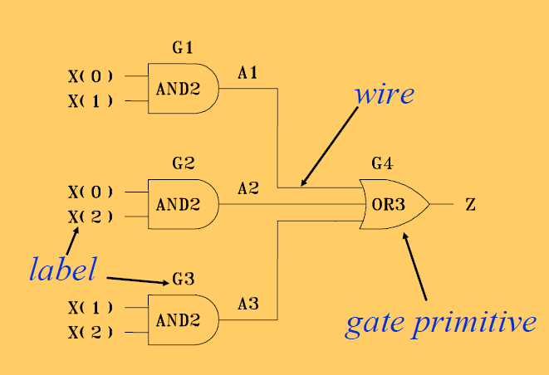
Example of Schematic Entry

Slide 16
Text Based Design Entry
Choose a specific HDL.
•Use text editors to describe the design.
–e.g. vi, emacs, notepad etc.
–Some tools have built-in editors
•Enter your design conforming to the language lexicon, syntax and semantics.
•Check for errors.
•“Compile”to get a simulation model.

Slide 17
What Makes HDLsDifferent?
Hardware systems are concurrent in nature.
•Hardware systems may be distributed in nature.
–Many components
–Different rates for processing data, different clocks.
•Hardware systems are timed.
–All hardware components have inherent delays and hence managing timing is crucial.
•Traditional software design techniques are insufficient.

Slide 18
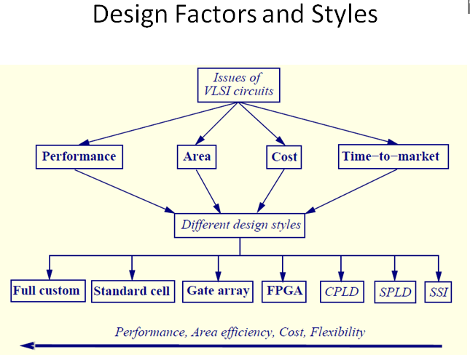

Slide 19
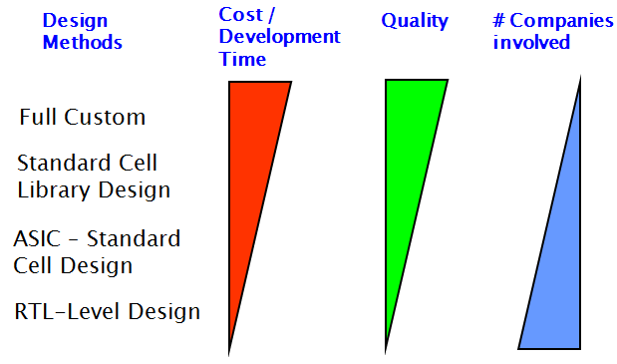
The Big Picture: IC Design Methods

Slide 20
Optimization: Levels of Abstraction
Algorithmic
Encoding data, computation scheduling, balancing delays of components, etc.
Gate-level
Reduce fan-out, capacitance
Gate duplication, buffer insertion
Layout / Physical-Design
Move cells/gates around to shorten wires on critical paths
Abut rows to share power / ground lines
Effectiveness
Level of details

Slide 21
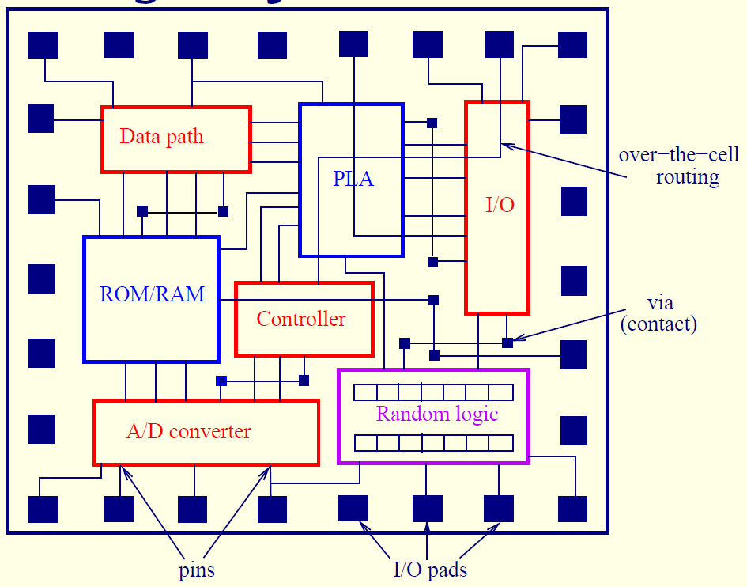
Full Custom

Slide 22
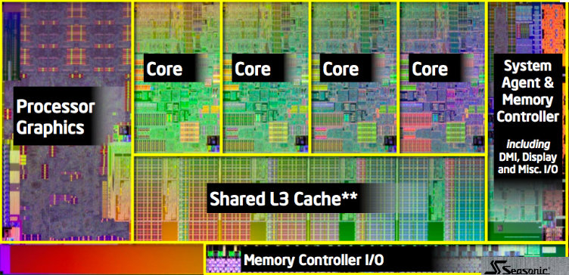
Full Custom

Slide 23
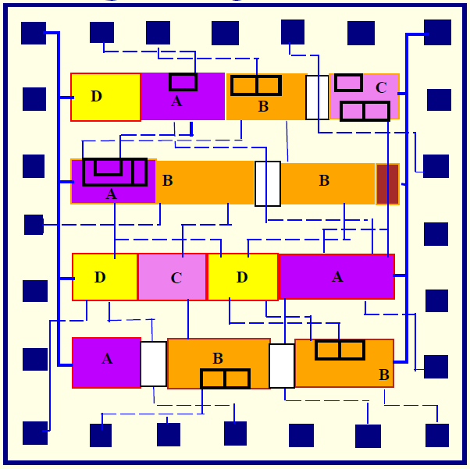
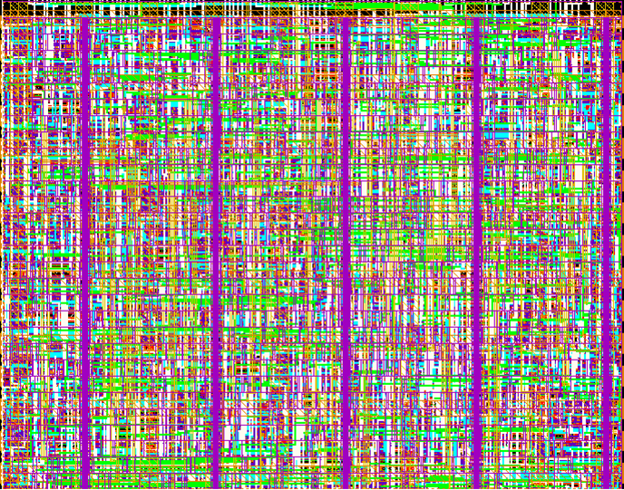
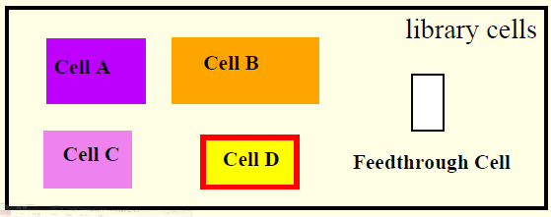
Standard Cell (Semi Custom)

