Slide 1
VLSI CAD Overview: Design, Flows, Algorithms and Tools

Slide 2
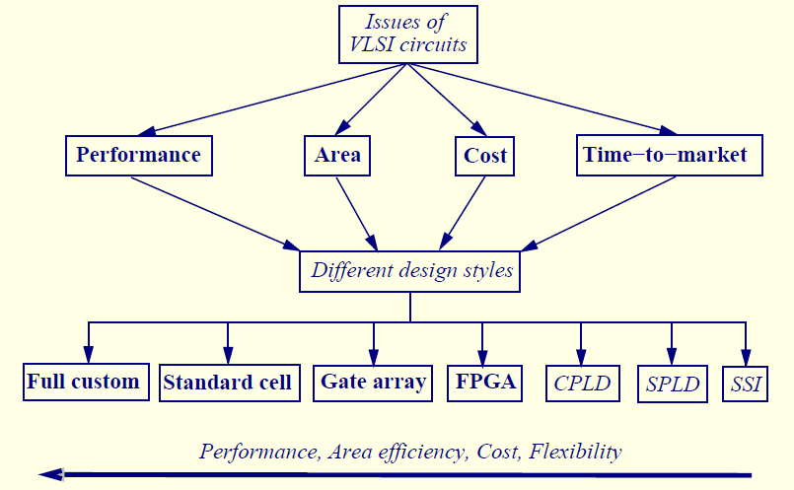
Design Factors and Styles

Slide 3
The Big Picture: IC Design Methods
Design Methods
Cost / Development
Time
Quality
# Companies involved
Full Custom
Standard Cell
Library Design
ASIC – Standard Cell Design
RTL-Level Design
Notes:
What is the difference between full custom and ASIC design?
Tools used in Full Custom would be Magic-like, and tools used in RTL-Level Design would be CAD tools for synthesis, physical design, etc.
Since Full Custom costly (number of designers, design time, fabrication cost, scalability, etc.) only companies like Intel afford
This course will cover the underlying theory for the tools that are used mostly in the last two methods.

Slide 4
Optimization: Levels of Abstraction
Algorithmic
Encoding data, computation scheduling, balancing delays of components, etc.
Gate-level
Reduce fan-out, capacitance
Gate duplication, buffer insertion
Layout / Physical-Design
Move cells/gates around to shorten wires on critical paths
Abut rows to share power / ground lines
Level of details
Effectiveness

Slide 5
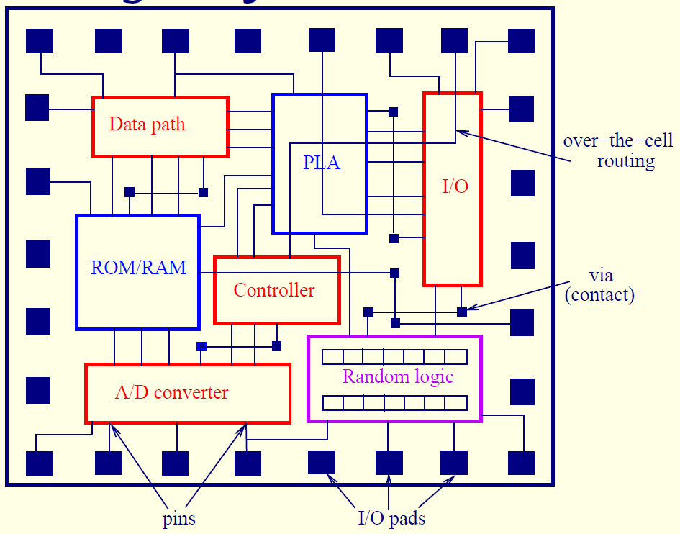
Full Custom

Slide 6
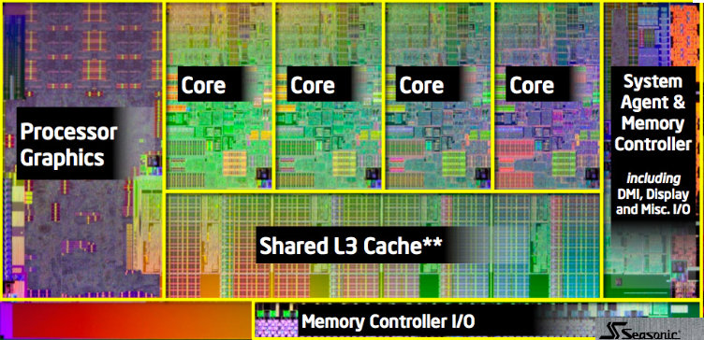
Full Custom

Slide 7
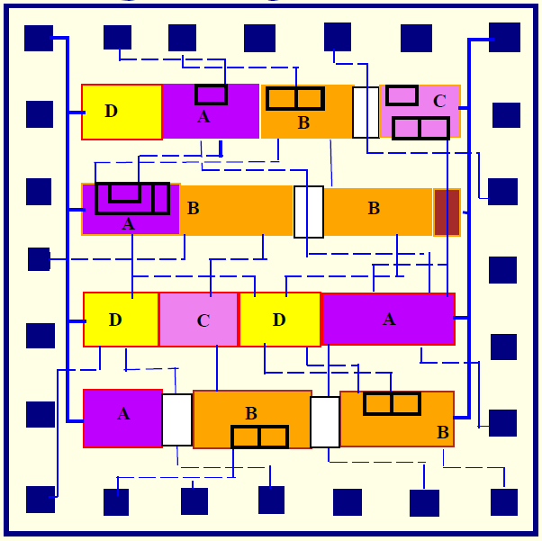

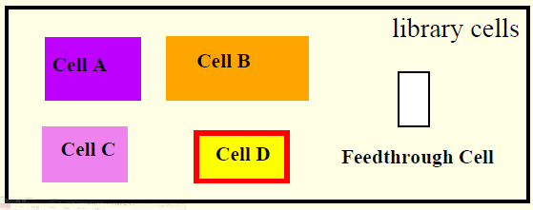
Standard Cell (Semi Custom)

Slide 8
Cell-Based Design (Standard Cells)
Routing channel
requirements are
reduced by presence
of more interconnect
layers

Slide 9
FPGA: Lookup Table (LUT)
Look-up Table
Truth table implemented in hardware
Can implement arbitrary function with fixed number of inputs (typically 4-5) by programming the storage bits (customizing the truth table)
Programming bit P
F = x₁’x₂’ + x₁x₂
2-Input LUT
x1 x2 F
0 0 1
0 1 0
1 0 0
1 1 1
1
0
0
1
0/1
0/1
F
0/1
0/1
x1 x2

Slide 10
FPGA: Logic Element
Logic Element: the basic programmable element of FPGA
Contains LUT
Programming is a domain of specialized technology mapping onto device specific structure
Inputs
Look-Up
Out
Table
(LUT)
Clock
State
Enable

Slide 11
FPGA: Architecture
Logic Element
Tracks
LE
LE
LE
LE
LE
LE
LE
LE
LE
LE
LE
LE
Each programmable logic element outputs one data bit
Interconnects are also programmable
A domain of physical synthesis (place and route)

Slide 12
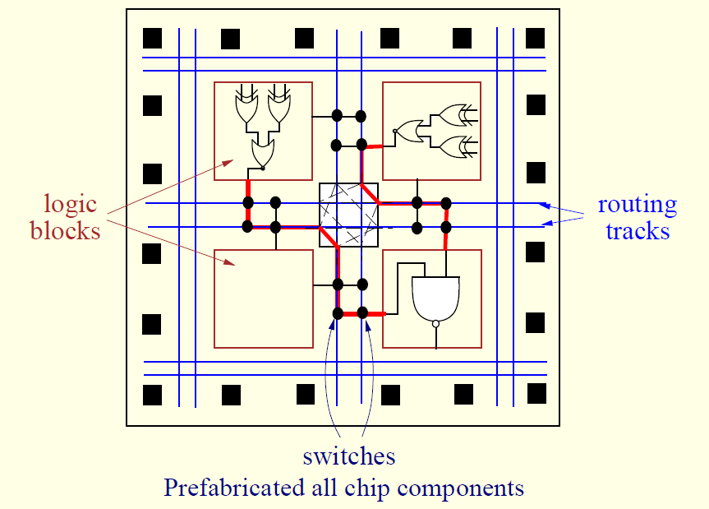
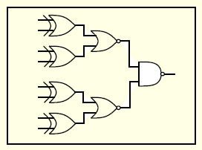
FPGA: Architecture

Slide 13
Comparison of Design Styles
style

Slide 14
Comparison of Design Styles
style
full-custom
standard cell
gate array
FPGA
Area
compact
compact
to moderate
moderate
large
Performance
high
high
to moderate
moderate
low
Fabrication layers
ALL
ALL
routing layers
none

Slide 15
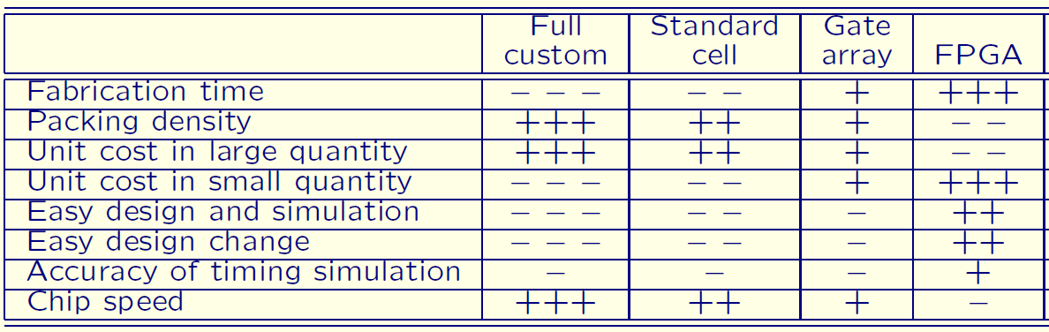
Comparison of Design Styles

Slide 16
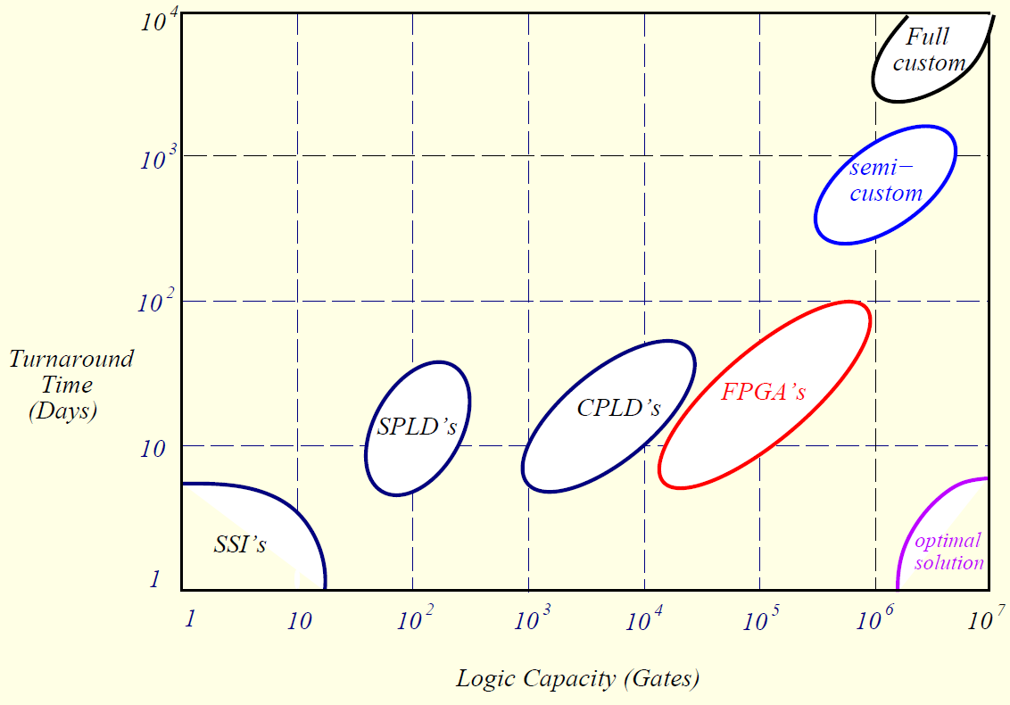
Design Styles Tradeoffs

Slide 17
The Inverted Pyramid (~2000)
Electronic Systems > $1 Trillion
Semiconductor > $220 B
CAD $3 B

Slide 18
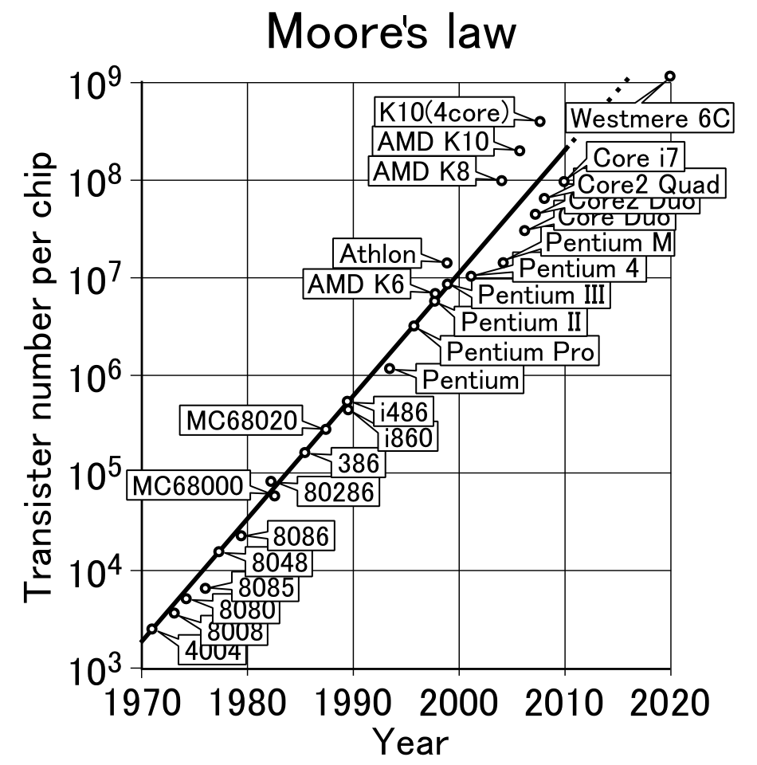
Moore’s law
Moore’s law – exponential growth in complexity
1 billion transistors
Notes:
Explain why design went multicore and what are main limitations (power, complexity, interconnect)

Slide 19
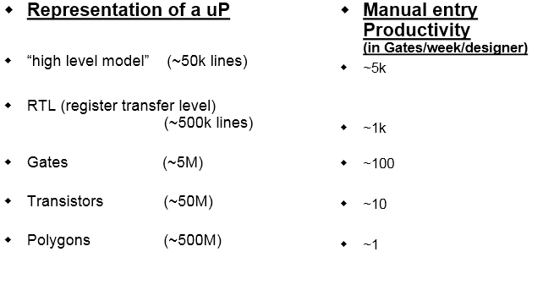
Data explosion and productivity
Notes:
Emphasis on physical design

Slide 20
Evolution of the EDA Industry
What’s next?
Results
(design productivity)
Synthesis – Cadence, Synopsys
Schematic entry – Daisy, Mentor, Valid
Transistor entry – Calma, Computervision, Magic
Effort (EDA tool effort)

Slide 21
History of VLSI Layout Tools

Slide 22
Synthesis and Design Process (High Level)
Application (graphics, DSP, general processor)
Algorithm (Z-buffer, FFT)
Architecture (pipeline, cash sharing, parallelism)
High level synthesis
Logic and physical synthesis

Slide 23
VLSI Design Flow
System Specification
Partitioning
Architectural Design
ENTITY test is port a: in bit; end ENTITY test;
Functional Design and Logic Design
Chip Planning
Circuit Design
Placement
Physical Design
Clock Tree Synthesis
Physical Verification and Signoff
DRC LVS
ERC
Signal Routing
Fabrication
Timing Closure
Packaging and Testing
Chip

Slide 24
High Level Synthesis (HLS)
Converting high-level design description to RTL
Input:
High-level languages (C, system C, system Verilog)
Hardware description languages (Verilog, VHDL)
State diagrams / logic networks
Tools:
Parser, compiler
Library of modules
Constraints:
Resource constraints (number of modules of a certain type)
Timing constraints (latency, delay, clock cycle)
Output:
Operation scheduling (time) and binding (resource)
Control generation
RTL architecture

Slide 25
Design Compilation
Lex
Compilation front-end
Parse
Separation into
Data Path (arithmetic)
Control (Boolean logic)
Behavioral Optimization
Intermediate form
Arch synth
Logic synth
HLS backend
Lib Binding

Slide 26
Behavioral Optimization
A
c
x
B
Techniques used in software compilation
Expression tree height reduction
Constant and variable propagation
Common sub-expression elimination
Dead-code elimination
Operator strength reduction (e.g., *4 → << 2)
Hardware transformations
Conditional expansion
If c then x = A
else x = B;
Compute A and B in parallel: x = C ? A : B (MUX)
Loop unrolling
Replace k iterations of a loop by k instances of the loop body
x = a + b × c + d
+
+
+
+
×
×
a
b
c
d
a
d
b
c

Slide 27
Data Flow Graph Transformation
Transformation
F = a*(b + c)
F = a*b + a*c
a
b
c
b
a
c
+
x
x
x
+
F
F

Slide 28
Optimization in Temporal Domain
Scheduling
Mapping of operations to time slots (cycles)
Uses sequencing graph (data flow graph, DFG)
Goal: minimize latency (s.t. resource constraints)
NOP
NOP
1
×
×
×
×
+
1
×
×
+
2
×
×
+
<
2
×
×
<
3
-
3
-
×
×
-
-
+
4
4
NOP
NOP

Slide 29
Optimization in Spatial Domain
Resource allocation & binding
Assigning operations to hardware units
Allocating registers
Binding operations to same resource
Goal: minimize resource (s.t. latency constraints)
NOP
1
×
×
×
×
+
2
×
×
+
<
3
-
-
4
NOP

Slide 30
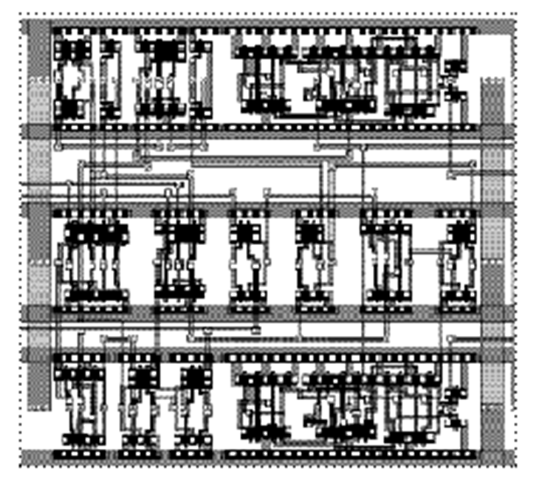
Synthesis Flow at Logic Level
a multi-stage process
Specification
Logic Extraction
module example(clk, a, b, c, d, f, g, h)
input clk, a, b, c, d, e, f;
output g, h; reg g, h;
always @(posedge clk) begin
g = a | b;
if (d) begin
if (c) h = a&~h;
else h = b;
if (f) g = c; else a^b;
end else
if (c) h = 1; else h ^b;
end
endmodule
Technology-Independent Optimization
a
b
a
Technology-Dependent Mapping
g1
h
e
0
Physical Synthesis
G
b
g0
f
G
g
h5
d
c
b
h3
g
d
H
e
a
H
h
f
e
h1
c
c
clk
d
f
clk

Slide 31
Logic Optimization Methods
Depends on target technology
Logic Optimization
Two-level logic (PLA)
Multi-level logic
(standard cells)
Heuristic
(espresso)
Exact (QM)
Boolean
Structural
(SIS,ABC)
Functional
(AC, Kurtis)
Functional
(BDD-based)
algebraic
Boolean

Slide 32
Optimization Criteria for Synthesis
Area occupied by the logic gates and interconnect (approximated by literals = transistors in technology independent optimization)
Critical path delay of the longest path through logic
Degree of testability of the circuit
Power consumed by the logic gates
Placeability, Wireability

Slide 33
Transformation-Based Synthesis
sequence of transformations that change network topology and its characteristics
All modern synthesis systems are built that way
work on uniform network representation
use scripts, lists of transformations forming a strategy
Transformations are mostly algebraic
very little is based on Boolean factorization
Representation
Cube notation, BDDs, AIGs
The underlying algorithms
Algebraic transformations
Collapsing, decomposition
Factorization, substitution

Slide 34
Multi-Level Logic Minimization
Objective
Minimize number of literals
Literals represent inputs to CMOS gates
Representation
Factored form
Compatible with CMOS
Optimization techniques
Algebraic factorization and decomposition (heuristic)
Technology independent
Requires mapping onto target architecture
Standard cells
FPGAs (LUT)

Slide 35
Two-Level Logic Minimization
Representation
Truth tables
Karnaugh maps
Sum of Products (SOP) form
Binary Decision Diagrams (BDD)
Objective
Minimize number of product terms in SOP
Challenge: multiple-output functions
Optimization techniques
Quine McCluskey (optimal)
Espresso logic minimizer (heuristic)
Ashenhust-Curtis functional decomposition (nearly optimal)
BDD-based (heuristic)

Slide 36
Physical Design Steps
Circuit partitioning
Floorplanning
Pin assignment
Placement
Routing
Convergence

Slide 37
Partitioning
System Specification
Partitioning
Architectural Design
ENTITY test is port a: in bit; end ENTITY test;
Functional Design and Logic Design
Chip Planning
Circuit Design
Placement
Physical Design
Clock Tree Synthesis
Physical Verification and Signoff
DRC LVS
ERC
Signal Routing
Fabrication
Timing Closure
Packaging and Testing
Chip

Slide 38
Partitioning
Circuit:
1
Cut c_{b}
3
2
7
8
4
6
5
Cut c_{a}
Block A
Block B
Block A
Block B
8
3
4
1
8
5
4
1
7
6
5
2
7
6
3
2
Cut c_{a}: four external connections
Cut c_{b}: two external connections

Slide 39
Partitioning - optimization Goals
In detail, what are the optimization goals?
Number of connections between partitions is minimized
Each partition meets all design constraints (size, number of external connections..)
Balance every partition as well as possible
How can we meet those goals?
Unfortunately, this problem is NP-hard
Efficient heuristics developed in the 1970s and 1980s. High quality and low-order polynomial time.
39

Slide 40
Floorplanning
System Specification
Partitioning
Architectural Design
ENTITY test is port a: in bit; end ENTITY test;
Functional Design and Logic Design
Chip Planning
Circuit Design
Placement
Physical Design
Clock Tree Synthesis
Physical Verification and Signoff
DRC LVS
ERC
Signal Routing
Fabrication
Timing Closure
Packaging and Testing
Chip

Slide 41
Floorplanning
I/O Pads
Floorplan
Module a
Module b
Block a
Block c
Module c
Chip Planning
GND
Block d
VDD
Block Pins
Block b
Module d
Block e
Module e
Supply Network
© 2011 Springer Verlag

Slide 42
Floorplanning
Example
Given: Three blocks with the following potential widths and heights
Block A: w = 1, h = 4 or w = 4, h = 1 or w = 2, h = 2
Block B: w = 1, h = 2 or w = 2, h = 1
Block C: w = 1, h = 3 or w = 3, h = 1
Task: Floorplan with minimum total area enclosed
C
A
B
B
C
A
A

Slide 43
Floorplanning
Example
Given: Three blocks with the following potential widths and heights
Block A: w = 1, h = 4 or w = 4, h = 1 or w = 2, h = 2
Block B: w = 1, h = 2 or w = 2, h = 1
Block C: w = 1, h = 3 or w = 3, h = 1
Task: Floorplan with minimum total area enclosed

Slide 44
Floorplanning
Example
Given: Three blocks with the following potential widths and heights
Block A: w = 1, h = 4 or w = 4, h = 1 or w = 2, h = 2
Block B: w = 1, h = 2 or w = 2, h = 1
Block C: w = 1, h = 3 or w = 3, h = 1
Task: Floorplan with minimum total area enclosed
Solution:
Aspect ratios Block A with w = 2, h = 2; Block B with w = 2, h = 1; Block C with w = 1, h = 3
This floorplan has a global bounding box with minimum possible area (9 square units).

Slide 45
Placement
System Specification
Partitioning
Architectural Design
ENTITY test is port a: in bit; end ENTITY test;
Functional Design and Logic Design
Chip Planning
Circuit Design
Placement
Physical Design
Clock Tree Synthesis
Physical Verification and Signoff
DRC LVS
ERC
Signal Routing
Fabrication
Timing Closure
Packaging and Testing
Chip

Slide 46
Placement
a
Linear Placement
c
b
g
h
a
c
b
g
h
d
f
e
d
f
e
h
e
d
a
VDD
h
e
d
a
g
f
c
b
GND
g
f
c
b
© 2011 Springer Verlag
2D Placement
Placement and Routing with Standard Cells

Slide 47
Placement
Global Placement
Detailed Placement

Slide 48
Placement Optimization Objectives
Total Wirelength
Number of Cut Nets
Wire Congestion
Signal Delay
© 2011 Springer Verlag

Slide 49
Routing
System Specification
Partitioning
Architectural Design
ENTITY test is port a: in bit; end ENTITY test;
Functional Design and Logic Design
Chip Planning
Circuit Design
Placement
Physical Design
Clock Tree Synthesis
Physical Verification and Signoff
DRC LVS
ERC
Signal Routing
Fabrication
Timing Closure
Packaging and Testing
Chip

Slide 50

Routing
Given a placement, a netlist and technology information,
determine the necessary wiring, e.g., net topologies and specific routing segments, to connect the cells
while respecting constraints, e.g., design rules and routing resource capacities, and
optimizing routing objectives, e.g., minimizing total wirelength and maximizing timing slack.

Slide 51
Routing
Netlist:
Placement result
N₁ = {C₄, D₆, B₃}
N₂ = {D₄, B₄, C₁, A₄}
N₃ = {C₂, D₅}
N₄ = {B₁, A₁, C₃}
3
4
C
1
A
1
2
4
Technology Information (Design Rules)
1
3
B
4
5
6
4
D

Slide 52
Routing
Netlist:
N₁ = {C₄, D₆, B₃}
N₂ = {D₄, B₄, C₁, A₄}
N₃ = {C₂, D₅}
N₄ = {B₁, A₁, C₃}
3
4
C
1
A
1
2
4
N₁
Technology Information (Design Rules)
1
3
B
4
5
6
4
D

Slide 53
Routing
Netlist:
N₁ = {C₄, D₆, B₃}
N₂ = {D₄, B₄, C₁, A₄}
N₃ = {C₂, D₅}
N₄ = {B₁, A₁, C₃}
3
4
C
1
A
1
2
N₄
4
N₂
N₃
N₁
Technology Information (Design Rules)
1
3
B
4
5
6
4
D

Slide 54
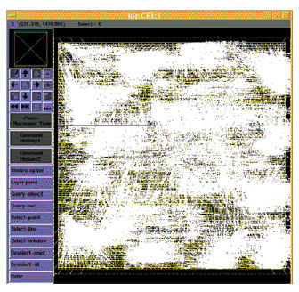
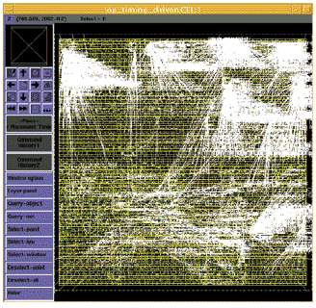
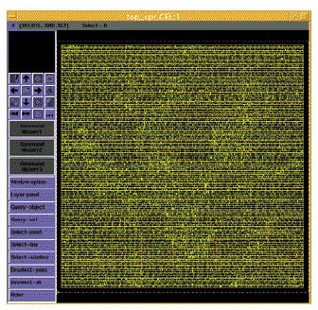
The Design Closure Problem
Iterative removal of timing violations (white lines)

Slide 55
Design Verification
Ensuring correctness of the design against its implementation (at different levels)
model
≡ ?
Design
behavior
HDL / RTL
≡ ?
function
Logic level
≡ ?
structure
Gate level
≡ ?
layout
Mask level

Slide 56
Algorithm Design Techniques
Greedy
Divide and Conquer
Dynamic Programming
Network Flow
Mathematical Programming (e.g., linear programming, integer linear programming)

Slide 57
Reduction
Idea: If I can solve problem A, and if problem B can be transformed into an instance of problem A, then I can solve problem B by reducing problem B to problem A and then solve the corresponding problem A.
Example:
Problem A: Sorting
Problem B: Given n numbers, find the i-th largest numbers.
Notes:
“How to solve it” – george polya(Hungarian)

Slide 58
Analysis of Algorithm
There can be many different algorithms to solve the same problem.
Need some way to compare 2 algorithms.
Usually run time is the most important criterion used
Space (memory) usage is of less concern now
However, difficult to compare since algorithms may be implemented in different machines, use different languages, etc.
Also, run time is input-dependent. Which input to use?
Big-O notation is widely used for asymptotic analysis.

