Slide 1
Cloud Computing:

Slide 2
Introduction to cloud context
  Technology context: multi-core, virtualization, 64-bit processors, parallel computing models, big-data storages…
  Cloud models: IaaS (Amazon AWS), PaaS (Microsoft Azure), SaaS (Google App Engine)
Demonstration of cloud capabilities
  Cloud models
  Data and Computing models: MapReduce
  Graph processing using amazon elastic mapreduce
A case-study of real business application of the cloud

Slide 3
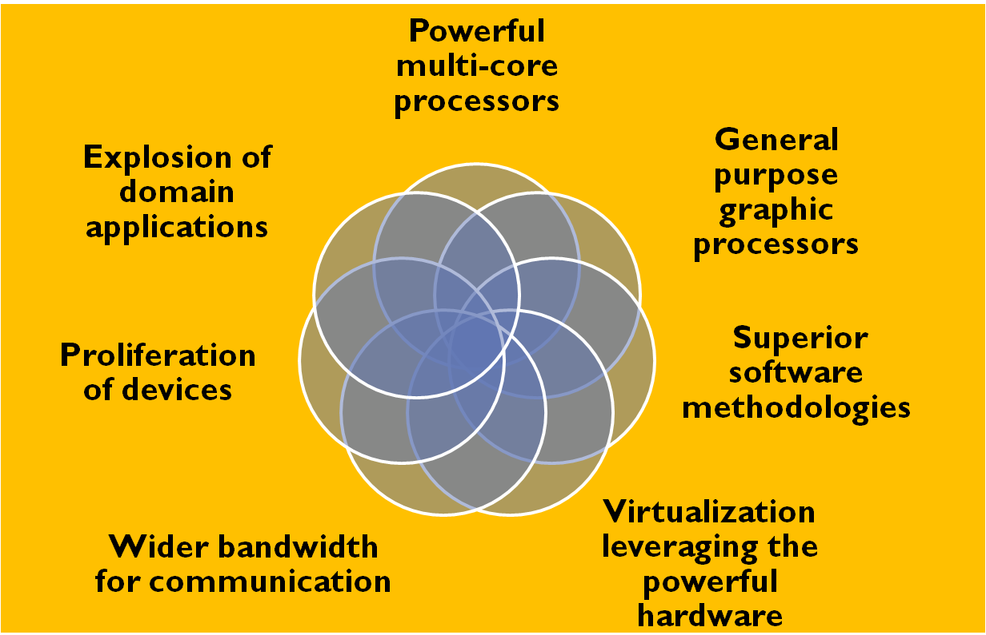
Introduction: A Golden Era in Computing

Slide 4
Cloud Concepts, Enabling-technologies, and Models: The Cloud Context

Slide 5

Evolution of Internet Computing
scale
web
Data-intensive
HPC, cloud
deep web
Semantic
discovery
Data marketplace and analytics
Social media and networking
Automate (discovery)
Discover (intelligence)
Transact
Integrate
Interact
Inform
Publish
time

Slide 6
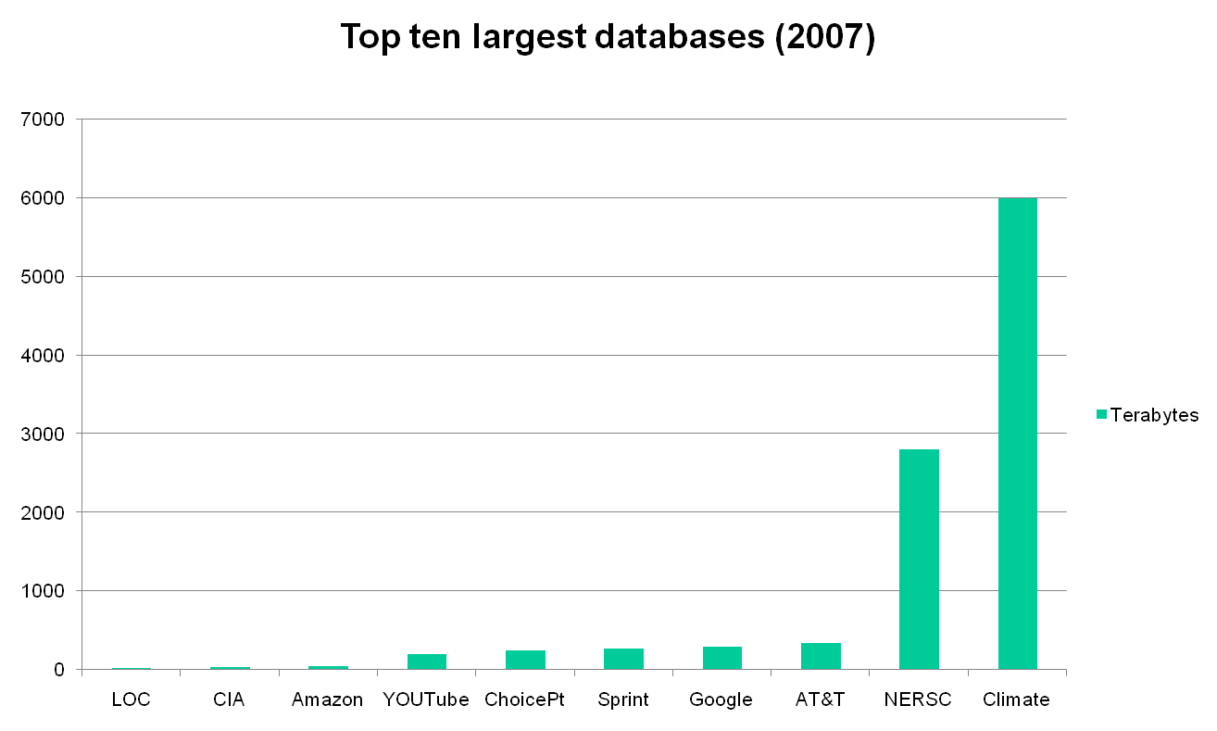
Top Ten Largest Databases
Ref: http://www.focus.com/fyi/operations/10-largest-databases-in-the-world/

Slide 7
Challenges
Alignment with the needs of the business / user / non-computer specialists / community and society
Need to address the scalability issue: large scale data, high performance computing, automation, response time, rapid prototyping, and rapid time to production
Need to effectively address (i) ever shortening cycle of obsolescence, (ii) heterogeneity and (iii) rapid changes in requirements
Transform data from diverse sources into intelligence and deliver intelligence to right people/user/systems
What about providing all this in a cost-effective manner?

Slide 8
Enter the cloud
Cloud computing is Internet-based computing, whereby shared resources, software and information are provided to computers and other devices on-demand, like the electricity grid.
The cloud computing is a culmination of numerous attempts at large scale computing with seamless access to virtually limitless resources.
  on-demand computing, utility computing, ubiquitous computing, autonomic computing, platform computing, edge computing, elastic computing, grid computing, …

Slide 9

“Grid Technology”
Emerging enabling technology.
Natural evolution of distributed systems and the Internet.
Middleware supporting network of systems to facilitate sharing, standardization and openness.
Infrastructure and application model dealing with sharing of compute cycles, data, storage and other resources.
Publicized by prominent industries as on-demand computing, utility computing, etc.
Move towards delivering “computing” to masses similar to other utilities (electricity and voice communication).”
Now,
Hmmm…sounds like the definition for cloud computing!!!!!

Slide 10
It is a changed world now…
Explosive growth in applications: biomedical informatics, space exploration, business analytics, web 2.0 social networking: YouTube, Facebook
Extreme scale content generation: e-science and e-business data deluge
Extraordinary rate of digital content consumption: digital gluttony: Apple iPhone, iPad, Amazon Kindle
Exponential growth in compute capabilities: multi-core, storage, bandwidth, virtual machines (virtualization)
Very short cycle of obsolescence in technologies: Windows Vista→ Windows 7; Java versions; C→C#; Python
Newer architectures: web services, persistence models, distributed file systems/repositories (Google, Hadoop), multi-core, wireless and mobile
Diverse knowledge and skill levels of the workforce
You simply cannot manage this complex situation with your traditional IT infrastructure:

Slide 11
Answer: The Cloud Computing?
Typical requirements and models:
  platform (PaaS),
  software (SaaS),
  infrastructure (IaaS),
  Services-based application programming interface (API)
A cloud computing environment can provide one or more of these requirements for a cost
Pay as you go model of business
When using a public cloud the model is similar to renting a property than owning one.
An organization could also maintain a private cloud and/or use both.

Slide 12






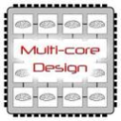
Enabling Technologies
Cloud applications: data-intensive, compute-intensive, storage-intensive
Bandwidth
WS
Services interface
Web-services, SOA, WS standards
VM0
VM1
VMn
Storage Models: S3, BigTable, BlobStore, ...
Virtualization: bare metal, hypervisor. …
Multi-core architectures
64-bit processor

Slide 13
Common Features of Cloud Providers
Development
Environment: IDE, SDK, Plugins
Production
Environment
Simple
storage
Table Store <key, value>
Drives
Accessible through
Web services
Management Console and Monitoring tools
& multi-level security

Slide 14

Windows Azure
Enterprise-level on-demand capacity builder
Fabric of cycles and storage available on-request for a cost
You have to use Azure API to work with the infrastructure offered by Microsoft
Significant features: web role, worker role , blob storage, table and drive-storage

Slide 15

Amazon EC2
Amazon EC2 is one large complex web service.
EC2 provided an API for instantiating computing instances with any of the operating systems supported.
It can facilitate computations through Amazon Machine Images (AMIs) for various other models.
Signature features: S3, Cloud Management Console, MapReduce Cloud, Amazon Machine Image (AMI)
Excellent distribution, load balancing, cloud monitoring tools

Slide 16

Google App Engine
This is more a web interface for a development environment that offers a one stop facility for design, development and deployment Java and Python-based applications in Java, Go and Python.
Google offers the same reliability, availability and scalability at par with Google’s own applications
Interface is software programming based
Comprehensive programming platform irrespective of the size (small or large)
Signature features: templates and appspot, excellent monitoring and management console

Slide 17
Demos
Amazon AWS: EC2 & S3 (among the many infrastructure services)
  Linux machine
  Windows machine
  A three-tier enterprise application
Google app Engine
  Eclipse plug-in for GAE
  Development and deployment of an application
Windows Azure
  Storage: blob store/container
  MS Visual Studio Azure development and production environment

Slide 18
Cloud Programming Models

Slide 19
The Context: Big-data
Data mining huge amounts of data collected in a wide range of domains from astronomy to healthcare has become essential for planning and performance.
We are in a knowledge economy.
  Data is an important asset to any organization
  Discovery of knowledge; Enabling discovery; annotation of data
  Complex computational models
  No single environment is good enough: need elastic, on-demand capacities
We are looking at newer
  Programming models, and
  Supporting algorithms and data structures.

Slide 20
Google File System
Internet introduced a new challenge in the form web logs, web crawler’s data: large scale “peta scale”
But observe that this type of data has an uniquely different characteristic than your transactional or the “customer order” data : “write once read many (WORM)” ;
  Privacy protected healthcare and patient information;
  Historical financial data;
  Other historical data
Google exploited this characteristics in its Google file system (GFS)

Slide 21
What is Hadoop?
At Google MapReduce operation are run on a special file system called Google File System (GFS) that is highly optimized for this purpose.
GFS is not open source.
Doug Cutting and others at Yahoo! reverse engineered the GFS and called it Hadoop Distributed File System (HDFS).
The software framework that supports HDFS, MapReduce and other related entities is called the project Hadoop or simply Hadoop.
This is open source and distributed by Apache.

Slide 22
Fault tolerance
Failure is the norm rather than exception
A HDFS instance may consist of thousands of server machines, each storing part of the file system’s data.
Since we have huge number of components and that each component has non-trivial probability of failure means that there is always some component that is non-functional.
Detection of faults and quick, automatic recovery from them is a core architectural goal of HDFS.

Slide 23
HDFS Architecture
Namenode
Metadata(Name, replicas..)
(/home/foo/data,6. ..
Metadata ops
Client
Block ops
Read
Datanodes
Datanodes
B
replication
Blocks
Rack1
Write
Rack2
Client

Slide 24
Hadoop Distributed File System
HDFS Server
Master node
HDFS Client
Application
Local file system
Block size: 2K
Name Nodes
Block size: 128M
Replicated

Slide 25
What is MapReduce?
MapReduce is a programming model Google has used successfully is processing its “big-data” sets (~ 20000 peta bytes per day)
  A map function extracts some intelligence from raw data.
  A reduce function aggregates according to some guides the data output by the map.
  Users specify the computation in terms of a map and a reduce function,
  Underlying runtime system automatically parallelizes the computation across large-scale clusters of machines, and
  Underlying system also handles machine failures, efficient communications, and performance issues.
-- Reference: Dean, J. and Ghemawat, S. 2008. MapReduce: simplified data processing on large clusters. Communication of ACM 51, 1 (Jan. 2008), 107-113.

Slide 26
Classes of problems “mapreducable”
Benchmark for comparing: Jim Gray’s challenge on data-intensive computing. Ex: “Sort”
Google uses it for wordcount, adwords, pagerank, indexing data.
Simple algorithms such as grep, text-indexing, reverse indexing
Bayesian classification: data mining domain
Facebook uses it for various operations: demographics
Financial services use it for analytics
Astronomy: Gaussian analysis for locating extra-terrestrial objects.
Expected to play a critical role in semantic web and in web 3.0

Slide 27
Large scale data splits
Map <key, 1>
<key, value>pair
Reducers (say, Count)
Parse-hash
Count
P-0000
, count1
Parse-hash
Count
P-0001
, count2
Parse-hash
Count
P-0002
Parse-hash
,count3

Slide 28
MapReduce Engine
MapReduce requires a distributed file system and an engine that can distribute, coordinate, monitor and gather the results.
Hadoop provides that engine through (the file system we discussed earlier) and the JobTracker + TaskTracker system.
JobTracker is simply a scheduler.
TaskTracker is assigned a Map or Reduce (or other operations); Map or Reduce run on node and so is the TaskTracker; each task is run on its own JVM on a node.

Slide 29
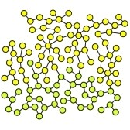
Demos
Word count application: a simple foundation for text-mining; with a small text corpus of inaugural speeches by US presidents
Graph analytics is the core of analytics involving linked structures (about 110 nodes): shortest path

Slide 30
A Case-study in Business:
Cloud Strategies

Slide 31
Predictive Quality Project Overview
Problem / Motivation:
Identify special causes that relate to bad outcomes for the quality-related parameters of the products and visually inspected defects
Complex upstream process conditions and dependencies making the problem difficult to solve using traditional statistical / analytical methods
Determine the optimal process settings that can increase the yield and reduce defects through predictive quality assurance
Potential savings huge as the cost of rework and rejects are very high
Solution:
Use ontology to model the complex manufacturing processes and utilize semantic technologies to provide key insights into how outcomes and causes are related
Develop a rich internet application that allows the user to evaluate process outcomes and conditions at a high level and drill down to specific areas of interest to address performance issues

Slide 32
Why Cloud Computing for this Project
Well-suited for incubation of new technologies
  Semantic technologies still evolving
  Use of Prototyping and Extreme Programming
  Server and Storage requirements not completely known
Technologies used (TopBraid, Tomcat) not part of emerging or core technologies supported by corporate IT
Scalability on demand
Development and implementation on a private cloud

Slide 33
Public Cloud vs. Private Cloud
Rationale for Private Cloud:
Security and privacy of business data was a big concern
Potential for vendor lock-in
SLA’s required for real-time performance and reliability
Cost savings of the shared model achieved because of the multiple projects involving semantic technologies that the company is actively developing

Slide 34
Cloud Computing for the Enterprise
What should IT Do
Revise cost model to utility-based computing: CPU/hour, GB/day etc.
Include hidden costs for management, training
Different cloud models for different applications - evaluate
Use for prototyping applications and learn
Link it to current strategic plans for Services-Oriented Architecture, Disaster Recovery, etc.

Slide 35
References & useful links
Amazon AWS: http://aws.amazon.com/free/
AWS Cost Calculator: http://calculator.s3.amazonaws.com/calc5.html
Windows Azure: http://www.azurepilot.com/
Google App Engine (GAE): http://code.google.com/appengine/docs/whatisgoogleappengine.html
Graph Analytics: http://www.umiacs.umd.edu/~jimmylin/Cloud9/docs/content/Lin_Schatz_MLG2010.pdf
For miscellaneous information: http://www.cse.buffalo.edu/~bina

Slide 36
Summary
We illustrated cloud concepts and demonstrated the cloud capabilities through simple applications
We discussed the features of the Hadoop File System, and mapreduce to handle big-data sets.
We also explored some real business issues in adoption of cloud.
Cloud is indeed an impactful technology that is sure to transform computing in business.

